Slide 1
Accessing the expertise of teachers and people with lived experience to drive innovation in braille literacy assessment and teaching
Emily White, PhD

Slide 2
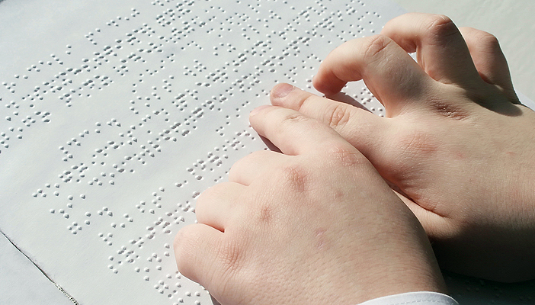
The premise

Slide 3
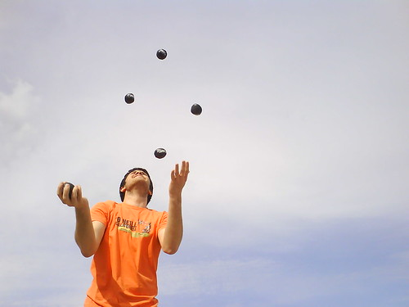
Developmental progression for juggling
Juggle parenting and/or aging parents and fulltime employment
Juggle four balls
Toss and catch two balls
Can hold a ball

Slide 4
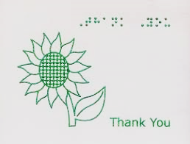
Thanks, Queensland!

Slide 5
Building validity arguments
Literature plus subject matter expertise in development
Intended purpose, cohort, and context/s; taxonomy/ies
Construct definition and mapping
Piloting - representative end users
Revision with subject matter experts
Data collection
Data calibration and interpretation
(Griffin et al., 2004; Masters, 1982; Messick, 1989; Wilson; 2005; Wolfe & Smith, 2009)

Slide 6
Building validity arguments
Literature plus subject matter expertise in development
Intended purpose, cohort, and context/s; taxonomy/ies
Construct definition and mapping
Piloting - representative end users
Revision with subject matter experts
Data collection
Data calibration and interpretation
(Griffin et al., 2004; Masters, 1982; Messick, 1989; Wilson; 2005; Wolfe & Smith, 2009)

Slide 7
Building validity arguments
Literature plus subject matter expertise in development
Intended purpose, cohort, and context/s; taxonomy/ies
Construct definition and mapping
Piloting - representative end users
Revision with subject matter experts
Data collection
Data calibration and interpretation
(Griffin et al., 2004; Masters, 1982; Messick, 1989; Wilson; 2005; Wolfe & Smith, 2009)

Slide 8
Defining the construct of braille literacy for the purpose of assessment
“The ability to use the sense of touch and the braille script to build and convey meaning, and process and gain information.”

Slide 9
Mapping the construct
Construct
Capabilities
Indicative behaviours/
behavioural indicators
Quality criteria
(Woods & Griffin, 2003)

Slide 10
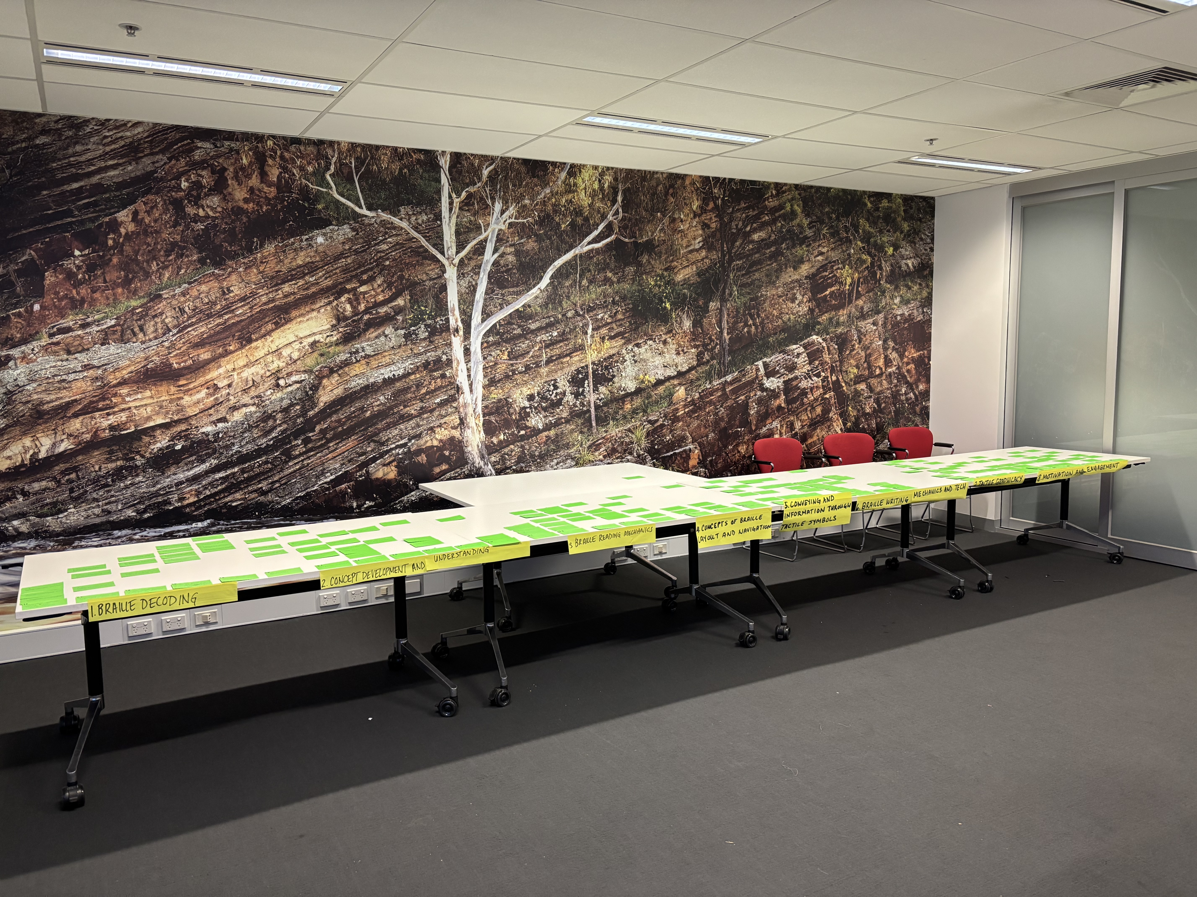
Writing indicators and quality criteria -> pair-wise comparison

Slide 11
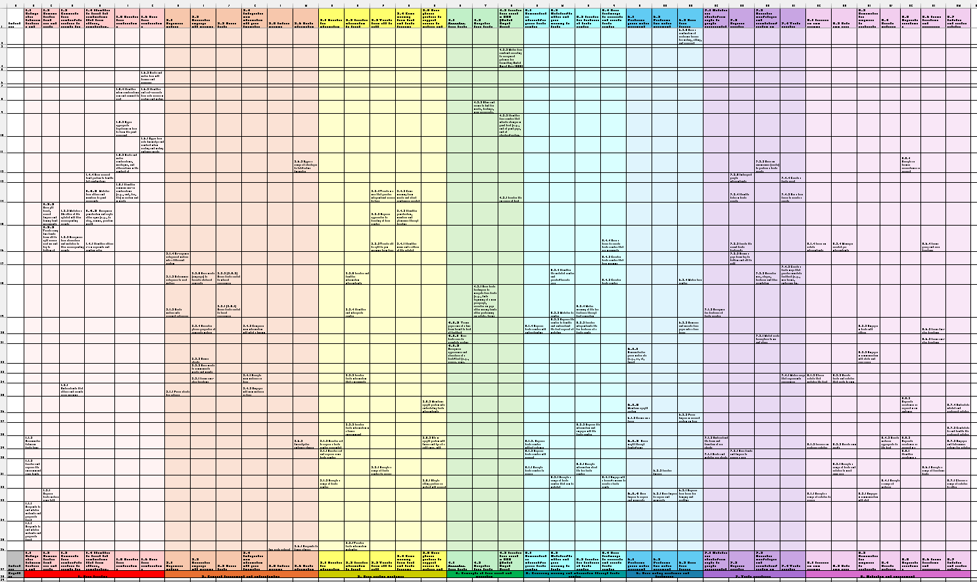
Draft construct map

Slide 12
Draft capabilities
Braille decoding (red): 6 indicators
Concept development and understanding (orange): 6 indicators
Braille reading mechanics (yellow): 5 indicators
Concepts of braille layout and navigation (green): 3 indicators
Conveying meaning and information through tactile symbols (teal): 4 indicators
Braille writing mechanics and technology (blue): 3 indicators
Tactile graphicacy (purple): 4 indicators
Motivation and engagement: 7 indicators

Slide 13
Current and next steps
Ongoing literature review
Piloting: representative end users
Revision: subject matter experts
Large-scale trial
Data analysis and calibration
Use to create assessment and teaching resources

Slide 14
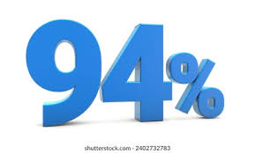
How accurate are expert teachers of students with disability?

Slide 15
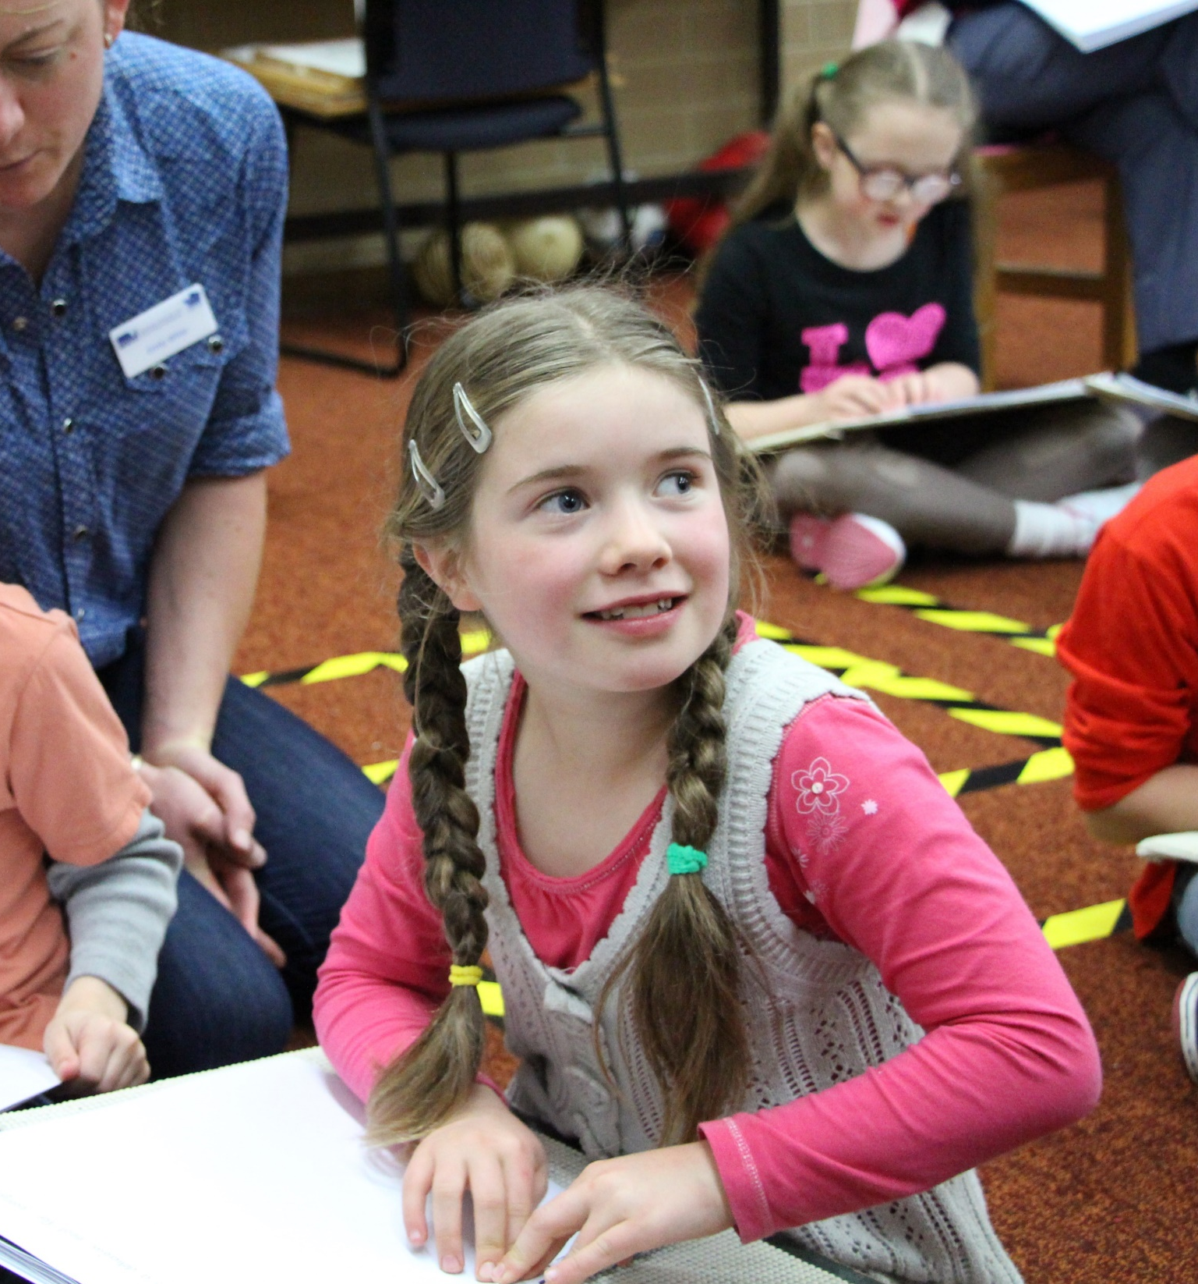
Thank you
emily.white
@unimelb.edu.au
CRICOS 00116K

