Slide 1
Transcription at the speed of Microsoft Word
For requests that were needed yesterday
Michael Walker & Janine Land

Slide 2
The Accessible Format Production (AFP) Toolkit
Microsoft Word
Styles
Templates
Macros
Duxbury
Adobe Illustrator (outside scope of this presentation)
Templates
Actions
Scripts

Slide 3
The pipeline
Requests from Specialist Teachers
Librarian sources publisher PDF
Publisher PDF copied into MS Word
Formatting applied using Macros/Styles
Proofing, Embossing, Final assembly
Duxbury (SWIFT) used to translate Word document
Diagrams created in Illustrator (if required)

Slide 4
AFP Word Templates
We have templates for all document types we produce:
Large Print (Verdana N18, N24, N30, N36)
Braille
Braille Note Touch Plus
We have some students who prefer Word documents read in KeyWord on their BNTP, this template is designed to work within those limitations

Slide 5
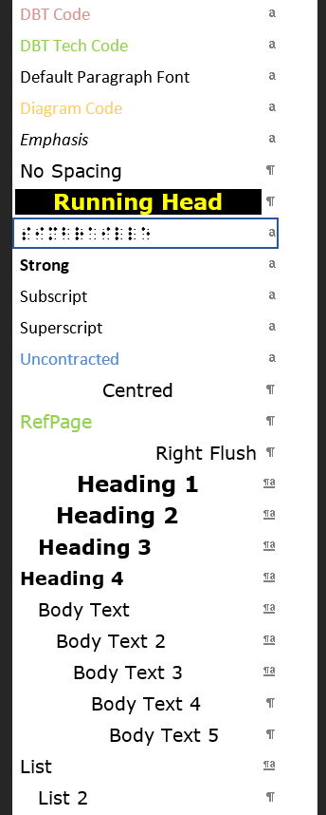
AFP Word Templates (cont.)
All templates are inter-operable
Replaces most of the default Word Styles with Verdana based styles
Font, sizing and spacing of styles are setup with reference to the Guidelines for Producing Clear Print
All styles work with the standard ABA UEB DBT template (no SWIFT/MWS file customisation required)

Slide 6
AFP Automation
Broadly a variety of Macros that perform modifications to a Word document
Most useful macro is the “Find/Replace Core”
Gives us the ability to save Word Find and Replace queries to a spreadsheet and replay them at any time
We have ~50 tasks that are available for regular use
10+ “Publisher files”, Find/Replace tasks that perform a number of operations on files from specific series i.e. the Haese Mathematics for Australia textbooks

Slide 7
Do you format anything in Duxbury?
Mostly No
No
Almost all formatting is done in Word and imported to Duxbury
The Word document is the “single source of truth”
We write changes back to the Word document
E.g. when making space for diagrams using [[*sk#*]] codes we adjust in Duxbury and Word

Slide 8
The pipeline (revisited)
Requests from Specialist Teachers
Librarian sources publisher PDF
Publisher PDF copied into MS Word
Formatting applied using Macros/Styles
Most of the Heading, List, Body Text etc. formatting done here
Duxbury (SWIFT) used to translate Word document
Fine tuning of Braille on the page. Ensuring correct splitting across lines/pages etc.
Diagrams created in Illustrator (if required)
Proofing, Embossing, Final assembly
Find/Replace Core tasks run here

Slide 9
Demonstration

