Slide 1
ANZAGG
Accessible 3D Printing Workshop
Round Table Conference 2025 Workshop, Melbourne Australia
Australia and New Zealand Accessible Graphics Group (ANZAGG)
Facilitated by Leona Holloway, Sarah Hayman, Adrian Riessen

Slide 2
Workshop outline
Introduction to the workshop
Case study: 3D makers club designing a mug at SASSVI
Choose-your-own adventure activity stations:
  Exploring 3D printers - hands on access and printing icons and tactile graphics
  3D model examples - samples from different repositories and examples of models by blind designers
  Accessible 3D Design - design a 3D dice by coding in OpenSCAD
Discussion time

Slide 3
Introduction
Notes:
Leona

Slide 4
Accessible 3D printing - 3D printing BY people with print disabilities
STEM learning
Becoming the designers/makers of the future
DIY creation of your own solutions for
  Access
  Customised assistive devices
  Fun!
Notes:
We are now beginning to master the art of 3D printing FOR people with print disabilities, with most accessible format production agencies in Australia and New Zealand now providing 3D printing as one of their standard formats.
However, there still remain barriers to 3D design and printing BY people with print disabilities. In Australia and New Zealand we do not have any official supports for 3D printing accessibility and very few people doing it in practice, as they are forced to figure it out for themselves.
At the same time, 3D printing accessibility is of huge interest to the print disability community. 3D model design and printing is valuable for 2 main reasons:
Participation and inclusion in STEM learning, as a stepping stone towards becoming designers and makers of the future.
As a DIY method of creating your own solutions for
access, e.g. what does that famous building look like?
Customised assistive devices, e.g. kitchen gadgets
Fun

Slide 5
The 3D Printing Process
Find a 3D printing file (.stl)
Check the model
Slice
(printer settings)
3D print
Design your own
3D model
Notes:
We do not have time to cover all of the details regarding the 3D printing process, however it is worthwhile giving a very brief overview.
FDM printers, which are the most common type, print one thin layer at a time, each building up on the last.
The first step of the process is to obtain a 3D model file. This can be done by either searching for an existing file or making your own.
Step 2 is to check the model to make sure that it shows what you want, is suitable for touch access, and is suitable for 3D printing.
Step 3 is to “slice” the model - this uses specialised slicing software to give the printer instructions about how to print the model, e.g. which way up the model should be positioned, how thick each layer should be, and whether it needs any supporting materials to be added while printing.
Step 4 is operating the 3D printer. This means loading the materials, sending the file to the printer, checking for errors, and fixing any problems.
[Image description: Flow chart with five boxes.
Box 1: Find a 3D printing file (.stl).
Box 2: Design your own 3D model.
Arrows from 1 & 2 to Box 3.
Box 3: Check the model. Arrow to Box 4.
Box 4: Slice (printer settings). Arrow to Box 5.
Box 5: 3D print.]

Slide 6
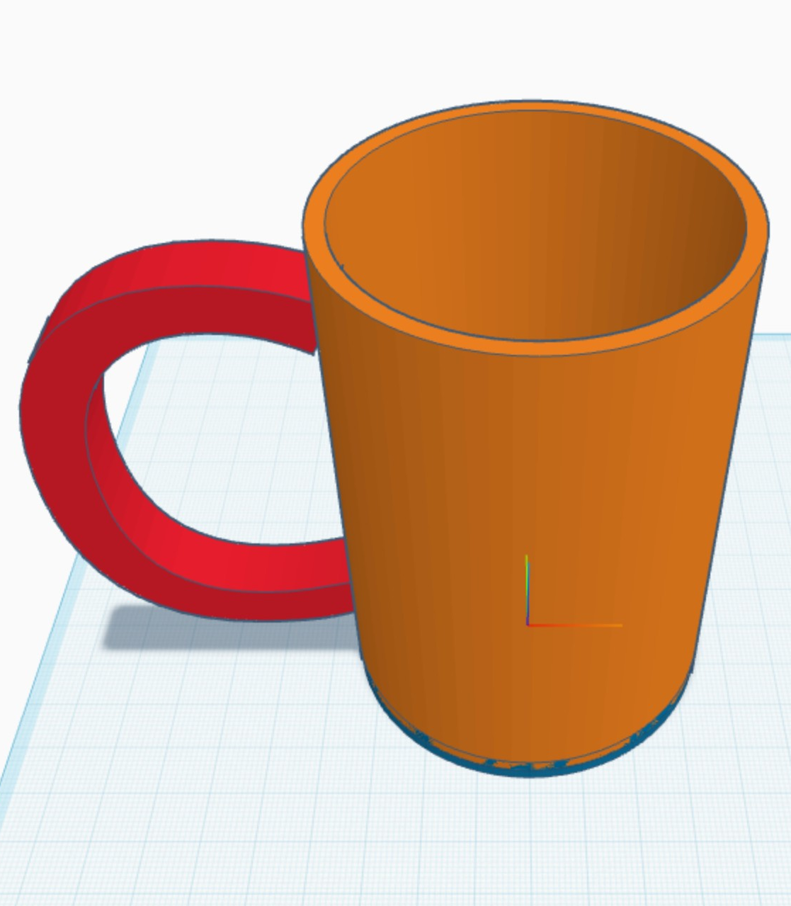
SASSVI 3D Printing Club - Adrian Riessen
About the club
TinkerCAD
TinkerCAD is a free, online software for simple visual design.
https://www.tinkercad.com/
Notes:
Adrian - With access to designing your own 3D model being dependent on knowledge of CAD processes and concepts with programs that often require high levels of visual access and input and the basics of CAD and program coding now being taught in primary schools across the Australia as part of Digital Technologies, at SASSVI, as a primary school setting, we have a 3D printing club that has been running since 2018 (?) as part of the 3D Printing in Primary Schools project by the SA Department for Education. This was started as a way to include students with vision impairment in the process of 3D making using CAD. Initially this was using Makers Empire just with students with low vision, but as this was not inclusive of our tactile learners we explored options for better access at a primary school appropriate level and landed on using Codeblocks within the Tinkercad program the last 2 years.
Being a primary school setting the focus is on building conceptual understanding for further accessible 3D printing as part of digital technologies as it advances in High School. This includes building spatial and geometric understanding of 3D shapes, understanding how translations and rotations affect a 3D shape, and understanding of 3D axes, coordinates and planes. It is also an opportunity to reinforce learning around measurement, metric conversion, and measurement of angles. In addition students work through the sequencing of an algorithm, inputting basic instructions to build coding concepts.
Tinkercad is a free, online operated application for simple visual design. However, Tinkercad itself is not accessible with a screen reader, so I have had to make some adaptations to make it usable.

Slide 7
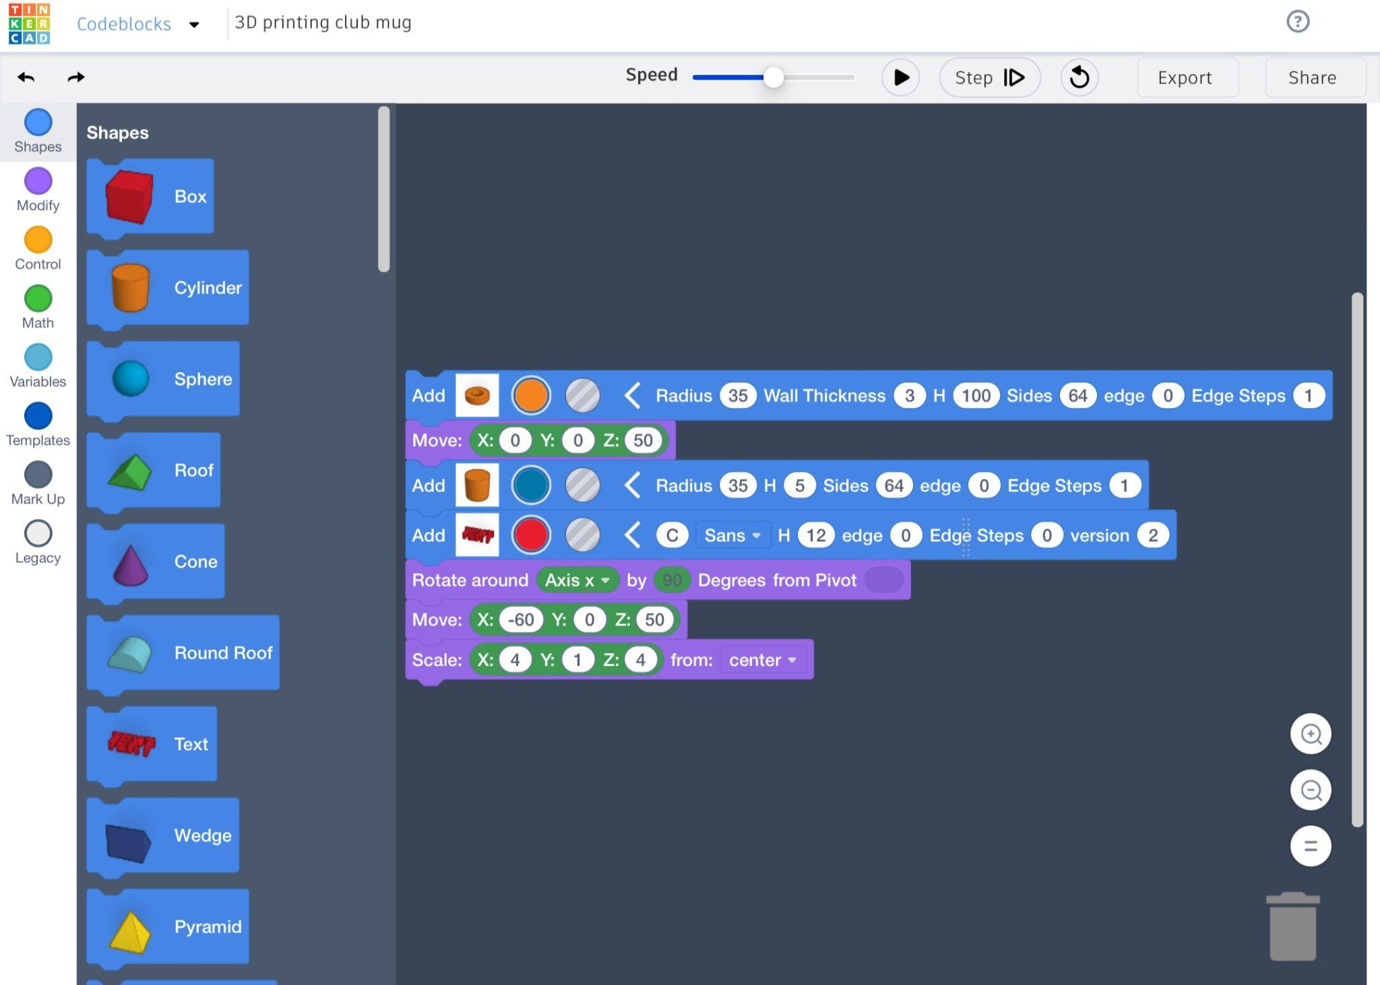
SASSVI 3D Printing Club
Brief TinkerCAD methods
Example project - design a mug
Notes:
Using the simple structure of its Codeblocks design feature students are able to select shapes and write out coded instructions, into a document or text note, in the same format at presented in Tinkercad. For example, the students decided that they wanted a 10cm high mug that was 7cm wide. They chose the “tube” shape to create the main body of the mug and based on the parameters provided in the instruction. The the first instruction of this algorithm students write out “add tube, radius=35, wall thickness=3, H=100, sides=64, edges=0, edge steps=1”. The following instructions are then completed on individual lines underneath the previous instruction. This builds an algorithm that can then be easily transcribed into Tinkercad to create the 3D model.
For review of the design I have been printing the model after each instruction is added. This is obviously time consuming but aims to build understanding of how each instruction affects the design.
The aim is that learners can then take these skills and concepts through to more independently accessible options such as openSCAD.

Slide 8
Activity stations
Notes:
Share some 3D prints designed by people who are BLV, including Judy Dixon’s models

Slide 9
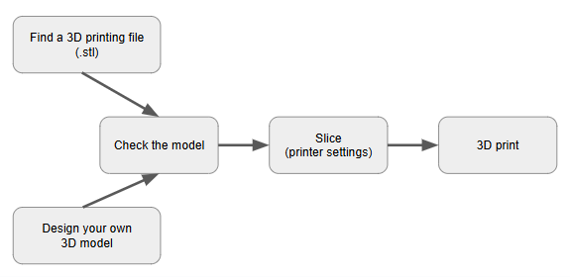
Activity stations
Please choose your own adventure - choose one or more stations to visit (30 minutes)
3D model examples and using AI to check designs
OpenSCAD designing
3D printers
1
1
3
2
Notes:
*** There is only one hearing loop available in the room, attached to the lectern. Ask if there is anyone using the hearing loop. If there is more than one, ask if they can coordinate to go to the same stations together. ***

Slide 10
1. 3D model examples
Explore the models
Consider the source of the models - 3D printing repositories and example models designed by people with a print disability.
Use AI to describe original model images - how do these compare to the actual model?
  https://imagedescriber.online/
  BeMyEyes
  SeeingAI
  ChatGPT
Think about how you might design these models yourself. What basic shapes make up the model?
Notes:
Sarah- Embryo development, LP protractor
Leona - biology cells (from Thingiverse, of various qualities), Eiffel tower (designed by BLV using AI), kitchen rack (designed by BLV using OpenSCAD)
Adrian - Cup progression
3D Makers - Tom Babinski, Judy Dixon, Ka Li, Chancey Fleet, Edis

Slide 11
2. OpenSCAD
OpenSCAD is an open-source text-based 3D design software.
Objects are created and then placed in 3D space using various commands, often based on vectors. Measurements are in millimetres.
An excellent resource is the OpenSCAD User Manual on Wikibooks.
Lesson plans for blind students are available from https://www.accessiblestem.org/.
Dice activity roundtable. Complete the remaining faces on the dice.
Notes:
An activity file is available at Dice activity roundtable. Open the file in a text reader or OpenSCAD. It contains the code to render a 6-sided dice with dots on 4 faces. Can you make sense of the code? Can you complete the remaining faces on the dice?

Slide 12
3. 3D Printers
Explore a 3D printer
Start printing a simple model (tacticons or 3D printed tactile graphics)
Observe the process of printing
Check the finished print
Notes:
3D printers are provided to allow for touch (and visual) exploration of a 3D printer. Filament (on a reel at the back or top of the printer) is fed into a heated printing head. The filament is extruded through the head (which moves back and forth and side to side) in thin layers onto the printing bed, which moves down slightly for each new layer. Some small 3D model files have been pre-sliced for selection and printing. Choose from a TactIcon (small 3D icon for a map) or a tactile graphic, which can be printed onto paper.
While the printer is running, think about non-visual methods for monitoring the print:
Loose filament tends to move around on the plate, making a high-pitched ticking sound that indicates a printing error.
Raised corners due to adhesion problems cause a scraping sound when the nozzle passes over that area.
Depending on the printer, the filament spool may make a noise as it turns, confirming that there is no blockage.
The filament can be touched as it enters the feed tube to check that it is moving.
It is safe to pause the print and touch the partially completed model. If well familiarised with the printer, adults may check a print in progress by using one hand to track where the print head is working and the other hand to gently touch a part of the model that is not currently being printed. However, it is generally best not to touch the printing area as the nozzle is extremely hot, the printing head can be easily moved and oils on the skin can interfere with adhesion.

Slide 13
Discussion time

Slide 14
Discussion prompts
Do you have any questions?
What new insights have you gained today?
How can you apply learnings from today’s workshop to your own practice?
Will you start to design/download your own models after today?
What more would you like to learn (using further resources or via future ANZAGG activities)?

Slide 15
Further Resources

Slide 16
ANZAGG resources
ANZAGG 2025 workshop resources https://drive.google.com/drive/folders/1GI0qTLhSL5m_1VVmSGnZvzxElUYPJUgb?usp=sharing
Round Table Guidelines for Producing Accessible 3D Prints
  3D model repositories https://printdisability.org/about-us/accessible-graphics/3d-printing/repositories/
  The 3D printing process https://printdisability.org/about-us/accessible-graphics/3d-printing/printing/
  3D printing accessibility https://printdisability.org/about-us/accessible-graphics/3d-printing/blvmakers/
3D printing group - meets monthly for discussion and guest speakers. Contact leona.holloway@monash.edu to join.

Slide 17
Guidelines, Tutorials and Lesson plans
Round Table guidelines https://printdisability.org/about-us/accessible-graphics/3d-printing/blvmakers/
Accessible STEM lesson plans for blind and low vision students to create their own 3D models using OpenSCAD and command line to send their files to the 3D printers. https://www.accessiblestem.org/
Accessible 3D demonstration of non-visual design in OpenSCAD and printing. https://www.youtube.com/watch?v=KCrYGqgOjN0

Slide 18
Groups
ANZAGG 3D Printing Group - meets monthly via Zoom. Contact leona.holloway@monash.edu to join.
Accessible 3D printing listserv https://groups.io/g/3d-Printing-Access
Blind & Low Vision 3D Printing Facebook group https://www.facebook.com/groups/blv3p
r/BlindMakers reddit group https://www.reddit.com/r/BlindMakers/

Slide 19
Model repositories - general
Thingiverse - largest repository of 3D models, including collections by ANZAGG, SVRC, NSW Department of Education (BLPS), NextSense and See3D (see3dprinting) https://www.thingiverse.com/
STLFinder - search engine for 3D printing models https://www.stlfinder.com/
For touch readers:
BTactile - metalibrary for tactile graphics and touch-friendly 3D models https://btactile.com/
Tactiles.eu - European project with repository designed for accessibility

Slide 20
Model repositories - specialist topics
MiniWorld3D - buildings and landmarks https://www.myminifactory.com/users/MiniWorld
Scan the World - museum and cultural arefacts https://www.myminifactory.com/scantheworld/full-collection
Nonscriptum - maths models with lesson plans http://www.nonscriptum.com/geometry
For touch readers:
NASA 3D resources - space models, including some with braille labels https://nasa3d.arc.nasa.gov/
Tactile Universe - accessible astronomy models with lesson plans https://tactileuniverse.org
Medien Augenbit - maths and science models for touch readers https://medien.augenbit.de/category/modelle/
Microbiology for the Blind and Visually Impaired - with lesson plans https://sites.google.com/view/microbiologyfortheblind

Slide 21
3D Design Software
OpenSCAD - Open source software for designing 3D models via coding https://www.openscad.org/
Braille Gen 7.1 - generate 3D printable braille labels from print text
Terrain2STL - menu-based web page allowing you to specify an area to convert into a topographic map https://jthatch.com/Terrain2STL/
TouchMapper - menu-based web page allowing you to specify an area to produce a street map https://touch-mapper.org/en/
KIRI engine - iOS 3D scanner app that can be used with VoiceOver to take a picture of an object (or handmade model) and convert it into a 3D file. https://www.kiriengine.app/
AI - e.g. ask ChatGPT to write OpenSCAD code or use Luma Genie to generate the STL for a 3D model based on your prompt https://lumalabs.ai/genie

Slide 22
Slicing Software
Simplify 3D (paid) accessible slicer https://www.simplify3d.com/
Slic3r https://slic3r.org/
OctoPrint https://octoprint.org/#full-remote-control-and-monitoring
3D Make software (next slide)
Notes:
Bambu slicer
Sighted assistance is required to set up default print settings, after which the slicer and printer can be used independently.
Open the context menu on an STL file > Open with > Bambu Studio. Wait 5-10 seconds.
Once Bambu Studio is open, press Ctrl-R to slice. Wait 5-30 seconds.
Ctrl-Shift-G to send to the printer. If slicing is ready, you will hear a dialog popping up.
Tab to the second button which is labelled and press enter.

Slide 23
3D Make software
3D Make software is in development, with feedback warmly invited and further documentation underway.
https://github.com/tdeck/3dmake
Command line interface for:
OpenSCAD coding
Checking your design
  AI description of your design
  Export a 3D-printed line drawing of a plane from your design
Slicing
Printing
Demonstration video at https://www.youtube.com/watch?v=OCyDKVi6wAc

Slide 24
3D Printing Services
Blindness Organisations: NextSense & Vision Australia
Education Departments: Victoria, Canberra, NSW, South Australia, WA, BLENNZ
Local libraries
See3D - free service for people with print disabilities, relying on an international network of volunteer designers and producers. https://see3d.org/
EvenGrounds - 3D printed building models for purchase.
Ask around - friends and family
Commercial providers

Slide 25
Accessible 3D Printers
No 3D printers have been designed specifically for accessibility, however these printers include some “accidentally accessible” features:
Prusa, used in combination with Prusa Connect cloud service
AnkerMake, used in combination with the iOS app. A template needs to be added over the touchscreen. The printer beeps with every action on the touchscreen.
Bambu PS1 and PS2 have control buttons and are compatible with Simplify3D
Notes:
Prusa 3D printers have a sound assist mode that plays a beep when you land on an item and when you reach the top/bottom of a menu as you turn a physical click knob. It is possible to memorize the menu items (or list them beside the printer) and then count to select the desired item using the physical click knob. Prusa Connect is a cloud service for controlling the printer, including uploading and starting prints.
AnkerMake 3D printers have a touchscreen that can be used by adding a template over the screen. The printer beeps with every action on the touchscreen and the printer beeps when it is ready and when it is finished. The iOS app is mostly accessible but the desktop software is not.
The Bambu P1P and P1S have buttons rather than a touchscreen and are compatible with Simplify3D slicing software.

