Slide 1
Developing a Braille Needs Assessment for Early Childhood (EC BNA)
Tricia Izzard: Early Childhood Specialist Teacher/Children and Young People Senior Practitioner, Vision Australia
Tricia d’Apice: Lead Consultant: Vision Impairment, NextSense
Dr. Sue Silveira: PhD, Course Director, Master of Disability Studies, Macquarie University/NextSense Institute
Round Table 2025

Slide 2

Notes:
On the screen is an image of a piece of artwork that Vision Australia commissioned Holly McLennan-Brown, a proud Yorta Yorta woman and a contemporary Aboriginal artist to produce for our Reconciliation Action Plan. It is titled "Yapaneyepuk (Working Together)". The artwork depicts independence, social inclusion, employment and education which is VA’s 4 pillars. There is a tactile version located at Kooyong.
Since my presentation is aimed at young children, I thought it would be fitting to include an Acknowledgment of Country tailored to the early childhood years. You're welcome to join in.
Hello land (touch the ground)
Hello sky (reach up high)
Hello me (hug yourself)
Hello friends (open arms wide
)We thank the Wurundjeri People of the Kulin nation for sharing this beautiful land.

Slide 3
Evolution
2021: Tricia d’Apice and Sue Silveria developed the Braille Needs Assessment (BNA) tool for use with school aged children with the intention of keeping or putting braille on the agenda.
BNA’s purpose:
to obtain a profile of the child’s clinical and visual functioning
to look at the stability of the visual diagnosis
to look at the child’s preferred access modes, visual and/or tactual
Notes:
Endorsed by Professor Cay Holbrook, who works at the Educational and Counselling Psychology, and Special Education
Vancouver Campus and was based on the ideas from Learning Media Assessment developed by: Koenig A.J., and Holbrook M.C.,1995.)

Slide 4
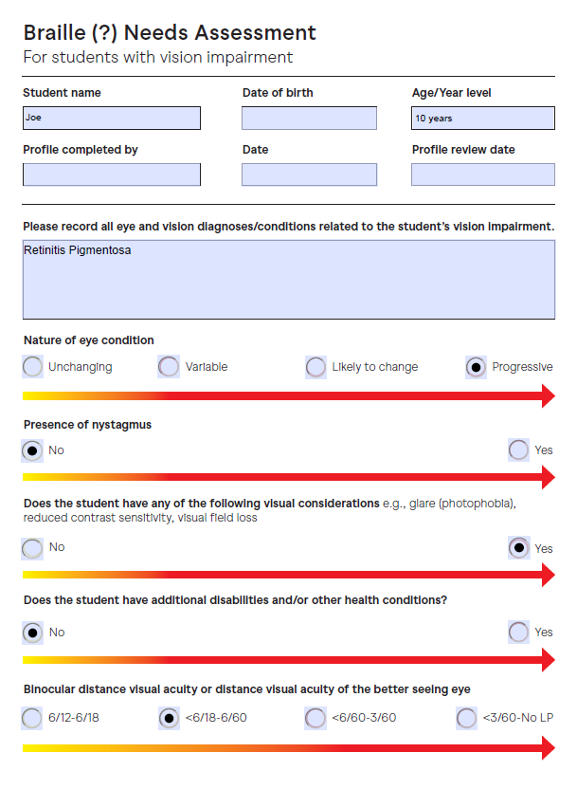
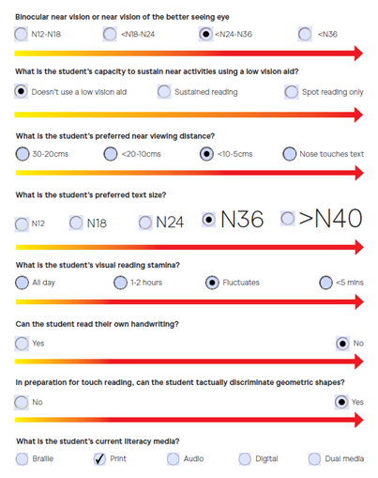
BNA
Notes:
Image of the first two pages of a hypothetical student Joe:
Profiling student’s diagnosis, visual functioning, and distance acuity with sliding arrows on question to indicate the impact on access to print literacy.
Preferred font size, viewing distance, visual stamina, current literacy modes used, and can they read own handwriting? With sliding arrows to plot their ability to access print.

Slide 5


EC BNA
Image retrieved from: https://www.letspartywithballoons.com.au/foil-round-best-teacher-ever-balloon/
Image retrieved from: https://www.istockphoto.com/photos/curious-emoji
Notes:
On the screen there are two images: the one on the left is a round foil balloon with colourful stars and colourful words that say, “Best Teacher Ever” and the one on the right is a yellow emoji with a curious expression on its face and dark framed glasses.
In 2021 when completing my professional placement for The Master of Disabilities Studies: Specialising in Education /Vision Impairment, I was fortunate to have Tricia d’Apice as my supervisor - I looked up to her as a mentor and expert in the field and I had an enormous amount of respect for her knowledge, experience, passion and expertise around braille instruction and access to literacy development for children with blindness. It was while she was sharing the BNA that I asked the question “ What about younger children…they need access to meaningful literacy experiences before they start school”.
And so, the seeds were planted to start to look at what tools were currently available to identify whether braille should be on the agenda for children in the early childhood years….fast forward and here we are now in the development phase of the EC BNA.

Slide 6
BNA and EC BNA differences
The BNA is not suitable for use with children in the early childhood years.
The EC BNA supports families, caregivers, and professionals in making informed decisions about the potential need for early access to braille and tactile learning.
The EC BNA aims to raise awareness of the importance of getting braille on the agenda early in a child’s life.
The EC BNA emphasizes building strong relationships by engaging families in conversations and observations.
Notes:
For instance: “When your child explores a toy or book, what do you usually notice—do they respond more to visual or tactile elements?”

Slide 7
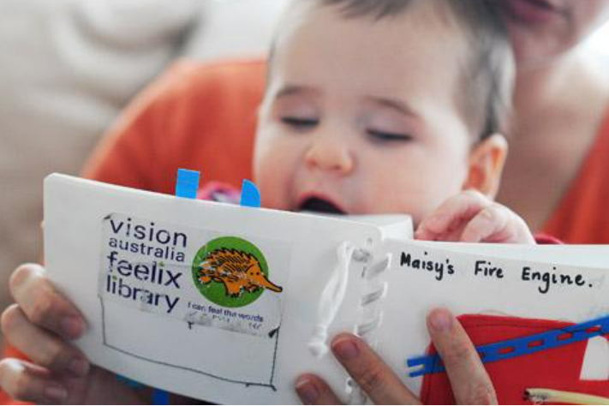
EC BNA Aim
To get braille on the agenda early so that all children have the same opportunity for developing literacy, independence, and social inclusion.
Image retrieved from: https://www.visionaustralia.org/feelix
Notes:
It's not just about getting ‘braille’ on the agenda — it's also about focusing on early tactile learning, fine motor development, and concept development. These are all valuable skills that can lay the groundwork for successful braille reading later on.

Slide 8
EC BNA
The EC BNA captures a range of information, including:
Input shared directly by families and caregivers
Details from reports and formal assessments
Observations from professionals working with the child
The child’s eye condition and functional vision
How the child uses touch and/or vision to understand their environment
How the child plays and explores objects
The typical distance at which the child views objects
Notes:
A child will always attempt to look at an object first; whether its information is meaningful or not. (Izzard, P. 2024)

Slide 9
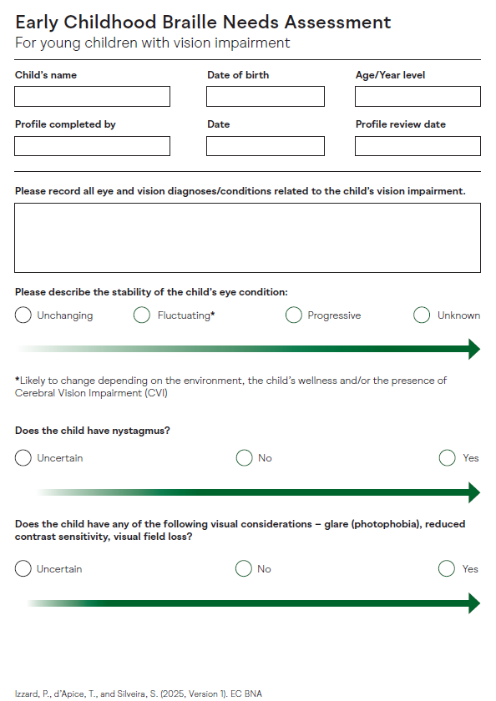
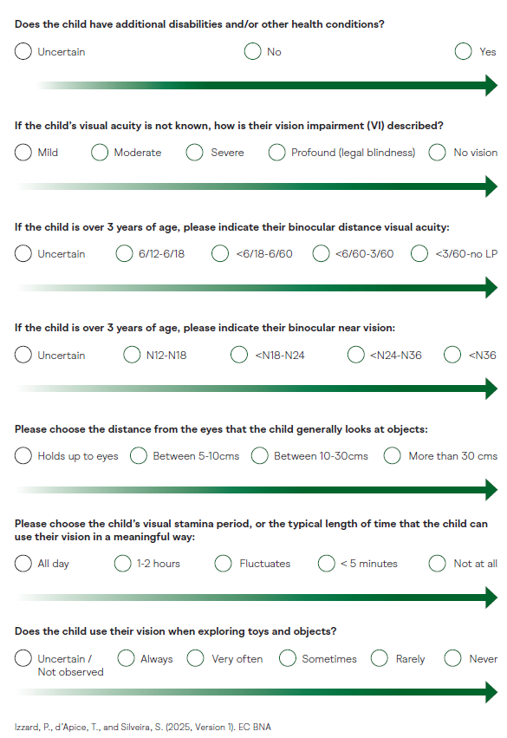
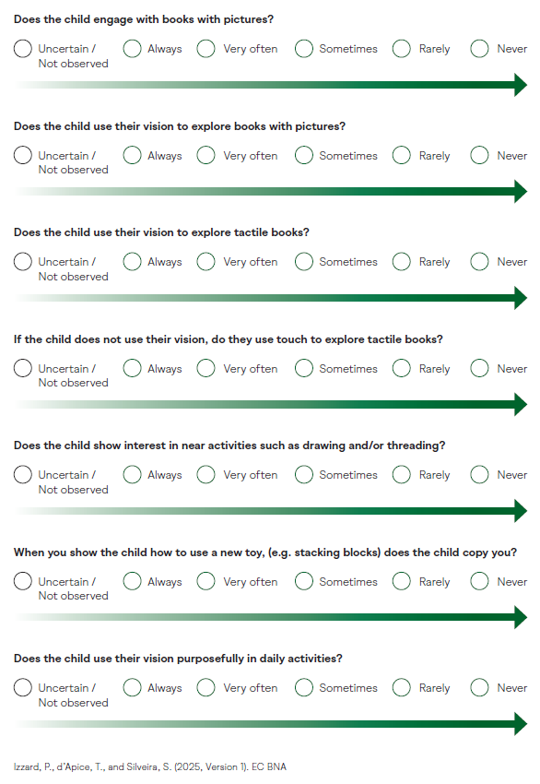
Notes:
GREEN – good to go for putting Braille on the agenda.
Please describe the stability of the child’s eye condition:
Does the child have nystagmus?
Does the child have any of the following visual considerations – glare (photophobia), reduced
contrast sensitivity, visual field loss?
Please choose the distance from the eyes that the child generally looks at objects:
Does the child use their vision when exploring toys and objects?
When you show the child how to use a new toy, (e.g. stacking blocks) does the child copy you?

Slide 10
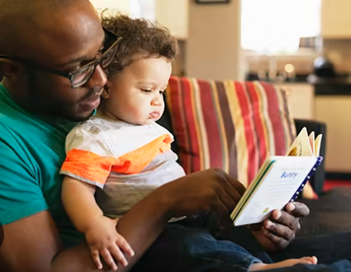
Why the need to start early?
Early experiences are at the heart of literacy development.
Emergent braille literacy is the earliest phase of language development where children, from infancy, are exposed to direct, repeated and meaningful interactions with braille literacy materials and events (Rex, Koenig, Wormsley, & Baker, 1995).
Research has shown that young children who are exposed to early braille literacy have a better chance of success in education, employment and social interaction (Doepel, 2015; Janus, 2011; Makin & Spedding, 2012; McGee & Richgels, 2014; Salmon, 2014).
“[Braille] changes lives and evidence shows that it improves access to higher education and the workplace” (Sue Silveira).
Image retrieved from: https://www.baptistjax.com/juice/stories/child-health/the-benefits-of-books
Notes:
Why start early? Early experiences are at the heart of literacy development.
What is the effect of visual impairment on the development of literacy?
Children without a VI are typically exposed to a flood of language, books, and experiences before they are formally taught to read and write. For sighted children, the exposure to new information and experiences seems almost automatic. They can engage in a full range of sensory experiences to enable them to quickly observe the patterns in their world and to connect words to these experiences and their symbols. They begin to identify objects, symbols, and letters through their ongoing exposure via direct experience, television, and books. (For example, note the amount of information sighted children are exposed to during one episode of Sesame Street).
Children with blindness, however, do not have the same access to incidental visual learning, and therefore depend on a range of meaningful, hands-on experiences to develop specific concepts and skills.
On The Australian Parenting Website: Raising Children.Net.au in the section “Developing Literacy 0-8 years)”, they state that “before children can learn to read and write, they need to develop the building blocks for literacy – the ability to speak, listen, understand, watch and draw, they need to learn about the connection between letters on a page and spoken sounds.
For this to happen, children need plenty of experience with:
-pictures and objects – how you can use words to talk about them
-letters and words – how they look and sound, and what they’re called
-and sounds
Would we expect a child who is a visual learner to be starting their formal education at school to be ready to learn to read and write if they had never even seen a written letter or symbol ….ever !! Imagine the work that would have to be done to build these foundational skill to begin to learn to read and write. What are these markings on a page? What is this tool that makes marks on a piece of paper?
https://www.pathstoliteracy.org/overview-emergent-literacy/

Slide 11
Next steps
Validity study.
Circulate an invitation to trial the tool.
To gain ethics through Macquarie University.
Once the tool is finalized and ready for implementation, make sure it is freely available to all professionals working with young children with blindness or low vision.
Notes:
Validity study to assesses how accurately the tool measures what it's intended to measure
We are still in the preliminary stages, and it remains a work in progress, but we’re getting close to having the first version of the tool ready for testing.

Slide 12
THANK
YOU

