Slide 1
Improving Mathematics Accessibility
and Inclusion for Students who are
Blind or have Low Vision
Prof. Kim Marriott and A/Prof Matt Butler

Slide 2
Project In A Nutshell
We want to create an accessible digital workbook that supports secondary school mathematics students who are blind or have low vision (BLV).
Difficulty accessing visual materials, graphing calculators and collaborating with teachers and peers has led to low participation rates by BLV students in secondary school mathematics, limiting future employment opportunities.
Using human-centred co-design methods we will create an innovative digital workbook that allows mathematics and graphics to be manipulated and shared by BLV students, educators and their peers.

Slide 3
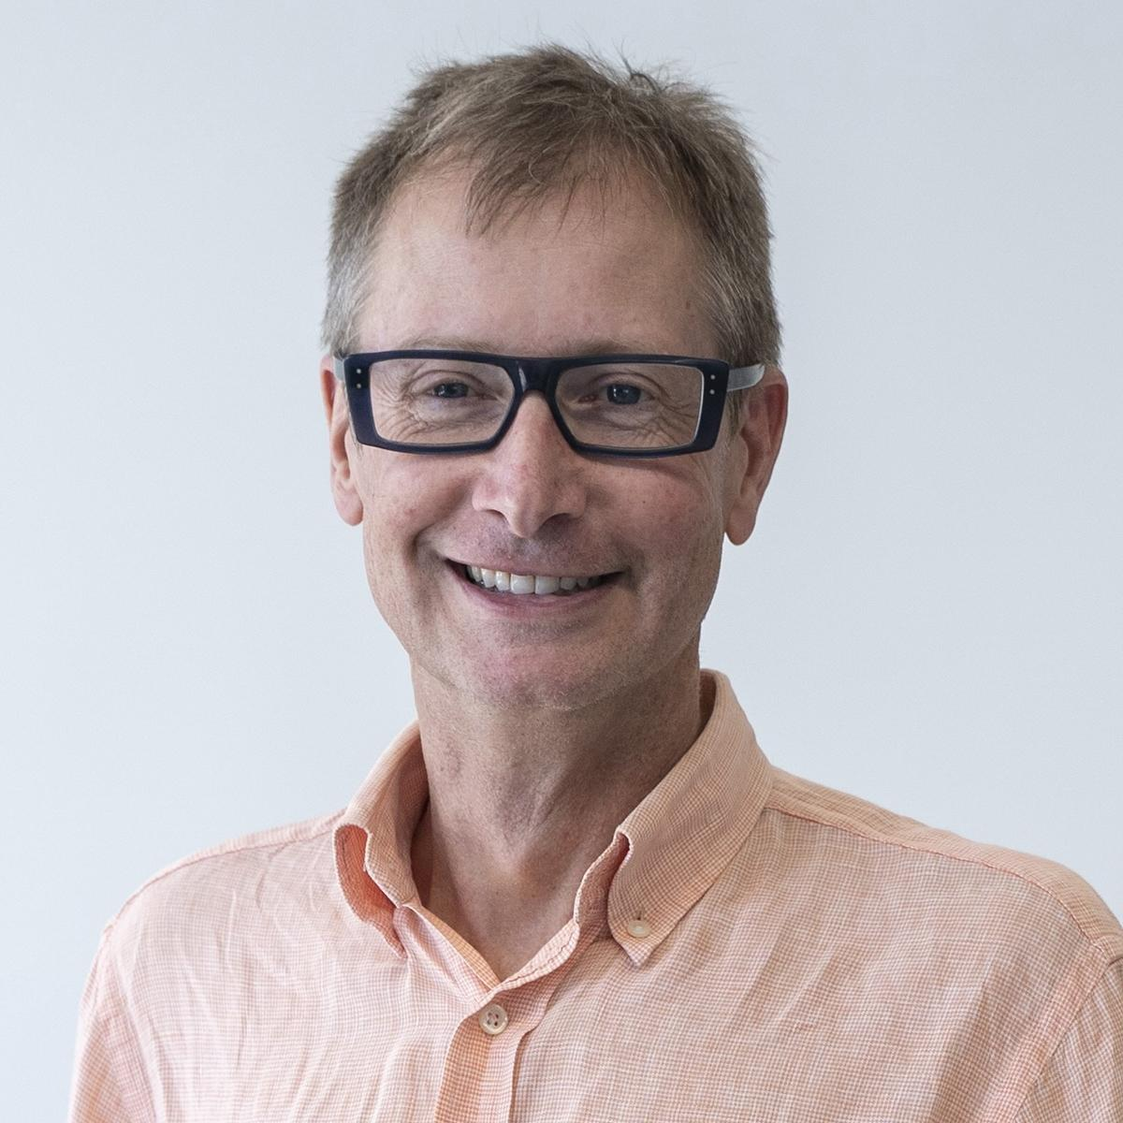
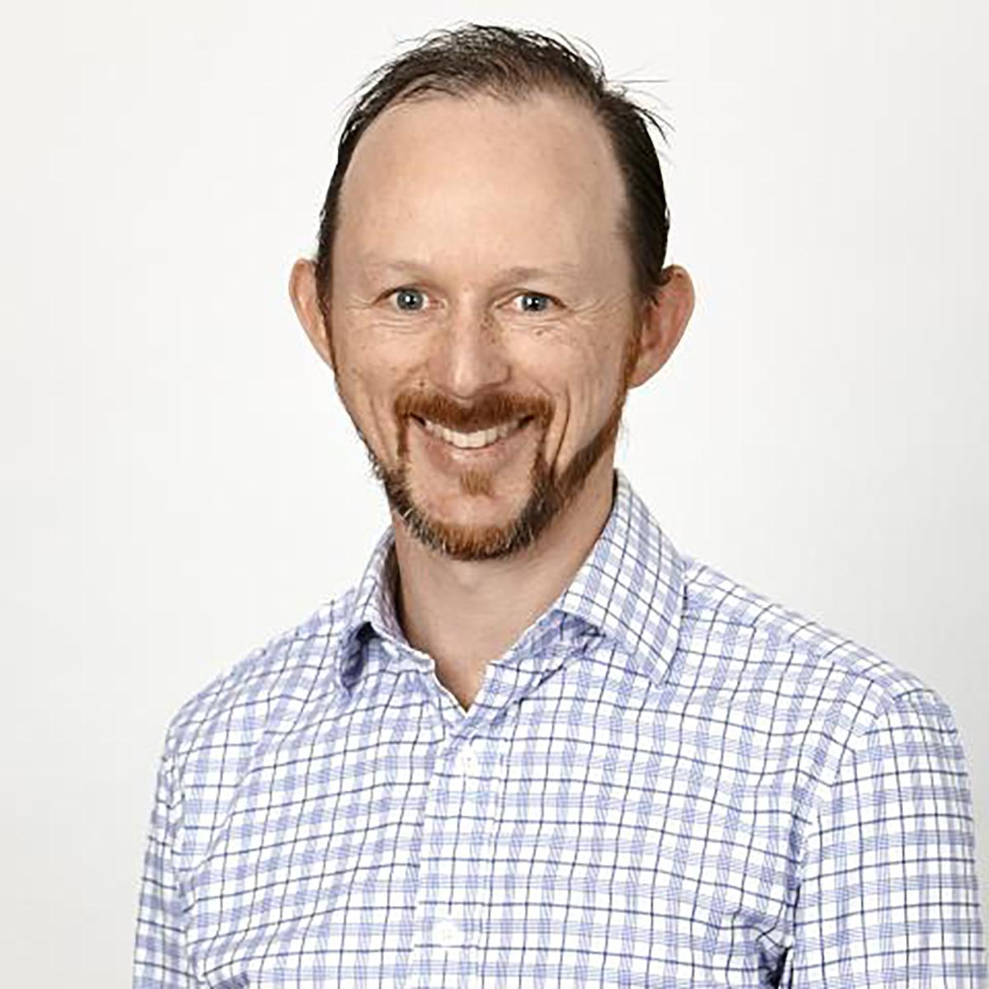
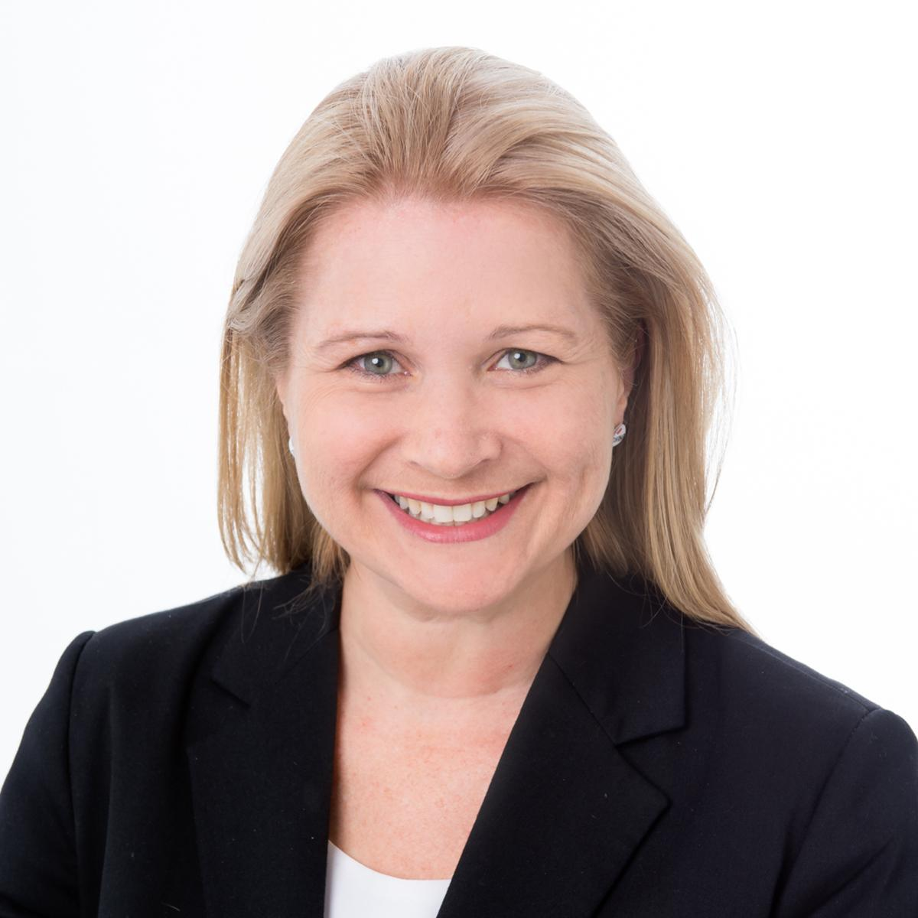
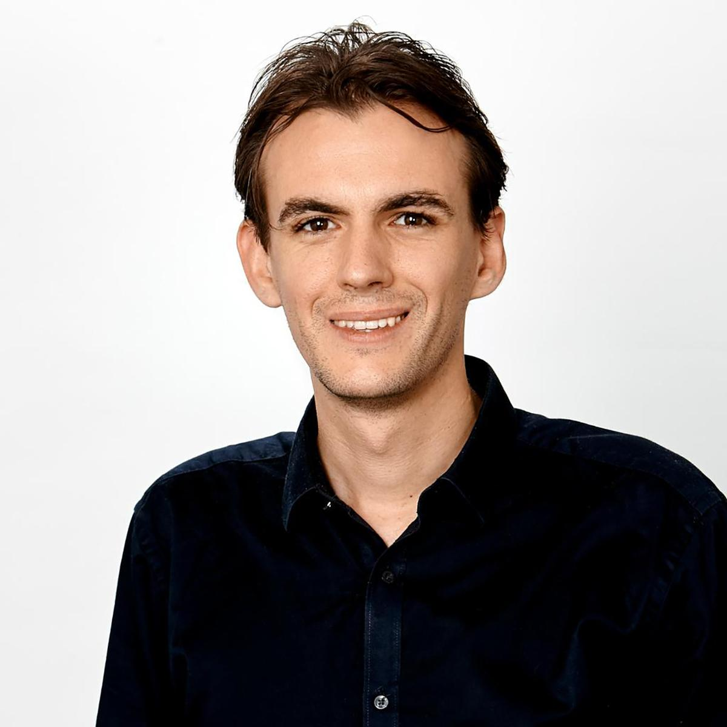
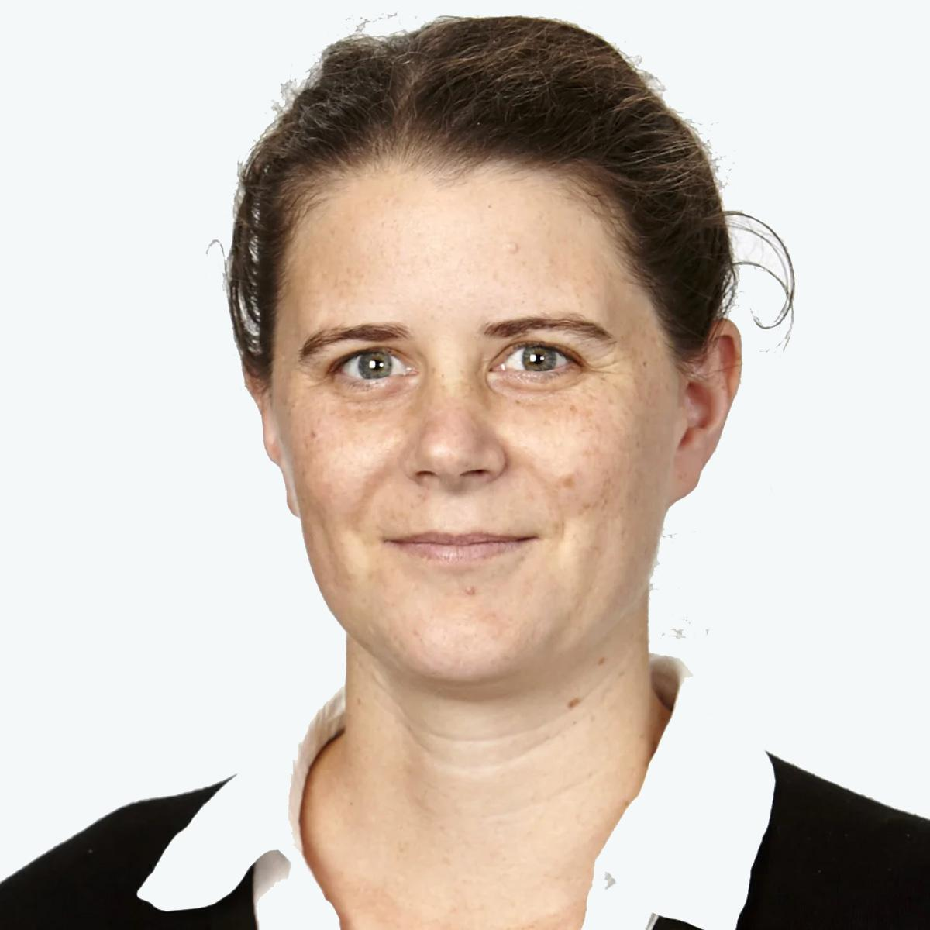
The Project Team
Monash University and University of Southern Queensland:
Kim Marriott Matthew Butler Melissa Fanshawe Michael Wybrow Leona Holloway
Our Partner Investigators:
Sarah Hayman (VIC), Meagan Rodda (NSW), Aitken Jardine (QLD) & Phia Damsma (Sonokids)

Slide 4






Our Partners

Slide 5
Project Background and Motivation
Barriers to academic achievement of BLV students are higher in mathematics compared with other academic subjects (Opie et al., 2017).
BLV students are choosing not to undertake mathematics and related Science, Technology, Engineering and Mathematics (STEM) fields in upper secondary school (Emerson & Anderson, 2018; Fanshawe, et al., 2023) and university (Butler et al., 2017).
Lack of access impacts educational opportunities, and severely impacts future employability.

Slide 6
Project Aims
The aim of this project is to overcome current barriers to collaboration and access to graphics and calculation that face BLV students studying mathematics in upper secondary school.
This project poses four research questions:
RQ1 How to support collaboration between BLV students and their educators and peers?
RQ2 How to support BLV students to create and view mathematical graphics?
RQ3 How to support BLV student access to calculation devices?
RQ4 How to use these technologies in the classroom to effectively support student learning?

Slide 7
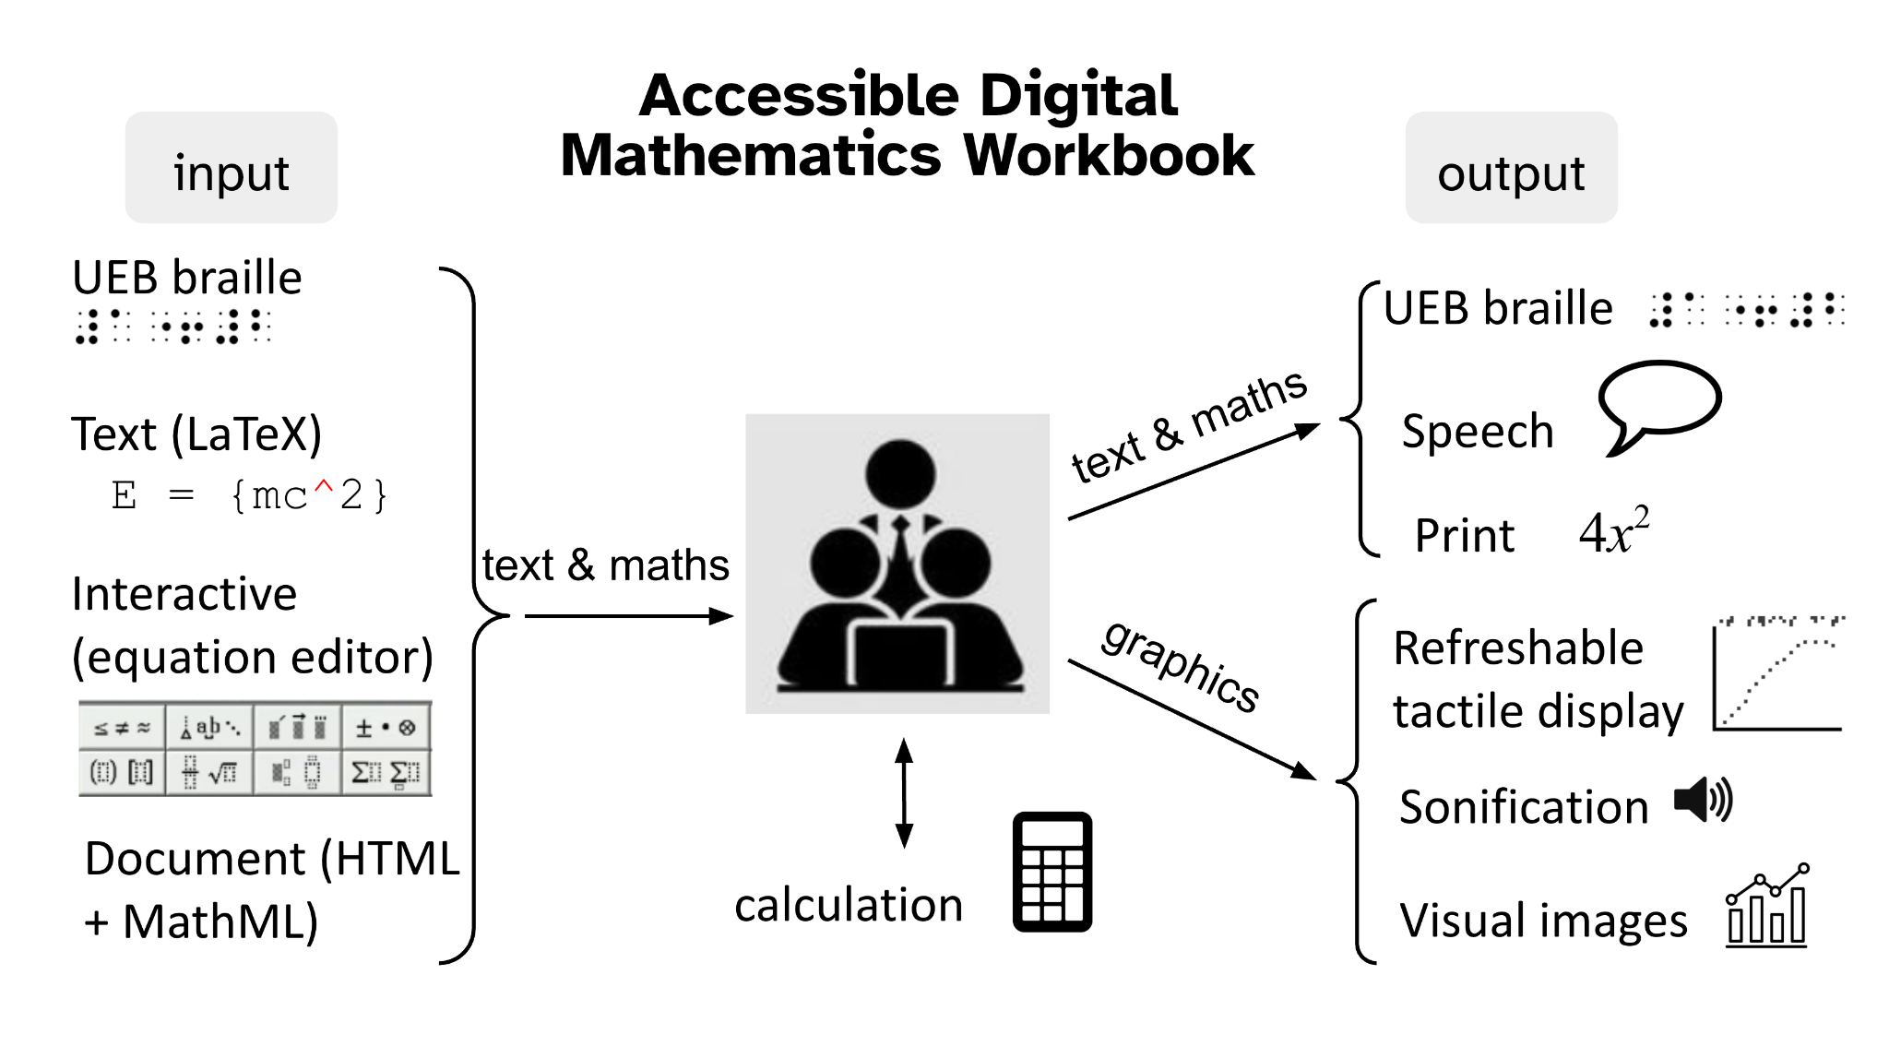

Slide 8
Project Plan mid 2025 - mid 2028
Creation of the Core Digital Workbook
This will support documents containing headings, text, lists, tables and mathematical equations and expressions (HTML, MathML)
Support dual braille and visual views
Accessible calculation
Support customisable calculators
Accessible graphics
Support graphics on refreshable tactile displays (RTDs) + sonification
Dissemination
Guidelines and resources, workshops and training sessions
Based on a survey of our partners, the workbook will be developed as a native iPad app (that also runs on macOS)

Slide 9
Community Engagement
Our Partner Investigators
Our Project Partners
An Expert Advisory Committee
Co-Designers and Testers throughout the project

Slide 10
How Could You Be Involved?
At different stages of the project we will be looking for advice, insights, experiences, and testing
If you are interested in providing any of these things, please let us know!

Slide 11
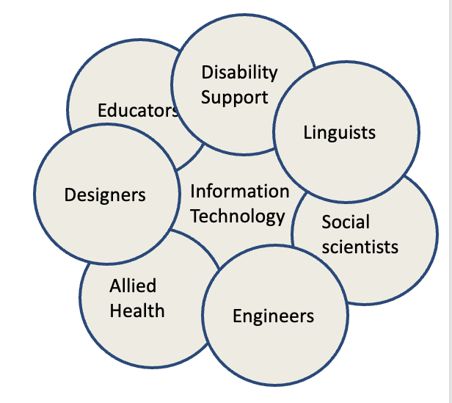
Monash Assistive Technology and Society (MATS)
MATS has 100+ researchers and educators from across Monash
Disability & (assistive) technology

Slide 12
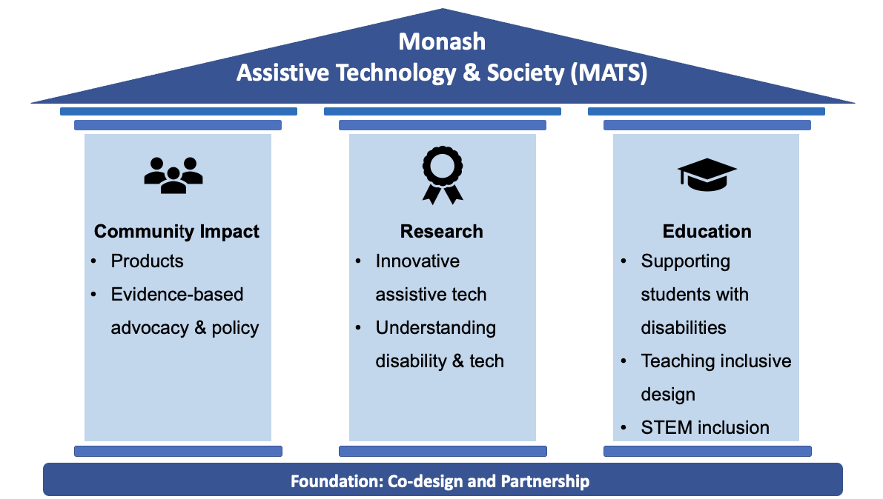

Slide 13
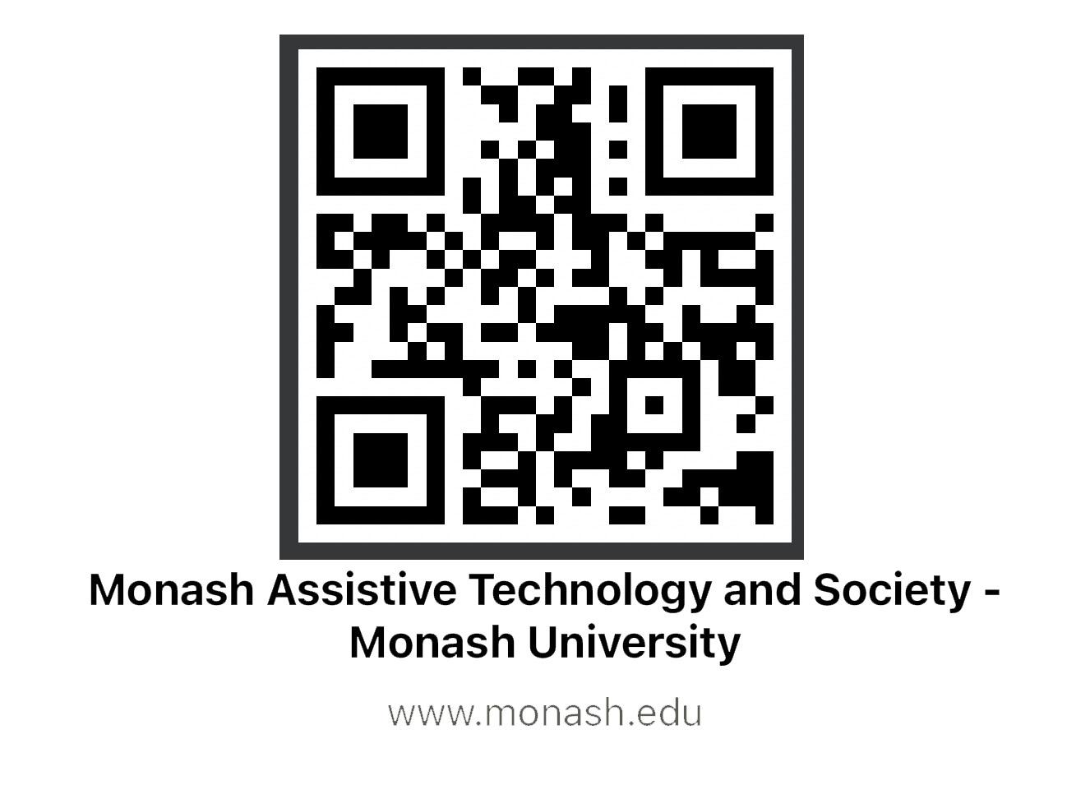
Stay In Touch With MATS
MATS Partners Program
MATS Friends Program

