Slide 1
Supporting independent healthcare using mobile devices for people who are blind or have low vision
William Chen and Associate Professor Matthew Butler
Monash Assistive Technology and Society

Slide 2
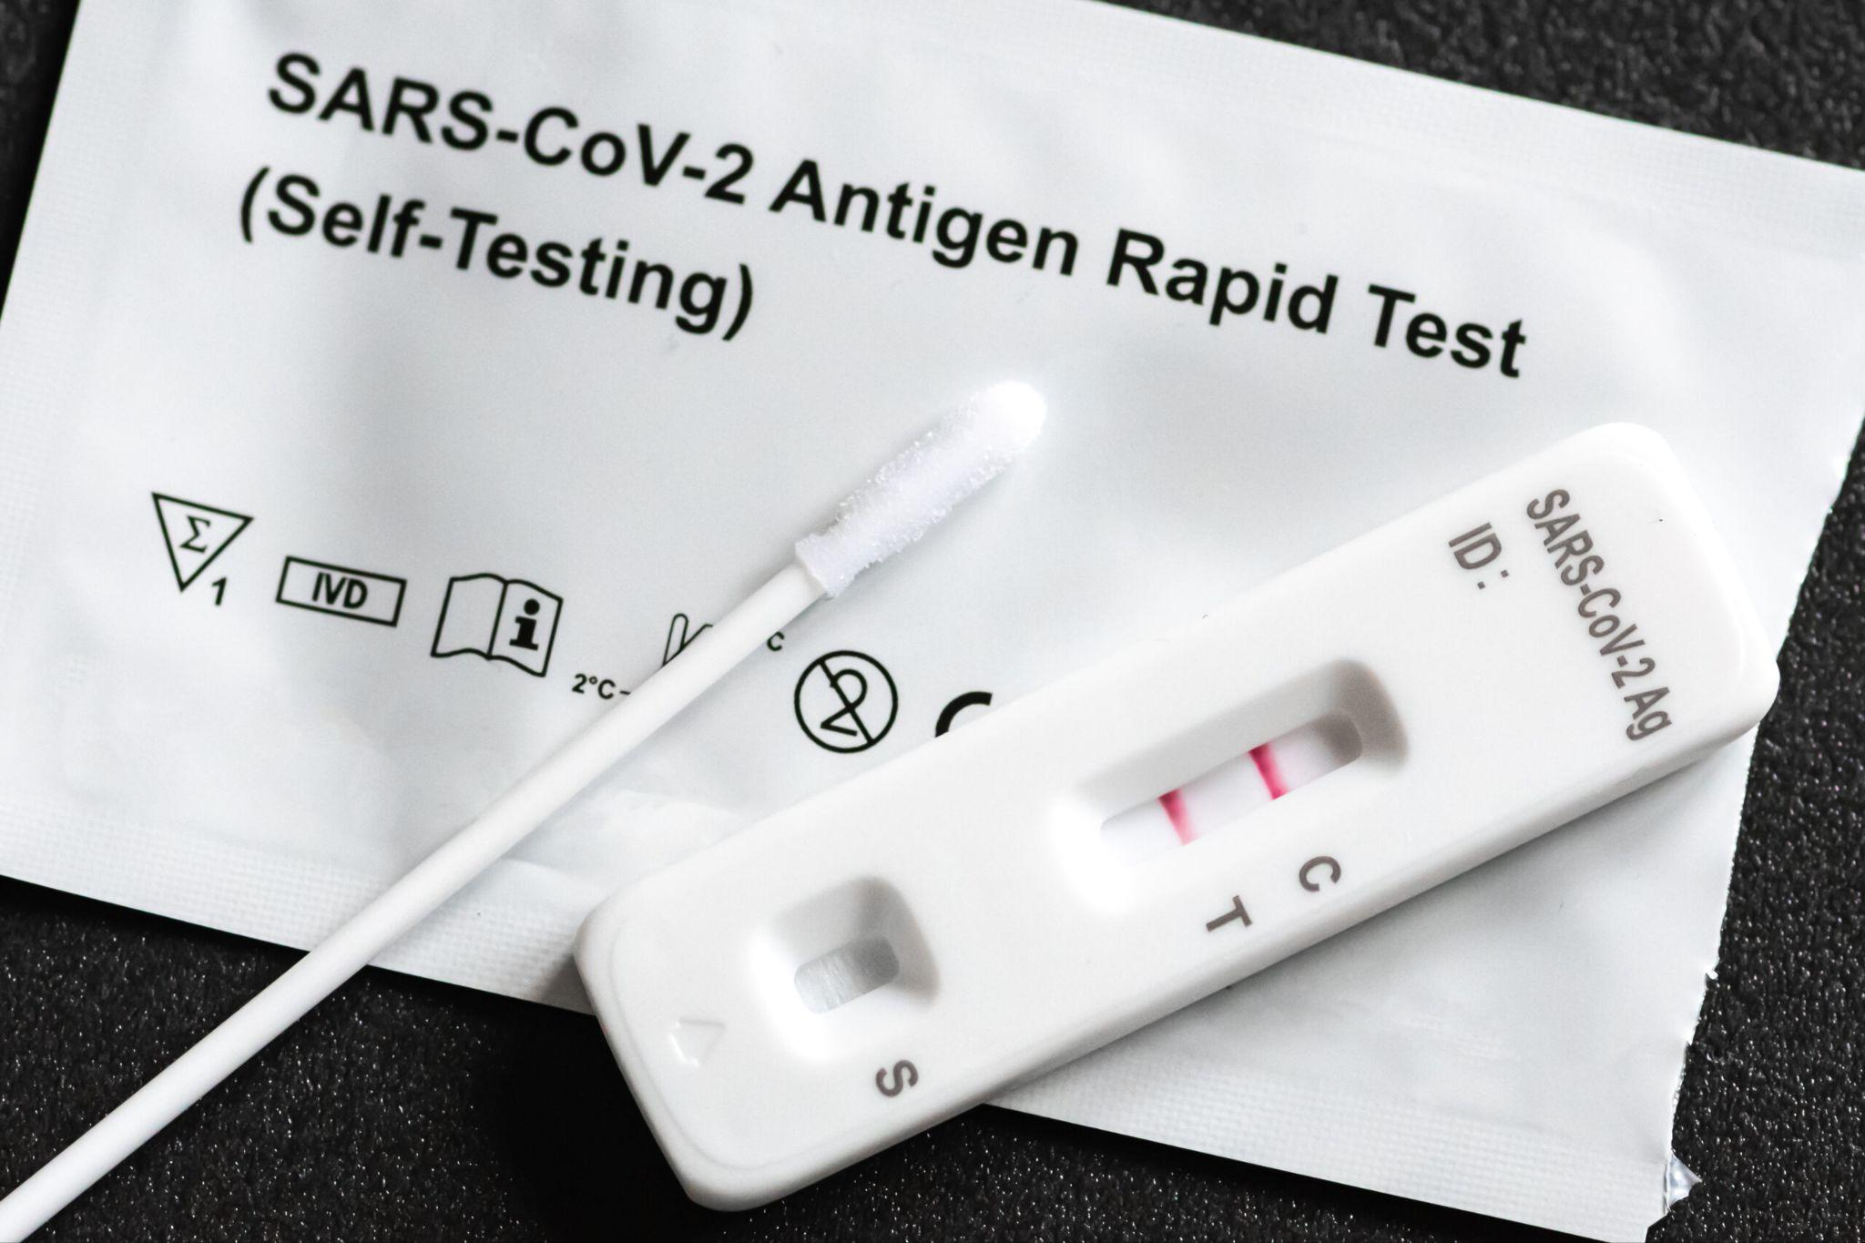

Slide 3
Problem statement
Challenges facing a blind/low vision individual in taking a medical self test
Not knowing how or where to start
No way of interpreting the results
Having to share the results with someone
Limited electronic medical self tests exist on the market
Faced by 285 million blind or low vision individuals around the world

Slide 4
“... mix of frustration and just feeling a bit helpless.”
User Interview
"... Do I really want them to know I'm positive?"
User Interview
“Not satisfied, because they’re not accessible … someone without any vision or very low vision couldn’t do it.”
Bill Jolley: Chair, Vision Australia
“The lack of accessibility says... that the blind or visually impaired do not matter and do not deserve the same resources as people who are fully sighted."
Women With Disabilities Australia
“... Never the first to know what is happening to (our) own bodies”.
Royal National Institute of Blind People

Slide 5
Market Size - SAMTs
$20.35 Billion
Global Self Test Market 2023
$ 146.5 Million
Australian Self Test Market
10.5%
Compound Annual Growth Rate
Notes:
William starts here
Though most people were first introduced to self testing through COVID, the global self testing market is massive and is predicted to be 20.35 billion dollars this year and Australia is predicted to account for 146.5 million dollars. This is a huge and promising market with an annual compound growth rate of 10.5% highlighting the need for an adequate solution that promotes inclusion of blind and low vision individuals.

Slide 6
Our predictions - Theia
$3.6 Billion
TAM
$ 8.99 Million
SAM
$3.9 Million
SOM
Notes:
So we did some calculations, if we were to opt in via a subscription based model for our application Theia, along with a fee per use model as well as an alternative, the serviceable obtainable market within Australia alone would be 3.9 million dollars. This may sound miniscule compared to some of the other solutions presented here today but its a good start for a promising technology in a tested, and co-designed solution thats proven to work.

Slide 7
Current solutions
 | Volunteer based apps BeMyEyes | Paid assistance apps AIRA | Smart tests Ellume COVID RAT
Independent or Private
Cost
Scalable
Gen AI
$140 for 120 minutes
Free
$38
Notes:
Here are the current solutions on the market.
There's no one centralized solutions that offers Australians privacy, independence and low-costs.
There are live assistance mobile applications. Here, users have to pick between:
- Free apps run by volunteers, which lacks standardised quality:
- or professional agents, for an eye-watering $140 per 2 hours.
Smart Tests tho are private and independent, take years to be
approved by regulatory bodies, and aren't available globally and for every health condition and are very expensive to purchase
Lastly, generative AI. I know some of us, especially those who are frequent users of Generative AI might be skeptical of its performance, the consequences of AI hallucination is exemplified in this context as the BLV community is particularly vulnerable to misinformation as it is hard for them to verify the AI models output, not to mention, a misinterpretation on a personal health monitoring device could have damaging effects.

Slide 8
Generative AI - Accuracy
 | Gemini | OpenAI | Llama
Negative | 95.8% | 100% | 73.95%
Weak Positive | 78.3% | 3.5% | 2.7%
Positive | 12.4% | 88.8% | 7.5%
Notes:
So we ran some tests, we used 3 of the most popular generative AI models on the market, I am sure we are all familiar with these names. We then gave each of the AI models 1,300 images of negative, weak positive and positive test results. We’ve tested these AI models on multiple different prompts and we were honestly quite surprised at its accuracy. Not a single generative AI model seems to be suitable for interpreting rapid antigen test results as all of them seem to have biases towards a certain result. For example…

Slide 9
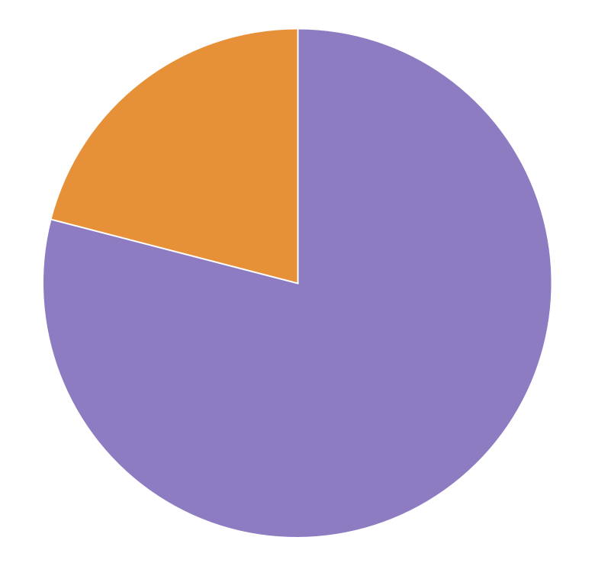
Our solution
79%
Smartphone users
21%
All in one mobile application that is capable of guiding a blind or low vision user through conducting a self test and interprets its results without the need of human input.
Non smartphone users
“I can’t think of a better approach, actually.”
Bill Jolley: Chair, Vision Australia
Notes:
That is why we are proposing a solution that serves as All in one mobile application that is capable of guiding a blind or low vision user through conducting a self test and interprets its results without the need of human input.
We aim to reduce the dependency on synchronous assistance and offers accessible instructions through a lowcost solution.
We chose a mobile application as the blind or low vision community is made up of 79% smartphone users.
We discussed this idea with Bill Jolley and he said, he cant think of a better approach.

Slide 10
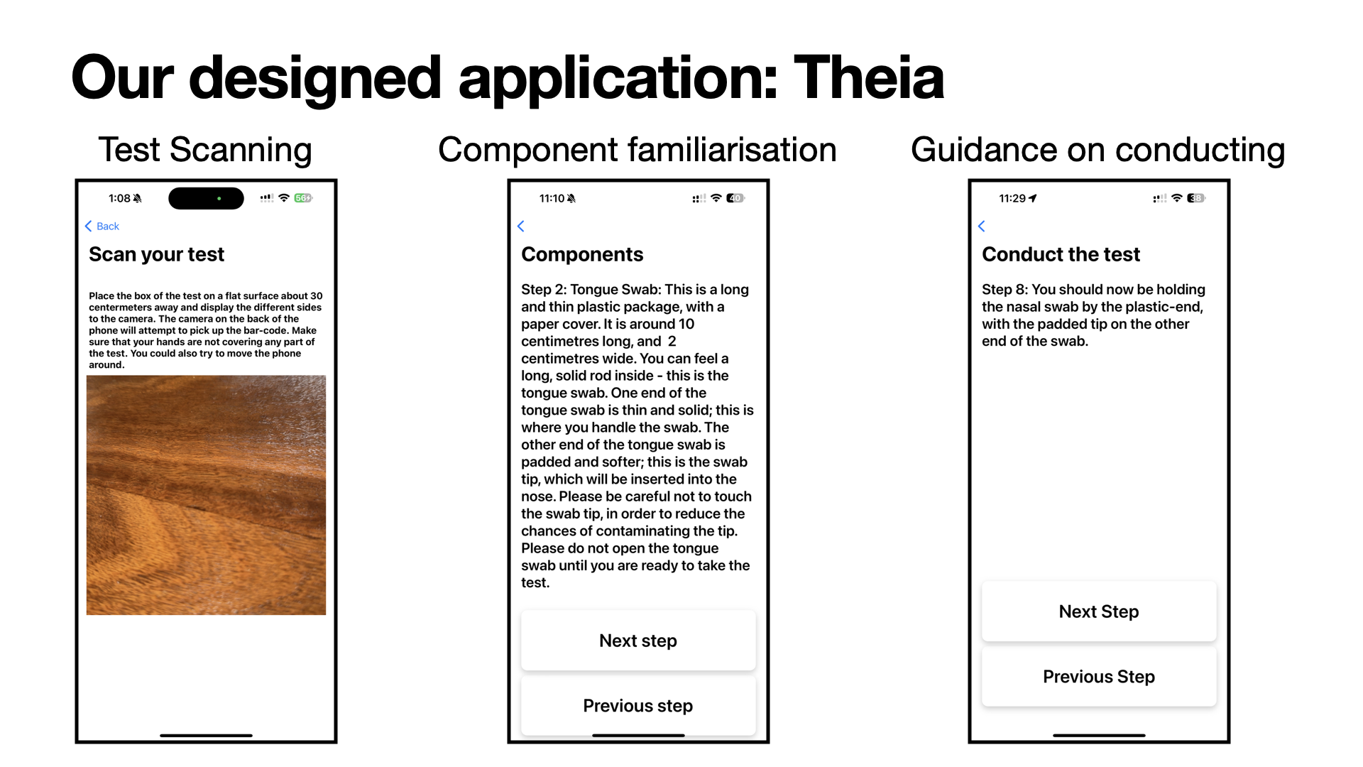
Notes:
Our designed application Theia, is capable of recognising the test the user is conducting using the camera, provide tactual descriptions of the components, and provide accessible instructions that removes the reliance on graphical instructions. Don’t worry, I do have demonstrations available today so feel free to come find Matt or myself to play around with the app yourself.

Slide 11
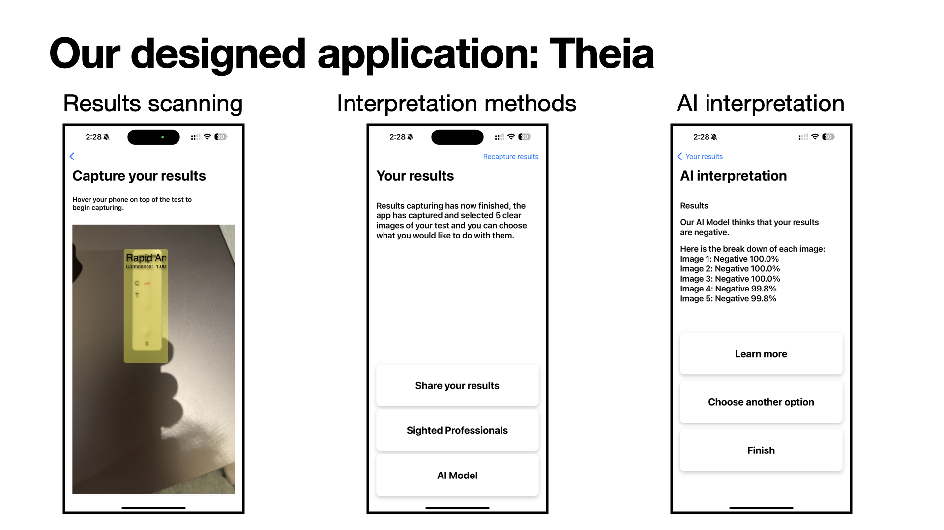
Notes:
The app is also capable of automatically capturing the test windows, and offers three different methods for interpretation. First one being sharing the results with a family or friend where the app will send the captured test Windows to a designated contact of the user.
The second option being sighted professionals where the app would upload the test window images to a medical professional and they would interpret the test results and communicate that back to the user.
Lastly AI interpretation where it’s the only private and instantaneous method of interpreting the test results.

Slide 12
Core functionalities
Human intervention
Human intervention
Recognition of the test
Guidance
Capture
User chooses one or more
AI Model
Share
GP
Interpret
Notes:
In a more higher level sense, There are 6 main functionalities of our propose application. It first recognises the type of test that the user is conducting through scanning the packaging.
The steps are then broken down into accessible formats such as haptics and sound cues.
The app automatically captures the results when the user hovers their phone over the tests and selects only the non blurry images.
The app offers a range of interpretation options.
AI model that will interpret the test windows
Users can share the results to their family and friends to have them help them
Or they can have the results deidentified and submitted to a group of annotators on our end.
You’ll see that both the Share option and GP options have the words “Human intervention” underneath it, that is because those are the two methods that would involve another human seeing the result. Which of course, brings up privacy concerns as well as the idea of autonomy. So we were skeptical as to whether anyone would even choose those options.

Slide 13
Our pilot evaluation
Exploring the relationship between trust, privacy and independence.
Does our app even work?
What improvements could we make?
When would someone give up their independence and privacy due to distrust in AI.
User evaluation sessions:
10 in person evaluation sessions focusing on:
Usability and accessibility of the app
Interpretation preference for the result.
Notes:
So we evaluated our app, and let’s take a quick moment to recall that we touched on earlier, people tend to be a bit skeptical about AI. So, we’re essentially left with three options that all have some level of doubt attached. So to evaluate our application and most importantly, assess the different interpretation methods, we conducted 10 in person evaluation sessions with these three key questions in mind: Does our app even work? What improvements could we make? When would someone give up their independence and privacy due to distrust in AI?
These questions explore three key themes: trust, which represents one’s trust in AI as well as the app, privacy and independence. We wanted to find out at what point would someone ask for sighted assistance, have another sighted person interpret their results for them because they might not trust what the AI is telling them.

Slide 14

Trust towards AI
97.2%
Chose AI first to interpret their results
Consistent Scenario
Inconsistent Scenario
38.1%
Human Intervention
64.3%
Human Intervention
Notes:
During our evaluation session, the participants had the chance to interact with the app to independently conduct a mock COVID 19 test, we also anticipated that trust would build over time but due to the time constraints of my honours program, it wasn’t feasible to obtain data through an organic 7 day interaction of continued usage. Therefore we had constructed two scenarios where we presented 7 prompts and 7 mock test results. So there is the consistent scenario and the inconsistent scenario. For example in the consistent scenario the participants were told that they had no symptoms and the results would also be negative. Where as in the inconsistent scenario, the symptoms do not align with test results. For example, the participants were told that they had Covid symptoms but their results would be negative. The participants were randomly assigned to the two scenarios, and through this, we wanted to observe trust overtime as well as trust compared to expectations where we anticipated that the inconsistent scenario would result in less trust placed in the AI interpretation because it didn’t align with expectations. The participants were asked to scan the test results and choose the interpretation methods that they’d like, whether it is AI, asking a friend or sending it to a GP.
An interesting metric that I’ve included is that 97.2% of the participants chose AI first, even though there were times where the AI model got it wrong, or when they’ve clearly stated that they were skeptical towards AI.
To our prediction, we found that the inconsistent scenario resulted in a higher chance of confirming the AI interpretation through a human where 64.3% of the time the participants chose another option that involved humans to verify the results of the AI model. Which proves that yes, expectations is a huge factor in the amount of trust one places in AI. More importantly, it also shows that AI alone isnt not enough to instill trust in medical diagnosis.

Slide 15
Human intervention - Trading privacy and independence for accuracy
Improving trust in medical diagnosis via AI
Why
“Maybe you wouldn’t want to tell people you
had COVID because you want to go desperately to that wedding”
Participant
Agency
Privacy
“Why shouldn’t a blind person have the ability to be
as evil as a sighted person in those thoughts?”
Participant
Independence
Notes:
So what we found was really interesting, it revealed the way people would interact with AI in a medical context and this is especially important due to the fact that our target population is extremely vulnerable and has been left with no other private and independent alternative.
Notably, one participant mentioned that: maybe you wouldn’t want to tell people you had COVID because you want to go desperately to that wedding and that Why shouldn’t a blind person have the ability to be as evil as a sighted person in those thoughts?
Through user testing, it not only proved how important independence and privacy is, but also the idea of autonomy, being able to be in control and make decisions on your own about your own results.

Slide 16
AI in mHealth
Skepticism towards AI diagnosis
Accuracy concerns
Privacy concerns
Trust is directly correlated with expectations
Improving trust in AI in mHealth
Human intervention
Privacy concerns
Agency
Multiple AI sources
Mentioned by participants
Range of LLMs
Different fine tuned models
#MIMESYMPOSIUM24

Slide 17
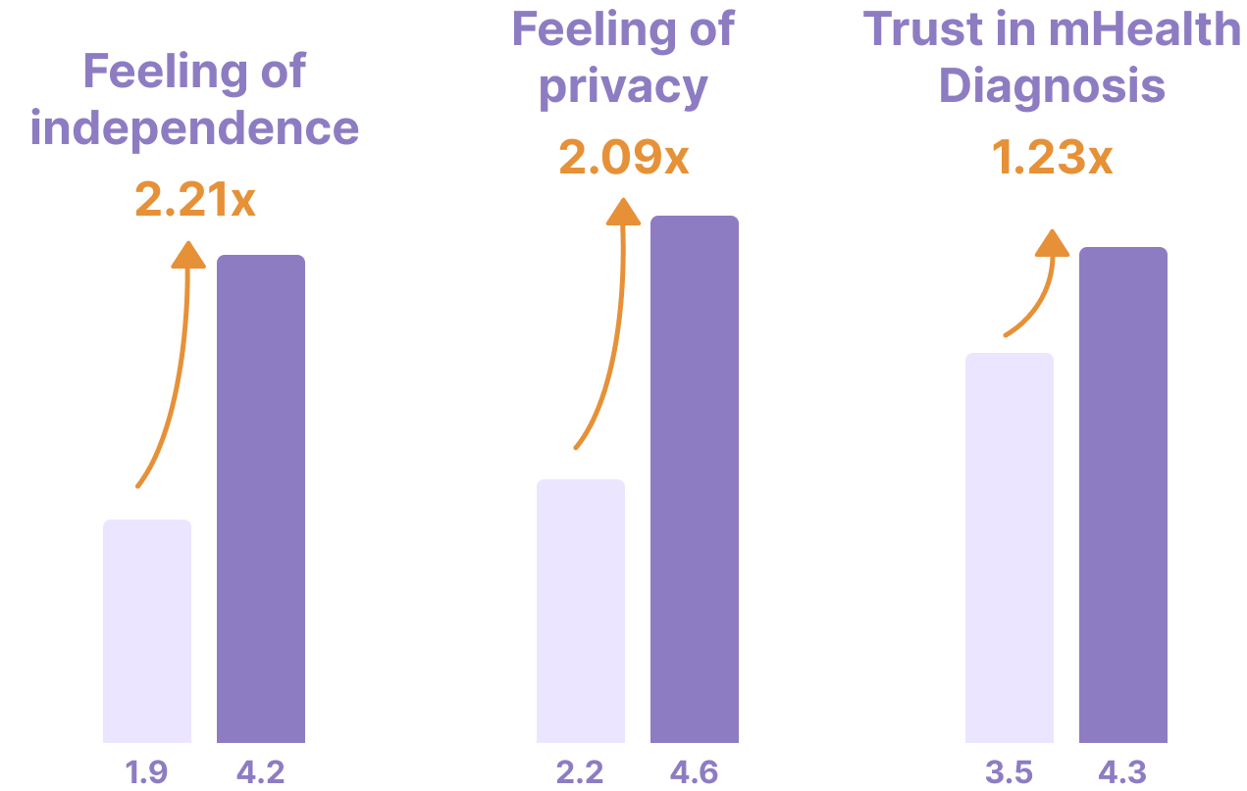
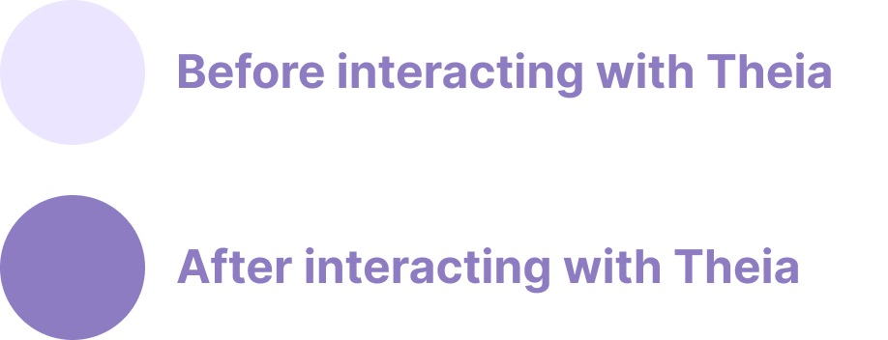
Theia’s potential
Notes:
So to prove that our solution works, we asked the participants to rate how independent and private they felt conducting a SAMT both before using our app and after using our app and we saw a huge jump in their feeling of independence, another massive increase in feeling of privacy using our app and lastly, we saw an increase in trust in mHealth diagnosis, which really shows the potential adoption of our solution.

Slide 18
Our plans
Co-design and development work
Product release
Phase 2
12 months
Phase 4
Phase 1
3 months
Phase 3
3 months
Product vision
User testing
Finish developing a working prototype
User testing and improvements based on feedback
Form partnerships with existing disability support groups
Self sustainable through government schemes or subsidies
Ongoing integration with future tests
Extensive collaboration with end users
Notes:
We are currently near the end of our phase 2, which is development and codesign. We believe that the only way to truly design an application that will be used by the users is by designing it with the them. We plan on beginning phase 3 very shortly by making the app available in a closed beta environment and inviting BLV individuals to try out the app on their own. We really want to make a solution that not only makes it onto the market, but is something that is well perceived, actively used and well maintained.

Slide 19



Whats next
New tests
Ongoing support
Regulatory approval
Crowdsourcing accessible instructions from the community
Partnering with manufacturers
Included within NDIS or Department of Health and Aged Care budget
Release the application without AI diagnosis until we obtain regulatory approval
Notes:
And theres plenty that needs to be done to achieve that, We need to include a wide range of tests within the application, so far it only supports COVID tests but we are expanding to include pregnancy tests as well as bowel cancer screening tests. We would love to partner with manufacturers to get an early hands on their instructions or tests to make it available on the app as soon as the tests are on the market. We have ambitious plans of self sustaining through government funded schemes or including this application within the NDIS budget but these are all up in the air at the moment. And of course, we plan on releasing the application without our in house trained AI model onto the market and will only include it after we obtain regulatory approval.

Slide 20
Future of our solution: Challenges
New tests
Time and monetary efforts required to incorporate new tests
Ongoing support
Maintenance of the application
Ensuring there are GPs registered on the application
Regulatory approval
If we choose to include fine tuned models then we would need TGA approval
#MIMESYMPOSIUM24

Slide 21
Our plan
New tests
Crowdsourcing accessible instructions from the community
Partnering with manufacturers
Ongoing support
Included within NDIS or Department of Health and Aged Care budget
Regulatory approval
Release the application without fine tuned models until we obtain regulatory approval
Feedback from our evaluation sessions
Improving our solution based on the feedback from the user studies
#MIMESYMPOSIUM24

Slide 22

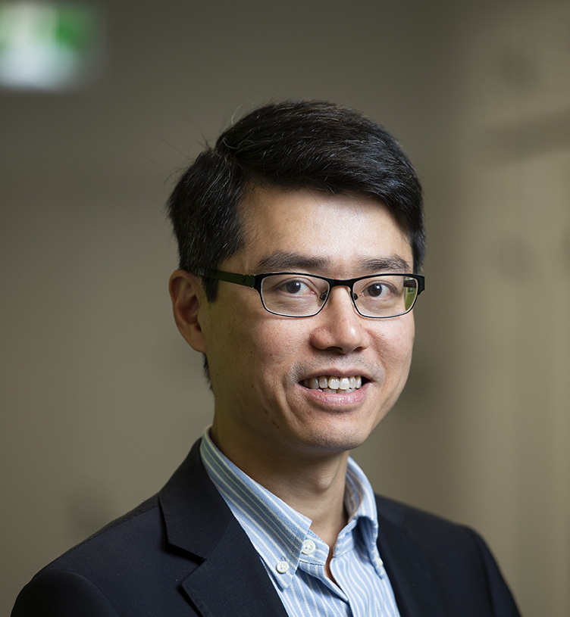
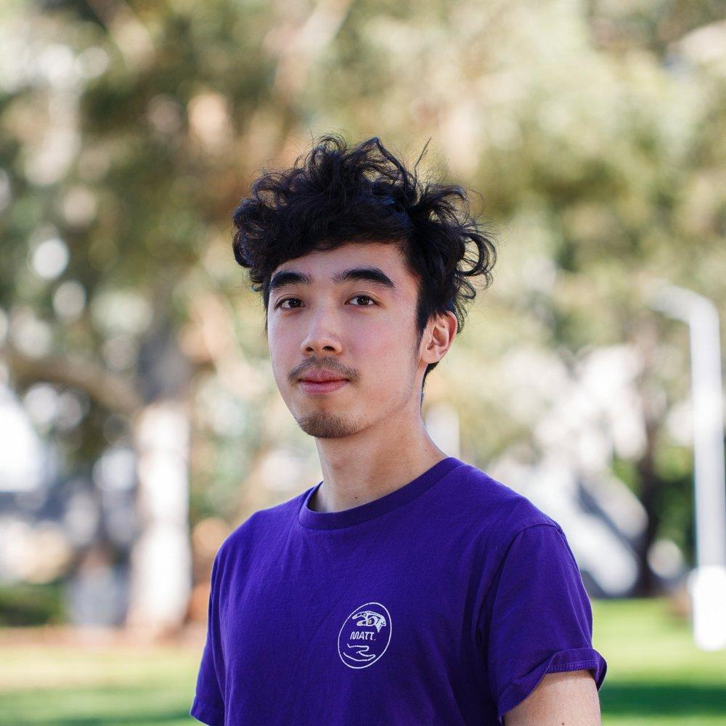
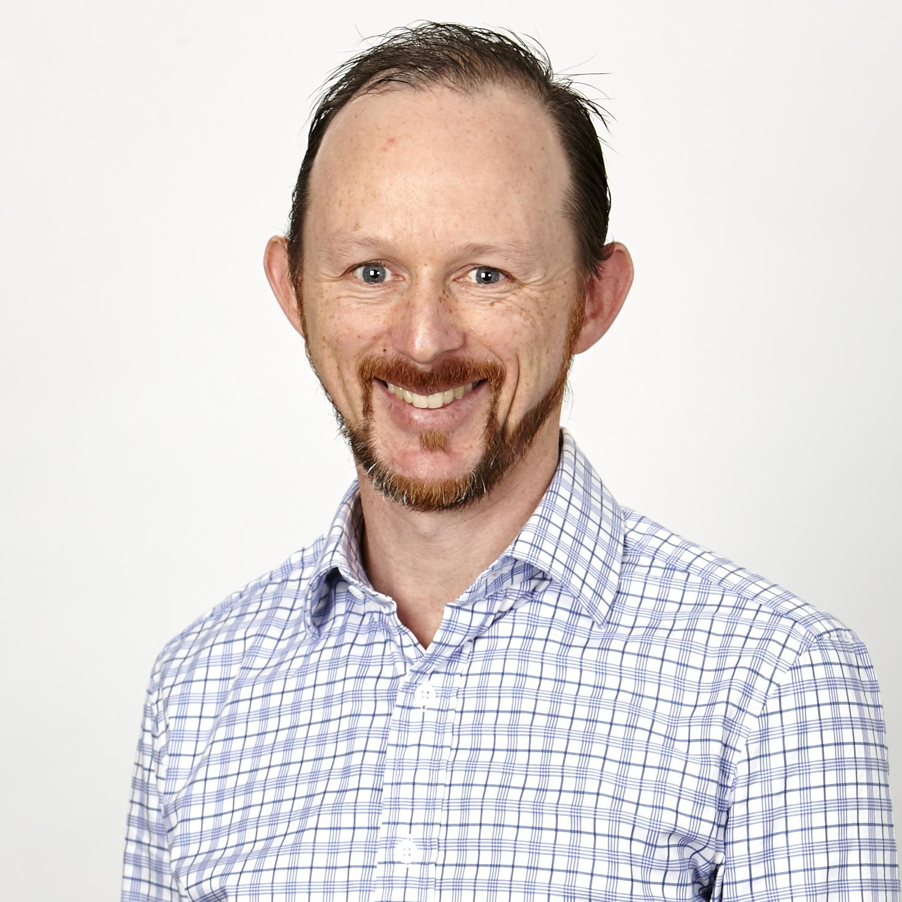
Meet Our Team
Professor Patrick Kwan
Clinical Champion
William Chen
Developer
A/P Matthew Butler
Academic Advisor
Notes:
This is the team behind theia, note that this is just a snapshot of the current team and does not include prior academics or students that have contributed some amazing ideas to the project. I have the privilege of working with Professor Patrick Kwan who is our clinical champion, Associate professor Matthew Butler and Dr Omar Haggag who are the academic advisors on the project.

Slide 23
Easy.
Independent.
Private.
Affordable.
Notes:
So this is theia, our solution aims to make the process of conducting a medical self test, easy, independent, private and affordable. Like the way it should be, the way that is has been afforded to sighted individuals. We are pushing for equitable healthcare.

Slide 24
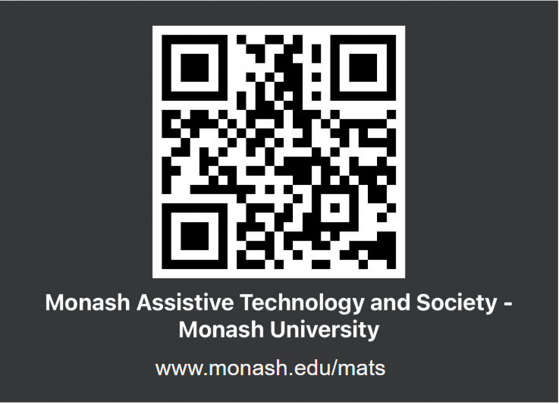
THANK YOU

Slide 25
