Slide 1
Disability &
Digital Citizenship
Prof Gerard Goggin
Institute for Culture & Society
Western Sydney University
Keynote address for Access Unlocked
Print Disabilities Roundtable 2025 Conference
Melbourne 23-26 May 2025

Slide 2
Main messages
Access & participation unlocked: We are at a critical juncture for information equity, where full participation in social life is still being denied for many people, especially people with print disabilities
Unfinished business in digital inclusion: Advocates, researchers & others have put forward ways to address this over many years to little avail so far – though there are encouraging moves from Federal Govt with National Plan on Accessible Info & Communication & Human Rights Commission with Guidelines on Equal Access to Digital Goods & Services
Digital citizenship: Participation relies on digital technologies –realities of this are neither well understood or being addressed in policy – but ‘digital citizenship’ can help us rethink this

Slide 3
To unpack idea of ‘digital citizenship’ as holistic way to understand participating & navigating ‘digital society’, my talk will cover:
Highlights/main points of Disability & Digital Citizenship report (Oct 2024) – PDF & Easy Read version available
Brief overview of new 5-year Disability & Digital Citizenship project - very much welcome feedback/engagement (Forum in Sydney/online on Mon 17 Nov 2025)

Slide 4

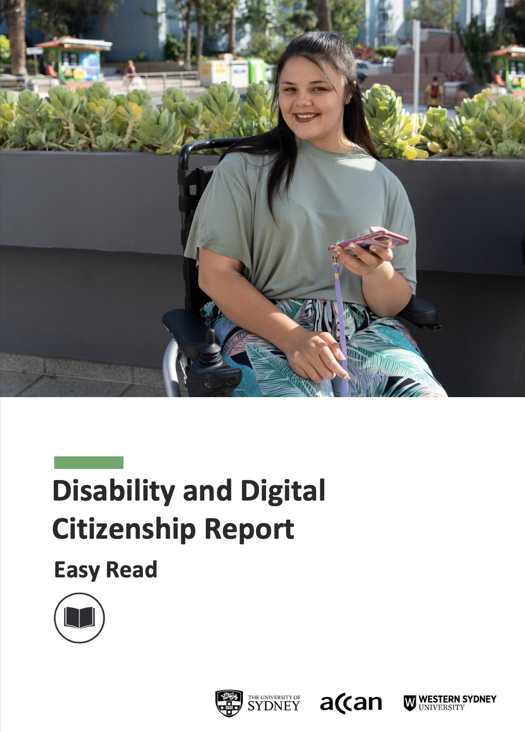

Slide 5
1. Disability & Digital Citizenship report
Supported by U. of Sydney & Australian Communications Consumers Action Network (ACCAN) + Western Sydney U.
2023-2024 research included review & analysis of submissions, reports & other ‘grey literature’ as well as research literature
consultation & discussion with disability & consumer groups, facilitated by ACCAN Disability Advisory Forum

Slide 6
Disability & digital inclusion
– unfinished business
“2023 Australian Digital Inclusion Index figures show that 24.5% of people with disability are highly digitally excluded [cf. 9.4% of the Australian population]” (Thomas et al., 2023, p. 10).
Australia has a long history of pioneering developments and discussions concerning disability and technology
yet, tangible progress has remained limited
this report provides a progress update on disability inclusion and accessibility – noting much unfinished business across access, affordability, and digital ability
Lack of forward looking, integrated legislative approach – cf EU Accessibility Act & AI Act; Accessible Canada Act; US Communications & Video Accessibility Act (2010) and 2024 Americans with Disabilities Act reforms

Slide 7
’What good is consumer info in plain language on an accessible website if the method of interacting with the entity is a real-time, typed English conversation in a chat box that you can’t see properly or follow?
‘Affordability issues can be exacerbated by the default position of technology companies, equipment vendors, platform and software providers ‘sunsetting’ devices (built-in obsolescence), encouraging or requiring upgrades (“upgrade culture”) …be particularly frustrating for persons with disability who are used to a certain operating system/device, only to be forced to have to change it’
[quotes from advocates & key points from Disability & Digital Citizenship report]

Slide 8
‘People are being forced to use technologies to access government services rather than finding their way to digital engagement and delivery through their own choice and preferences. Given the inaccessible nature of many of these services and the absence of disabled perspectives from their design, this forced adoption has interesting equity and rights implications …’
[quotes from advocates & key points from Disability & Digital Citizenship report]

Slide 9
Disability & (digital) citizenship – possibilities
digital citizenship involves recognition as an active participant in a digital society, with the right to access and, in turn, contribute.
digital technologies can support the “development of disability citizenship and active citizenship” (Simon Darcy et al., 2019, p. 538)
Shaping of digital technology has opened up new spaces & practices of citizenship for people with disabilities (which this conference has showcased)
such practices and cultures (especially digital cultures of people with disabilities) are part of highly active yet largely invisible terrain of everyday life

Slide 10
Disability & (digital) citizenship – problems?
Exciting new kinds of digital citizenship practices & prospects yet
citizenship involves exclusions, limits, and doesn’t capture sovereignty, belonging, and expectations for many groups
technology is prominent in contemporary neoliberal (market-based) ideas of disability – so the “disabled digital citizen” faces major hurdles overcoming significant digital exclusion and inequality

Slide 11
Digital citizenship – linchpin for new approach?
essential role digital technology plays in fundamental belonging and participation, well-being, & rights
digital citizenship could function as a linchpin for a transformative new framework
a robust whole-of-society commitment to ameliorating the known digital barriers people with disability currently face and ensure that our future digital society includes all Australians, including people with disability
As a participant in our project phrased it: “If I need it to participate in society, then it needs to be accessible from day one.”– Disability & Digital Citizenship report

Slide 12
2. New Disability & Digital Citizenship 5-year project
Funded by Australian Research Council
11 researchers from 7 Australian universities
International partners - leading researchers in universities in Singapore, South Africa, US & Canada
Led by Gerard Goggin & Prof Katie Ellis (Curtin), includes Prof Paul Harpur (U. of Qld)
Consultation, collaboration & co-design with disability organizations

Slide 13
Research questions
1. What experiences, contexts, and socio-technical systems shape digital citizenship for people with disability?
2. To what extent are provider embracing inclusive design and other transformative practices to support citizenship?
3. How do assistive technologies, their uses, market and policy systems interact with those for consumer and mainstream digital technology?
4. How should our understandings of digital citizenship (& digital inclusion/information equity) be reimagined to genuinely include and capitalize on the perspectives of people with disability?

Slide 14
approach
– International Context and Approaches – best practice internationally, and what Australia offers and can learn
Digital Citizenship: Experiences & Barriers – qualitative research providing rich, textured understanding of digital technology experiences and participation across touchpoints of everyday life.
Disability & Digital Citizenship National Survey - Improving inclusiveness and quality of survey data
- Markets and Policy - integrated account of the Australian markets and policy frameworks & how these can be optimized for inclusive digital citizenship.
** We very much welcome your engagement & interest in the new Disability & Digital Citizenship project **

Slide 15
Final thoughts
innovation is crucial element in rethinking and achieving full access to and participation for people with disability /what we are exploring as digital citizenship
innovation fuses social and cultural creativity and innovation with the technical dimensions (as this 2025 Roundtable conference shows)
for the innovation ecosystem to work properly, there needs to be adequate resourcing for people with disability and key enabling organizations and capacities to play their part
overdue legislative & governance reform is also a precondition for information & digital equity & equality

