Slide 1

Hearing the Progress of Audio Accessibility
Dom Parker (she/her)

Slide 2

I’d like to begin by acknowledging the Traditional Owners of the land on which we meet today. I would also like to pay my respects to Elders past and present.
Notes:
I’d like to begin by acknowledging the Traditional Custodians of the land on which I live and work—the Cammeraygal people of the Eora Nation—and pay my respects to their Elders past and present. I acknowledge that sovereignty was never ceded.
I encourage everyone here to take a moment to reflect on the land you’re on today, and to honour the Indigenous peoples who have cared for it across generations.
I’m very fortunate to live on Cammeraygal land, on Sydney’s north shore. There are beautiful bushwalks and national parks near where I live, and one of the things I love most is the native wildlife—especially the birds.
From the delicate chirps of fairy-wrens to the bold screeches of cockatoos, these bird calls are part of the land’s identity. They remind me daily of the deep, ongoing connection between First Nations peoples and the environment.

Slide 3


Hi, my name is Dom! (she/her)
Audio designer (Doggy Don’t Care)
Audio engineer
eLearning Coordinator - Cerebral Palsy Alliance
Dom Parker on LinkedIn
Notes:
Hi, I’m Dom! I use she/her pronouns, and I’m from Sydney, Australia on Cammeraygal land.
For anyone who may find it helpful, here’s a brief visual description of me: I’m a Caucasian woman in my 30s with visible tattoos, long dark brown hair, and I wear glasses with yellow-tinted lenses to reduce glare—something I’ve learned to manage due to light sensitivity.
I actually started my career in music education while dabbling in game development on the side. I taught music with the Catholic Diocese of Parramatta, and I’ve always been passionate about learning and development. On the side, I recorded and produced music—and one of my proudest moments was graduating from Abbey Road Studios in London with a degree in music production and audio engineering.
Today, I’m the eLearning Coordinator at Cerebral Palsy Alliance where I spearhead accessibility in online learning, and I also work as a freelance accessible game designer and audio designer.
It’s a privilege to share what I’ve learned about audio accessibility and deep dive into video game audio.

Slide 4
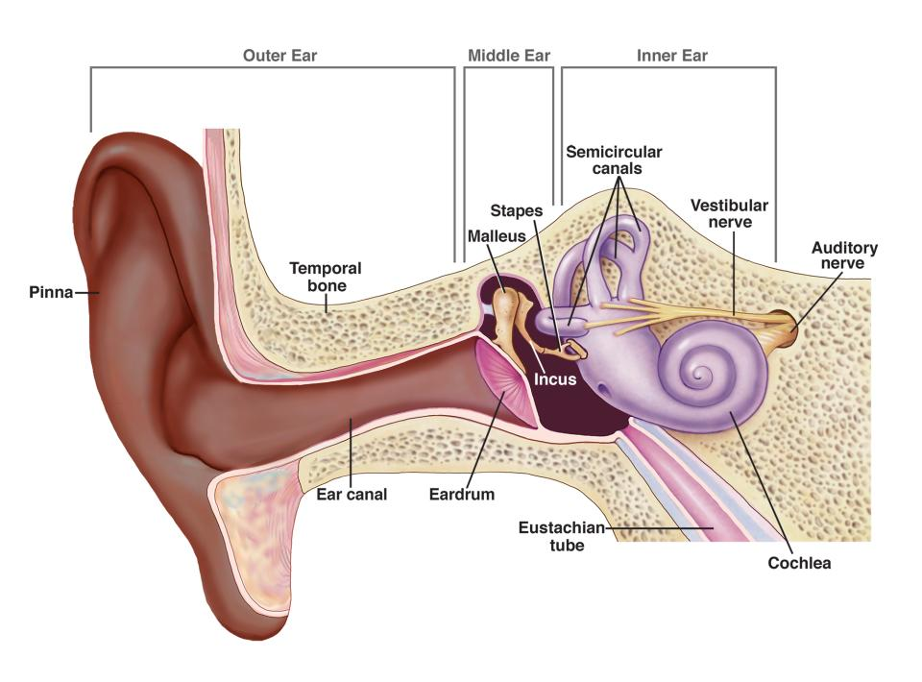
How do we hear?
Sound enters the ear canal and vibrates the eardrum.
Vibrations travel through tiny bones in the middle ear.
The cochlea turns these vibrations into electrical signals. The auditory nerve carries signals to the brain.
The brain interprets these as sound.
Source: NIH/NIDCD
Notes:
“Here’s a quick overview at how we hear.
Sound waves enter through the ear canal and make the eardrum vibrate. These vibrations are passed through three tiny bones in the middle ear, which amplify the sound.
The vibrations then reach the cochlea in the inner ear—a fluid-filled, spiral-shaped structure. Inside the cochlea, tiny hair cells respond to different pitches.
As these hair cells move, they convert sound vibrations into electrical signals. These signals travel along the auditory nerve to the brain, which interprets them as sound.
This whole process happens in milliseconds—and it’s what allows us to recognize voices, locate where sounds are coming from, and stay oriented in space.
In video games, this ability can be harnessed to support gameplay and accessibility.”

Slide 5
Audio Formats
Stereo Two-channel audio (left and right); standard for music and video playback.
Surround Sound Multi-channel audio that creates a sense of space and direction—common in home theatres.
Binaural Audio 3D sound recorded with two microphones to mimic human hearing; best experienced through headphones.
Dolby Atmos Advanced, object-based sound format; allows precise placement and movement of audio in 3D space (used in cinemas and premium headphones).
wav vs .mp3 .wav: Uncompressed, high-quality audio; larger file size. .mp3: Compressed format; smaller file size with some quality loss—better for web and portable use.
Notes:
Stereo: Mention that stereo sound is the most common format people are familiar with. It simply splits audio into left and right channels, creating a basic sense of direction but not immersion.
Surround Sound: Explain that surround sound adds more speakers around the listener—like in a 5.1 or 7.1 setup—so you can hear sounds from behind, beside, and in front, enhancing immersion in movies and games.
Binaural Audio: This is recorded using microphones placed in a dummy head to capture how humans actually perceive sound. It’s a great way to deliver a 3D audio experience through regular headphones. Good to demo with a sample if time allows.
Dolby Atmos: Unlike traditional formats, Atmos treats sounds as objects that can move freely in 3D space—above, behind, anywhere. It's increasingly used in both theatres and consumer tech like soundbars and gaming headsets.
.wav vs .mp3: Emphasize that .wav files are ideal for editing and professional use because they preserve full audio quality, while .mp3s are more efficient for sharing and streaming. It’s a trade-off between quality and file size.

Slide 6
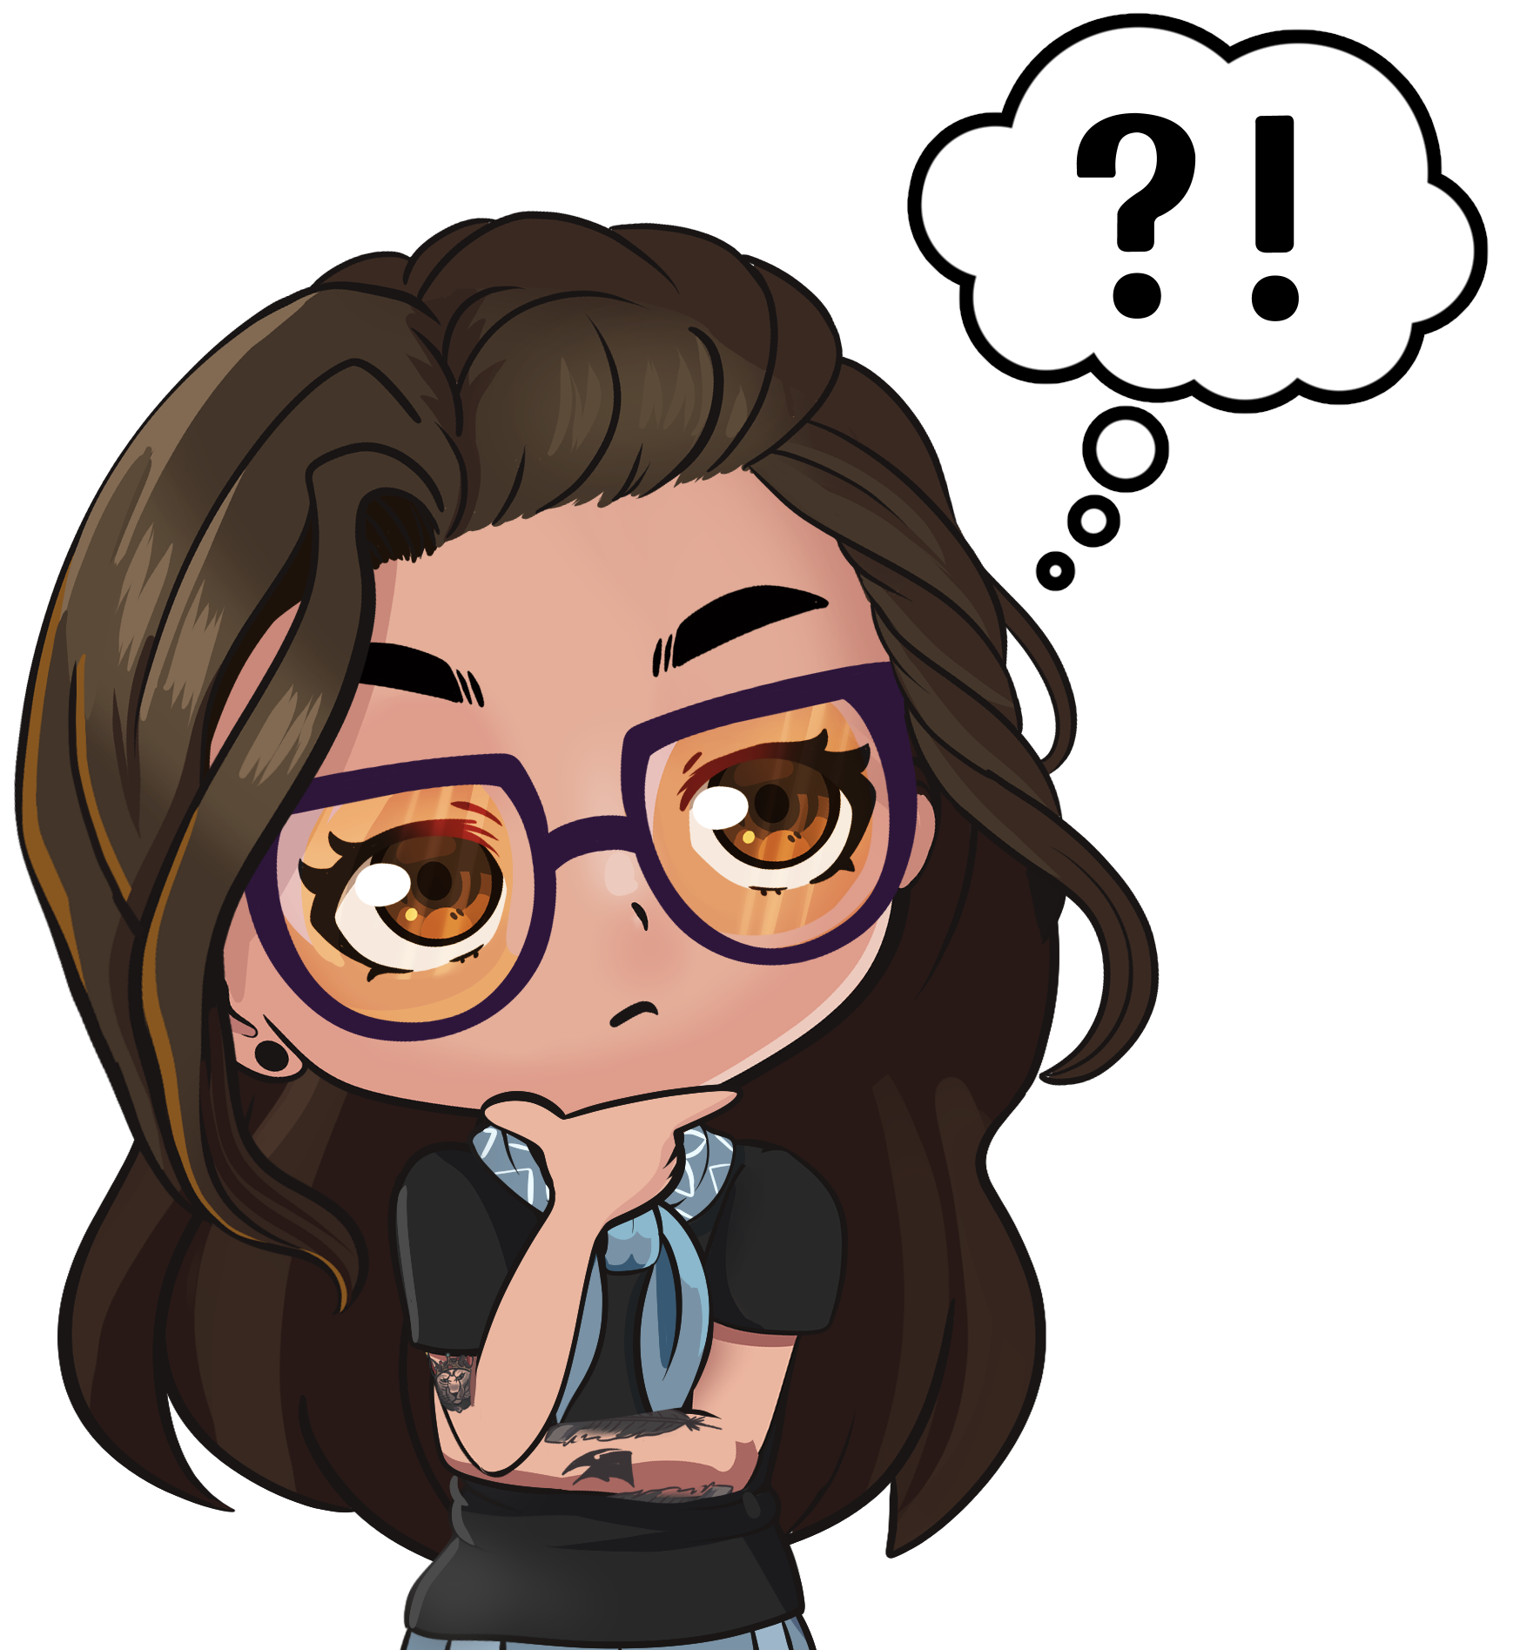
Why Audio in Video Games?
Audience: 3 billion players, 20% have a disability, 70% use a11y features
Economics: $200 billion annually
Social: community and belonging
Technology: Adaptive controllers, screen readers, mono outputs etc
Notes:
Why is Video Game Accessibility Important?
Large Audience: Over 3 billion players worldwide, including those with disabilities.
Economic Impact: The gaming industry generates over $200 billion annually.
Social Significance: Games foster community and belonging, making accessibility essential for equitable participation.
Advances in Technology: Innovations like adaptive controllers and haptic feedback make inclusivity more achievable.

Slide 7
Audio Concepts in Action

Slide 8
Audio is a Compass
Audio can guide players through game worlds
Works like a second compass for navigation
Directional sounds help with orientation (e.g. louder wind when facing north)
Distinct audio themes signal different locations
Especially important for blind, low vision, and screen-distant players
Notes:
“I often use the metaphor of audio as a compass—especially when talking about accessibility in games.
Just like a compass helps you find your way, well-designed audio can guide players through a game’s world. For some players—especially those who are blind, have low vision, or who don’t rely heavily on the screen—sound becomes the primary navigational tool.
Take me for example. I’m a console player. I sit on a couch, my TV is a bit further away, and I often use enlarged UI. Sometimes I can’t clearly see what’s happening on screen—but I can hear it.
Audio designers can create directional cues—like a breeze that grows louder when facing north, or subtle environmental differences between left and right—to help players orient themselves. Distinct audio themes or ambient tracks can signal different locations, so players learn where they are by ear.
Spatial audio technologies—like binaural sound—let players feel where sound is coming from: behind, above, or beside them. These can be implemented directly in engines like Unreal, which has a tool called MetaSounds, or Unity’s audio engine. Alternatively, middleware like FMOD or WWISE gives sound designers even greater control over how sounds behave in space.

Slide 9
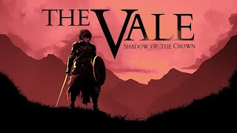
The Vale: Shadow of the Crown
Audio-only action-adventure game
Designed for blind and low vision players
No visuals—navigation through 3D spatial audio
Footsteps, echoes, and voices guide direction and distance
Combat relies on timing sound cues to block, dodge, or strike
Notes:
Lets examine a game that fully embraces audio as its interface: The Vale: Shadow of the Crown.
“The Vale is entirely audio-driven. Players navigate forests, towns, and even battles using only sound. It’s designed for headphones, using spatial audio so you can tell if something is behind you, to your left, or in front of you.
The level of detail is astonishing—you hear wind direction, surface changes underfoot, or distant voices calling you forward.
It’s a brilliant demonstration of how audio can function as a complete replacement for sight in game navigation.”
This is a rare example of a mainstream-style game that’s designed entirely without visuals. It was created for blind and low vision players by a Canadian studio called Falling Squirrel, in partnership with the Canadian National Institute for the Blind.
You navigate using only your ears—footsteps, voice direction, echoes, and ambient sounds guide you through villages, forests, and battles.
Combat is especially clever. You rely on audio cues to time your blocks or attacks—if you hear an enemy grunt or a sword being drawn, you respond accordingly. It’s intense, immersive, and entirely accessible without a single visual cue.
The Vale shows us what’s possible when developers prioritize sound—not just for immersion, but for access.”

Slide 10

Audio is a Prominent Secondary Indicator
Audio reinforces or clarifies visual actions
Adds urgency, emotion, or attention to key moments
Useful for low vision, cognitive load, or screen-distance
Part of multi-sensory design: visuals + audio + haptics
Makes gameplay feedback more accessible and intuitive

Slide 11

Until Dawn
“Butterfly Effect” visually marked and sonically reinforced
Soft chime signals a major narrative shift
Paired with subtle vibration in controller
Multi-sensory feedback = more inclusive storytelling
Notes:
“The game I’ve chosen for this example is Until Dawn, a narrative horror game known for its butterfly effect system—where small choices can lead to big, sometimes deadly, consequences.
Whenever a player makes a decision that shifts the story, a butterfly icon appears on screen. But that’s not the only cue. You also hear a soft, fluttering chime—an audio signature that gently signals: this moment matters.
That sound is paired with a subtle vibration in the controller. It’s this multi-sensory feedback—visual, audio, and haptic—that makes the butterfly effect feel emotionally and narratively significant.
For players who may not clearly see the icon—due to low vision, cognitive processing differences, or just playing far from the screen—this combination of sound and vibration becomes a secondary indicator. It reinforces the mechanic by quietly saying: ‘That choice mattered.’
This is a great example of how accessibility doesn’t always mean adding new features—it can be about making what’s already there communicate through more than one channel.
And the best part? It means everyone gets frightened equally!”

Slide 12
Audio as Descriptive Narrative
Audio can convey visual, emotional, and spatial information
Functions like "alt text" in storytelling
Helps blind/low vision players access tone and context
Builds immersion through voice, not just visuals
Supports screen reader–like experiences inside games
Notes:
“So what does it look like when a game uses audio not just to set the mood, but to tell the story and describe what can’t be seen? Let’s look at Baldur’s Gate 3.”

Slide 13
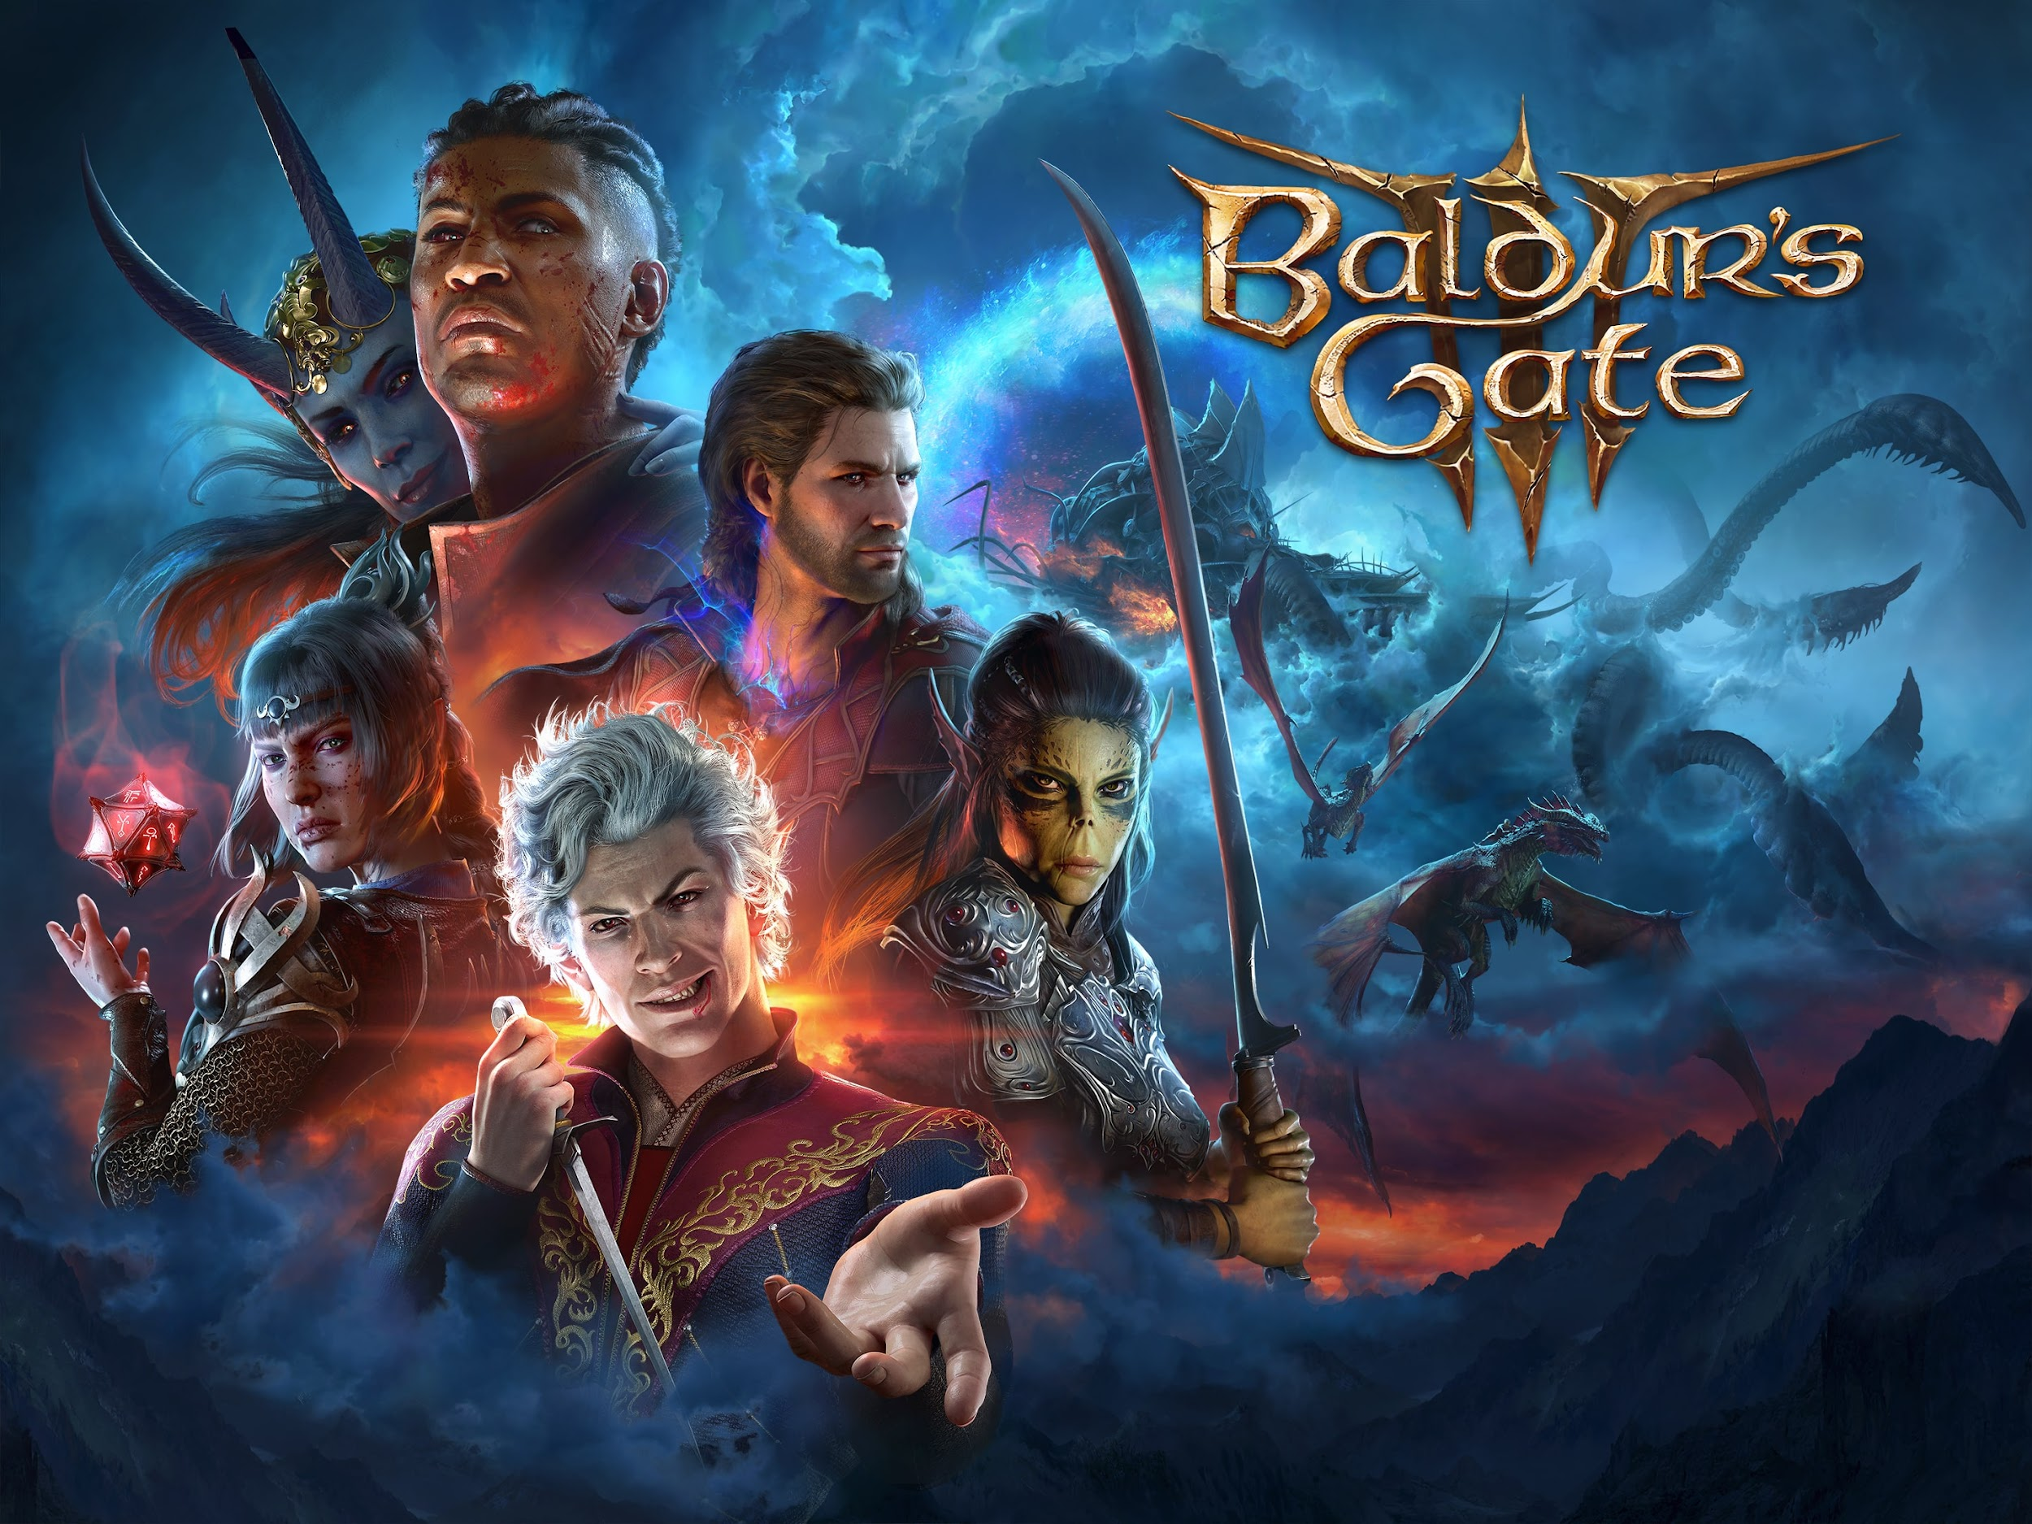
Baldur’s Gate 3
Fully voiced characters and narrator
Narrator describes facial expressions, movement, and tension
Example: ‘You hear rustling behind the trees…’
Turns visual context into spoken narrative
Adds depth and accessibility without needing visual input
Notes:
“In Baldur’s Gate 3, the narrator acts as a descriptive guide. They’ll say things like: ‘The tiefling scowls, her voice sharp with anger.’
That description might not appear in the game visually—but hearing it gives you the tone, the body language, and the emotional cues you’d otherwise need to see.
It’s a brilliant example of how games can integrate accessibility into core design—not by adding a separate feature, but by writing narration that naturally serves everyone.”

Slide 14
What Next?
AI-generated audio descriptions (e.g. real-time narration)
Integration with hearing aids and cochlear implants
Apple AirPods evolving as assistive hearing devices
Community-led accessibility mods and hacks
Growth of audio-first design in AR/VR spaces
Notes:
“So what’s next for audio accessibility in games and beyond? There’s a lot to be excited about.
First, we’re starting to see the potential of AI-generated audio descriptions. This could mean real-time narration of on-screen actions, dynamic ambient detail, or even AI voiceovers for player-generated content.
There’s also increasing integration with hearing aids and cochlear implants. Some platforms are exploring ways to send audio directly to assistive devices—so players with hearing loss can experience spatial sound and voice cues more clearly.
And devices like Apple AirPods are quietly shifting toward functioning as entry-level hearing aids. They support spatial audio, transparency mode, and even personalized sound profiles—features that can benefit gamers with mild to moderate hearing loss.
On the community side, we’ve seen brilliant accessibility mods—fan-created solutions like custom audio cues, voice control packs, and alternative feedback systems. These often push studios to think more creatively about inclusive design.
Finally, AR and VR are growing rapidly, and with that comes a new frontier of audio-first experiences. Games and experiences built for immersive soundscapes, haptic feedback, and even voice-based navigation open up new ways to play—and to make play more inclusive.
The future is multi-sensory, and audio will be at the heart of it.”

Slide 15
Takeaways
Audio is a key source of in-game information
Sound has layers: foley, ambience, effects, dialogue, music
Audio can act as a compass, alt text, or a secondary indicator
Multi-sensory design supports a wide range of player needs
Notes:
“To wrap up, here are the key takeaways I hope you’ll remember:
First, audio in games has evolved into a powerful source of information. It doesn’t just set the mood—it guides players through the world, conveys emotion, and signals important decisions.
And there are layers to this: foley, ambience, sound effects, dialogue, music—each one contributes something unique to the experience. When thoughtfully designed, they all work together to communicate meaning.
We’ve seen how audio can function as a compass, a secondary indicator, or even alt text, depending on how it's used.
Good audio design is inherently multi-sensory. It combines sound with touch, visuals, and interaction to support a wide range of player needs and preferences.
And finally, detailed, intentional audio design improves accessibility. It supports clarity, enhances immersion, and makes the experience better for everyone—not just players with disabilities.
When we design with our ears as well as our eyes, we create more inclusive, meaningful, and memorable play for all.”

Slide 16

Let’s chat!
https://www.linkedin.com/in/dom-parker/
Domsmusic94@gmail.com
Level up in A11y Gaming!
Dom Parker
Notes:
Slide 8: Call to Action
Design with Purpose: Aim for games that are fun and inclusive for all.
Be Part of the Change: Together, we can create a gaming industry that welcomes everyone.

