Slide 1
Building Community
Presented by:
Ed Gamble
Kyleigh Langrick
Vision Australia Library Service

Slide 2
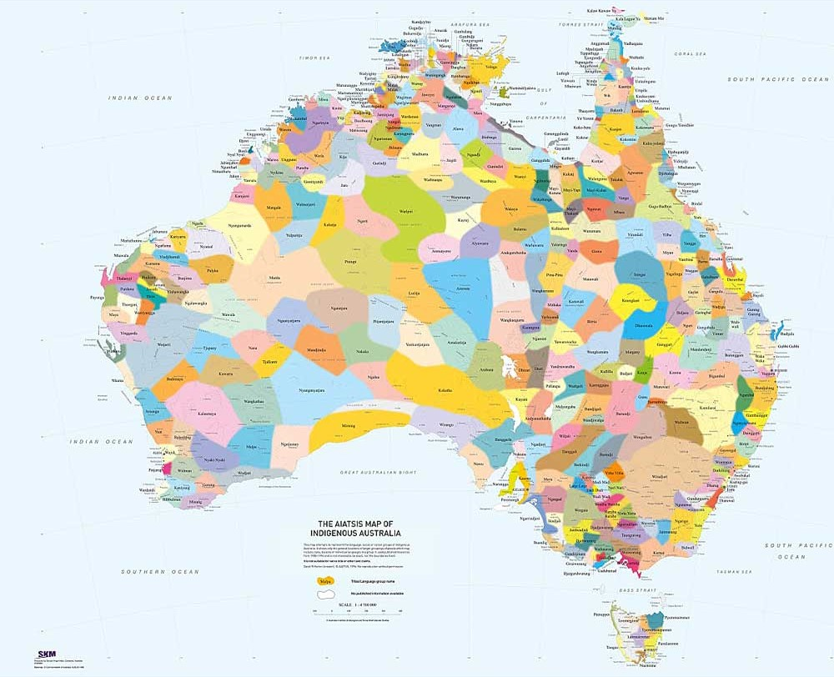
Notes:
(Kyleigh)
Vision Australia Library acknowledges the Wurundjeri people of the Kulin nations, the Traditional Owners of the land on which we are gathered today. We pay our respects to their elders, past, present and emerging, recognising their rich history over tens of thousands of years as the original storytellers of this land. We commit to the telling of first nations’ stories and supporting the traditions of oral storytelling.

Slide 3
Vision Australia Library
The Vision Australia Library provides a collection of audio and braille books, newspapers, magazines and podcasts for people with a print disability, including people of all ages, from all over Australia.
Partnerships are important because they improve community access, funding, awareness, and create connection and inclusion for all.
Today we will provide some tips on how to make partnerships flourish and then focus specifically on our partnerships with public libraries to share access to inclusive technology.
Notes:
Kyleigh – 3 mins
Access to information extends beyond accessible formats into the ability to build a community around oneself to engage, converse and explore knowledge and new ideas. Through a range of innovative programs that empower individuals to fully participate in the cultural, educational, and social fabric of their communities, Vision Australia Library is striving to be much more than a book repository. In 2024, the library facilitated over 30 programs across a range of ages, locations and areas of interest.
These programs are not just about access to content, but about fostering connection and inclusion. By creating social spaces for individuals to share experiences and stories, Vision Australia Library nurtures a vibrant community where people can engage with the world in ways that best suit their needs.
Aligned with the theme of "Access Unlocked: Innovating for Information Equity," this session will explore how our library programs and partnerships form initiatives that work to bridge the gap between technology, advocacy, and community building.
Much of the work Vision Australia Library does is supported by partnerships, which allow for greater advocacy in the community, deeper conversation around real inclusivity and better access for all. This talk will provide useful tips on creating sustainable partnerships that support a shared vision.

Slide 4
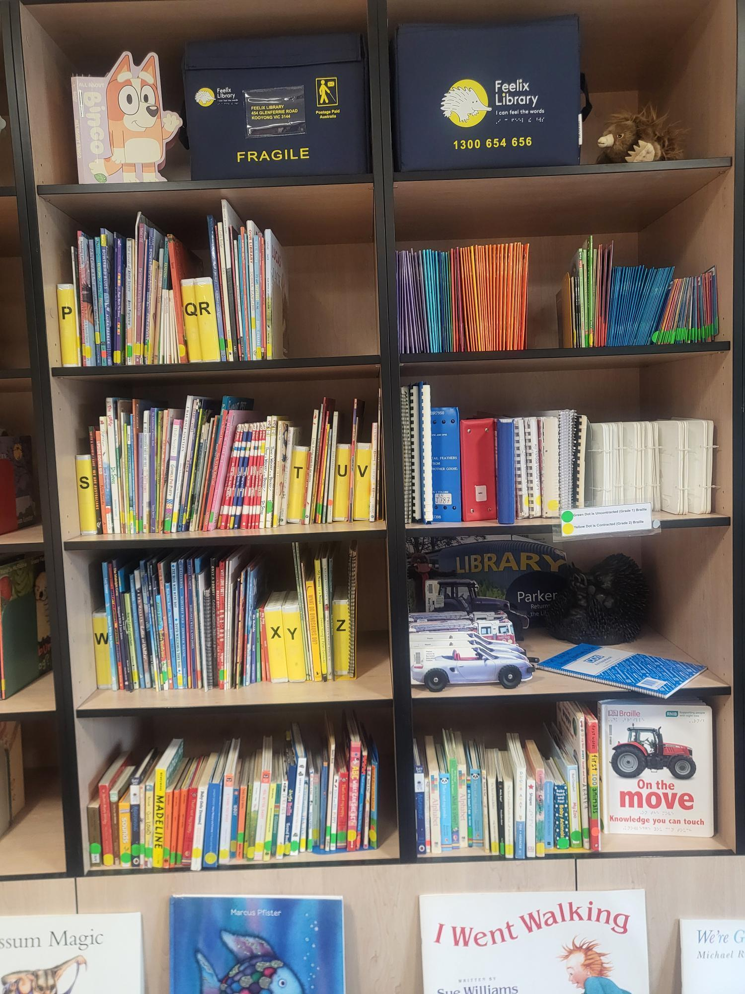
Children and Young People
Feelix kits
Print braille collection
Decodable collection
LEGO Braille bricks
Collection development
Programming and events
Partnerships – internal and external
Notes:
Kyleigh – 1 min

Slide 5



Current Partnerships
ACLF – Australian Children’s Laureate Foundation
ILF – Indigenous Literacy Foundation
ALIA – Australian Library and Information Association
SLV – State Library Victoria
Notes:
Kyleigh – 3 mins

Slide 6
Aligned values of partners
What are the goals and strategies of each organisation?
What does each organisation get out of the partnership?
How can we amplify the message of the partner?
Notes:
Kyleigh – 3 mins

Slide 7
Importance of paperwork
Paperwork doesn’t have to be elaborate
- emails, MOU, partnership agreements
Sets expectations of each partner’s workload and commitments
- Who is doing what and when
Ensures the partnership is sustainable beyond just the people in the organisation
- Documents provide set up if people leave the organisation, change job roles or go on leave
Notes:
Kyleigh 3 mins

Slide 8
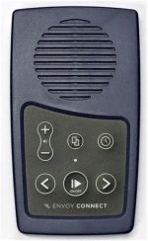
Envoy players
Envoy players are a:
flexible
low tech
low cost
audio solution
To maintain the enjoyment of books and stories when traditional print is not an option.
Creating partnership opportunities for VA and public libraries across Australia.
Notes:
Ed 2 mins
a brief reminder of what it is
suitable for those without the means/capacity for on-line delivery
let's look at how we have developed partnerships with various groups

Slide 9
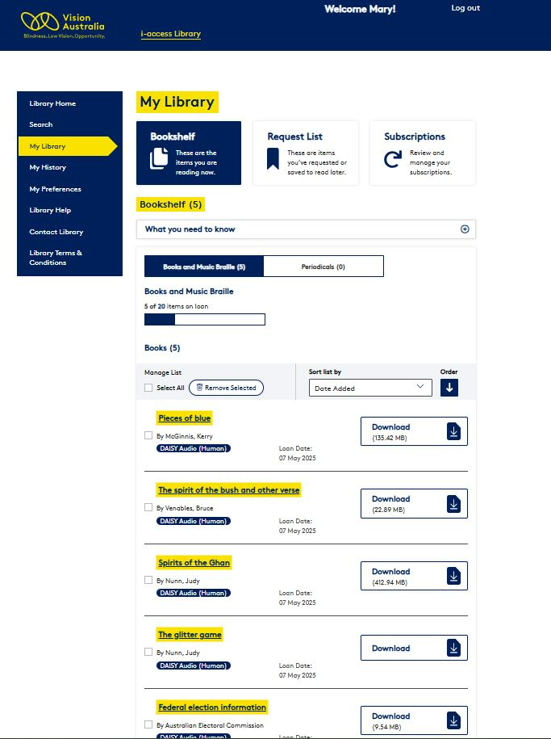
Website for library
Apart from ‘library managed’ clients, we also have many ‘self-managed’ clients.
Public libraries use of Envoy players is growing by word of mouth and has inreased to several hundred players around the country from public libraries.
We support public library partnerships because we recognise & value the social benefits of people receiving services within their own local community & networks.
Notes:
ED 2 mins
We support public library partnerships (we recognise & value the social benefits of people receiving services within their own local community & networks)
Elaborate with more details and examples of real experiences (talk more with VI etc

Slide 10
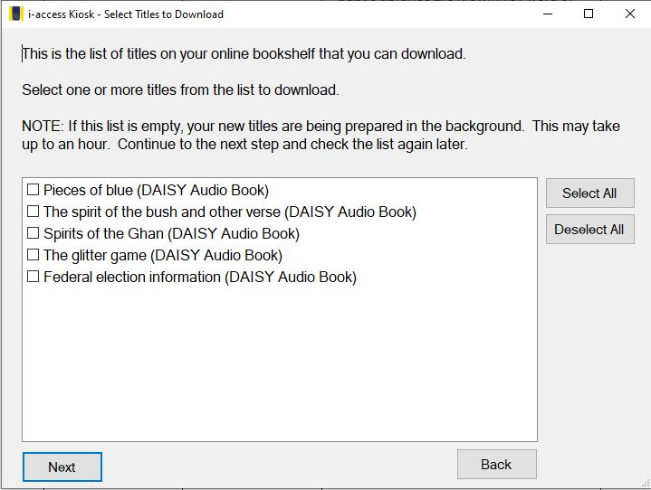
i-access kiosk for Envoy
We support supply of Envoy players and content. We have a range of options to suit their usage.
All VA content
Part VA content
No VA content
Swapping SD cards instead of swapping players
Notes:
Ed. 2 mins

Slide 11
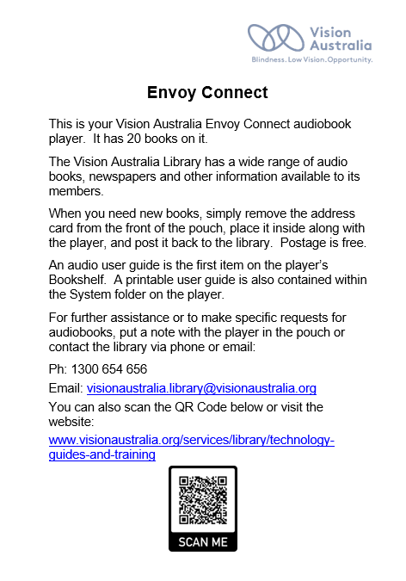
VA user documents
We share our written instructions documents (public libraries are welcome to modify etc.)
Notes:
Ed 2 mins

Slide 12
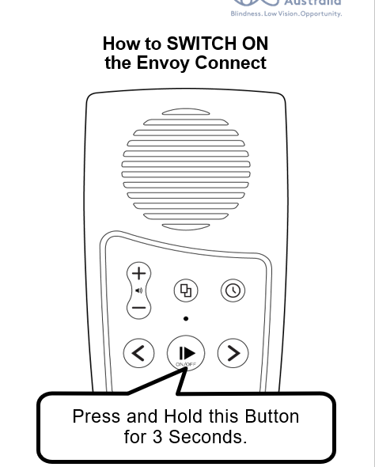
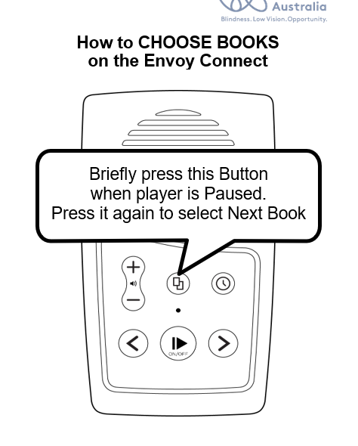
VA user documents

Slide 13
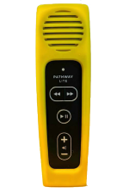
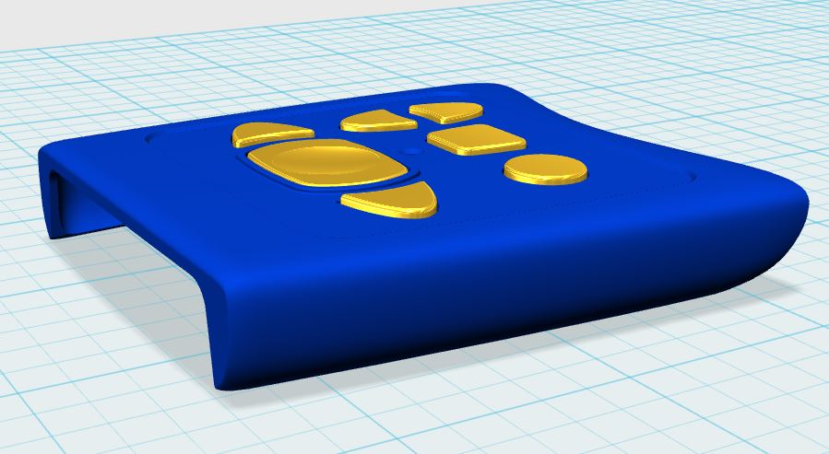
What’s next?
Pathway player (L) and mask for an Envoy player (R) – developed at VA

Slide 14
Questions and Answers
Kyleigh Langrick
Feelix Library
Kyleigh.Langrick@VisionAustralia.org
Ed Gamble
Vision Australia Library
Ed.Gamble@VisionAustralia.org

