Slide 1
A Journey to Accessibility: Enhancing Braille Discoverability in Trove Partners Search
26th May 2025
Lihong Zhang, Program Manager National Library Australia
Notes:
Slides are correct, notes/words have not been written so far. They still reflect a previous talk and should not be used

Slide 2
Notes:
I’d like to begin by acknowledging the Australian Aboriginal and Torres Strait Islander peoples of this nation. We acknowledge the traditional custodians of the land and pay our respects to ancestors and elders, past and present.
We are committed to honouring Australian Aboriginal and Torres Strait Islander peoples’ unique cultural and spiritual relationships to the land, waters and seas and their rich contribution to society.

Slide 3

Agenda
Project Background
Our approach
Next steps

Slide 4

Project Rationale
    The National Library of Australia is committed to providing equitable access to information for all users.
    This project directly supports the library's strategic goal of Disability Inclusive Action Plan.
    By enhancing discoverability, we aim to empower readers with print disabilities and promote greater inclusivity.
Notes:
When and where the story was started.

Slide 5

Project Initiative and Objective
Project Goal:
To enhance the discoverability of braille materials in Trove Partners Search.
Project Objectives:
To standardise cataloguing practices for braille materials through collaborative efforts.
To refine SOLR indexing rules to expand indexing criteria for braille resources.
Our Partners:
Roundtable on Information Access for People with Print Disabilities
Vision Australia Library

Slide 6
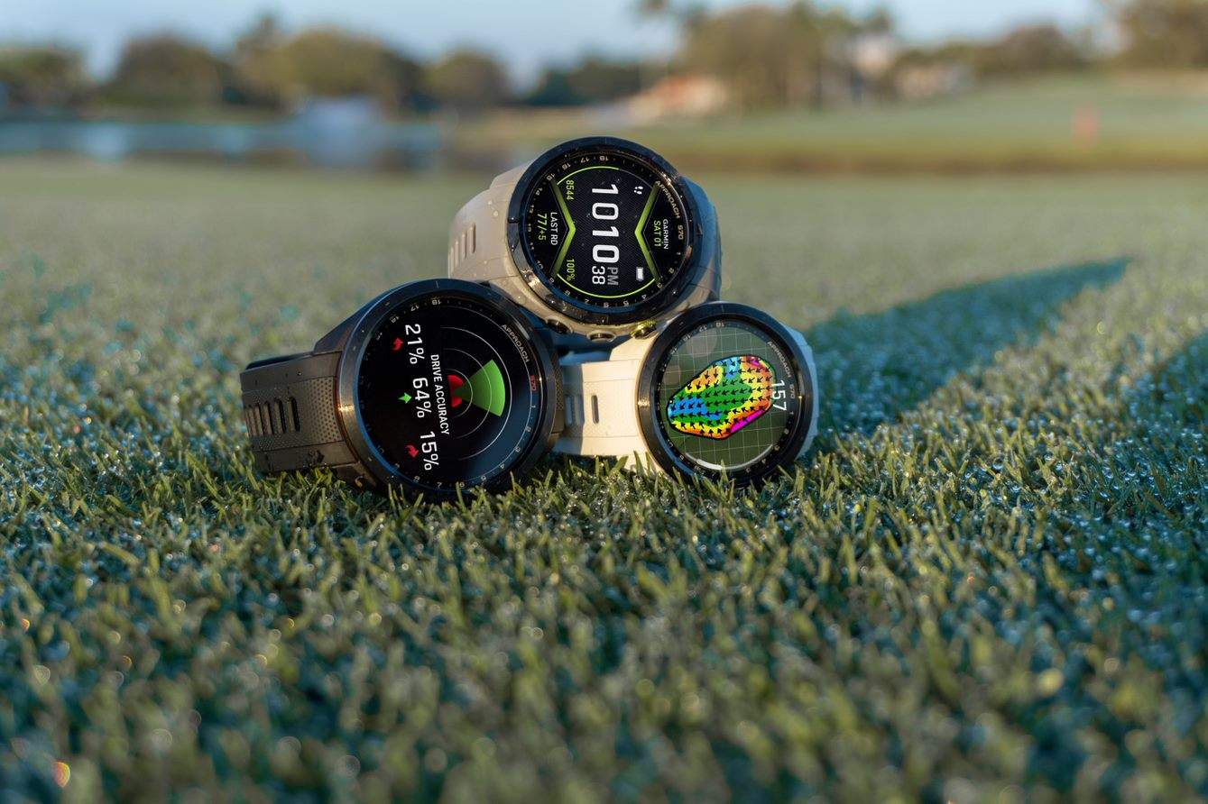
Our approach: Enhancing Discoverability Through Metadata
Standardised Bibliographic Records: Addressed inconsistencies in how braille materials were described, ensuring accurate and complete information.
Leveraged Key MARC Fields: Identified and utilised specific MARC fields to capture essential details about braille format, enabling more precise searching.
Refined SOLR Indexing: Expanded indexing criteria from 6 to 21, allowing for more granular and effective search results.

Slide 7
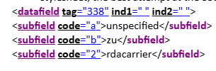
Our approach: Enhancing Discoverability Through Metadata (Cont.)
Standardised Bibliographic Records:
Addressed inconsistencies in how braille materials were described, ensuring accurate and complete information.

Slide 8
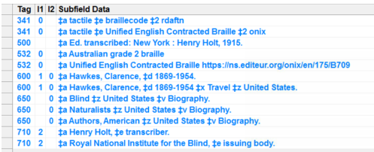
Our approach: Enhancing Discoverability Through Metadata (Cont.)
Leveraged Key MARC Fields:
Identified and utilised specific MARC fields (e.g., 336/337/338 for Content Type/Media Type/Carrier Type, 341for Accessibility Content and 532 for Accessibility Note) to capture essential details about braille format, enabling more precise searching.

Slide 9
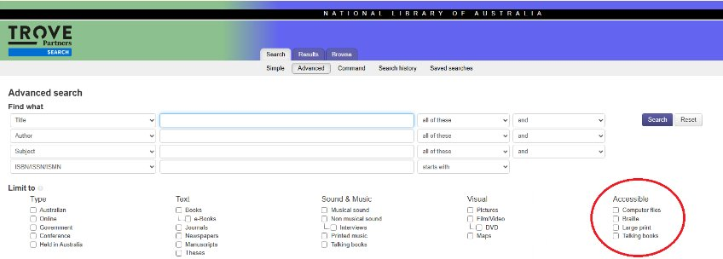
Our approach: Enhancing Discoverability Through Metadata (Cont.)
Refined SOLR Indexing:
Expanded indexing criteria from 6 to 21, allowing for more granular and effective search results.

Slide 10
The Impact: Enhanced Access and Discovery
Significantly improved search results for braille materials, making it easier for users to find relevant resources.
Increased accessibility of the Trove Partners Search for users with print disabilities.
Positive feedback from user testing, highlighting the ease of use and improved accuracy.
This project has empowered readers with print disabilities, providing them with greater access to information and promoting inclusivity.

Slide 11
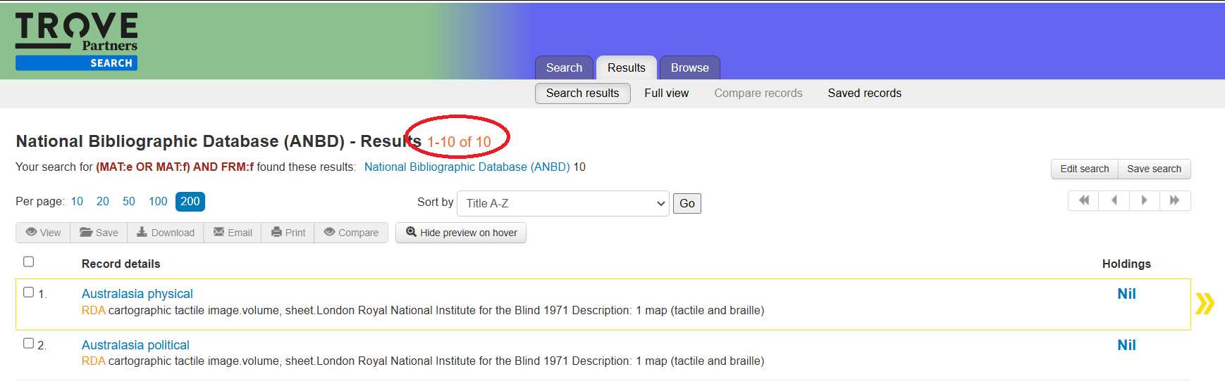
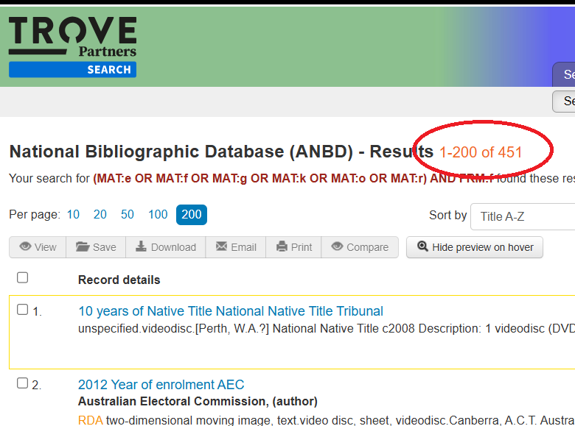
“before” and “after” screenshots of search results
Taking the index rule for "Leader/06 and 008/29" as example:
Before
After

Slide 12
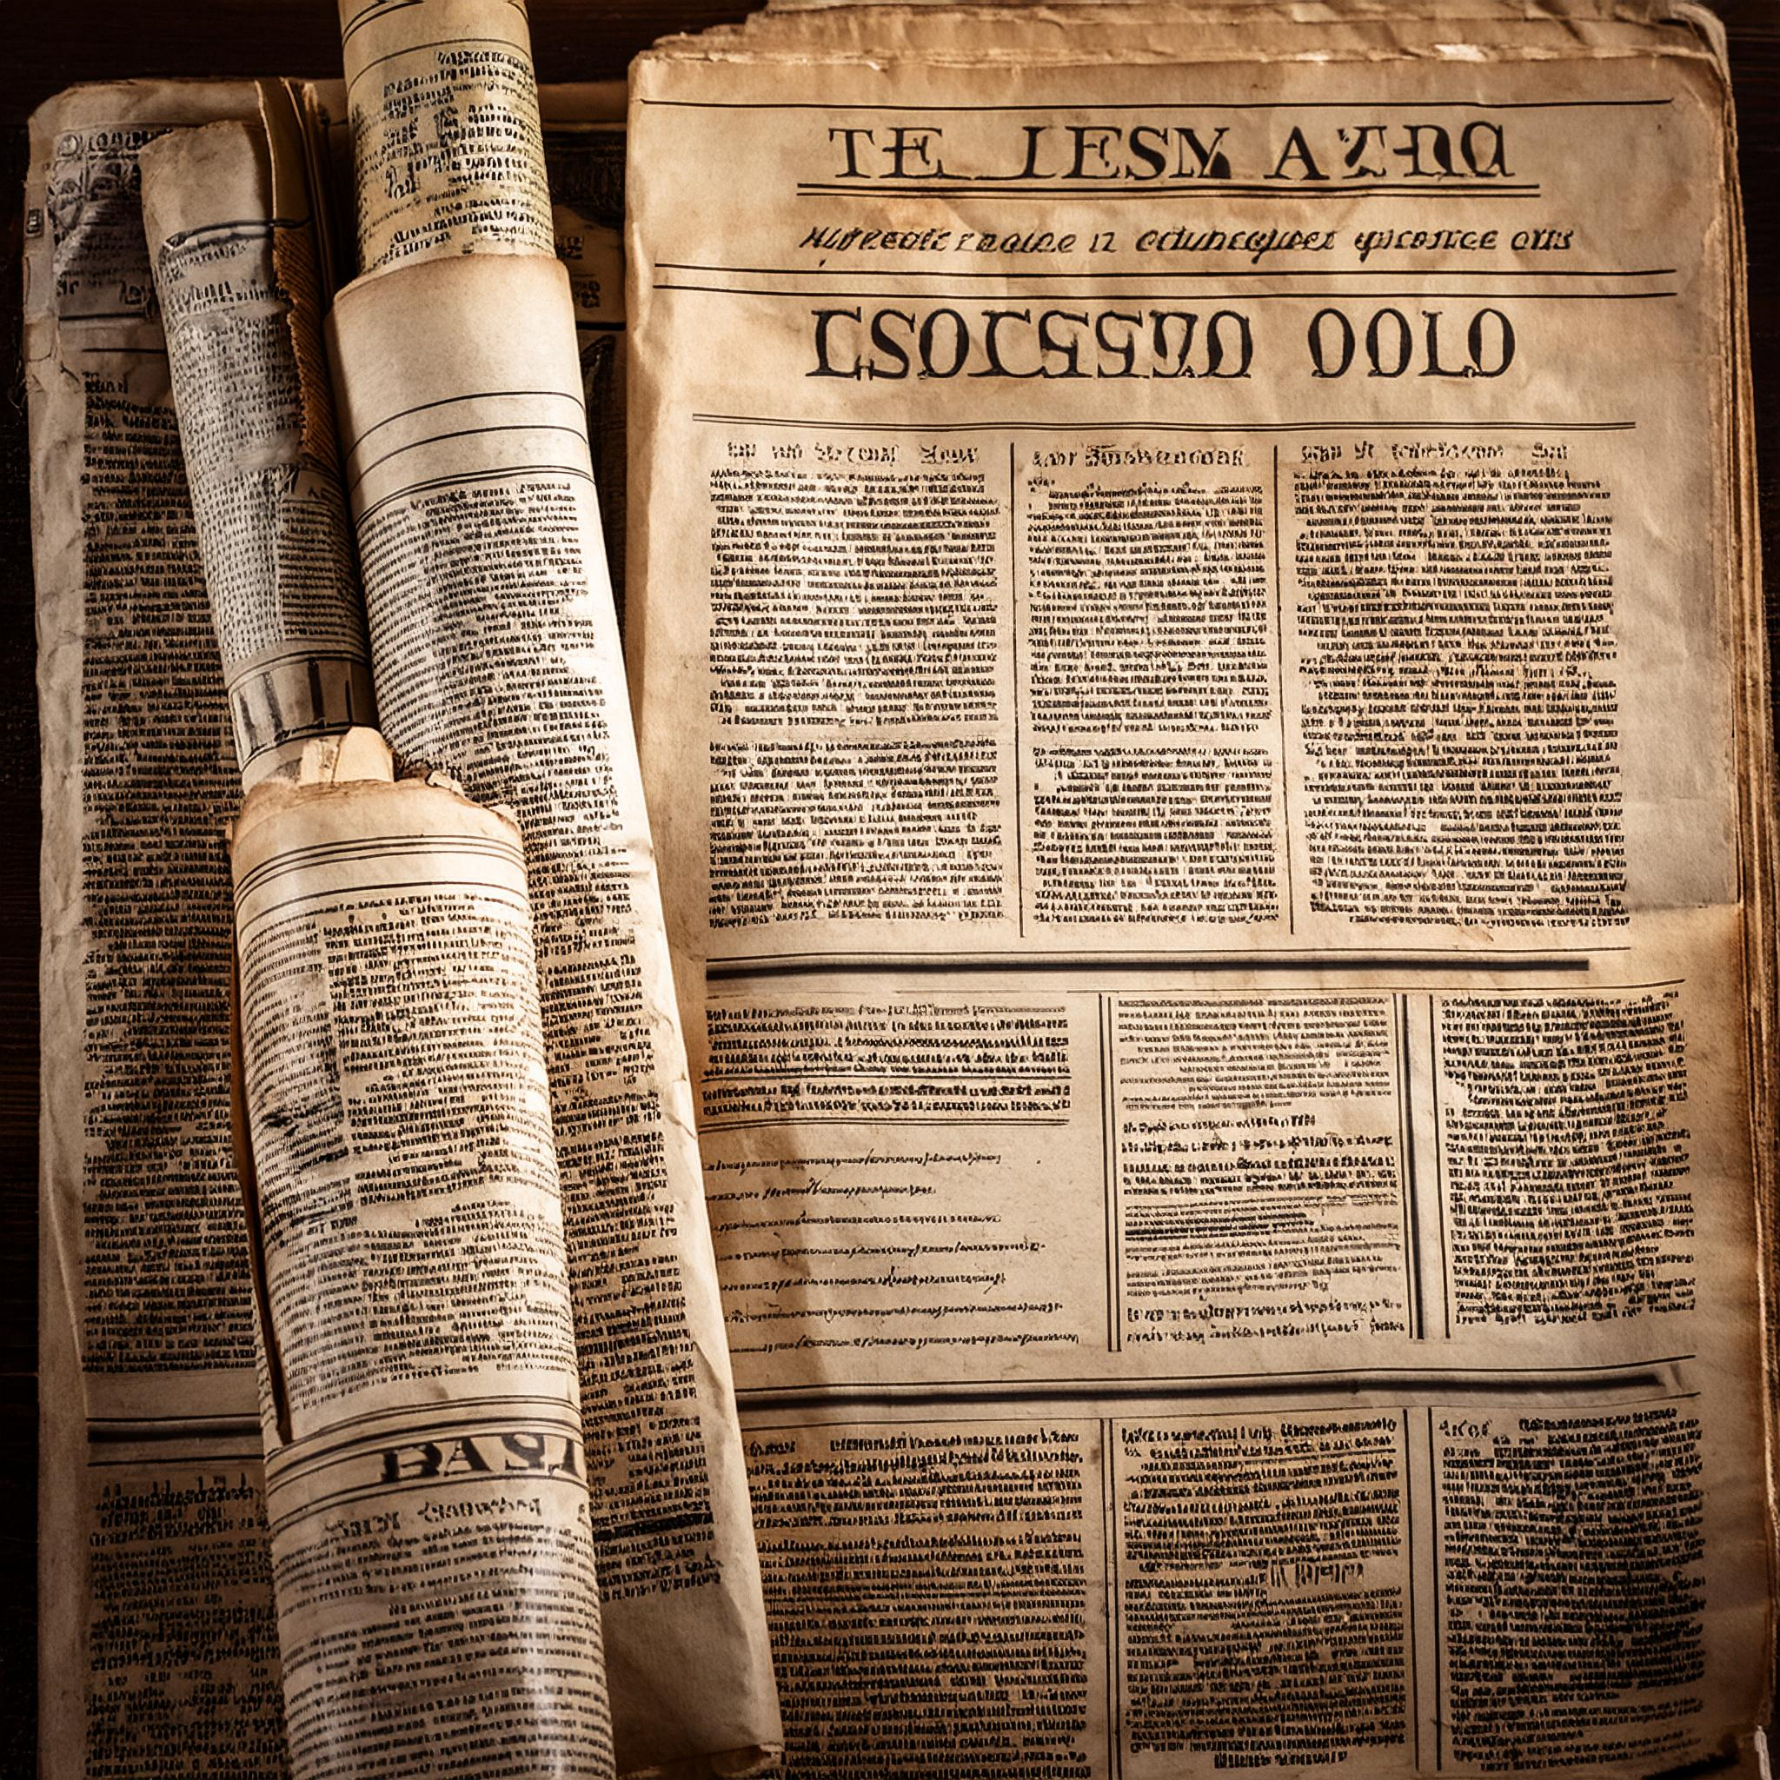
Next Steps

Slide 13
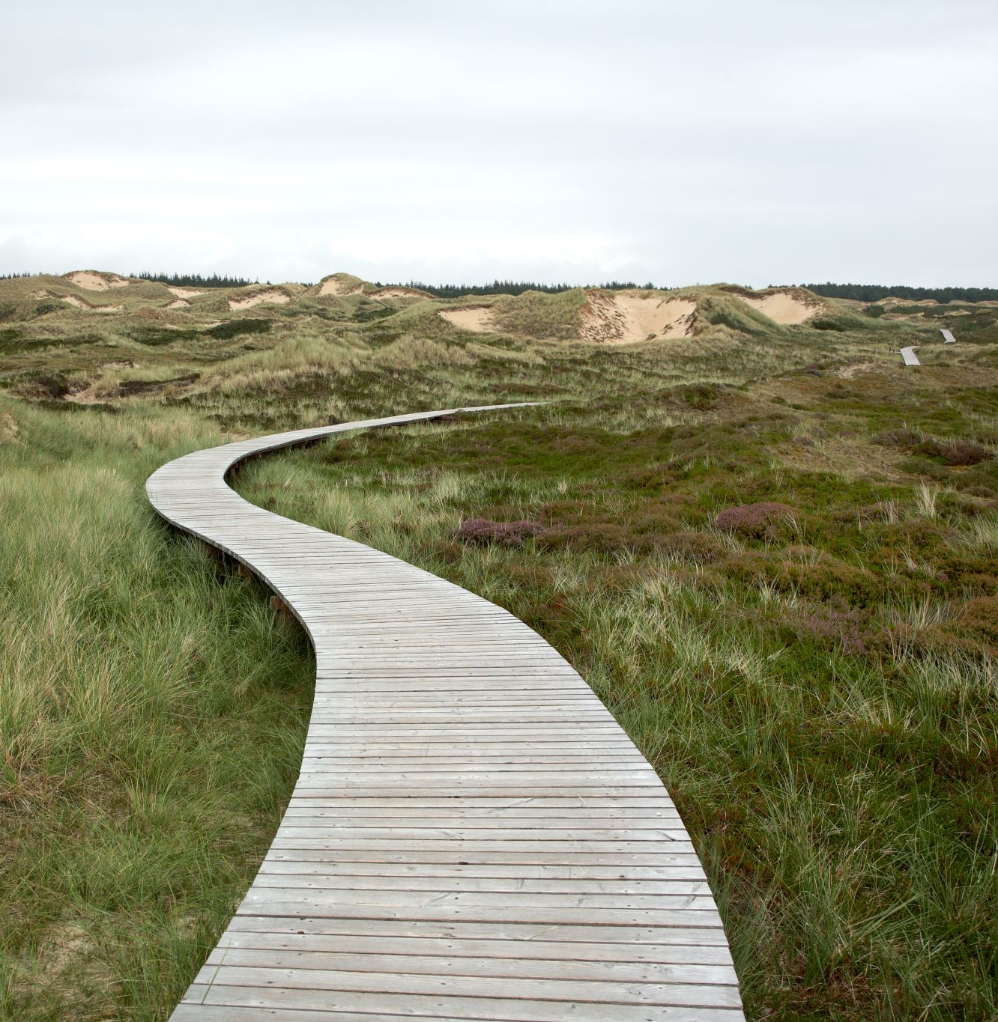
The Future: Sustaining and Expanding Accessibility
Ongoing monitoring and evaluation of the enhanced search functionality.
Exploring further improvements to cataloguing practices for other alternative formats.
Collaborating with Vision Australia and other partners to ensure ongoing user feedback and needs are met.
Investigating new technologies to further enhance accessibility within Trove

Slide 14
Thank you!
Contact information
Pi Klinjun
Director, Trove Data and Platforms, National Library of Australia
trovedataplatforms@nla.gov.au

