Slide 1
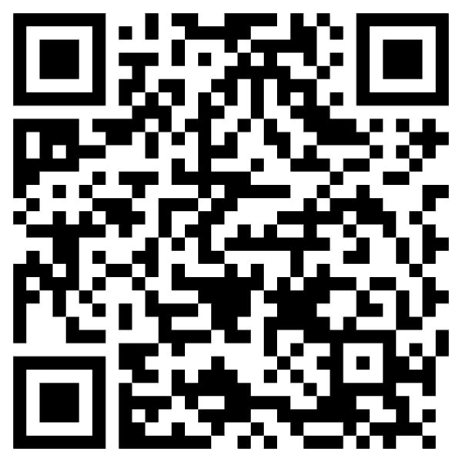
2025 Round Table Conference
11b. WORKSHOP: Braille at the Opera
Facilitators: Brad Cohen, General director, NZ Opera & Paul Brown, Director, Audio Described Aotearoa
Monday, 26 May 2025 11:15am – 12:15pm
Note for Delegates
If you're attending our workshop, you can use the URL link below to connect to the system.
URL: bit.ly/VisionAus
We've also included a QR code for your convenience – this will be displayed on the screen during the session, so you can simply scan and connect that way too.
QR Code:

