Slide 1


A World of Sound:
DAISY’s Initiatives in Braille Music
Christina Christensen (Hayes)
Chair – DAISY Music Braille Production Network (MBPN)
Multi format producer (Music Specialist)
Vision Australia
Round Table on Information Access for People
with Print Disabilities Inc., Melbourne, May 2025
Notes:
Page shows logo icons of DAISY Consortium and Vision Australia
A World of Sound: DAISY’s Initiatives in Braille Music
A presentation for the Round Table on Information Access for People with Print Disabilities Inc., Melbourne, Australia, May 2025.
Presenter: Christina Christensen (Hayes)
Current 2025 Chair, DAISY Music Braille Production Network (MBPN)
Multi Format Producer (Music Specialist), Vision Australia

Slide 2
Overview
What will you learn from this presentation?
Braille Music:
Its role today and moving forward
The DAISY Braille Music Project: achievements and the future
Ways that you can get involved
Notes:
Good morning everyone. It's a pleasure to be here in Melbourne for the Round Table conference. My name is Christina Christensen Hayes, current Chair of the DAISY Music Braille Production Network, and a Multi Format Producer, Music Specialist at Vision Australia. Here is a summary overview of what you will learn from today’s presentation:
Braille Music: It’s role today and moving forward
The DAISY Braille Music Project: achievements and the future
Ways that you can get involved

Slide 3
Introduction
Significant work of the DAISY Braille Music Project
Honour the work of Dr. Sarah Morley Wilkins.
This presentation builds upon her excellent work and her more recent presentations.
Notes:
Today, I'll be speaking about the significant work being done by the DAISY Consortium in the realm of braille music.
This presentation builds upon the excellent work and insights shared by Dr. Sarah Morley Wilkins recently, and I want to acknowledge her foundational contributions to this field.

Slide 4

Special Mentions
Dr. Sarah Morley Wilkins: Project Manager & User Experience Consultant of the DAISY Consortium's Music Braille Project, and previous MBPN Chair.
Arne Kyrkjebø: Head of Production at the National Library of Norway. DAISY Board Member, oversees and champions the DAISY Music Braille Project.
Haipeng Hu: DAISY Music Braille Project Technical Consultant and founder of BrailleOrch
Notes:
Image of a microphone and a keyboard is shown.
I'd also like to take a moment to mention some key individuals who are instrumental in driving the DAISY Music Braille initiatives forward.
Firstly, Dr. Sarah Morley Wilkins, the Project Manager & User Experience Consultant for the DAISY Consortium's Music Braille Project. Her dedication to research and fostering collaboration is truly commendable.
Next, Arne Kyrkjebø, the Head of Production at the National Library of Norway. Arne is the DAISY Board Member who oversees and champions the DAISY Music Braille Project.
And finally, Haipeng Hu, the DAISY Music Braille Project Technical Consultant and founder of BrailleOrch, whose technical expertise in braille music is invaluable.

Slide 5

Why Braille Music Still Matters
Braille music is a living, essential tool for blind and print-disabled musicians.
It enables independence, education, performance, and creative participation.
Notes:
Image shows a woman’s face silhouette singing into a microphone
There’s a myth that braille music is outdated. The reality? It’s foundational. Just as sighted musicians use notation to learn, analyse, and perform, blind musicians rely on braille. Without it, they’re excluded from entire genres, careers, and communities. This is about restoring equity—not nostalgia. Let me give you an example: a student preparing for a performance exam without a tactile score is simply being asked to fail.

Slide 6
The DAISY Consortium’s Role
DAISY is a global leader in accessible publishing standards.
It responded to the braille music access crisis in 2017 by initiating a multi-year project to improve access and is currently still running!
Notes:
DAISY is a global leader in accessible publishing standards.
In 2017, global concerns highlighted shrinking access specific to Braille Music, prompting the DAISY Consortium to take decisive action. As a recognized leader in accessible digital publishing, DAISY understood the urgent need for intervention.
It responded to the braille music access crisis in 2017 by initiating a multi-year project to improve access and is currently still running!

Slide 7
The DAISY Music Braille Project
DAISY's music braille project began in response to a global shortage of accessible music scores.
It has grown into a comprehensive initiative addressing tools, training, standards, and international collaboration.
Notes:
To tackle this pressing issue, DAISY launched its Music Braille Project. This ambitious initiative was made possible through the generous funding and support of DAISY members.
This project fostered unprecedented international collaboration, bringing together experts and organizations from across the globe. Our shared aim was to significantly improve access to music braille resources for individuals with print disabilities, including those who are blind, have low vision, or dyslexia.
Image Icon of trumpet: Text reads “DAISY's music braille project began in response to a global shortage of accessible music scores.”
Image Icon of 3 people with an arrow up to suggest growth: Text reads “It has grown into a comprehensive initiative addressing tools, training, standards, and international collaboration.”

Slide 8

The Music Braille Production Network (MBPN)
An ongoing global network of music braille producers sharing files, expertise, and production practices.
Explore at: www.daisy.org/MBPN
Notes:
To combat isolation and duplicated effort, we established the Music Braille Production Network (MBPN). This global collective empowers music braille producers to efficiently share and obtain scores.
The MBPN has also established unified production guidelines to foster file compatibility and improve international user comprehension. You can explore these further at www.daisy.org/MBPN.
MBPN is an ongoing global network of music braille producers sharing files, expertise, and production practices of which I am currently Chair.

Slide 9
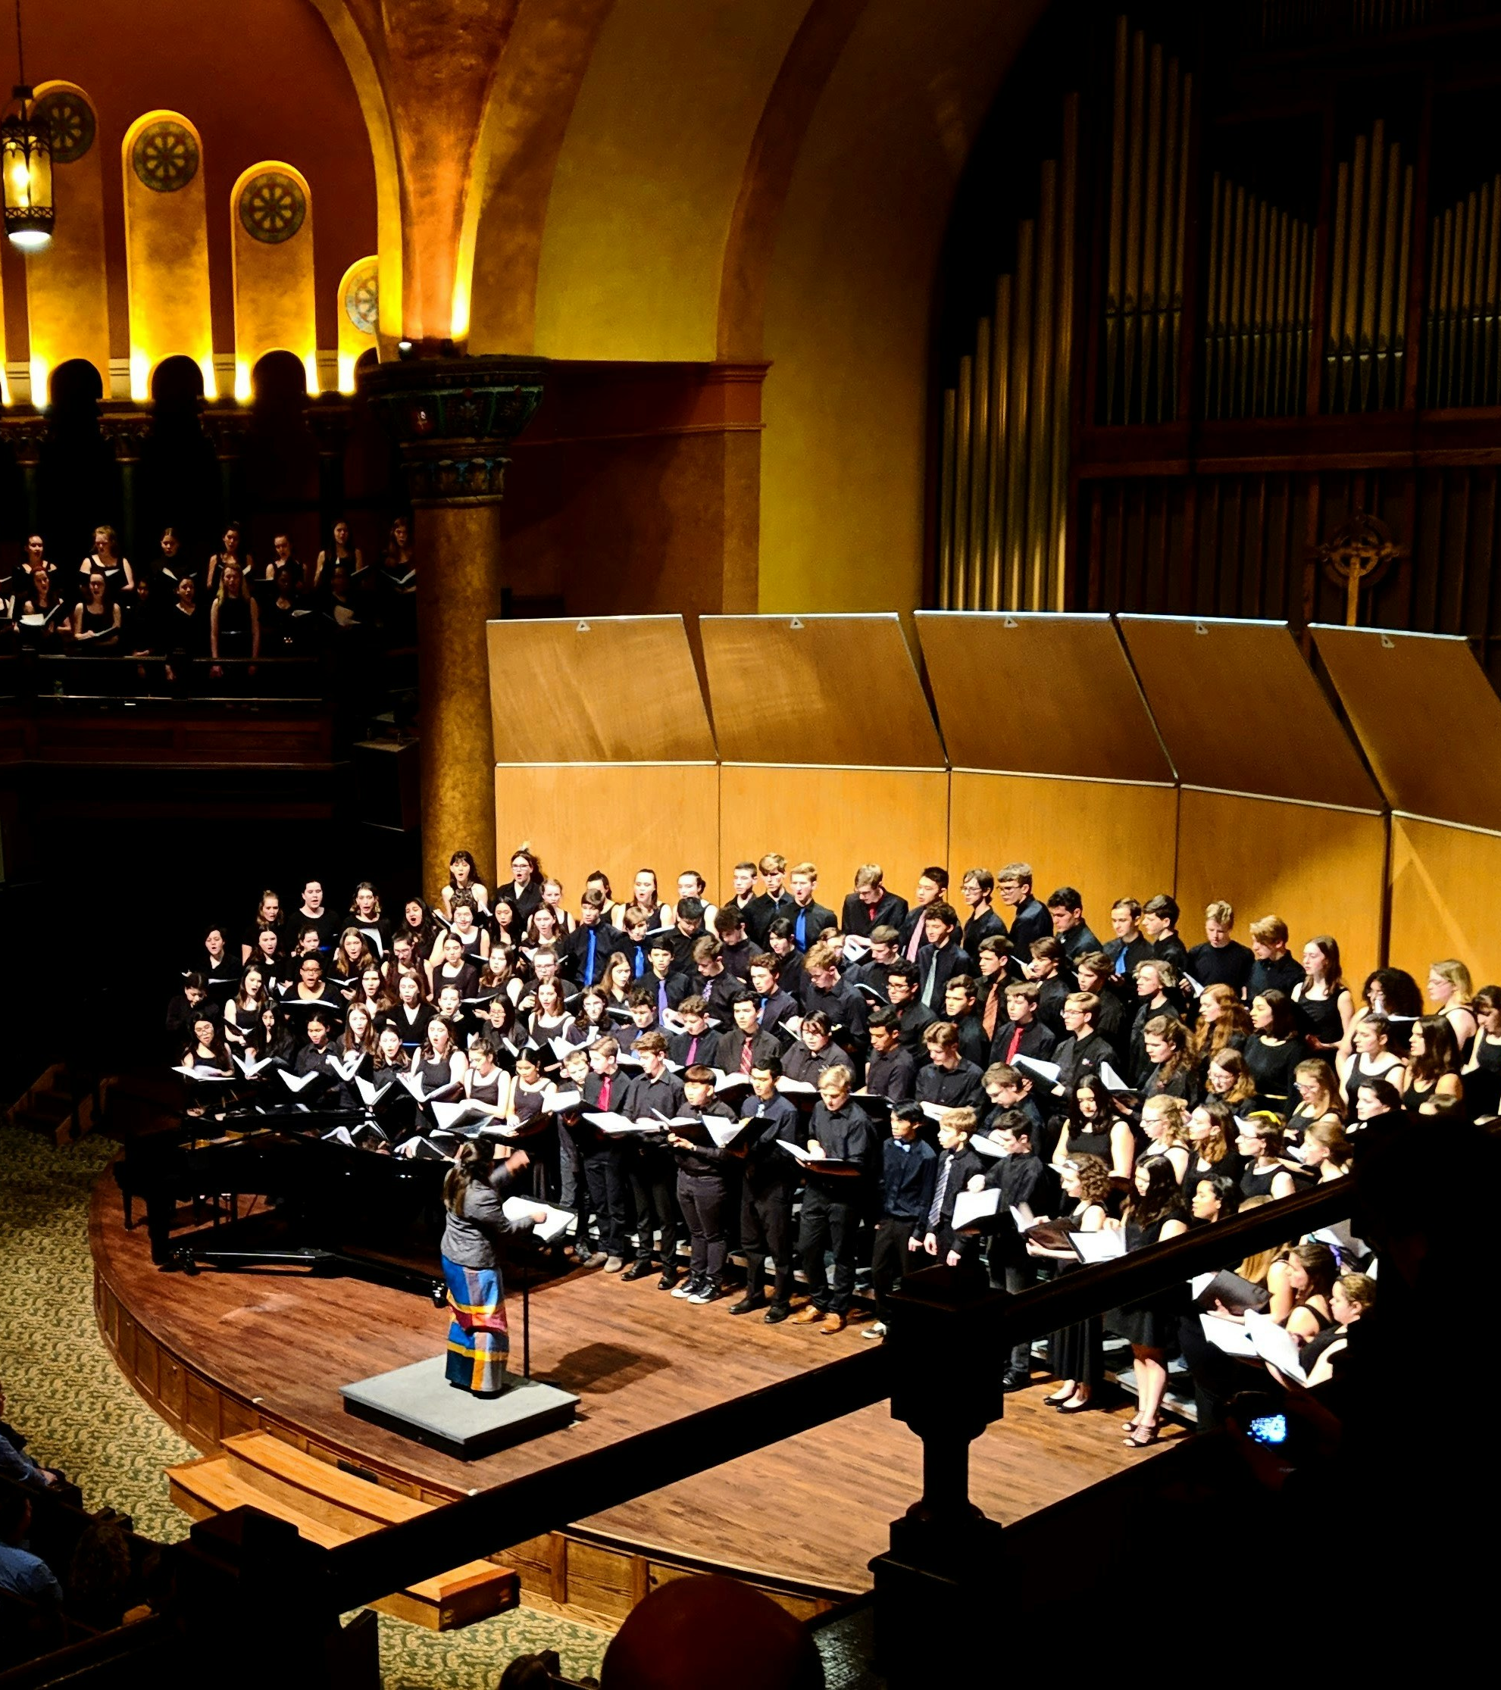
From Research to Implementation
Following sector research, DAISY implemented a series of strategic activities focused on:
Enhancing the quantity of available music braille.
Improving the quality and consistency of braille music production.
Increasing the availability of music braille in both physical and digital formats.
Notes:
Our approach was informed by thorough sector research. This research provided crucial insights into the challenges and opportunities within the music braille landscape.
Based on these findings, DAISY implemented a series of strategic activities focused on:
Enhancing the quantity of available music braille.
Improving the quality and consistency of braille music production.
Increasing the availability of music braille in both physical and digital formats.
Our overarching goal was to create a more accessible musical landscape for braille readers.

Slide 10
Tools Enabling Modern Braille Music
Supported by the DAISY Music Braille Project:
MakeBraille: Converts MusicXML and scanned scores into braille
Sao Mai Braille Converter (SMB): Text, math, and music to braille
MuseScore: Mainstream music notation editor
Other Tools:
GoodFeel: Music Braille Translator and input
BME2: – for braille input by blind end users and simple conversion to print music
Notes:
DAISY supported specific tools:
MakeBraille: This tool assists in creating braille music by converting MusicXML files or scanned scores. It offers customizable country-specific formatting and is used by major braille production agencies worldwide. It's free for end-users and licensed for organizations.
Sao Mai Braille Converter (SMB): A free, multi-functional program, SMB converts text, images, math, and importantly, music into braille. It's available as a Windows application and a simplified web version, widely used by blind users and educators.
MuseScore with SMB Integration: The free music notation software MuseScore has significantly improved accessibility. It now features a live braille display and 6-key braille input, both powered by SMB. Exporting MuseScore files as MusicXML and then using SMB provides the most accurate braille conversion.
Other Tools:
GoodFeel: Music Braille Translator and input – still used by blind end users to date.
BME2 – for braille input by blind end users and simple conversion to print music.

Slide 11
Successful Interventions:
Standards and Metadata
Enhanced MusicXML tagging through W3C collaboration
1
Standardised production and transcription guidelines
2
Metadata standards for consistent file sharing
3
Notes:
We recognized that better braille conversion relies on refined file formats. While music notation software exports PDFs (which are inaccessible), earlier MusicXML files lacked crucial data for accurate braille translation.
Through collaboration with W3C and software developers, essential tags were added to MusicXML. For optimal braille conversion, we now recommend using the latest versions of software like MuseScore, Sibelius, Finale, or Dorico with the Dolet plug-in.
Slide shows points 1-3:
1 Enhanced MusicXML tagging through W3C collaboration
2 Standardised production and transcription guidelines
3 Metadata standards for consistent file sharing

Slide 12
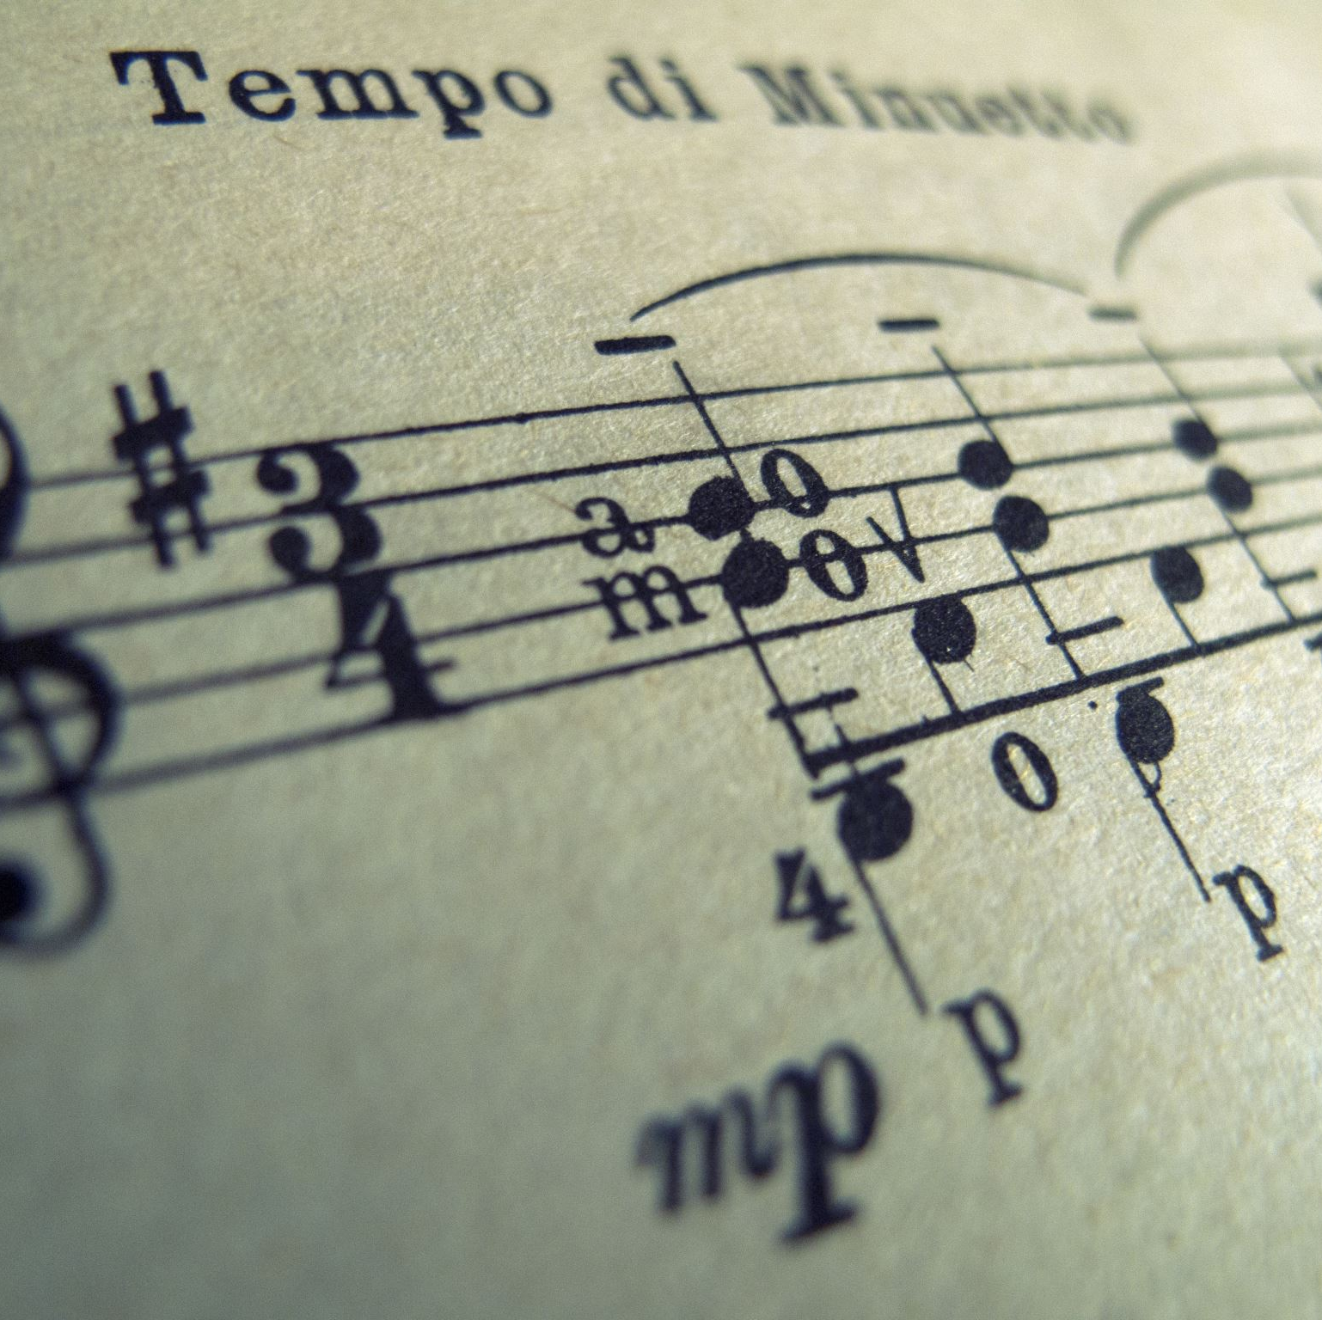
Successful Interventions:
Born Accessible Publishing
AMPAG (Accessible Music Publishing Action Group) encourages publishers to produce scores that are 'born accessible' by:
Using DAISY engraving guidelines
Exporting MusicXML files
Supporting direct access by users
Notes:
Historically, inaccurate music engraving has been a significant barrier to effective braille conversion. Visually correct scores can lack the necessary semantic accuracy for automated conversion.
To address this, accessibility guidelines for music engraving were created. Mainstream publishers are now adopting these guidelines, ensuring new scores are "born accessible," facilitating immediate conversion to formats like braille. Efforts are also underway to improve the conversion of older music files into high-quality MusicXML.
The AMPAG group encourages publishers to produce scores that are 'born accessible' by:
Using DAISY engraving guidelines
Exporting MusicXML files
Supporting direct access by users
Image shows print music of start of a Minuet for guitar.

Slide 13
Born Accessible Publishing – AMPAG’s Role
The Accessible Music Publishing Action Group (AMPAG) works with:
Publishers
Composers
Engravers
AND promote MusicXML-first workflows and support universal access from creation to distribution.

Slide 14
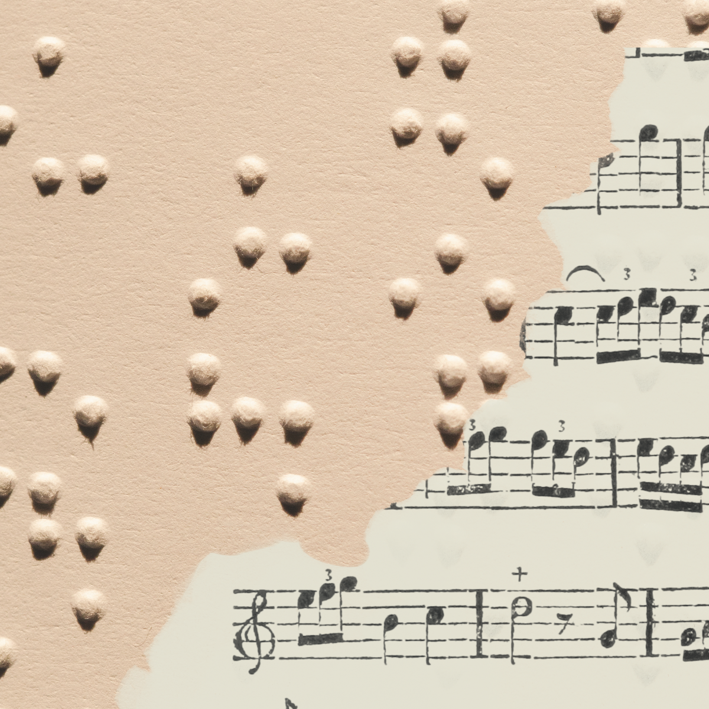
Advancing Global Notation Standards
MBPN will contribute to ICEB in creating an Addendum to the New International Manual of Music Braille (NIM).
Our contributions include identifying gaps and proposing content, building on existing proposals.
Leading music braille experts will conduct a joint review.

Slide 15
Present efforts
(3 Key Areas):
Implementing
Creating foundational learning materials for our DAISY tools and guidelines.
Promoting
Encourage take-up of born-accessible publishing.
Driving
Driving global awareness and action, via presentations and sharing information online.

Slide 16
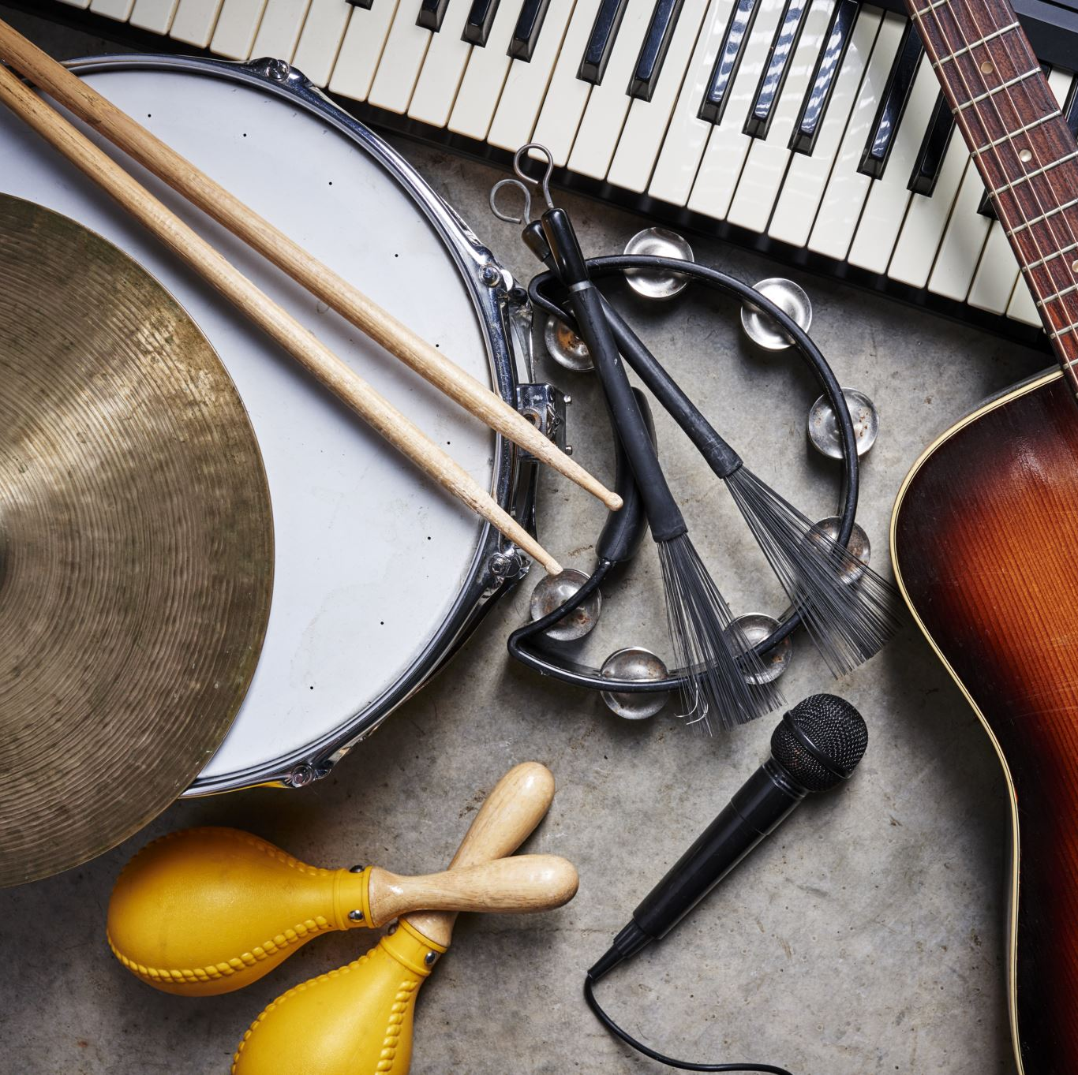
The Future:
2026 and Beyond
Sector will self-sustain with standard tools
Publishers will routinely provide MusicXML
DAISY would like to see AI being used to speed up the preparation of complex music theory books for braille.
OMR and markup automation would be key focus areas.

Slide 17
What Does Participation Look Like?
Publishers: Follow DAISY engraving guidelines, and export MusicXML
Educators: Use DAISY resources
Transcribers: Share with MBPN
Developers: Improve tools and OMR
Advocates: Spread the word about music accessibility
End-users: Use DAISY resources and personal support services e.g. Vision Australia

Slide 18
Call To ACTION
Join us:
There are several ways to engage with the DAISY Music Braille Project and our activities:
Visit our web pages at www.daisy.org/MusicBraille
Sign up to our mailing lists: https://forms.office.com/e/MRS7DpmWUr
Email us at MusicBraille@daisy.org
For publishers or engraving guidelines: DAISY.org/AccessibleMusicPublishing
We actively welcome new contributors – including music braille producers, educators, publishers, and accessibility advocates – and we look forward to hearing from you.

Slide 19

Contact and Acknowledgements
DAISY:
www.daisy.org/MusicBraille
MusicBraille@daisy.org
Vision Australia:
https://www.visionaustralia.org
printaccess@visionaustralia.org
With thanks to Sarah Morley Wilkins and all DAISY funders and partners.
Notes:
We welcome your participation in building a more accessible world of music.
DAISY contact channels
https://www.daisy.org/MusicBraille
MusicBraille@daisy.org
For Vision Australia contact channels
https://www.visionaustralia.org
printaccess@visionaustralia.org
With thanks to Sarah Morley Wilkins and all DAISY funders and partners.
Thank you for your time and your interest in this vital area. I'm happy to answer any questions you may have.

