Slide 1


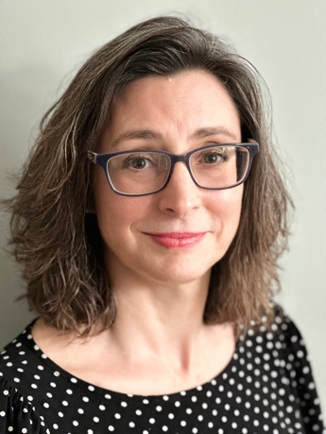
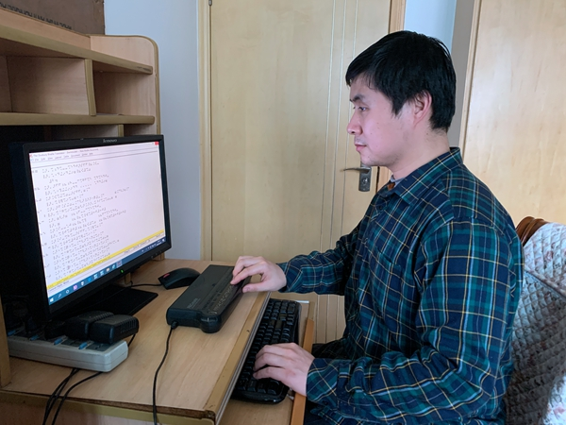
Music Braille:
Empowering the mainstream and specialist sectors with software, good practice guidance, and networking
The DAISY Music Braille Project
Dr. Sarah Morley Wilkins
Arne Kyrkjebø & Haipeng Hu

Slide 2

Introduction
A time for celebration!
Global and collaborate efforts
DAISY Music Braille Project

Slide 3
The DAISY Consortium
International non-profit membership organization
To improve access to reading for people with print disabilities
Leading standards and good practice
Works with technology companies and standards agencies

Slide 4

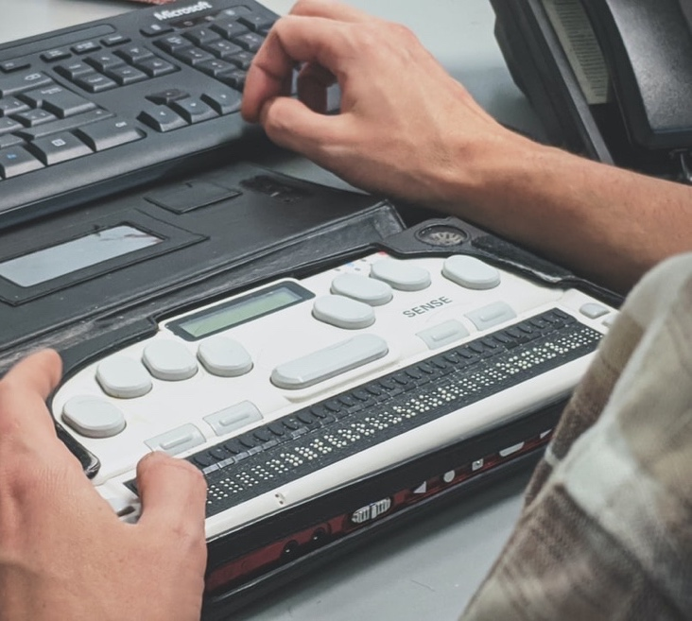

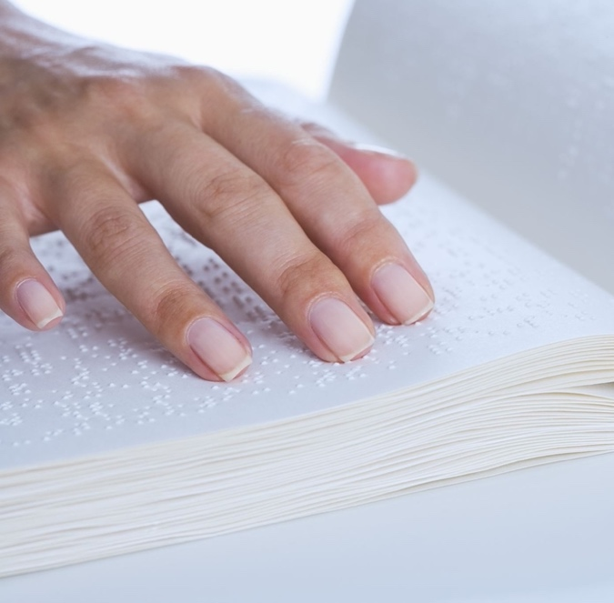
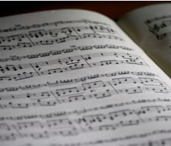
Our vision
Through international collaboration, musicians who read braille enjoy timely and affordable access to increased numbers of accurate music braille scores in hard-copy and digital formats produced by effective and reliable conversion tools.

Slide 5

Strategic interventions
Common concern: decline of production and use
Global sector report
Activities to positively impact future quantity, quality and availability of music braille

Slide 6

Successful interventions

Slide 7
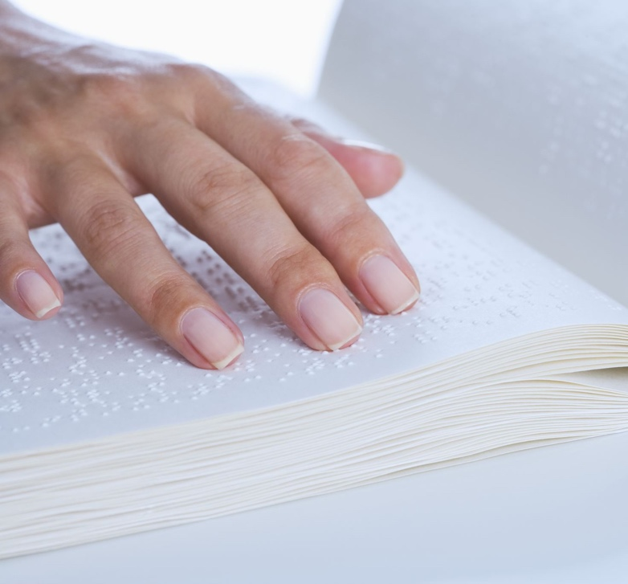
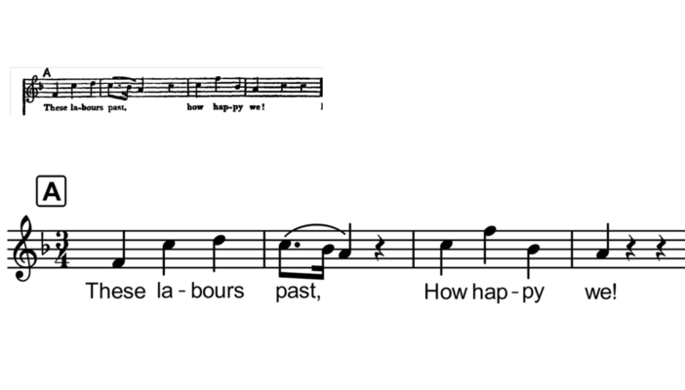

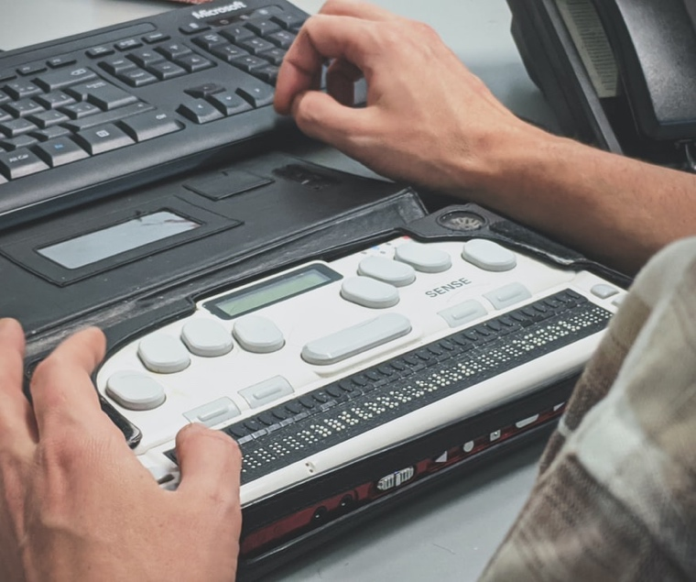

Converter tools make it easier to produce music braille
Automated conversion into braille or Modified Stave Notation
Music Notation File
Music XML
End-user reads the file immediately in music notation tool with specialist access software

Slide 8
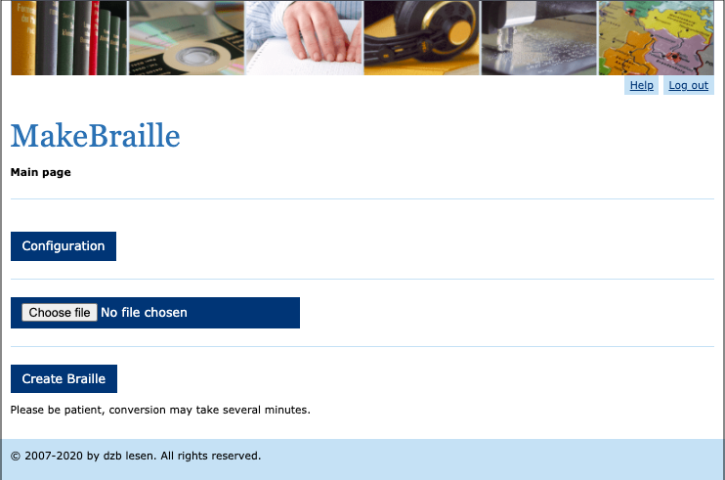

MakeBraille
Online, automated tool
from dzb lesen, Germany
MusicXML and capX files
Country-specific rules and
user requirements
Used by end-users, educators
and agencies
Free (end users)
licence (organizations)
Extensive support materials

Slide 9

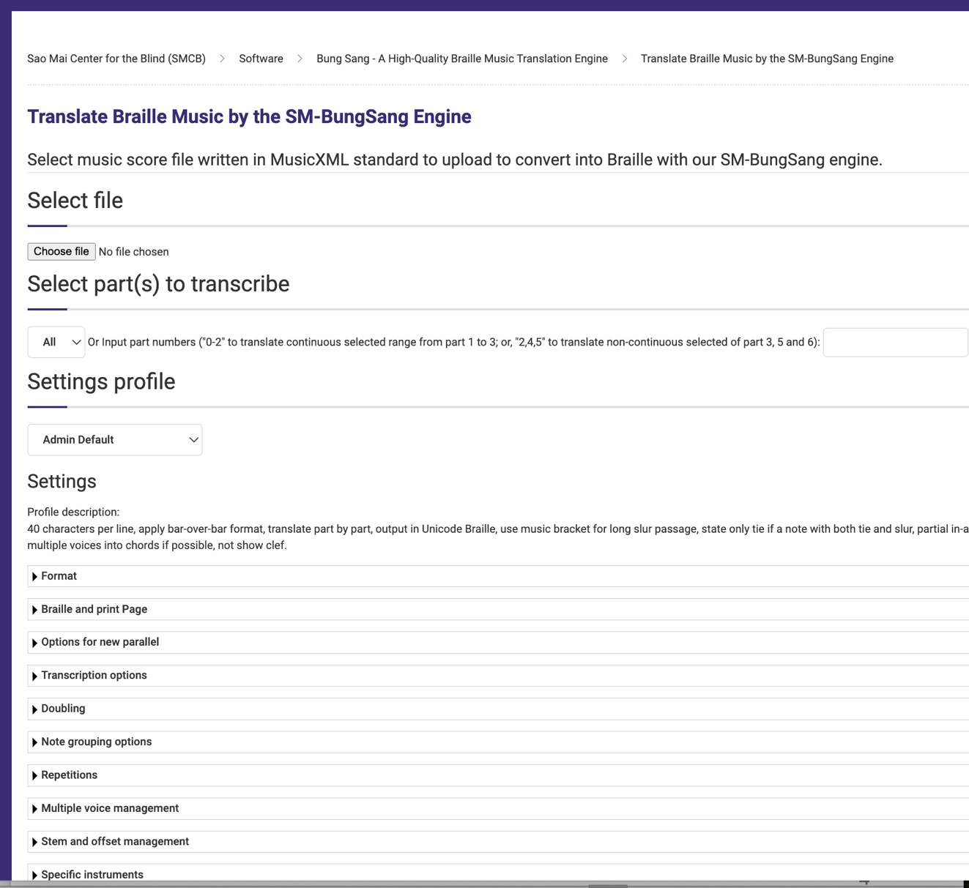
Sao Mai Braille Converter
(SMB)
Free, from Sao Mai Centre for the Blind, Vietnam
Full braille translation program, Windows, with online music-braille converter
MusicXML files
Various conversion options
Used by end-users, educators and braille producers, often with MuseScore
Support materials being added

Slide 10
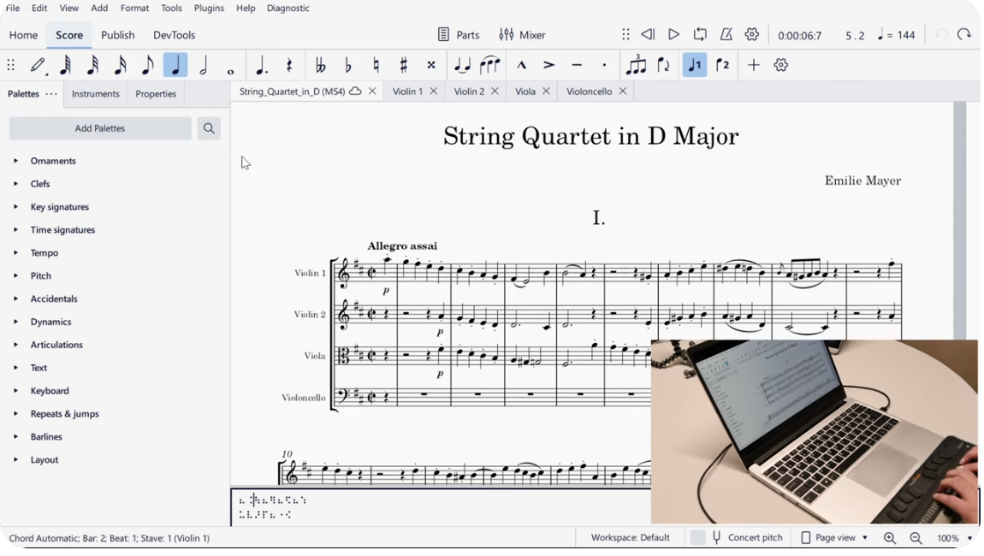

MuseScore Studio
Free, mainstream music notation editor
Improved accessibility
Live braille, 6-key input (basic)
Also: Modified Stave Notation
Export as MusicXML, convert with SMB
Extensive support and user base

Slide 11
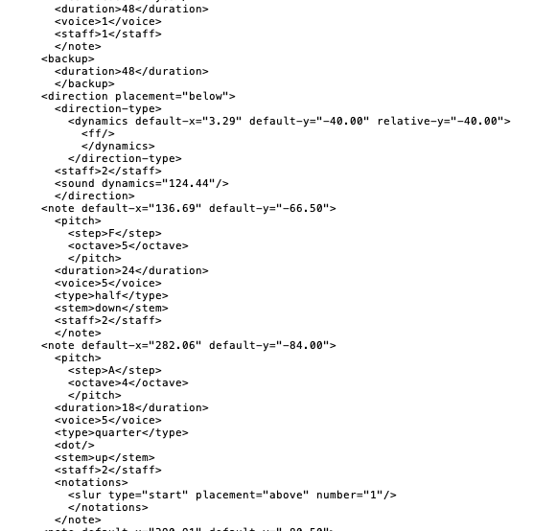
Improved file format standards
MuseScore, Sibelius, Finale, Dorico
PDFs are not helpful
Improved MusicXML gives better conversion into accessible formats
Use latest version (with Dolet plug-in)

Slide 12
Start from ‘good’ MusicXML files
‘Good’ files are suitable for conversion
Well-engraved = good conversion
Poorly engraved = bad/no conversion
Sense-check before converting
Notes/texts, slurs/ties, labels etc
Guidance coming
Music XML

Slide 13
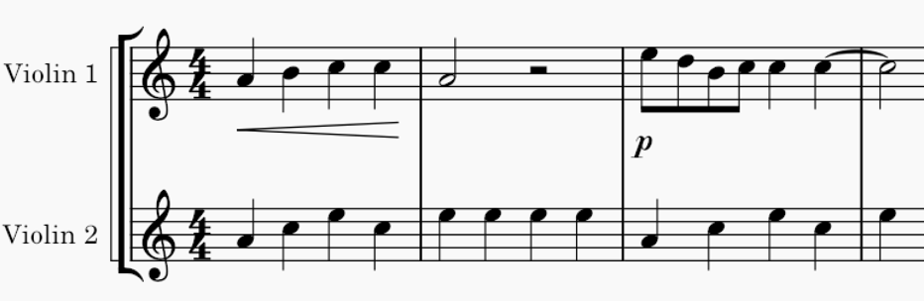
Engraving guidelines
For engravers, composers, educators
Best practice plus specific advice
Good scores suitable for automated conversion
Easy to follow

Slide 14

‘Born accessible’ scores
Well-engraved scores = ‘born accessible’
Ready for immediate conversion and for use in notation tools

Slide 15
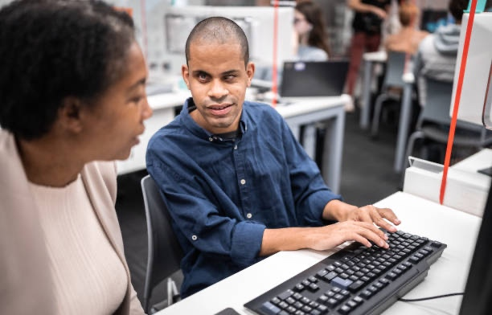

Online teaching and learning resources
Shortage of shared knowledge
Affecting availability of tuition
Collated and signposted online resources
Grouped by end-user type and stage

Slide 16

Music Braille Production Network
Global group of producers
Source and procure files
Agreed harmonized music braille formatting
For widest end-user benefit

Slide 17
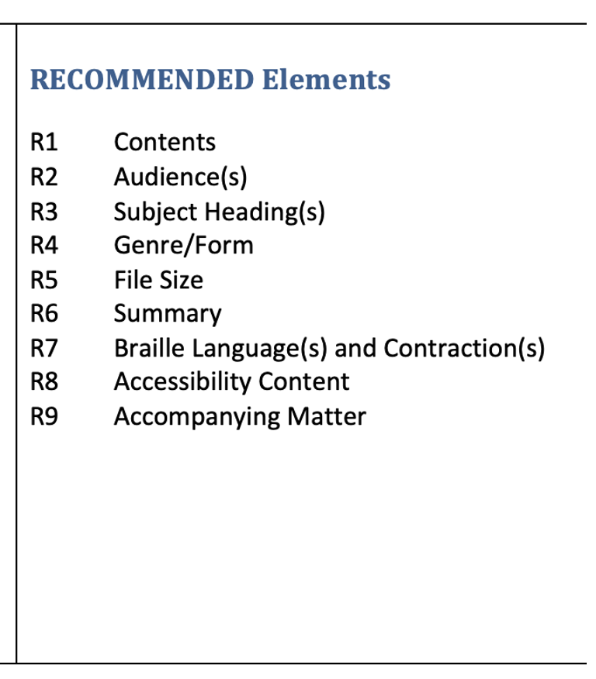
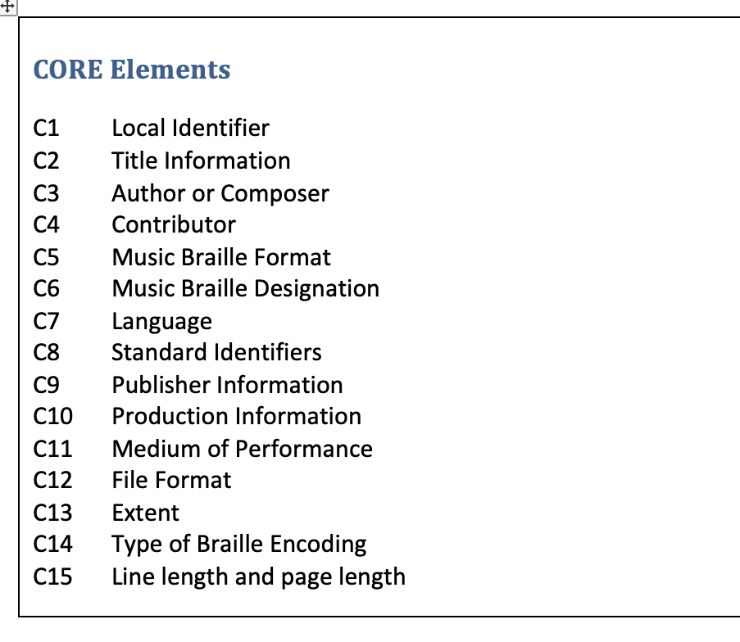
Metadata for music braille
Harmonized metadata fields
Consistent and helpful
Easier search and retrieval
Easier sharing with online
collections
National Library Service and
ABC Global Book Service
Core and Recommended
elements

Slide 18
Current interventions

Slide 19

‘Getting Started’ resources
Find out about, learn how to use
For educators, end-users, transcribers
Videos, user guides, practice materials
Optical Music Recognition software
Finding and checking files suitable for conversion

Slide 20
'Born accessible’ music publishing
‘Born accessible’ music publishing
International activity with mainstream music publishers
Automated conversion into braille or Modified Stave Notation
Music Notation File
Music XML
End-user reads the file immediately in music notation tool with specialist access software

Slide 21
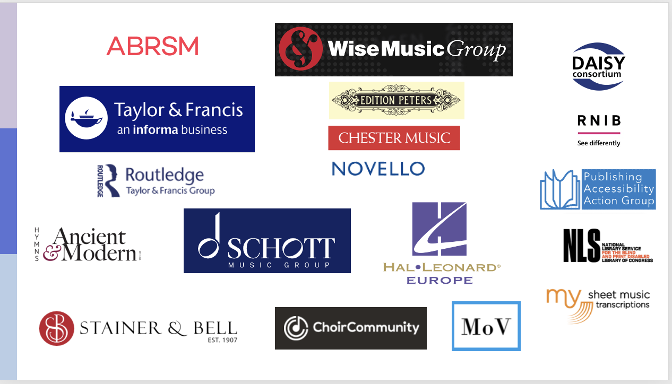
Accessible Music Publishing Action Group

Slide 22
Publisher policy and practice
Adopt engraving guidelines
New productions and
back-catalogue scores
Engraving companies, file-conversion
services
Establish policies and procedures for the supply of digital files
Engaging with publishing associations

Slide 23

Practical solutions for teaching and learning music braille
Music braille teaching practitioners
Practical teaching resources
Share worldwide
Increase teaching support in schools

Slide 24
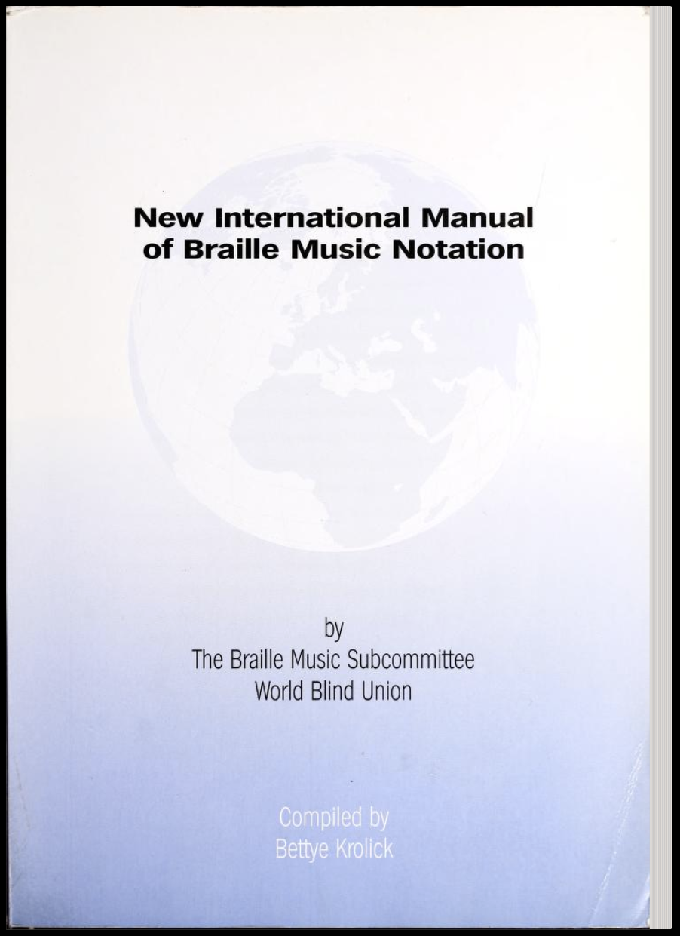
Music braille standards
For transcribers and developers of conversion tools
New International Manual of Braille Music Notation (NIM)
Gaps and ambiguities
Clarifications
Notation without braille equivalent
Big international effort needed

Slide 25
The future

Slide 26

By Spring 2025…
Mainstream music publishers provide ‘born accessible’ files
Effective networking and collaboration
Conversion tools, user groups, development
Authorized Entities using ABC Global Book Service
More teaching
Increased demand

Slide 27

Contact details
Project pages:
www.daisy.org/MusicBraille
Email us:
musicbraille@daisy.org

