Slide 1
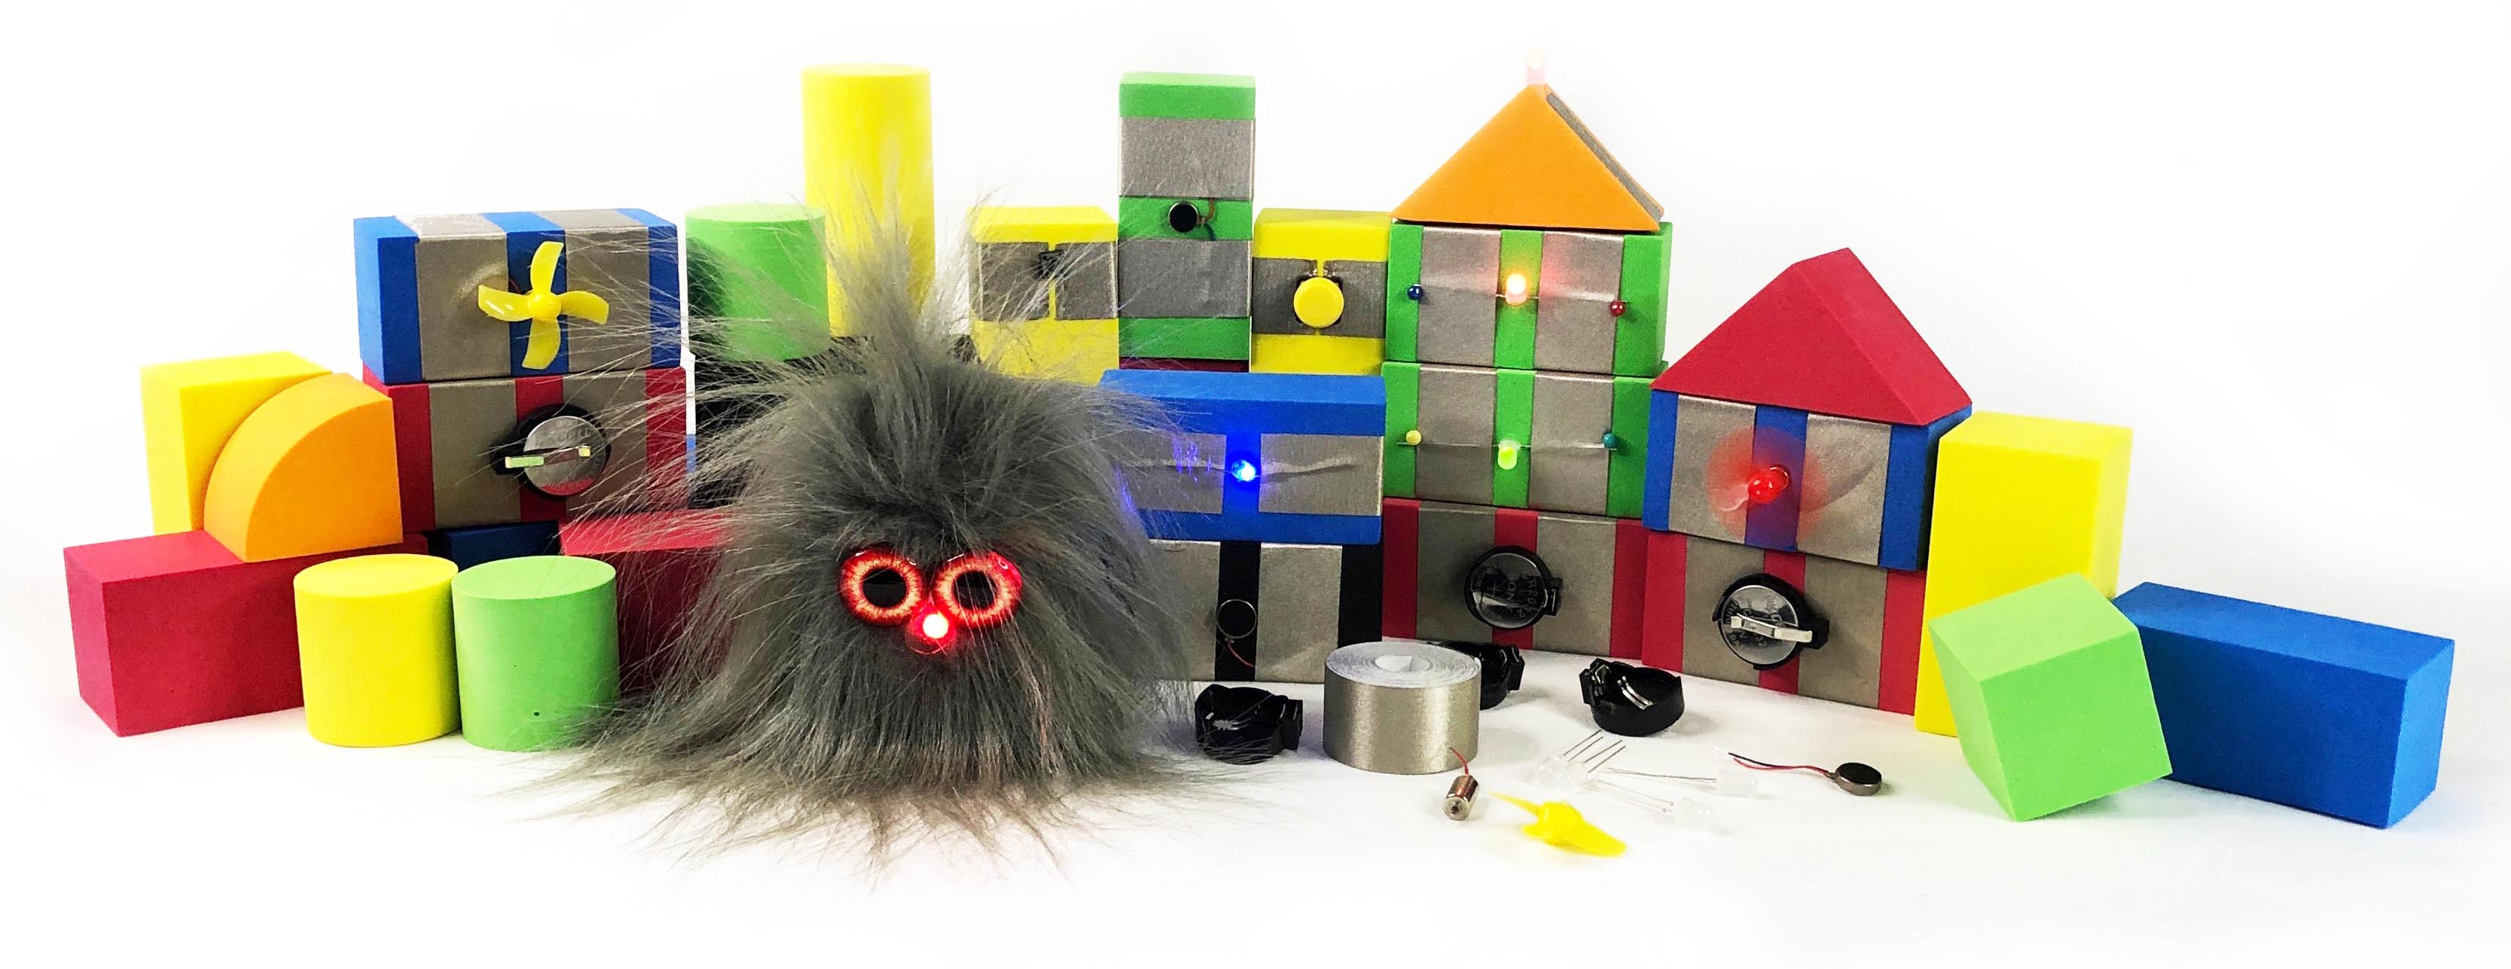
TapeBlock: Creative circuit making for all
Dr Kirsten Ellis
Monash University

Slide 2
Plan for Today
Make circuits with TapeBlocks
Vibration and Light
Power
Make a Power TapeBlock
Make a Vibration TapeBlock

Slide 3
What are TapeBlocks
Accessible circuit making
Use foam blocks
The tape is conductive
Electronic components on or under

Slide 4
Block Orientation
Top
Short End
Short Side
Long Side

Slide 5
Notes:
TapeBlock Circuit

Slide 6
Things you need to know
Wires are covered in plastic
Ends are conductive
Cut the backing not the conductive tape
We have conductive dots

Slide 7
Notes:
Make a Power TapeBlock

Slide 8
Notes:
TapeBlock Vibration

