Slide 1

Books without barriers
A practical guide to inclusive publishing
www.iped-editors.org/resources-for-editors/books-without-barriers
Notes:
Julie – a quick intro

Slide 2
About the guide
Notes:
Agata – I will give you some background before we talk about the content.

Slide 3
Background
The result of over 2 years’ research and writing by members of the Institute of Professional Editors
Builds on Inclusive publishing Australia: an introductory guide
Supported by the Australian Publishers Association and the Copyright Agency Cultural Fund
Focuses on making books accessible in multiple formats
Covers the entire publication workflow
Notes:
Agata – background

Slide 4
Contents
Publishing policy and planning
Advice for authors, editors and designers
Complex textbooks such as mathematics and science
Multisensory language and tactile elements for children’s books
Descriptions for images and tables
Digital formats, audiobooks and talking books
Reviewing and testing for accessibility
Notes:
Agata

Slide 5
Research
Experience of AIWP team members and Sydney University Press
International literature and existing guidelines
Surveys (with the University of Sydney)
Consultation with readers, accessibility experts and the publishing industry
Notes:
Agata

Slide 6
Creating “born-accessible” books
Traditional publishing workflows are print first.
Other formats need to be remediated, making them costly and slow to produce.
PDFs are supplied to alternative-format producers because publishers work in Adobe InDesign.
Books without barriers encourages publishers to change to digital-first workflows.
Notes:
Agata

Slide 7
Editing for accessibility
Notes:
Julie

Slide 8
Advice for editors and writers
Structure and hierarchy
Style
Language
Tables
Image descriptions
Notes:
Julie

Slide 9

There is no need to change our style from single quotation marks to double quotation marks on accessibility grounds.
Australian Government Style Manual newsletter, October 2022
Notes:
Julie

Slide 10
Making the case for double quotation marks
Current advice is based on considerations for screen readers only.
It does not consider the issues for braille transcription.
Changing house style to double quote marks is not difficult.
Double quotes do not negatively impact readers without print disability.
Notes:
Julie

Slide 11

It’s okay to be flexible!
Absolute fidelity to the print edition is unnecessary.
Editors apply rules of style flexibly, depending on the context.
If an element does not work well in braille, consider ignoring it.
Notes:
Julie

Slide 12
The challenges for STEM texts
Notes:
Maryanne

Slide 13

Issues with mathematics software
Books without barriers recommends the use of MathML.
Not all screen reading software supports MathML.
The coding must be checked both visually and read aloud.
Non-accessible formats such as LaTeX are sometimes still needed.
Notes:
Maryanne

Slide 14
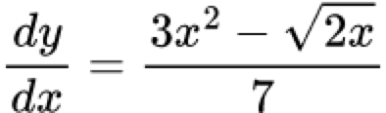
The need for accessible equations
Consider this equation:
The LaTeX code used to create this equation is:
  \frac{d y}{dx} = \frac{3x^{2}-\sqrt{2x}}{7}
Accessible equation software will read the equation in an understandable way, rather than forcing users of screen readers to interpret complex coding.
Notes:
Maryanne

Slide 15
Maths images require alt text
Image alt text must be unambiguous, and focused on the specific information being communicated.
Simple maths expressions may be rendered as an image.
Subject experts are required to ensure no errors are made. This may add time and cost to the process.
Notes:
Maryanne

Slide 16
Chemical symbols
When a chemical symbol is rendered by an image, (for instance ), the image’s alt text can be typed as “A R” to ensure that it is read correctly by a screen reader.
Body text is trickier – “negatively charged Ar ions” will be read as “are ions” instead of “A R ions”.
A solution is still needed. What will work for visual, aural and tactual formats?
Notes:
Maryanne

Slide 17
The challenges for children’s books
Notes:
Kayt

Slide 18
Convincing publishers
How do you make a visual storytelling medium accessible to a reader with low or no vision?
How do you do so in an industry that believes picture books to be a physical medium?
Notes:
Kayt

Slide 19
Creative adjustments
Improvements recommended by Books without barriers include:
  language that appeals to senses other than vision alone
  design elements that improve readability and engagement
  image descriptions suitable for the target age group
  illustrations that can be transferred to tactile elements.
Notes:
Kayt

Slide 20
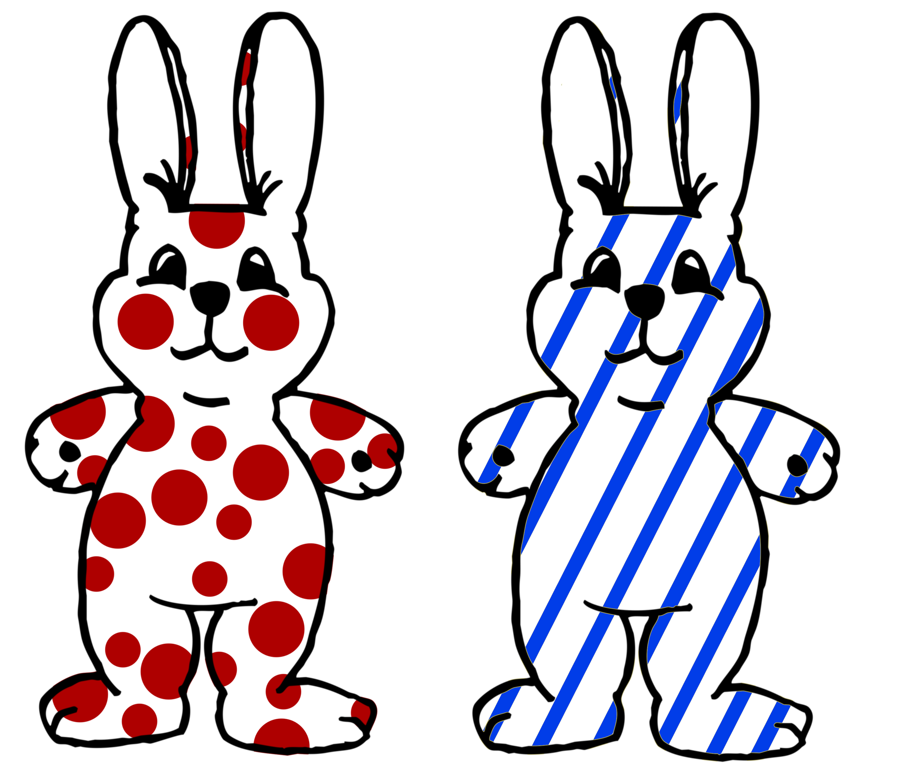
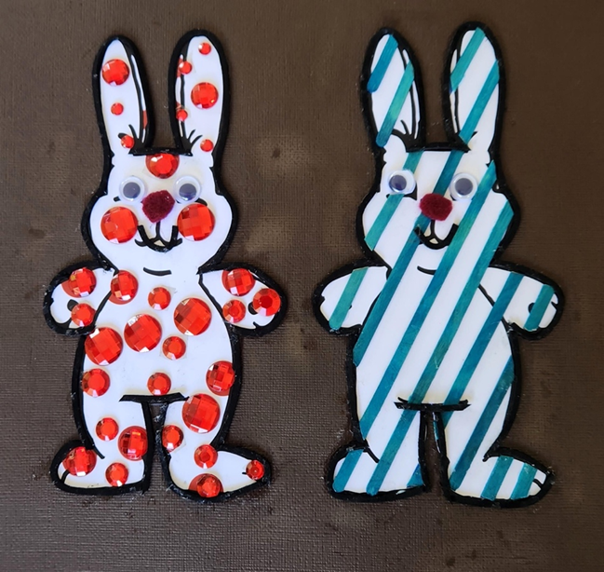
Supplementing colour with texture
Notes:
Kayt

Slide 21

Contact details
Julie Ganner
Agata Mrva-Montoya
Maryanne Park
Kayt Duncan
aipi@iped-editors.org
Notes:
Julie – please read out the email address

Slide 22

Questions
Notes:
Agata to field the questions.

