Slide 1
AAC and physical print disability:
What's the link and where to next

Slide 2
About me
Mum
Carer
Blogger
Disability Advocate

Slide 3
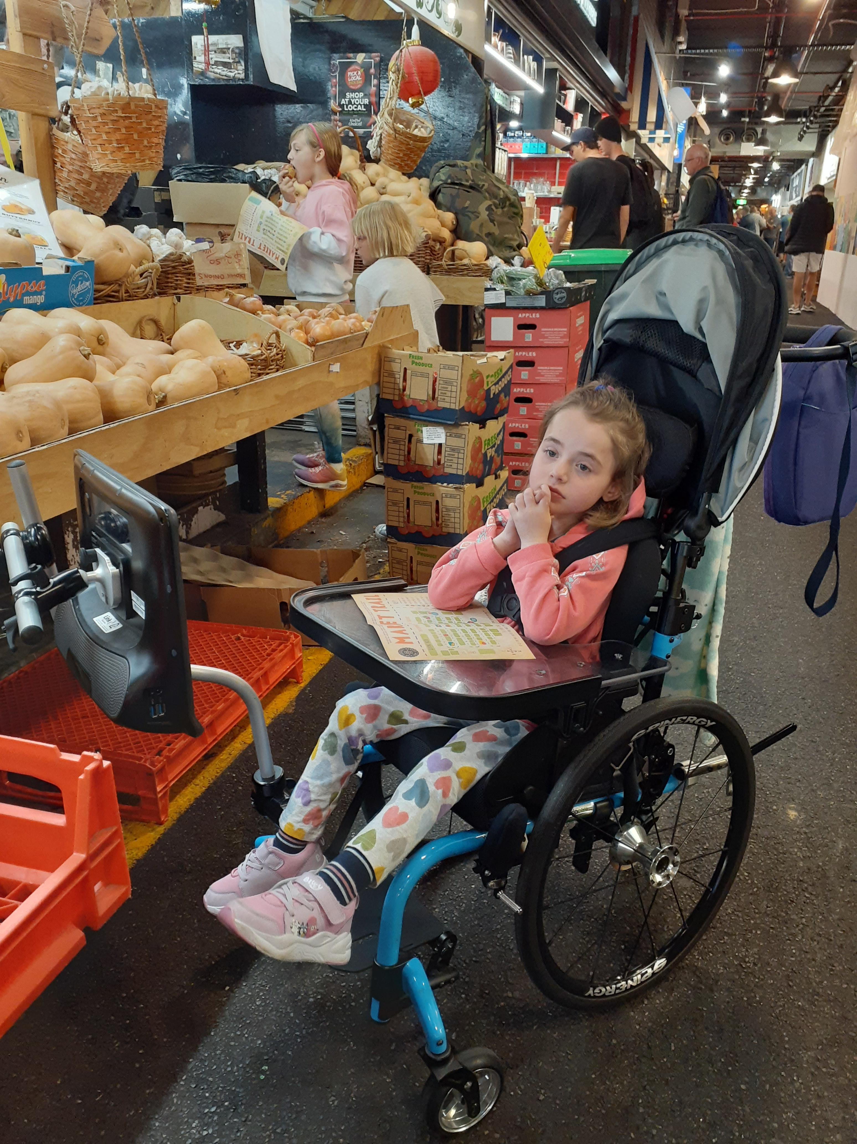
Hello! My name is Isabelle (Izzy)

Slide 4
Augmentative and Alternative Communication (AAC) definition
"Any type of communication strategy for people with a range of conditions who have significant difficulties speaking."
Source: Speech Pathology Australia

Slide 5
Two main types of AAC - Aided AAC
high technology systems (e.g. speech generating device, computer, mobile phone, tablet)
low/light technology systems such as object symbols, communication boards, books
Source: Speech Pathology Australia

Slide 6
Two main types of AAC - Unaided AAC
do not require the use of an external aid eye contact (e.g. facial expression, body language, gestures, manual sign)
Source: Speech Pathology Australia

Slide 7
AAC access methods
"Depending on their physical abilities and needs, a person can control a computer or a communication aid using a slight movement of their foot, blinking an eye or moving their head."
Source: Communication Matters

Slide 8
AAC access methods - examples
Pressing (e.g. touch screen, switches)
Eye gaze
Pointing
Source: Communication Matters

Slide 9
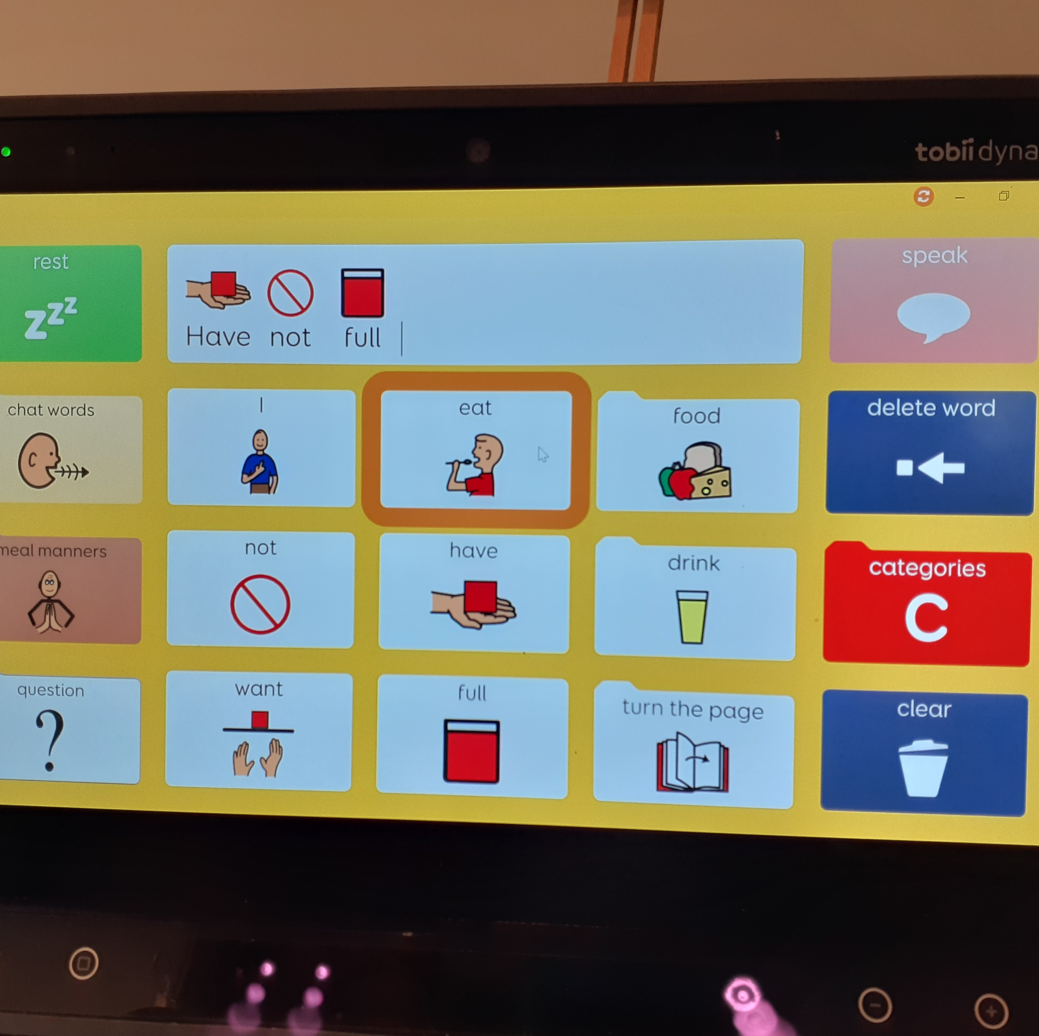
PODD communication
Where we started

Slide 10
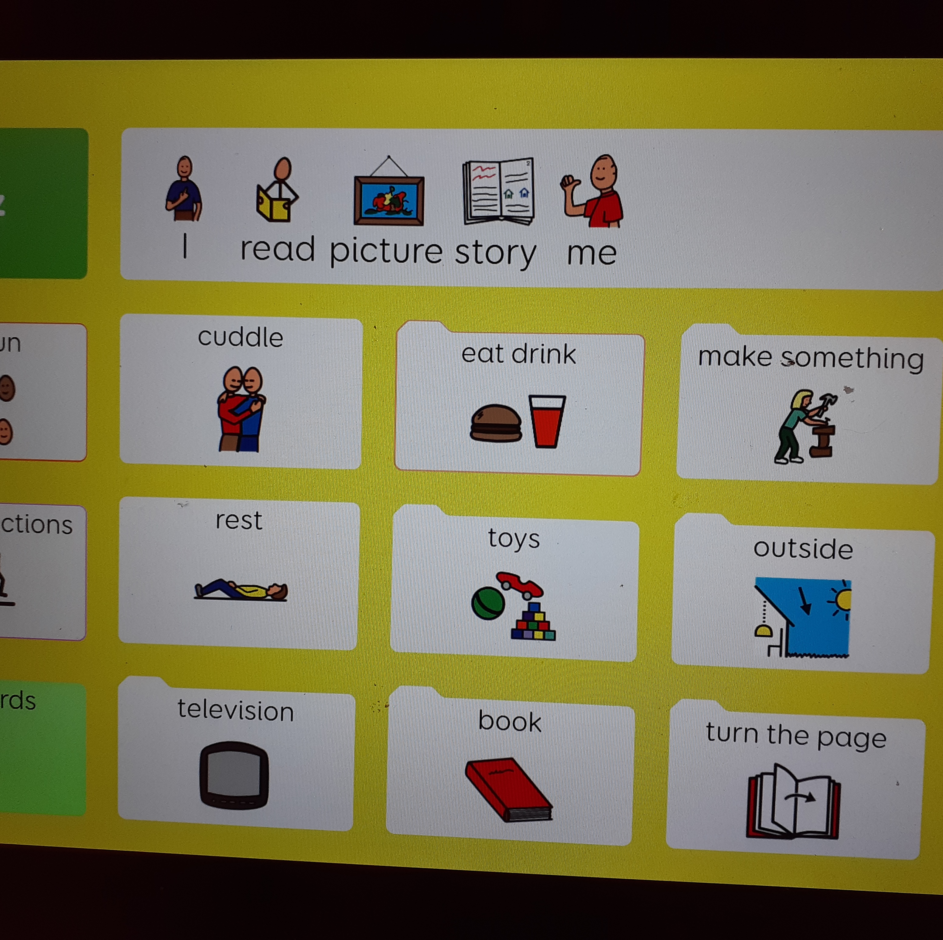
PODD communication
Why I started blogging

Slide 12
Why should we make mainstream books universally accessible on all AAC devices and with AAC features?

Slide 13
Three core reasons
Voice
Choice
Control

Slide 14
What is physical print disability?
"A beneficiary person is a person who:
is unable, through physical disability, to hold or manipulate a book or
to focus or move the eyes to the extent that would be normally acceptable for reading; regardless of any other disabilities."
Source: Amendment 3(c) - Marrakesh treaty

Slide 15
Physical print disability: barriers to universal access
Lack of awareness
Fund dependent
No standards or guidelines
DIY mindset; Tar Heel Reader, Flickr, PowerPoint, Pictello, Grid 3 template, etc.

Slide 16
AAC adapted book - read along & aloud type
Source: CandLE AAC

Slide 17
AAC adapted book - read along & aloud type
Source: CandLE AAC

Slide 18
This is why!

Slide 19
#canturnthepage campaign
People with communication disability and physical print disability;
do not currently have access to a variety of mainstream books on their AAC devices.
with the right AAC features, people with physical print disability, who are unable to hold or manipulate﻿ a book, #canturnthepage at their own pace and as independently as possible on their preferred devices

Slide 20
#canturnthepage campaign
The current definition of a "person with a disability" in the Copyright Act 1968 is unclear and does not specifically acknowledge physical print disability that renders a person unable to hold or manipulate a book.
To achieve this, an online petition was created to ask the House of Representatives to clarify the definition of a "person with a disability" in the Copyright Act 1968.

Slide 21
Contact details
Marie-Christine Lamy
Blogger - Disability Advocate
0422 860 370
readilyaaccessible@gmail.com

