Slide 1
Accessible libraries for people with print disabilities in Australia.
Dr. Jo Kaeding
University of South Australia
https://www.wipo.int/wipo_magazine/en/2018/01/article_0001.html
All images in this presentation are stock or public domain unless indicated otherwise.
Notes:
Hi, as you just heard, my name is Dr Jo Kaeding:
I am a lecturer and academic at UniSA teaching in the field of library and information management.
I have also worked in libraries for over 20 years and was one of the first children’s librarians to setup sensory story times for children in Australian public libraries.
My research and passion is in developing accessible and inclusive libraries – and I did my PhD on how to improve public library access for children with disability and their families.
Thank you for inviting me to talk today – I am very excited to share with you what is happening in libraries in the regard to access for people with disability.

Slide 2
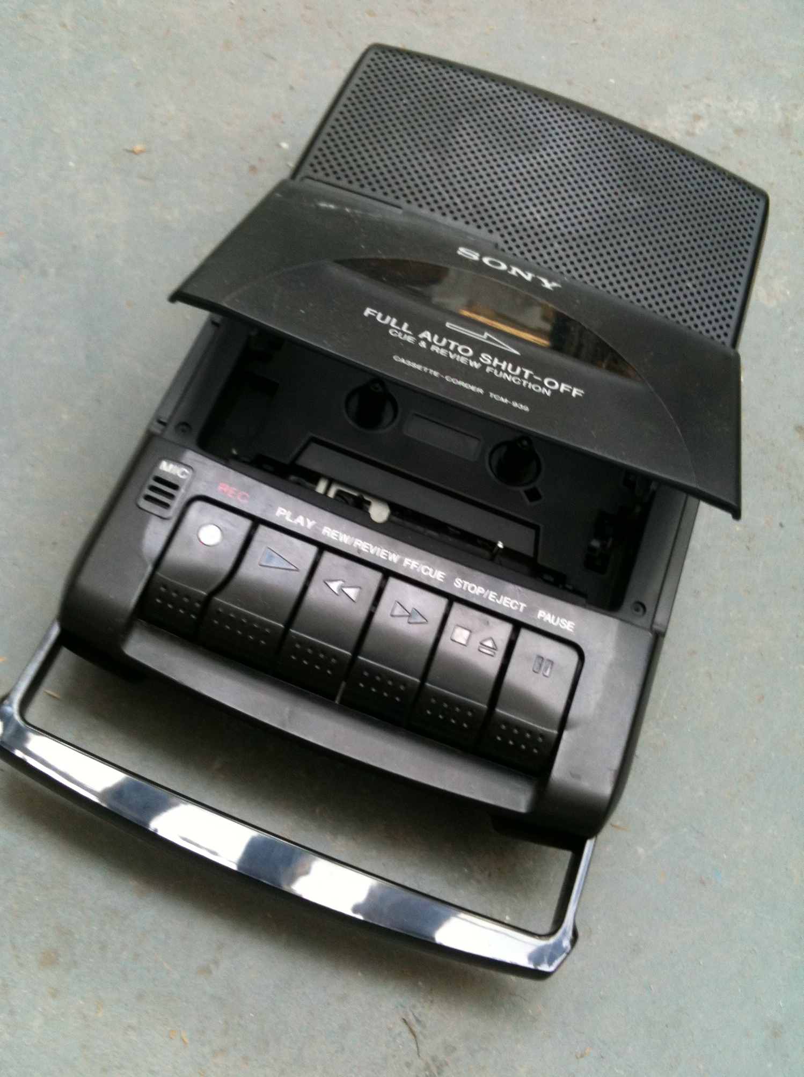
Core Values
Specific services and materials must be provided for those users who cannot, for whatever reason, use the regular services and materials, for example … people with disabilities...
(International Federation of Library Associations, 2022, p1-2)
Notes:
Accessibility is a core value of public libraries.
In 2022 the International Federation of Libraries and UNESCO published the international library manifesto. This document states that:
Specific services and materials must be provided for those users who cannot, for whatever reason, use the regular services and materials, for example … people with disabilities...
(IFLA-UNESCO Public Library Manifesto, 2022, p1-2)
However, public libraries have had a long history of providing access to resources for people with disability (H. Hill, 2013; Jaeger, et al., 2015a).
Initially, this was through partnerships with specialised library services, for example public libraries providing access to audio newspapers on tape. Some of you may remember using old cassette players like that on the slide to listen to these tapes in the library.
In Australia, state libraries had an ad hoc partnership with the Royal Society for the Blind Library, primarily supporting the distribution of resources throughout Australia. This partnership was gradually formalised by the National Library of Australia, which eventually lead to the development of the Round Table (Murray & Wallis, 1996).

Slide 3
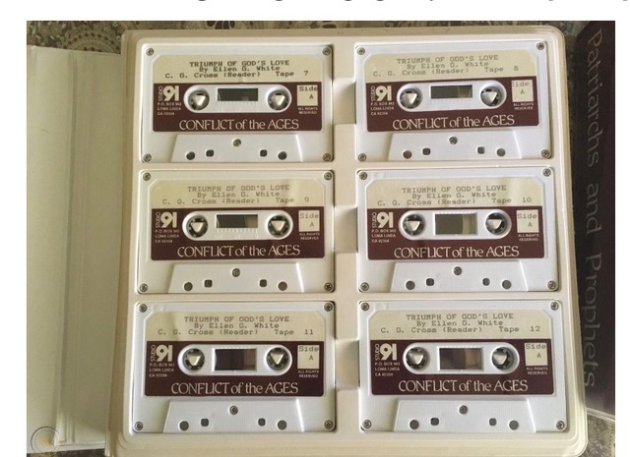
Technology
Notes:
The biggest developments in public library access started in the 1970s with the growth of audio books.
Public libraries began to setup their own audio book collections for people with disability. (Murray & Wallis, 1996).
Who remembers the big cassette cases like the one on the slide. These were used to store all of the of audio book cassettes just for one book. The cassette case on the slide has 6 cassettes, but some had even more.
Since these developments in the 1970s:
people with disability have moved out of institutionalised care into the community AND
technology and the internet have become part of our everyday lives
This has only further cemented the need for public libraries to be accessible and inclusive for all members of their communities.

Slide 4
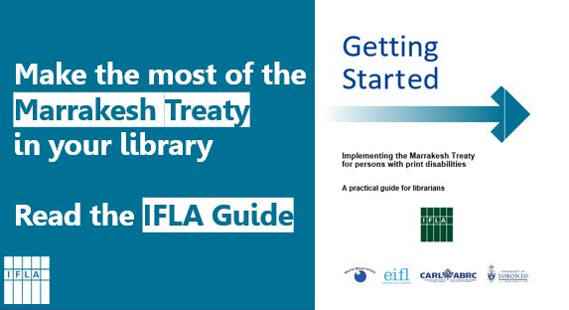
Treaties and Guidelines
Libraries are central to the success of this ground-breaking Treaty, and librarians have a key role in its implementation.
(Hackett, 2018, p.5).
Notes:
In Australia there have been two very important documents in the last 20 years that have addressed libraries and accessibility.
These documents are:
the Marrakesh Treaty AND
the Policy and guideline documents produced by the professional body for Australian libraries & information associations (also known as ALIA)
Most of you would be familiar the Marrakesh Treaty.
This Treaty has significant implications on Australian copyright laws and libraries; including that it now possible for all 1500 public libraries in Australia to provide copies of resources in accessible formats to people with disability.
The following quote from the International Federation of Libraries states the importance of the Treaty for libraries:
Libraries are central to the success of this ground-breaking Treaty, and librarians have a key role in its implementation.
The policy documents written by library professional body ALIA acknowledge the legal right of people with a disability to equitable access and inclusion in all library and information services.
And the guidelines supporting the policy exist:
… to provide all libraries, regardless of type, size or resourcing, with minimum standards for the provision of accessible and inclusive services for people with disabilities
Let’s now have a look at how these guidelines.
What sorts of accessible services and resources can a person with print disability expect from a public library?

Slide 5
Disability Access and Inclusion Plan (DAIP)
Notes:
To start with it is recommended that all libraries have have a Disability Access & Inclusion Plan (DAIP) and that there should be opportunities for the community to have a say in the plan. On the slide is an example advertisement from the Moreton Bay Council asking the community to comment on their draft DAIP.
Why is it important for all public libraries to have a DAIP?
Because:
These plans clearly document how the library will provide access.
and crtically they are documents that public libraries can be held accountable for.
SO, ask your library to see their DAIP – this might be a Council DAIP, but it should cover the library.
Consider what is currently in the plan and what should be included in the plan that would improve access for people with print disability?
Every DAIP should have have a date range - this is your opportunity to get changes made - put it in writing.

Slide 6
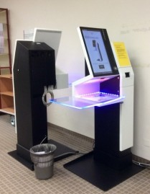
Physical Environment
Notes:
Although urban planners, builders and architects should be aware of building and accessibility standards – they do not always understand libraries or how the community access libraries. – I am sure many of you have great examples of this.
I once worked at a library where the initial planning designs included a large permanent teepee in the middle of the children’s space.
Although gorgeous it significantly impacted access to the children's area – including even for prams.
A library manager at another library told me how they had a ramp installed to provide access to the second level of the library. Unfortunately, mid way up the ramp there was a very tight turn, which could not be navigated by people using mobility scooters.
In my research I have spoken to a number of families who do not visit their local library because of the difficulty they have in accessing the building. However, they have a right to access the library.
Some of the things that the library guidelines recommend for libraries are:
well lit and non-slip paths to the library
maintained footpaths, with minimal gradient
convenient pedestrian crossings if visitors need to cross the road
Lifts with braille and synthetic speech
And information on how to ’Plan your visit’ including maps with accessible routes and facilities.
Once inside; the library should have:
Lighting which can be dimmed, and/or natural lighting
Comfortable seating areas with bright reading light
Safety markings on glass doors
Low patterned flooring, with any changes in flooring clearly marked
stairs marked with contrasting colours
signage which is high-contrast, large print, with braille and pictograms.
adjustable desks
Speech enabled Library checkout machines
private or quiet study spaces
If your library doesn’t have these, consider asking for them to go in the DAIP.

Slide 7
Collection Development
https://www.behance.net/gallery/30101433/Tactile-Picture-Book-for-Blind-Children
Notes:
In an ideal world, all library materials should be accessible for all people.
However, currently only 5-7% of the material published worldwide is fully accessible for people with print disability.
So, there is a critical need for libraries to invest in developing accessible collections.
Just as importantly, the Marrakesh Treaty states that if the library does not have the format requested by a patron with print disabilities, library staff should know how to borrow such materials from other libraries.
Some of the collection formats that it is recommended libraries have include:
talking books
Talking newspapers
video/DVD books with subtitles and/or sign language
Braille books
accessible e-books and e-audio – that are compatible with screen readers
easy-to-read books or other non-print materials – often referred to as HiLo collections
Dyslexia friendly books
Books written in plain English
Tactile picture books (like the one on the slide which has circle of fluffy fabric).

Slide 8
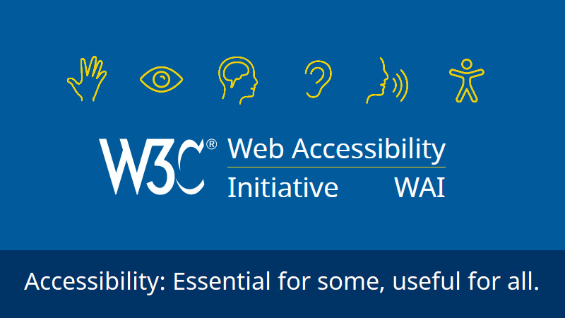
Communication
Notes:
One of the main ways libraries communicate with their borrowers is through their websites.
However, if the website is not accessible then, like the image of the small boy on the slide, the library might as well stand out on an empty road in the middle of nowhere, and use a old fashioned megaphone to talk their borrowers and hope someone can hear them.
All library websites should meet the W3C accessibility standards developed by the Web Accessibility Initiative. On the slide there is a promotional image for the W3C
Using these standards the library website should:
be readable by screen readers
Have alt text
use plain English
Have a simple design with plenty of white space
use high contrast text, with large readable font size
list the accessibility services that are available in the library and at all the events and programs
give the libraries Busy and quiet times.
Include information about the library outreach services
Give details of how to get assistance
Unfortunately, recent research has found that not all library websites in Australia do this.

Slide 9
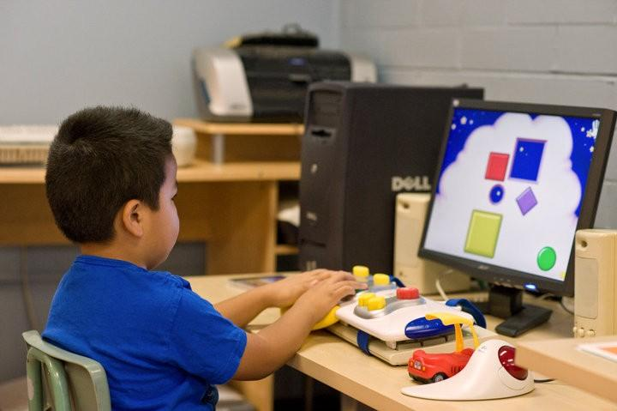
Assistive technologies and computers
Notes:
The rate of development with technologies is hard to keep up with – and this is even more reason for public libraries to provide access.
Public libraries have a role in providing access to technology that people might like to trial before they buy – this includes communication software like storyboard.
The image on the slide is an example of a young child using a range of gaming computer input devices, including large toggle buttons and switches. Libraries can provide access to these kinds of technologies.
The ALIA guidelines also recommend that libraries not only provide assistive technologies for use in the library, but that one or more library staff also know how to use the technology. Because there is no much point in having a technology that know one knows how to setup or access.
Some of the technologies recommended for public library include:
Ipads with communication software
Large keyboards and other computer input devices
Illuminated magnifiers
Computers with screen adapters and software designed for persons with reading and cognitive disabilities
Computers equipped with screen reading programs, enlargement, and synthetic speech
Computers equipped with spelling, and other instructional software suitable for persons with dyslexia
CD player to complement the audio visual collection
Once again if your library does not provide these technologies, this is where a DAIP can be useful.

Slide 10
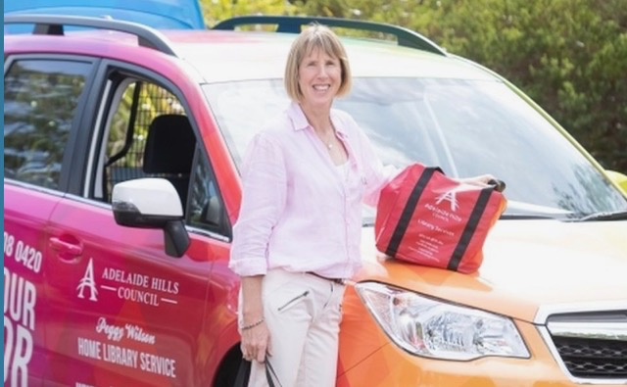
Services
Notes:
People with all disabilities including print disability should feel welcome in the library – this can be achieved by having disability aware staff and by providing a range of services that meet the needs of people with print disability.
Some of the common services that public libraries provide include:
Home delivery service for persons who are not able to come to the library
Outreach services to persons in institutions and care facilities
Some libraries also provide:
Reading service for patrons with reading difficulties (e.g., short texts, letters, instructions, articles on tape or CD) or scanning texts to make them accessible on a computer with screen reader
Regularly scheduled consultations for persons with reading disabilities
Also, all events, presentations and programs should also be accessible. This would include:
Large presentation screens – which also provide vision of the presenter
Good microphone and audio equipment
speakers should be visible, audible, clearly spoken and (where possible) use plain English?

Slide 11
Accessible and Inclusive Libraries of the Future
Notes:
So, what will accessible and inclusive libraires of the future look like?
Knowledge and awareness of providing accessible library services to people with disability is growing rapidly – what was once considered an area for special libraires is now something that all libraries in Australia are involved in.
As suggested by the image on the screen of a computer wearing glasses and reading a book technology will be involved.
However, technology and AI is developing so quickly that it is hard to know what libraries will be like in 2, 5 or 10 years.
But we do know that the through the European Accessibility Law ‘born accessible’ publications will be part of this future.
The exact role of libraries in this space is unclear, however, library policies, guidelines and DAIPs have are critical to helping public libraries navigate this changing landscape.
‘Born accessible’ publications and public libraries is something that I am researching with Agata Mrva-Montoya from University of Sydney – so as they say ‘stay tuned’.

Slide 12
References
Australian Government. Federal Register of Legislation. (2016). Disability Discrimination Act 1992. https://www.legislation.gov.au/Details/C2016C00763
Australian Library and Information Association. (2018). Library and information services for people with a disability. https://read.alia.org.au/library-and-information-services-people-disability

Slide 13
References
Australian Library and Information Association. (2019). Guidelines on library and information services for people with disabilities. https://read.alia.org.au/guidelines-library-and-information-services-people-disabilities
Hackett, T. (2018). Preface. In J. Coates et al. Getting started: Implementing the Marrakesh Treaty for persons with print disabilities - A practical guide for librarians, (p.5). IFLA. https://repository.ifla.org/handle/123456789/443
Notes:
2406hash

Slide 14
References
Hill, H. (2013). Disability and accessibility in the library and information science literature: A content analysis. Library & Information Science Research, 35 (2), 137–142. DOI:10.1016/j.lisr.2012.11.002
International Federation of Library Associations and Institutions (IFLA) (2022). IFLA-UNESCO Public library manifesto 2022. https://repository.ifla.org/handle/123456789/2006

Slide 15
References
Irvall, B. & Nielsen, G. (2005). Access to libraries for persons with disabilities: Checklist. International Federation of Library Associations and Institutions.
Murray, J. & Wallis, L. (1996). Library services to Australians with disabilities. Health Libraries Review, 13, 81-89.
Wentz, B., Jaeger, P. T., & Bertot, J. C. (Eds.) (2015). Accessibility for persons with disabilities and the inclusive future of libraries, Advances in Librarianship, 40.

Slide 16
References
World Wide Web Consortium. (2019). Standards. https://www.w3.org/standards/

Slide 17
Contact Details
Dr Jo Kaeding (she/her)
Course Coordinator - Information Management
UniSA STEM | F2-60, Mawson Lakes Campus SA 5095
University of South Australia
Email: jo.kaeding@unisa.edu.au

