Slide 1
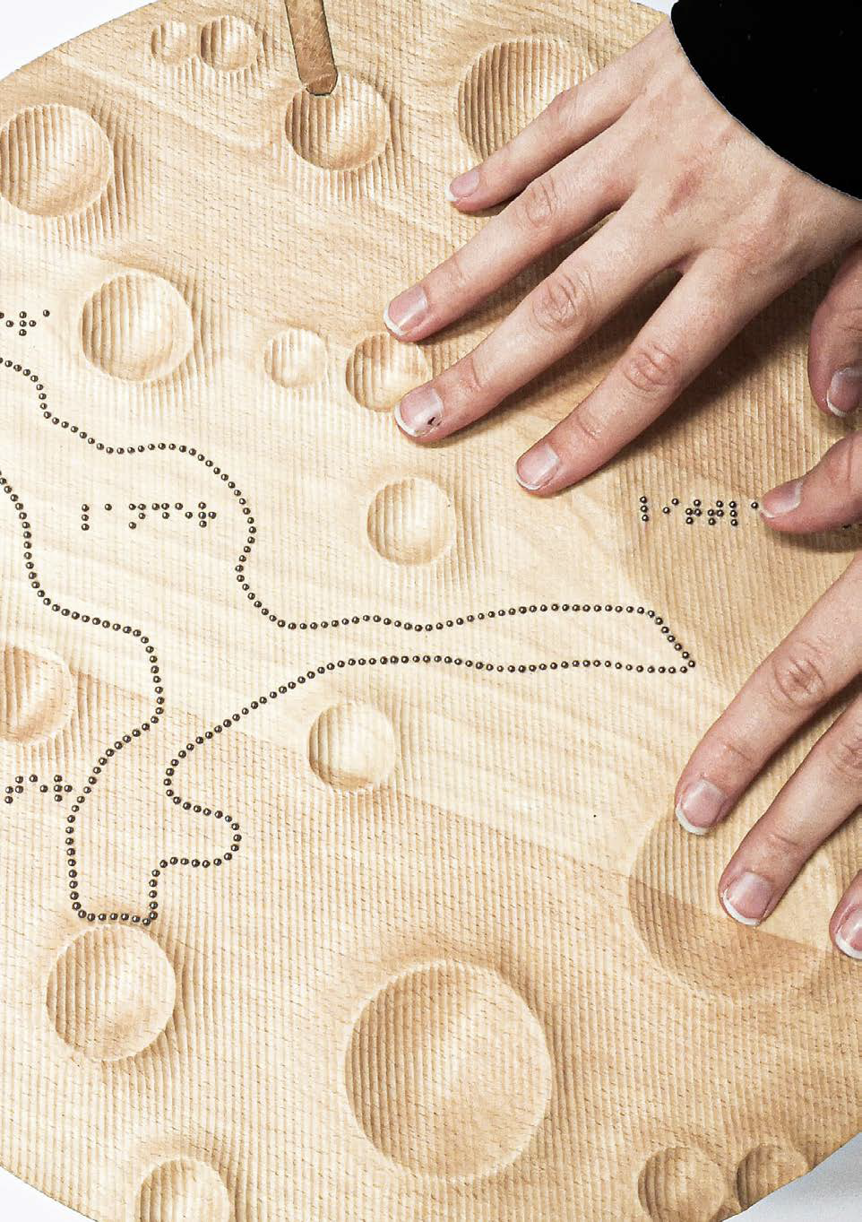
MUSEUM FOR TOUCH
Understanding Museum Exhibits through Touch
– Towards Object Based Learning and Universal Access
for Blind and Low Vision Children and Adults
RT ROUNDTABLE PRESENTATION/WORKSHOP
MAY 7, 2023
Dagmar Reinhardt and Leona Holloway

Slide 2
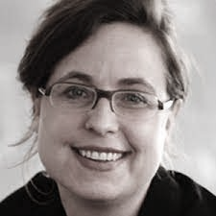
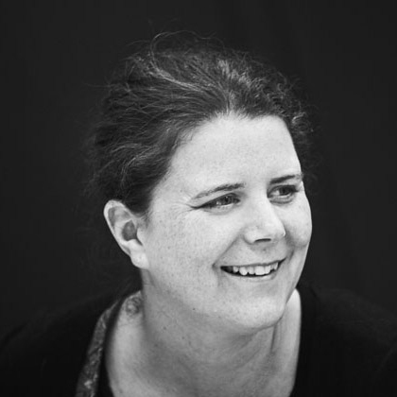
Dagmar Reinhardt Leona Holloway Eve Guerry Jane Thogersen
and
Birgit Christensen, Sonali Marathe
Dane Jensen (RA)
The team:
The University of Sydney and Monash University
Nextsense and IBOS (Institute for Blind and Partially Sighted, Denmark
CCWM Chak Wing Museum, Sydney and Natural History Museum, Copenhagen
The grant: 2023 ASF Alastair Swayn Foundation Grant

Slide 3
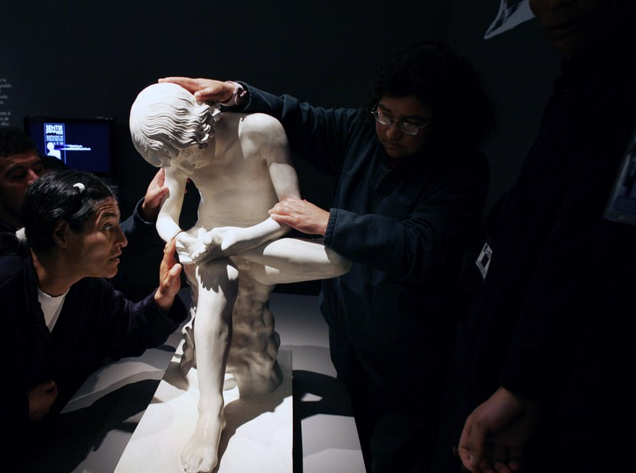
Description
Museums collect artworks, artefacts and specimens that are safeguarded behind barriers.
These exhibits cannot be touched and are consequently inaccessible (not existing) to blind and low vision children and adults.
We propose design and evaluation of touch models that enable everyone to engage in the cultural narratives and knowledge that these objects represent.
A museum where you learn by touch means engaging all senses – offering a larger experience to everyone.

Slide 4
There exist some initiatives in museums to reproduce collection pieces for touch for blind and partly sighted audiences, but these are few. There are
no methods for giving blind people access to Natural History museum collections;
no comprehensive collection that compares touch access;
no design framework for how to make objects, artefacts and specimens accessible in meaningful ways for Blind and Low Vision audiences;
no comprehensive research or documentation as to how touch representations can be best exhibited and interacted with in museums.
Museums (often) don’t know how to best enable access to their collections and exhibitions for Blind and Low vision people.
Notes:
Strategies in museums around the world are to date limited to
letting blind or low vision people touch sculptures (Museo Ufficio, Italy, Louvre, France); or providing samples of
exerts such as coins as a 2:1 scaled replica (Historical Museum Frankfurt, Germany); or reproducing simplified
reliefs of paintings (Bendigo Gallery, Australia); or a cauldron space (Moesgaard Museum, Denmark).

Slide 5
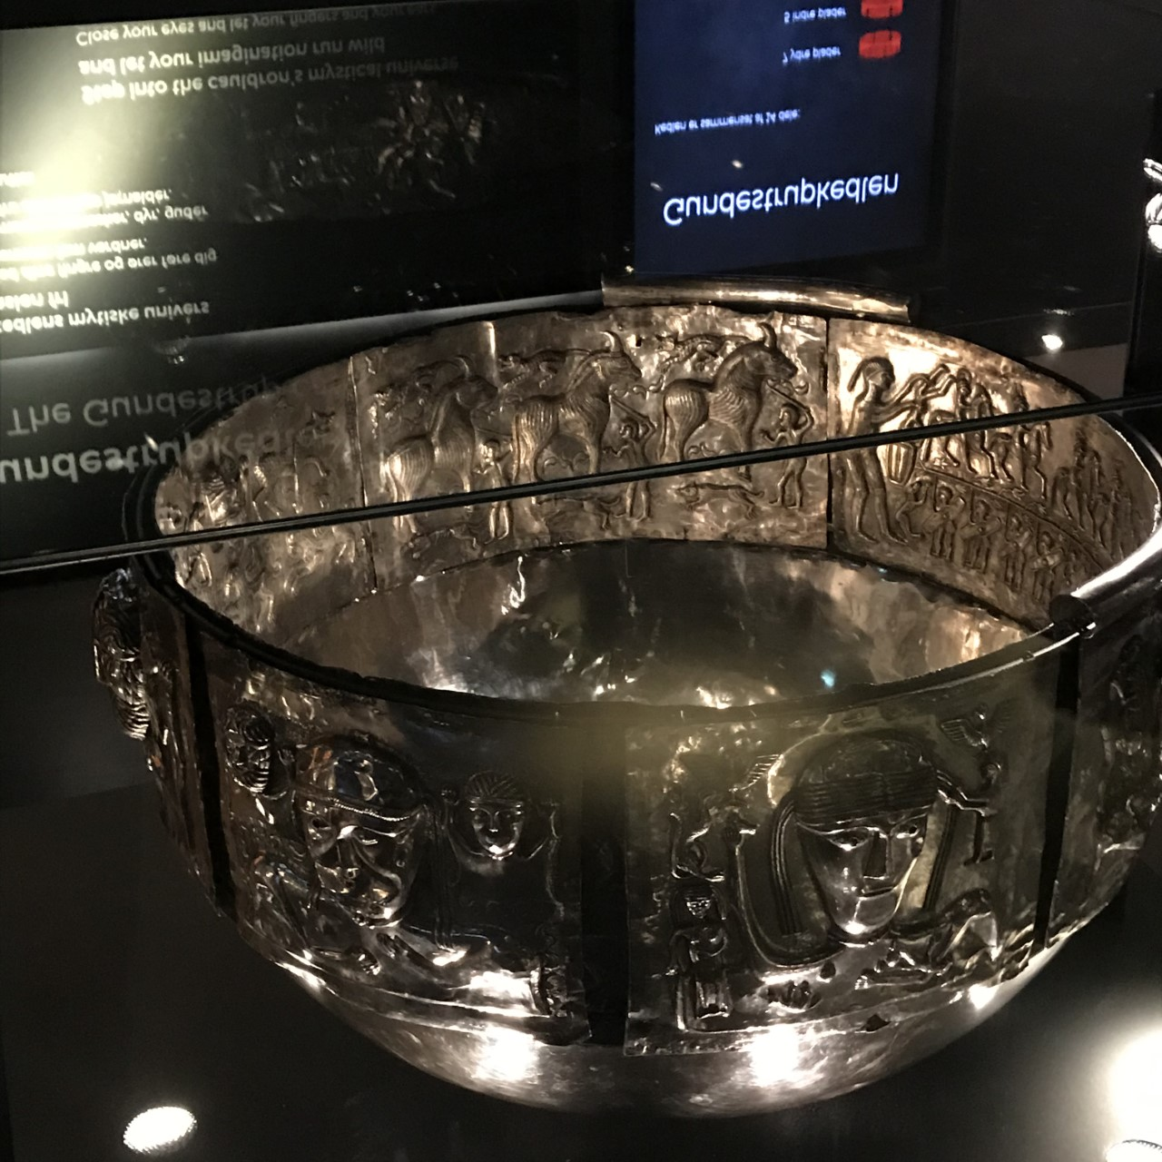
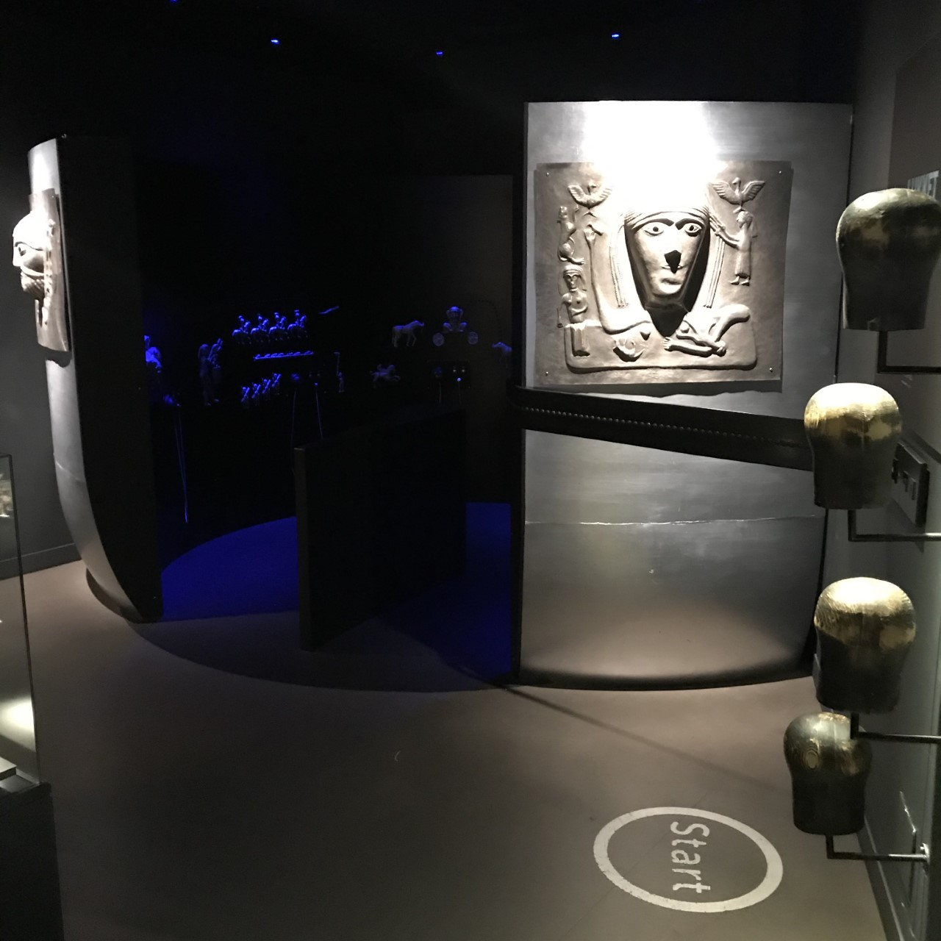
Good examples include the Cauldron that becomes a space at Moesgaard Museum, Denmark

Slide 6
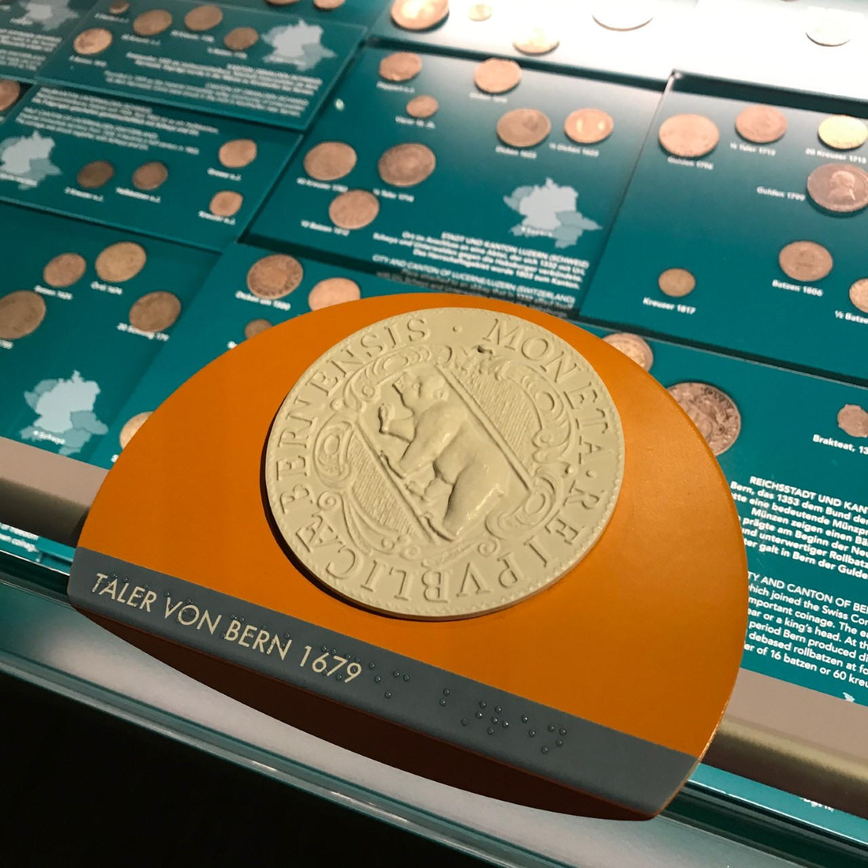
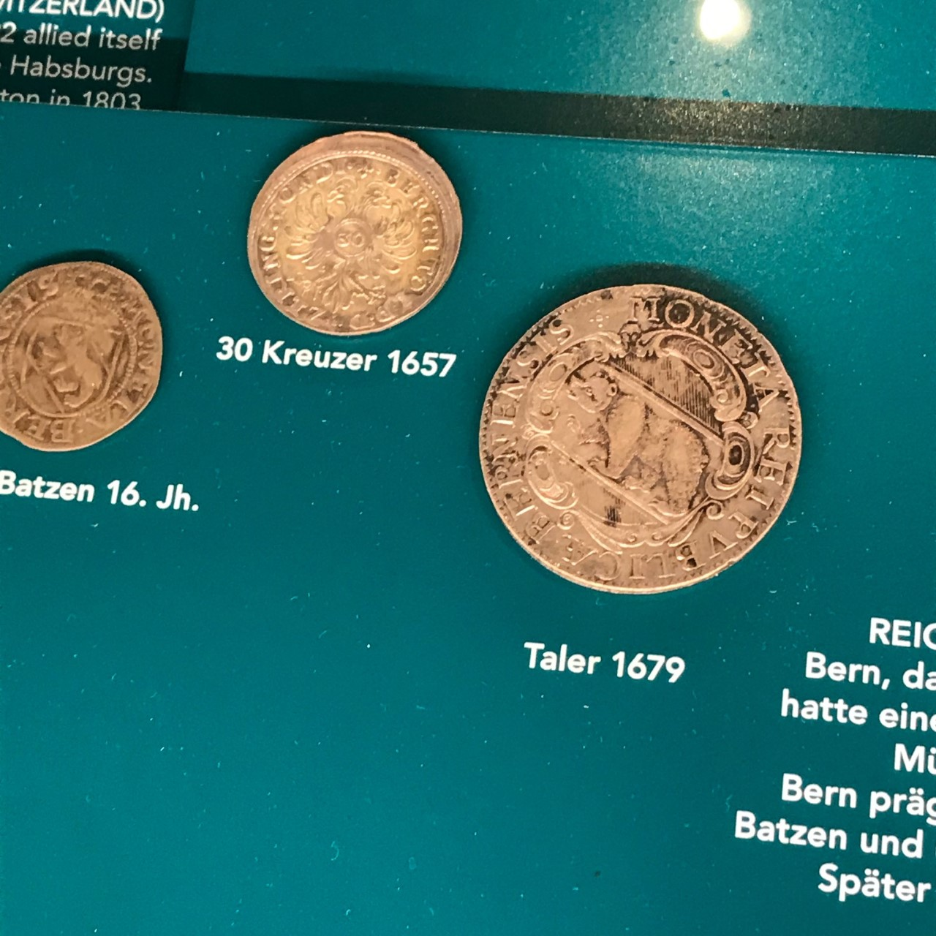
An example is the enlarged 3D printed coin at Frankfurt Historical Museum, Frankfurt am Main, Germany.
Frankfurt Historical Museum

Slide 7
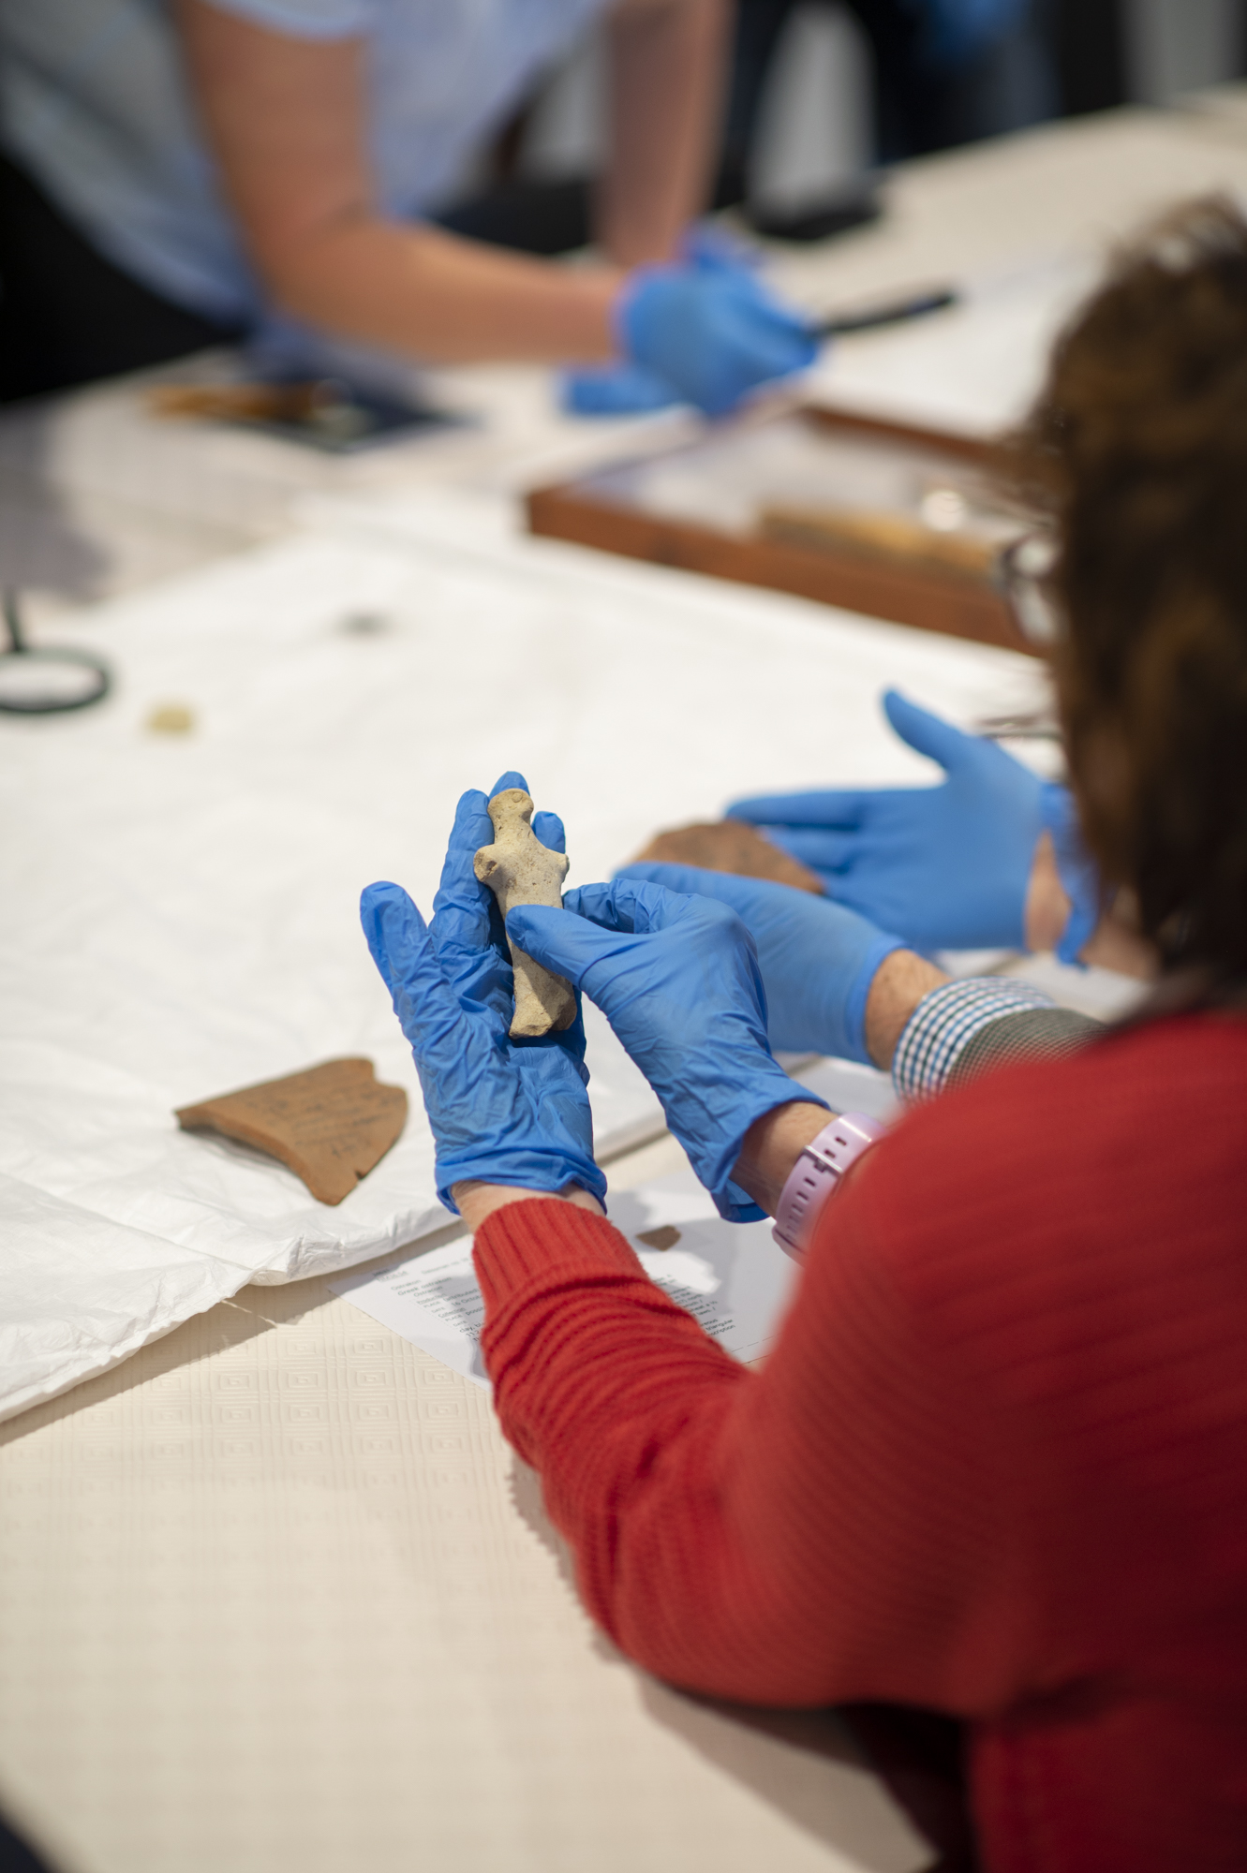
CCONTEXT: CWM/Sydney
We are collaborating with the Chau Chak Wing Museum, The University of Sydney.
Collections include natural history, art, science, history and ancient cultures.
OBL Object Based Learning Program
2D and 3D Digital Repository
4/15

Slide 8
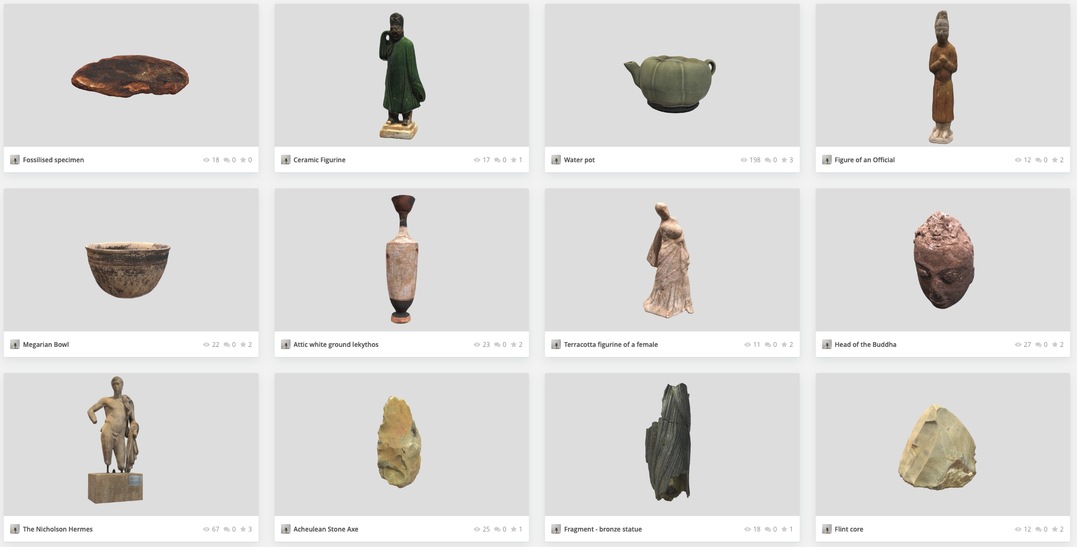
CCONTEXT: CWM/Sydney
The 2D and 3D Digital Repository collects items of the exhibitions and makes them accessible for download/showing:
https://sketchfab.com/CCWM/models
4/15

Slide 9
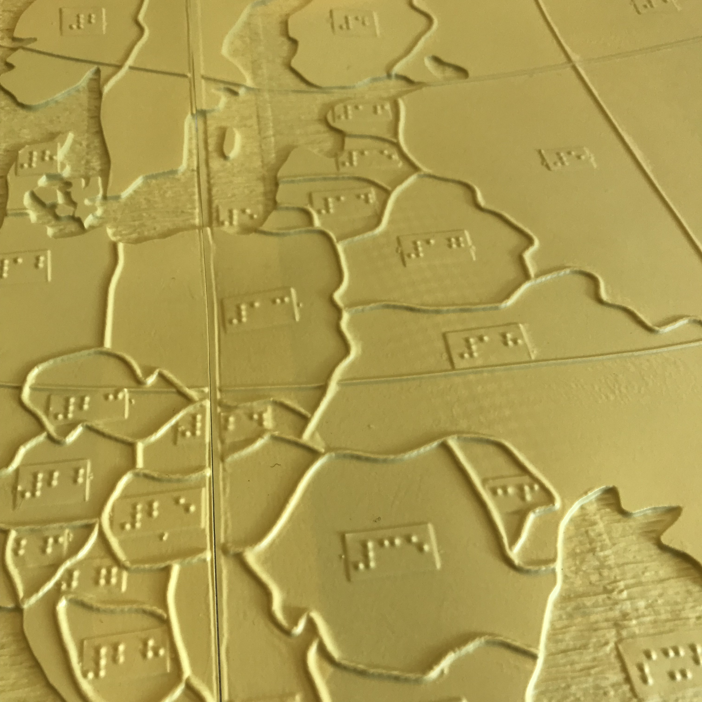
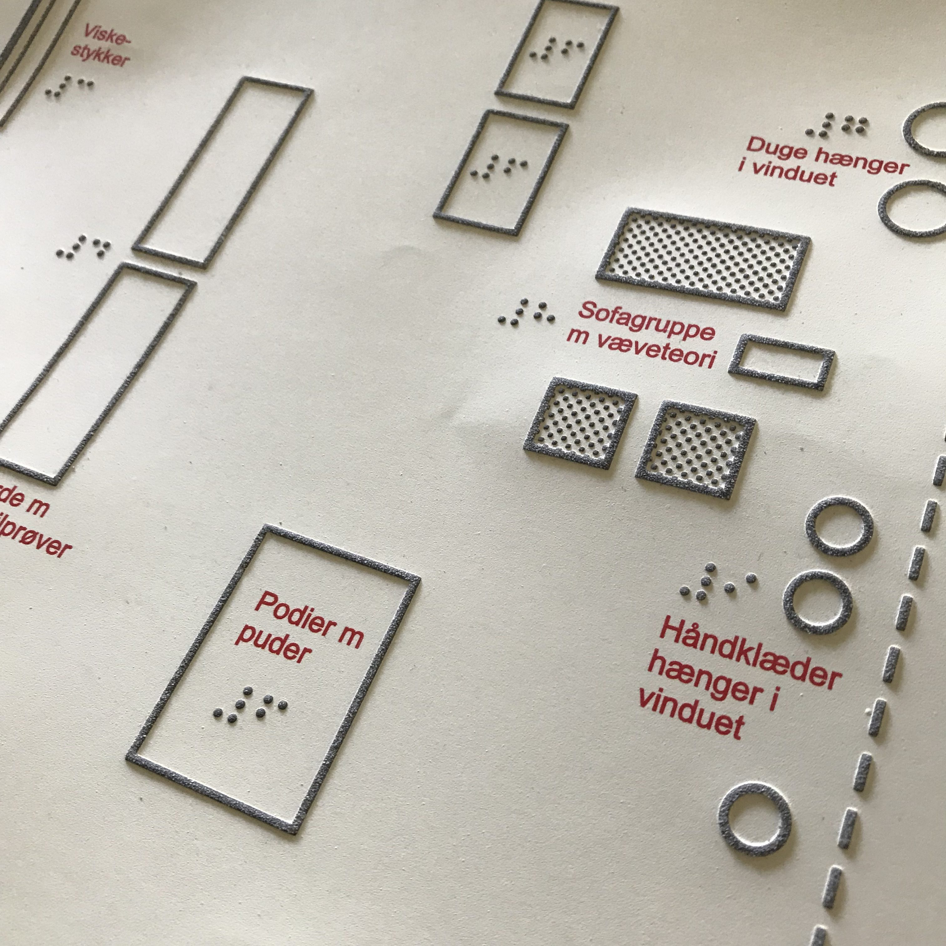
We aim to move beyond Swell paper and Thermoforming to develop 3D physical representations of museum objects.
Notes:
Swell paper:
Lines, dots and surfaces are used to create relief images, either by drawing straight into the swell paper or by transferring a drawing to it.
Swell paper is ordinary paper coated with a thermosensitive emulsion.
By using a carbon-based pen or copying a picture in an ordinary copying machine onto swell paper and then exposing the swell paper with the image to infrared heat, you obtain a relief. The swell paper image is the commonest type of relief image occurring today, and these pictures are technically simple to produce
Thermoform: is a technique of moulding plastic in a matrix, using a vacuum press at high temperature.
matrix design that decides the appearance and quality of the finished relief image. The grain of plastic chosen can affect the readability of the finished image.
A thermoform image can have several different levels of relief, and in this way one object on the surface of the image can be distinguished from another, not only by its shape and extent but also by differences in height. Most thermoform images are monochrome, but there are also images of this kind printed in polychrome, with colours matching the different textures and lines of the picture surface.

Slide 10
SCAN AND 3D PRINT
We will scan existing museum objects, clean the data, remodel and scale them for touch access by a human
hand. We will then print data locally in various materials (and add other fabrication techniques such as lasercutting and CNC (wood, metal); and share with partner where objects can also be printed and tested.
• Develop best practice for scanning and modelling techniques for model production (Einscan and photogrammetry);
• workflow that is shared, tested and evaluated in parallel; made available to pedagogy and
institutions and community

Slide 11
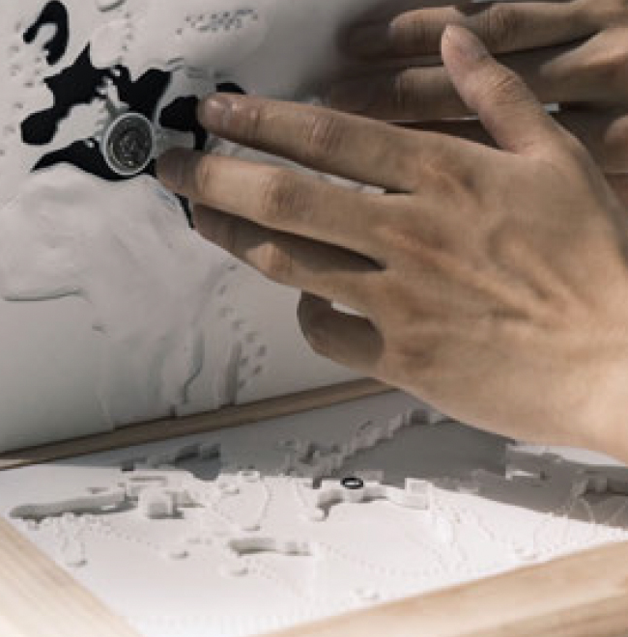
We will develop together between the museums and BLV partners an in-depth survey that enquires what blind and partially sighted people want to experience in a museum, and what they will enjoy touching. We will visit and document what design practice exists and comprehensively collate this.
• Working with people directly and carefully tease out their experiences and desires for a touch access
museum
• Discussing and preparing curators specific items within museum collections that are fit for scale
(butterfly, diatom, whale bones, moon surface, etc)
• Include spatial setups of the local museums (ie orientation map that support mobility inside museum)
XINYI CHENG, KANGCHENG ZHENG
THE WHALE AND THE ROMAN

Slide 12
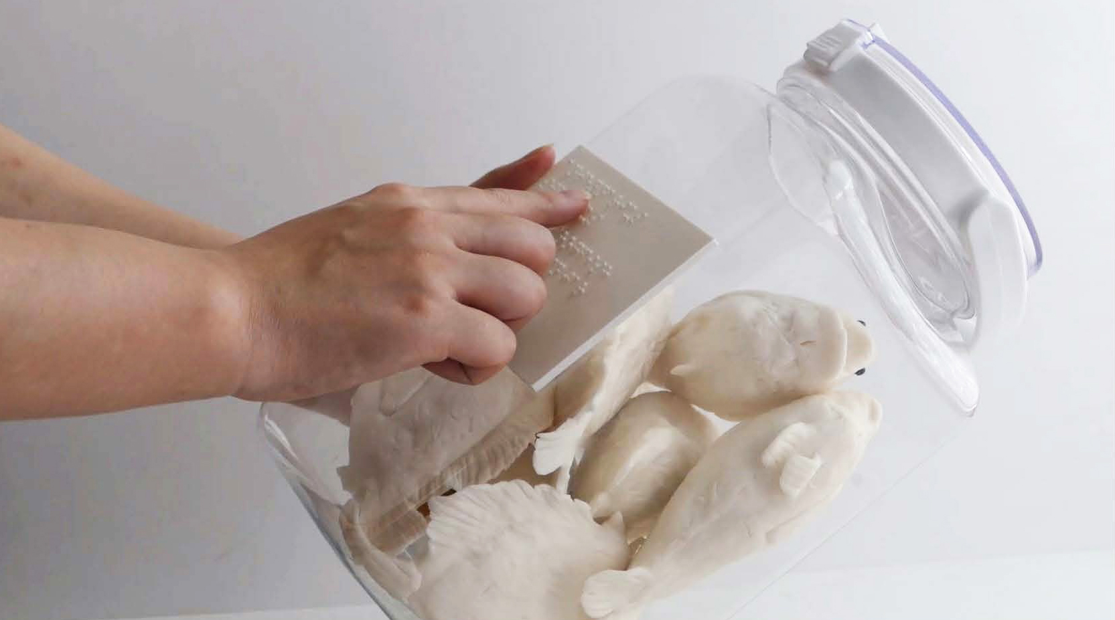
Wet Specimen Example
Nature collections often feature exhibits that cannot be touched, such as specimen in a jar.
We have tested how we can translate this into a physical object.

Slide 13
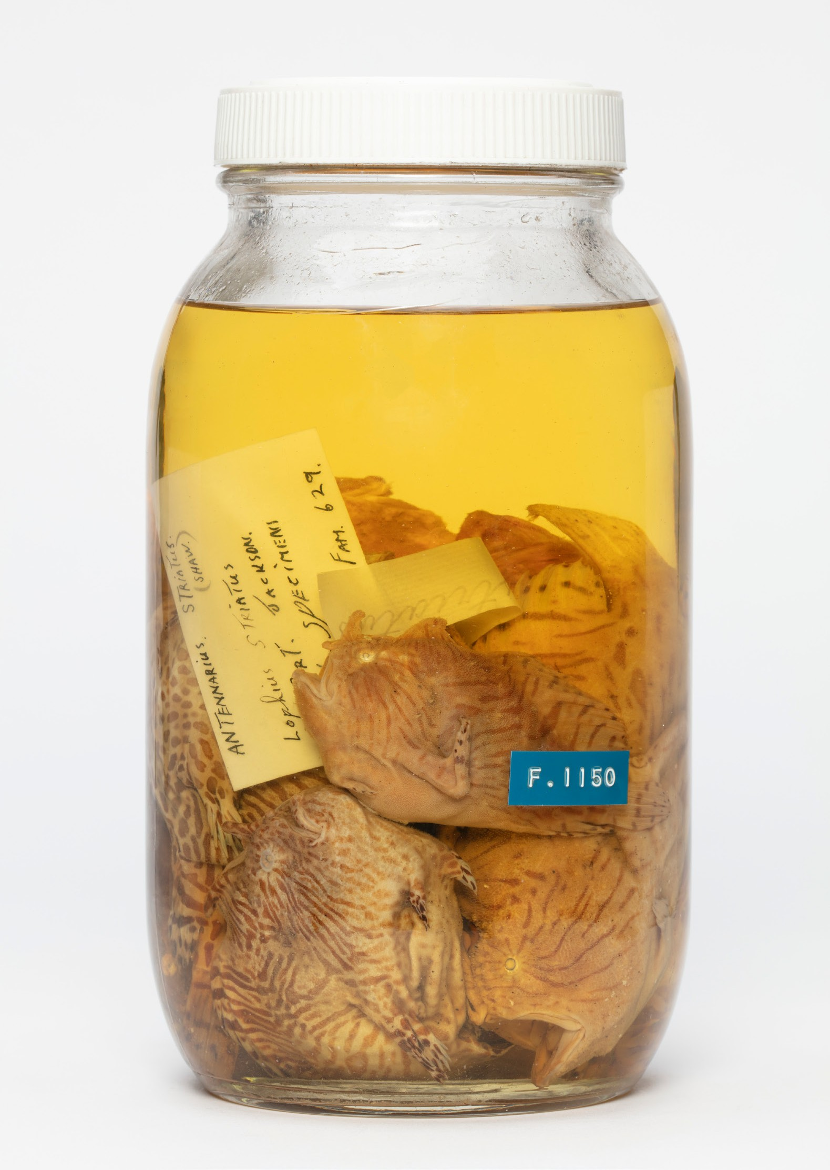
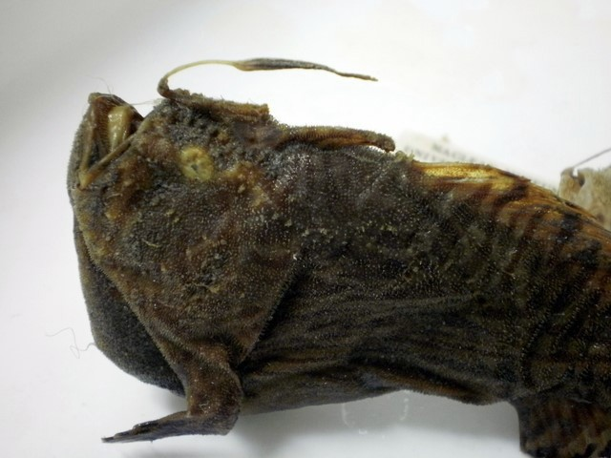
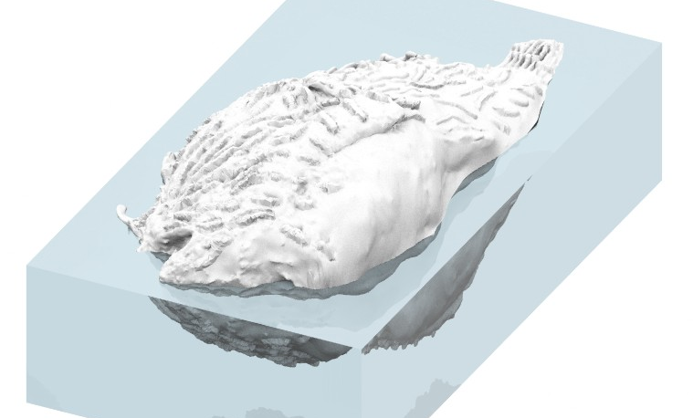
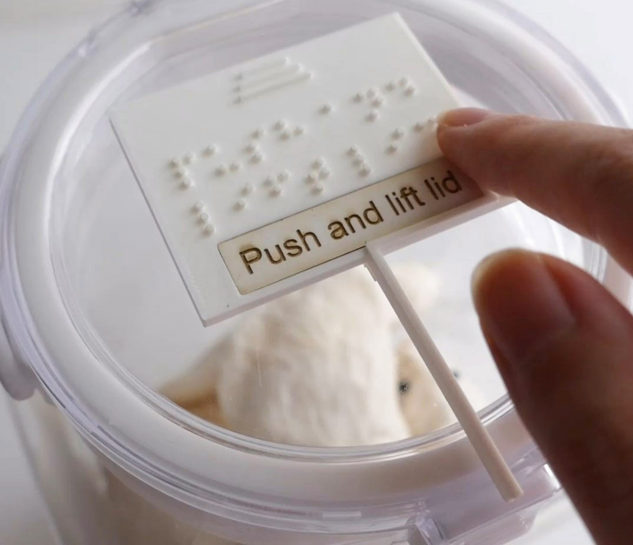
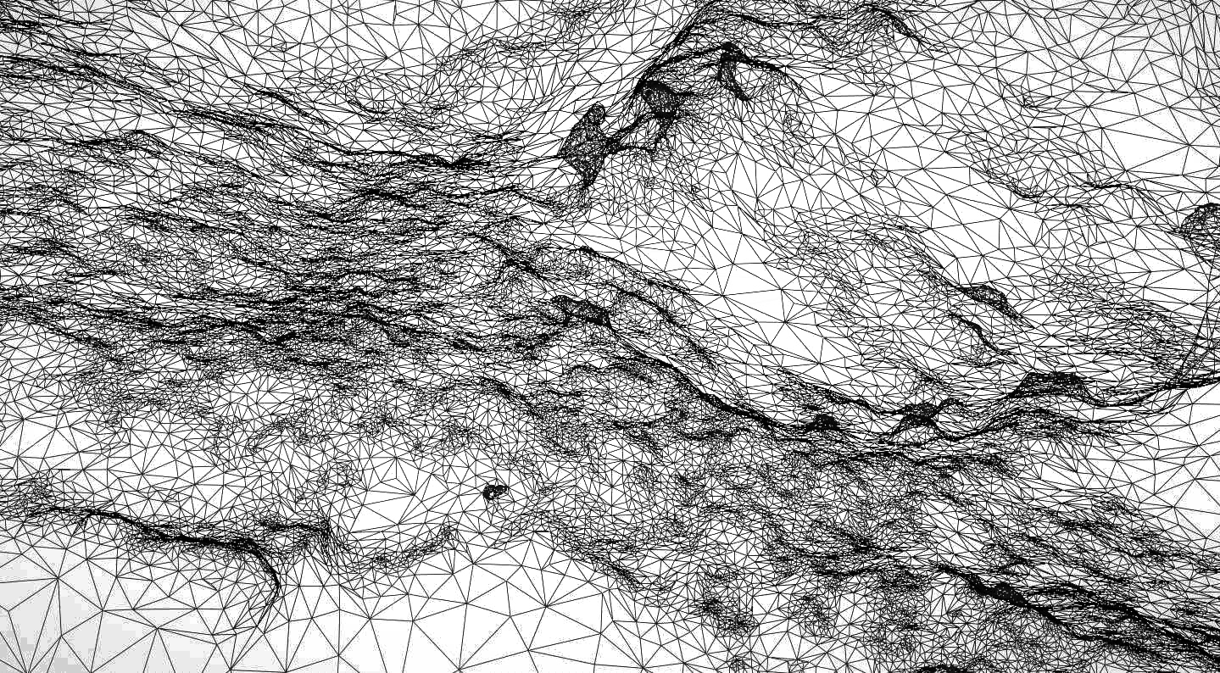
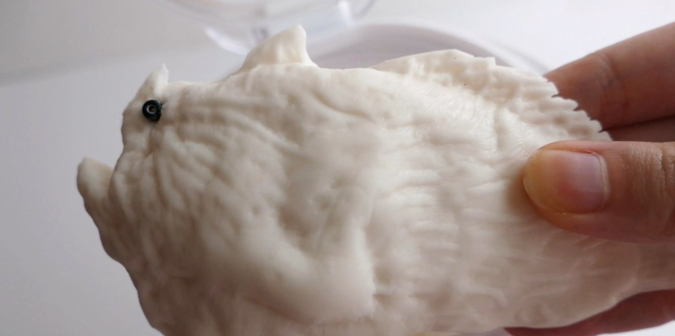
TOUCH EXAMPLES
Enclosed specimen that can be ‘unbottled’ : scanned, modelled, printed mould, multiplied.
Touchable with instructions.
+Fossils;
Amber enclosures.
Jar of Frogfish, NHF.1150
10/15

Slide 14
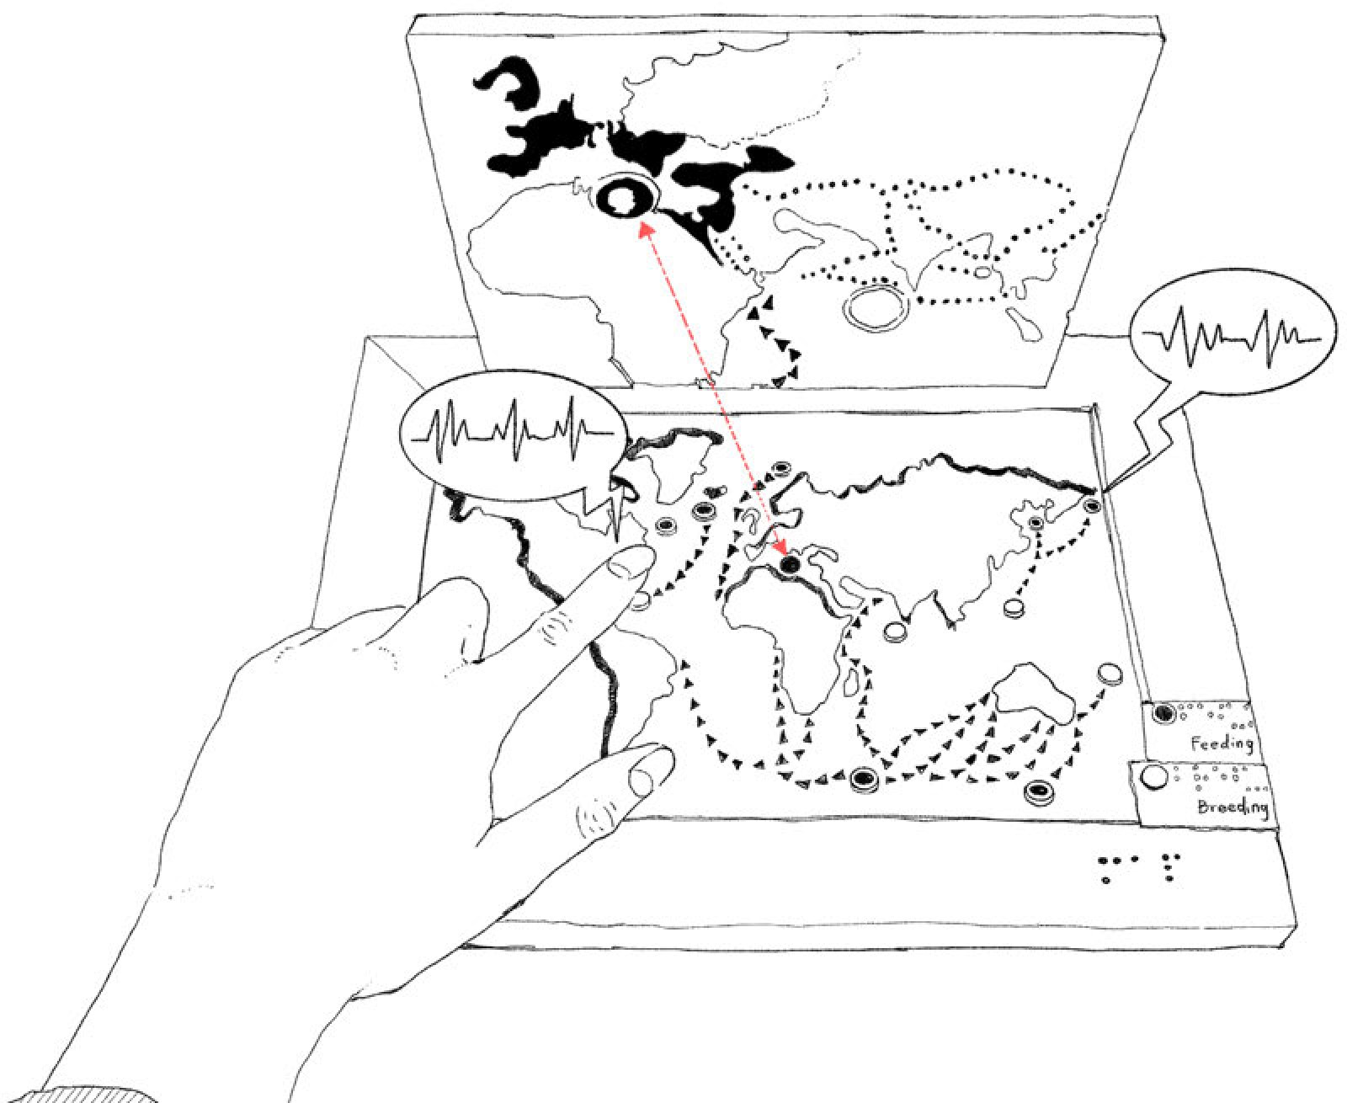
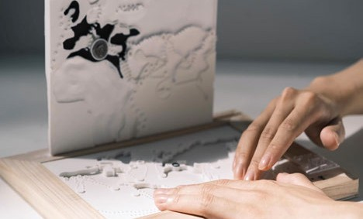

Slide 15
We aim to
Study
o run an initial survey asking BLV audiences for their experiences, and what museum with
objects they want;
o collate current practice examples across selected other museums;
o scan and print prototypes across several comparable collections in Australia and Denmark;
Test
o test objects with BLV audiences and listen and change according to their feedback;
o trial, evaluate and report back on how to exhibit touch access objects in a museum context;
o compare with other museum to identify best practice

Slide 16
We aim to
Share
o produce a user manual on methods and technologies that could be adopted by others;
o produce a guideline of best practice with visual examples/process description.
Show
o produce a report at closure of the project;
o write paper dissemination through journals and conferences;
o exhibit in small show.
System
o create a share website as open platform, where object representations can be downloaded as 3D files that can be printed on any makerbot (3D printer) around the world, thus making these
accessible through educational institutions including also schools and libraries; and
o a book publication.

Slide 17
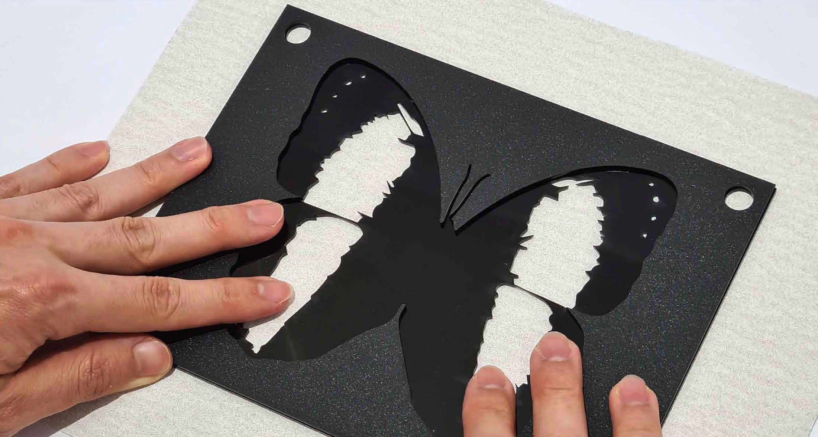
MUSEUM FOR TOUCH
Understanding Museum Exhibits through Touch
– Towards Object Based Learning and Universal Access
for Blind and Low Vision Children and Adults
Please contact us:
Dagmar Reinhardt, dagmar.reinhardt@sydney.edu.au
and Leona Holloway, leona.holloway@monash.edu

