Slide 1
(Accessibly) Mapping Werribee Mansion and Gardens
Leona Holloway, Monash University
Dr Dagmar Reinhardt, University of Sydney
Robyn Dean, Parks Victoria

Slide 2
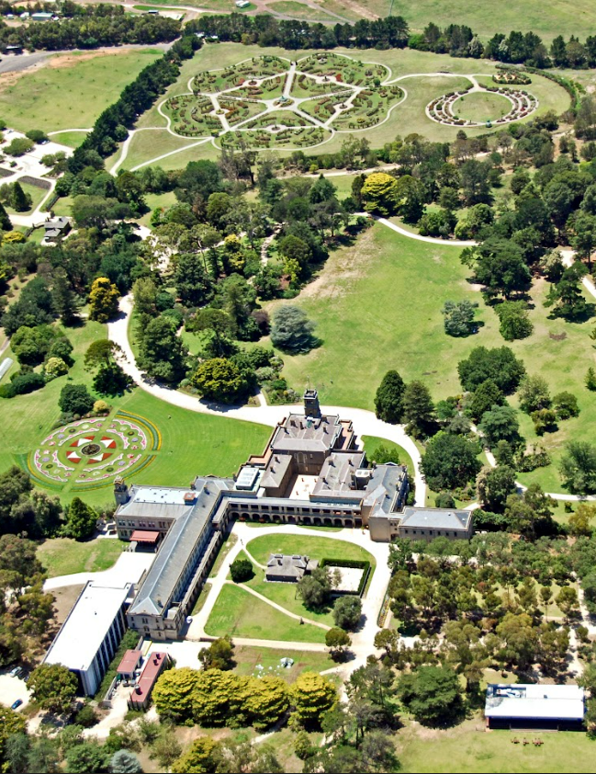
Outline
About Werribee Mansion
The Mapping Project
Overall map of the grounds and Mansion
Close-up up of the Mansion
Fabrication
Next Steps
Bonus content

Slide 3
Parks Victoria
We inspire Victorians to protect and enjoy our unique natural and cultural heritage. Putting nature first today for tomorrow, we champion the importance of nature by managing, protecting and sharing Victoria’s precious places.
In partnership with Traditional Owners, we help connect people with Country, understand cultural heritage and contribute to human health and wellbeing.

Slide 4
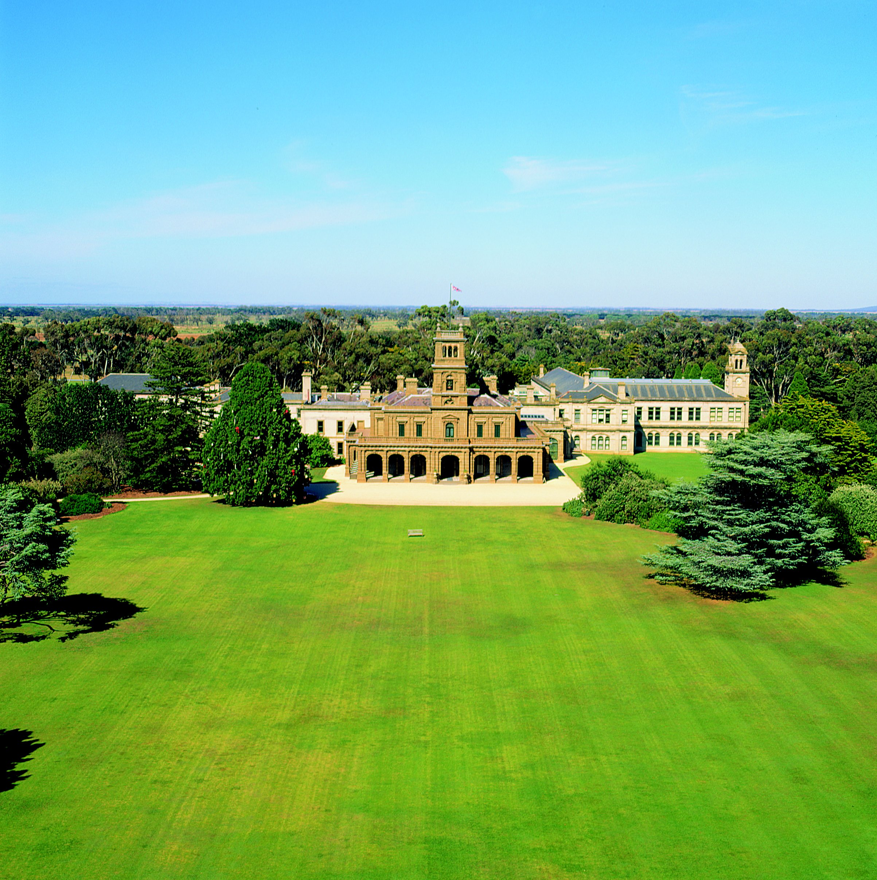
Werribee Park & Mansion
Heritage site open to the public:
Werribee Mansion and museum
Formal gardens
Victoria State Rose Garden
Historic farmyard buildings

Slide 5
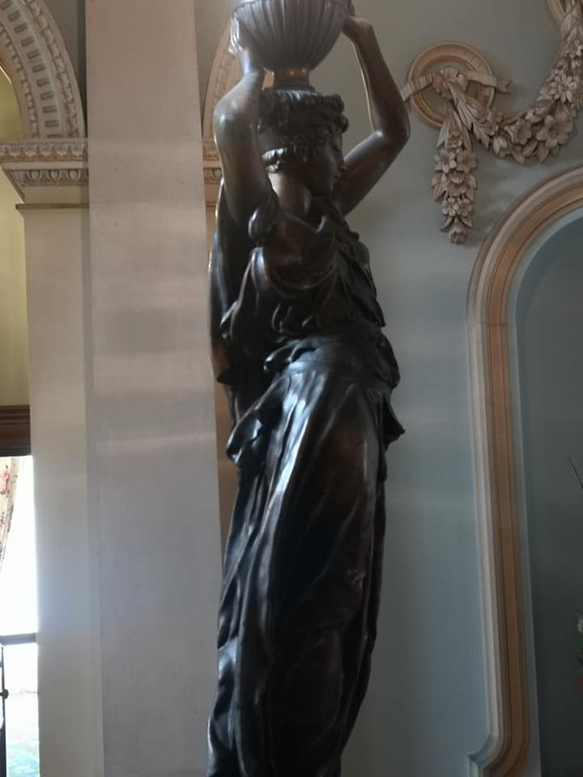
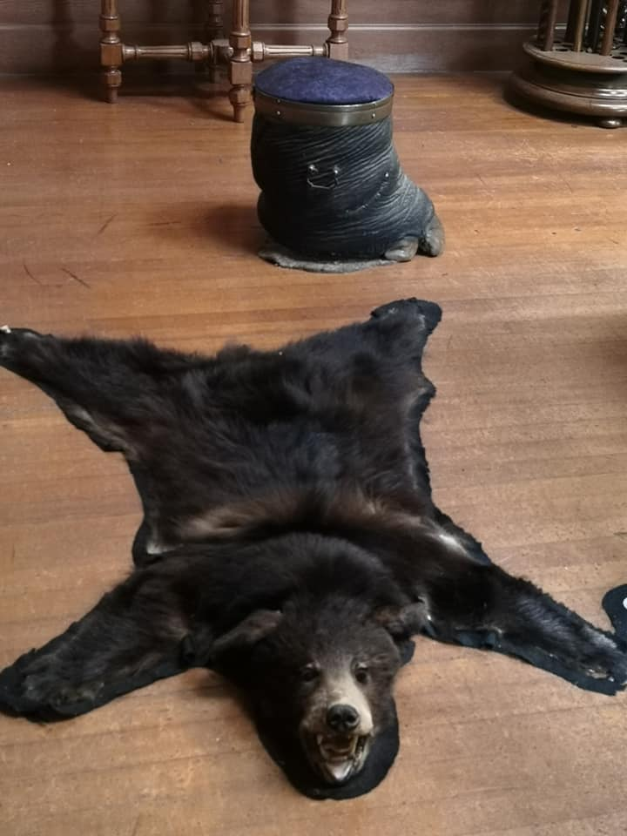
Touch Tours
Accessible tours offered weekly
Guided description
Touch access to artefacts

Slide 6
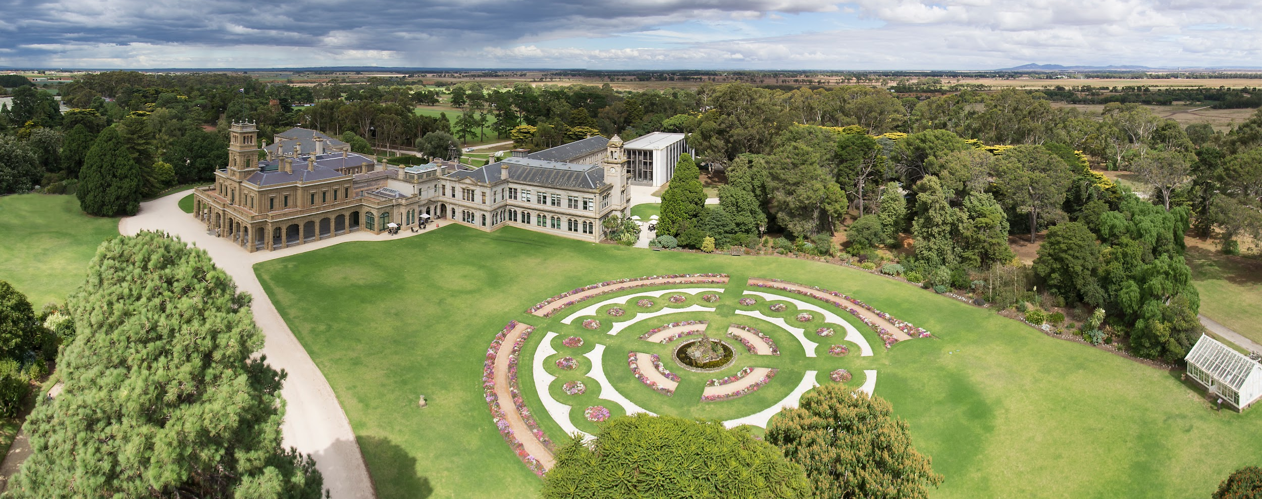
How to convey the architecture and grounds?

Slide 7
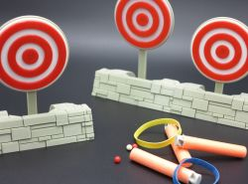
Mapping project
To provide visitors who are blind or have low vision learn more about the architecture and grounds (not for wayfinding)
To support tours for people who are blind or have low vision
To provide an inclusive experience for all visitors (the map should be available for use by all visitors, not just those who are blind or have low vision)
To demonstrate that Werribee Mansion is committed to providing an inclusive experience for all visitors

Slide 8
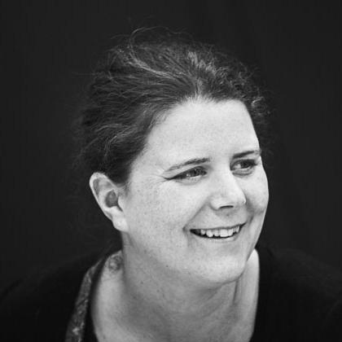
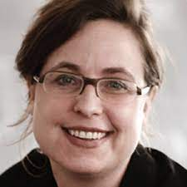
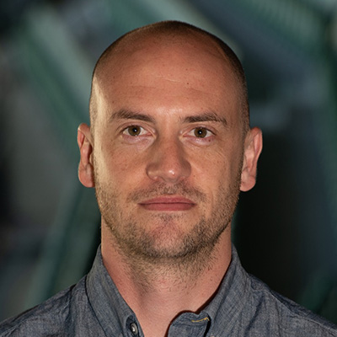
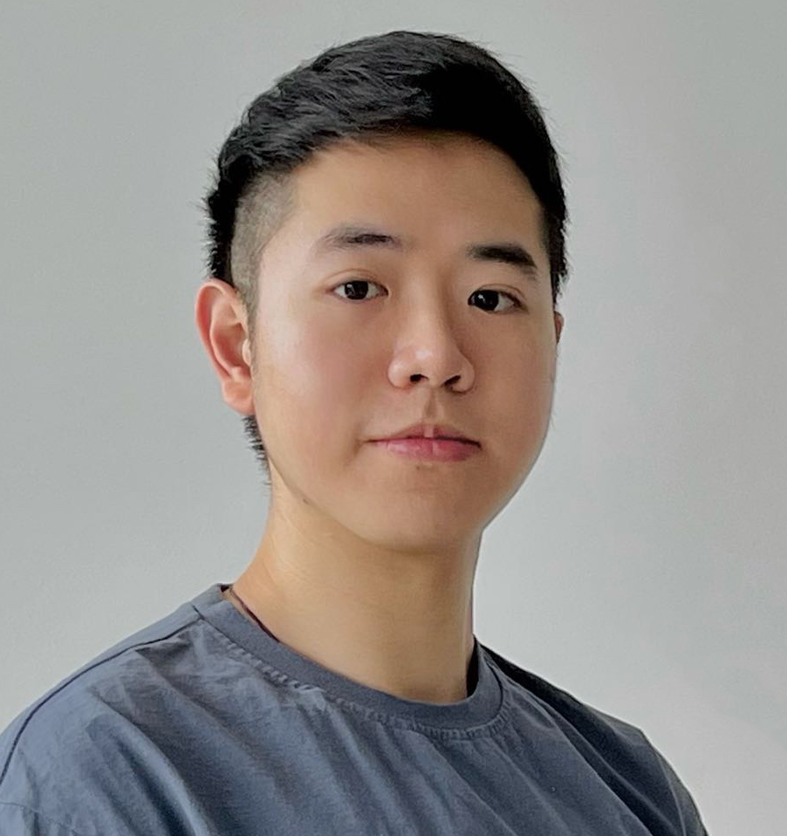
Meet the team
Leona Holloway Monash Uni Accessible graphics
Dagmar Reinhardt University of Sydney Architecture
Robyn Dean Parks Victoria Tour guide
Jim Smiley Monash Uni Lab manager
Zhenpeng Tan University of Sydney Architecture

Slide 9
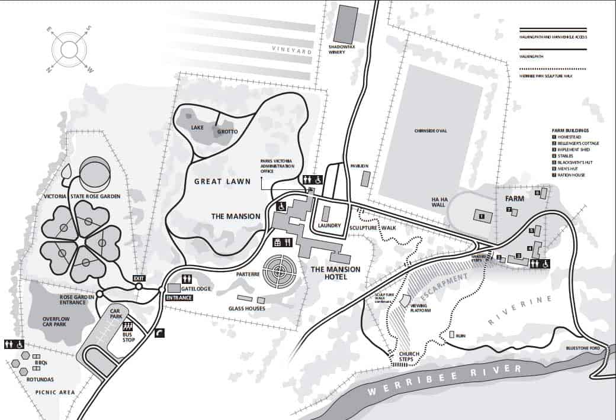
Map of the grounds

Slide 10
Considerations
1. Inclusive
2. Engaging
Multi-sensory
3. High quality
4. Durable
Materials

Slide 11
Components

Slide 12
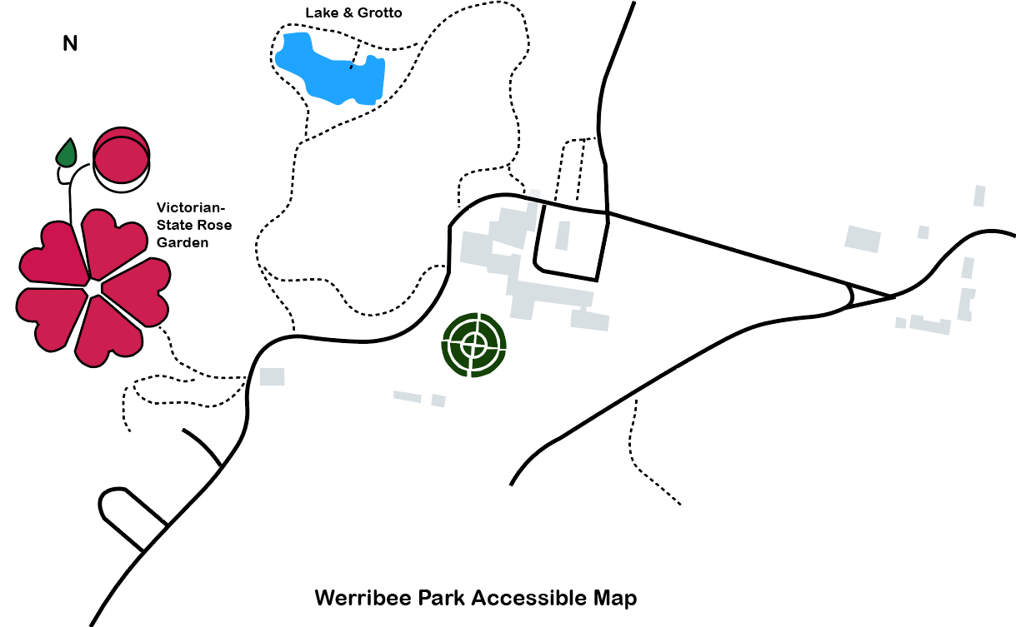
Clear Print

Slide 13
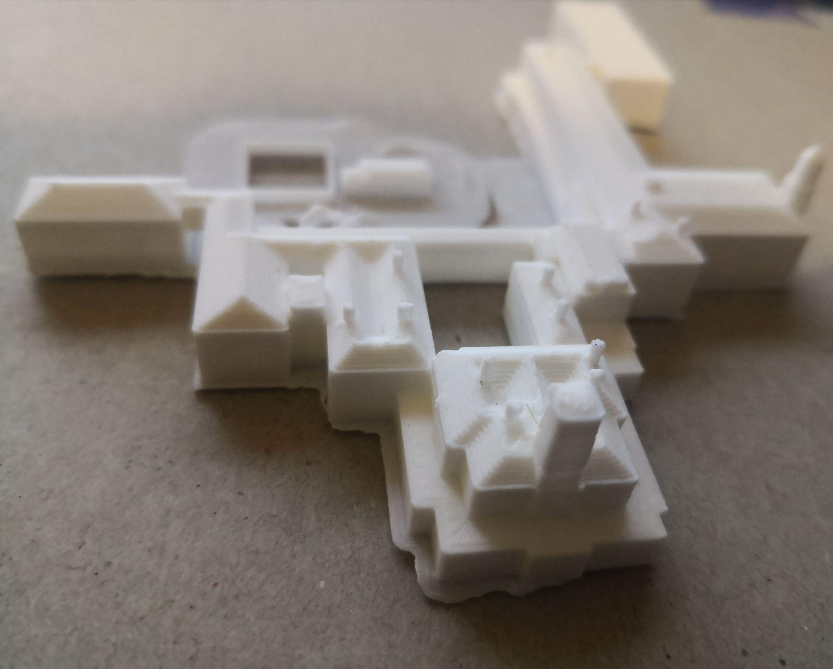
Building Models

Slide 14
Tactile Icons (TactIcons)
entrance
toilets
picnic
lake & grotto
greenhouses
farm
car park
rose garden
Refectory cafe
Holloway, L., Butler, M., & Marriott, K. (2023). TactIcons: Designing 3D Printed Map Icons for People who are Blind or have Low Vision.

Slide 15
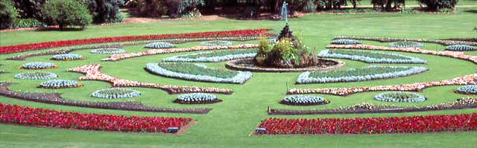
Audio labels
Level 1: location name
Level 2: history and timelines
Level 3: visual description

Slide 16
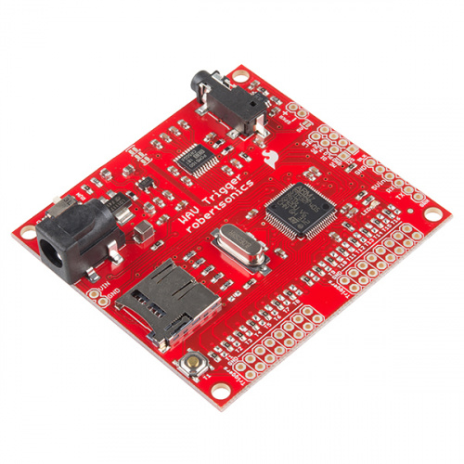
Audio Labels
Touch buttons for interactive audio
Wav Trigger Hookup
Arduino
Speaker

Slide 17
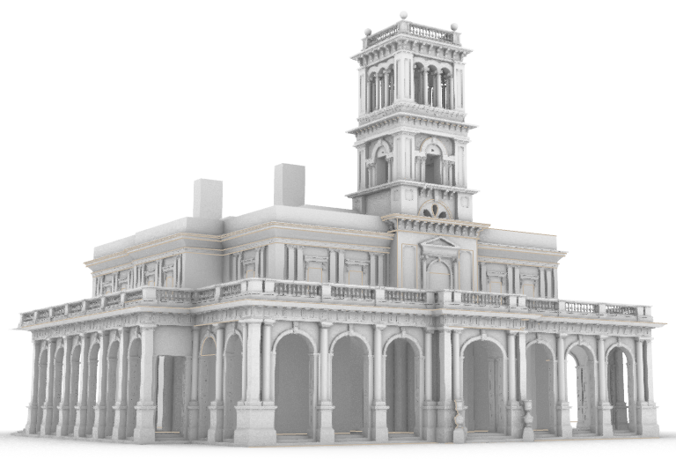
Enlarged model of the mansion

Slide 18
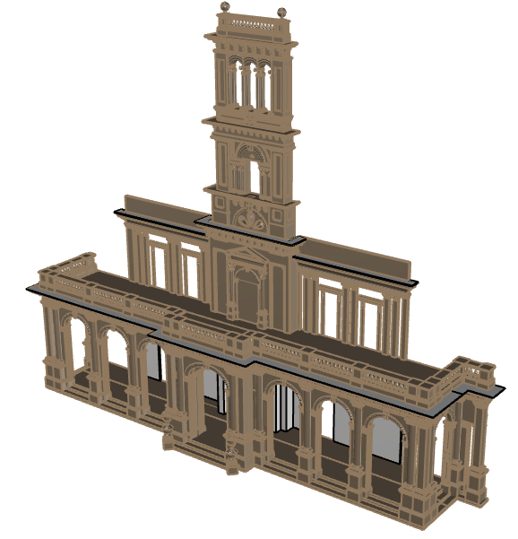
Facade

Slide 19
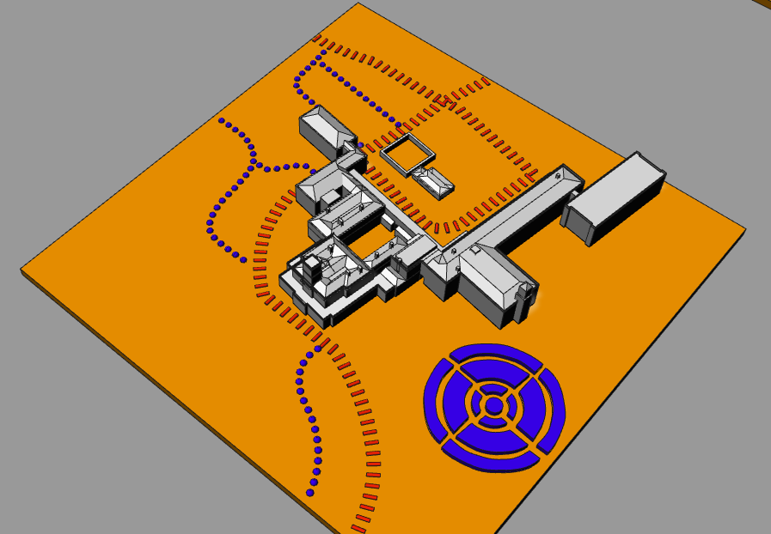
Testing
Sample materials available for testing at the Conference
Please touch, listen and give us your honest feedback

Slide 20
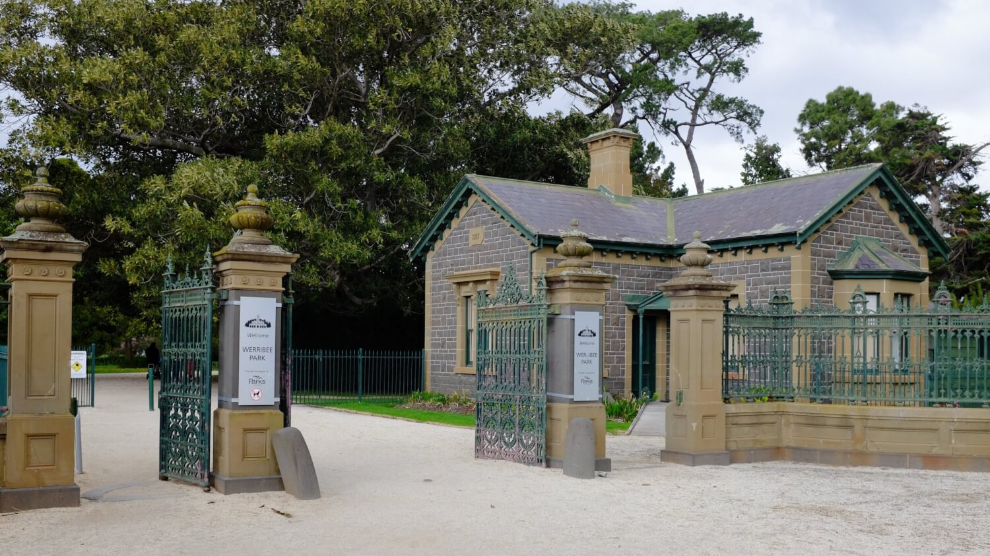
Invitation
Next steps
Invitation to visit
Leona Holloway
Inclusive Technologies
Monash University
leona.holloway@monash.edu
Dagmar Reinhardt
Architecture, Design & Planning
University of Sydney
dagmar.reinhardt@sydney.edu.au
Robyn Dean
Customer Service
Parks Victoria
robyn.dean@parks.vic.gov.au

Slide 21
Bonus extra content!

Slide 22
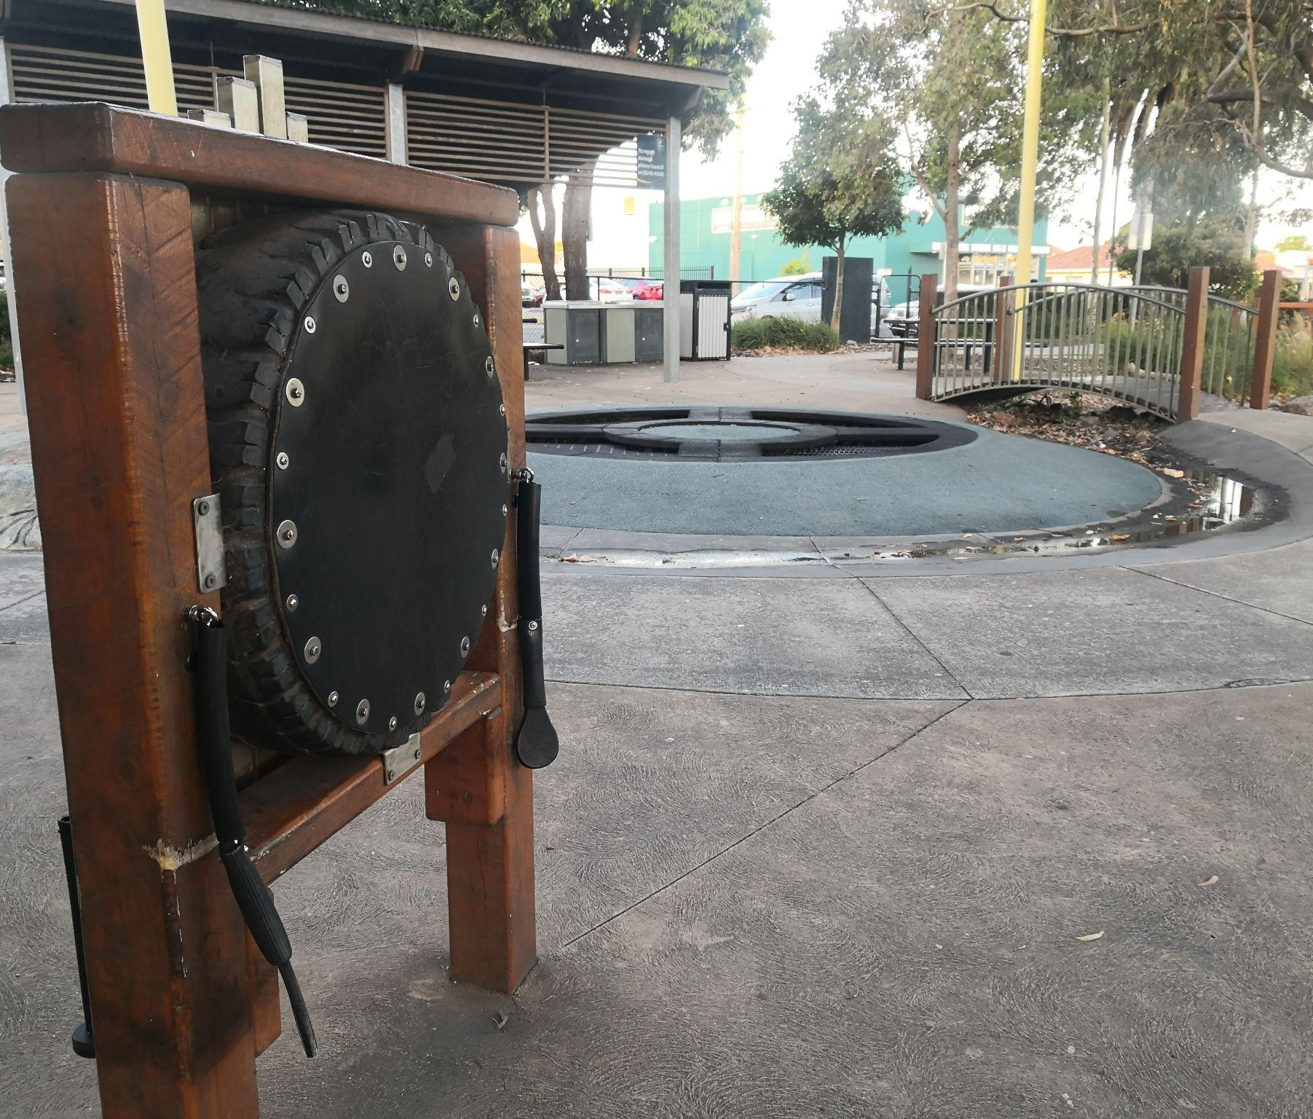
Accessible playgrounds
BLV accessibility of parks and playgrounds
Scoping - done
Surveys
Parents https://sydney.au1.qualtrics.com/jfe/form/SV_eevC9X8CNimjBZk
Teachers coming soon via SPEVI list
3. Playground audits - coming soon
Please contact us if you are interested in getting involved.

Slide 23
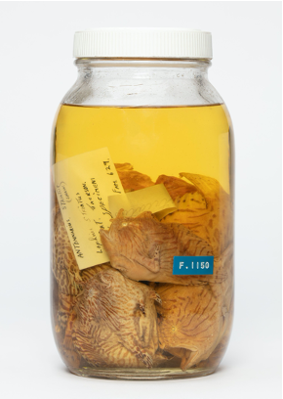
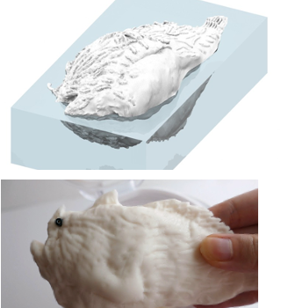
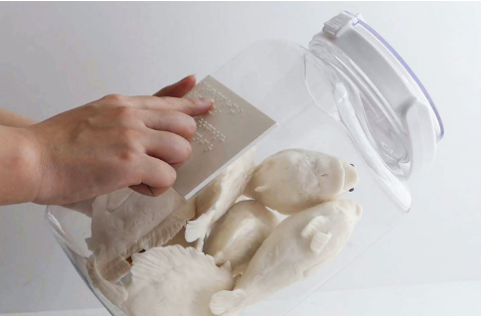
Museums for Touch
Understanding Museum Exhibits through Touch – Towards Object Based Learning and Universal Access for Blind and Low Vision Children and Adults
Project funded by the Alistair Swayne Foundation
Partnership with University of Sydney, Chau Chak Museum, Monash University, NextSense, Ibos (Denmark)

Slide 24
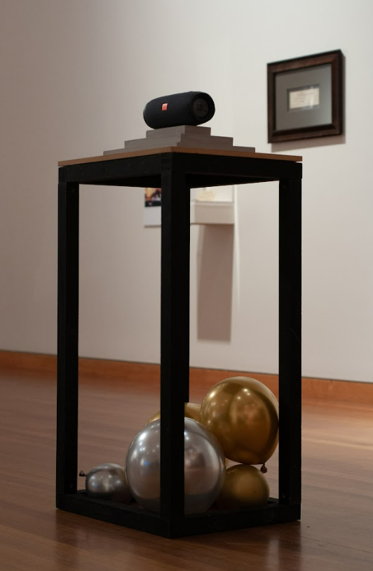
Melbourne Design Week
Accessible Gallery Experiences for people who are blind or have low vision
Friday 26 May, 11am-1pm
No Vacancy Gallery, QV, Melbourne CBD
Registrations via https://www.monash.edu/mada/events/2023/mdw/whats-on/Using-Design-to-Facilitate-Inclusive-and-Accessible-Gallery-Experiences

