Slide 1
Monash ASSISTIVE TECH & SOCIETY (MATS) CENTRE
Kim Marriott

Slide 2
WHY?
One in six Australians live with a disability
One in ten Australians use assistive technology to complete daily tasks
Emerging digital technology promise powerful new assistive technologies
Artificial intelligence
3D printing
Wearables and smart glasses
All digital technologies, not just bespoke assistive technology

Slide 3
Transdisciplinary
80+ researchers & educators
From across the university
Disability Support
Educators
Linguists
Designers
Information Technology
Social scientists
Health Services
Engineers

Slide 4
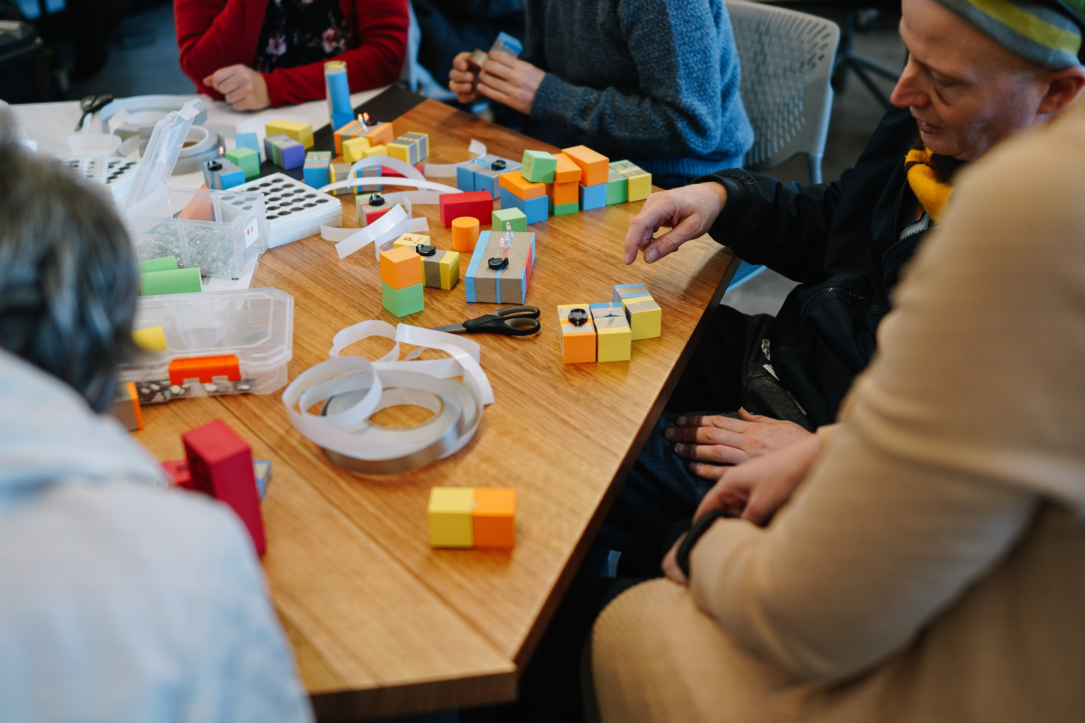
Community Led
Partnering with community organisations and people with lived experience of disability
No participation without representation
Co-design central to all activities

Slide 5
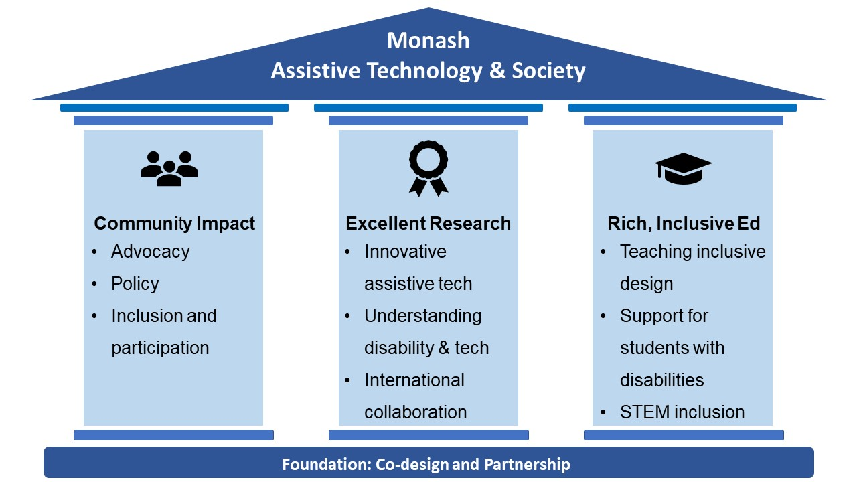
Overview

Slide 6
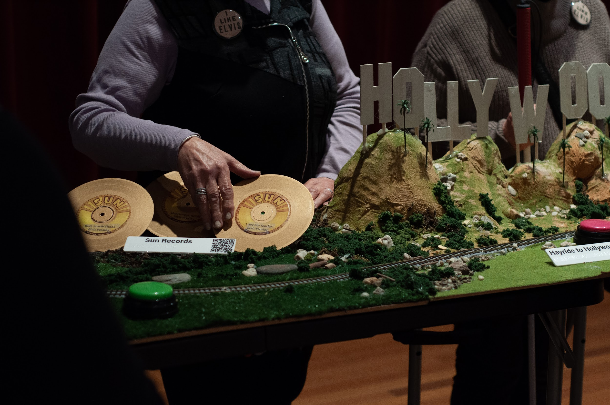
Pillar 1: Community Impact
Co-design central to all Centre activities
New assistive products
Advocacy
Policy advice and submissions

Slide 7
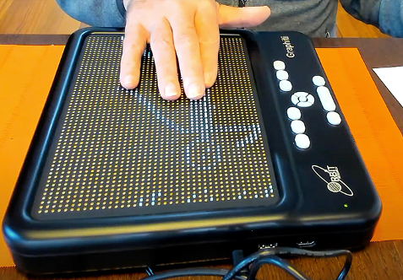
Pillar 2: Excellent Research
Innovative assistive technology with a focus on emerging digital technologies
Understanding of how and why people with disabilities use technology and current barriers limiting use

Slide 8
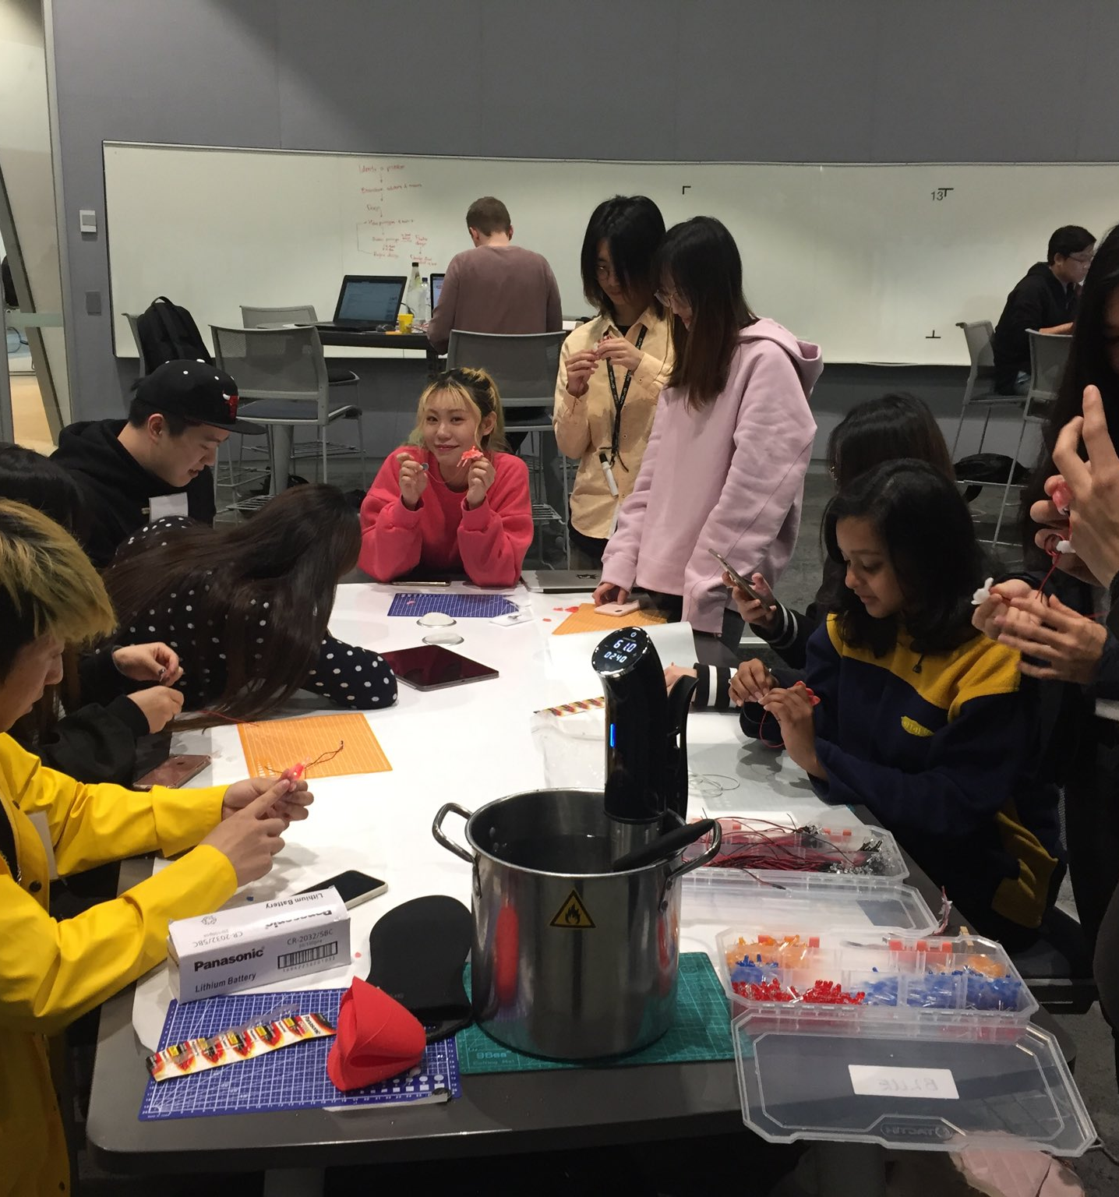
Pillar 3: Rich, Inclusive Education
Supporting Monash students with disability
Increase STEM participation by people with disability
Ensure all Monash students aware of inclusive design

Slide 9
Pillar 3: Rich, Inclusive Education
Ensure all Monash students have the opportunity to work on projects with disability organisations.
Great opportunity for organization to get students to work with them

Slide 10
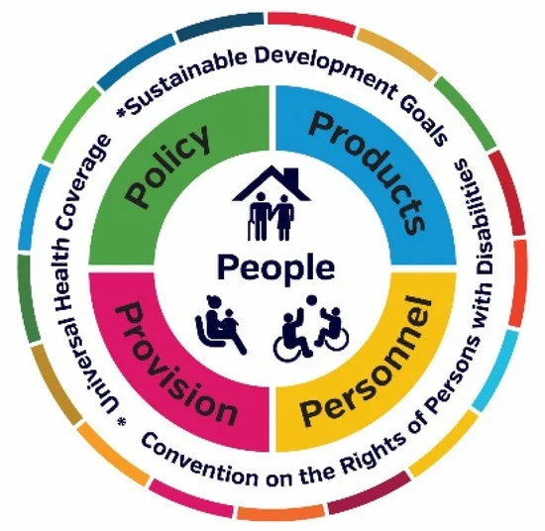
Example Projects: Advocacy
Worked with WHO exploring COVID-19 related experience of assistive tech users and suppliers across the world.
COVID-19 exacerbated inequity and access issues
Dr Natasha Layton

Slide 11
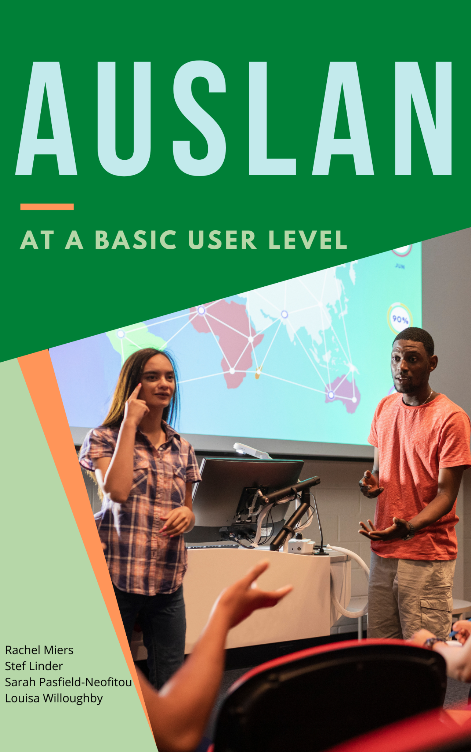
Example Projects: Deaf Community
Preeminent team of researchers in Auslan
Broadcaster standards for Auslan
Curriculum for Auslan training
Signbank, an Auslan dictionary
A/Prof Louisa Willoughby

Slide 12
Example Projects: Inclusive STEM
Tape Blocks: EVA foam blocks wrapped in conductive tape with electronic components.
Accessible introduction to technology and the maker movement for people with disabilities.
Dr Kirsten Ellis 2022 Eureka Prize Winner for STEM Inclusion
Notes:
Buzzers and fans give an immediate indication of success for when people who are blind or have low vision create a circuit.

Slide 13
Example Projects: Multisensory Art Exhibitions
Working with the Bendigo Art Gallery to create multimodal experiences for blind and low-vision visitors
Mary Quant: : Fashion Revolutionary
Elvis: Direct from Graceland
A/Prof Matt Butler

Slide 14
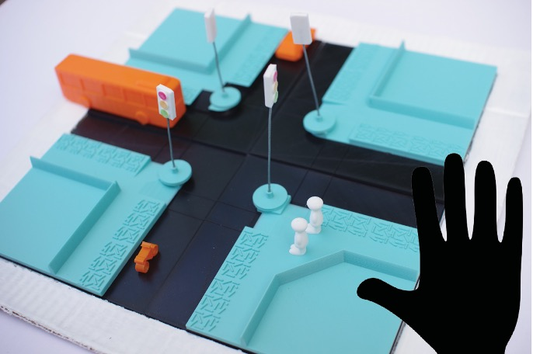
Example Projects: O&M Training
In partnership with Guide Dogs Victoria created 3D printed toolkit to teach blind and low vision children about street crossings and traffic
Leona Holloway
(Part of ARC Linkage Project on 3D printing)

Slide 15
Example Projects: 3D Printed Educational Materials
Developed 3D models for education
As part of ANZAGG
Leona Holloway
(Part of ARC Linkage Project on 3D printing)

Slide 16
Example Projects
3D printed models + conversational agents
Making spreadsheets more accessible
Smart glasses: What are they good for?
Accessible data visualization
Accessible mathematics for students who are blind or have low vision

Slide 17
MATS
Transdisciplinary
Largest group of researchers in technology and disability in Australia & one of the biggest in the world
Focused on real-world issues affecting people with disability, their families, carers and educators.

Slide 18
Want to be Involved?
Kim Marriott (Director) Kim.Marriott@monash.edu
Notes:
Consumer representative groups, not-for-profit organisations and businesses with an interest in assistive technology are invited to register as MATS partners. These partners will be kept informed of MATS activities and invited to initiate and participate in research that is of value to you.

