Slide 1
Accessible formats – steps to access and inclusion: What is still missing?
Dr Meredith Prain
Cathy Basterfield

Slide 2
Overview
Who are we?
People with print disability
Accessible formats
What’s missing?
Best practice examples

Slide 3
Who are we?
Dr Meredith Prain
Speech Pathologist
Researcher
Over 25 years working with people with deafblindness

Slide 4
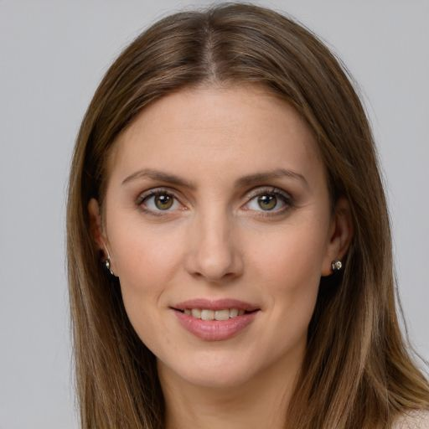
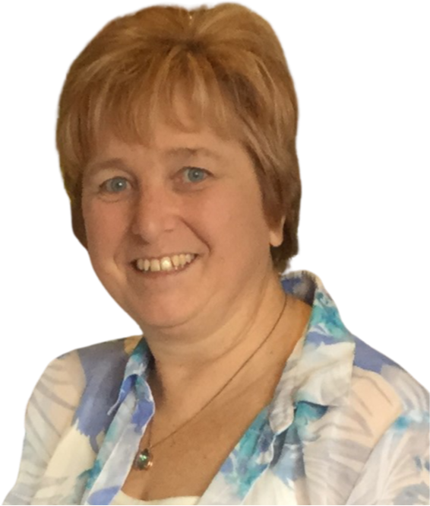
Who are we?
Cathy Basterfield
Speech Pathologist
35 years working with multiple and complex communication needs.
18 years developing Easy English.

Slide 5
People with print disability
People
who are blind or have low vision
with intellectual disability
English as a second language
Aboriginal and Torres Strait Islander people

Slide 6
People with print disability
And people
who are Deaf or Deafblind
with acquired disability
with poor educational outcomes
with mental illness

Slide 7
People with print disability
What about these people?
sick
stressed
carers
support staff
tourists and migration visas.

Slide 8
Australian literacy statistics
Percent of
16 - 65 year olds
PIAAC, OECD 2013 – 2019
2013

Slide 9
Accessible formats
Plain language
Easy English
Audio format with visual cues
Translation into other languages
Auslan videos
Plain text for braille conversion

Slide 10
People with print disability
Where can you find information?
mostly on-line, need for digital literacy
Key issues
sometimes accessible versions available but who do you ask for it?
budget for printing and embossing
ideally – mail, library, neighbourhood house

Slide 11
Best practice examples
Deafblind Information Australia - website audit
Two Medical Research Futures Fund funded projects regarding communication of health information
Virtual Disability Conference
Aged care accessible information project

Slide 12
Best practice Easy English
Text - reading equivalence
Key language checkpoints
Images per page
Consumer engagement

Slide 13
With www.bumpyroad.org.au

Slide 14
With www.AWAVA.org.au Young women’s survey.

Slide 15
With WA Parliament Food security

Slide 16
What is missing?
funding to convert information to accessible formats
consumer testing
individualised 1:1 support to access information
awareness raising
capacity building – what can you do?

Slide 17
Contact us
Dr Meredith Prain
meredith.prain@senses.org.au
Cathy Basterfield
cathy@accesseasyenglish.com.au

