Slide 1
Bringing LEGO ® Braille Bricks
down under
Notes:
All slides have a Vision Australia logo and a LEGO braille bricks logo.
This slide has an image of the Lego braille bricks kit.
We will be reading and explaining all of the content on each slide.

Slide 2
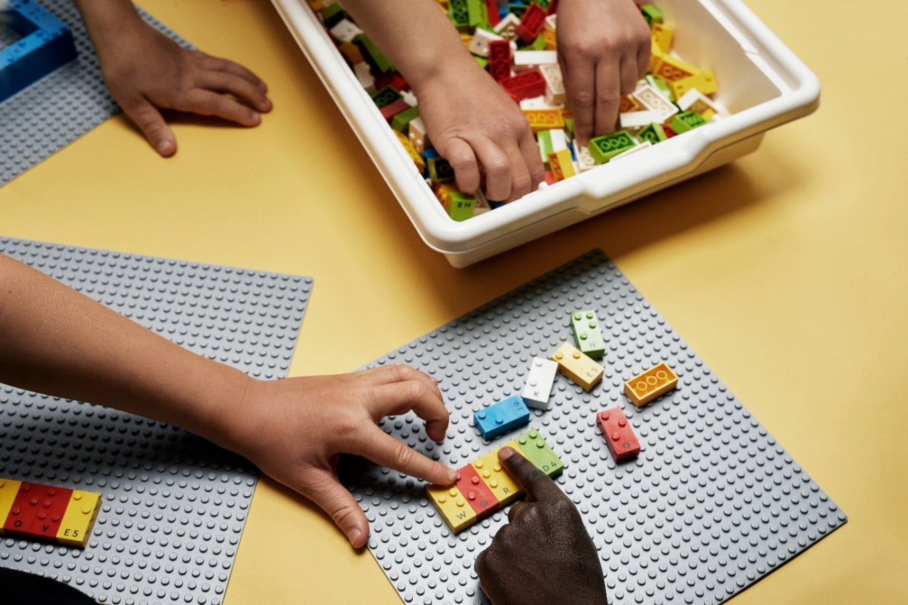
LEGO® Braille Bricks
LEGO Braille Bricks are a play-based conceptual tool to teach braille to children who are blind or have low vision, alongside their sighted peers.
LEGO® Braille Bricks in the hands of a number of students designed as a playful introduction to braille
Notes:
LOGO – Vision Australia and LEGO Braille Bricks
IMAGE: LEGO® Braille Bricks in the hands of a number of students designed as a playful introduction to braille

Slide 3
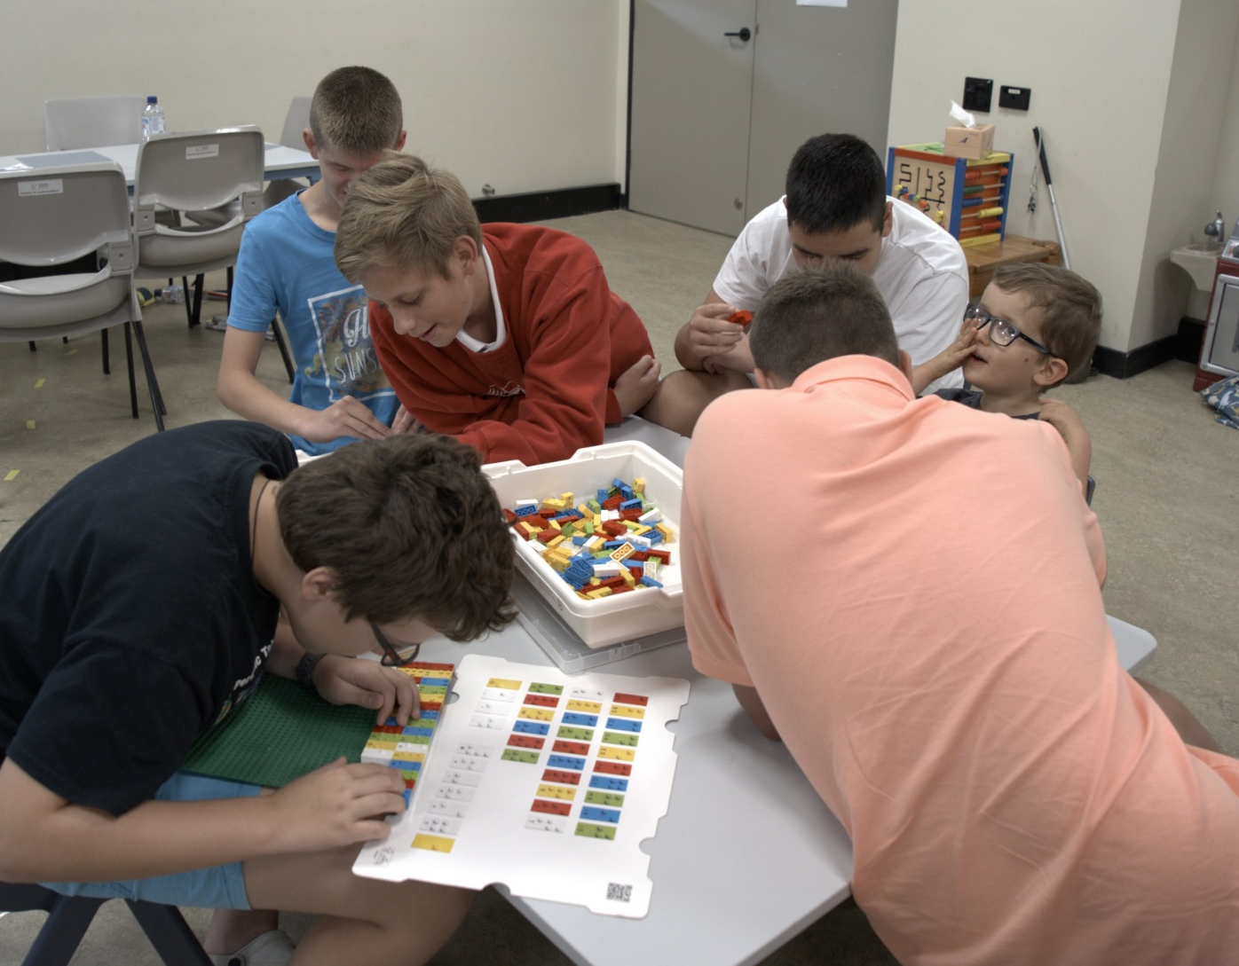
Characteristics
Joyful
Actively engaging
Socially interactive
Meaningful
Iterative
Five children of all ages playing with LEGO braille together and separately
Notes:
5 characteristics of a playful learning experiences are listed on the screen. These include: Joy, actively engaging, socially interactive , meaningful and Iterative.
These five characteristics ebb and flow as children are engaged in learning through activities. All five are not necessary all of the time, as depicted by the image on the screen of 4 older students and 1 younger child engaged with the braille Lego Bricks, some working by themselves and others sharing the activity together But over time, children should experience moments of joy and surprise, a meaningful connection and be active and absorbed, iterative and engage with others.
Expanding on the meaning of these characteristics
Joyful – play needs to be fun and have an element of surprise
Actively engaging – to be absorbed in the activity
Socially interactive- playing with other children
Meaningful- have some meaningful connection for the child
Iterative- children learn through their mistakes, through experimenting, through trial and error
IMAGE: Five students sitting together at a table exploring a Lego braille brick kit together.

Slide 4
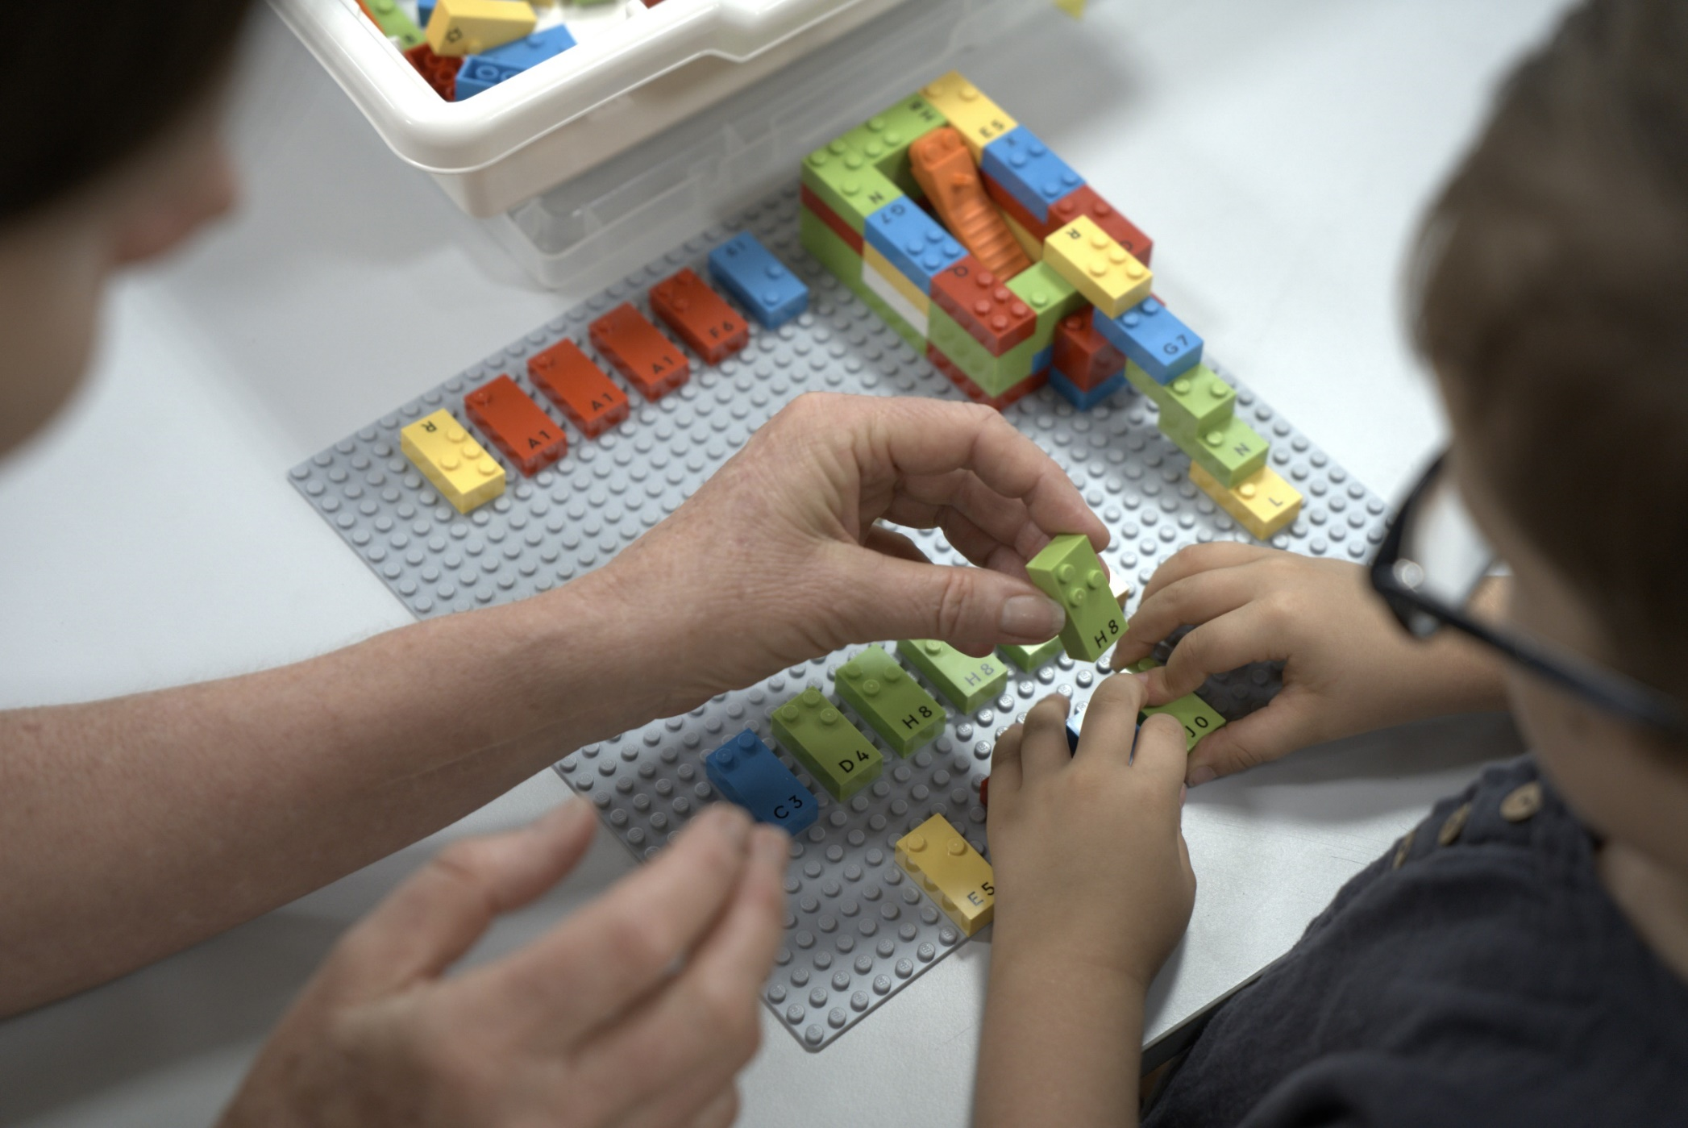
Bringing the bricks down under
Preparation
Trained the practitioners
Delivered the LBB boxes
Child and adult hands playing with Lego braille bricks together.
Notes:
Wave 1: Brazil, Denmark, France, Germany, Norway, UK, USA
Wave 2: Australia, Austria, Belgium, Canada, Finland, Ireland, Italy, NZ, Portugal, Spain, Sweden, Switzerland, The Netherlands,
IMAGE: Child and adult hands playing with Lego braille bricks together.

Slide 5
Training
Marie being filmed training practitioners in Australia
Notes:
Training from Marie Oddoux & Marc Angelier - Braille Experts for the LEGO Foundation – Brisbane, Sydney, Melbourne and online.
IMAGE: Marie being filmed training practitioners in Australia

Slide 6
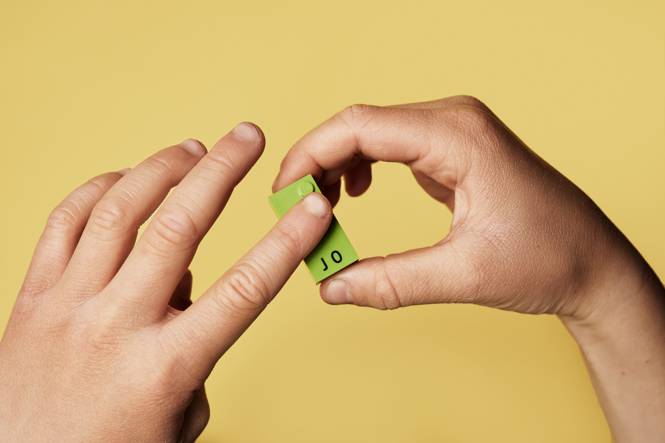
Difficulties
Fingers feeling the raised braille dots
Notes:
IMAGE: Fingers feeling the raised braille dots
ACTIVITY: Building towers
Who were the right people to promote to
Recognising value
How to store
Connect with educators
Train
Ongoing training
Play
Inclusion – using only for students
Dots different size

Slide 7
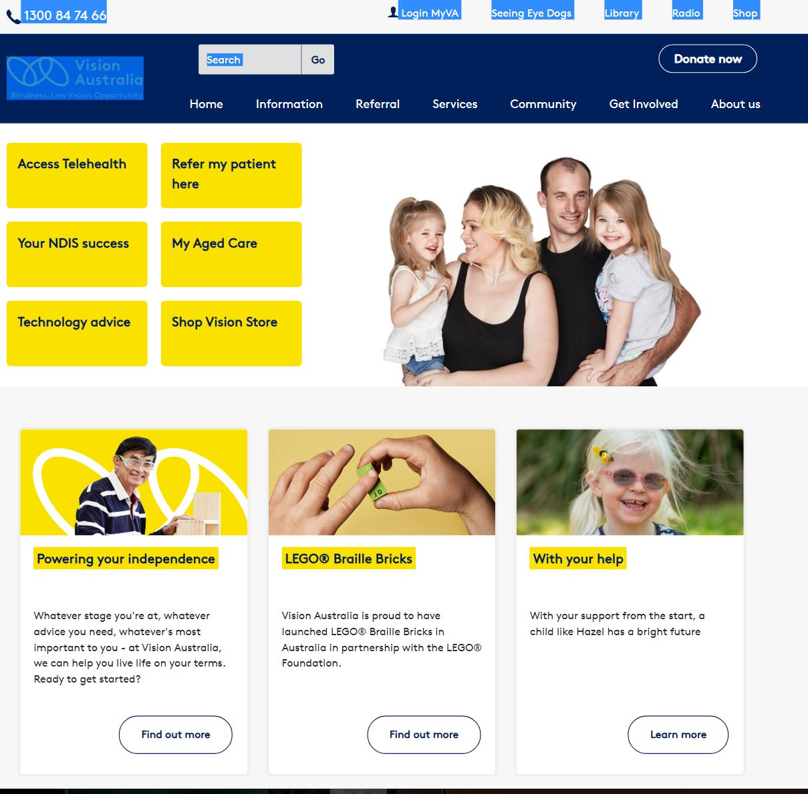
Vision Australia Website
Vision Australia website to order LEGO Braille Bricks
Notes:
This slide shows you the home page for the Vision Australia Website and you will notice there is the Lego Braille Bricks as the second tile next to Powering your Independence.

Slide 8
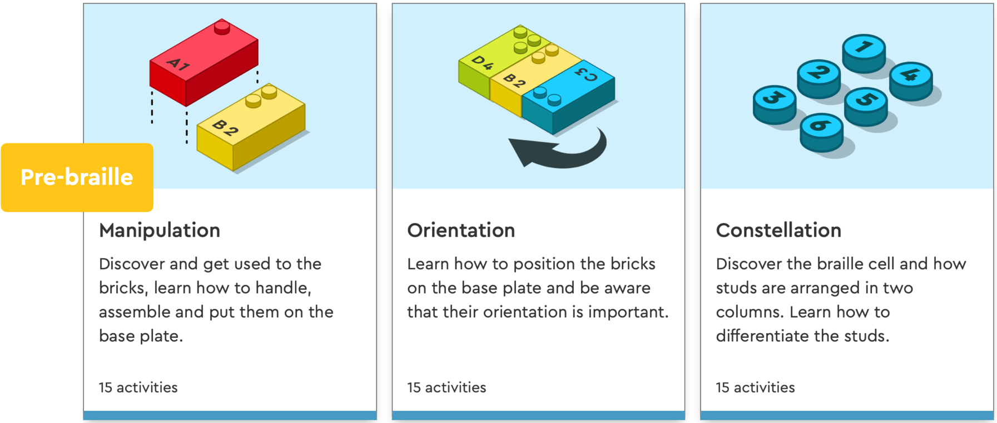
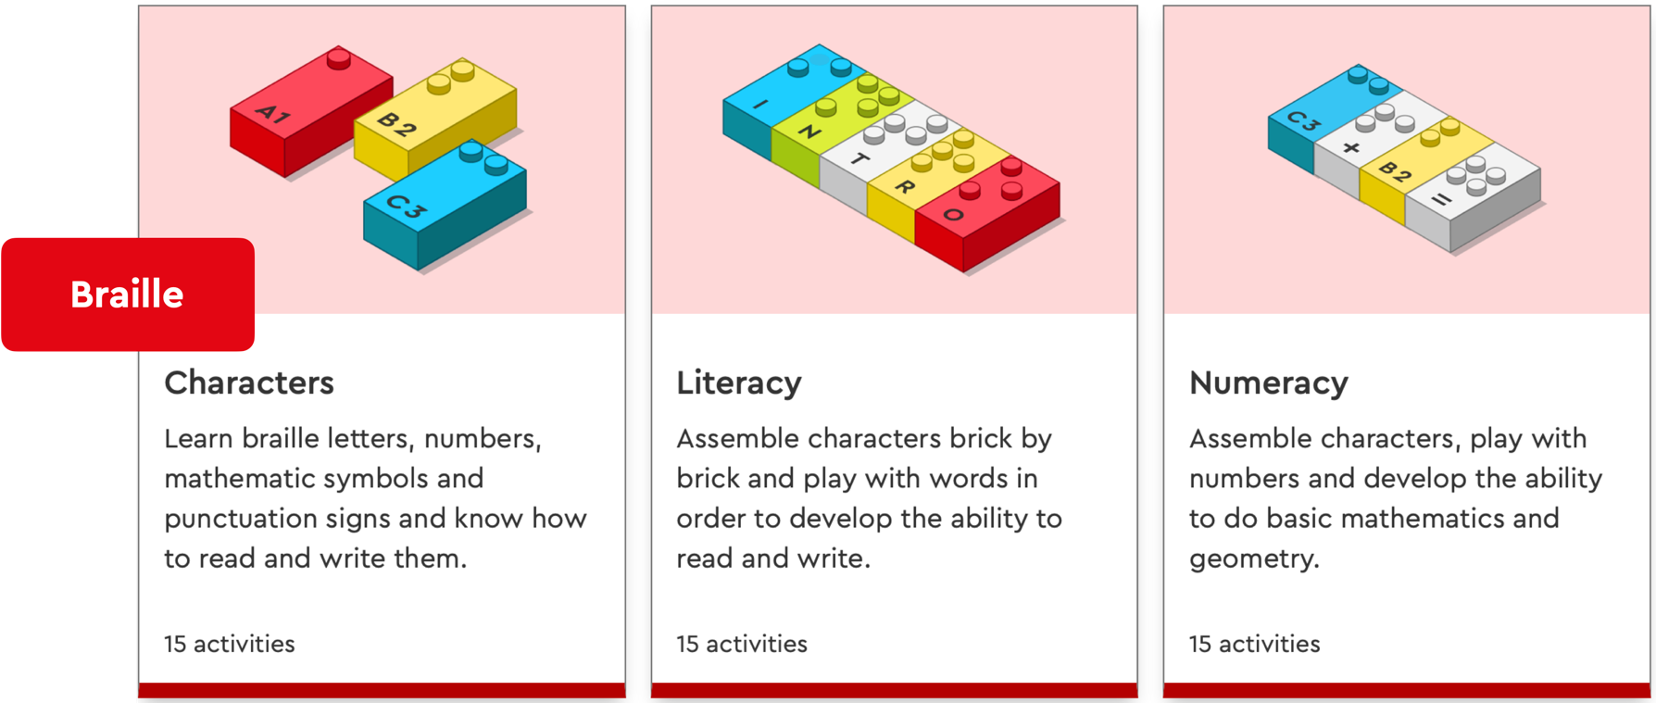
Activities
There are currently 90 activity sheets – which are divided into pre-braille and braille activities.
https://legobraillebricks.com/activities
Notes:
Image There are currently 90 activity sheets – which are divided into pre-braille and braille activities.

Slide 9
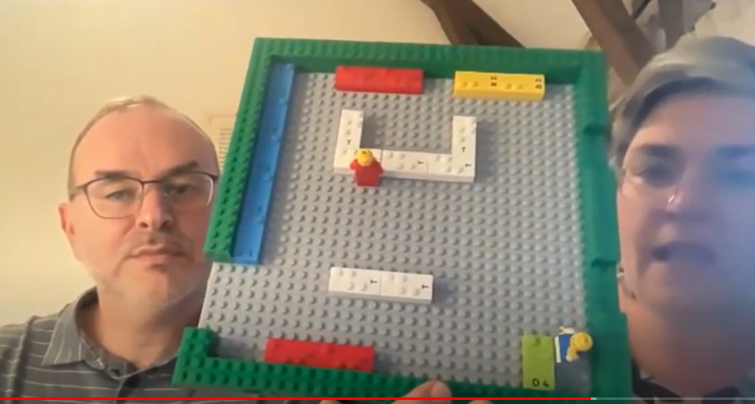
MOOC and videos
Marc and Marie presenting LEGO Braille Bricks for Orientation and Mobility in video
Notes:
Labels – door

Slide 10
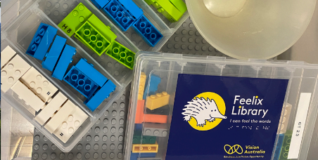
Feelix library
Feelix Library: A small kit of braille to trial and support reading books or activity
Notes:
IMAGE: small kit of braille to trial and support reading books or activity

Slide 11
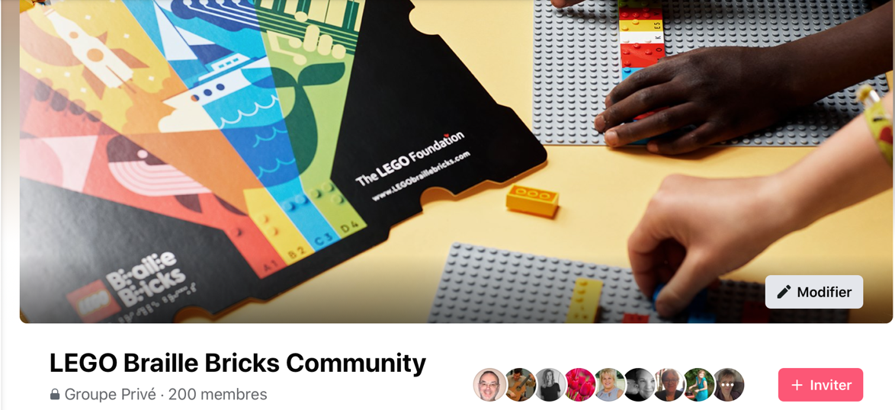
Facebook Community
Facebook
LEGO braille bricks community Facebook site.
Notes:
IMAGE: LEGO braille bricks community facebook site.
The LEGO Foundation knowledge base
LEGO Braille Bricks Community on Facebook
LEGO Six Bricks Community on Facebook https://legoaudioinstructions.com/

Slide 12
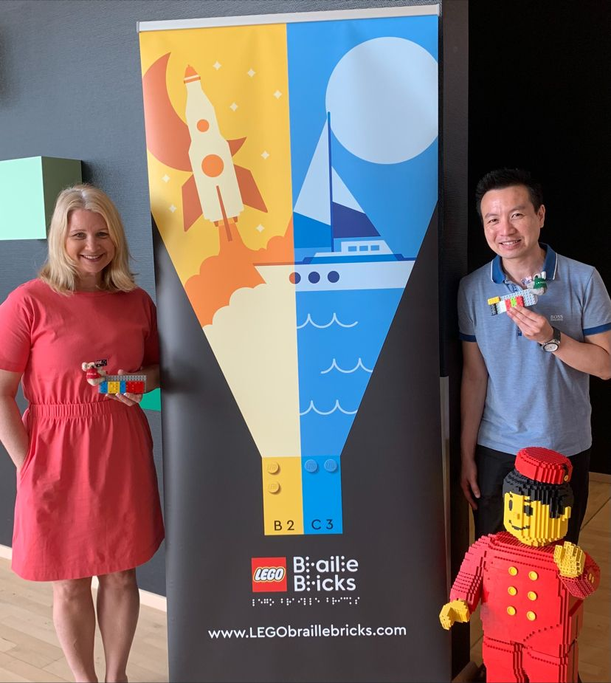
Possibilities
Tony Wu
Tony.Wu@visionaustralia.org
Melissa Fanshawe Melissa.Fanshawe@usq.edu.au
Melissa and Tony in front of a LEGO braille bricks sign and a person made out of LEGO.

