Slide 1
3D Printing for Touch Readers: The Finishing Touches
Leona Holloway
Inclusive Technologies, Monash University

Slide 2
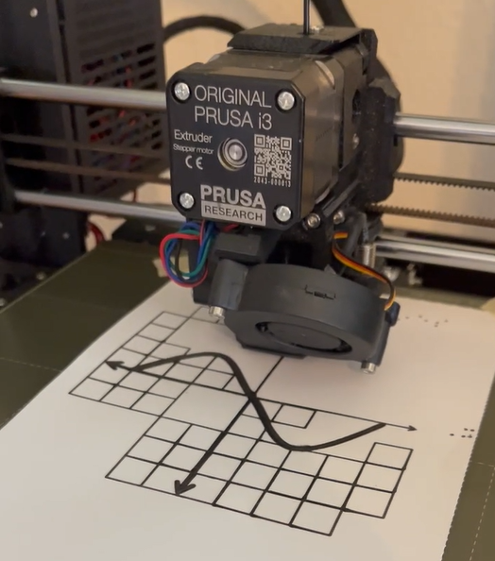
Outline
About the Project
Why 3D Print?
Barriers & Enablers
Ongoing work

Slide 3
About the Project

Slide 4
Project Partners
Australian Research Council
Round Table on Information Access for People with Print Disabilities, with special thanks to
South Pacific Educators in Vision Impairment
VisAbility
Blind and Low Vision New Zealand
Department of Education Victoria (SVRC)
Guide Dogs Victoria
NextSense
Royal Society for the Blind (SA)
And Expert Advisory Group members from Blind Citizens Australia, Vision Australia and Queensland Tactual Mapping Committee.

Slide 5
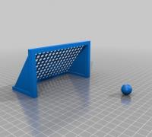
Project Aims
Investigating the use of 3D printing for touch readers with application for Education and Orientation & Mobility.
Aiming to support best-practice adoption of 3D printing by the print accessibility community in Australia and New Zealand.

Slide 6
Why 3D print?

Slide 7
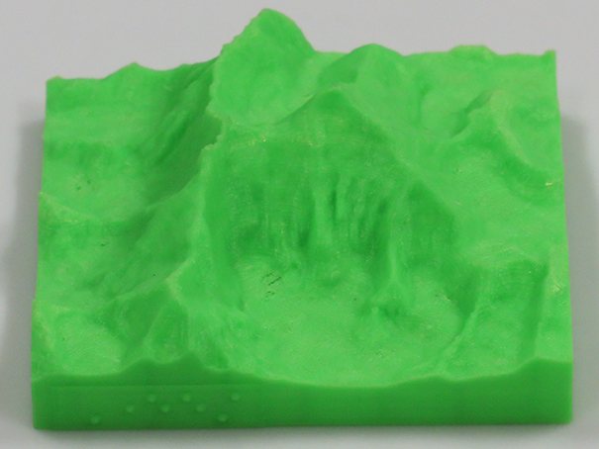
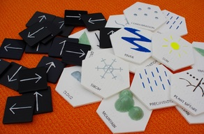
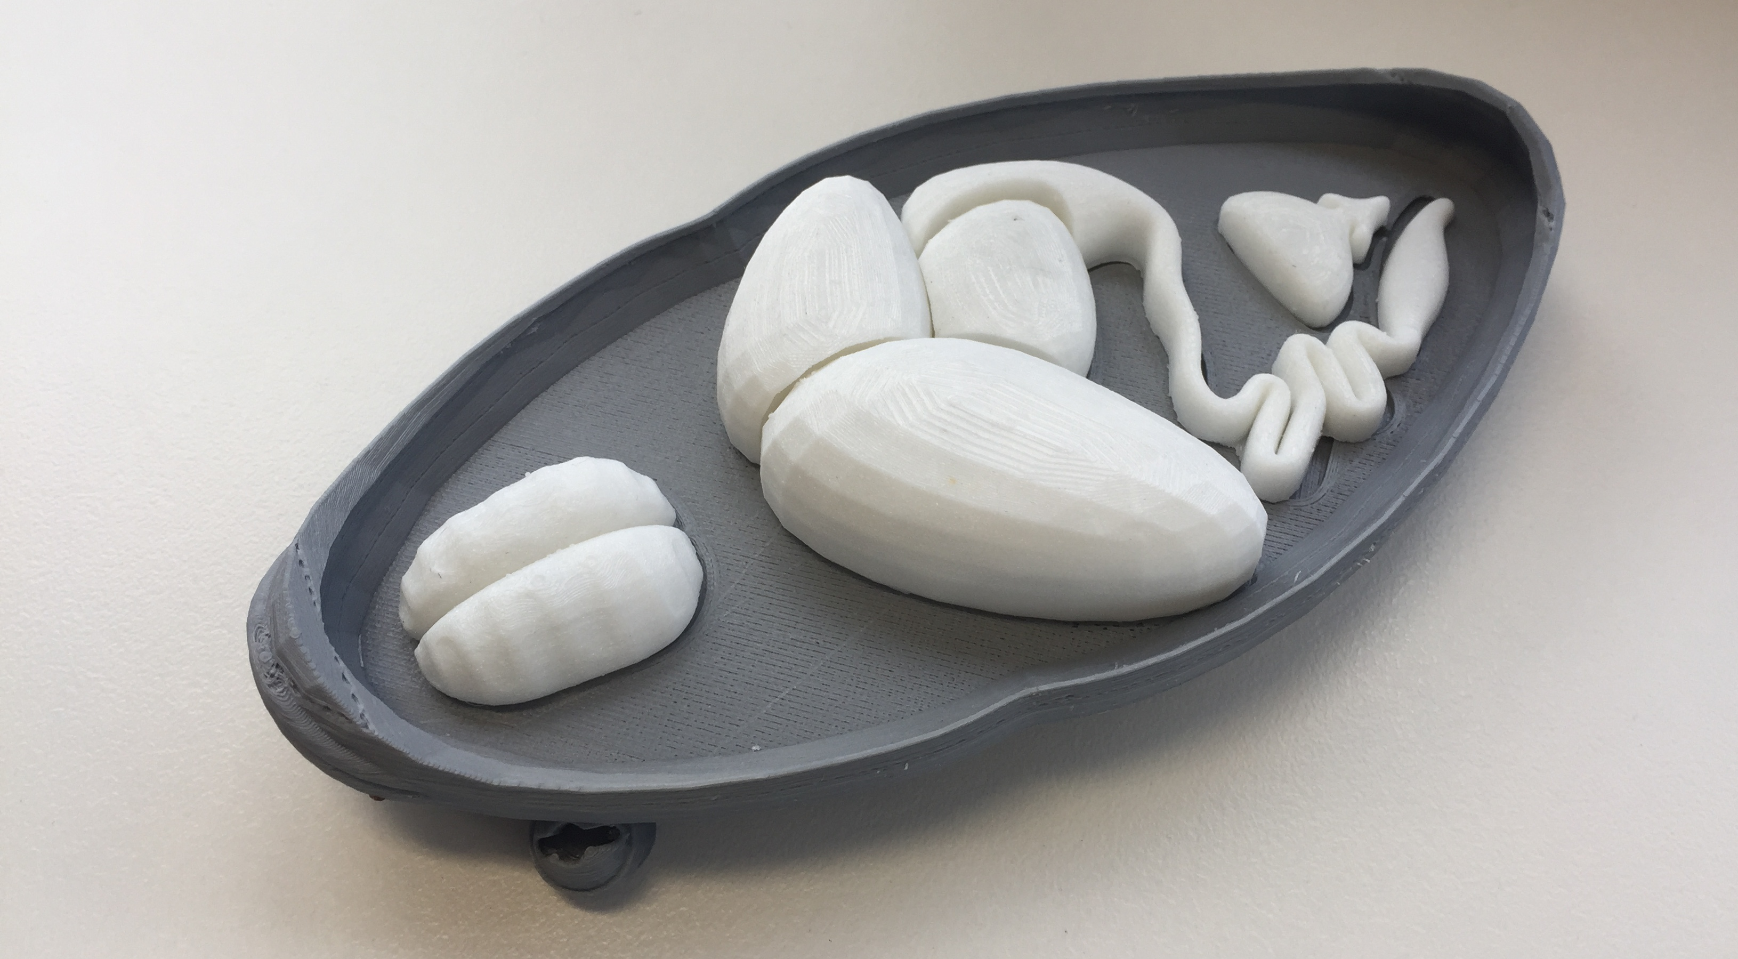
Education - Curriculum materials
Easier to understand
More engaging
More inclusive

Slide 8
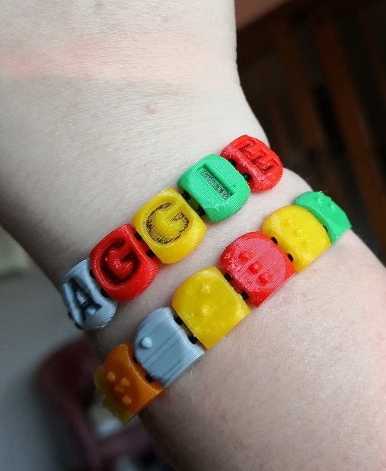
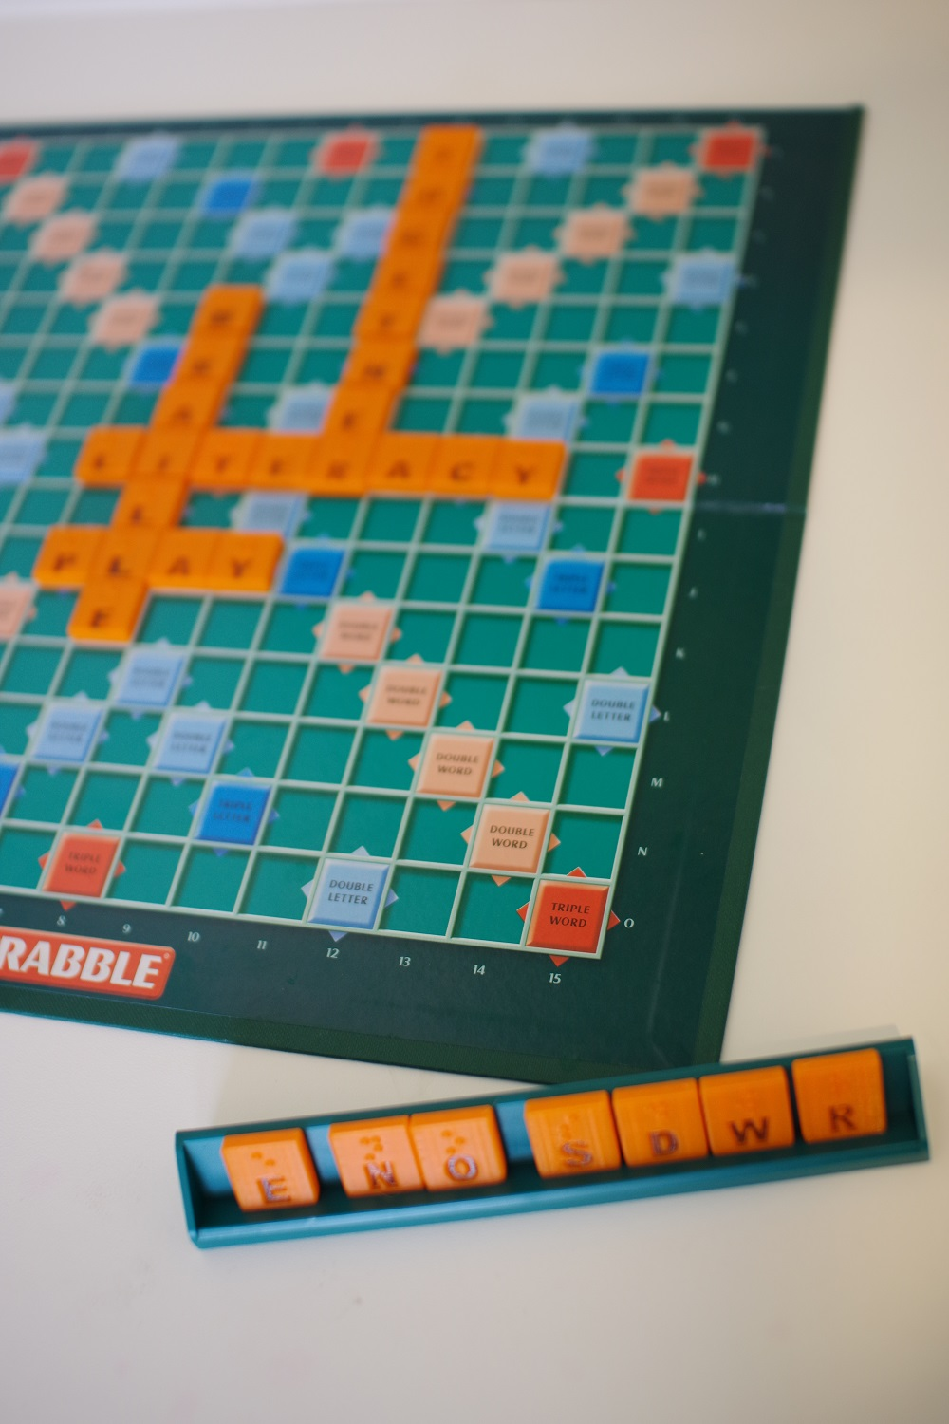
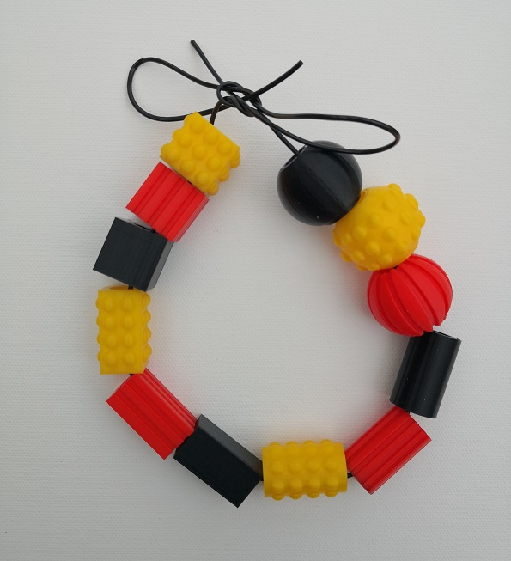
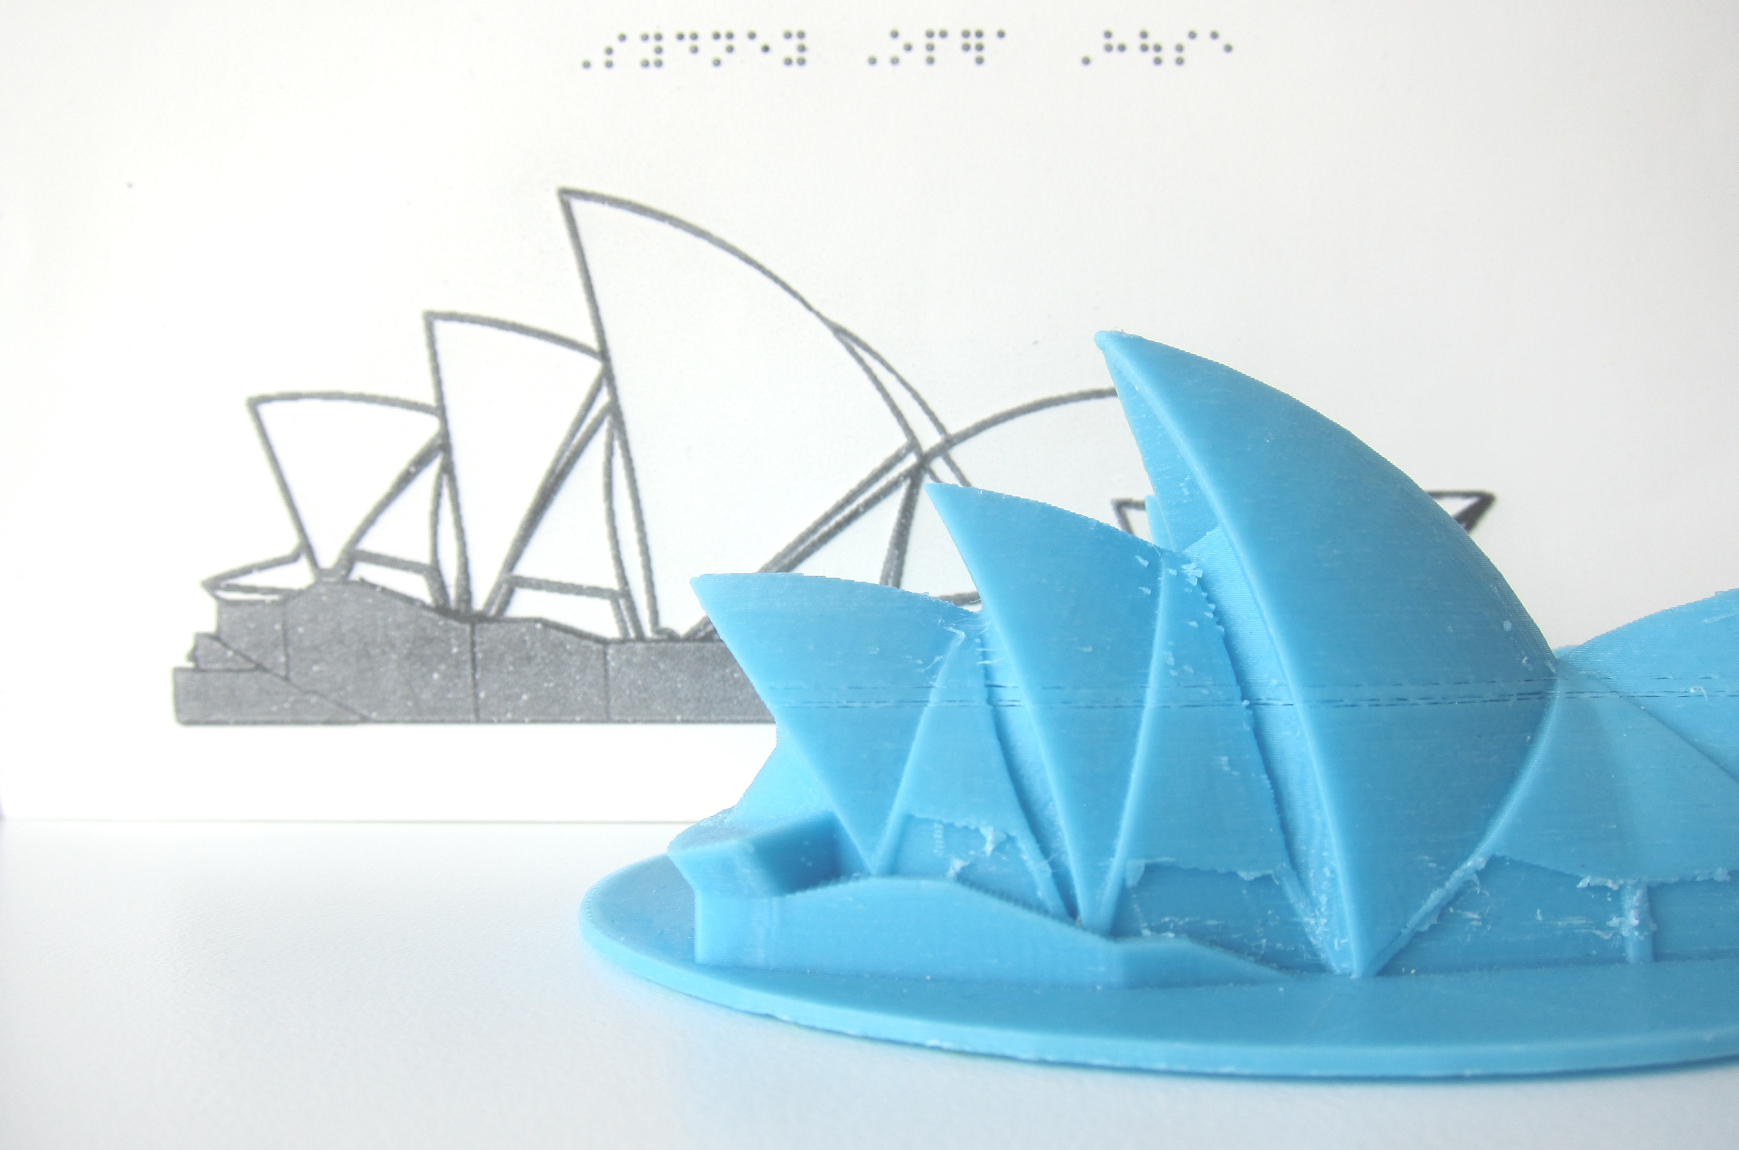
Education - Tactile literacy
Extended core curriculum
Braille learning tools
Engagement with tactile materials
How to interpret 2.5D tactile graphics

Slide 9
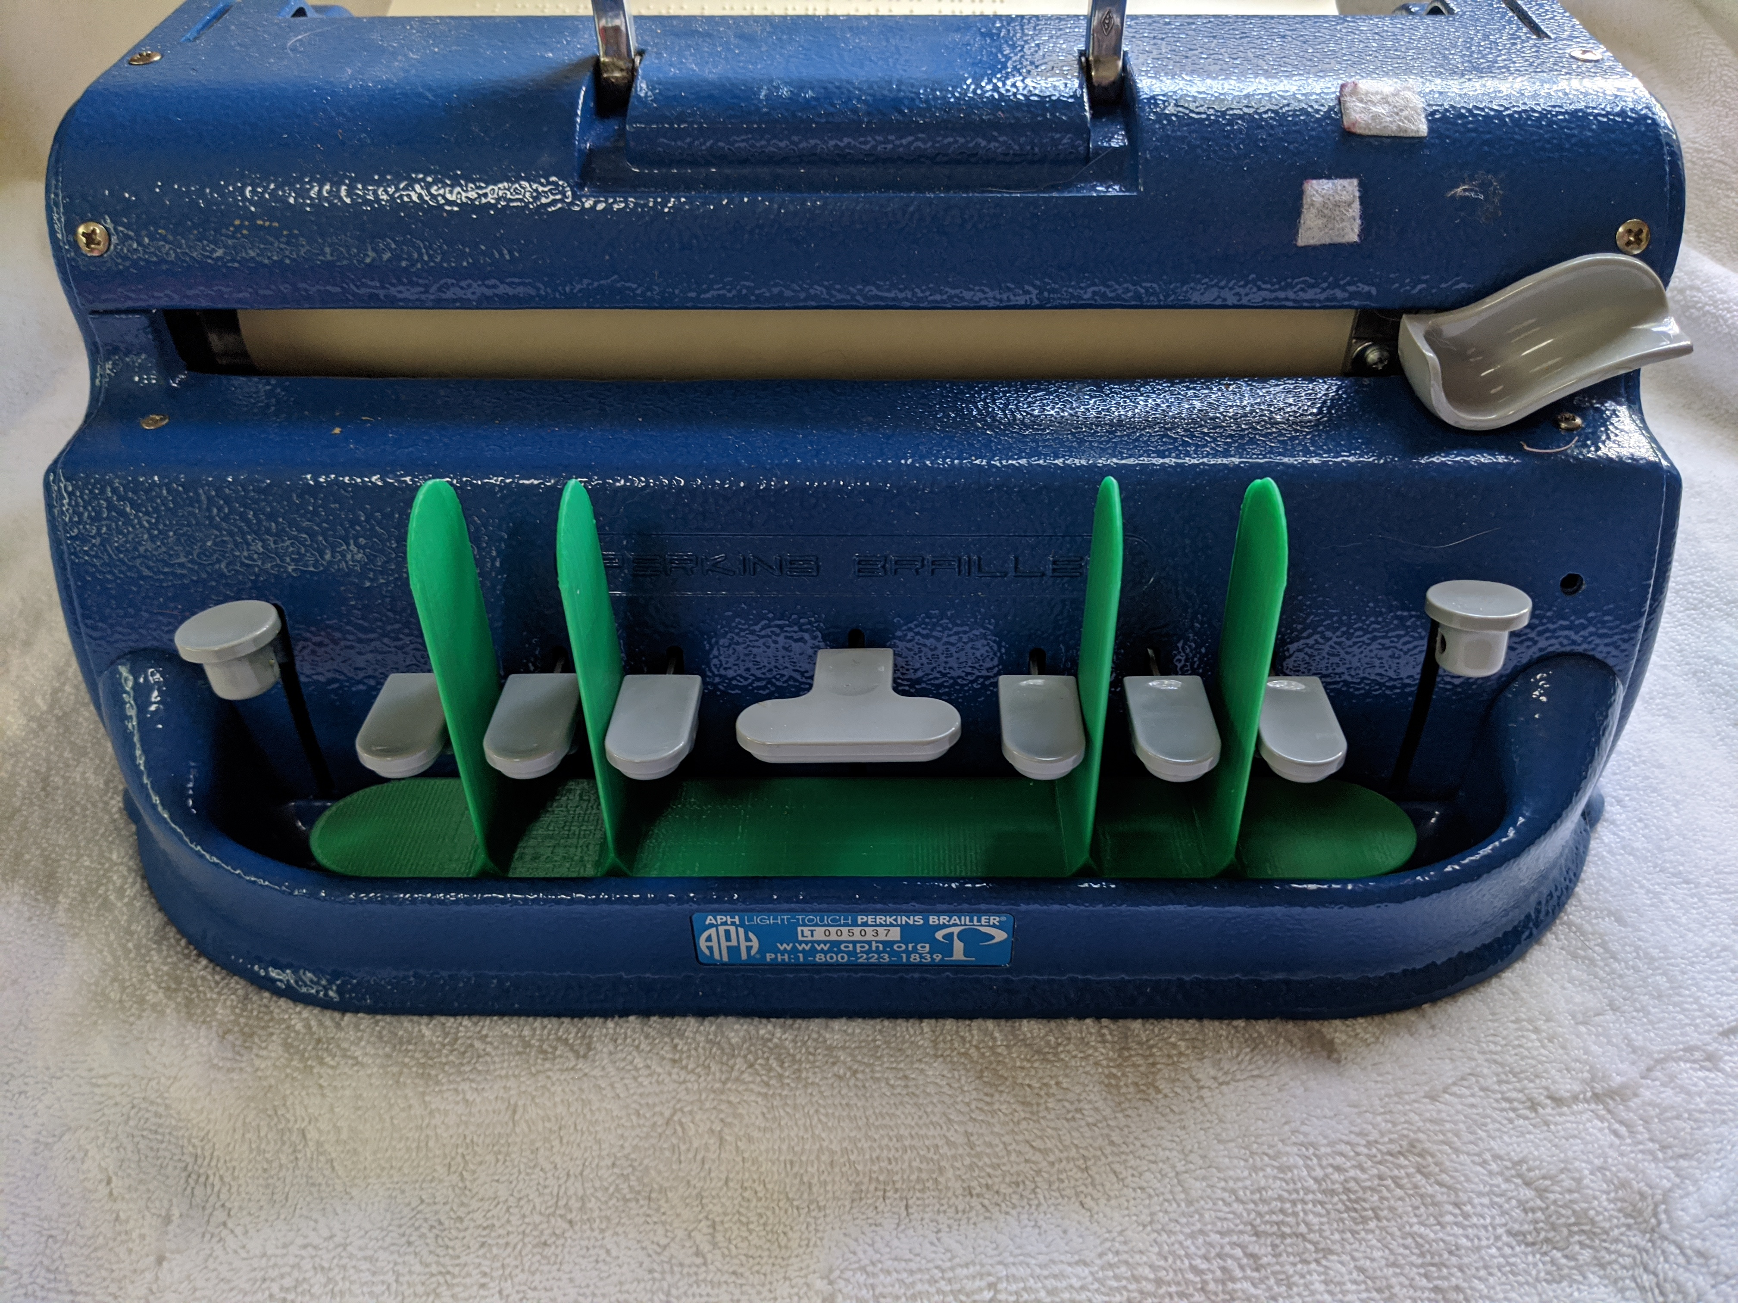
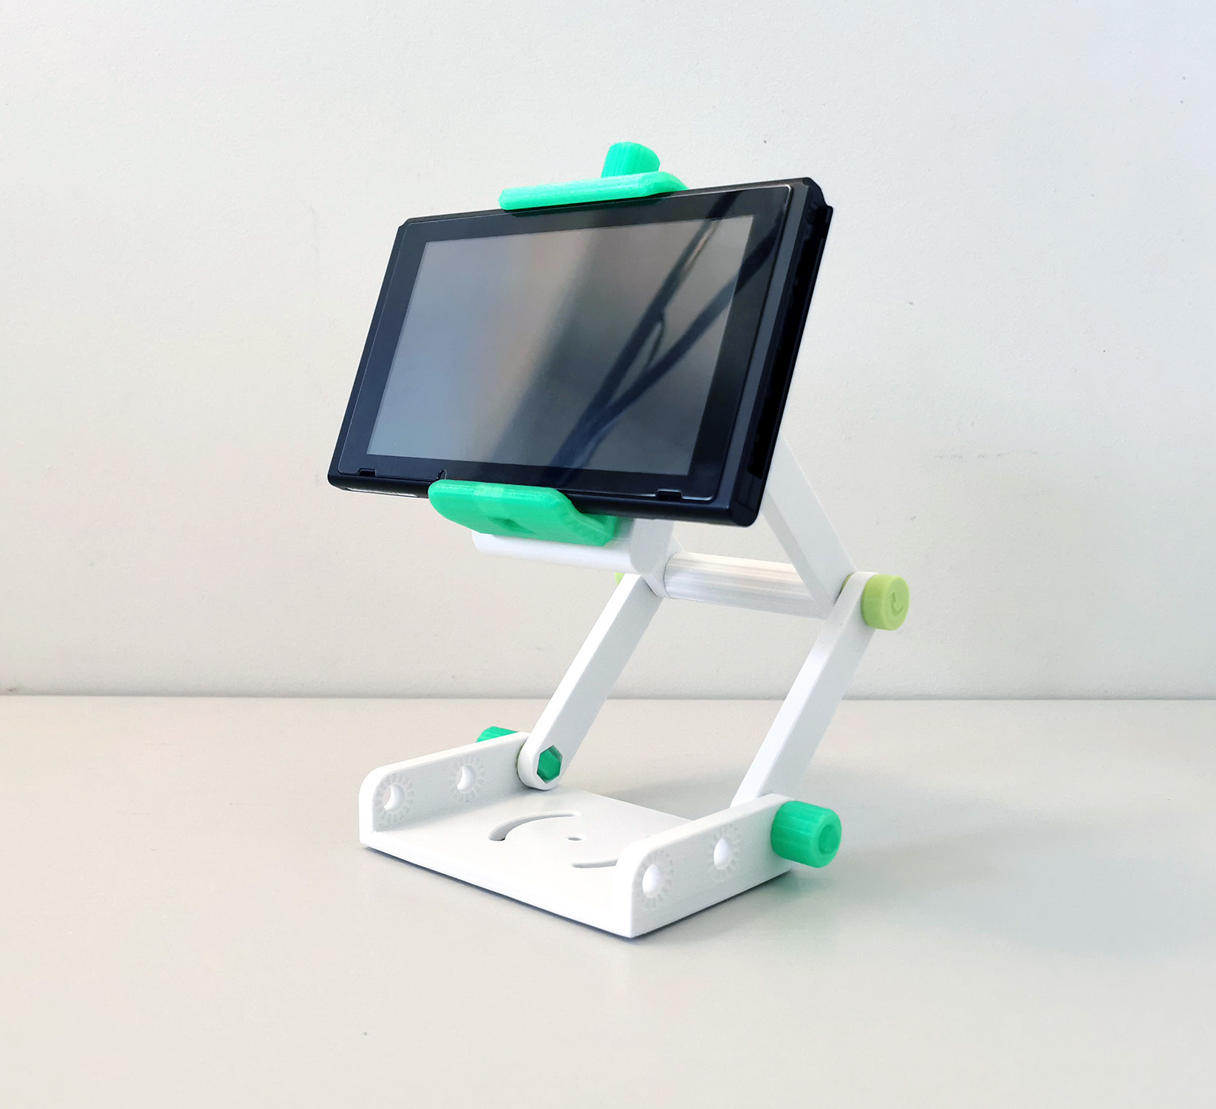
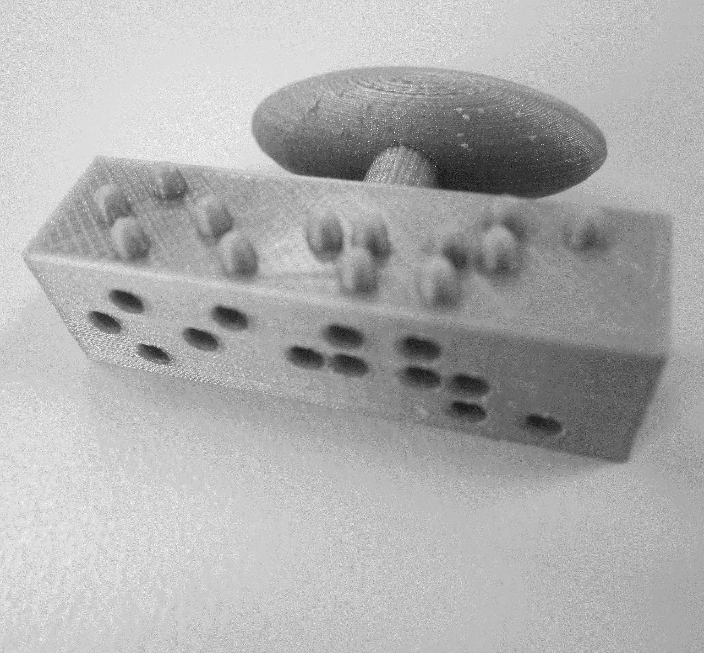
Education - Tools / Personalisation
Adaptive equipment
Individualised solutions

Slide 10
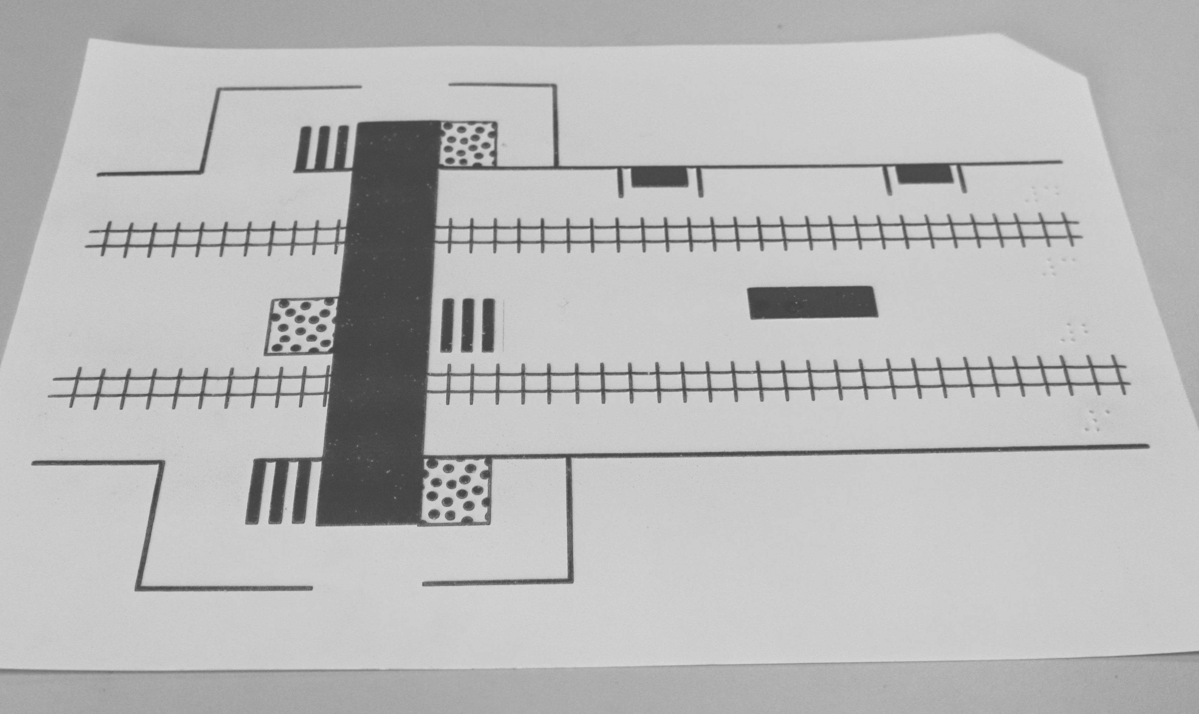
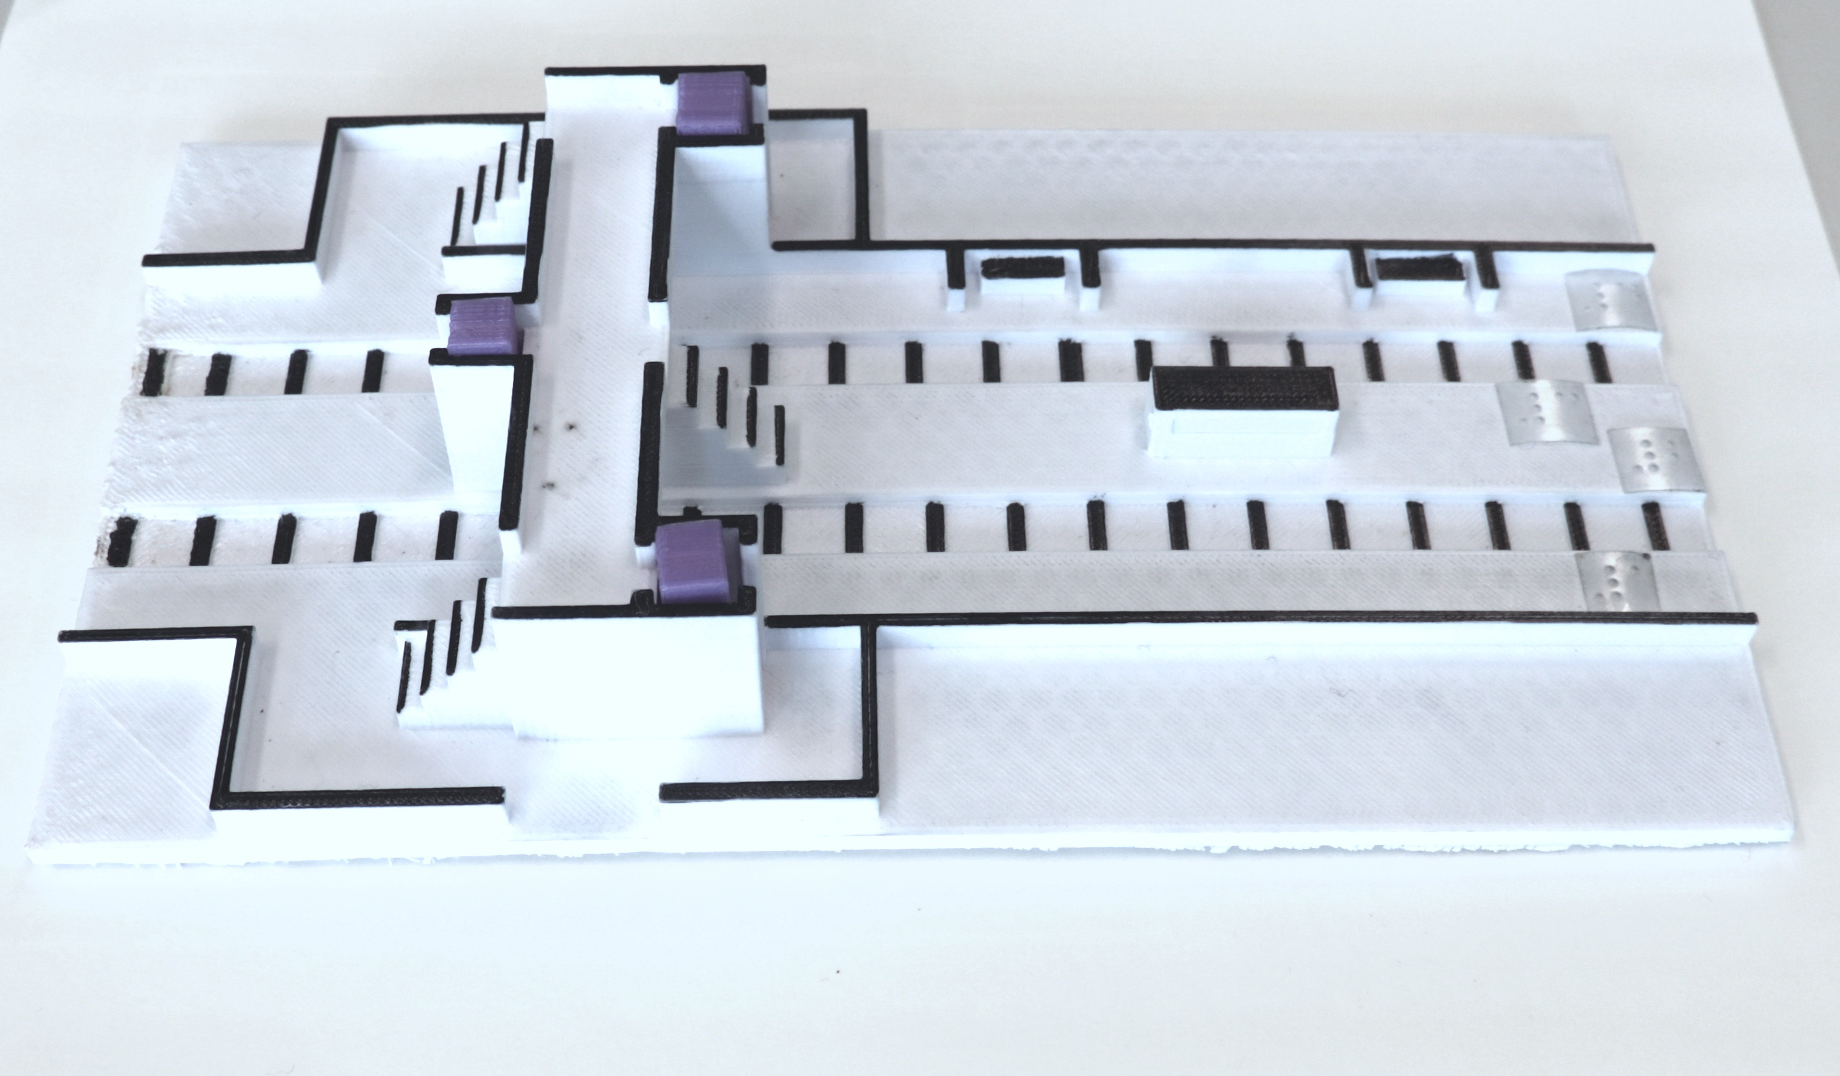
Mapping – Easy to understand
Holloway, L., Butler, M., & Marriott, K. (2018). Accessible Maps for the Blind: Comparing 3D Printed Models with Tactile Graphics.

Slide 11
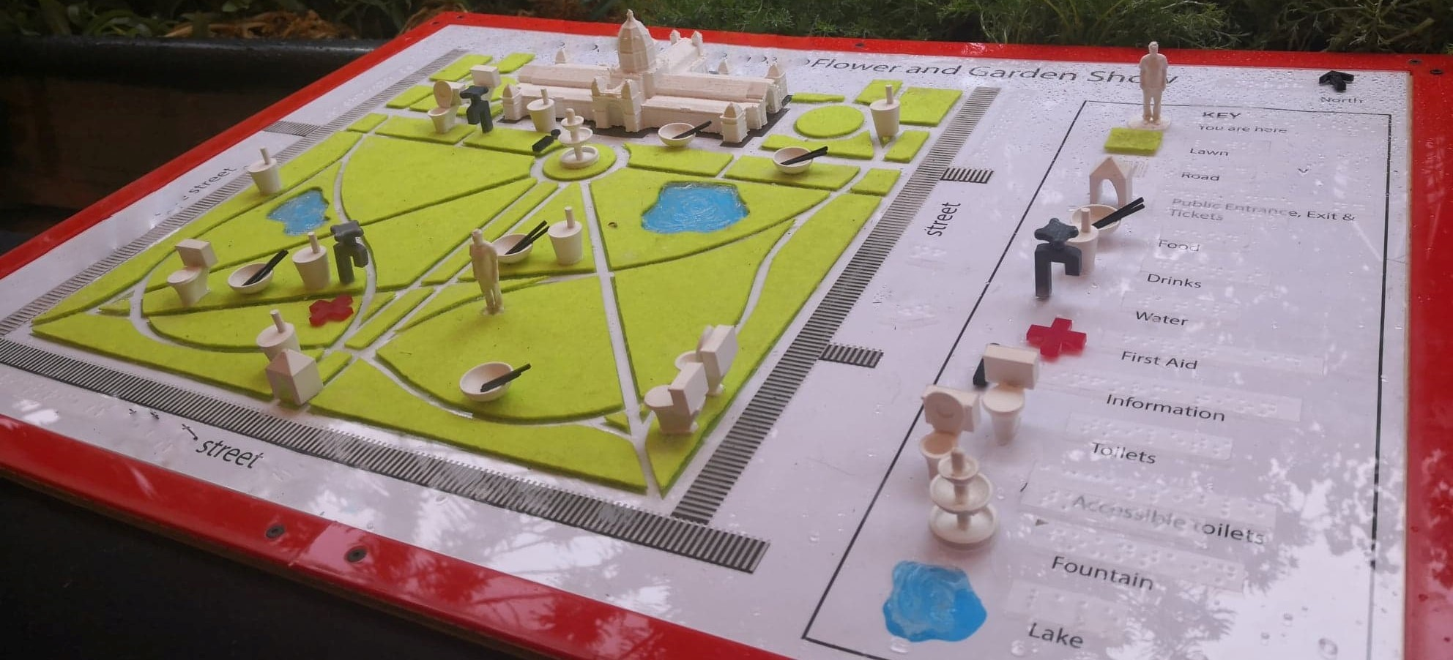
Mapping – Inclusive
Holloway, L., Marriott, K., Butler, M., & Reinders, S. (2019). 3D printed maps and icons for inclusion: Testing in the wild by people who are blind or have low vision.

Slide 12
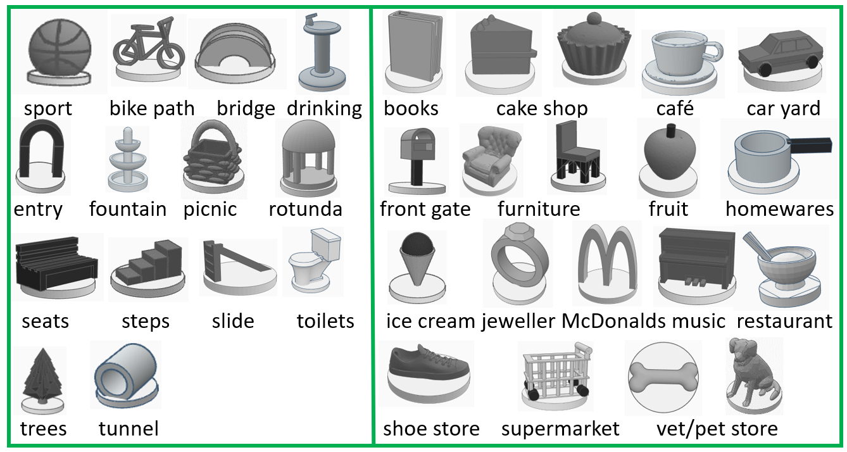
3D Tactile Icons
Holloway, L., Butler, M., & Marriott, K. (2023). TactIcons: Designing 3D Printed Map Icons for People who are Blind or have Low Vision
https://www.thingiverse.com/thing:5841775

Slide 13
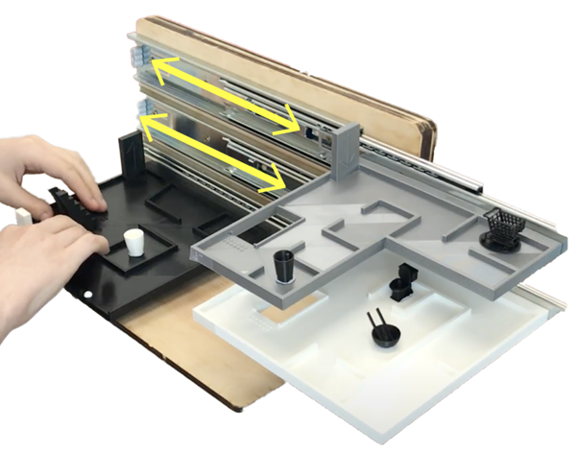
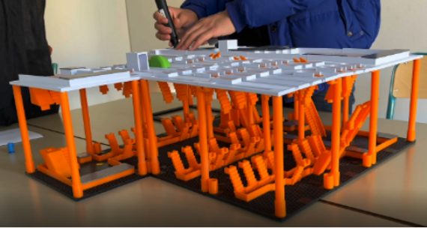
3D Multi-level building plans
Nagassa, R., Butler, M., Holloway, L., Goncu, C., & Marriott, K. (2023). 3D Building Plans: Supporting Navigation by People who are Blind or have Low Vision in Multi-Storey Buildings.
Sargsyan, E., Oriola, B., Macé, M. J.-M., Serrano, M., & Jouffrais, C. (2023). 3D Printed Interactive Multi-Storey Model for People with Visual Impairments: Co-Design Process and Comparative Study between a 3D Model and 2D Tactile Maps.

Slide 14
Barriers

Slide 15
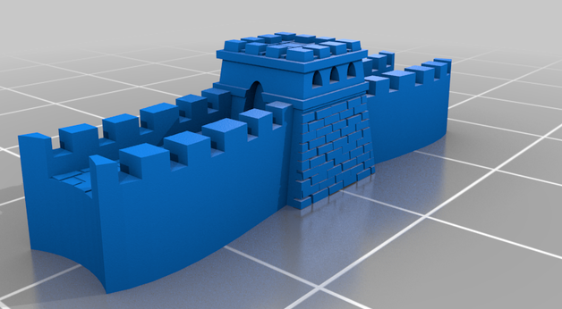
Barriers to the adoption of 3D printing
Awareness
Technical expertise
Availability of suitable 3D models

Slide 16
Enablers

Slide 17
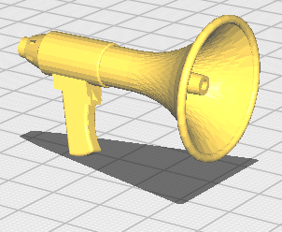
Awareness
Presentations
Guidelines
https://printdisability.org/about-us/accessible-graphics/3Dprinting
https://tactiles.eu/guidelines/
Catalogues
https://printdisability.org/about-us/accessible-graphics/3d-printing/repositories/
https://tactiles.eu/database/
ANZAGG 3D working group

Slide 18
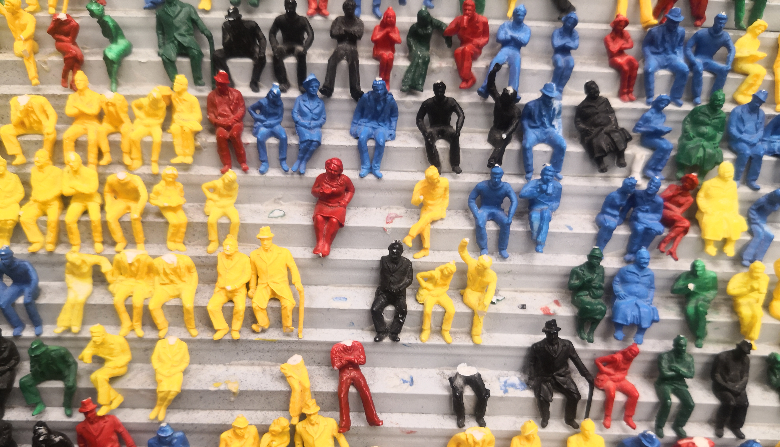
Technical Expertise
Guidelines
https://printdisability.org/about-us/accessible-graphics/3Dprinting
https://tactiles.eu/guidelines/
ANZAGG 3D working group
Online 3D printing communities
Technical champion
Centralised distribution model

Slide 19
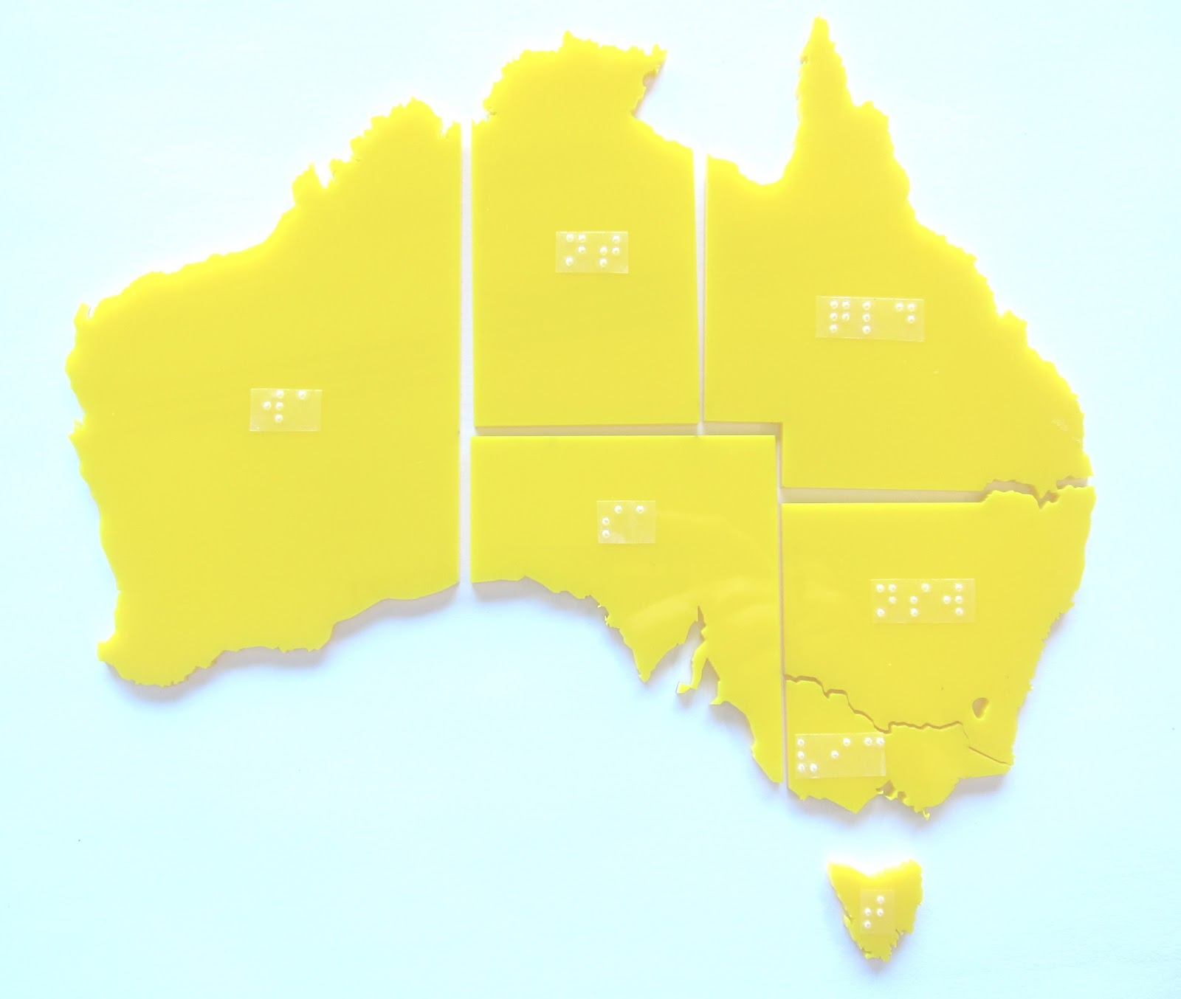
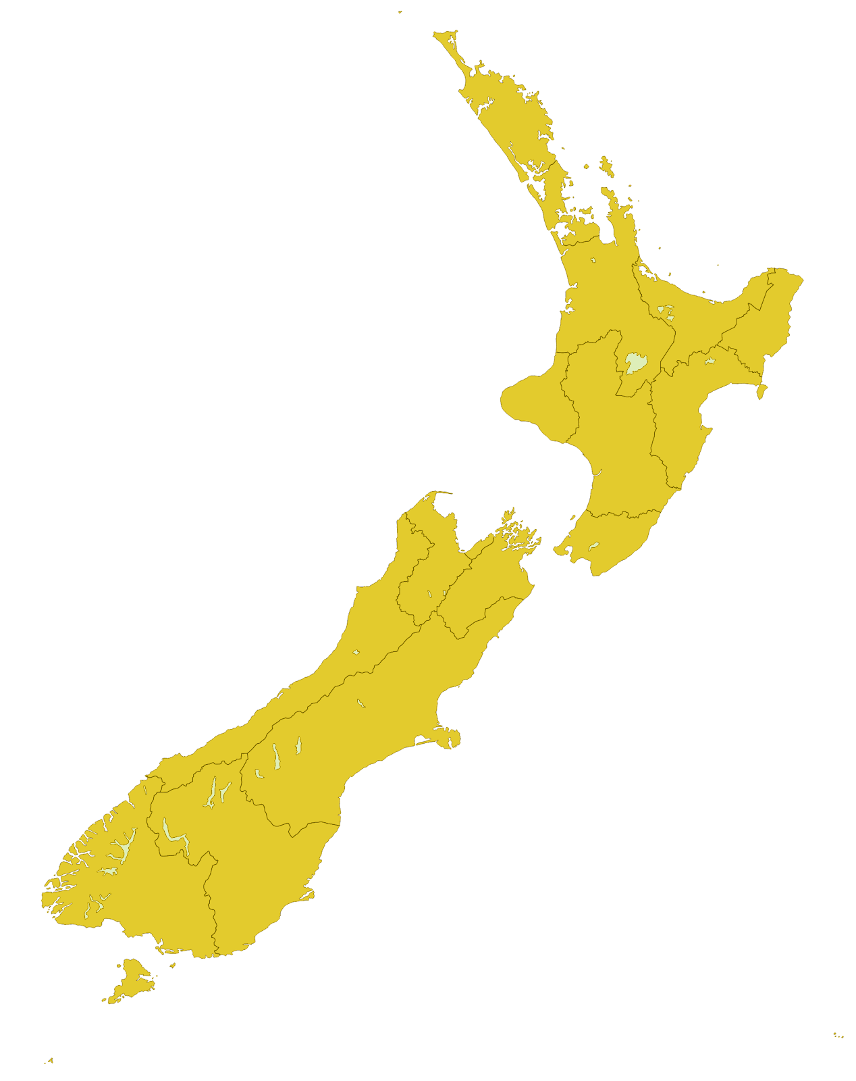
Successful adoption in Australia and New Zealand
BLENNZ: By request
NextSense: Catalogue
BLPS: Catalogue
VA: By request
ACT: By request
SASSVI: By request
SVRC: catalogue

Slide 20
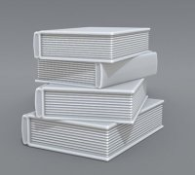
Suitable designs
Online repositories
https://printdisability.org/about-us/accessible-graphics/3d-printing/repositories/
Collaboration between requestor and designer
Design champion
Design guidelines
https://printdisability.org/about-us/accessible-graphics/3d-printing/design/

Slide 21
Ongoing work

Slide 22
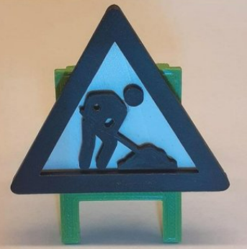
Ongoing work
ANZAGG 3D printing working group
https://tactiles.eu
Further research by PhD students: Leona Holloway, Samuel Reinders, Ruth Nagassa

Slide 23
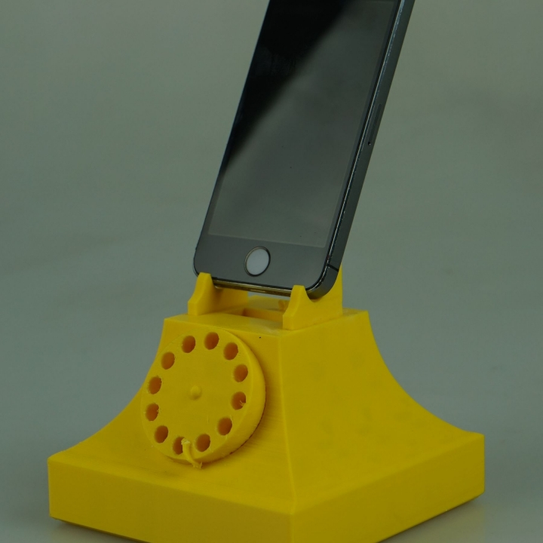
Contact Us
https://www.monash.edu/it/hcc/inclusive-technologies
Twitter @MonashInclusive
Leona.Holloway@monash.edu
www.thingiverse.com/leonah/designs
https://accessiblegraphics.org/research/3dprints/arc/updates/

