Slide 1
Creating Accessible Documents in InDesign & Adobe Acrobat DC Pro
Vithya Vijayakumare
Digital Accessibility Specialist
Accessible Information Services

Slide 2
Presentation Outline
Accessibility overview
Screen reader demonstration
Built-in Accessibility Checker Tool in Adobe Acrobat DC Pro
InDesign and Adobe Acrobat DC Pro
Notes:
1. This is the outline for today’s workshop.
2. I will kick start by providing a quick Accessibility overview and demonstrate, how assistive technology like a screen reader reads an inaccessible vs accessible document and we will jump straight into workshop.

Slide 3
Accessibility Overview: What is a print disability?
Blind or vision impaired
Physical disabilities
Learning disability
Notes:
Print disability refers to those who have difficulties reading printed materials.
This includes those who are blind or who have a vision imparment like macular degeneration, glaucoma or blindness
Have a physical disability like MS, cerebral palsy or severe arthritis which prevents someone them from holding a print book or turning a page
Or have a learning disability like dyslexia, which limits their ability in processing information and follow line of print/ which limit their ability to follow a line of print or which affect their concentration e.g. dyslexia

Slide 4
Accessibility Overview: Policy & Legislation
Under the section 24 - Disability Discrimination Act 1992 – maintained by the Australian Human Rights Commission
Information & services are accessible
Comply to Web Content Accessibility Guidelines (WCAG) 2.0/2.1 AA accessibility standards & PDF Accessible Universal (A/U) digital document standards
Accessibility in the Digital Service Standard (DSS)
Point 9: Make it accessible - make sure your service is accessible and the product or service is tested with people with disabilities.
Australia Accessibility ICT (Information & Communication Technology) Procurement
Specifies a broad range of accessibility requirements applicable to ICT products and services
Notes:
There are several policies and legislation that have been put in place here in Australia in order to ensure individuals with disabilities are given equal access to services, products and information as others in the community.
2. The accessibility law tents to fit in the following categories I have listed on my slide. The details are also available in your handbooks that I will be sharing after today’s workshop. Please feel free to study these policies in order to ensure all accessibility requirements are met.

Slide 5
Accessibility Overview: Australian context
5.3 million or 22% of the population have a print disability
4% are Blind-Low Vision (BLV) and others 18% (other print disability)
< 10% published material is accessible
Source from Cielo24
Notes:
According to the World Blind Union, 5.3 million or 22% of the population have print disability. (World Health organisation)
Out of the 22%, 4% are blind-low vision and the other 18% are those with intellectual and physical disability
3. According to World Blind Union, only less than 10% of all published materials are made available in various accessible formats

Slide 6
Accessibility Overview: Multiple tools
MS Suite:
Adobe Suite:
Wordpress (HTML):
MailChimp:
SurveyMonkey
Notes:
There are multiple tools or programs available to create accessible content. The tools I have listed on my slides contains reasonable guidelines on how you can create accessible content.
Today I will be showing you some essential accessibility steps to make your content more accessible and inclusive for everyone to use using Microsoft Word and InDesign. These steps will also come in handy when you are using other tools to create marketing materials, blog post, eNewletters, Surveys and Forms
We will also be looking at the accessibility requirements to make your video and audio content accessible for everyone to use.

Slide 7
Accessible for All
Importance of making your content accessible

Slide 8
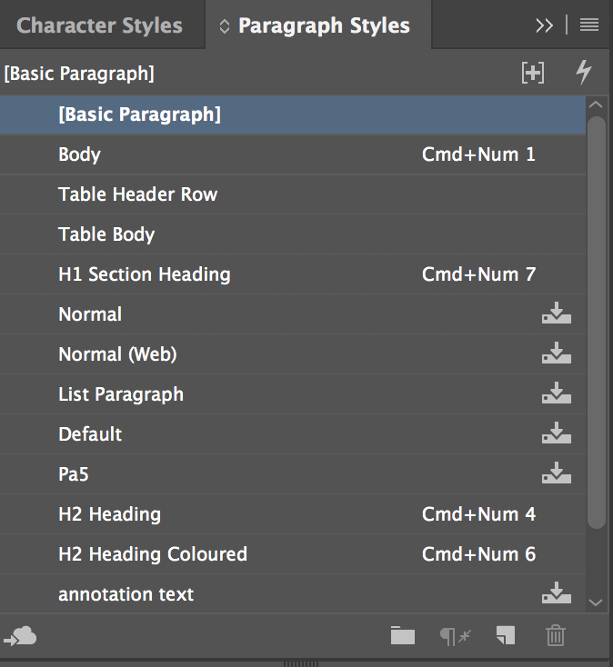
Headings and Structure: Paragraph Styles
Good structure is important.
Navigation points for users.
Use InDesign’s Paragraph Styles to create heading tags.
Notes:
Creating a good structure is an important accessibility principle when creating any type of documents.
A person with vision impairment or blindness gain a good understanding of how the document is organized/structured through headings.
A good structure for your document is created through Paragraphy styles and the implementation of headings tags within the paragraph style.
3. Sighted users often look for big, bold text to get an idea of its structure and content
5. Also, a person who is blind and vision impaired using a screen reader can also use this as navigation points to jump from one heading to another heading.
6. This makes navigation within the document much more efficient and easier.
7. Making text larger and bold does not make it a heading.
8. Before we look into how to use paragraph styles and creating headings tags, there is a few things that needs to be taken into consideration when you are formatting your styles in paragraph styles.

Slide 9
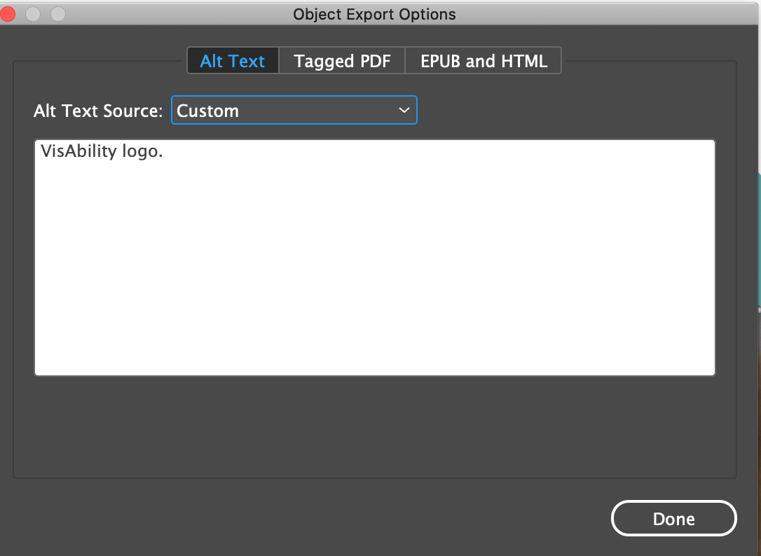
Alternative text for Images
Alternative text provides image description for screen readers.
Use Object Export Options in InDesign.
Use existing metadata as Alt text (if available).
Notes:
Alternative text or Alt text is a way to describe images or illustrations in the form of text to screen reader users.
2. A good way to think of alt text is how you would describe an image to someone over the phone.
3. Like Ms Word, can you also add alt text in InDesign and I am going to show you how.

Slide 10
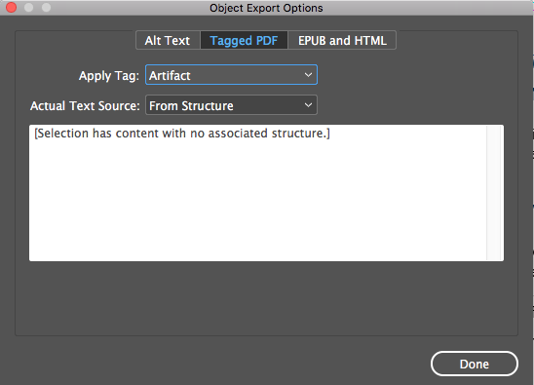
Decorative Images
Mark decorative images/illustration as “Artifacts”.
Screen readers will ignore images marked as artifact
Notes:
Images that does not convey any meaning for screen reader user or if it duplicates the content in the text can be mark as an “artefact”. Screen reader will ignore images marked as artifacts.
Anchoring images will also ensure that the alt text is read at the right location – this could be before or after the text.

Slide 11
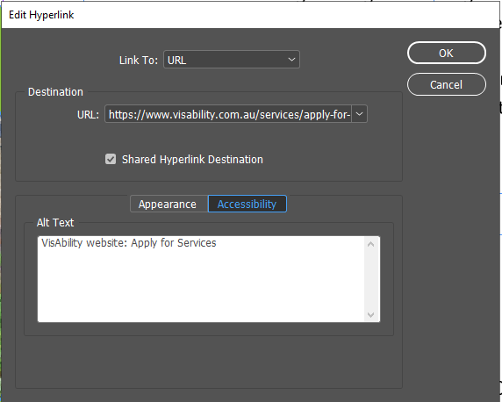
Hyperlinks
Make Hyperlinks active and descriptive
Give a description in the ‘Accessibility” tab in the hyperlink section.

Slide 12
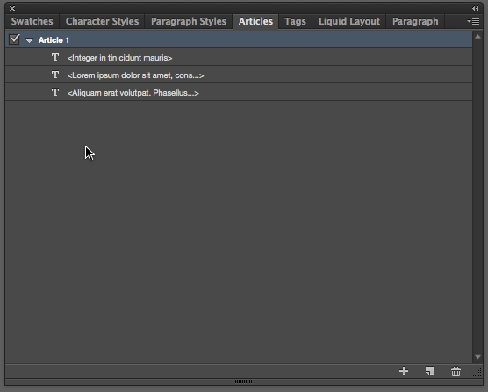
Tag orders
Specify correct reading order for assistive technology to read the content in the right order.
Use the “Articles panel” in InDesign to organise the order.
Enable “Used for Reading Order in Tagged PDF”
Notes:
1.Tags are the basis of creating an accessible PDF document.
2. They indicate the structure of the document, communicate the order in which items should be read by a screen reader and;
3. Determine exactly which items will be read by a screen reader.

Slide 13
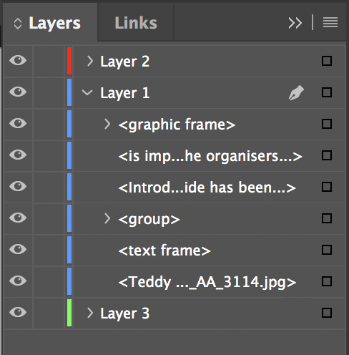
Flow order
Controls how the content re-flows on the page.
This is used by users with low vision.
Re-stack the order from bottom to top in the layers panel.

Slide 14
Export to accessible PDF (Print)
Make sure to check the following boxes:
Create Tagged PDF
Bookmarks
Hyperlinks
Advance settings: Document Title
Notes:
1. Creating an accessible PDF is simple if you have structured you accessible word document well, based on the accessibility principles
2. There are two ways you can use to convert your document to accessible PDF.
3. This option would grab all your heading styles and converted it into appropriate headings for your PDF document.

Slide 15
Finalising PDF in Adobe Acrobat DC
Accessibility items to be checked/remediated:
Setup Acrobat with accessibility elements (Tags, Order, Content)
Check metadata
Change initial view of the document
Conduct a full accessibility check
Add document tab order
Check reading order which includes tag order and re-flow order
Improve table accessibility: tag dual header columns & alt text
Check heading tags
Check/Setup bookmarks

Slide 16
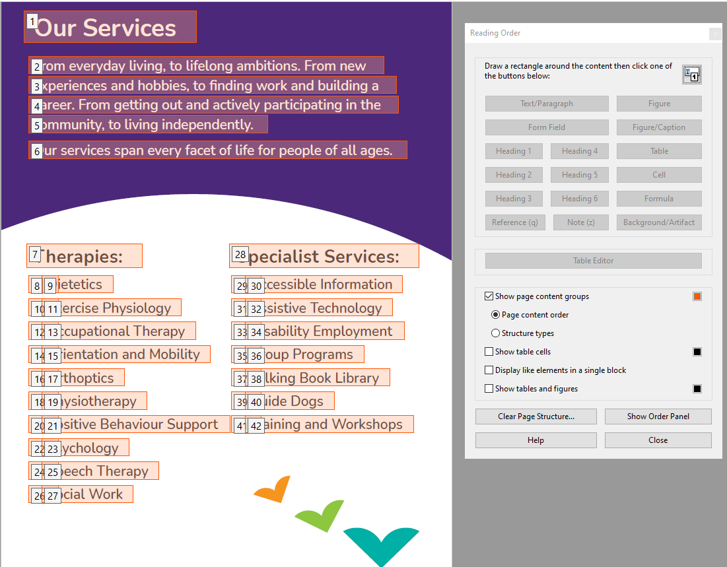
Finalising PDF in Adobe Acrobat DC
Touch up and finalise document in Acrobat.
Certain accessibility elements have to be remediated in Acrobat.
Notes:
Make accessibility fixes in Acrobat

Slide 17
Thank you!
Email: library@visability.com.au / accessible@visability.com.au
Facebook: VisAbilityAU
Twitter: @visabilityAU, @vithyavv
Linkedin: VisAbilityAU, Vithya Vijayakumare
Instagram: @visabilityAU
VisAbility: www.visability.com.au
Phone: 1800 847 466 (1800 VISION)
Notes:
Thank you for taking the time to attend our session today and for giving us the opportunity to come out here. We hope you have learnt some great tips for making your documents accessible.
Our aim is to make information readily accessible for all, whether it is for work, learning or leisure.
We have printed a summary of the tips Vithya has covered today and they are included in your packs. Please remember to take them with you.
If you have any feedback on today’s session please feel free to come and have a chat with any of us. We will also be sending out a feedback survey in the next week.
We do offer other accessibility services. If you have anything specific in terms of Web/print/braille/physical building access please feel free to have a chat with one of us or contact us anytime.
Our contact details have been provided on the sheet in the packs.

Slide 18
VisAbility
Every support at any stage.
VisAbility website: www.visability.com.au

