Slide 1
Big Visions:
Creating diverse content
at Vision Australia Library

Slide 2
The landscape
Limited children’s books with diverse characters
Outdated, uninspired stories
Few stories that explore jobs/careers for people with a disability
No print and braille books commercially produced in Australia
Few audiobook versions available

Slide 3
The challenge
Three aspirational real-life stories
Funny, relatable, beautiful stories
Role models for young people to believe what they can be
Books have UV printed braille on each page – the first in Australia and made available in braille
Development of three books: concepts, interviews, creation, design, proofing, printing
Launch Surfing in the Dark
Launch Dressed for Success
Funding
received
2019
2021
2022
Feb 2023
Mar 2023
Jul 2023
Sept 2023
Partnership est. with Berbay Publishing
Launch Big Visions movement
Launch Cooking up a Storm

Slide 4
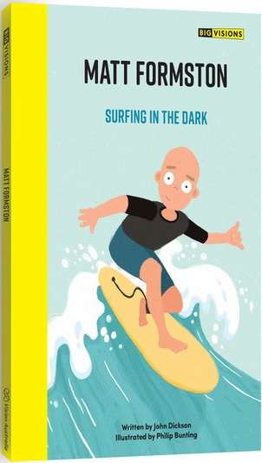
Surfing in the Dark
Award winning author John Dickson and bestselling illustrator Philip Bunting
All rights and copyright belong exclusively to Vision Australia
Influencer campaign, reaching 1.4M people
Sold in major retailers including Big W, Dymocks, Amazon, Booktopia and more
Outstanding reviews in industry publications
Available in 2,500+ libraries and schools across Australia
Primary Education Teachers Association Australia (PETAA) have created a teaching unit for their 100,000+ users
Listed on the Premier’s Reading Challenge lists
International translation applications
“this necessary and worthy book is the first in what is sure to become a ground-breaking and vital series for all ages.”

Slide 5
Big Visions
Celebrating diversity and inclusion
Creating kinder bookshelves and better conversations
Telling real stories – no stereotypes
Built into teaching units and curriculum
Introducing braille concepts to the wider community

Slide 6
What we know, so far
Mission over profit
Seek alternate funding
Partner with SMEs
Seek industry partnership and support
Check your ownership

Slide 7
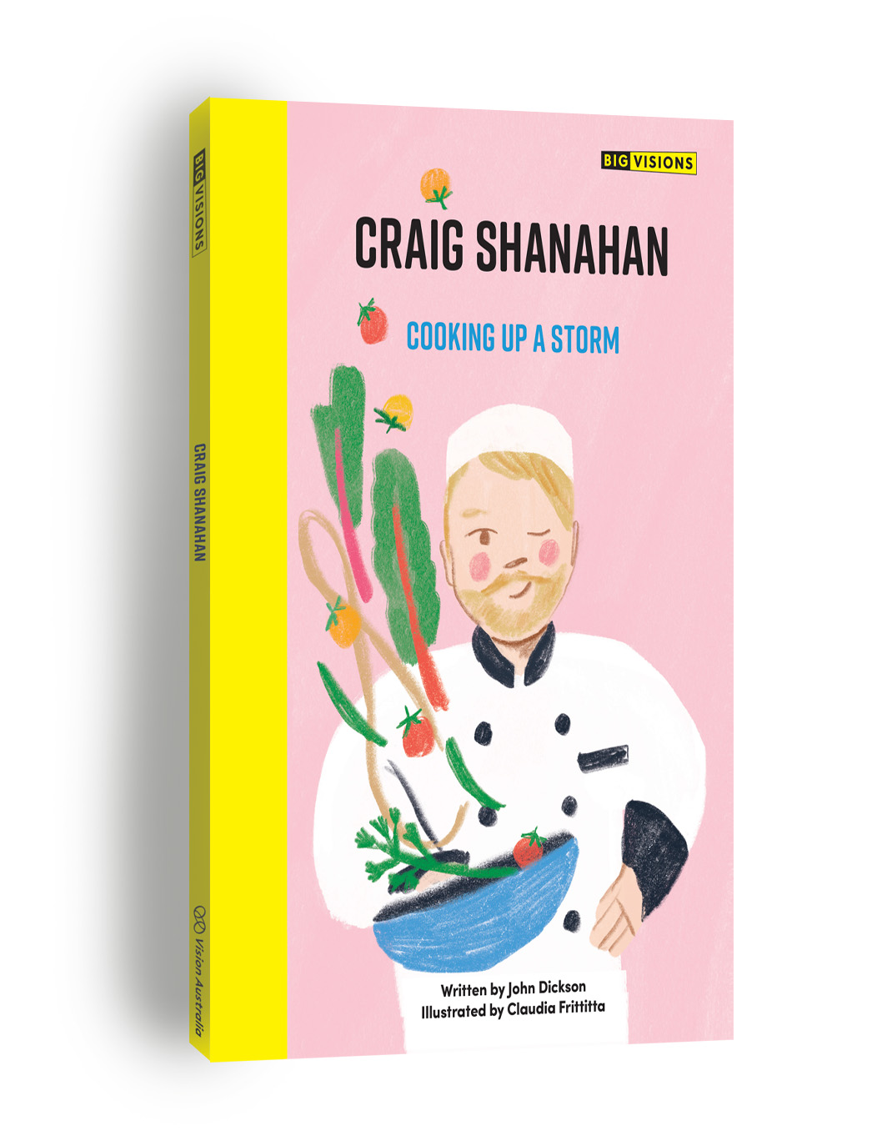
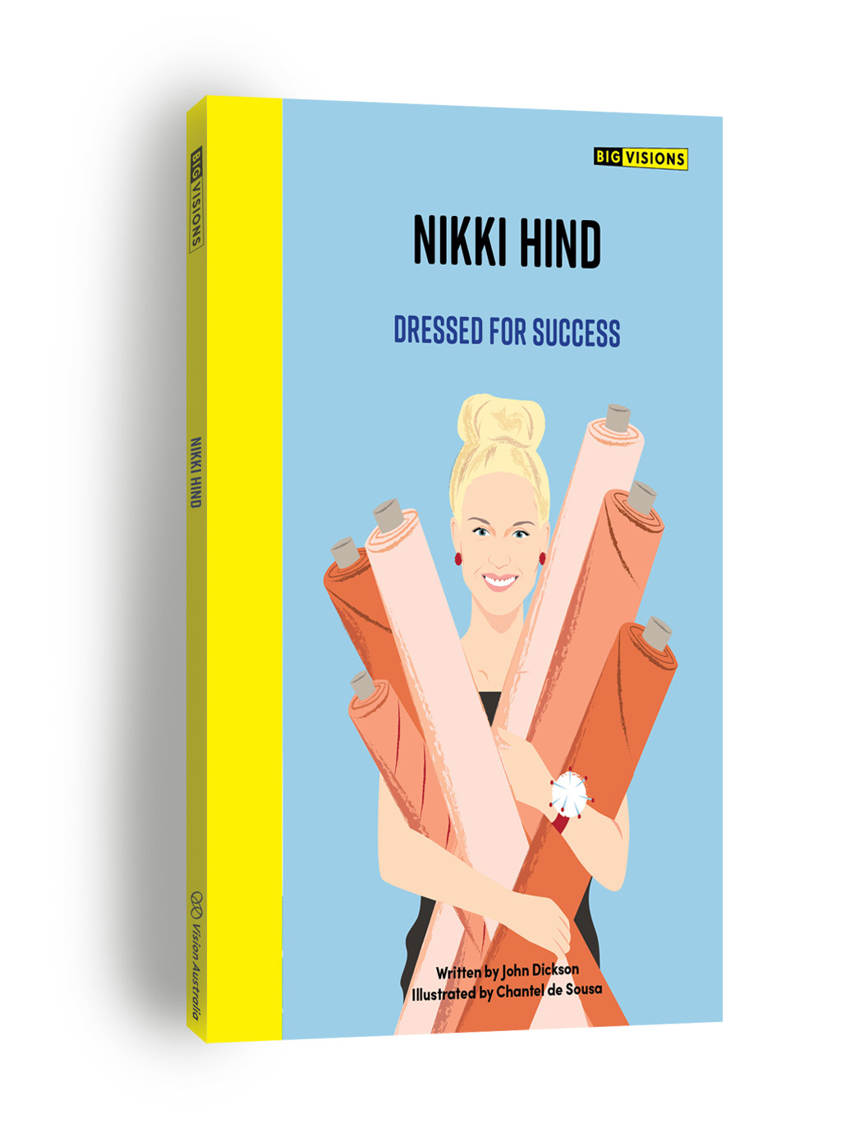
Next Steps
Establishing the Big Visions brand to be recognisable and trusted
Setting best practice in accessibility
Creating new forms of content; i.e. bibliotherapy
Out July
Out Sept

Slide 8
Questions
Vision Australia Library
www.visionaustralia.org/library
library@visionaustralia.org

