Slide 1
UV Printing and Laser Cutting Accessible Materials.
Peter Le
peter.le@visionaustralia.org
Trent Betts
trent.betts@visionaustralia.org

Slide 2
UV Printing - How
UV printing is simple ink-jet printing but allows you to “over print” many layers of ink which is cured instantly by a UV lamp which is attached to the print head. This allows you to print multiple layers of ink on top of each other in a single print run.
These “Layers” can be controlled to determine how high and how tactile a print is.
Because you can lock the media on the print tray, you can perform multiple print runs on the one piece of media making the possibilities endless.

Slide 3
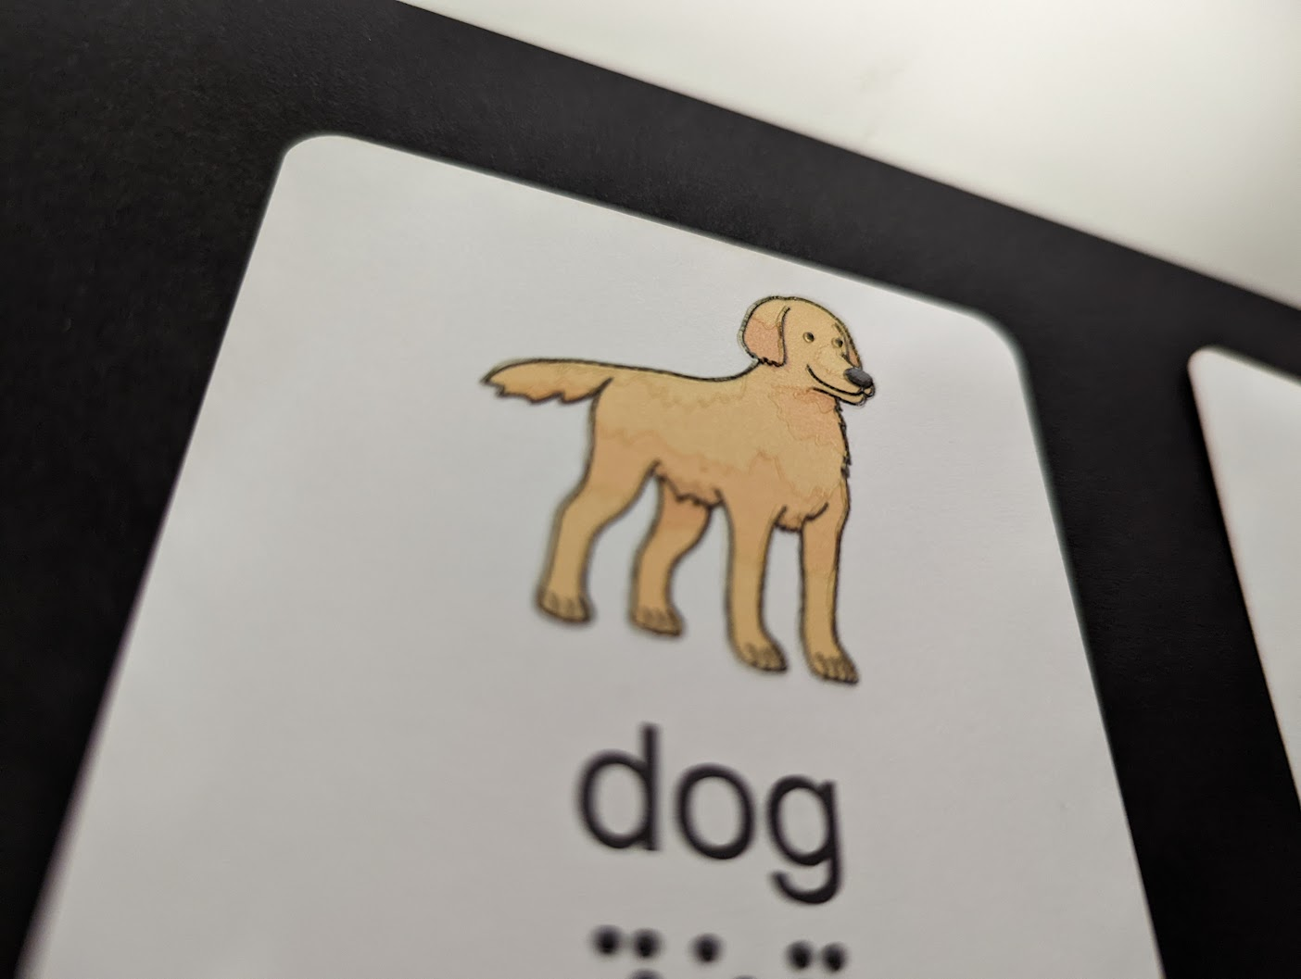
UV Printing - Lines
Unlike swell paper you can control both line thickness and height.
You can make a tactile line as thick as you want with out it “blowing out”.
You can make a line as fine as can be felt without having to worry about it being “to fine to puff”.

Slide 4
UV Printing - Textures
Because finer lines and shapes can be more easily distinguished tactually using UV printing compared to swell paper, you have a lot more scope on the textures you can use.
Textures can be designed to perfectly reflect the image that they are representing.

Slide 5
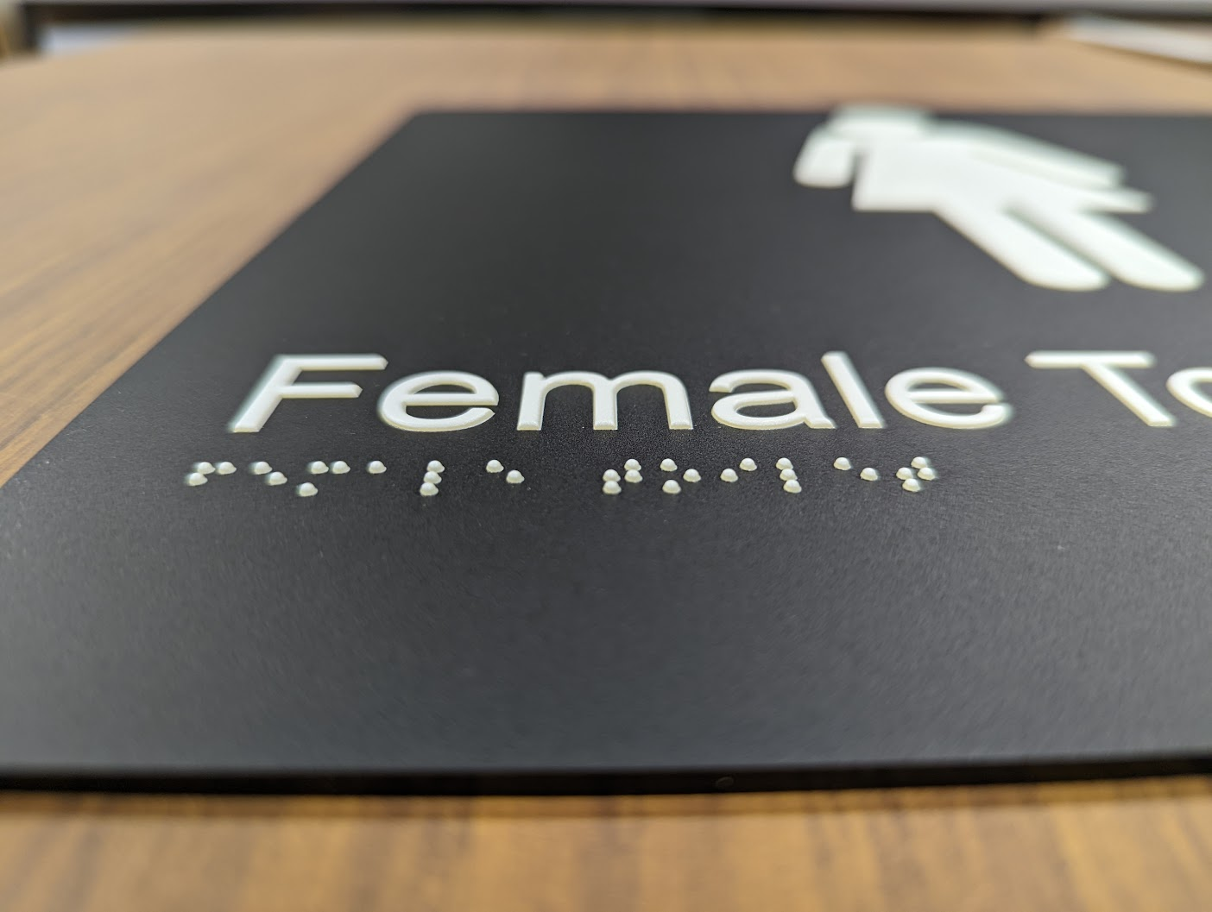
UV Printing - Braille
Because of the way that the ink drops, braille dots are created with a nice “dome”.
By being able to print multiple layers, you can determine how high the braille dots are.

Slide 6
Advantages Over Swell Paper
Consistency – You can print multiple copies and not worry about the copies puffing differently due to heat inconsistencies.
Colour Freedom – You have the option to create a thick tactile line over a pale printed line (or vice versa).
Print + Braille – Because you are not beholden to what is printed underneath, you can print “clear” braille over print.
Large Format – You are not limited to the size of the swell paper stock you have.
Media – You are not limited to printing on swell paper.
Intersecting Lines – although not ideal, intersecting are more clearly defined than using swell paper.

Slide 7
UV Printing - Problems
Printhead hitting the print stock or raised gloss – this will result in a ruined print, or “one for the sample box”.
Print Time – Some projects such as graphs with simple lines are much quicker to produce on swell paper.
Warping – Some materials can warp under UV light and gloss.
Clear gloss is still visible and can have a yellow colour.
You have to alter your existing files designed for swell paper to be UV printed.

Slide 8
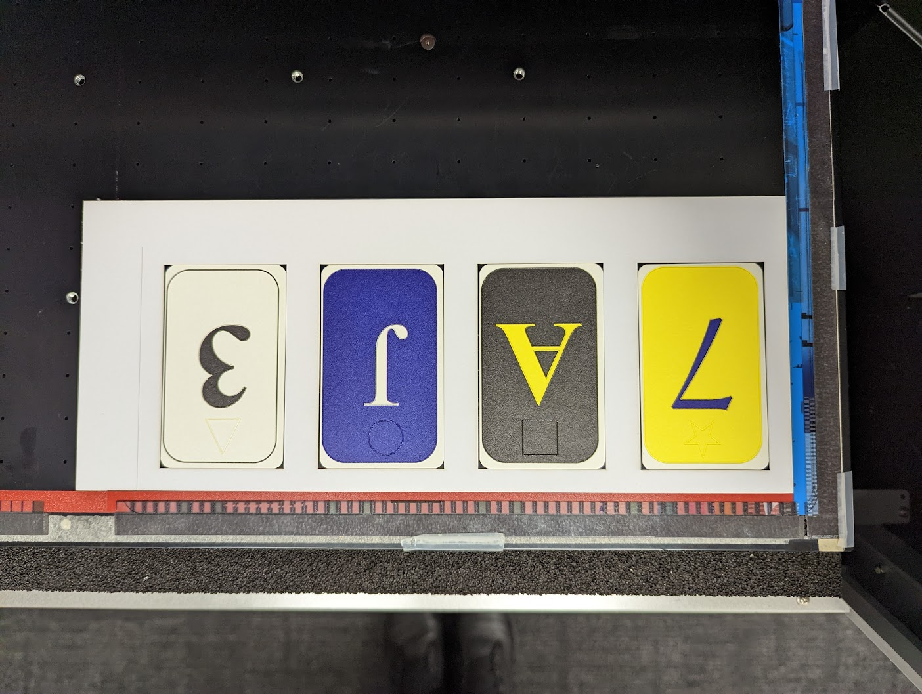
Laser Cutting
Jigs
Because of the precision that UV printing allows, it is important to place print media in the correct location on the print bed.
Laser cut jigs can be secured to the print bed to ensure consistent print runs.

Slide 9
Laser Cutting
Cutting Tactile Markers
Because you can cut any shape you design, it is possible to embed tactile markers in the cut.
Notes:
Could be something for measurement,
Could be something to indicate which way is up.

Slide 10
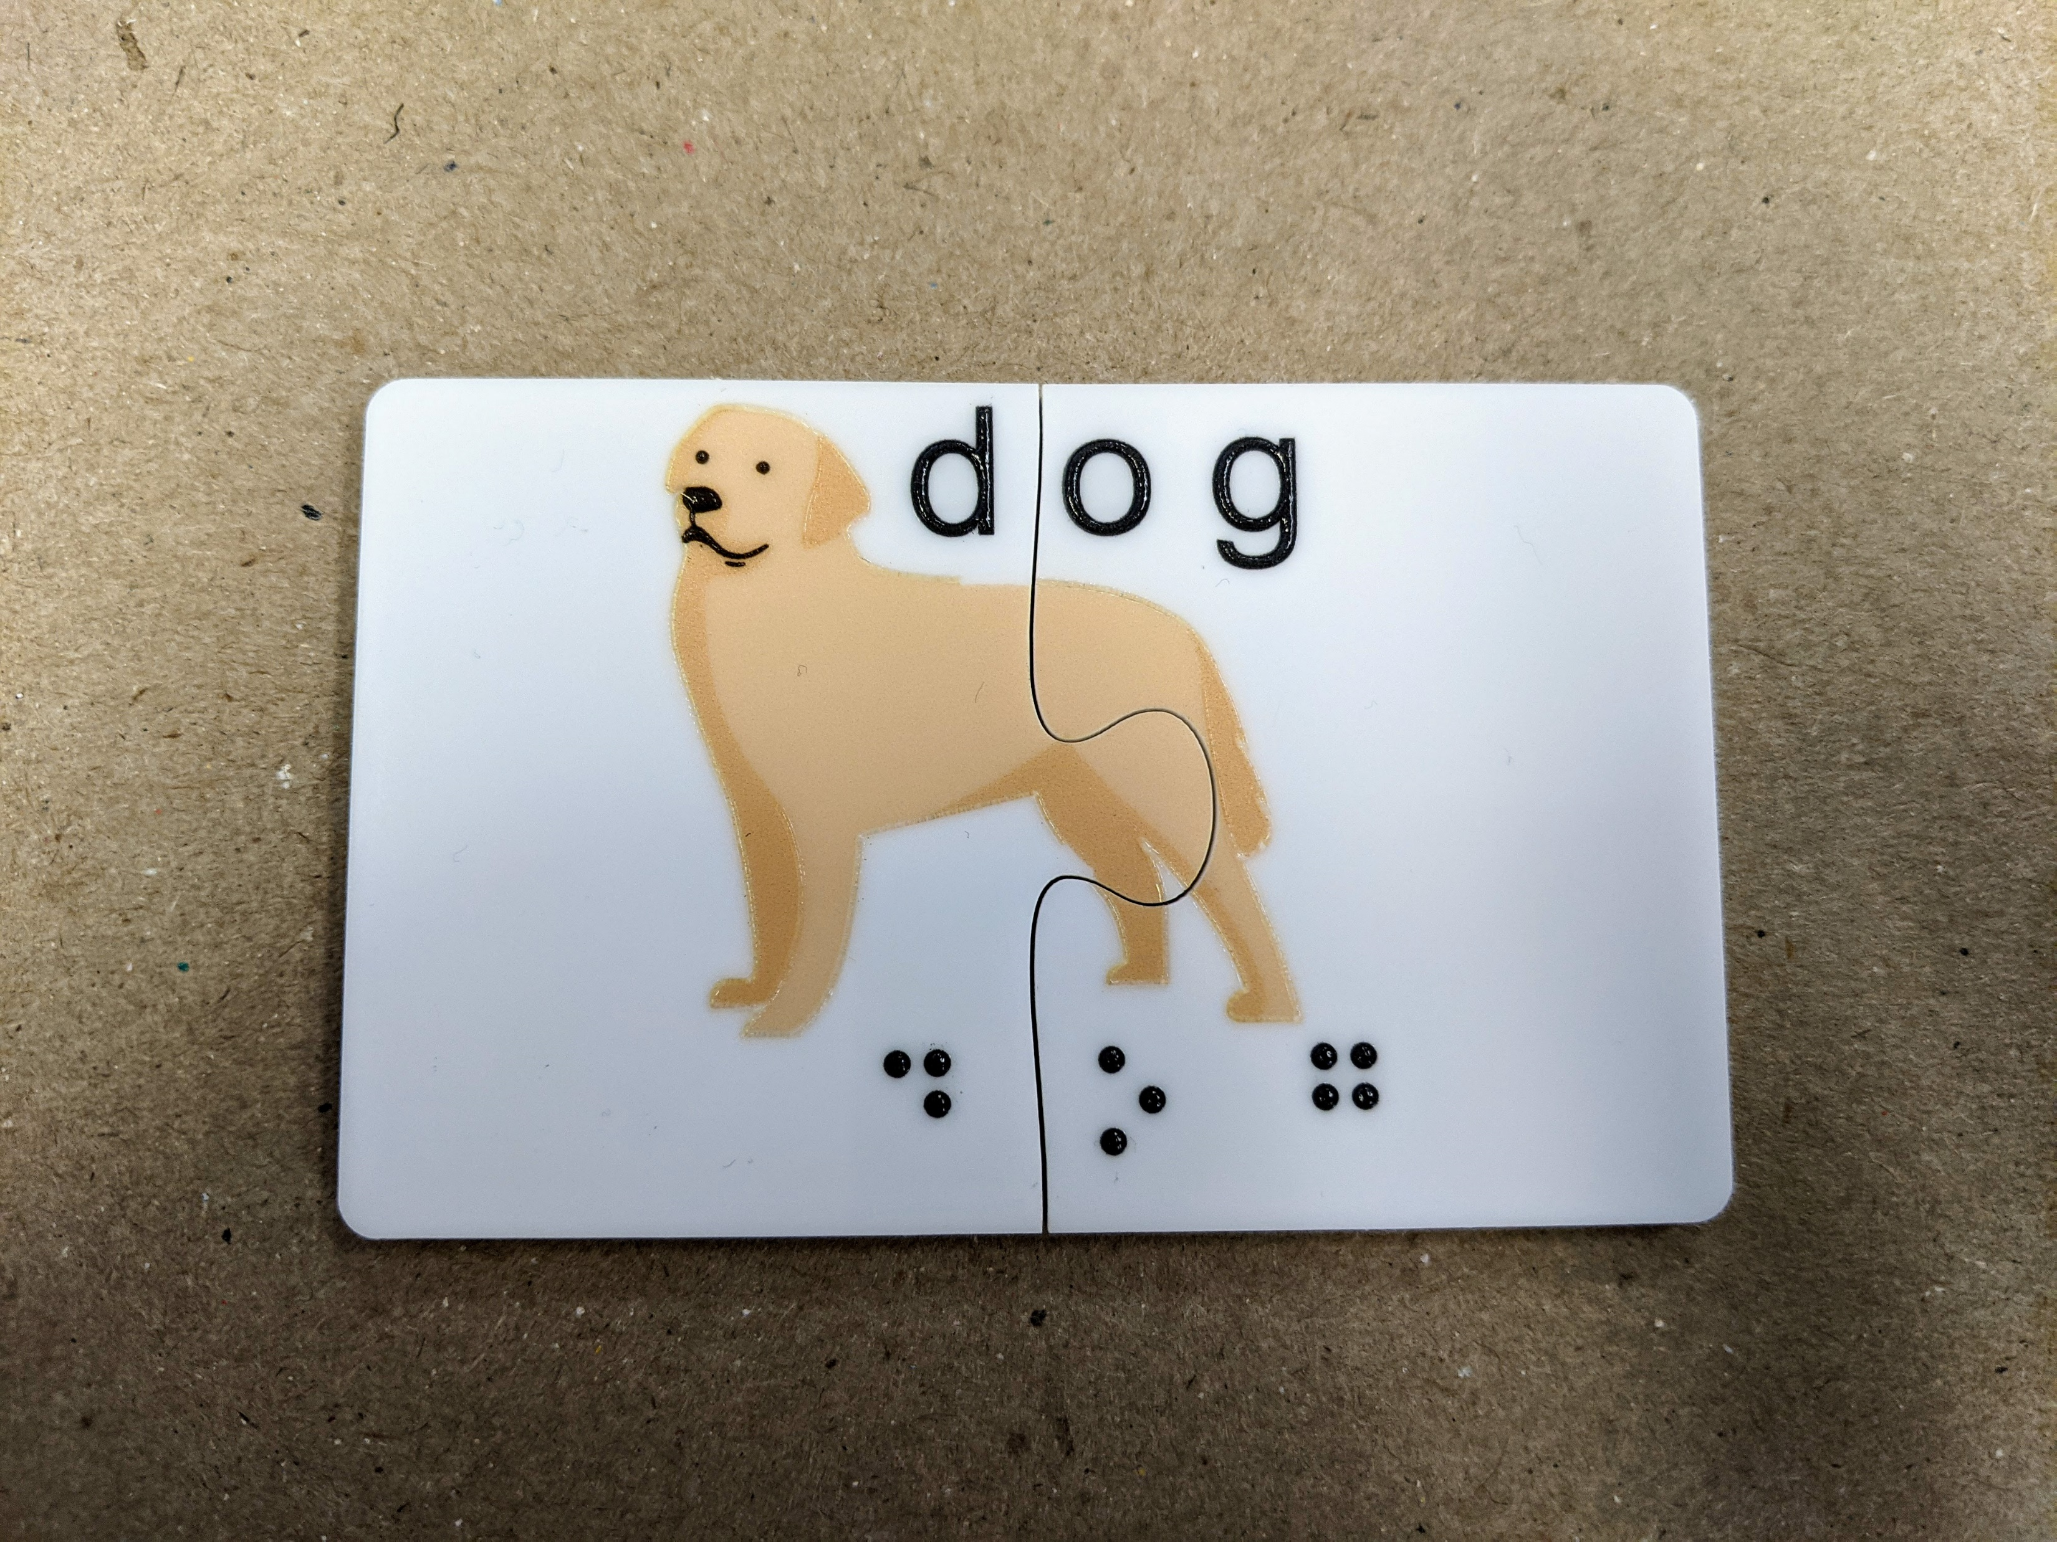
Laser Cutting
Puzzles
Because of the accuracy and the crispness of the cut lines, laser cutting jigsaw puzzles can be used to make simple and complex puzzles to aid in the learning of braille and tactile reading.
Likewise if a print project is larger than the printer, you can print in parts and have them interconnect after printing.

Slide 11
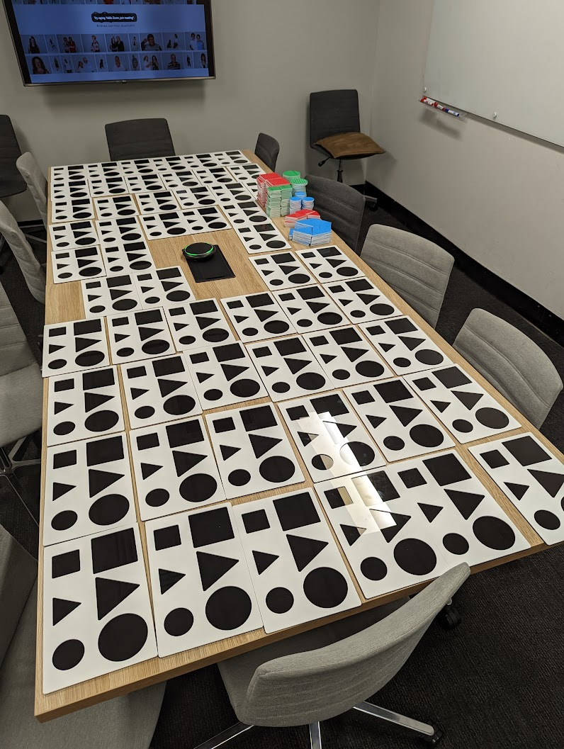
Laser Cutting
Production
Because of the speed of the laser cutter and the consistency, it is easy to produce large runs of custom print media.

Slide 12
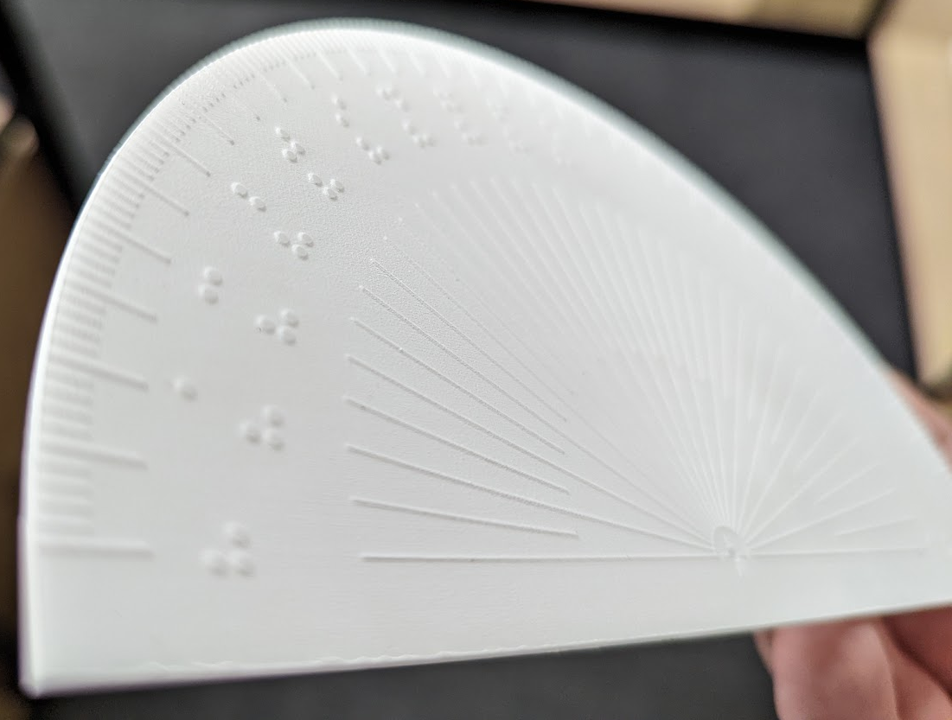
Laser Cutting
Deep Engraving
We have been experimenting with creating engraved tactile resources.
When creating these resources we have discovered the following:
Because there is so much to remove it is much slower than cutting.
Because the object spends so long under the laser, the acrylic can warp due to the heat it is exposed to, so a thicker acrylic is required (3mm).

Slide 13
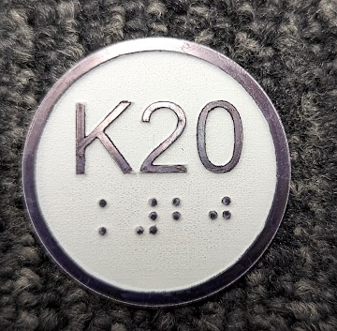
Laser Cutting
Laser Engraving Braille Dots
You can use the laser cutters to make braille dots. This is done by engraving away everything that is not a braille dot.
Because the braille is not stuck on, and is the same material as the rest of the work, it is virtually impossible to remove braille dots.
It does not feel the nicest, but is very rugged and could be used for outdoor purposes.

Slide 14
Laser Cutting
Limitations
Scorch Marks can be seen on the cut lines.
The “soot” which is created can get on your hands and mark the rest of the material.
The heat from the laser can warp materials such as acrylic.
You can not cut all materials specifically PVC based materials.

Slide 15
peter.le@visionaustralia.org trent.betts@visionaustralia.org

