Slide 1
The Power of AI for the Future of Information Access
Jack Tyrrell, Client Relationship Manager
Jennyfer Lawrence Taylor, Senior UX Designer/Researcher
Centre for Inclusive Design

Slide 2
Acknowledgement of Country
We would like to acknowledge the Traditional Owners and Custodians of this land, the Gadigal people of the Eora nation, and pay our respects to Elders, past and present.
We recognise their continuing connection to this land, which is, and always will, be Aboriginal land.

Slide 3
Presentation Overview
What is Artificial Intelligence (AI)?
AI Tools for People with a Print Disability
Opportunities and Challenges for Inclusive AI

Slide 4
What is Artificial Intelligence (AI)?

Slide 5
What is AI?
“A collection of interrelated technologies used to solve problems autonomously and perform tasks to achieve defined objectives without explicit guidance from a human being” [6, p.2]

Slide 6
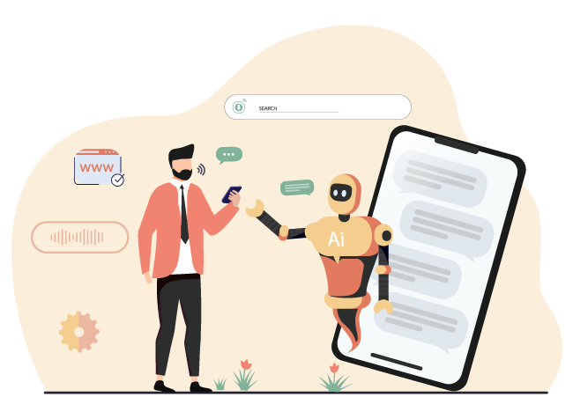
Natural-sounding conversations with people
01
A.I. can help us to understand what people are saying online or in person.
For example, Siri on iPhone.​

Slide 7
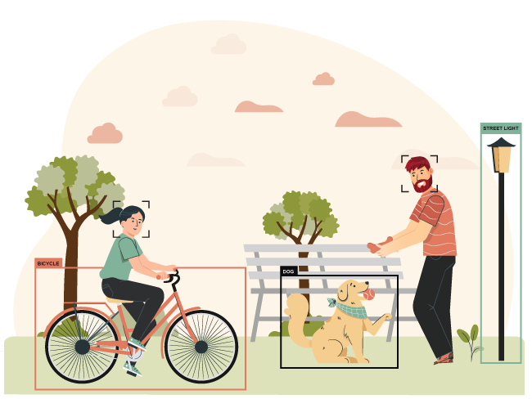
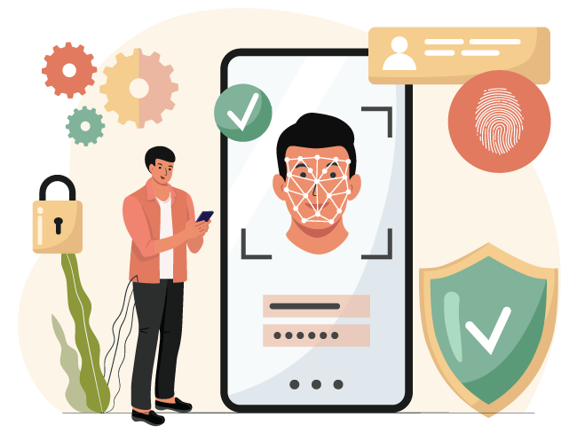
Recognition
02
A.I. might help us to identify and understand images, sounds, faces and gestures.
For example, to unlock an iPhone using face or touch ID.​

Slide 8
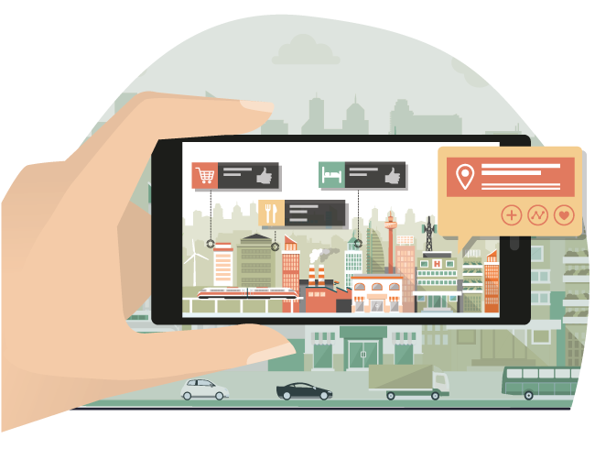
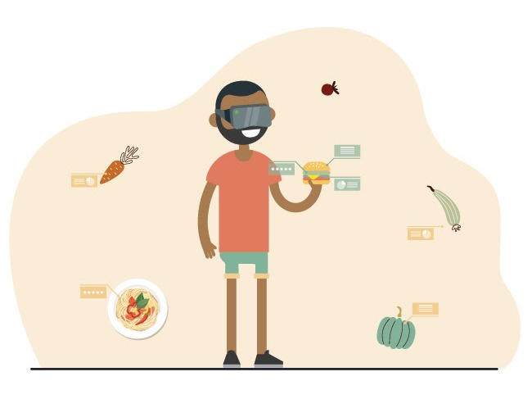
Bionic Vision
03
AI can be used to enhance the real world with useful information
A phone can use bionic vision (reality augmentation) to examine the ripeness of a bowl of strawberries

Slide 9
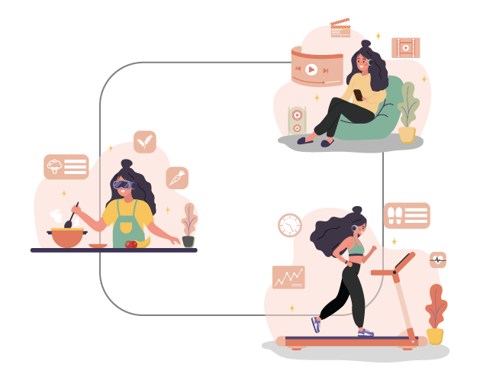
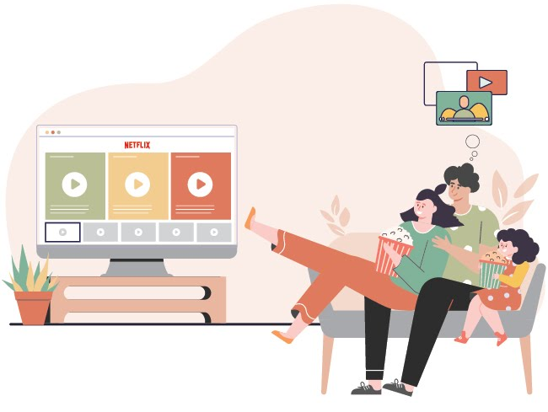
Personalisation
04
A.I. can put together information which is specific to people so that we can give them an experience that is truly made for them.
For example, Netflix uses AI to find movies that are very specific to your interests.

Slide 10
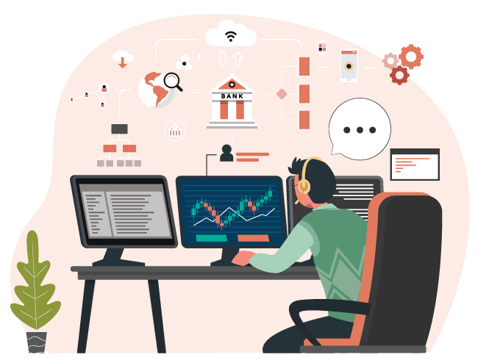
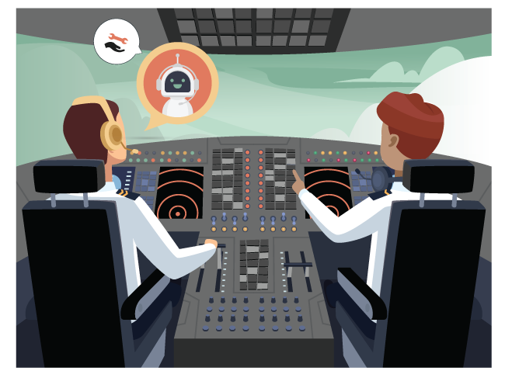
Patterns
05
A.I can help us to find normal and ‘not normal’ patterns and connections between different information.
For example, airlines monitor their planes for problems, so if they recognise something unusual, they automatically notify the pilots.

Slide 11
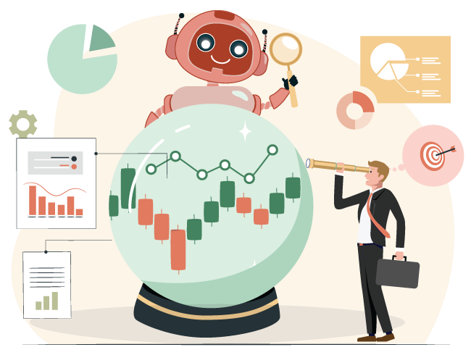
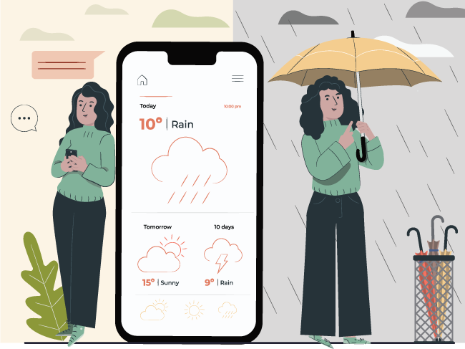
Prediction
06
A.I can help to make predictions about future situations.
For example, predictive technologies can assist meteorologists to develop accurate and up-to-date weather forecasts.

Slide 12
2. AI Tools for People with a Print Disability

Slide 13
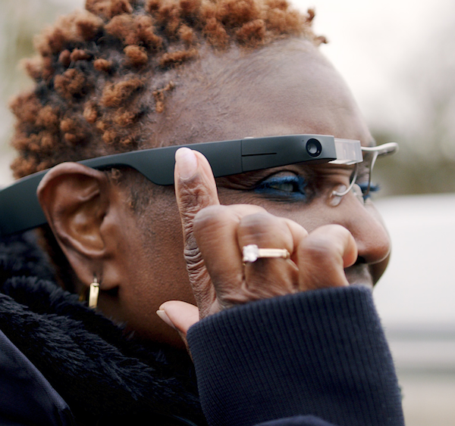
AI Tool 1: Envision Glasses
Articulating everyday vision into speech
Built on Google Glass Enterprise Edition two
Light weight glasses with a camera and a direct speaker
Less than 50 grams with 5 to 6 hours of charge
Speak out text in over sixty languages
Environmental information
Recognise faces, colour and light
Ability to call a friend to support

Slide 14
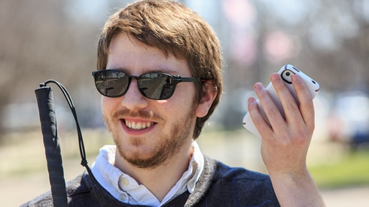
AI Tool 2: Seeing AI (Microsoft)
Uses the camera to turn the visual world into an audible experience
Complete multiple tasks with one app
Speak text
Scan barcodes on products
Recognise friends and describes their emotions
Identifies currency
Light and colours
Available in multiple languages

Slide 15
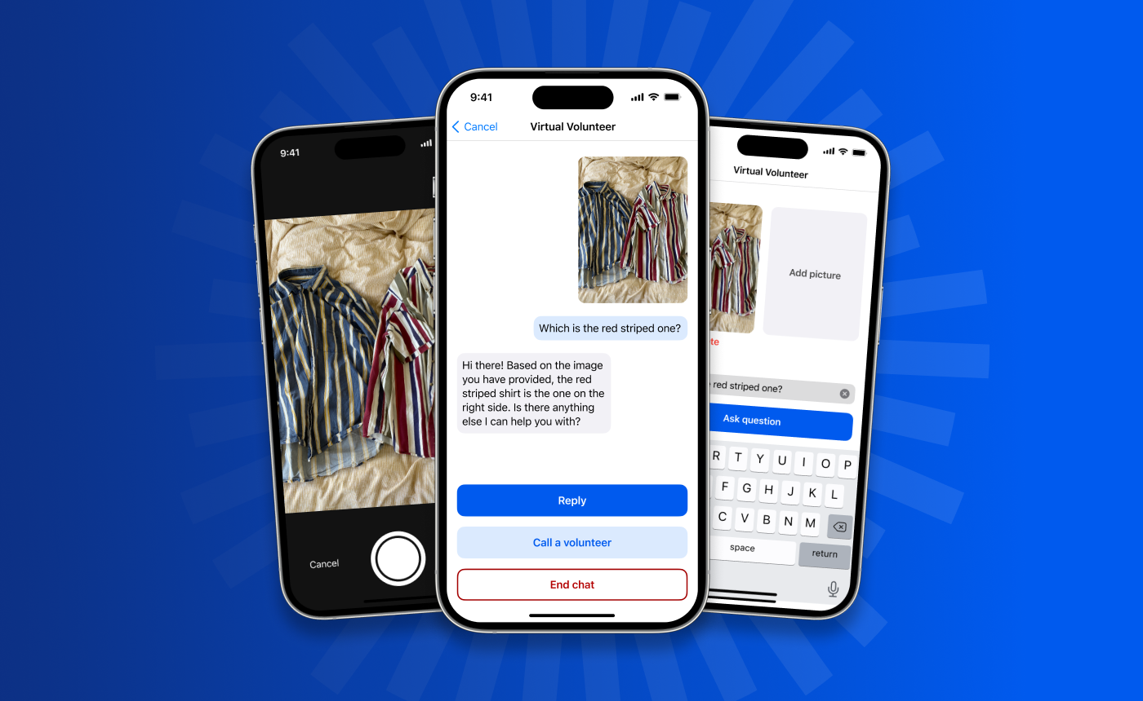
AI Tool 3: Be My Eyes
New feature to the Be My Eyes app
Virtual volunteer tool
AI powered visual assistance for instantaneous image-text generation
Users can send images to the tool for instant feedback
Response to be more conversational, for example recipes
Access to volunteer if required
Expect to launch at the end of 2023

Slide 16
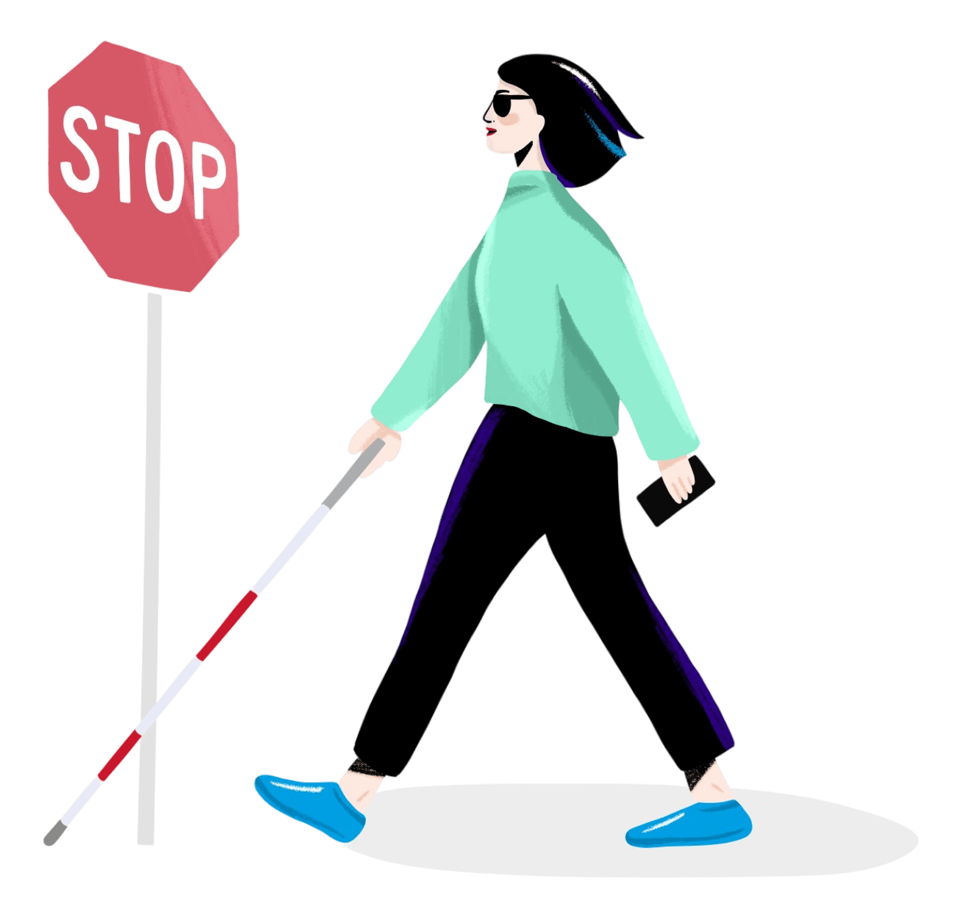
AI Tool 4: Biped
Self-driving tech to pedestrians
uses cameras and AI to generate short sounds to warn you
position of important obstacles
provides GPS instructions
a harness worn on the shoulders
equipped with cameras on the left of your chest, a battery behind your neck, and a small computer on the right of your chest.
works just like a self-driving car, for pedestrians

Slide 17
ABC Text to Speech Pilot
Imagine being able to choose articles from the ABC website and have them read to you by a natural sounding voice as you drive into work or head out for a walk.
Could voice AI offer our audiences greater choice in how they access news?

Slide 18
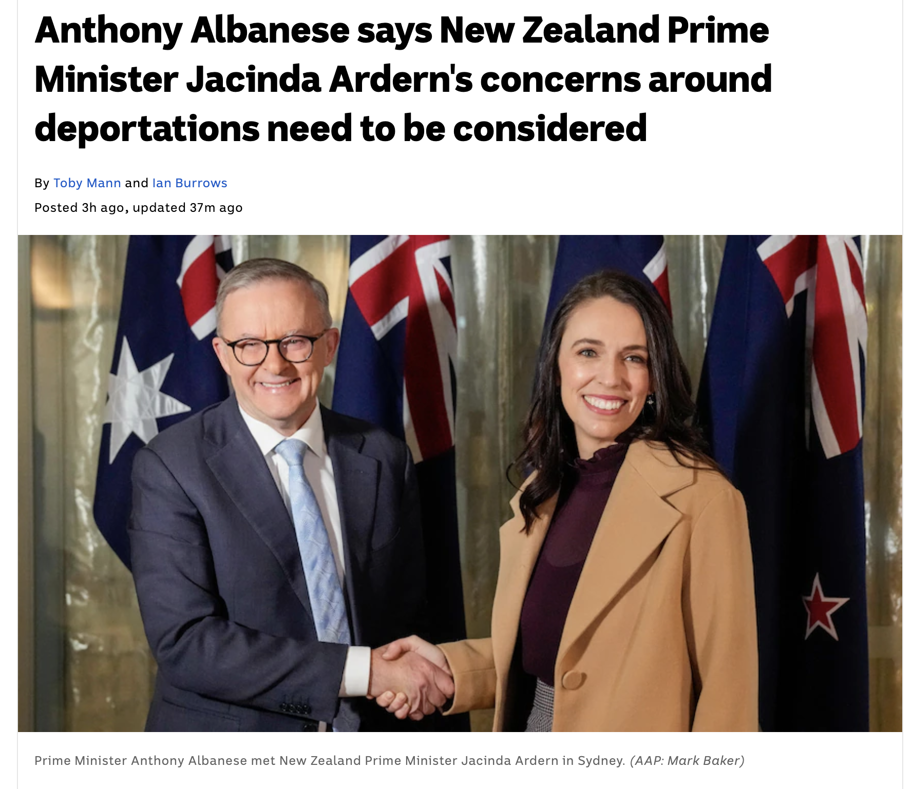
Reading an ABC Article
SIRI
Prime Minister Anthony Albanese has signalled Australia is likely to soften its policy of deporting criminals to New Zealand, after concerns were again raised by the country's Prime Minister, Jacinda Ardern.
Several New Zealand governments have complained about Australia's policy, which has led to thousands of New Zealanders with criminal records being deported.
The policy disproportionately affects New Zealanders because they have special rights to live and work in Australia, and Ms Ardern has called it a "significant issue".
Mr Albanese repeated that Australia would not be changing the core policy of deporting criminals, but indicated he was open to discussions on it.
DAVID (ABC)

Slide 19
ABC Podcast Transcription
We strive to share our content with all Australians. However, 98% of our audio content has no transcript, including our popular podcasts.
As a result, our audio content is inaccessible for the 1 in 6 Australians with hearing disabilities.
Could AI tools solve an old challenge – efficiently transcribing audio content?

Slide 20
Applying AI at the ABC
How can we use AI to make our content more accessible?​
Audio transcription, translation, text to speech, captioning, summarization, recommendations, personalisation​
​
How can we use AI to support our journalists?​
AI augmented newsrooms, AI tools for monitoring and story lead generation, fact checking, moderation tools
​
How can we use AI to help us create new content for our audiences?​
AI creative tools, virtual production, synthetic media, AI based talent and IP​
​
How we do these things responsibly and in keeping with our values?​
Responsible use of AI, ethical framework, transparency, trust

Slide 21
3. Opportunities and Challenges for Inclusive AI

Slide 22
Emerging AI products and benefits for people with a print disability
Enriching two-way communication [7]
Improving access to written materials [1, 12]
Providing new and augmented visual aids [9]
Providing virtual assistance with a wider range of tasks [5]
Improving employment opportunities and experiences [8]

Slide 23
Risks and Challenges in AI for People with Disability
Lack of AI development for disability in Australia [13]
Limited inclusive datasets for model training [2,10]
Barriers to accessing assistive technologies [10,14]
Lack of voice and representation in AI development [2,8]
Unfairness in patterns, decisions, and recommendations [8]
Perpetuating bias and discrimination [2,8]
Safety and wellbeing risks [13]

Slide 24
Some Tools for Addressing Risks and Challenges of AI
AI ethics frameworks specific to disability
R(AI)S principles – everyone’s responsibility
AI Risk/Impact assessment tools
Industry standards, guidelines, monitoring mechanisms
Need for funding for resource and methodology development
e.g., Framework for Artificial Intelligence-enabled Assistive Technology as Supports under the National Disability Insurance Scheme [13]
e.g., Accenture’s R(AI)S Principles for
academics, regulators/ policymakers, investors, and developers [8]
e.g., Artificial intelligence
assurance framework [11]
See: Data61’s Artificial Intelligence: Australia’s Ethics Framework [4]
See: Amin and Reid's The Effective and Ethical Development of Artificial Intelligence: An Opportunity to Improve Our Wellbeing [2]

Slide 25
Inclusive Design Approaches
Recognise diversity and uniqueness
Inclusive processes and tools
Broader beneficial impact
Inclusive design is design that considers the full range of human diversity with respect to ability, language, culture, gender, age and all other forms of human difference.
Designing inclusively results in better experiences for everyone.

Slide 26
Thank you!
Jack Tyrrell Client Relationship Manager
Mobile: 0411 827 419
Email: jack.tyrrell@cfid.org.au
Jennyfer Lawrence Taylor Senior UX Designer/Researcher
Mobile: 0413 000 748
Email: jennyfer.taylor@cfid.org.au

Slide 27
References
[1] Alexiou, G. (n.d.) How ai is being used to help blind students ‘visualize’ graphs and charts. Forbes. Retrieved 21 April 2023, from https://www.forbes.com/sites/gusalexiou/2022/07/27/how-ai-is-being-used-to-help-blind-students-visualize-graphs-and-charts/
[2] Amin M, Reid G (2018) Inclusive Design. Input paper for the Horizon Scanning Project “The Effective and Ethical Development of Artificial Intelligence: An Opportunity to Improve Our Wellbeing” on behalf of the Australian Council of Learned Academies, www.acola.org.
[3] Australian Government Department of Industry, Science, Energy, and Resources (2021) Australia’s AI Action Plan. Commonwealth of Australia.
[4] Dawson D and Schleiger E, Horton J, McLaughlin J, Robinson C, Quezada G, Scowcroft J, and Hajkowicz S (2019) Artificial Intelligence: Australia’s Ethics Framework. Data61 CSIRO, Australia.
[5] DiBenedetto, C. (2023, March 22) Be My Eyes meets GPT-4: Is AI the next frontier in accessibility? Mashable. https://mashable.com/article/chatgpt-openai-be-my-eyes-accessibility
[6] Hajkowicz SA, Karimi S, Wark T, Chen C, Evans M, Rens N, Dawson D, Charlton A, Brennan T, Moffatt C, Srikumar S, Tong KJ (2019) Artificial intelligence: Solving problems, growing the economy and improving our quality of life. CSIRO Data61, Australia.

Slide 28
References (continued 1)
[7] Hemsley, B., Power, E., & Given, F. (2023, January 19) Will AI tech like ChatGPT improve inclusion for people with communication disability? The Conversation. http://theconversation.com/will-ai-tech-like-chatgpt-improve-inclusion-for-people-with-communication-disability-196481
[8] Henneborn, L., & Eirel-Porter, R. (n.d.) AI for disability inclusion: Enabling change with advanced technology. Accenture. Retrieved 21 April 2023, from https://www.accenture.com/content/dam/accenture/final/a-com-migration/custom/_acnmedia/pdf-155/Accenture-AI-For-Disablility-Inclusion.pdf#zoom=40
[9] Magic EdTech. (2019, November 8) How AI is making assistive technologies more powerful. MagicBox. https://medium.com/magicbox/how-ai-is-making-assistive-technologies-more-powerful-670aa043bfcf
[10] Microsoft. (n.d.) AI for Accessibility: 3 years of progress. Retrieved 21 April 2023, from https://query.prod.cms.rt.microsoft.com/cms/api/am/binary/RWRbwS
[11] NSW Government. (n.d.) Artificial intelligence assurance framework. Retrieved 21 April 2023, from https://www.digital.nsw.gov.au/sites/default/files/2022-09/nsw-government-assurance-framework.pdf

Slide 29
References (continued 2)
[12] Sawhney, K. (2021, October 27) I-STEM: Accessible content conversion for children and youth with disabilities | UNICEF Innovation Fund. Retrieved 21 April 2023, from https://www.unicefinnovationfund.org/broadcast/updates/i-stem-accessible-content-conversion-children-and-youth-disabilities
[13] Silvera, D. et al (2022) Framework for Artificial Intelligence enabled Assistive Technology as Supports under the National Disability Insurance Scheme: Final Report.
[14] World Health Organisation (2018, May 18) Assistive technology. Retrieved 21 April 2023, from https://www.who.int/news-room/fact-sheets/detail/assistive-technology

