Slide 1
WCAG 2.2 and other standards
Sarah Pulis
Director
Notes:
Sarah

Slide 2
New and upcoming accessibility standards
WCAG 2.2
AS ISO 30071-1:2022
WWW Access: Disability Discrimination Act Advisory Notes refresh

Slide 3
New WCAG 2.2 Success Criteria
Notes:
Andrew
For each criteria, we will:
provide a plain language version of the success criteria with a link to the full version in the slides
go through the criteria in more detail and show you some examples
share who we think has primary and secondary responsibility in a digital team for implementing the criteria

Slide 4
What’s new
9
3
new success criteria
updated success criteria
2
5
1
1
Level A
Level AA
renamed
new level
2
1
Level AAA
removed
Notes:
Andrew
9 criteria (7 + 2) that most will need to address
Well talk briefly about the updated criteria the end

Slide 5
Candidate Recommendation
Candidate recommendation
January 2023
Proposed recommendation
Recommendation
July - Sept 2023
w3.org/TR/WCAG22/
Notes:
Andrew
Candidate recommendation was released September 2022. The information we will be sharing today is based on this release.
The document will then go to Proposed Recommendation stage, and we hope, fingers crossed, that it will be voted to become the final Recommendation by December.

Slide 6
Consistent Help – Level A
PLAIN LANGUAGE VERSION
Help channels can be found in a consistent location across the product.
See 3.2.6 Consistent Help for full version
Notes:
Andrew
This criteria is all about making it easy to find help when it is needed. People may give up if they encounter problems when completing a task and are not able to easily find help.
This criterion does not require you to provide help options, although providing help options is just good practice. Rather, this criterion says that if you do provide help options, they must be presented consistently.
Help channels:
Human contact details such as a phone number, email address, hours of operation.
Human contact mechanism such as a messaging system, chat client, contact form, social media channel.
Self-help option such as an up-to-date Frequently Asked Questions, How Do I page, Support page.
A fully automated contact mechanism such as a chatbot.

Slide 7
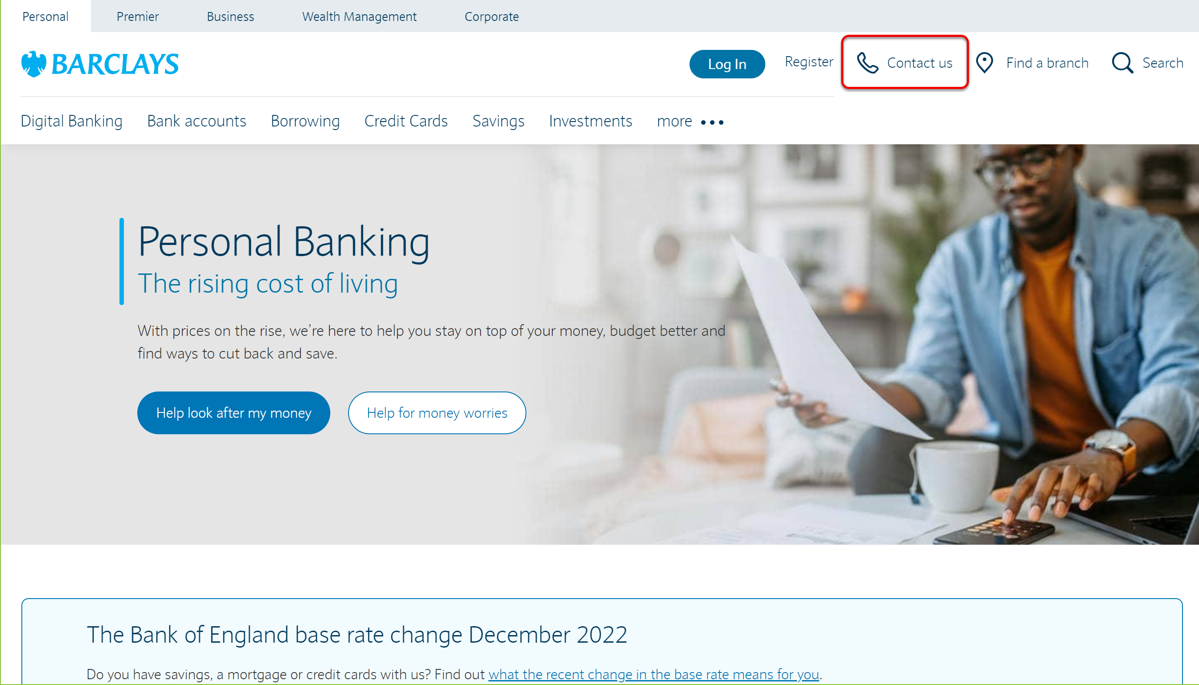

Slide 8
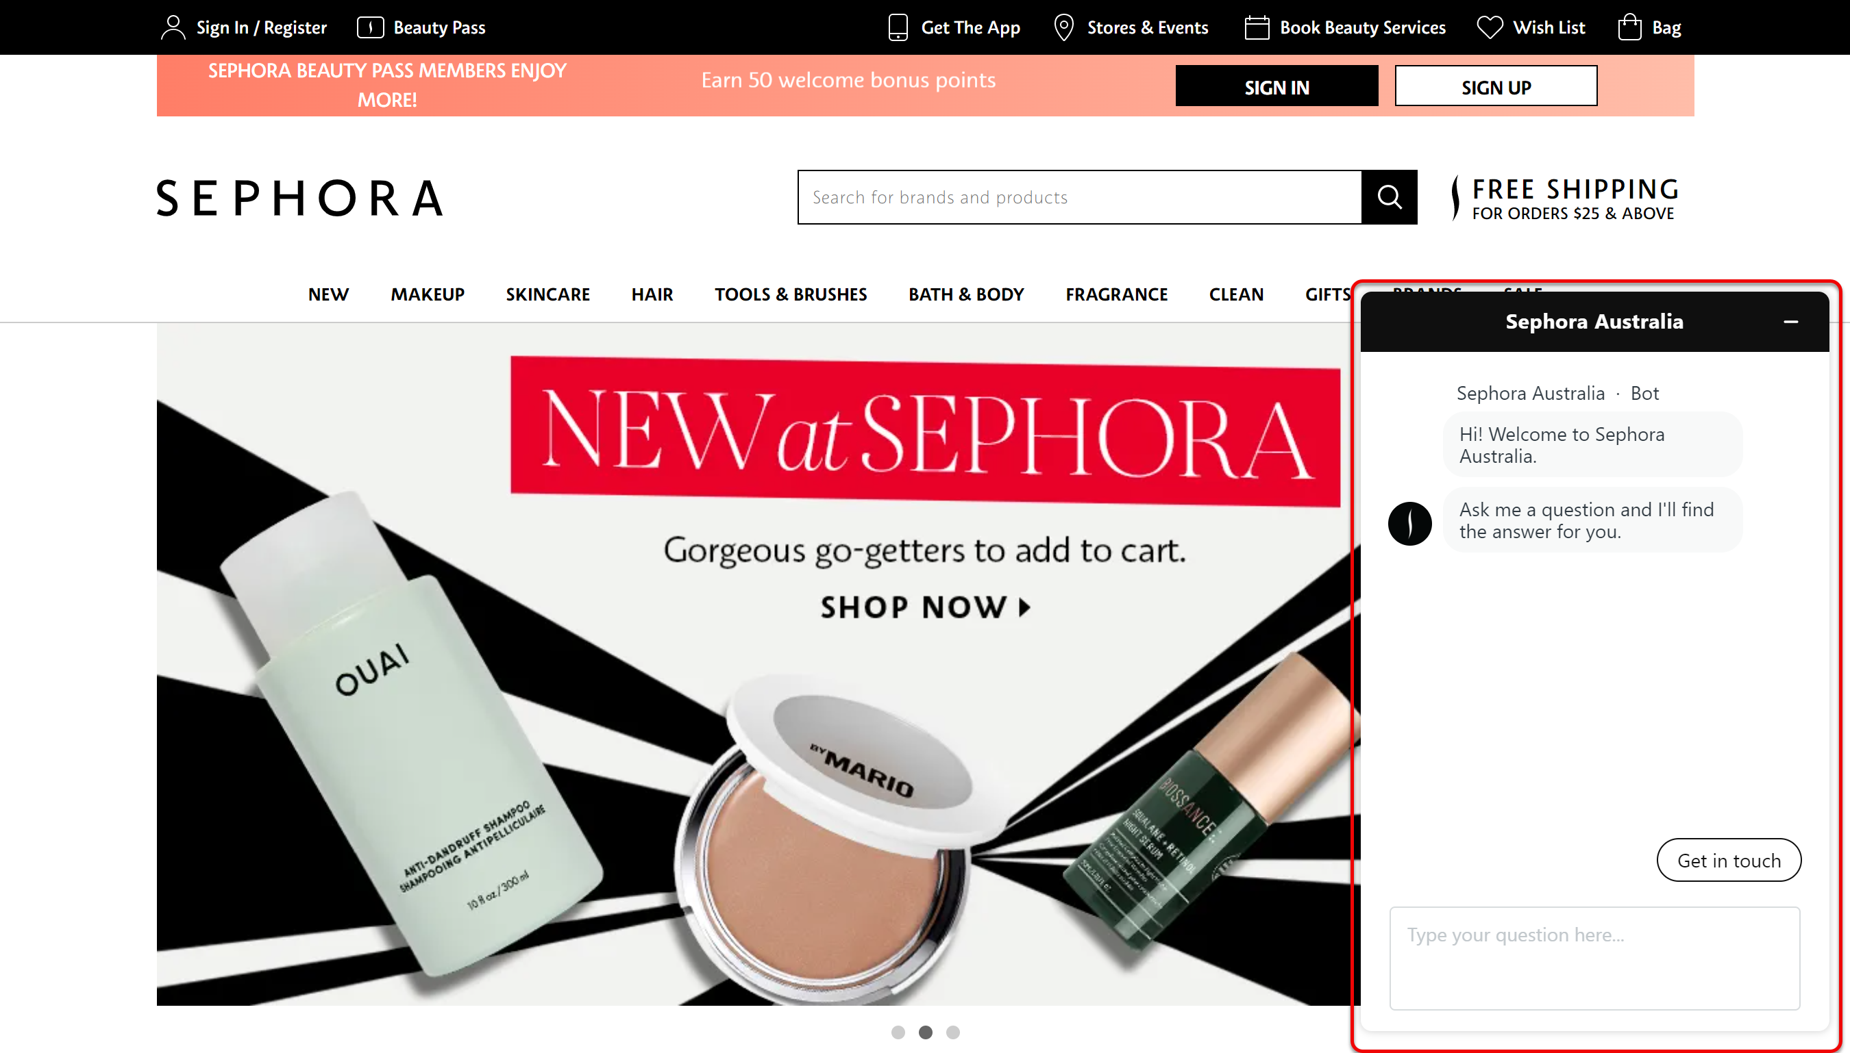

Slide 9
Redundant Entry - A
PLAIN LANGUAGE VERSION
People shouldn’t have to re-enter information they’ve already provided while completing a task.
See 3.3.9 Redundant Entry for full version
Notes:
Andrew

Slide 10
Focus Not Obscured (Minimum) – AA
PLAIN LANGUAGE VERSION
When someone tabs to an interactive element the component is not completely hidden by other content.
See 2.4.12 Focus Not Obscured (Minimum) for full version
Notes:
Andrew
In essence:
People need to see the element they’ve navigated to by keyboard.
Don’t hide the element people have tabbed to behind a another element such as a chat bot or a sticky banner.

Slide 12
Relationship between AA and AAA
AA “the component is not entirely hidden…”
AAA “no part of the focus indicator is hidden…”
Next
Next
See 2.4.13 Focus Not Obscured (Enhanced) for full version
Notes:
Andrew
The AA criteria says that when a person tabs to an interactive element (or component), no part of that component is entirely hidden.
The AAA criteria – Focus Not Obscured (Enhanced) says that when a person tabs to an interactive element or component, no part of the focus indicator is hidden.
So, AA references the component itself, whereas AAA only references the focus indicator.
Initially, the wording for AAA struck us as odd, except if you are meeting AAA, this also means you need to meet A and AA criteria. This means that these criteria are cumulative. So, you will need to make sure the component is not entirely hidden AND no part of the focus indicator is hidden as well.

Slide 13
Dragging Movements – AA
PLAIN LANGUAGE VERSION
Provide a single pointer alternative to drag-and-drop.
See 2.5.7 Dragging Movements for full version
Notes:
Andrew
Some people cannot perform dragging movements precisely or at all.
Examples of draggable elements include list items, text elements, and images.
Others may use specialised or adaptive input devices which makes dragging motions difficult or impossible.
This criteria is about provide an alternative that uses a single pointer – whether that is mouse or touch – and doesn’t require dragging.
This is distinct from 2.5.1 Pointer Gestures – intermediate points

Slide 14
Path-based versus dragging gestures
Path-based gesture (2.5.1 Pointer Gestures)
Dragging gesture (2.5.7 Dragging Movements)

Slide 15
Target Size (Minimum) – AA
Interactive elements meet a minimum target size or have enough space between them.
See 2.5.8 Target Size (Minimum) for full version
Notes:
Sarah
Make it easy for people to click or touch the right element.
Ensure buttons and other elements are big enough, or far enough apart, so people don’t select the wrong one by mistake.
Providing sufficient size, or sufficient spacing between targets, will reduce the likelihood of accidentally activating the wrong control.

Slide 16
Target size
Option 1: Target size meets minimum standards
Option 2: Target size + spacing meets minimum standards
24 pixels
24 pixels

Slide 17
Target size
Option 1: Target size meets minimum standards
Option 2: Target size + spacing meets minimum standards
24 pixels

Slide 18
Accessible Authentication – AA
PLAIN LANGUAGE VERSION
Make it possible for people to authenticate themselves using simple object recognition, or without needing to remember, transcribe or manipulate information.
See 3.3.7 Accessible Authentication for full version
Notes:
Sarah
By far the most complex Success Criteria to implement if you do have authentication methods that fit this criteria.
There are really two main scenarios here where authentication is used.
The first is security, which is often multi-factor authentication where you are asked to authenticate via two or more methods. This is obviously of huge concern.
The second is spam filtering where there are often alternative methods that can be used, which could be a webinar in and of itself.

Slide 19
Cognitive function tests
Remember e.g. password, patterns, personal questions
Transcribe e.g. typing a word or characters
Manipulate e.g. solving puzzles, doing calculations
Notes:
memorization, such as remembering a username, password, set of characters, images, or patterns. The common identifiers name, e-mail, and phone number are not considered cognitive function tests as they are personal to the user and consistent across websites;
such as typing in characters

Slide 20
Username/password
Meet this criteria by allowing entry via:
copy and paste
third-party software, such as a password manager

Slide 21
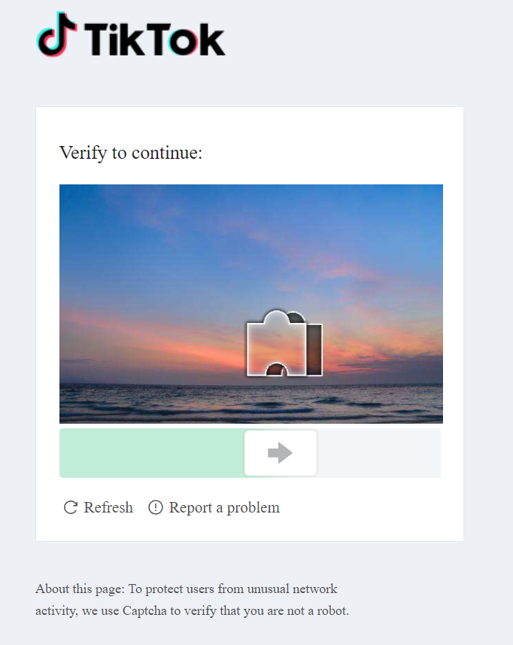
CAPTCHA
An option exists that doesn’t rely on a cognitive function test (remember, transcribe, manipulate).
Recognising objects in images is accepted at Level AA but not AAA.
Notes:
This criterion applies when these tests are used regardless of whether they are used every time or only triggered by specific scenarios.

Slide 22
Multi-factor authentication
Authenticator app or links
Biometric verification
Physical (USB) key
One-time password (only if you can copy and paste the code)

Slide 23
Relationship between AA and AAA
AA
AAA
Alternative (Level AA and AAA)
Mechanism Alternative (Level AA and AAA)
Object recognition (Level AAA only)
Personal content (Level AAA only)
See 3.3.8: Accessible Authentication (Enhanced) for full details
Notes:
Sarah
See 3.3.8: Accessible Authentication (No Exception) for full details

Slide 24
Focus Appearance – AA
PLAIN LANGUAGE VERSION
Interactive element have an easy to see focus indicator.
AT RISK
See 2.4.11 Focus Appearance for full version
Notes:
Sarah
All the following
Minimum area:
> 1 CSS pixel thick border
3:1 contrast ration between focused & unfocussed state border
31 contrast against adjacent colours
The rule applies to ‘user interface components’, which means: form fields, links, buttons. Essentially, any element you typically interact with. Note: this can also include things like horizontally-scrolling tables

Slide 25
What is ‘easy to see’?
Next
The area (or width) of the focus indicator
Next

Slide 26
What is ‘easy to see’?
Next
The area (or width) of the focus indicator
The contrast of the focus indicator against adjacent colours
#FFFFFF (white)
#3D3D3D (dark grey)
Ratio: 10.86:1

Slide 27
NEW MAP COMING SOON
Notes:
Sarah
For Intopia:
WCAG 2 map update to include 2.2 criteria
NotChecklist updated to include WCAG 2.2

Slide 28
AS ISO/IEC 30071-1:2022
Code of practice for creating accessible ICT products and services.
store.standards.org.au/reader/as-iso-iec-30071-1-2022

Slide 29
What is it?
A framework for building and maintaining accessible ICT systems
NOT a technical standard like WCAG

Slide 30
What it covers?
Creating an organisational ICT policy
Embedding accessibility into ICT processes and justifying your decisions
Creating an accessibility statement

Slide 31
Current DDA Advisory Notes
World Wide Web Access: Disability Discrimination Act Advisory Notes version 4.1 (published 2014)

Slide 32
Future DDA Advisory Notes
Draft Digital Goods and Services: Disability Discrimination Act Advisory Notes (soon to go to public consultation)

Slide 33
Areas of focus
All digital goods and services
About equal access to digital goods and services
Advice on delivering equal access of use

Slide 34
Let’s chat
Sarah Pulis
Director and co-founder
sarah@intopia.digital

Slide 35
Time to grill me!
Yes, that’s question and answer time

