Slide 1
Telstra 5G Touch and Track
May 2023

Slide 2
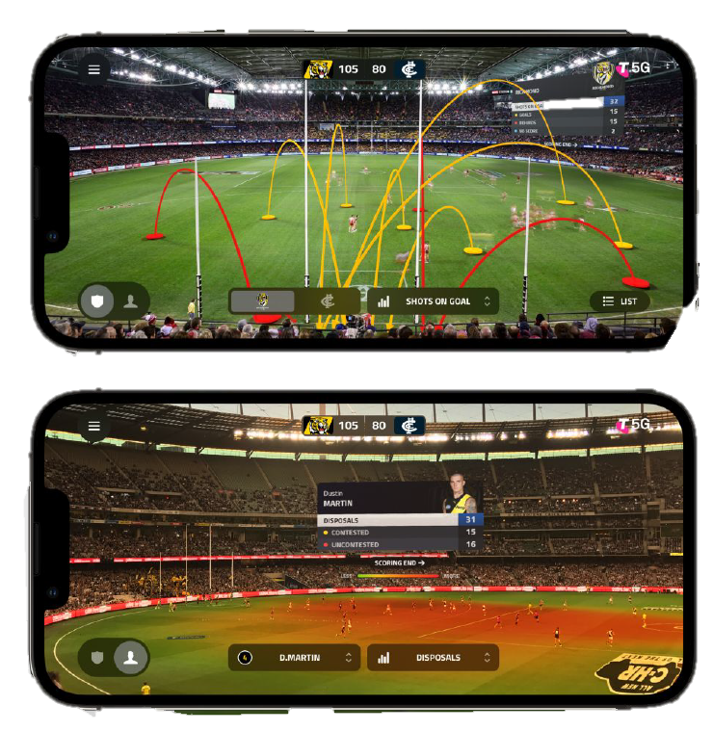
Telstra is passionate about sport
Telstra’s relationship to sport is deep and longstanding
As mobile networks have evolved from 3G to 4G to 5G, the experiences we can deliver to sports fans have changed dramatically

Slide 3
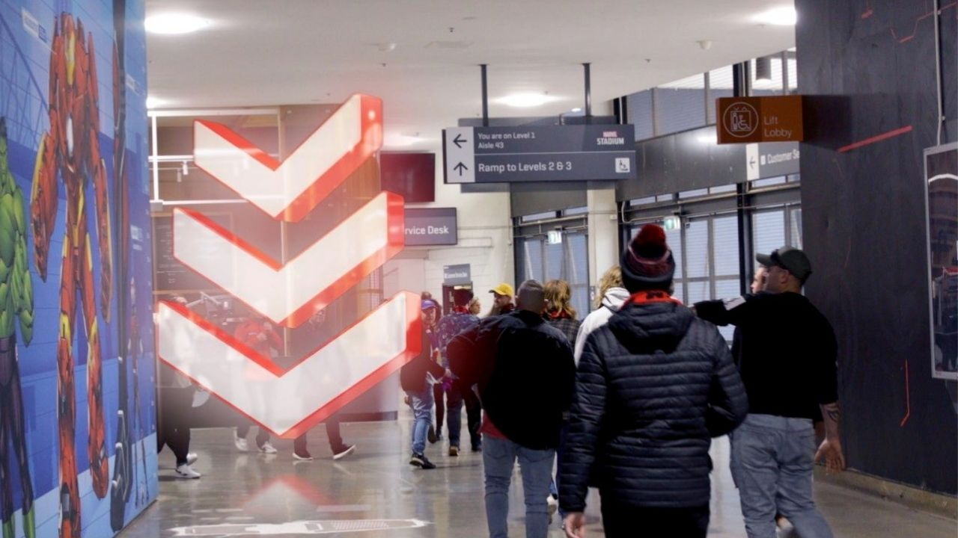
Telstra is passionate about sport
The recent upgrade to connectivity at Marvel Stadium has seen a step change in the network capacity, reliability and latency unlocked by 5G
It’s one thing to have new technology at your disposal, but sometimes you just need a little bit of inspiration

Slide 4
The viral video that served as inspiration

Slide 5
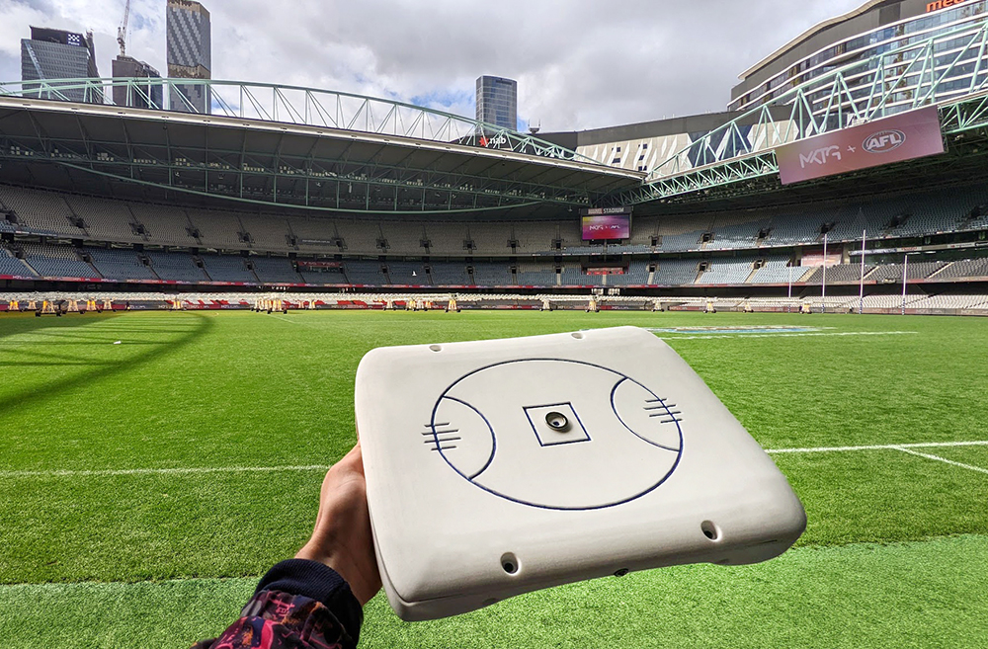
We were inspired to make the game more accessible
We partnered with an Irish startup company called Field of Vision
Our aim was to create a prototype device that could augment the gameday experience for vision impaired AFL fans
This could not only demonstrate the benefits of the 5G network, but make the game more accessible

Slide 6
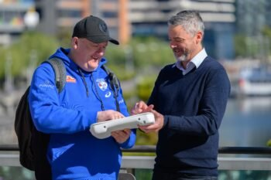
…but what do we know about all of this?
Our initial outreach via Vision Australia, AFL Blind league and the broader AFL fan base taught us plenty in a short space of time
This had to be a co-created experience. We needed people embedded in the team who were the ones who would use this product
”Nothing about us without us” was a phrase we had heard within accessibility working groups

Slide 7
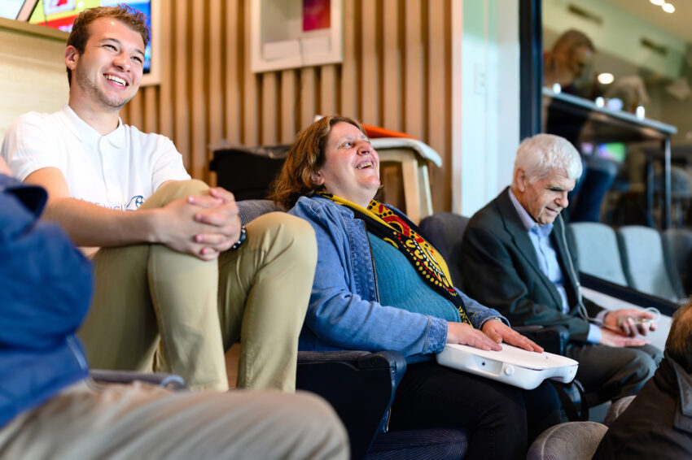
Testing the devices at a live match
Thanks to Vision Australia, we were able to invite a cohort of fans to Marvel Stadium for live testing in late 2022
The feedback was invaluable and we had a team of people documenting and observing the live experience
One of the most challenging aspects was onboarding someone completely new to the device and what the haptic feedback represented

Slide 8
There are things we need to improve
We need to ensure the device reflects live action as closely as possible
We also need to ensure the access and return of these devices within the stadium is easy and safe
Based on some consistent feedback, there may also be a way to combine audio commentary within the device

Slide 9
This video helped get the word out about the project

Slide 10
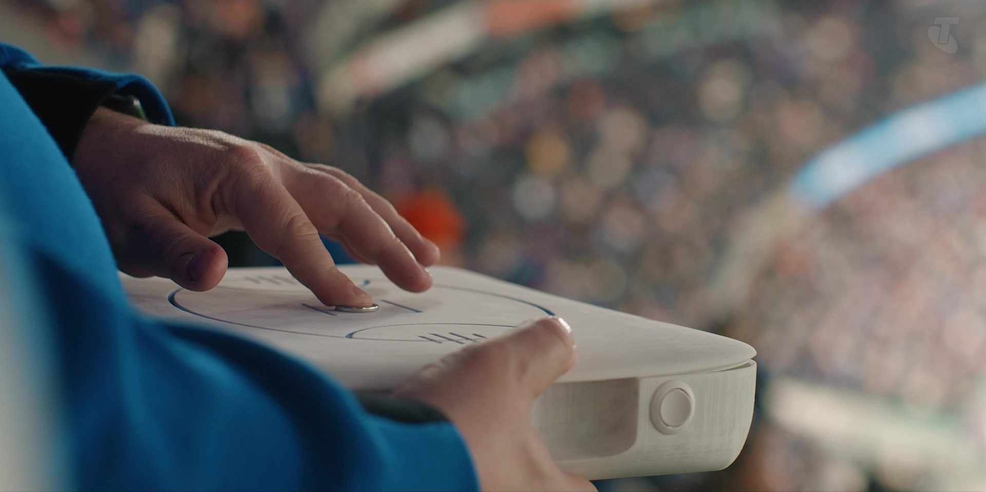
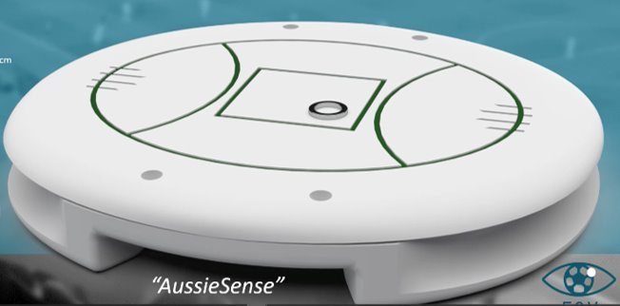
What might the future hold?
Could this experience translates to other sports and to other stadiums in Australia?
Could this work in the home environment as well as at the ground?
Could there be wearable devices that translate game information in real time?

Slide 11
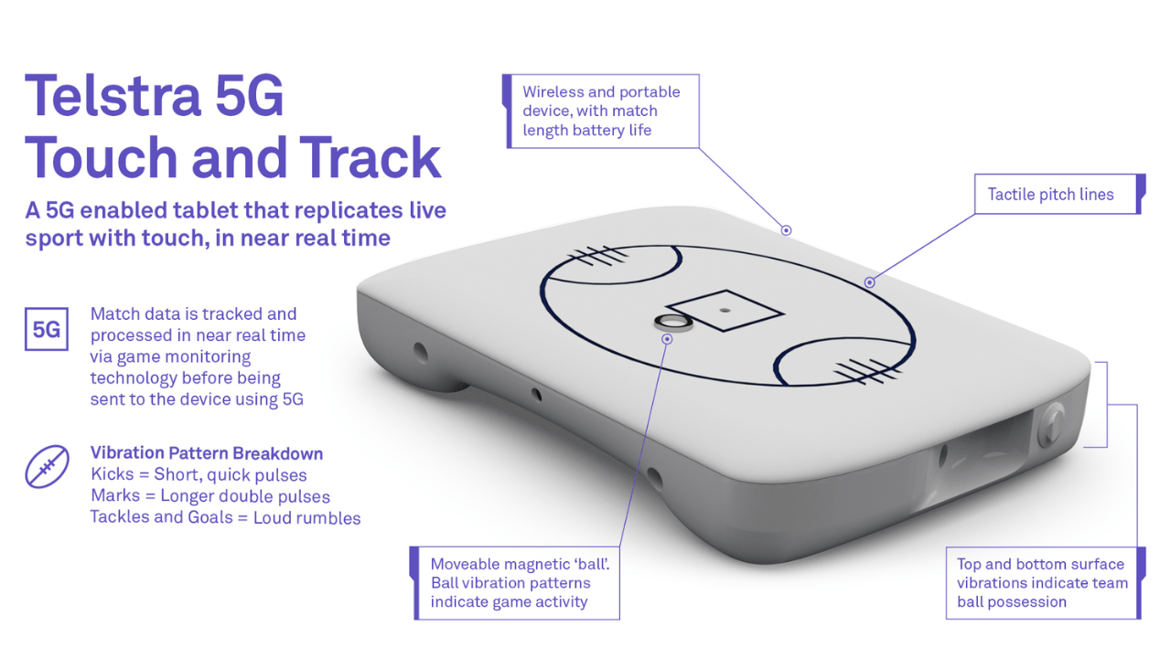
Questions?

