Slide 1
Digital Accessibility – State of the Nation
Stewart Hay
Co-Founder/Managing Director
Notes:
Sarah

Slide 2
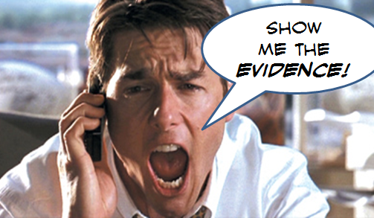
What do we know about the State of Digital Accessibility
No quantitative research available
Professional observations and Intopia as a proxy

Slide 3
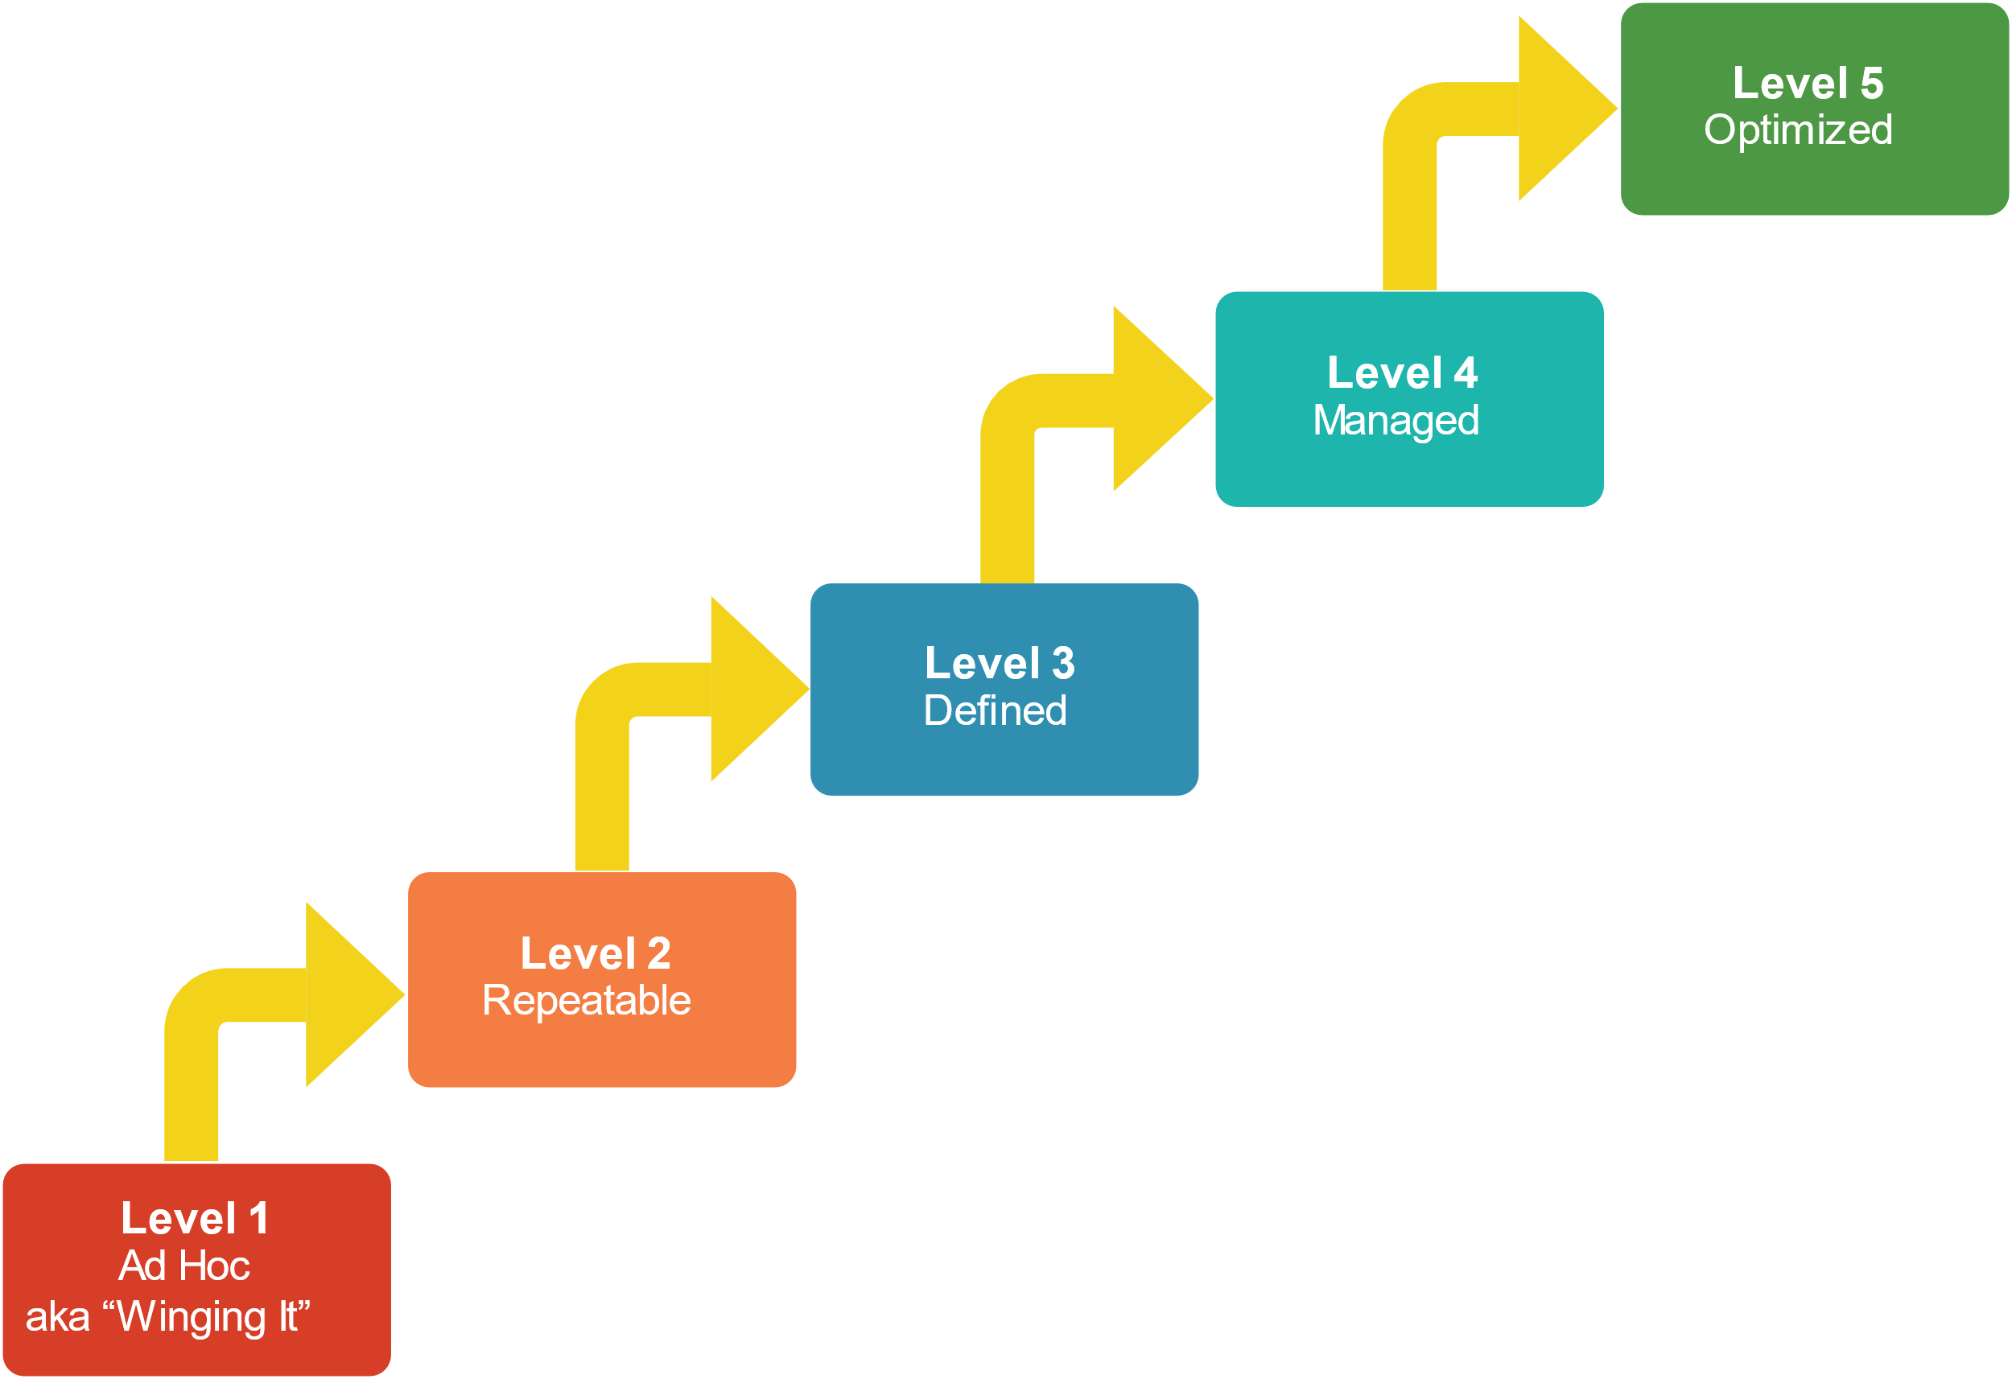
Organisation Maturity
Public vs Private vs Agencies they are all different
Accessibility Programs still rare
Customer facing still the key focus over internal business systems

Slide 4
Process and Procurement
11th hour testing behaviour still dominates
The rise of accessible design systems and component libraries
WCAG Standards 2.0 vs 2.1 vs 2.2
Procurement – we have a standard but is anyone following it?

Slide 5
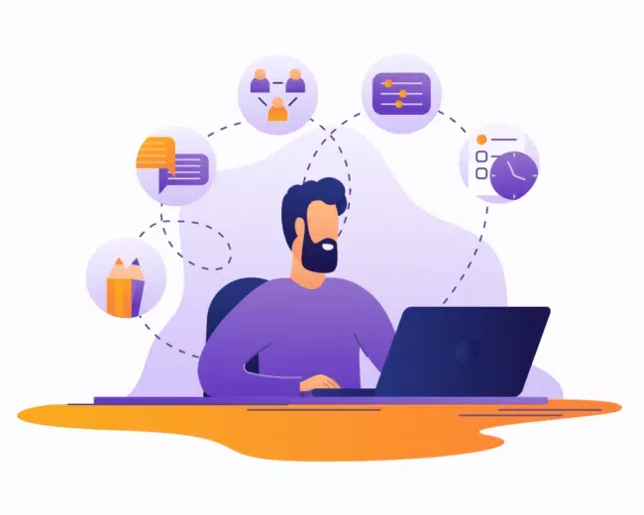
Industry Capability
Access to skilled and experienced experts is still an issue
The non-existent Chief Accessibility Officer
More training options – free, low cost, professional

Slide 6
User experience and inclusive design
Baby steps towards co-design and user research
Multiple organisations offering this service

Slide 7
Legal Risk
Court cases are as rare as hens teeth
Mediation is happening
Court cases in the USA is still increasing

Slide 8
Artificial Intelligence and false facts
There is a rapid rise in quick fix accessibility AI widgets
The companies are cashed up
False advertising of instant accessibility fixes
Encouraging band-aid approaches and detracting from inclusive design and shift left mentality

Slide 9
Let’s chat
10% off training when you use the code EOFY10
Stewart Hay
Managing Director and Co-founder
stewart@intopia.digital

Slide 10
Time to grill me!
10% off training when you use the code EOFY10
Yes, that’s question and answer time

