Slide 1
Barriers and enablers for ‘preparation for employment’ for students with blindness and low vision in mainstream secondary schools
Dr Melissa Fanshawe
Senior Lecturer, School of Education
University of Southern Queensland

Slide 2
Aim
This study explored what a range of stakeholders perceived were barriers and enablers to ‘participation in learning’ and ‘future employability’ in Australian mainstream secondary schools for students with blindness and low vision.

Slide 3
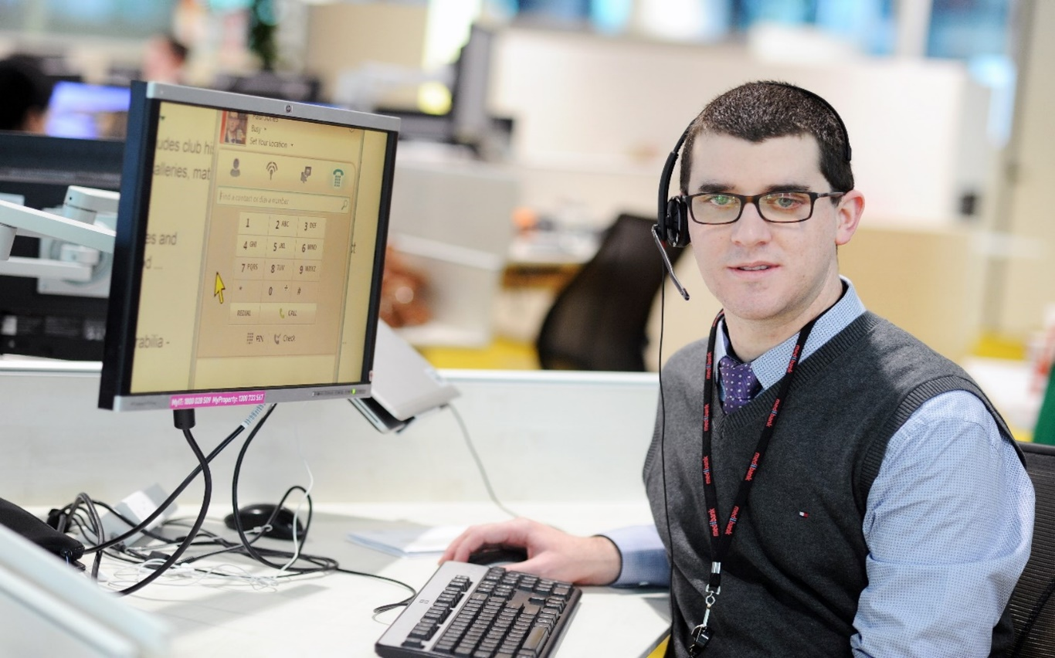
Findings - students
Access to curriculum materials
Assistive technology
Preparedness for employment

Slide 4
Findings – Employability skills for all students
cognitive components of employment
intrapersonal skills
interpersonal skills
Career readiness framework (Warner et al., 2020)
Notes:
cognitive components of employment, such as literacy, numeracy, and technology skills, along with critical thinking
intrapersonal skills, such as work ethic, attitude, and self-regulation, and
interpersonal skills, such as communication and the ability to work in a team

Slide 5
Findings – Employability skills specific to students with blindness and low vision
compensatory access
assistive technology
sensory efficiency
self-determination
orientation and mobility
learning about work

Slide 6
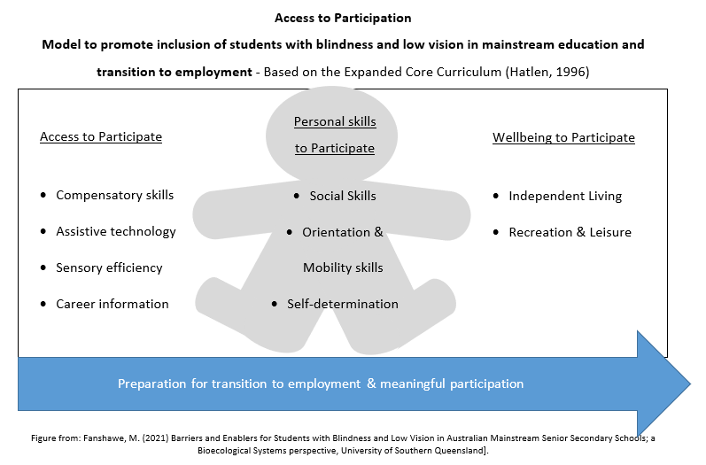
Notes:
Image: Employability skills specific to students with blindness and low vision – learning about work
Access to Participation
Preparation for transition to employment & meaningful participation
Model to promote inclusion of students with blindness and low vision in mainstream education and transition to employment - Based on the Expanded Core Curriculum (Hatlen, 1996)
Access to Participate
Compensatory skills
Assistive technology
Sensory efficiency
Career information
Personal skills to Participate
Social Skills
Orientation & Mobility skills
Self-determination
Wellbeing to Participate
Independent Living
Recreation & Leisure
Figure from: Fanshawe, M. (2021) Barriers and Enablers for Students with Blindness and Low Vision in Australian Mainstream Senior Secondary Schools; a Bioecological Systems perspective, University of Southern Queensland].

Slide 7
Findings – Impact of time
Preparation for transition to employment
Practicing work
Access technology skills
O&M
Changes over time
Assistive technology
Support in education
Notes:
Preparation for transition to employment
Practicing work
Access technology skills
O&M
Changes over time
Assistive technology
Support in education

Slide 8
Recommendations
Recognise that all students have diverse needs
Promote agency for independent access through technology
Increase focus of employability – all students
Consider time to prepare specific skills for employment
Certificates in Access technology training.gov.au - 10981NAT

Slide 9
Dr Melissa Fanshawe
Senior Lecturer, School of Education
University of Southern Queensland
Melissa.Fanshawe@usq.edu.au

Slide 10
Table 8.1 Stakeholders’ Perceptions of Factors That Influence Future Employability (as per individual participants in this study)
Stakeholder | Knowledge to do the job (cognitive skills) | Personal characteristics (intrapersonal) | Social skills (interpersonal) | Disability-specific skills
Students | general technology programs and skills | presentable efficient happy and willing to serve | communication teamwork dealing with bullies | support to creating resumes and cover letters assistive technology orientation and mobility (O & M)
Teaching staff | curriculum content | organisation |  | assistive technology
Advisory teachers/ therapists |  | confidence independence make decisions |  | workplace structure knowledge of types of jobs knowledge of job requirements opportunities for participation assistive technology braille compensatory skills
Policy-Makers | access to work materials | independence make decisions | group activities | career counselling participation in jobs chores braille O & M assistive technology
Parents |  | troubleshoot make decisions independent time management | social interactions | support to choose subjects guidance officer assistive technology O & M
People with lived experience |  | independent beliefs of others | social skills access to extra curriculum activities support systems | opportunities for participation compensatory skills braille assistive technology
Employment consultant/ employers | knowledge to do the job access to work materials | high expectations (previously modelled by others) | social interactions | opportunities for participation access—ability to make modifications independently assistive technology O & M braille
Table 8.1 Stakeholders’ Perceptions of Factors That Influence Future Employability
Notes:
Included for accessibility

