Slide 1
Representing Visual Information in Sound
Latest Learnings about Sonification Use
Phia Damsma

Slide 2
Sonification
Represents data or information in non speech sound, rather than as an image, chart, or graph.
Huge potential to improve access to science, technology, engineering, arts and mathematics (STEAM), and for science outreach
Is applied ever more widely
Overview

Slide 3
Sonification workshop 2022 RT Conference
Chatai Goncu, Action Audio
AO23 Tennis, similar listening hours as 2022
Interest from other sports. NBA, basketball.
Notes:
Bruce Mcguire
Stocks app
Apple Maps app
Charlie, scientific tlaking calculators
Catay, Tennis

Slide 4
Audio Universe Tour of the Solar System
Chris Harrison, Director. Inclusive, multi-sensory show
audiouniverse.org/tour-of-the-solar-system
Preliminary results survey from audience and organisers accessible planetarium show: Inclusive or ‘Special’?
Ask your local planetarium (or cinema) to play the show. It can be downloaded for free by them from: Full dome (planetarium version): https://www.eso.org/public/videos/au-totss-fulldome/ Flatscreen version: https://www.eso.org/public/videos/au-totss/
Notes:
Dr Chris Harrison is an astronomer based at Newcastle University in the United Kingdom. He is the director of 'Audio Universe' which is a project exploring how to use sonification for astronomy research and education. The goals are to use sound to enhance scientific discovery and to make astronomy more accessible.

Slide 5
Planets orbiting the Sun
Audio fragment of Audio Universe Tour of the Solar System, played with permission - Teaser

Slide 6
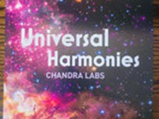
Popular Sonification Release
Matt Russo produces data sonifications of astronomical pictures for NASA with his project SYSTEM Sounds. NASA Chandra team. /Chandra Lab/Hellen Keller
YouTube (NASA Universe of Sound) https://chandra.si.edu/sound/
Album ‘Universal Harmonies’: Digital, CD and Vinyl
https://chandralabs.bandcamp.com/album/universal-harmonies
Mesmerising
Notes:
Proceeds of CD and Vinyl to benefit Helen Keller Foundation, on purple galaxy swirl wax

Slide 7
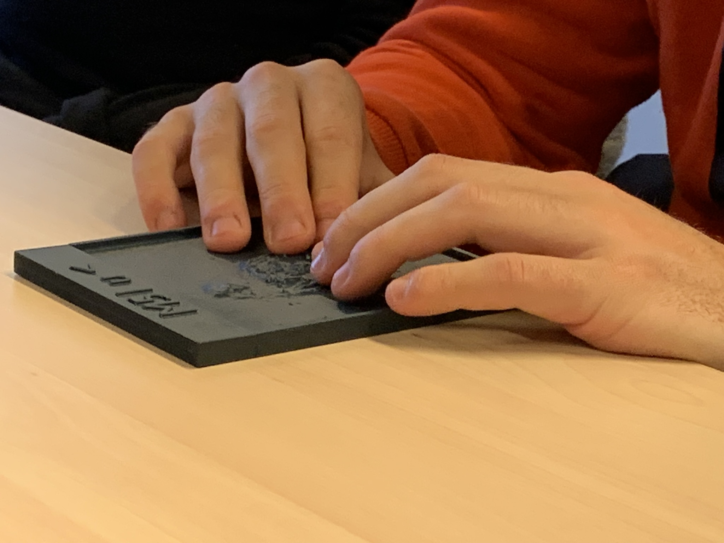
Education: Sonification World Chat (SWC)
http://sonificationworldchat.org/
SWC Working Group Learn: Lesson Plan Science and Music. Early testing stage. Tactile reliefs of M51 (Tactile Universe)
Collaborations

Slide 8
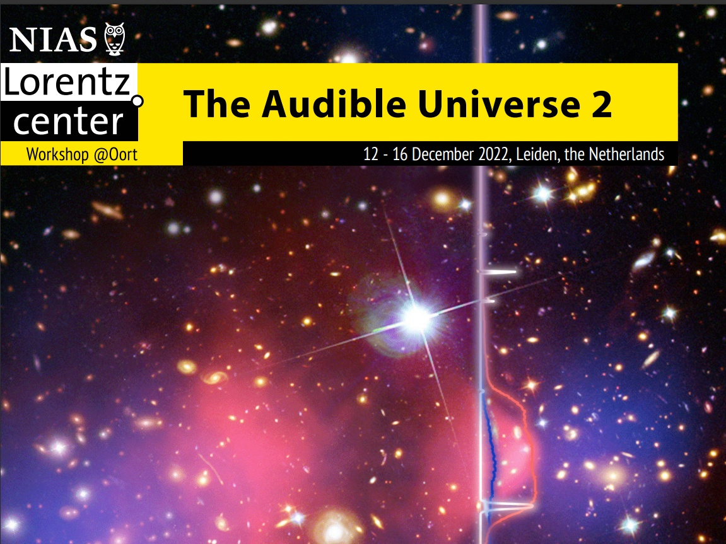
Audible Universe Workshops
Star people speak to sound people
Cultural differences sound perception
BLV
All passionate about sonification for accessibility
Yes, most for space (not all) and other high end science (and health) but space related inventions and innovation result in valuable mainstream products, trickles down.

Slide 9
Publications and publishers
Nature
Others
RT guidelines

Slide 10
IDPWD 2022
International Day of Persons with Disabilities 2022.
Event and Statement UNOOSA
In line with 2022 theme "Transformative solutions for inclusive development: the role of innovation in fuelling an accessible and equitable world", UNOOSA is raising awareness of sonification as a technological solution to remove barriers for equitable and meaningful participation of persons with disabilities in space sciences.
https://www.unoosa.org/oosa/en/ourwork/space4personswithdisabilites/index.html United Nations Office of Outer Space Affairs

Slide 11
International Community for Auditory Displays
Conference:
ICAD 2023 Sonification for the Masses @Linköping University, Norrköping, Sweden 26th – 30th June 2023
“It is about time for the breakthrough of sonification in terms of implementation in mass media and consumer markets: Sonification for the masses!”

Slide 12
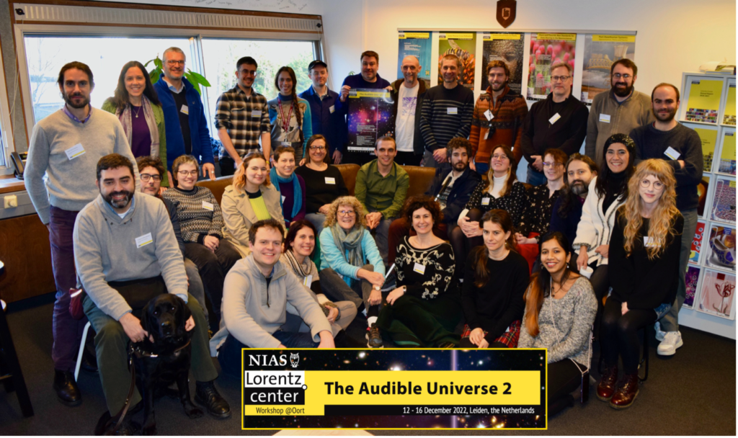
ICAD Statement
…full papers, abstracts,… …particularly interested in use cases from everyday life, implementations in mass media, sonification evaluation by wider populations, concepts of sonification in education, learnability and pleasantness of sonifications, and other ways to tackle the theme of sonification for the general public.
Special Track – AU2.
https://icad2023.icad.org/astrodatason/

Slide 13
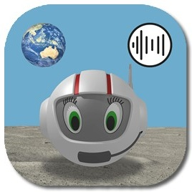
Educational game app
CosmoBally on Sonoplanet
RT 2022 (Finding Saliens)
Free app for iPad and Android tablets
More than 500.000 downloads
App for Early Learning generic sonification skills and concepts, or Emergent Sonification Literacy
Support site: https://www.sonoplanet.com Information, instructions, multi-sensory (space) projects
Supported by South Pacific Educators in Vision Impairment (SPEVI Inc)
Notes:
(Ballyland CosmoBally in Space)

Slide 14
Design Specifications
No tactile support, test power and limitations of sonification
Sonification mapping tested with 29 conference delegates
4 original sonification concepts
4 types of game
Audio games, optional visual support
Notes:
Starts with a space flight experience. Audio. Optional images.

Slide 15
Main aims
Inform future design of accessible sonification applications
Paper presentation for ICAD
Build capacity in young students to use sonification
Inform educational practice around sonification
Introduce sonification at fundamental level: sounds can have meaning
Preliminary Outcomes Online User survey. 15 questions.
Notes:
Introduce Early Learning of generic sonification skills and concepts Contribute to future use of sonification for access to STEM Serve as Proof of concept for design of accessible, innovative, gamified sonification applications. We hope that they will build the skills to then go on and use your applications and tools in the future.

Slide 16
Participants
Total 17, 6 identify as BLV
Parents: 1
Students: 2
Involved in education, teachers : 13, including 5 Specialist Teachers (Vision Impairment)
Simply interested in accessible games: 1

Slide 17
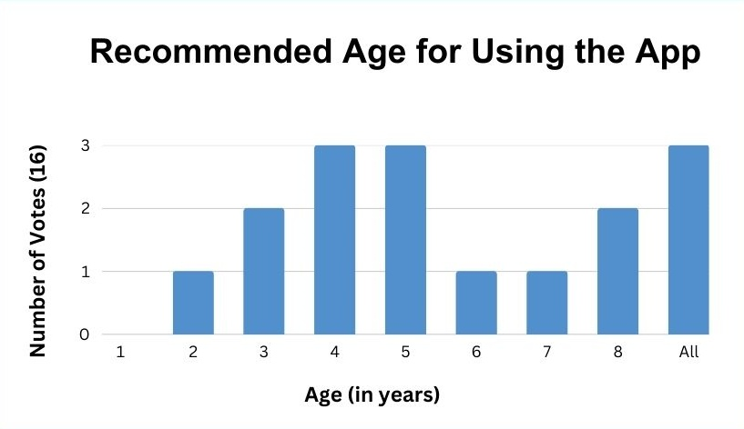
Build capacity in young students to use sonification

Slide 18
Sounds can have meaning…
“Please select one answer. The most important learning outcome of the app is:”
Skills to analyse and interpret sounds: 8 (highest score)
Learning directional concepts: 3
Awareness that sonification is accessible: 2
Improved fine motor skills: 2
Awareness that sonification is fun: 0
Learning shapes: 0
All the above: 2

Slide 19
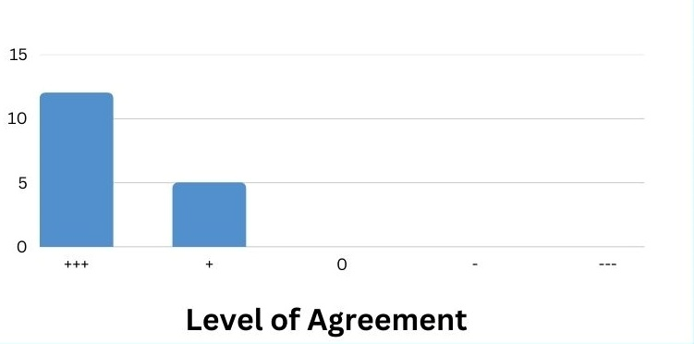
Power of Sonification
“This app shows that people who are blind or have low vision can use sonification to access information generally represented in a visual format.”

Slide 20
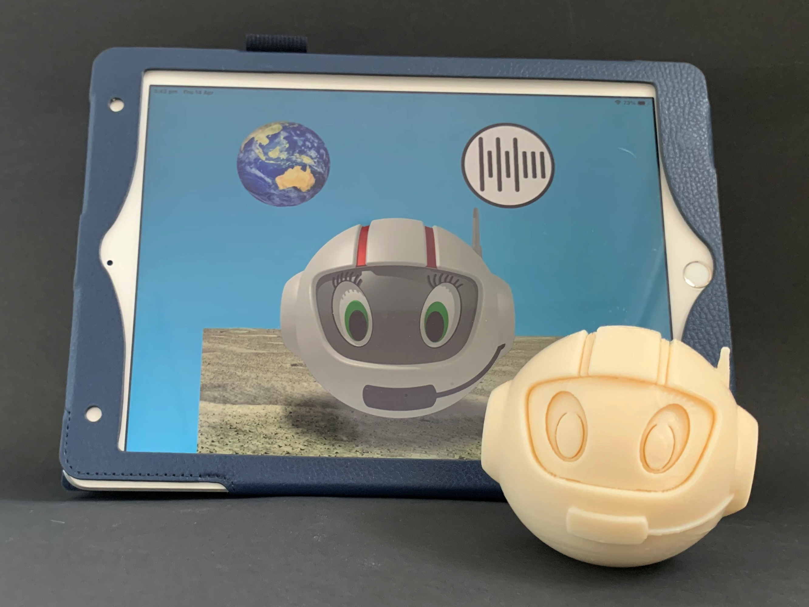
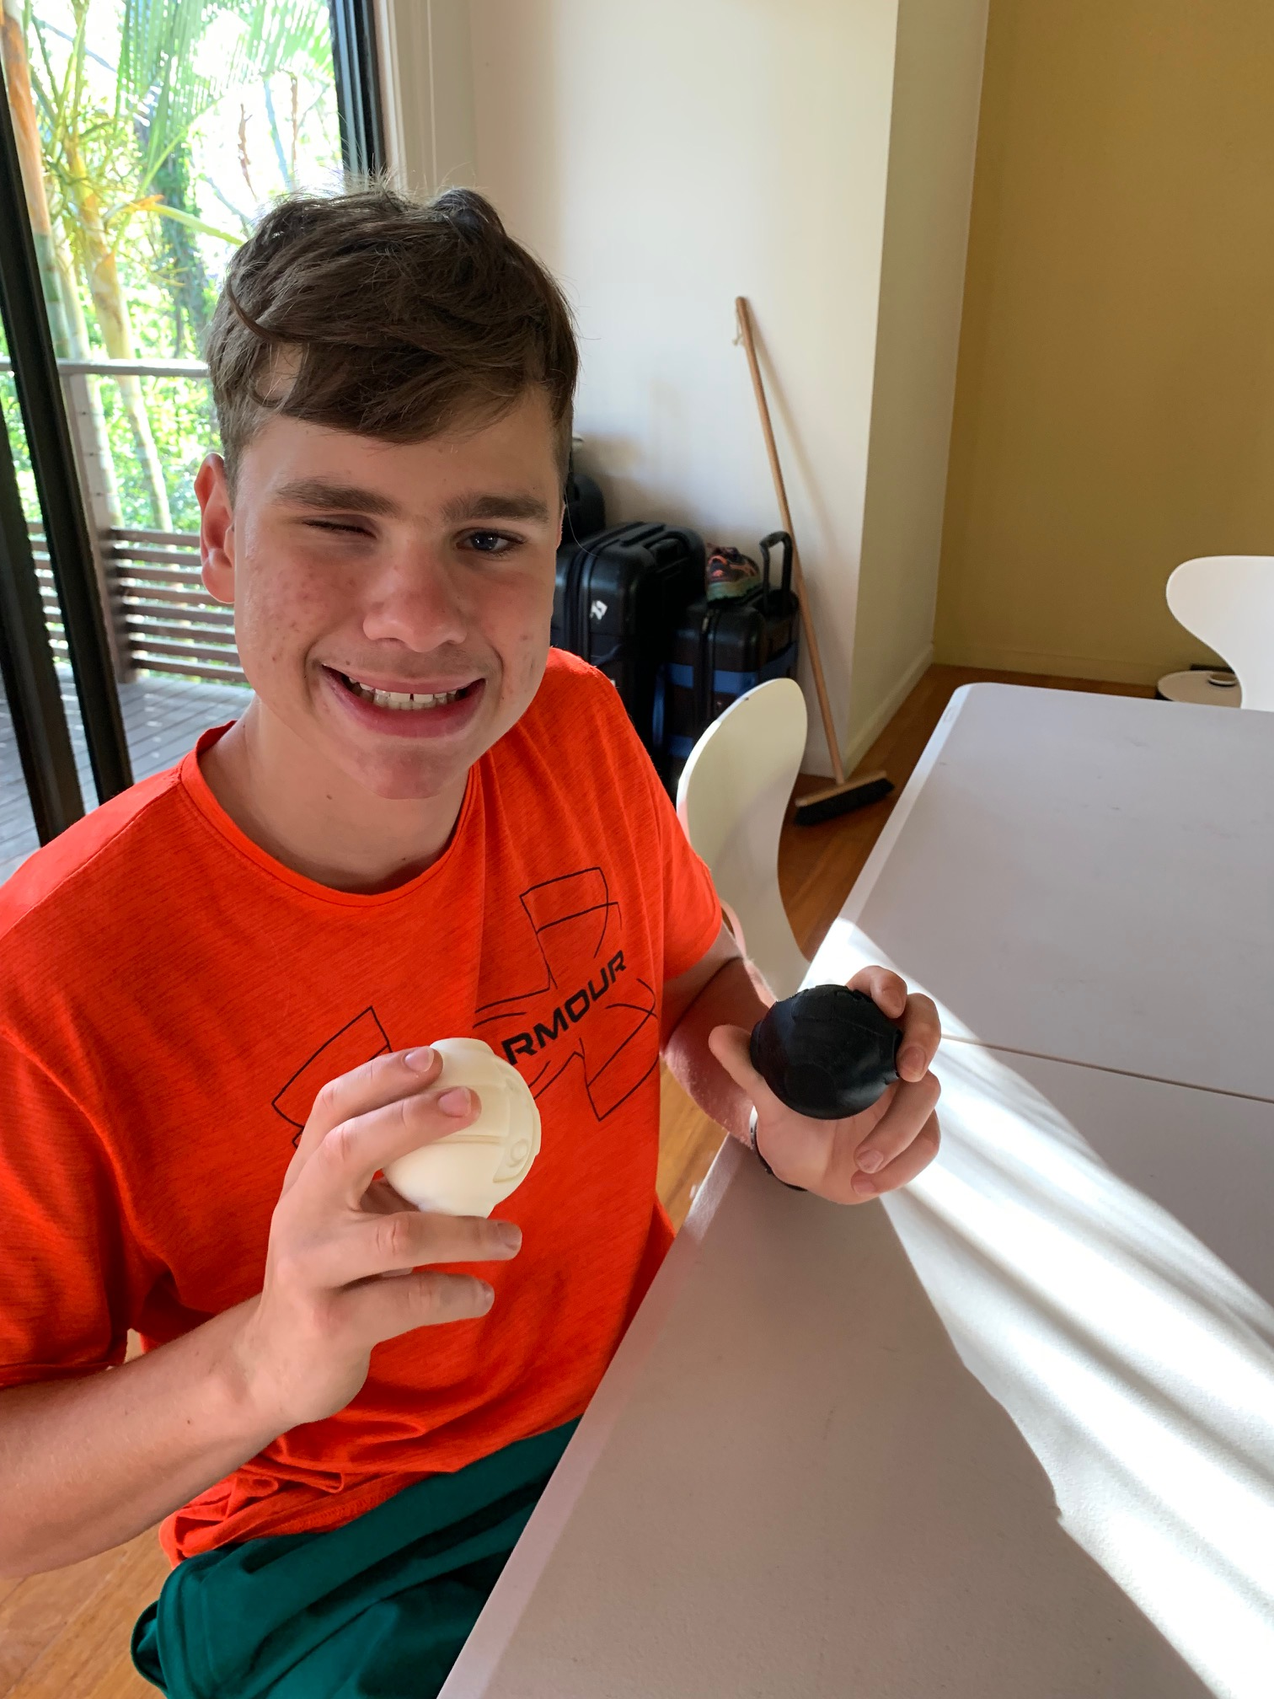
Tactile Learning Tool CosmoBally
Supported by Mable Community Grants
Notes:
Very positive feedback: best perhaps that one was stole from the Braille room of a school!
You can get one

Slide 21
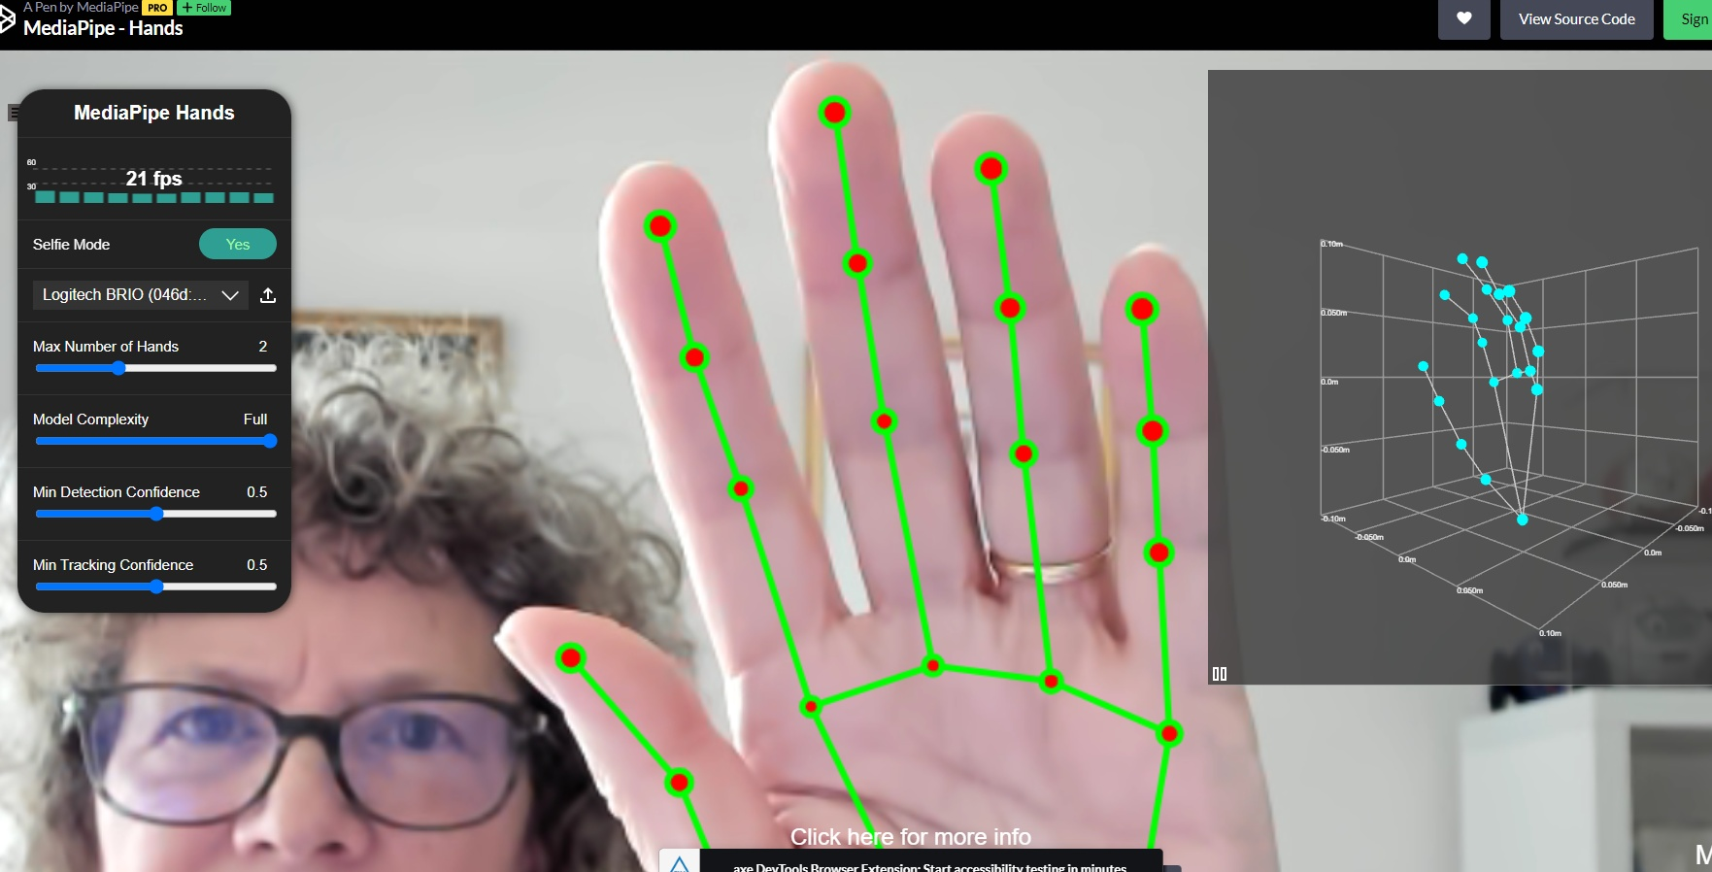
New Sonification app
Under Development.
Herakoi – Sonokids
Testers
Notes:
media pipe

Slide 22
Conclusion
More apps and programs (becoming) available, using sonification
Future looks (or sounds!) bright for sonification projects
Get involved

Slide 23
Contact:
phia@sonokids.com

