Slide 1
“AN EQUITABLE WORLD AT YOUR FINGERTIPS”

Slide 2
Incidental learning
What is it?
Students with sight learn simply by observing the world around them (e.g., watching fireworks bursting or birds flying). This is known as incidental learning.
Vision enables individuals to quickly take in a lot of information and gather the whole picture.
Similar concepts must be directly taught to children with visual impairments.
Learning through touch, which is sometimes the primary method for visually impaired children, requires students to first learn about the parts before putting them together to create the full entity (e.g., looking at a tree instead of touching its leaves, branches, or bark). This is known as part-to-whole learning.
Pre-braille tactile learning is an important component in the braille journey.
When should you start to learn braille?

Slide 3
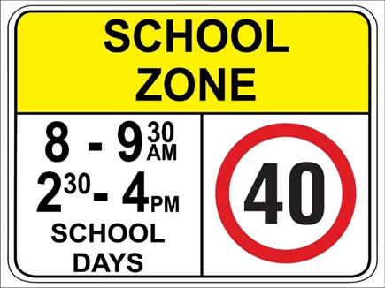
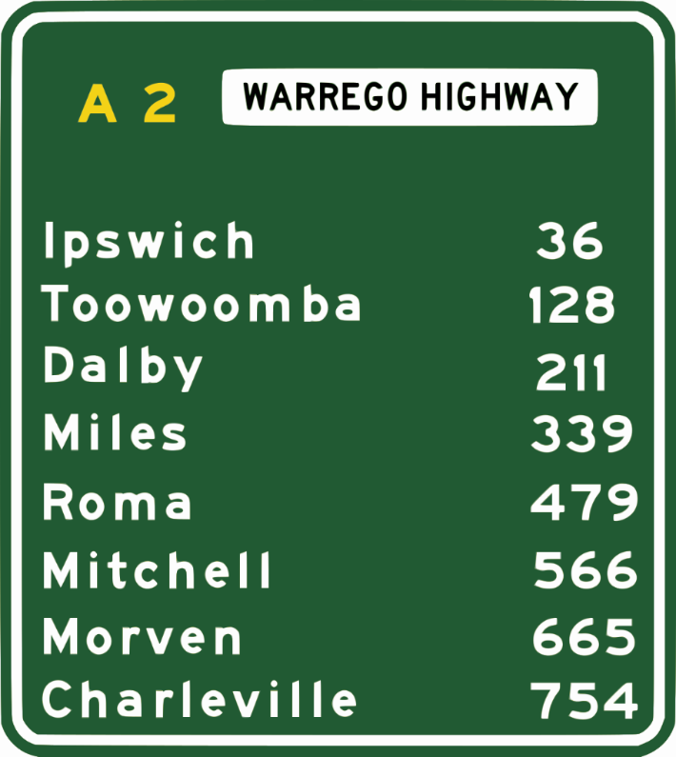

Slide 4
Tactile literacy
• Every tactile learner is potentially literate.
• Students function along a fluid continuum of motor, tactile, conceptual, and emotional skills.
• These are not disconnected skills. They are sequential, contingent, and interdependent.
There is also a belief that tactile literacy can take many forms. While most people recognize braille reading and writing as types of literacy, some may not be aware of other kinds of tactile literacy, such as real objects, textures, and tactile symbols. There are many skills that are the precursors for tactile literacy, such as shared attention, turn-taking, and gestures; as well as braille.
All of this is a path to literacy and that all learners can be literate at their functioning level.
• In order to encourage student movement along this continuum, educators and families must systematically promote and provide increased opportunities for movement, interaction, and stimulation to children who will be tactile learners.
• These tactile skills are the foundational skills for pre-braille.

Slide 5
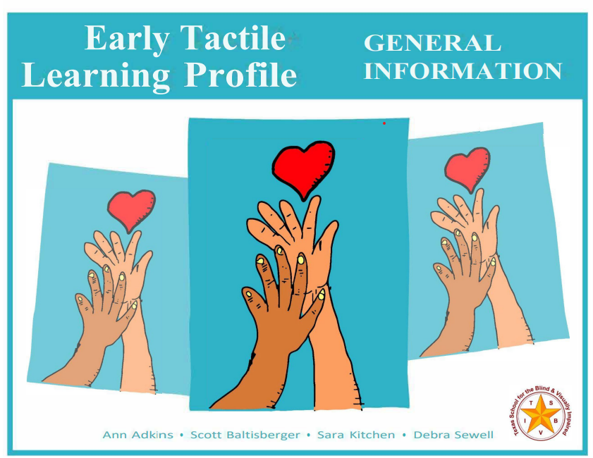
A great resource from Texas School for the Blind and Visually Impaired.

Slide 6
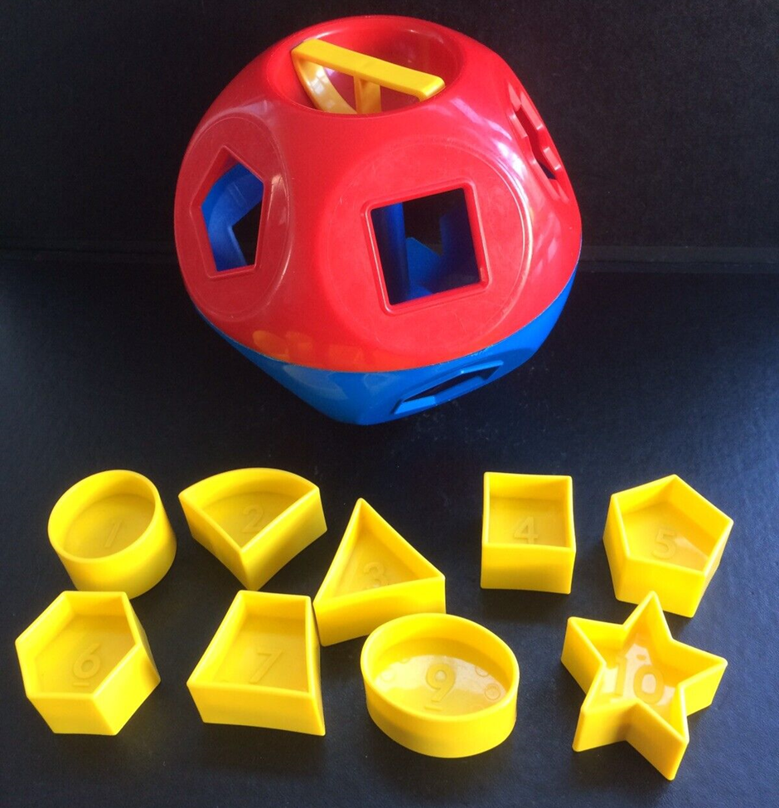
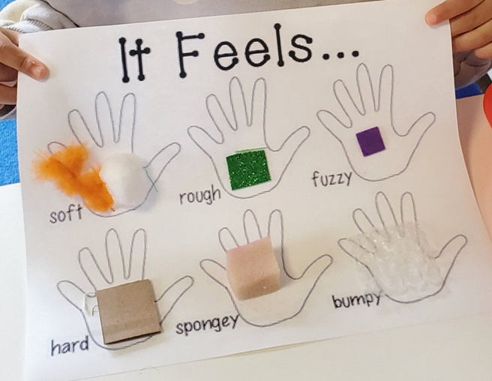
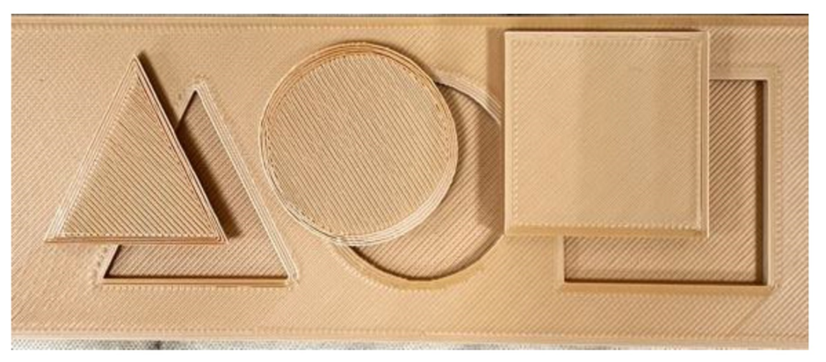
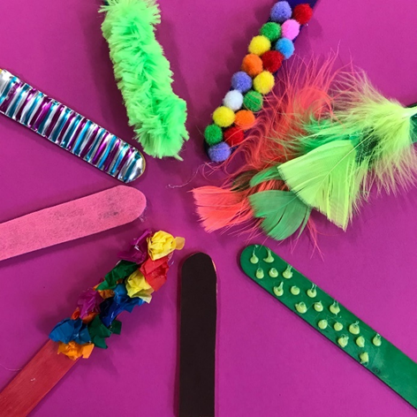
Pre braille examples

Slide 7
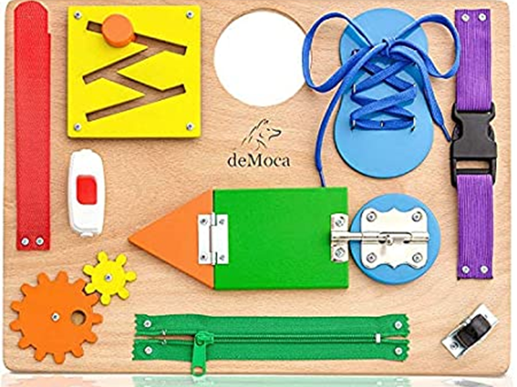
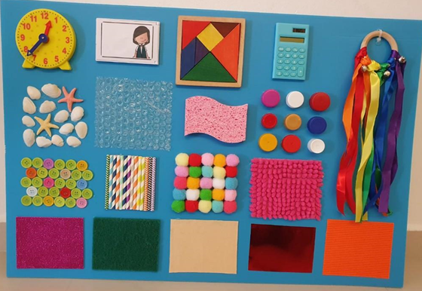
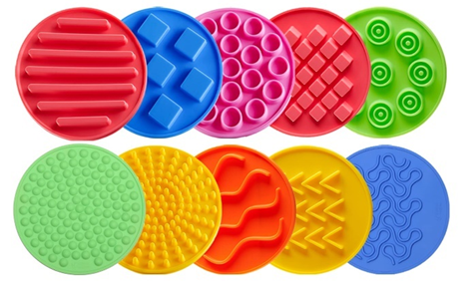

Slide 8
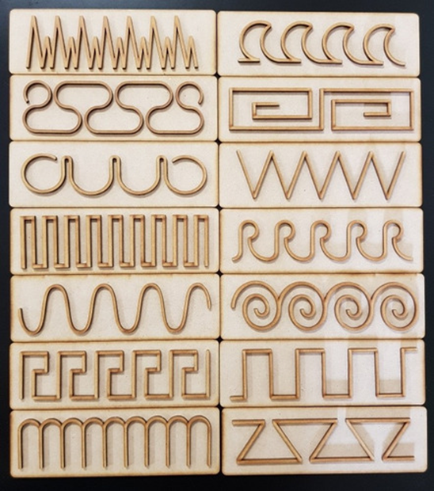
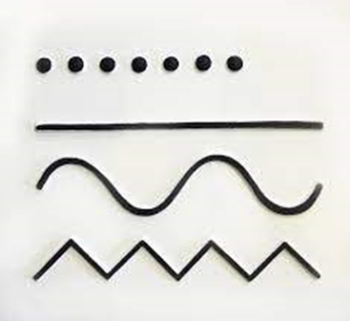

Slide 9
Tactile skills development:
is dependent on the development of both gross and fine motor skills. Gross motor skills (large muscles) develop first and provide the foundation for fine motor (small muscle) development and refined tactile skills.
is generally acquired in a sequence from gross to fine motor, concrete to abstract, and awareness/attention to understanding, creating a broad range of tactile skills at each level before moving on to the next level.
should be combined with concept development and language acquisition in order to develop skills for literacy.

Slide 10
Considerations
Steps when introducing tactile elements:
What is the best age to start?
Can I feel it? (eg. close your eyes and touch it yourself)
Does the person understand the concept?
Are there pre-made graphics or tools available?
What materials do I have available?
How do I step it up?
When do I introduce braille dots?

Slide 11
Contact:
Braille House Andrew Backhouse Marketing, PR and Communications Ph: 07 3848 5257 Email: andrewbackhouse@qbwa.org.au
www.braillehouse.org.au

