Slide 1
Keeping Braille on the Agenda
The Braille (?) Needs Assessment (BNA)

Slide 2
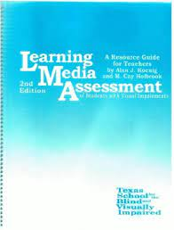
Origins
AJ Koenig, MC Holbrook (1995)
Developed Learning Media Assessment
Koenig & Holbrook’s approach
characteristics to consider were highlighted
NextSense approach – adapted Koenig and Holbrook’s approach
Consider functional use of vision alongside clinical understanding of vision – diagnosis, visual acuity, visual fields.
Trying to quantify many of these characteristics

Slide 3
Applying clinical outcomes: From the eye report
Clinical outcomes reveal assessment in an optimised but not everyday environment.
Vision is not continuously measured; doesn’t account for functional impact, the environment nor the student’s characteristics.
e.g. Applying distance acuity to a near task such as reading!
No information on functional use of vision, especially over time, no information on impact factors such as glare, fatigue or nystagmus.

Slide 4
Development and design
Characteristics as highlighted by Koenig and Holbrook (1995)
Distance acuity, stability of eye condition, near vision viewing distance, visual stamina, font size.
Added in impact factors such as: nystagmus and other visual considerations, viewing distance, visual stamina, handwriting.
Design to incorporate a visual as well as text to highlight Red Flags. It doesn’t currently have a scoring system.

Slide 5
Live demonstration – case study 1

Slide 6
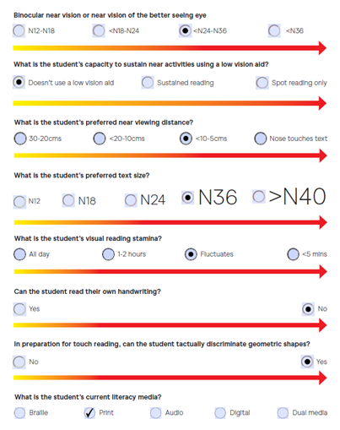
Case study 1 - Joe

Slide 7
Case study 2 - Kate

Slide 8
“so what now?”

Slide 9
Case study 2 - Kate

Slide 12
Research
Validity study
To gain ethics through Macquarie University
Circulate an invitation to SPEVI members – specialist teacher category

Slide 13
Thank you
?

