Slide 1
Designing a
Better Book
By John O’Neill and
Deanna Geneva Lorianni

Slide 2
Creative Lab That Makes Accessible Art and Design Solutions
Notes:
Worldwide, book creators are not making books accessible to people with visual- and print-disabilities. This deficit has created a book famine that leaves millions of people globally without access to the information books provide us.

Slide 3
Introduction
John O’Neill, Co-Founder
Deanna Loriani, Co-Founder

Slide 4
Our Approach
Multisensory
Art and Design
Notes:
Worldwide, book creators are not making books accessible to people with visual- and print-disabilities. This deficit has created a book famine that leaves millions of people globally without access to the information books provide us.

Slide 5
Touch
Notes:
Worldwide, book creators are not making books accessible to people with visual- and print-disabilities. This deficit has created a book famine that leaves millions of people globally without access to the information books provide us.

Slide 6
Hearing
Notes:
Worldwide, book creators are not making books accessible to people with visual- and print-disabilities. This deficit has created a book famine that leaves millions of people globally without access to the information books provide us.

Slide 7
What Are We Doing?

Slide 8
Designing a Better Book
Now / Between is a tactile art book of poetry and photography
“Now / Between” is a tactile art book of
poetry and photography
Notes:
Worldwide, book creators are not making books accessible to people with visual- and print-disabilities. This deficit has created a book famine that leaves millions of people globally without access to the information books provide us.

Slide 9
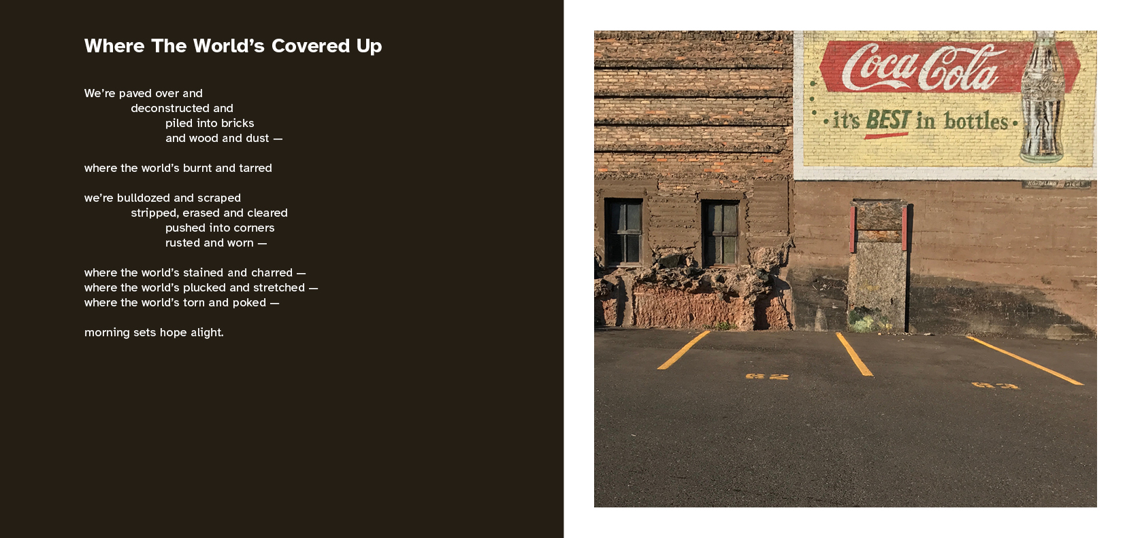
Image Description: A printed spread that contains two pieces of paper. The left page has a poem formatted in various lines of text. The page on the right contains a photo of a brick wall.
Notes:
Worldwide, book creators are not making books accessible to people with visual- and print-disabilities. This deficit has created a book famine that leaves millions of people globally without access to the information books provide us.

Slide 10
Image Description: A printed spread that contains four folded panels. The far left panel has a poem formatted in various lines of text. The panel on the far right contains a photo of a brick wall. The panels in the middle are left blank.
Notes:
Worldwide, book creators are not making books accessible to people with visual- and print-disabilities. This deficit has created a book famine that leaves millions of people globally without access to the information books provide us.

Slide 11
Designing a Better Book
We want to make art accessible to people who have low-vision and are Blind
Offer them a multisensory book experience
Notes:
Worldwide, book creators are not making books accessible to people with visual- and print-disabilities. This deficit has created a book famine that leaves millions of people globally without access to the information books provide us.

Slide 12
Designing a Better Book
→ Braille
→ Text using low-vision font
→ Tactile imagery
→ Audio readings of the book
Notes:
Worldwide, book creators are not making books accessible to people with visual- and print-disabilities. This deficit has created a book famine that leaves millions of people globally without access to the information books provide us.

Slide 13
Designing a Better Book
Today’s talk?
Supposed to be about outcomes
of our user testing on our first prototype.
Notes:
Worldwide, book creators are not making books accessible to people with visual- and print-disabilities. This deficit has created a book famine that leaves millions of people globally without access to the information books provide us.

Slide 14
Where Are We in the Process?

Slide 15
Where Are We in the Process
Printing Prototype for Our User Testing
Supposed to happen in April
So, why is it not done yet?
→ Life happened!
→ Printing this book is not easy!!
Supposed to be about the outcomes of our user testing on our first prototype
Supposed to happen in April
So, why is it not done yet?
→ Life happened!
→ Printing this book is not easy!!
Notes:
Worldwide, book creators are not making books accessible to people with visual- and print-disabilities. This deficit has created a book famine that leaves millions of people globally without access to the information books provide us.

Slide 16
Why Didn’t We Reach Our Goal?

Slide 17
Why Didn’t We Reach Our Goal?
Dimense printer we were using broke!
→ We can’t easily find another printer
only two exist in the US (1 of them is broken)
→ We need two printer partners
Notes:
Worldwide, book creators are not making books accessible to people with visual- and print-disabilities. This deficit has created a book famine that leaves millions of people globally without access to the information books provide us.

Slide 18
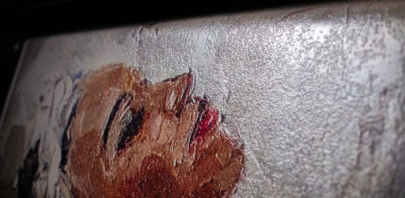
Dimense Print Example
Image Description: A glossy ink paper is coming out of a printer. A paint-like image of a woman appears on the paper. The woman has brown skin tones, and her eyes are closed. The image consists of various textures.
Notes:
Worldwide, book creators are not making books accessible to people with visual- and print-disabilities. This deficit has created a book famine that leaves millions of people globally without access to the information books provide us.

Slide 19
Why Didn’t We Reach Our Goal?
Limited Tactile-Print Options Available
We’ve been researching other printers and venues
→ Not too many printers and venues can do what we want for our book
Notes:
Worldwide, book creators are not making books accessible to people with visual- and print-disabilities. This deficit has created a book famine that leaves millions of people globally without access to the information books provide us.

Slide 20
Why Didn’t We Reach Our Goal?
Limited Tactile-Print Options Available
Problem
Aren’t able to deeply reproduce texture in images
→ Even more difficulty doing these images in a book format rather than a gallery exhibit
Notes:
Worldwide, book creators are not making books accessible to people with visual- and print-disabilities. This deficit has created a book famine that leaves millions of people globally without access to the information books provide us.

Slide 21
Why We Haven’t Found the Right Print Partner
We Want Fine Detail
→ A print machine needs to produce the photos in color and in high-contrast of texture
→ We aren’t able to deeply reproduce texture in images
Notes:
Worldwide, book creators are not making books accessible to people with visual- and print-disabilities. This deficit has created a book famine that leaves millions of people globally without access to the information books provide us.

Slide 22
Why We Haven’t Found the Right Print Partner
Existing Print Media Can’t Support This Production on Neither a Small or Large Scale
→ Combining imagery with Braille and text in a book isn’t typically done.
→ Need different printers to fulfill each element.
Notes:
Worldwide, book creators are not making books accessible to people with visual- and print-disabilities. This deficit has created a book famine that leaves millions of people globally without access to the information books provide us.

Slide 23
Why We Haven’t Found the Right Print Partner
Existing Print Media Can’t Support This Production on Neither a Small or Large Scale
→ Then, we need to bind the book together as one unit
→ So far, this step requires a manual production!
Notes:
Worldwide, book creators are not making books accessible to people with visual- and print-disabilities. This deficit has created a book famine that leaves millions of people globally without access to the information books provide us.

Slide 24
This New Book Is Expensive to Produce
Right Now, Printing Costs Are Prohibitive
→ One quote for simply an embossed tactile book with Braille was over $5,000!!!
→ Our aim is to keep the cost to buy a book accessible to people.
Notes:
Worldwide, book creators are not making books accessible to people with visual- and print-disabilities. This deficit has created a book famine that leaves millions of people globally without access to the information books provide us.

Slide 25
What Are Our Next Steps?

Slide 26
Test a Prototype in May
We still need to test our design!
→ Embossed tactile imagery
→ Braille (possibly not up to ADA standards in this prototype & text)
→ Manual assembly of the book
Notes:
Worldwide, book creators are not making books accessible to people with visual- and print-disabilities. This deficit has created a book famine that leaves millions of people globally without access to the information books provide us.

Slide 27
Test a Prototype in May
User Group includes people:
→ With Blindness
→ With low vision
→ Who read Braille
→ Without Blindness or low vision
Notes:
Worldwide, book creators are not making books accessible to people with visual- and print-disabilities. This deficit has created a book famine that leaves millions of people globally without access to the information books provide us.

Slide 28
Test a Prototype in May
Our aim?
→ Make sure that how we’re designing a better book works for our target audiences.
Notes:
Worldwide, book creators are not making books accessible to people with visual- and print-disabilities. This deficit has created a book famine that leaves millions of people globally without access to the information books provide us.

Slide 29
Test a Prototype in May
Our aim?
We want our book to be:
Beautiful
Functional
Enjoyable
Notes:
Worldwide, book creators are not making books accessible to people with visual- and print-disabilities. This deficit has created a book famine that leaves millions of people globally without access to the information books provide us.

Slide 30
How Are We Hoping to Achieve Tactile Imagery?

Slide 31
We Partner’re Exploring a New Printer
3DPhotoWorks
Beautiful
Functional
Enjoyable
Notes:
Worldwide, book creators are not making books accessible to people with visual- and print-disabilities. This deficit has created a book famine that leaves millions of people globally without access to the information books provide us.

Slide 32
Notes:
Worldwide, book creators are not making books accessible to people with visual- and print-disabilities. This deficit has created a book famine that leaves millions of people globally without access to the information books provide us.

Slide 33
We’re Exploring a New Printer Partner?
3DPhotoWorks
They’ve never done a book before.
→ We’re exploring if this is possible to do with them!
Notes:
Worldwide, book creators are not making books accessible to people with visual- and print-disabilities. This deficit has created a book famine that leaves millions of people globally without access to the information books provide us.

Slide 34
What’s Our Outlook for the Project?

Slide 35
Designing a Better Book Requires Innovation & Patience?
We’re creating something new!
→ Trial and error is a natural part of the process.!
Notes:
Worldwide, book creators are not making books accessible to people with visual- and print-disabilities. This deficit has created a book famine that leaves millions of people globally without access to the information books provide us.

Slide 36
“We need to make every single thing accessible to every single person with a disability.”
– Stevie Wonder
Notes:
Worldwide, book creators are not making books accessible to people with visual- and print-disabilities. This deficit has created a book famine that leaves millions of people globally without access to the information books provide us.

Slide 37
Questions?
Questions?
Notes:
Worldwide, book creators are not making books accessible to people with visual- and print-disabilities. This deficit has created a book famine that leaves millions of people globally without access to the information books provide us.

Slide 38
Thank you! 😊
John O’Neill
john@color-to-sound.com
Deanna Loriani
deanna@color-to-sound.com
Notes:
Worldwide, book creators are not making books accessible to people with visual- and print-disabilities. This deficit has created a book famine that leaves millions of people globally without access to the information books provide us.

