Slide 1
Exhibition at Hand: Inclusive Gallery Design for People with Low Vision and Blindness
Erica Tandori and Matthew Butler
(on behalf of the project team)
Inclusive Technologies, Faculty of Information Technology

Slide 2
Don’t touch the artwork

Slide 3
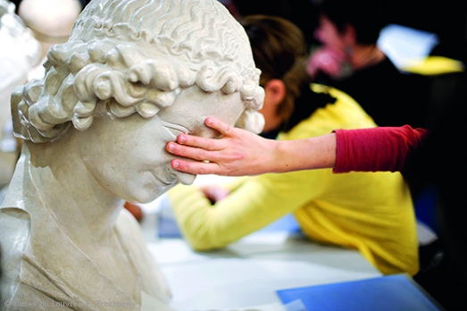
https://www.louvre.fr/en/touch-gallery

Slide 4
Accessibility at the Bendigo Art Gallery
We commenced a partnership with the Bendigo Art Gallery a number of years ago to explore with them how they could improve access for those who are blind or have low vision
We began exploring the use of 3D Printing, Laser Cutting, NFC, Web Resources, as well as non-technology based “making” in the creation of multi-sensory supporting materials for the gallery experience
We started with supporting the experience of blind and low vision visitors with a collection of works in the gallery’s permanent collection

Slide 5
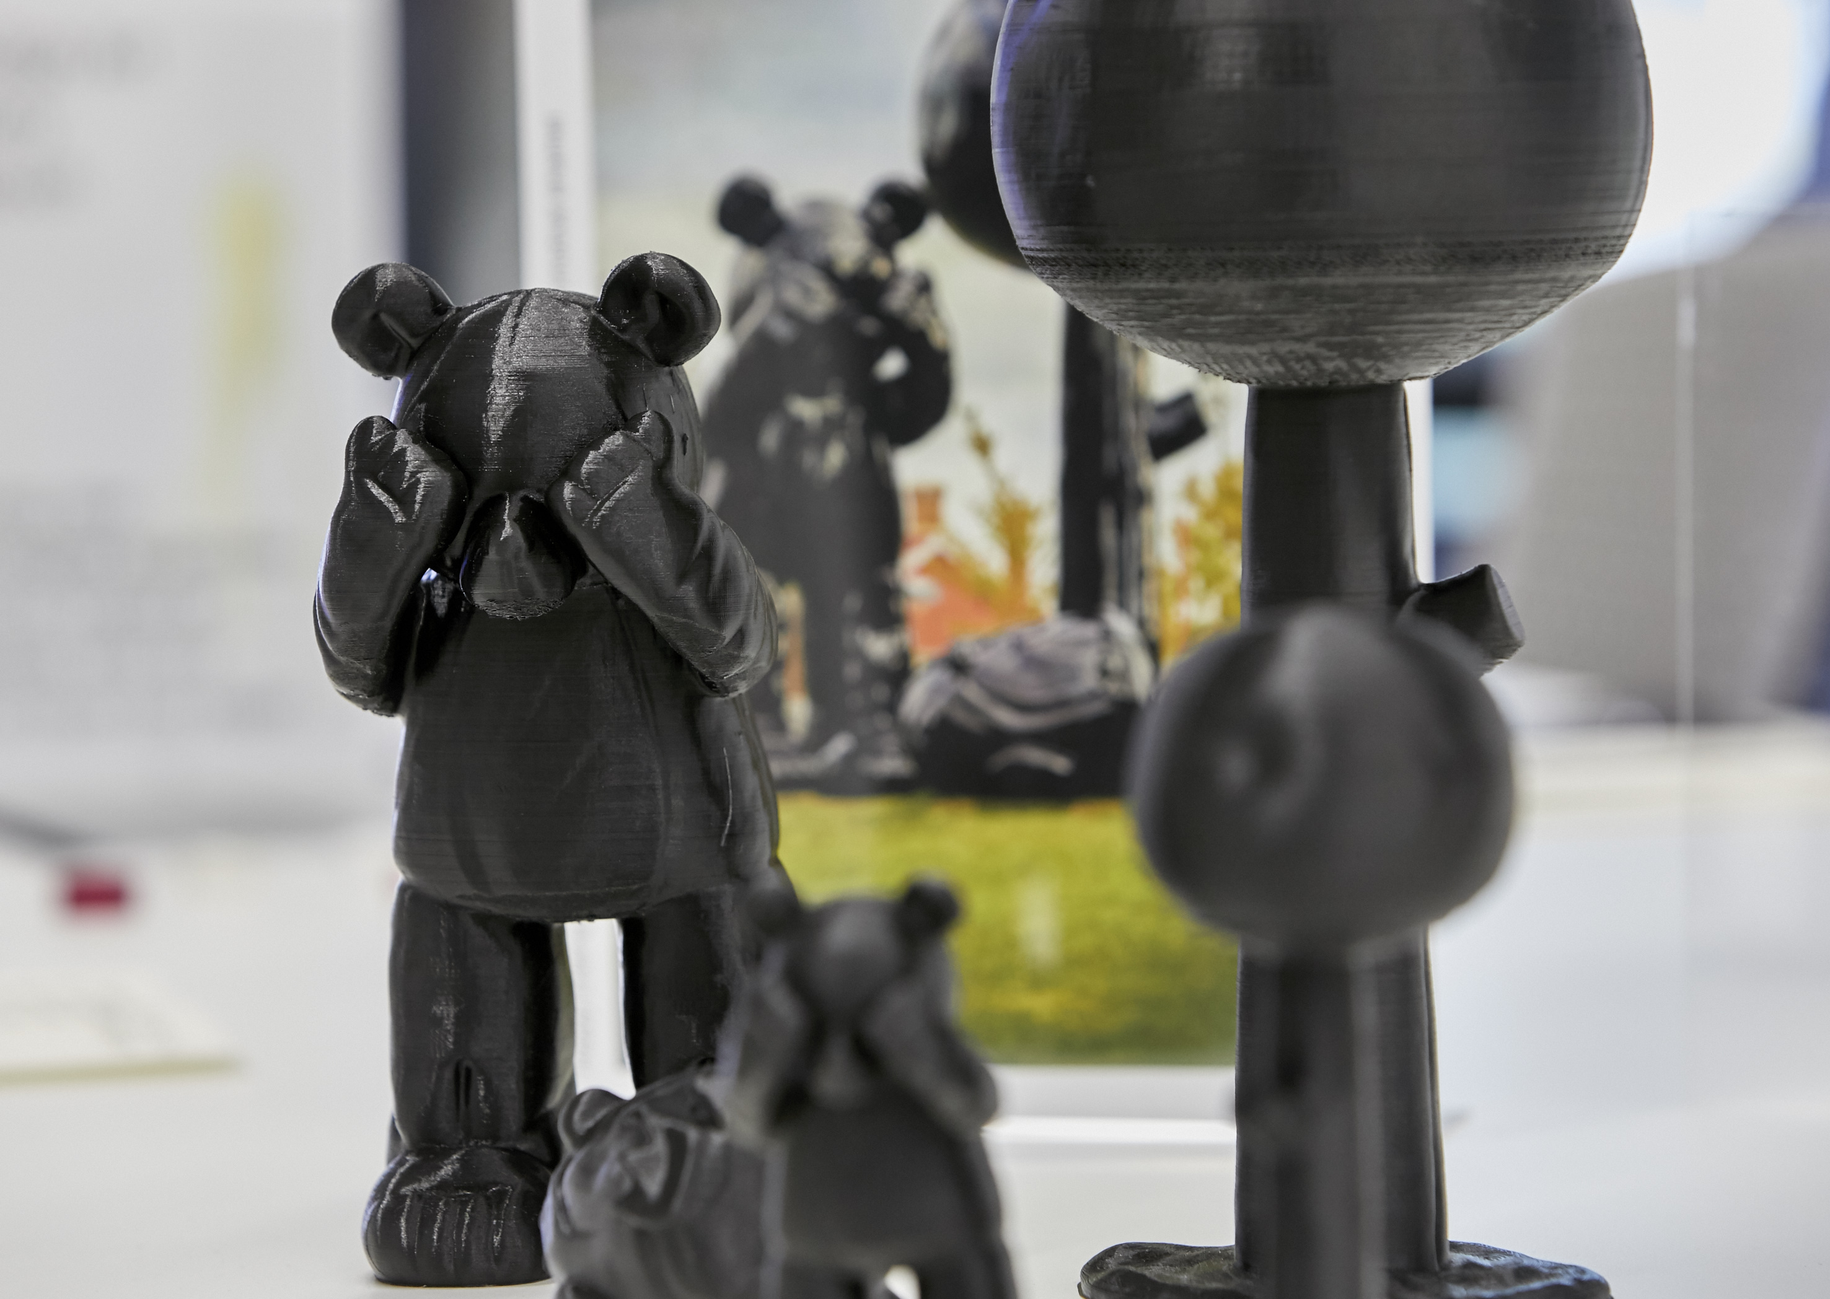
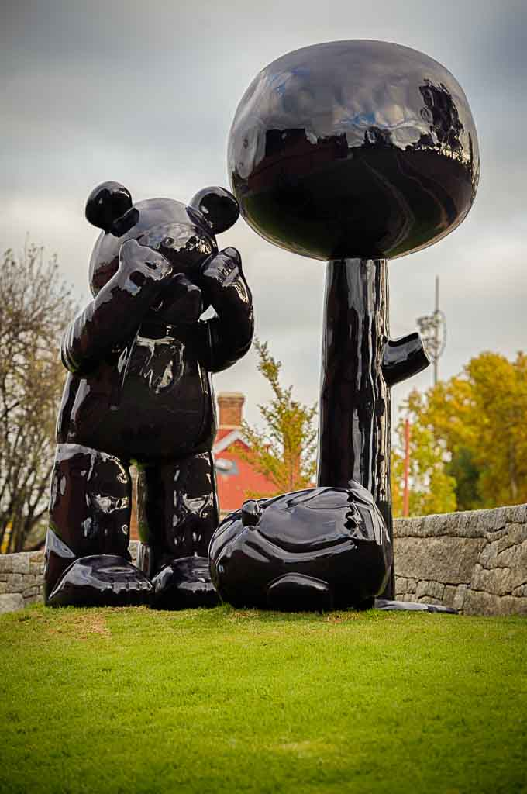
“Happy Ending” by Michael Doolan (2014)
© Collection Bendigo Art Gallery

Slide 6
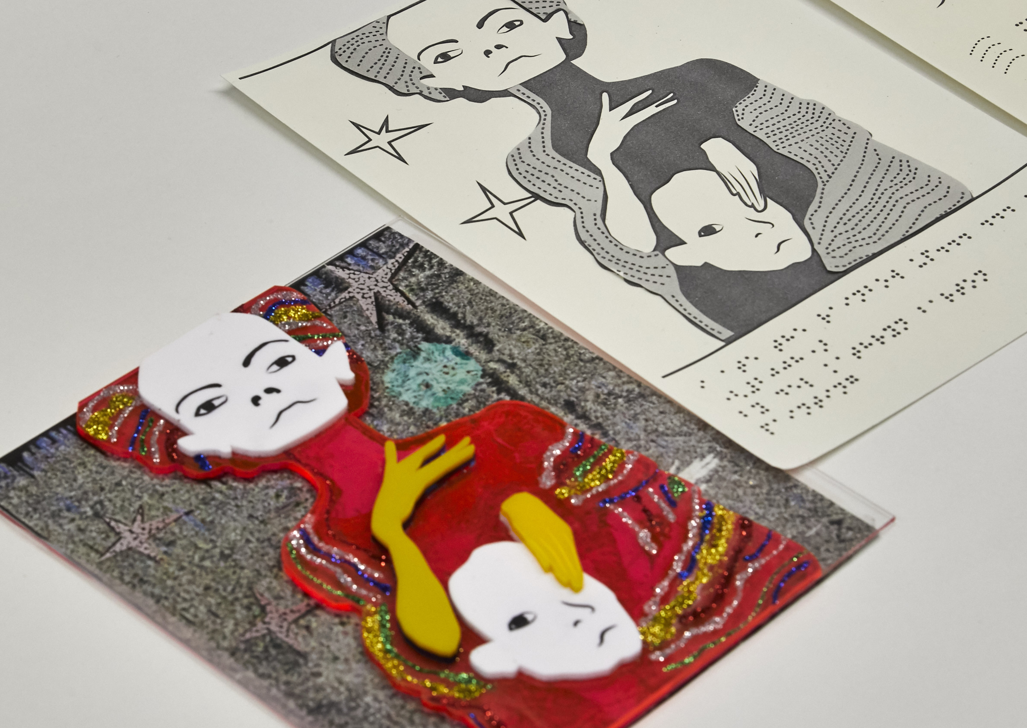
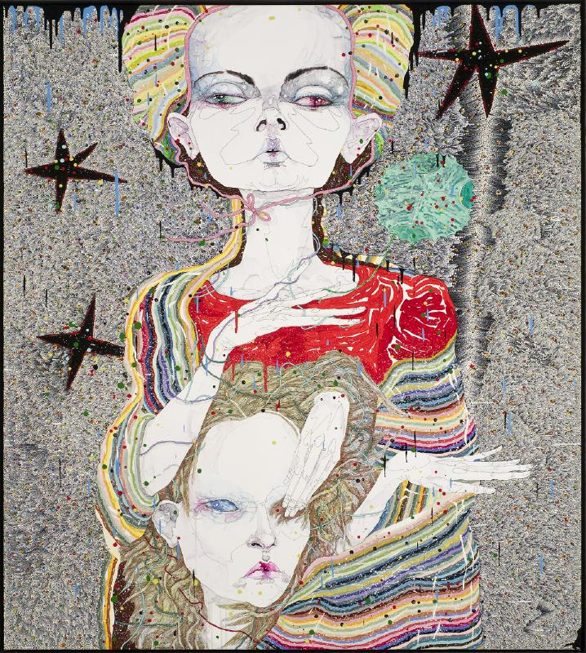
“i ate the rainbow up... ... ...” by Del Kathryn Barton (2008)
© Collection Bendigo Art Gallery

Slide 7
“Being totally blind, I’ve always found art galleries to be boring until . . . this virtual tour. Having the soundscape and the visual descriptions made it a meaningful experience.”

Slide 8
Helen Macpherson Smith Trust Support
The partnership has gone to the next level with the generous support of the Helen Macpherson Smith Trust, who have provided financial assistance to continue to the work
The project is looking to establish and disseminate evidence-based guidelines for galleries and museums, to support their efforts for ongoing inclusive practice
After delays to the start of the project due to the pandemic, the project has been able to work with the gallery to support two recent flagship exhibitions: Mary Quant in 2021 and Elvis: Direct from Graceland in 2022

Slide 9
Mary Quant
In 2021, the flagship exhibition for the gallery was the fashion of British designer Mary Quant, provided by the V&A London
It featured outfits designed by her along with other ephemera from the era
The research team ran a dedicated session and exhibition visit for 4 blind and low vision visitors on the final weekend of the exhibition (delayed due to ongoing lockdowns)
The session consisted of an hour introductory session and introduction to a number of multi-sensory supporting materials, an hour in the exhibition, and an hour afterward to discuss and continue interacting with the supporting materials

Slide 10
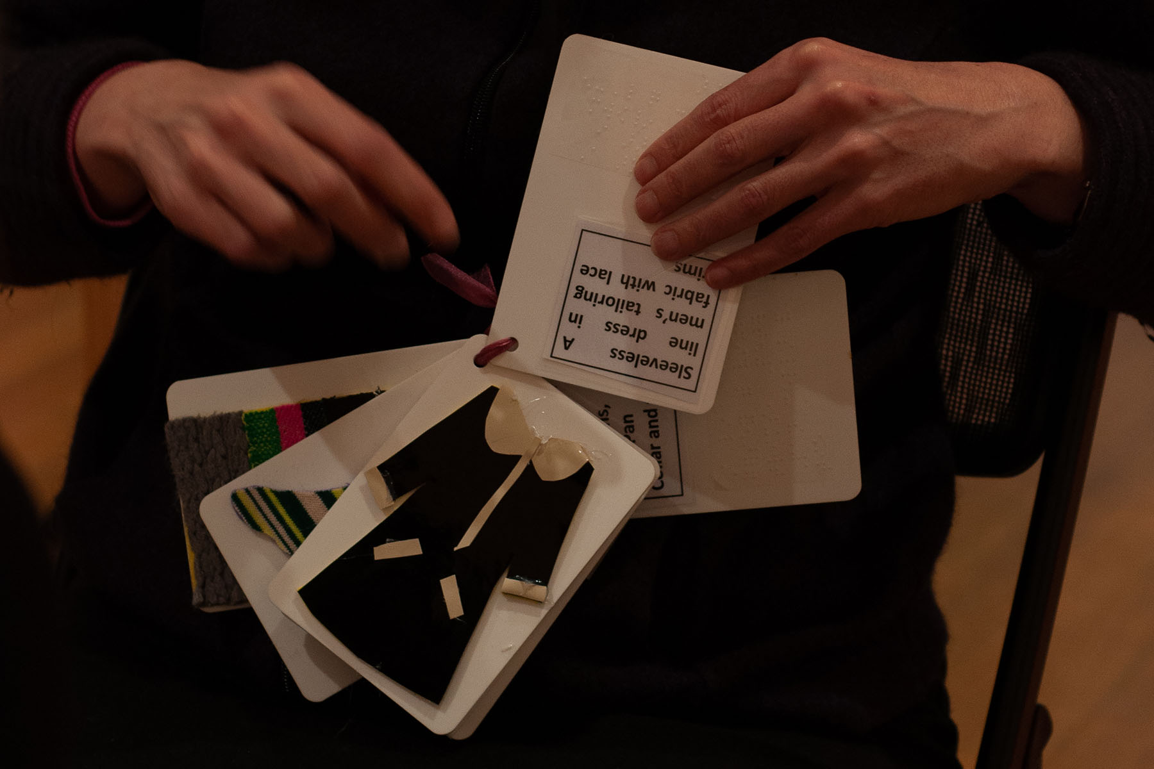
Tactile Concept Cards

Slide 11
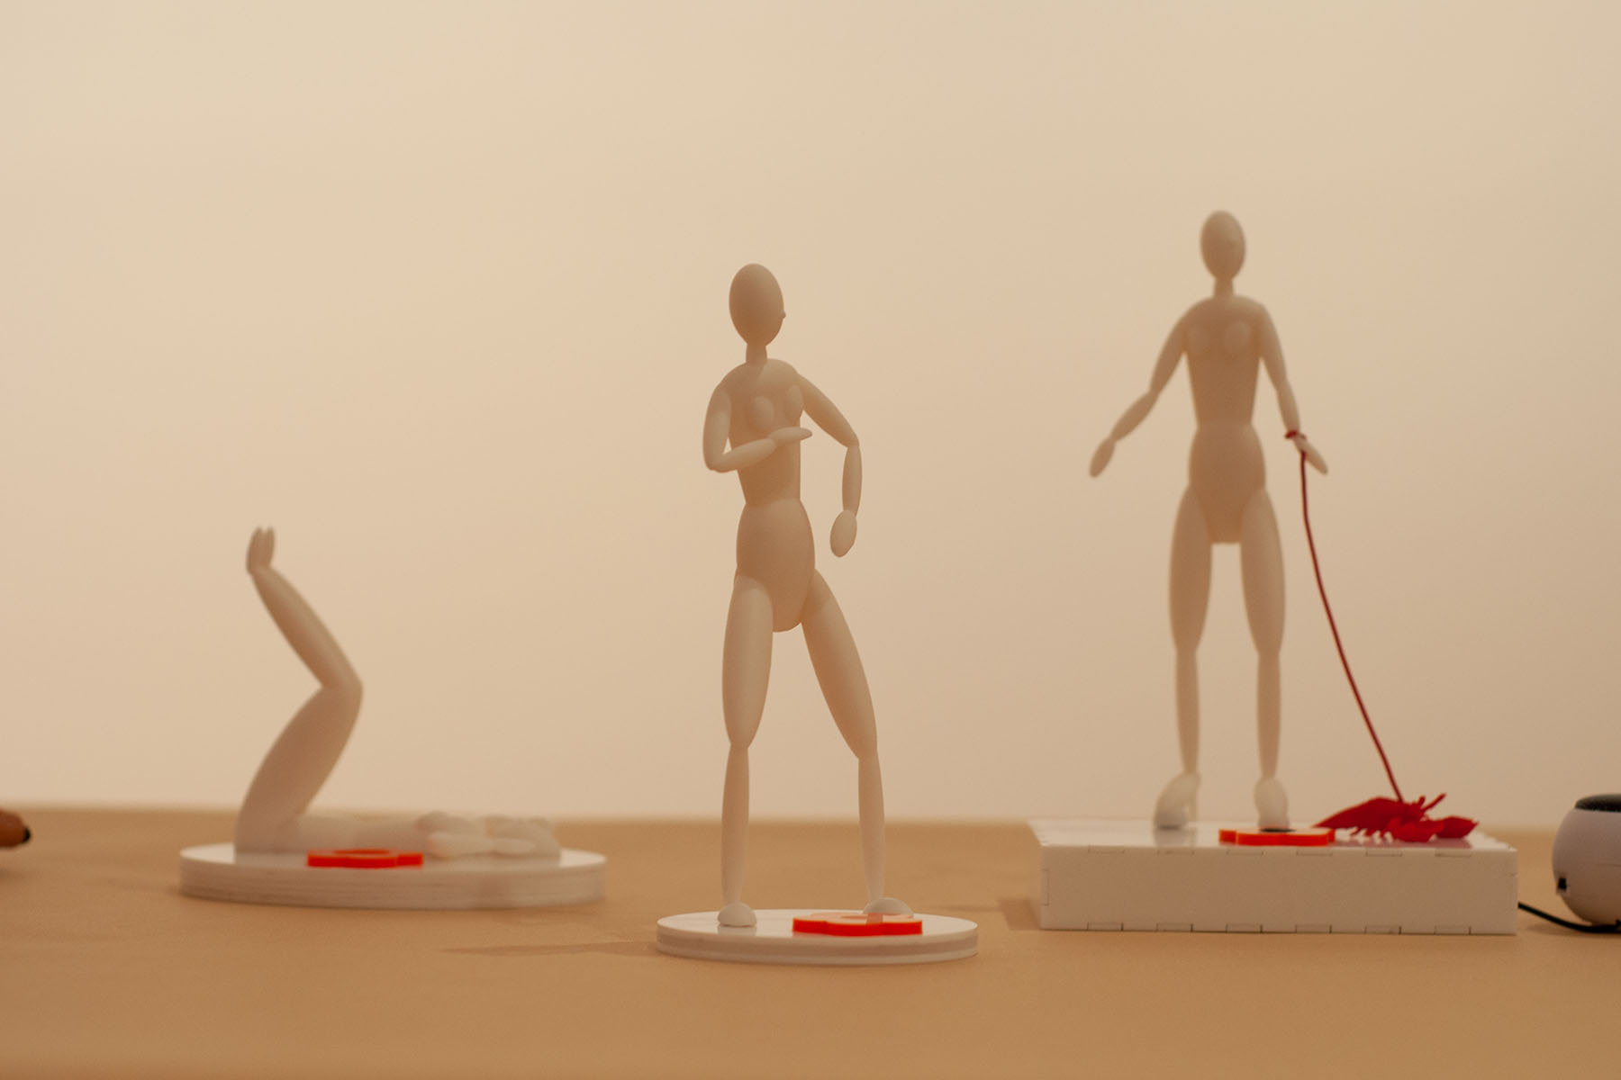
3D Printed Posing Models with Audio Labels

Slide 12
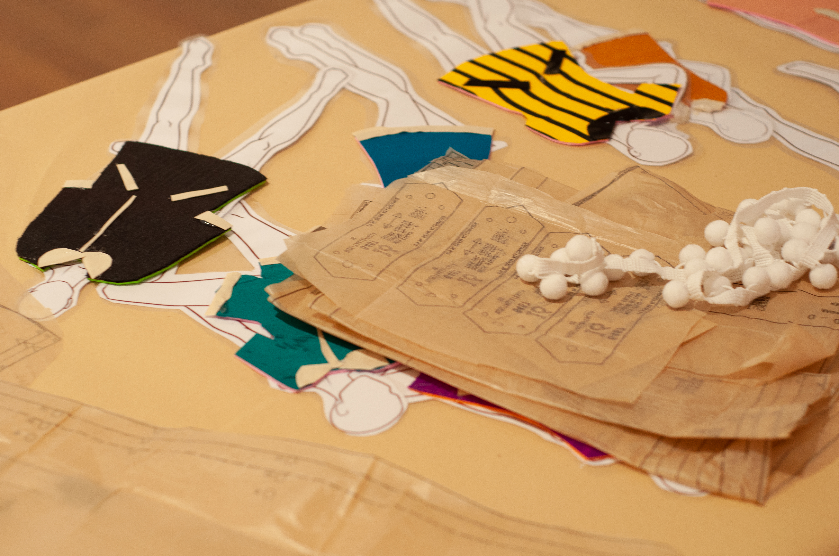
Paper Dolls and Patterns for Dressmaking

Slide 13
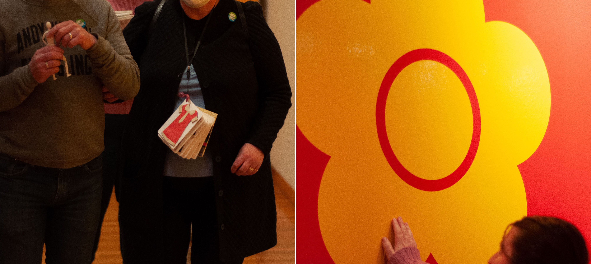
Exploring the Exhibition

Slide 14
Mary Quant - Outcomes
Importance of pre-visit
Access to web content and object descriptions
Access to alternate representations such as tactile objects
Supporting both independent access and bespoke experiences
Addressing equity means that independent access needs to be a cornerstone of an institution’s approach
However, supporting bespoke sessions can help alleviate anxiety and better support the individual needs of visitors
Supporting community
Galleries play an important role in communities, especially in regional areas… supporting equitable access is as much about supporting the community as it is about individuals.

Slide 15
Mary Quant - Outcomes
Timeliness
The most precious resource is often time
This is for galleries, who need considerable time to prepare for BLV visitors
It is also for individuals with different needs, as engagement can often be a more time consuming process
Community engagement
Truly equitable access will only happen with all stakeholders being invested
Expertise is often required, either for transcription or development of bespoke artefacts. Creating teams and communities of practice will facilitate this and not put the onus on any one gallery or set of stakeholders.

Slide 16
Elvis: Direct From Graceland
In 2022, the flagship exhibition is Elvis: Direct from Graceland
This features artefacts from the estate of Elvis Presley, including fashion, musical ephemera and personal objects
As part of the exhibition planning, the gallery organized 4 “Access Elvis” sessions… 2 for BLV visitors and 2 for deaf and hard of hearing people
The research team worked with the gallery to co-present the 2 BLV sessions
To date, one has taken place
For this session, we continued with some of the same types of artefacts (portable tactile concept cards, NFC and audio descriptions), and implemented some new ideas including dioramas, refreshable tactile displays, and multi-sensory “experiences”

Slide 17
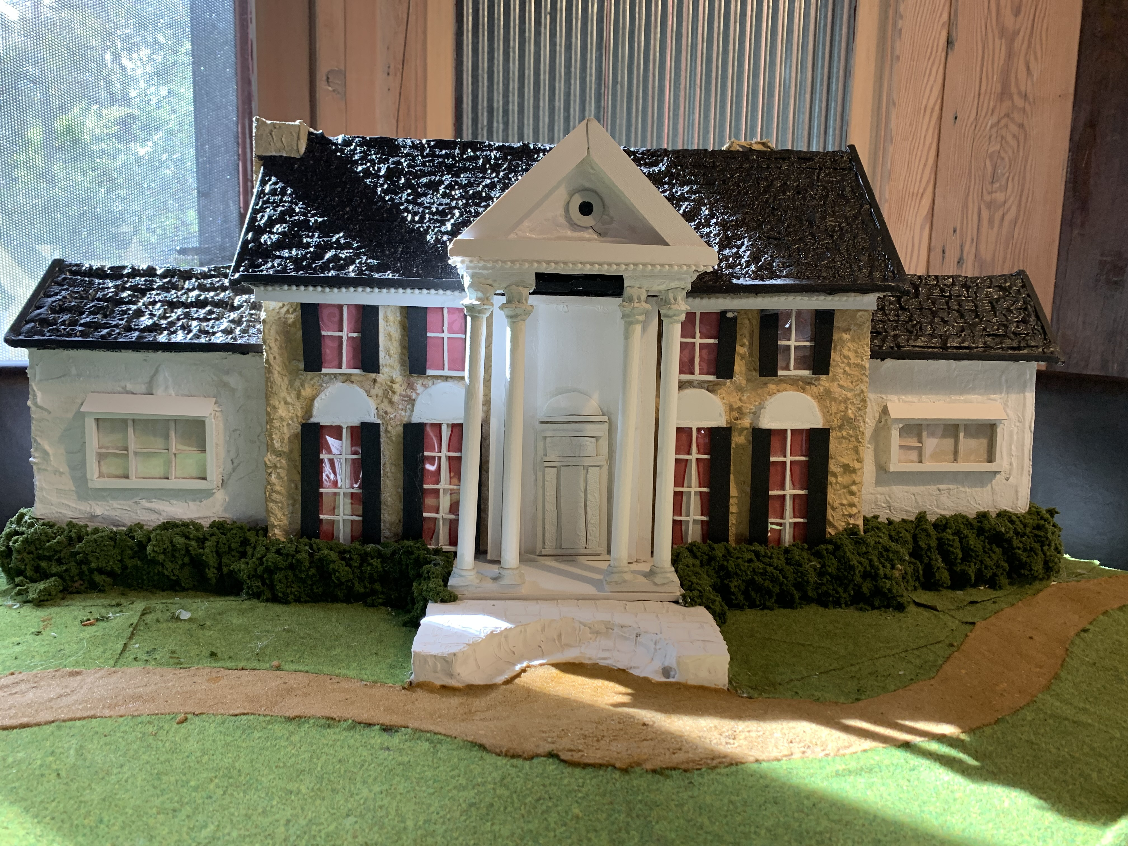
Graceland Model

Slide 18
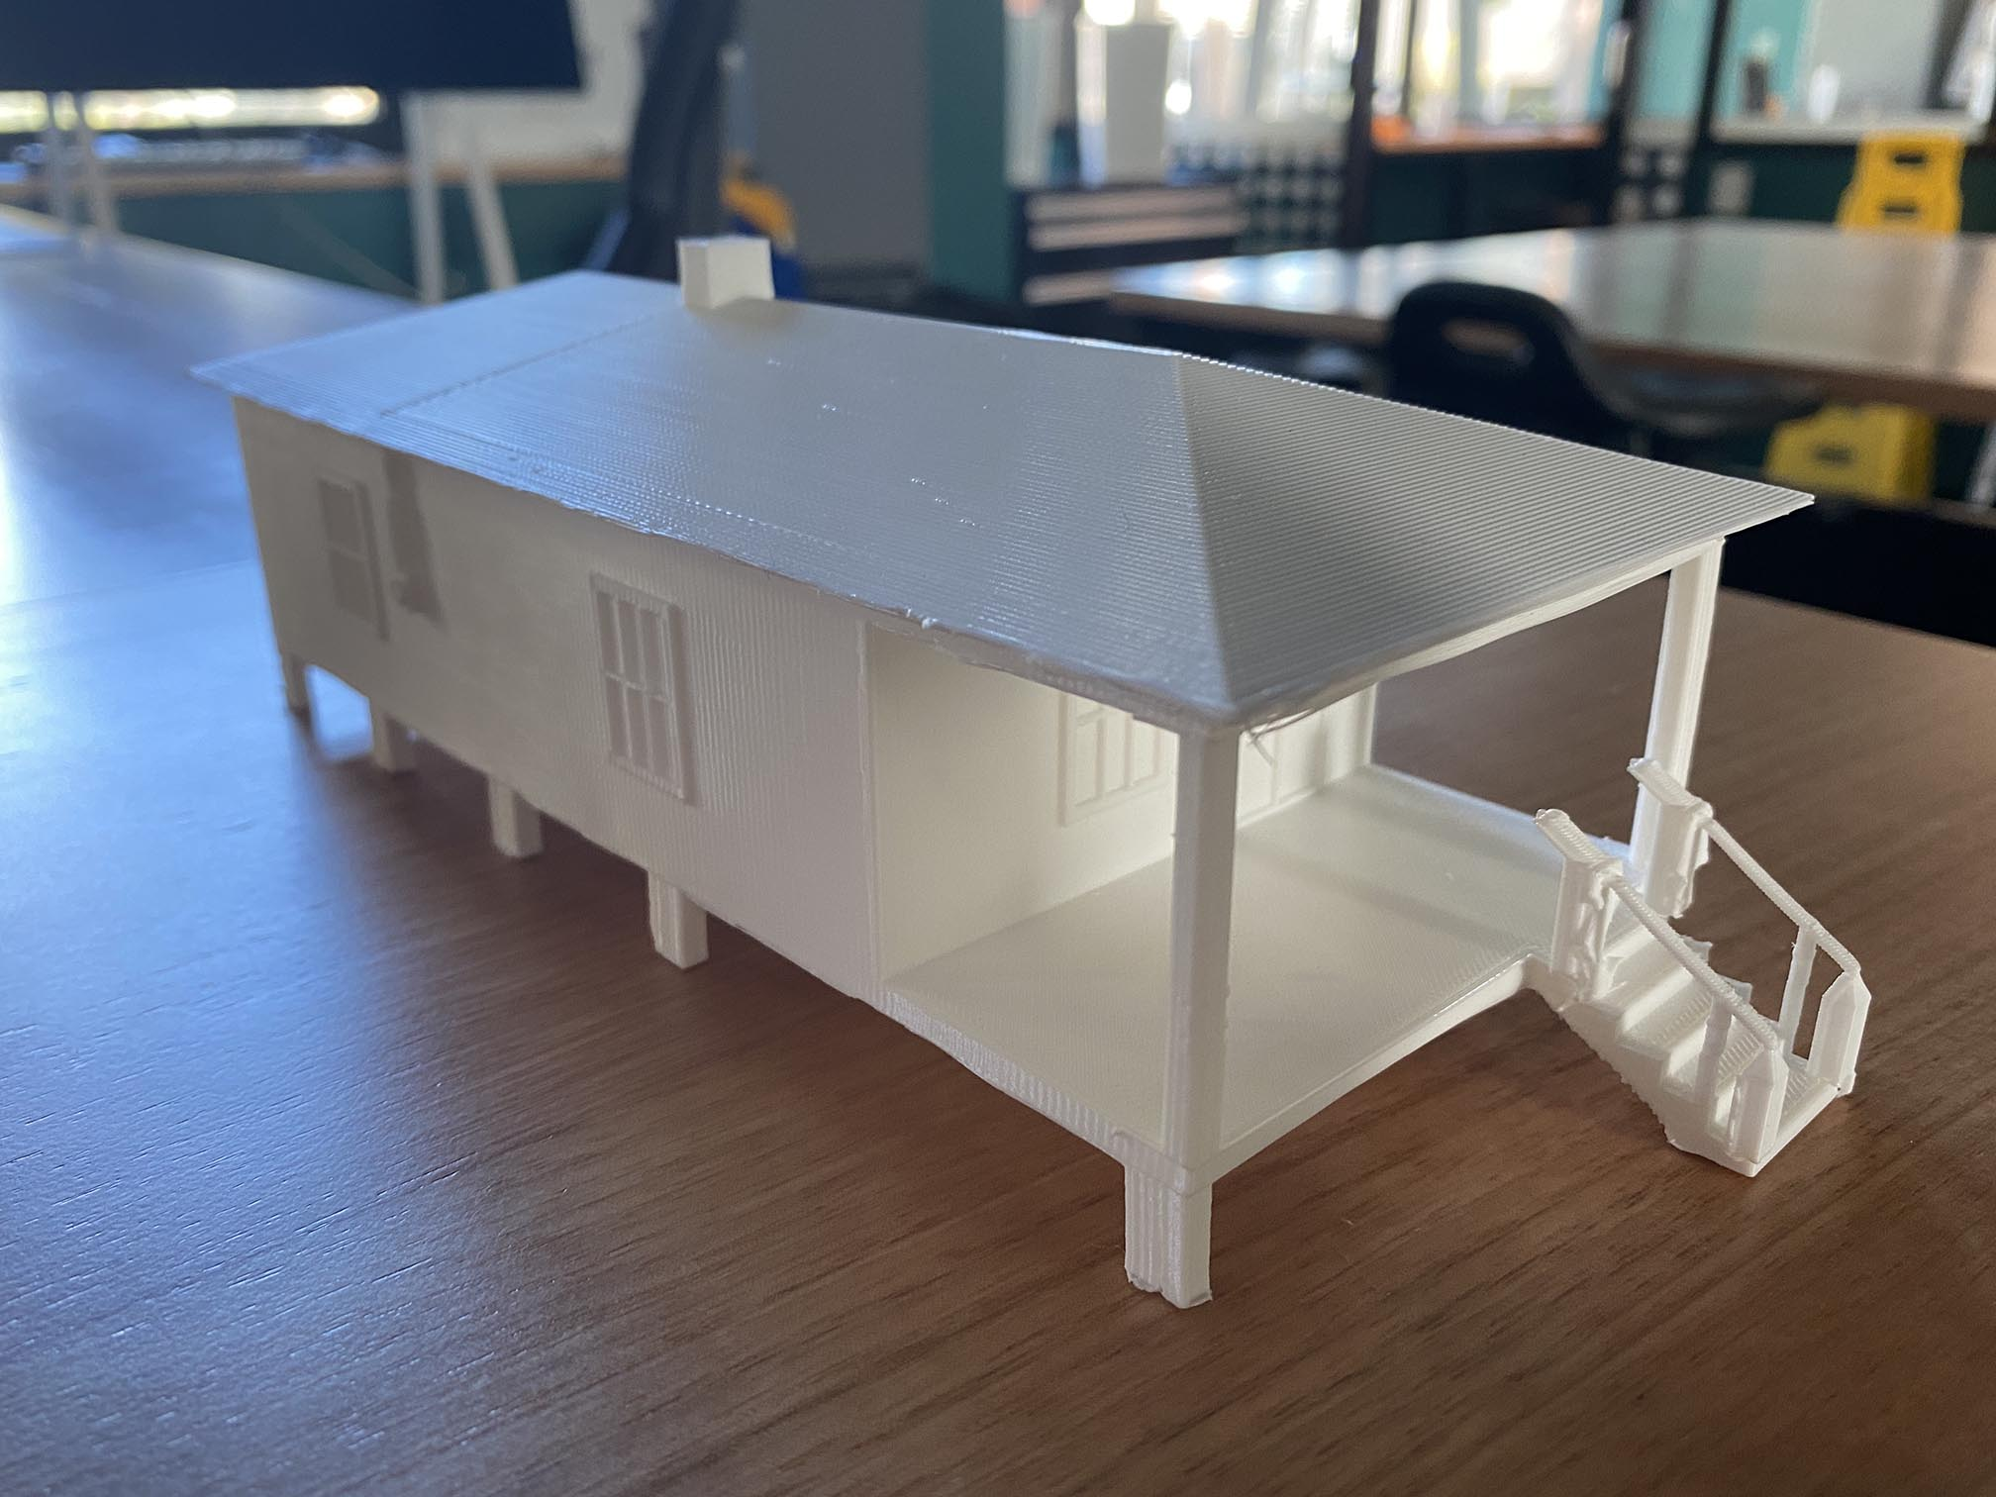
3D Printed House

Slide 19
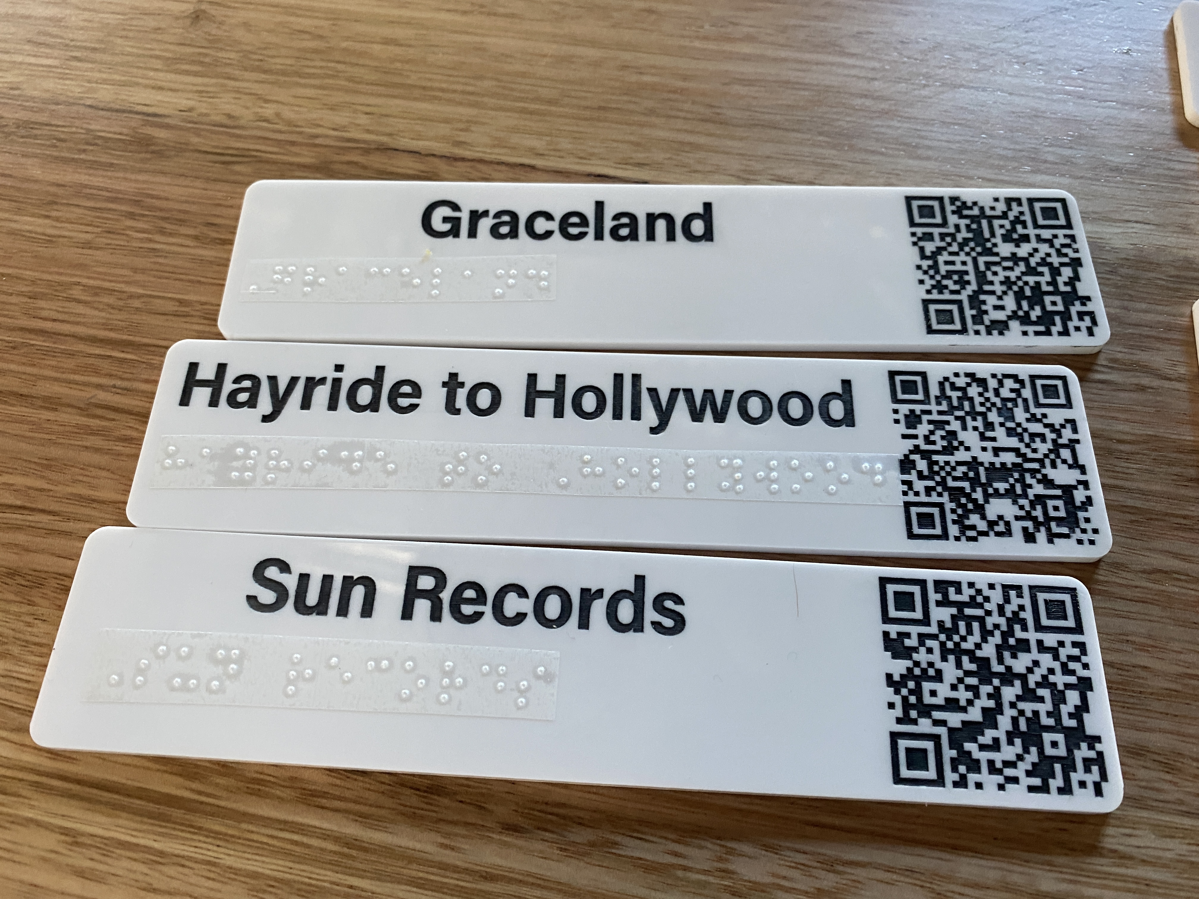
3D Printed Plaques with Links to Accessible Online Content

Slide 20
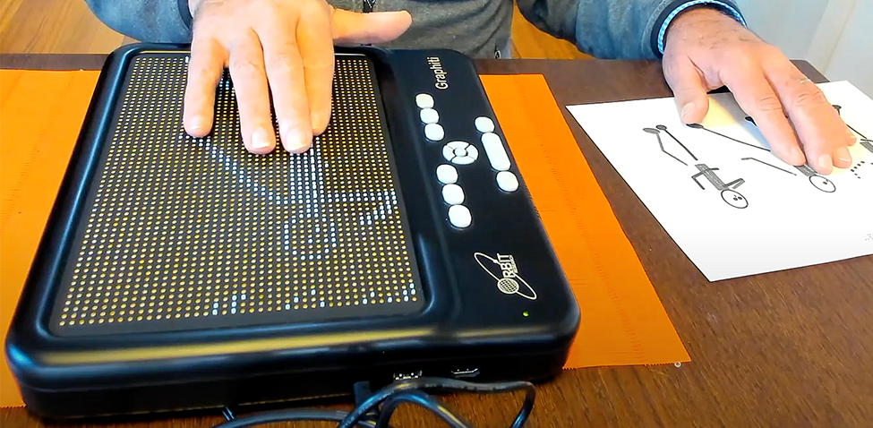
Graphiti Refreshable Tactile Display

Slide 21
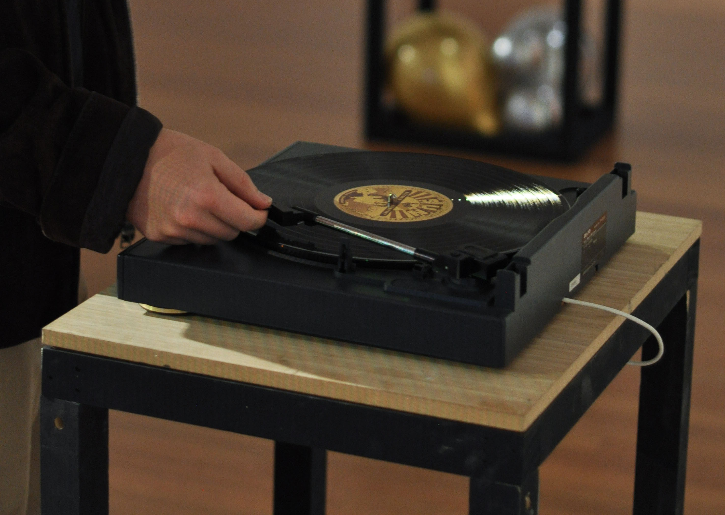
Interactive Turntable

Slide 22
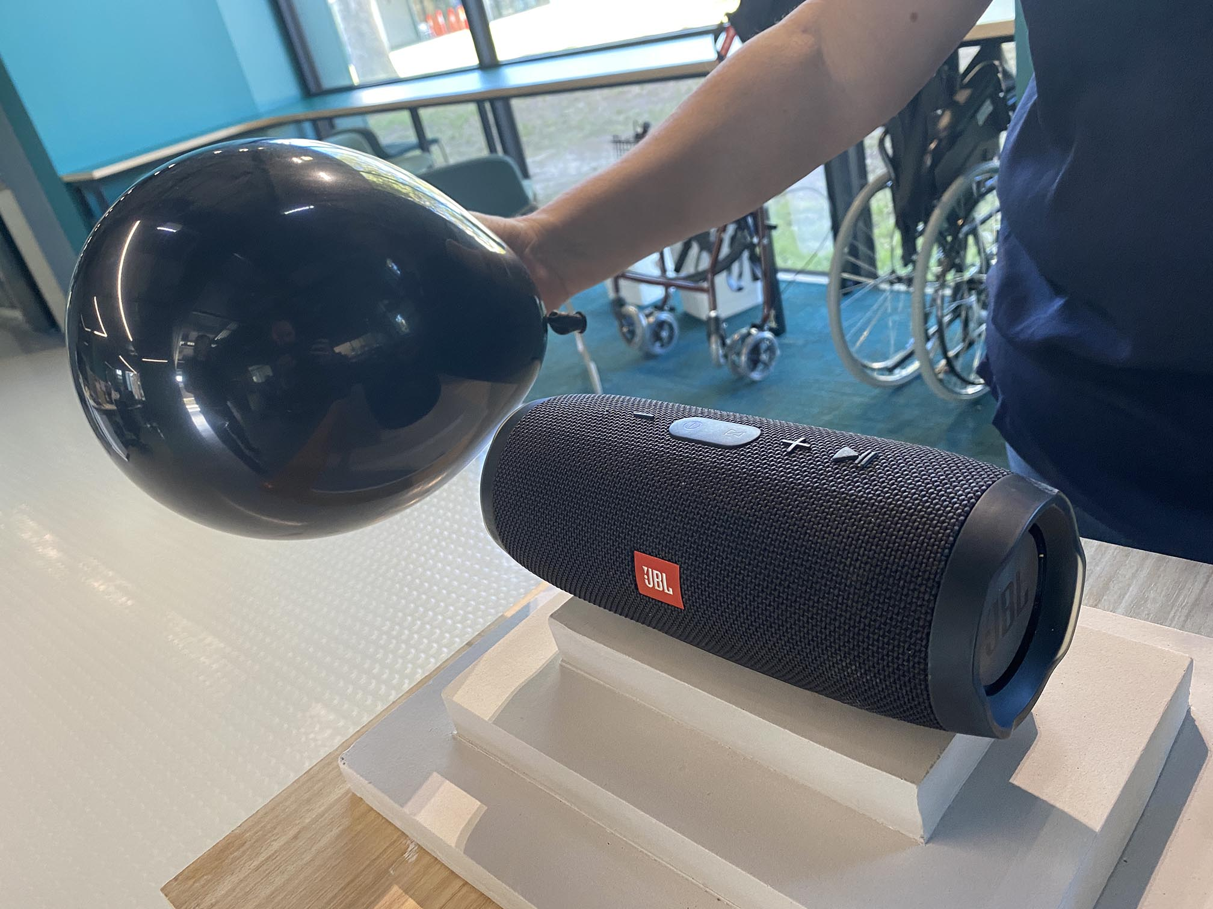
Elvis Through Vibration

Slide 23
Elvis: Direct From Graceland - Outcomes
Session went extremely well… sold out!
No post visit interviews undertaken yet
Will be tweaking experiences for the second session

Slide 24
Where To From Here?
We will be collecting as much feedback and data as we can from the Elvis sessions from both visitors and gallery staff
From there we will distill our findings down into a set of principles and guidelines we will look to put into practice in subsequent exhibitions and also with the Bendigo gallery’s permanent collection
We will then look to disseminate the guidelines more broadly

Slide 25
Thanks and Questions
Our sincere thanks are extended to the staff, volunteers, artists and visitors of the Bendigo Art Gallery for their work so far
Also a huge thanks to the Helen Macpherson Smith Trust for their generous support of this work
You can contact us at erica.tandori@monash.edu and matthew.butler@monash.edu
Read about our other work at https://www.monash.edu/it/hcc/inclusive-technologies

