Slide 1
Audio Description in Australia what have we learned 2022

Slide 2
Acknowledgement of Country
I would like to acknowledge the traditional owners of the Land in Australia where I reside and as a migrant acknowledge that this Land was never ceded.
I would like to also pay my respects to their Elders past, present and emerging, and
First Nations people who are viewing this presentation.

Slide 3
Thanks to
Katie Ellis and team - Curtin University and ACCAN
Gerry Neustatl and team – ABC
Michael Coonan and team – SBS
Michelle Ou – CfID

Slide 4
Global shift towards AD
AD as an integral accessibility feature.
Netflix, Disney+, Apple are leading the way.
AD users would like to see AD become normalised like Closed Captioning.
Netflix provides the most AD functionality while Disney+ has a strong reputation for accessibility and inclusion.
AD users subscribe to Netflix with the confidence that most, if not, all Netflix Originals now have AD. Disney+ platforms offer the widest range of accessibility features and functionality, including AD.

Slide 5
Where we’ve been and how we are going
Good to great
With availability audiences now want ‘great AD’.
Factors users consider include:
descriptiveness,
clarity,
pace,
timing,
volume and
narrator’s tone and voice.
Notes:
Quality of AD
Now that audio described content is more available, audiences do not simply want audio description, they want ‘great AD’. Factors users consider about AD quality include the descriptiveness, clarity, pace, timing, volume and narrator’s tone and voice.
AD increases sense of social connection and independence.
AD enables blind and vision impaired audiences to feel more socially connected when they can join conversations about visual media which they can’t access without AD. AD means they no longer need to feel disruptive asking others what’s on screen.
Inconsistent availability of AD.
There is a lack of AD for advertisements, trailers and sport. The inconsistent availability of AD can be particularly frustrating when only parts of series or seasons have AD.

Slide 6
There is no standard way.
Inconsistent availability of AD.
There is a lack of AD for advertisements, trailers and sport. The inconsistent availability of AD can be particularly frustrating when only parts of series or seasons have AD.
There is no standard way to find and identify AD content.
While Netflix, Disney+, Prime Video, BBC iPlayer and ITV Hub all offer AD on VOD, there is no consistent way to find and identify AD content across VOD providers or devices.
For example,
only some VOD providers have an AD category, but the location of the AD category is different across devices.
Netflix, Disney+ and Prime Video have implemented a consistent way of turning AD on/off via Audio and Subtitle Settings on the player control screen. Users select ‘English [Audio Description]’ from the list of audio options.
BBC iPlayer and ITV Hub have implemented this feature in a different way, with a toggle button – this approach is less scalable if more than one language is available.

Slide 7
Broader beneficial impact
AD increases sense of social connection and independence.
blind and vision impaired people, including:
people with autism or sensory disability
auditory learners
Children
the elderly
non-native speakers
people with learning or reading difficulties (e.g. dyslexia and aphasia).

Slide 8
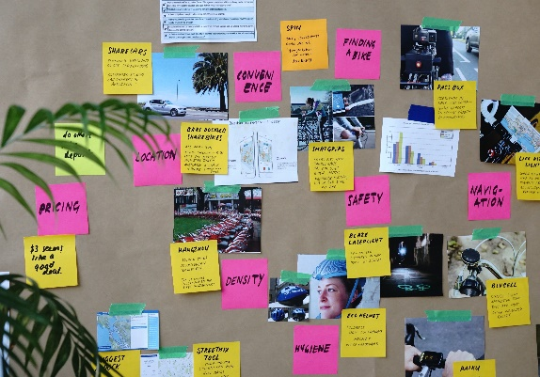
Solutions need to include feedback
2. Implementation and testing
1. Research
3. Comms plan and accessible communications
4. Advice/Implementation Support
Notes:
Promotion and communication.
Increase awareness about AD on broadcast TV and VOD, and the broader use cases.
Support inexperienced VOD users with instructions on how to use AD functionality such as where to find accessibility settings on their devices, how to find AD content and choose AD audio option.
ITV Hub implemented AD mobile-first.
Of you can’t do it all at once, be transparent.
Case study:
ITV Hub’s mobile-first implementation of AD functionality was well received until AD was mobile-only for several years but broadcast was stalled after it was promised because of other platform issues. The blind and vision impaired community were disappointed with the unfulfilled promise of AD on other devices and platforms.
Since the controversy, ITV Hub has worked with community to co-create upcoming implementation strategy where AD will be implemented next on Amazon Fire Stick, Apple TV, Samsung TV and Chromecast.

Slide 9
Key insights
AD isn’t useable or useful if you can’t access the service
AD users want to be able to explore and find content with AD easily.
AD users value the accessibility and flexibility of mobile apps for VOD
Inconsistent navigation and AD functionality is confusing.
AD users want their experience to be optimised by tailoring it to them
AD users want to be able to adjust their viewing options.
AD users don’t remember severe issues at account creation / log in after they have logged in

