Slide 1
Braille and Large Print Services
Kim Barber – Manager Braille and Large Print Services
Leanne Tucker – R/Coordinator Braille Production
Navkaran Virdi – Project Officer

Slide 2
Contents
Braille and Large Print Services – support for schools and teachers
Introduction and contents – slides 1 and 2
BLPS in brief – slide 3
Braille services – slides 4 to 9
Large print and library – slides 10 and 11
3D project – slides 12 to 16
Contacts – slide 17
End of slides

Slide 3
Braille and Large Print Services – in brief
Over 1200 students with vision impairment within NSW DoE schools
225 vision teachers – Itinerant Support Teacher Vision
25 vision teams based across the state
11 outpost operators
BLPS main team 22 swells to 30+ over peak production times
Produce accessible assessments (e.g. Check – in, VALID, Best Start, HSC)
One of the first to produce screen reader accessible Maths text books. (e.g. Check – in, VALID, Best Start, HSC)
Training and Development
Over 11,500 braille volumes and over 8,000 large print titles held within the library.
education.nsw.gov.au

Slide 4
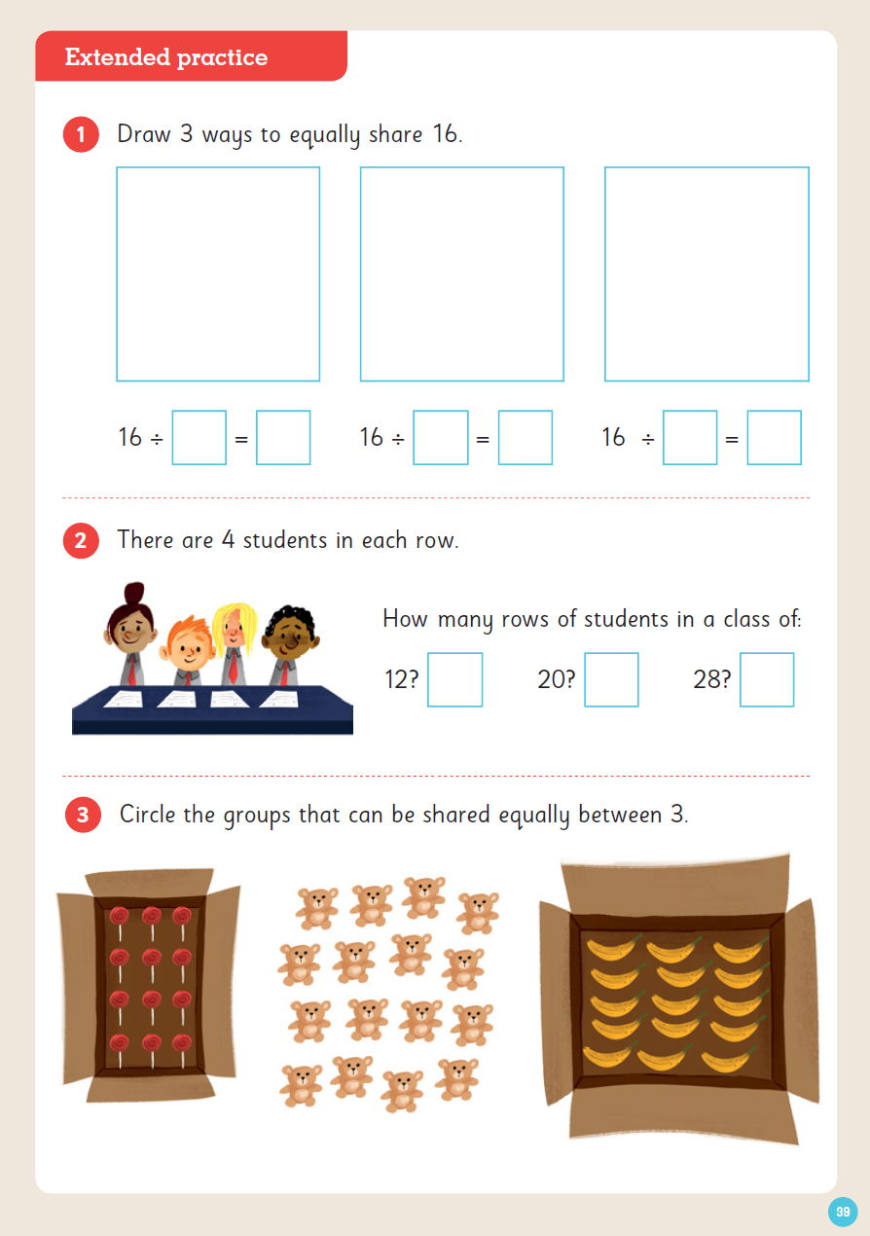
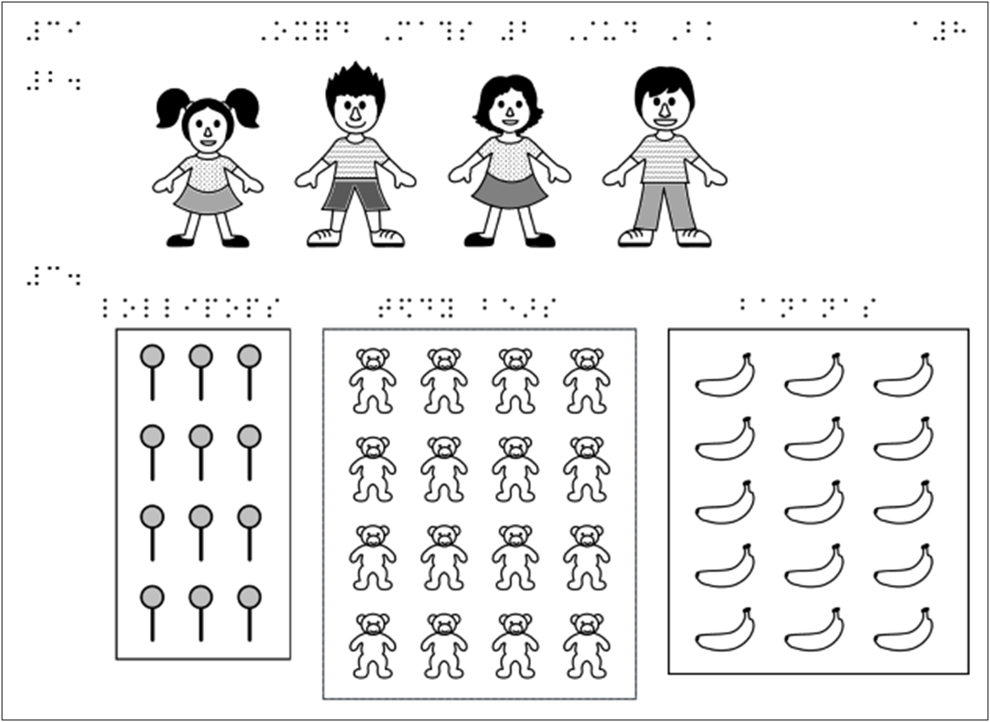
Braille and Large Print Services – Braille
The Braille Production Team
Primary text books

Slide 5
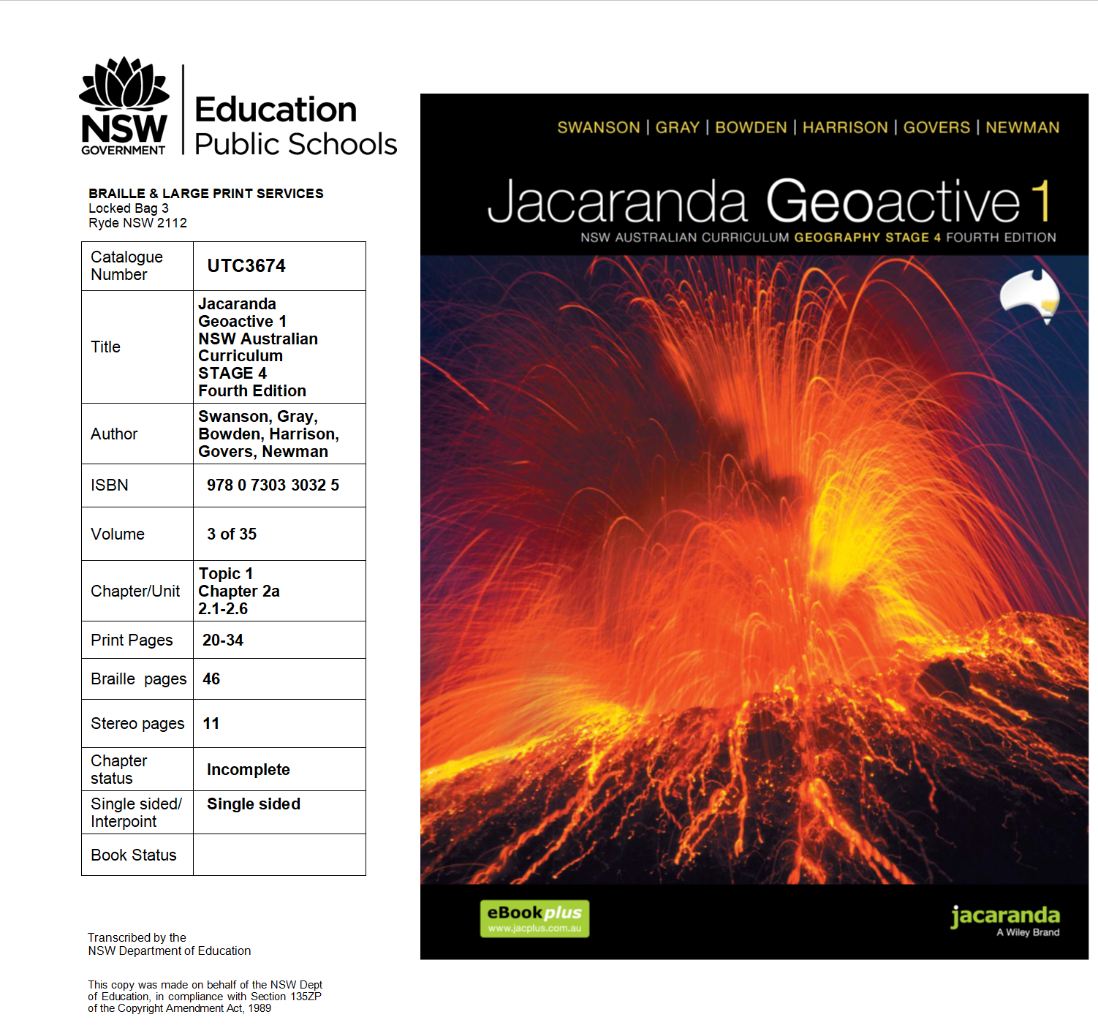
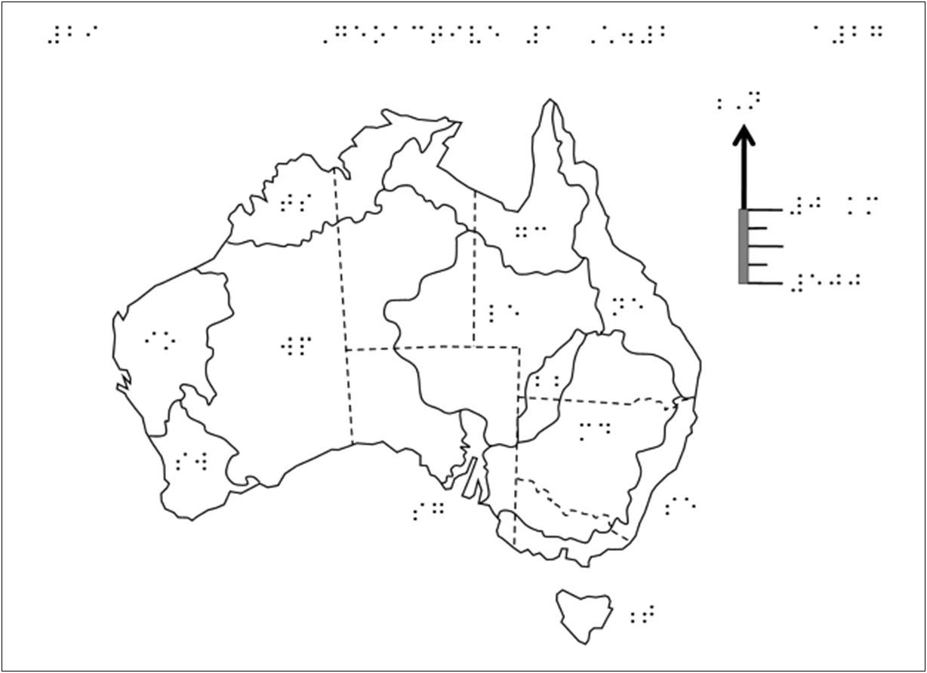
Braille and Large Print Services – Braille (a)
Secondary text books

Slide 6
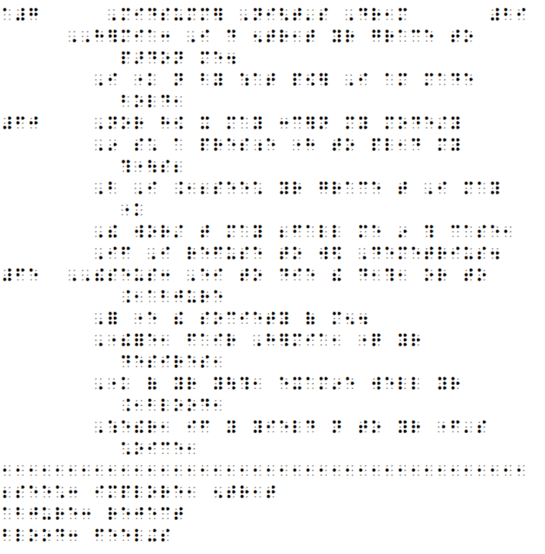
Braille and Large Print Services – Braille (b)
Novels and plays

Slide 7
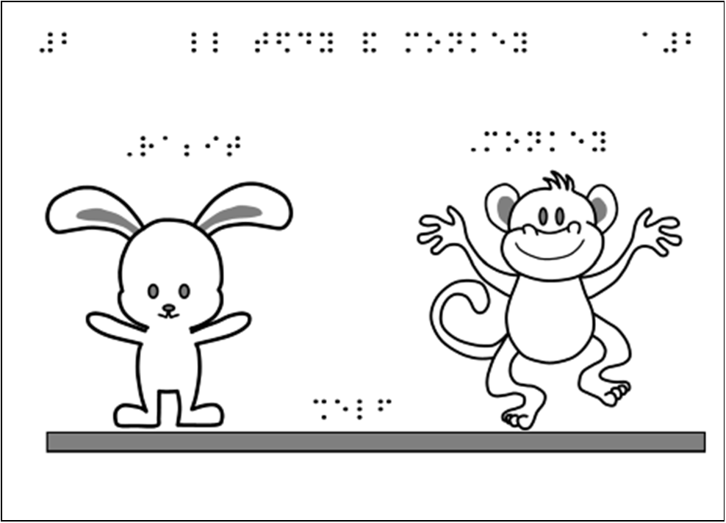
Braille and Large Print Services (c)
Braille – Early Readers

Slide 8
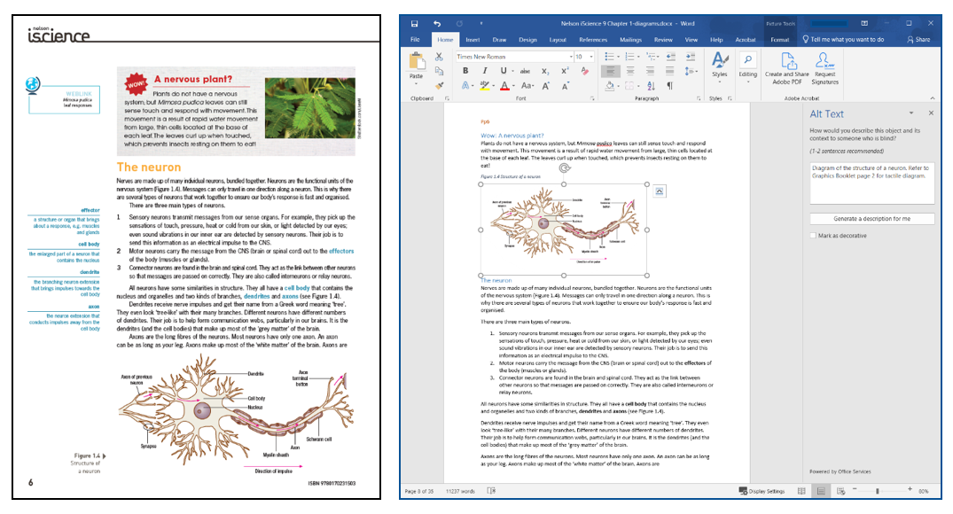
Braille and Large Print Services – Braille (d)
Increase in demand for accessible Word documents

Slide 9
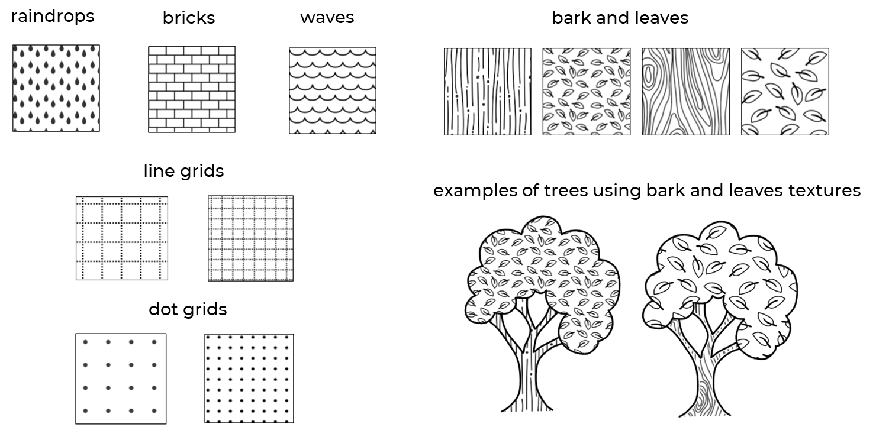
Braille and Large Print Services – Braille (e)
Developing textures

Slide 10
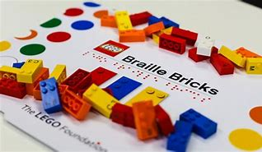
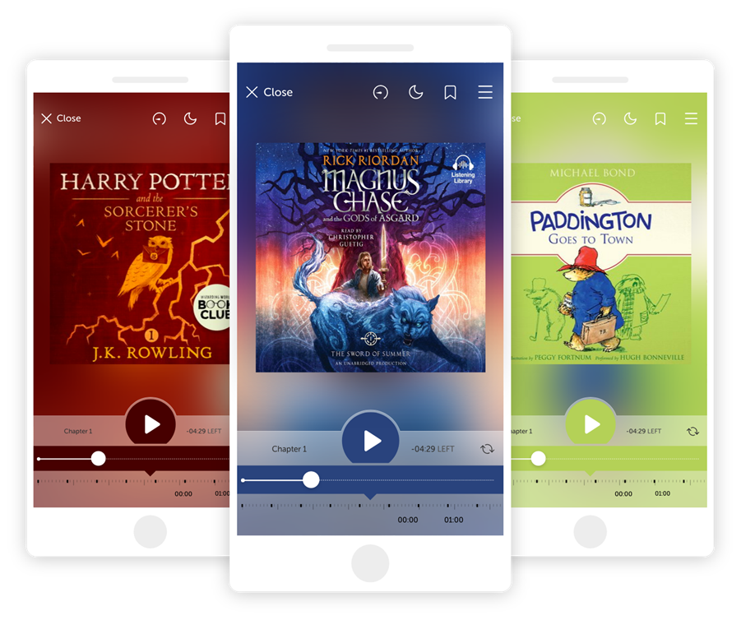
Braille and Large Print Services - Resources
Large Print and Library
Large print formats – N18, N24, N36, N48.
Sora – reading app, for audio and e-books
Tagged PDFs
Teacher resource library
Specialised equipment loans (Braillers, Braille LEGO, Draftman kits, tactile protractors to name a few)
Design and print specialised dark lined exercise books for students

Slide 11
Braille and Large Print Services – CVI books
Increased need for these resources
Files can be edited as students may have different visual colour preferences.
High contrast and image only books are being produced.

Slide 12
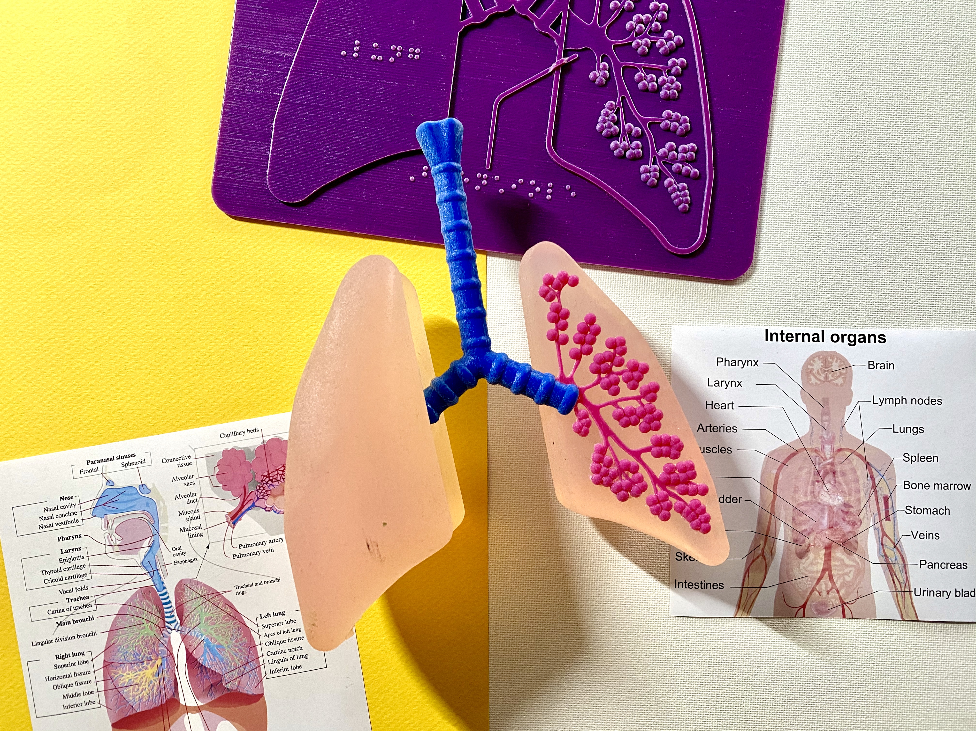
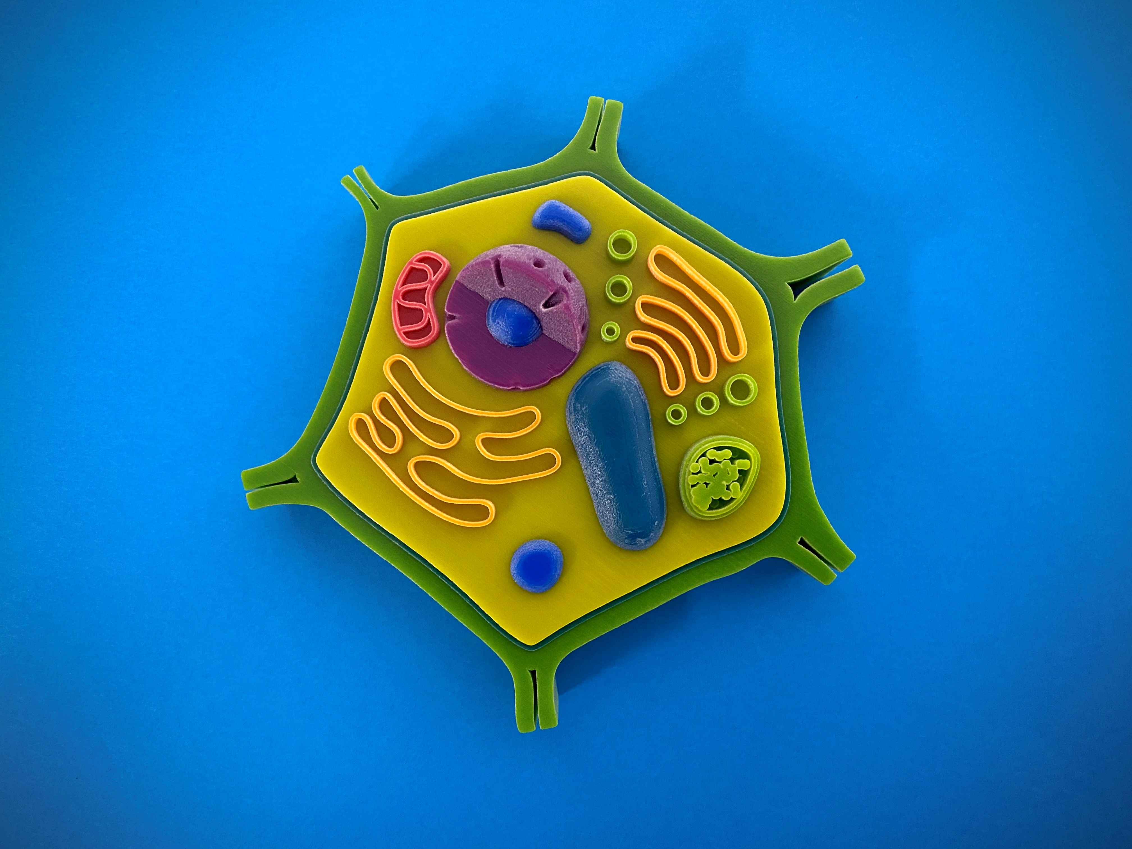
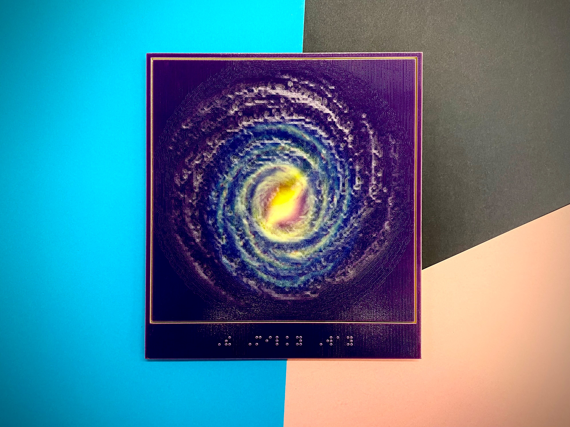
Braille and Large Print Services – 3D Prints (a)
What we offer – Science
Anatomy
Biology
Earth Science
Astronomy

Slide 13
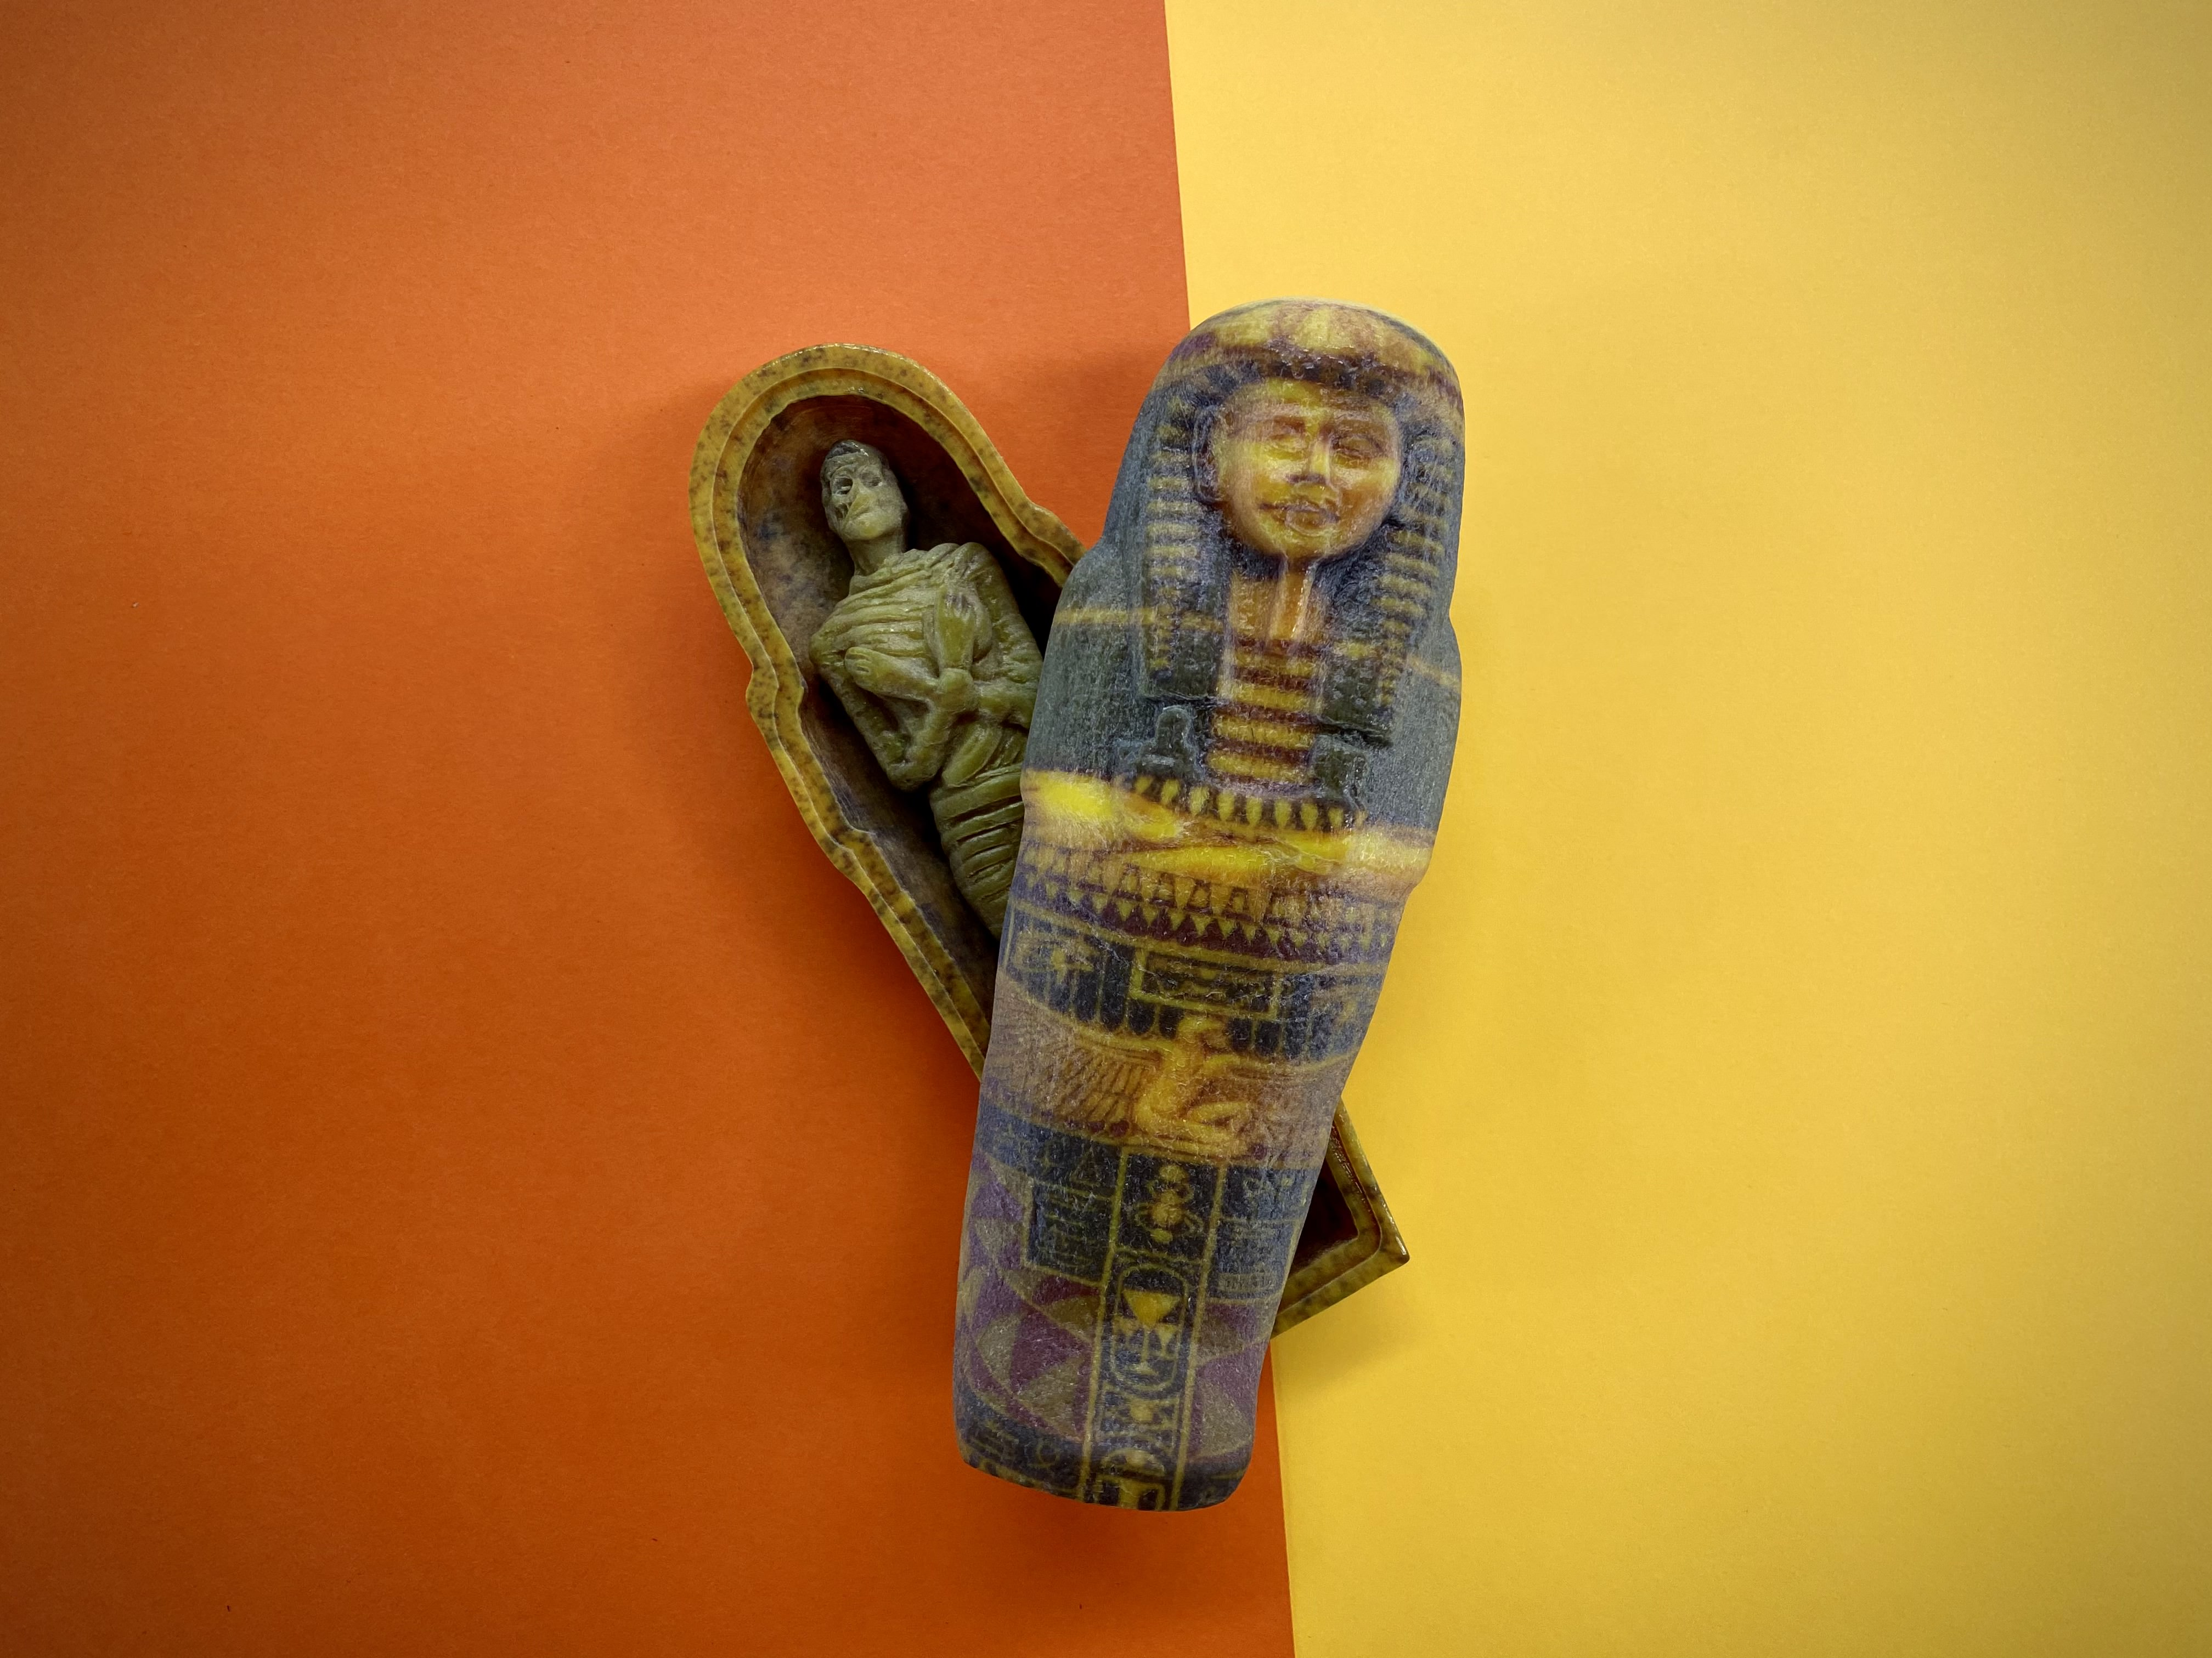
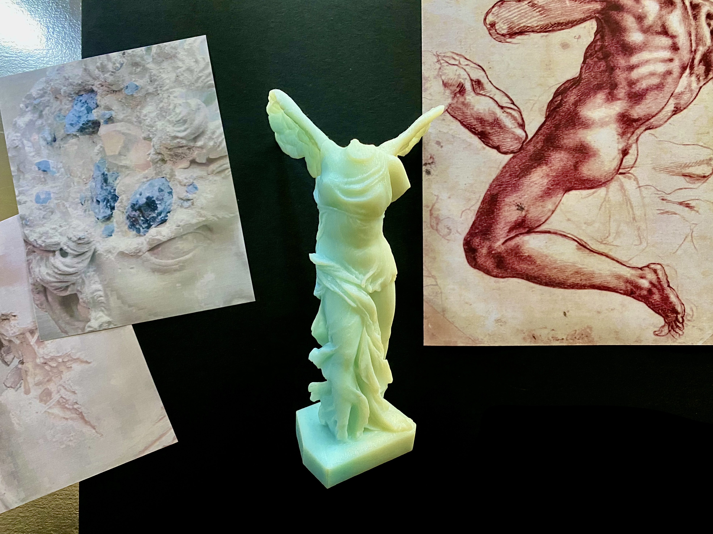
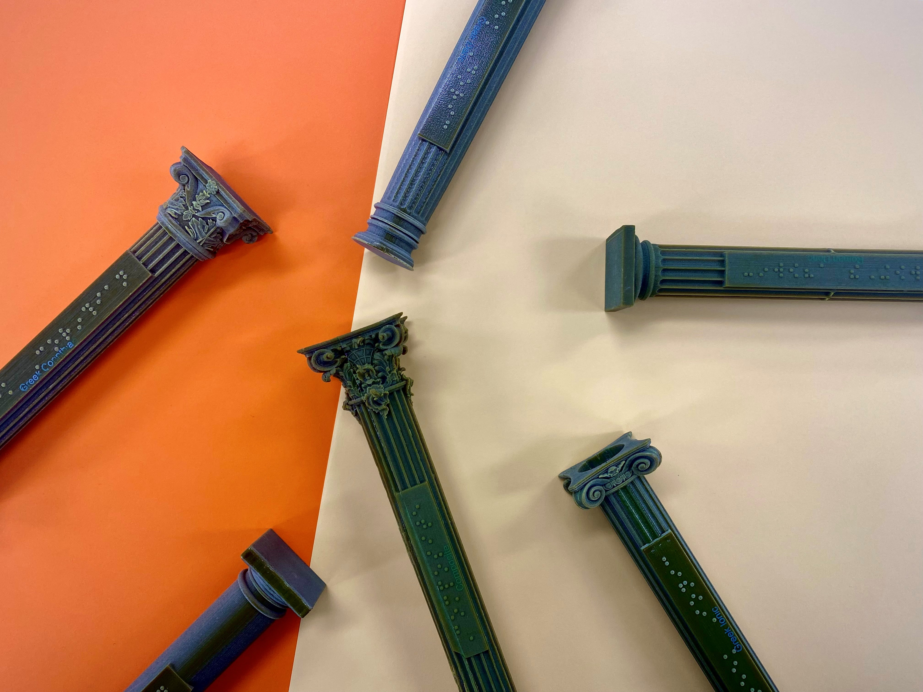
Braille and Large Print Services – 3D Prints (b)
What we offer – History
Ancient Egypt
Pompeii and Herculaneum
Art History
Ancient Greece

Slide 14
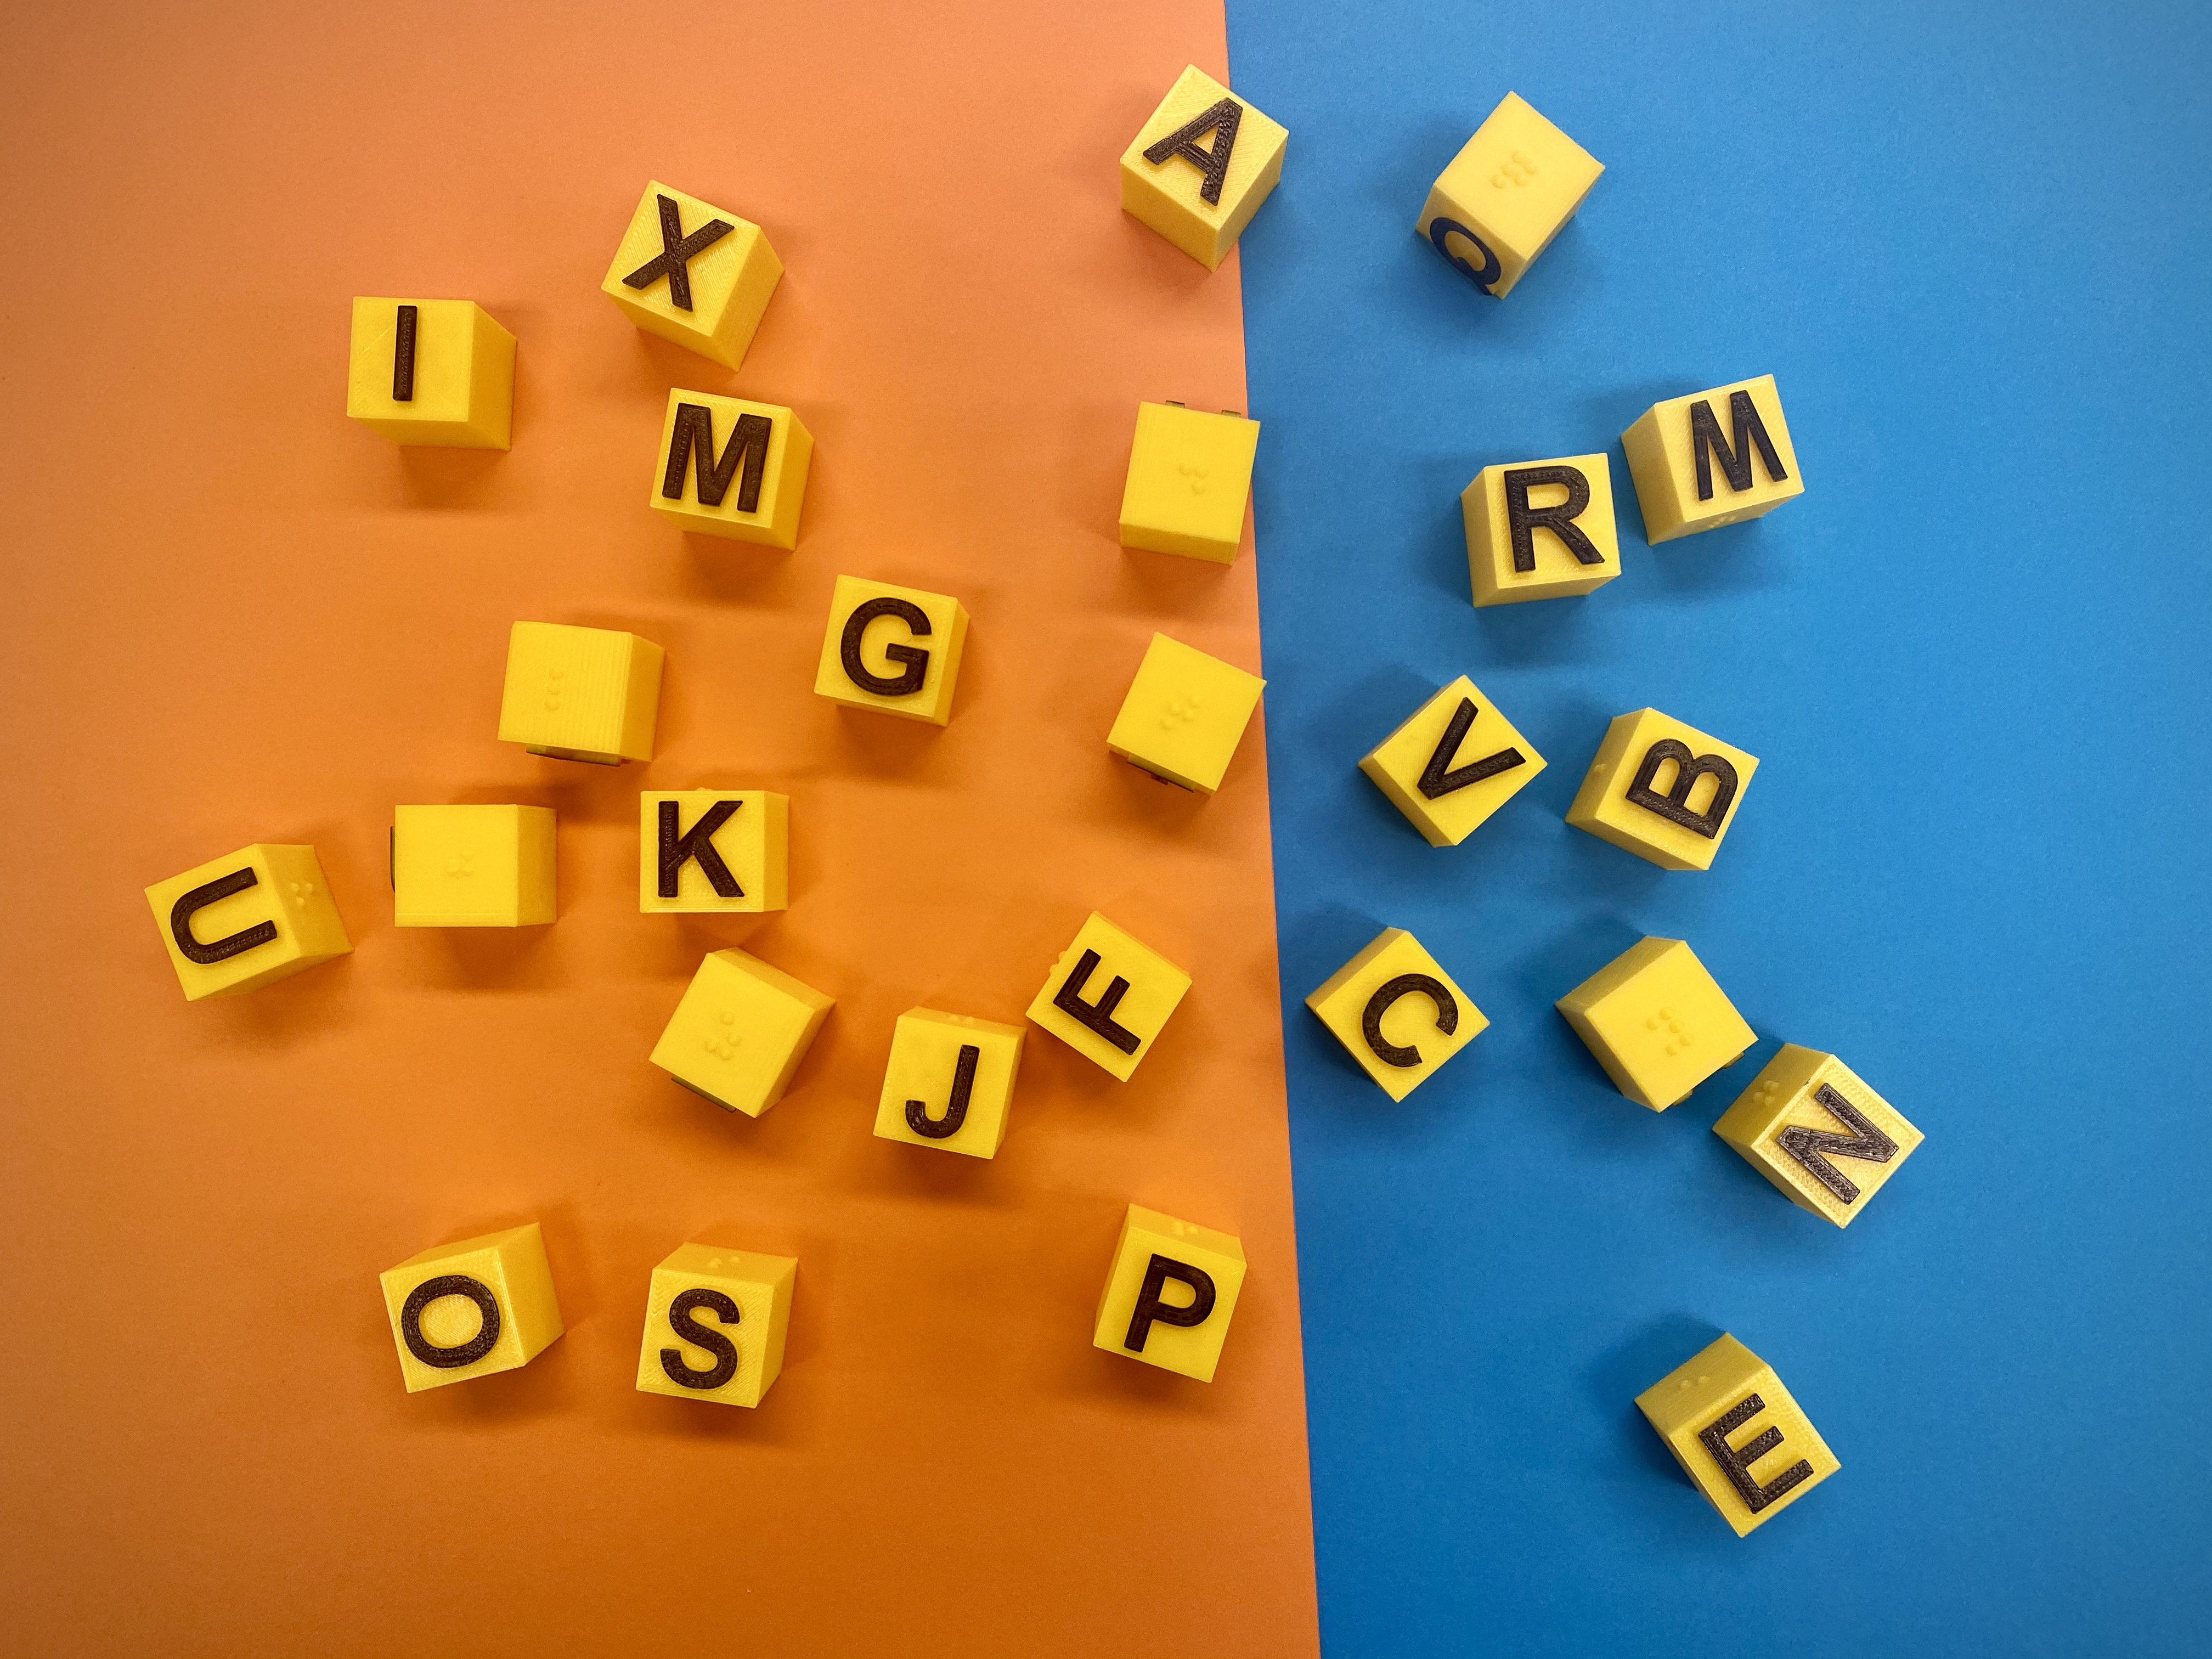
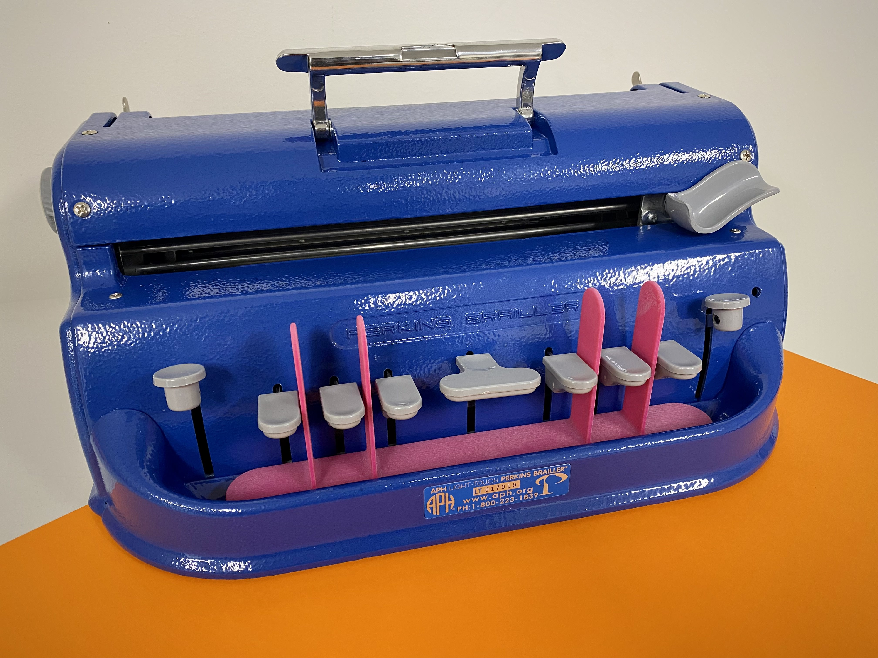
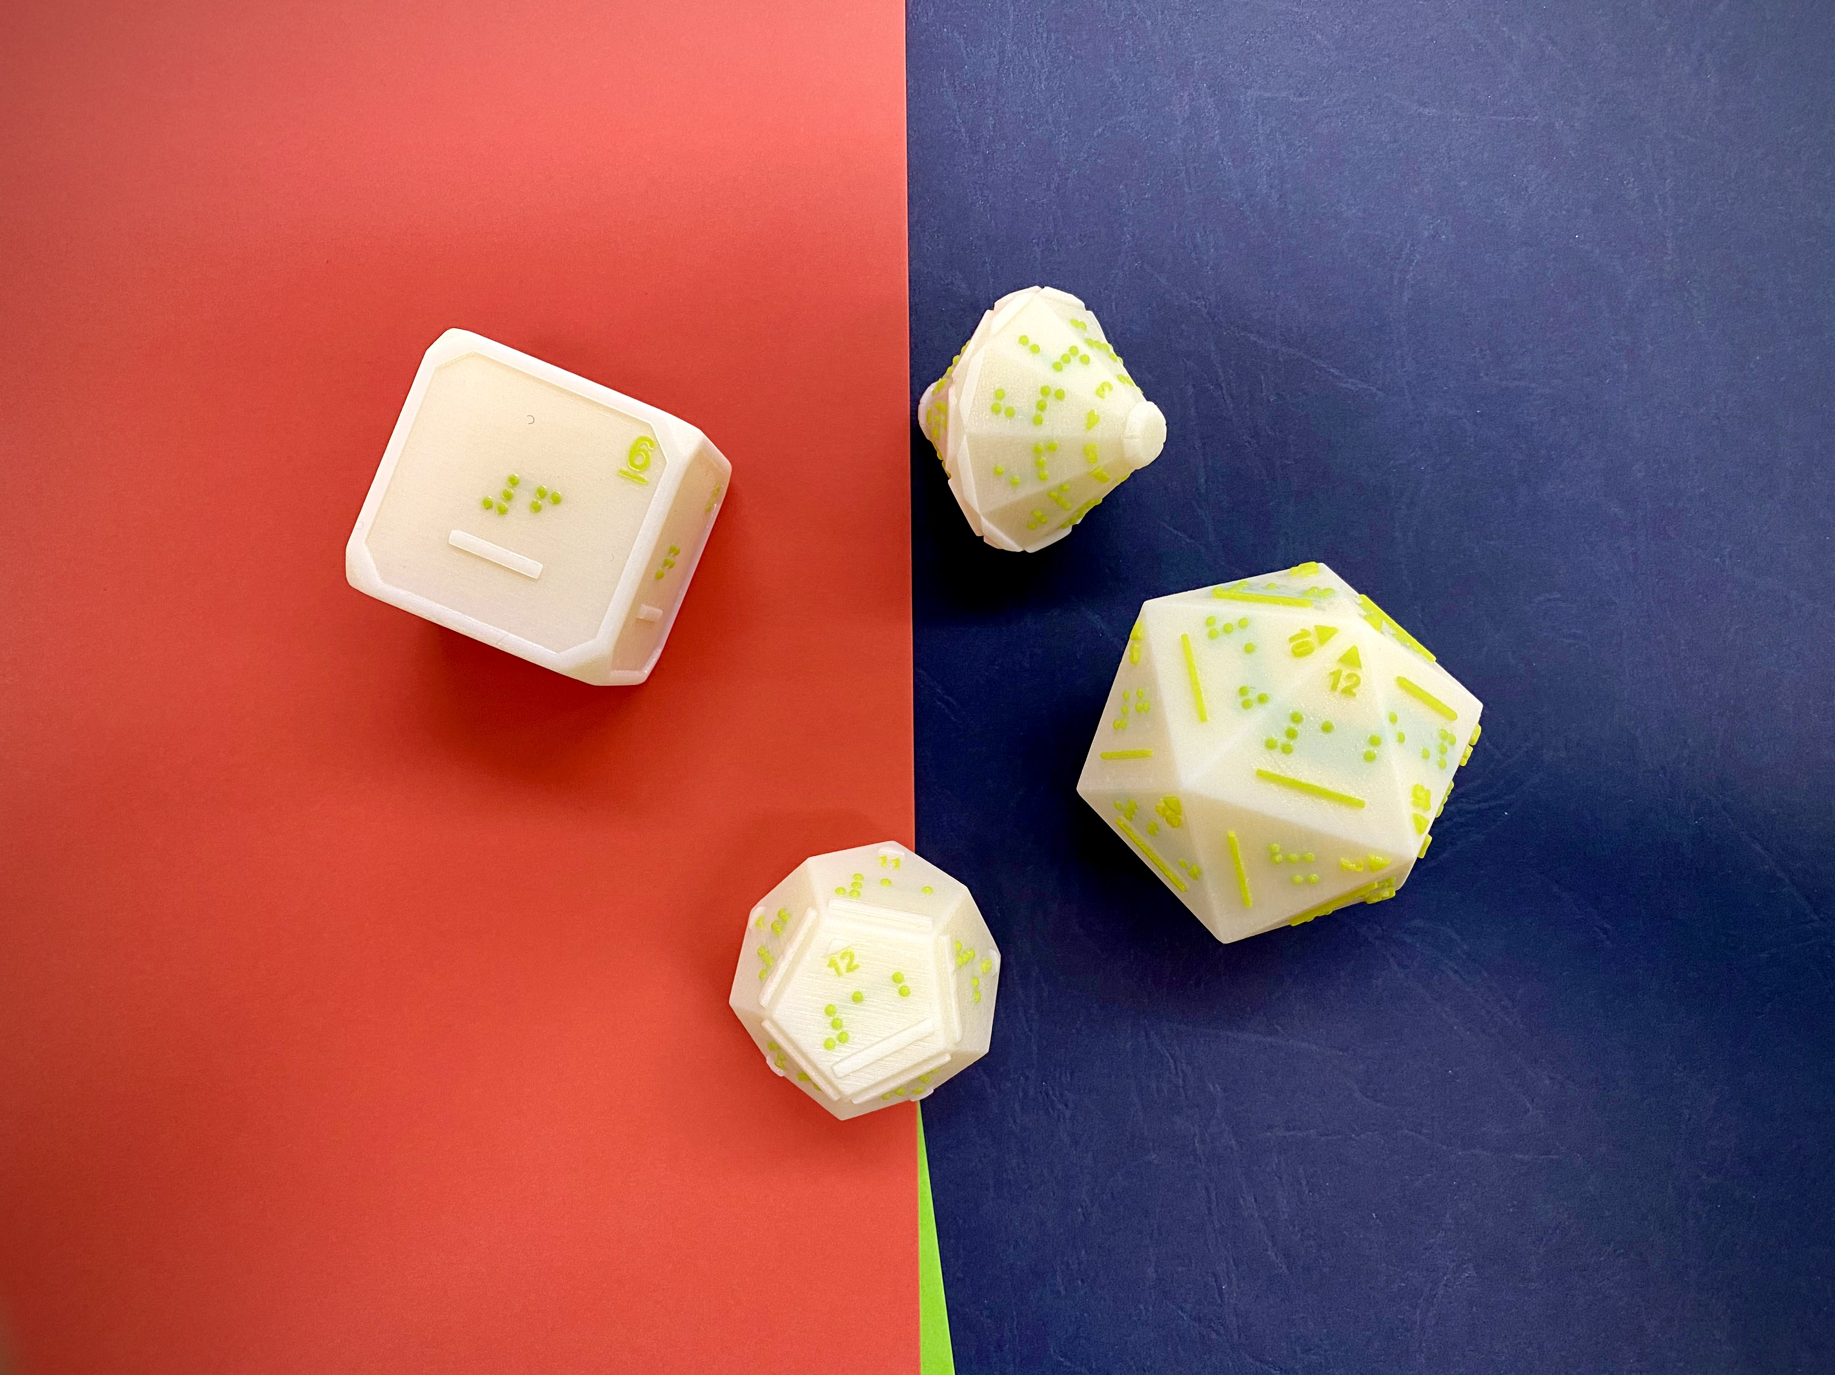
Braille and Large Print Services – 3D Prints (c)
What we offer – Classroom tools and teaching aids
Swing cells
Braille alphabet blocks
Brailler finger placement guides
Tactile dice

Slide 15
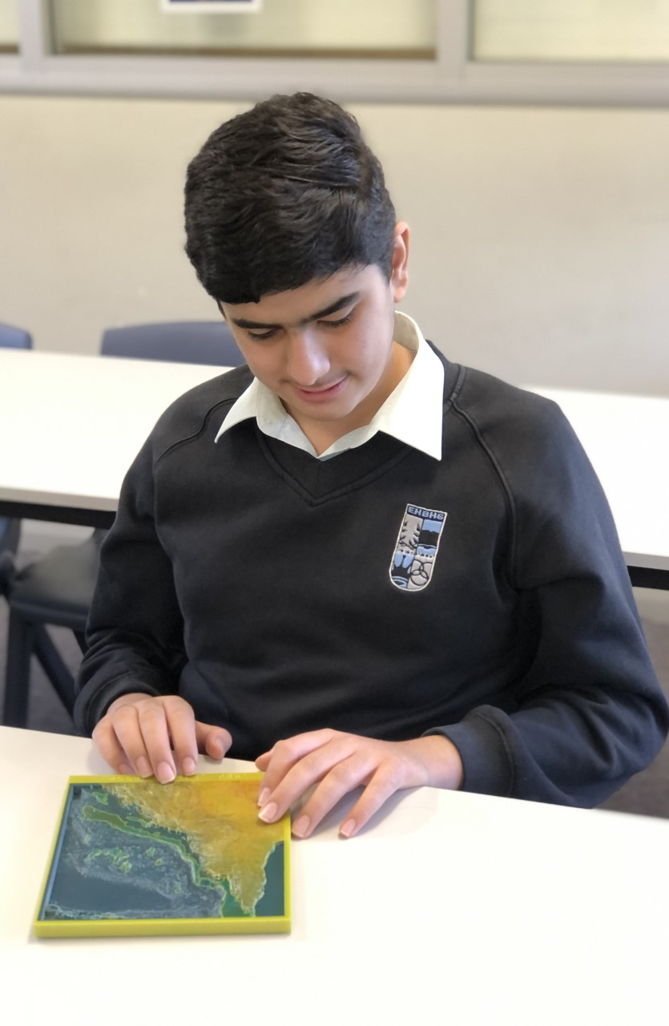
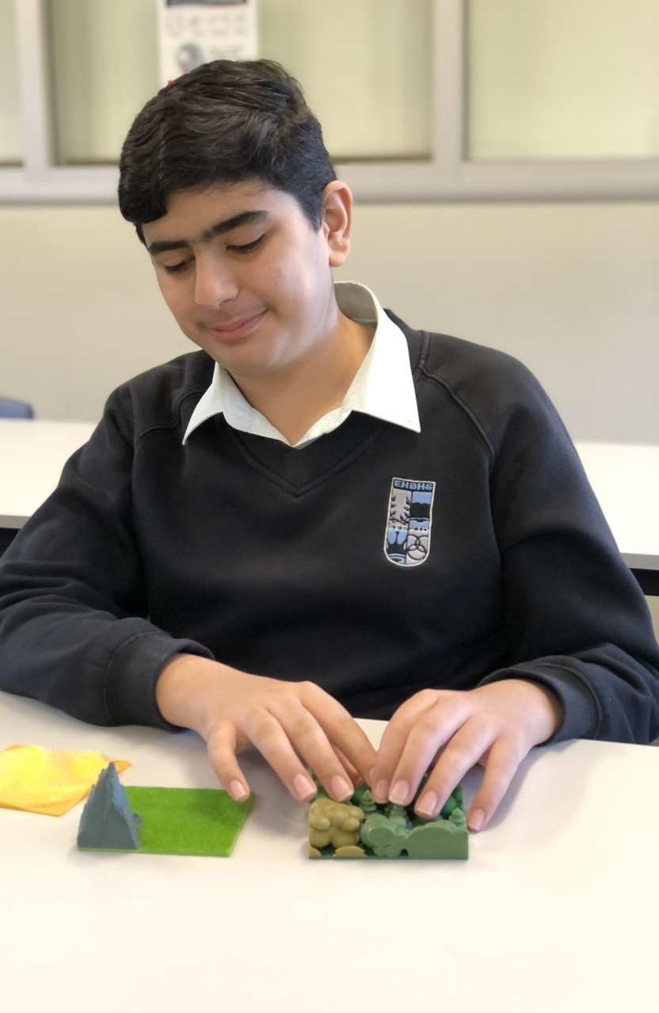
Braille and Large Print Services – 3D Prints (d)
Teacher and student feedback
Made teaching easier
Helped with visualising complex concepts
Made learning fun
Opened new pathways

Slide 16
Braille and Large Print Services – 3D Prints (e)
New ways to access
STL files available to anyone with an NSW DOE email address
Access for other states and countries being explored
edu.nsw.link/3DBraille

Slide 17
Contacts
BLPS.info@det.nsw.edu.au
Kim.Barber1@det.nsw.edu.au
Leanne.Tucker@det.nsw.edu.au
Navkaran.Virdi@det.nsw.edu.au

