Slide 1
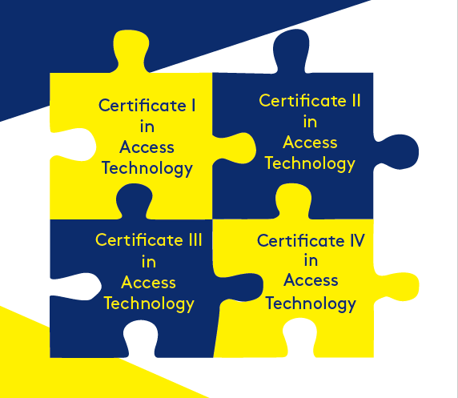
The process of implementing a disability specific curriculum for students with blindness and low vision throughout Australia
Presented by
Dr Melissa Fanshawe
University of Southern Queensland
This project is owned and sponsored by
Vision Australia
Notes:
Image description a square puzzle piece with certificate 1, II, III and IV in Access technology interlocked.
A University of Southern Queensland logo
A vision Australia logo

Slide 2
Project background
Employment is low for people who are blind or have low vision
Skills contained in Expanded Core Curriculum assist to gain employment
ECC is considered an ‘extra’ in schools
Notes:
Image description a square puzzle piece with certificate 1, II, III and IV in Access technology interlocked.

Slide 3
Aim
To create a series of nationally accredited subjects for students in year 9-12
based on the ECC for students with vision impairment
can be taught as a subject and be counted toward senior secondary
can be accessed anywhere throughout Australia
Notes:
Image description a square puzzle piece with certificate 1, II, III and IV in Access technology interlocked.

Slide 4
Target audience
Students:
in mainstream schools, who are blind or have low vision
in year 9-12
Congenital, degenerative or childhood onset of vision loss
Notes:
Image description a square puzzle piece with certificate 1, II, III and IV in Access technology interlocked.

Slide 5
Meet Nadel
Image of young person standing and smiling at the camera.
Image: Vision Australia
Notes:
Image description a square puzzle piece with certificate 1, II, III and IV in Access technology interlocked.

Slide 6
Meet Dotti
Image of young person standing and smiling at the camera, her arms filled with nursing books. Image: author’s own
Notes:
Image description a square puzzle piece with certificate 1, II, III and IV in Access technology interlocked.

Slide 7
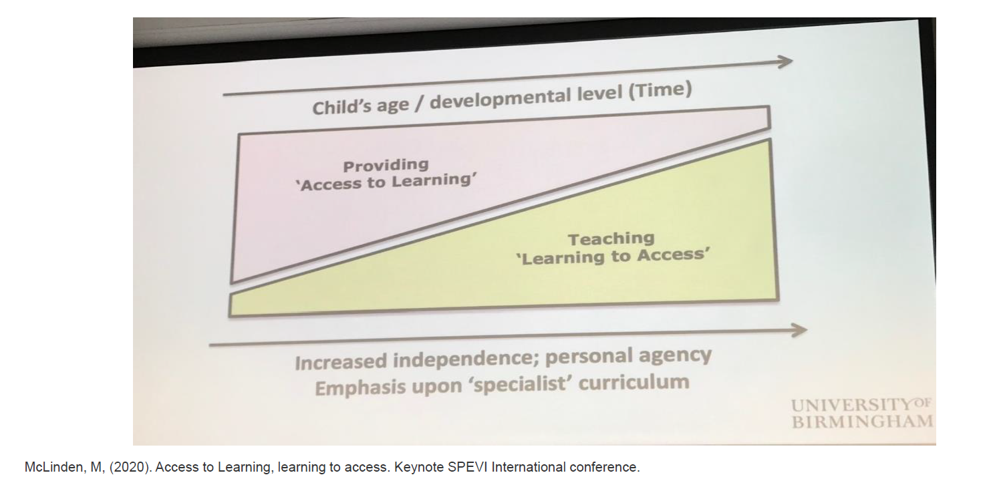
Notes:
Image description.
A diagram with a rectangle, cut diagonally from bottom left to top right to make two triangles. In the triangle on the left it says “providing access to learning’ and on the right teaching “learning to access” at the top it has child’s age and developmental level over time and at the bottom increased independence, personal agency, emphasis on specialist curriculum.
By the time students are in senior schooling it is expected that they are learning to access information and content independently. This means rather than giving students everything that is accessible, students should have the skills and ability to problem solve what tools to use to access information. Now this is not true for all of our students, I realise that, but the target group are students in senior secondary in mainstream schools.
However, as we know with excellent personalised service from our advisory teachers and therapists since they were little, support in schools and at home, many students have had a chance to interact with the disability specific skills of the Expanded core curriculum.
But as Nadel says… all of the technology and access takes so much extra time for me than the other kids in my class.

Slide 8
Who is involved?
Project Lead – Melissa Fanshawe – qualified specialist teacher (RIDBC), teacher, school administrator, researcher and parent
Project Sponsor – Vision Australia – national organisation committed to employability of people who are blind or have low vision by funding the project and hosting the LMS, providing free access for all students
Specialist writers and experts to review content – knowledge & experience
To date 96 stakeholders

Slide 9
Funding
Thanks to financial and in-kind support from Vision Australia this project has been an important priority in 2020/2021.
Notes:
Vision Australia logo

Slide 10
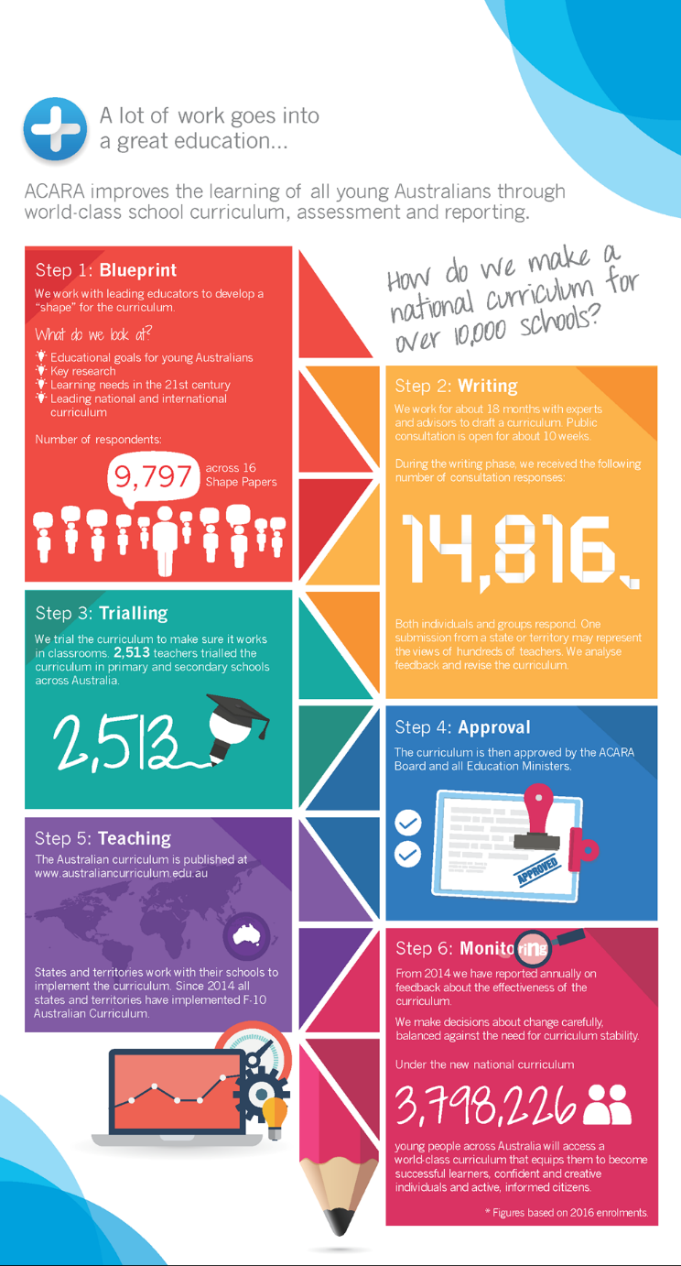
Methodology
Follows Australian Curriculum design development
Notes:
As certificates are all deemed to be the same level of qualification under the Australian Qualifications framework, there are rigorous standards and levels of consultations required to be able to create certificates. An earlier update of the certificates at the SPEVI conference ran through the process of how we did this. So given I have used up half my time already, I won’t go over this, but you can contact me should you wish to see this.
Image description
Step 1: Blueprint We work with leading educators to develop a “shape” for the curriculum. What do we look at? Educational goals for young Australians
Key research, Learning needs in 21st Century and Learning national and international curriculum. Number of respondents 9797 across 16 shape papers
Step 2: Writing We work for about 18 months with experts and advisors to draft a curriculum. Public consultation is open for about 10 weeks.
During the writing phase, we received the following number of consultation responses: 14816 Both individuals and groups respond. One submission from a state or territory may represent the views of hundreds of teachers. We analyse feedback and revise the curriculum
Step 3: Trialling We trial the curriculum in classrooms. 2513 teacher trialled the curriculum in primary and secondary schools across Australia. 2513
Step 4: Approval The curriculum is then approved by the ACARA Board and all Education Ministers
Step 5: Teaching The Australian curriculum is published at www.australiancurriculum.edu.au States and territories work with their schools to implement the curriculum. Since 2014 all states and territories have implemented F-10 Australian Curriculum.
Step 6 Monitoring From 2014 we have reported annually on feedback about the effectiveness of the curriculum. We make decisions about change carefully, balanced against the need for curriculum stability. Under the new national curriculum 3798226* young people across Australian will access a world-class curriculum that equips them to become successful learners, confident and creative individuals and active, informed citizens. * Figures based on 2016 enrolments.

Slide 11
Delivery
Online VET courses
Downloadable courses
Subject allocated to VET courses
Support from Teacher/Teacher Aide
Online support and verification of assessment
Notes:
Image description a square puzzle piece with certificate 1, II, III and IV in Access technology interlocked.

Slide 12
Role of Advisory Teachers and O&M specialists
Same service provision
Provide a known time to visit
Legitimise the importance of the ECC in schools for students
Many of these skills would already be taught in earlier years, but the focus is on student agency “learning to access” (McLinden et al., 2016)

Slide 13
Content
Units of competency
Elements, performance criteria, knowledge and assessment
Workbooks
Assessment guides
Notes:
Image description a square puzzle piece with certificate 1, II, III and IV in Access technology interlocked.

Slide 14
Update – May 22
Extensive stakeholder consultation
All four certificates have been mapped out
Elements, performance indicators, knowledge and assessment populated
Course documents prepared and submitted to ASQA
Certificate I, II, III & IV APPROVED and sitting on National register
Working with TAFE to finalise delivery

Slide 15
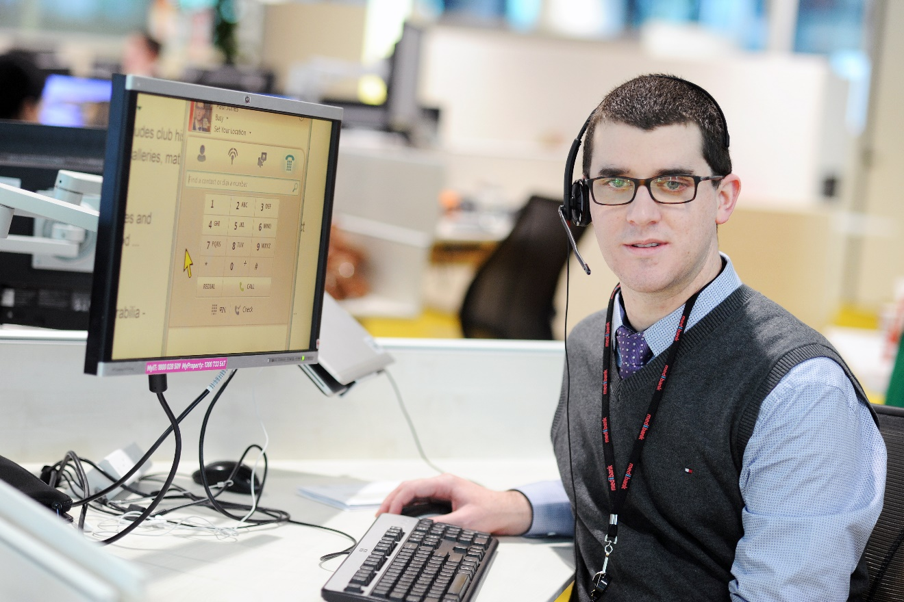
Meet Bob
Image of young person sitting at the computer with magnified screen. Image: Vision Australia
Notes:
Image description a square puzzle piece with certificate 1, II, III and IV in Access technology interlocked.

Slide 16
References
Hatlen, P. (1996). The core curriculum for blind and visually impaired students, including those with additional disabilities. Re:View, 28, 25-32.
Keil, S., & Cobb, R. (2019). Learning to Access: why we need a new UK specialist curriculum to enable equitable participation in education for children and young people with vision impairment. Retrieved from https://viewweb.org.uk/specialistcurriculum/
McLinden, M. (2020. January 12-15). ‘Access to learning’ and ‘learning to access’ [Keynote presentation]. SPEVI 2020 Conference:Creating a clear vision for the future SPEVI Conference, Adelaide, Australia.
McLinden, M., Douglas, G., Cobb, R., Hewett, R., & Ravenscroft, J. (2016). ‘Access to learning’ and ‘learning to access’: Analysing the distinctive role of specialist teachers of children and young people with vision impairments in facilitating curriculum access through an ecological systems theory. British Journal of Visual Impairment, 34(2), 177-195. doi:10.1177/0264619616643180
McLinden, M., Ravenscroft, J., Douglas, G., Hewett, R., & Cobb, R. (2017). The significance of specialist teachers of learners with visual impairments as agents of change: Examining personnel preparation in the United Kingdom through a bioecological systems theory. Journal of Visual Impairment & Blindness, 111(6), 569-584. doi:10.1177/0145482X1711100607

Slide 17
Dr Melissa Fanshawe, Senior Lecturer
University of Southern Queensland
Melissa.Fanshawe@usq.edu.au
Notes:
Image description a square puzzle piece with certificate 1, II, III and IV in Access technology interlocked.
USQ logo, Vision Australia logo

