Slide 1
“Inside the Pandemic – working with Governments to help get the pandemic response right”.
A/Prof Julian L. Rait OAM,
Chair, AMA Federal Council
Director, Vision Australia

Slide 2
The 1918-19 flu pandemic:
Global infections: ~ 500 – 600 million
Global mortality: ~ 50 – 100 million
Australian deaths: 15,000

Slide 3
The 1918-19 Spanish flu:
the second deadliest pandemic in human history
caused by the H1N1 sub-type of Influenza A
first observed in the final months of World War I (in Kansas)
25% to 30% of the world’s population of 1.8 Billion affected over the two years of 1918-1920 in four waves
an unusually high mortality amongst young adults
recurred in 1977 (Russian Flu) and 2009 (Swine Flu)

Slide 4
SARS Co-V-2 pandemic:
ongoing coronavirus infection
began in the City of Wuhan in October or November 2019
scientific consensus is that the virus is zoonotic in origin
SARS Co-V-2 is closely related to bat and pangolin coronaviruses
477 million cases and 6.1 million deaths
vaccination became widely available in December 2020
monoclonal antibodies and several antiviral medications are effective

Slide 5
Lessons from the 1918-19 influenza pandemic:
demonstrated how communities react to severe disease crises.
hospitals and medical personnel need to be well coordinated.
the popular press plays a defining role in presenting the pandemic to the public – either settling on aggravating public anxiety.
cooperation between various states and territories is critical to an effective public health response.

Slide 6
Secondary effects of pandemic:
misinformation continues to circulate through social and mass media
balance between public health imperatives and individual rights
late politisation of public health responses
emerging issues with health equity and access to vaccinations and timely medical care
repeated waves of infection straining health resources

Slide 7
Standard public health measures:
vaccination
social distancing
improved ventilation and air filtration
mask wearing (especially N95 respirator masks)
quarantine or home isolation of those exposed or infected

Slide 8
Additional government actions:
interstate and international travel restrictions
local or statewide lockdowns
business restrictions and closures
workplace hazard controls
widespread PCR / RAT testing
enhanced contact tracing
isolation of both primary and secondary contacts

Slide 9
National Centre for Disease Control

Slide 10
National Centre for Disease Control

Slide 11
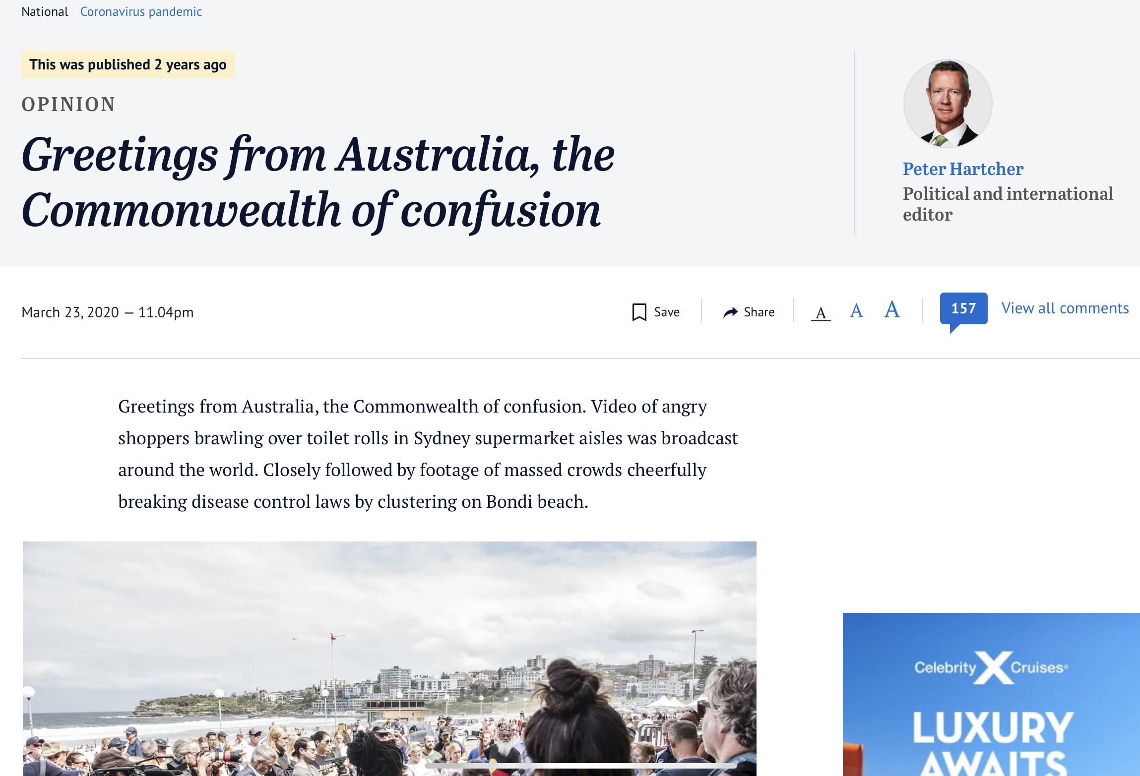
National Cabinet

Slide 12
Travel/movements restrictions: initial zero Covid strategy

Slide 14
Hotel quarantine

Slide 15
Is Covid-19 airborne?

Slide 16
National vaccination program

Slide 17
Transition to endemic disease

Slide 18
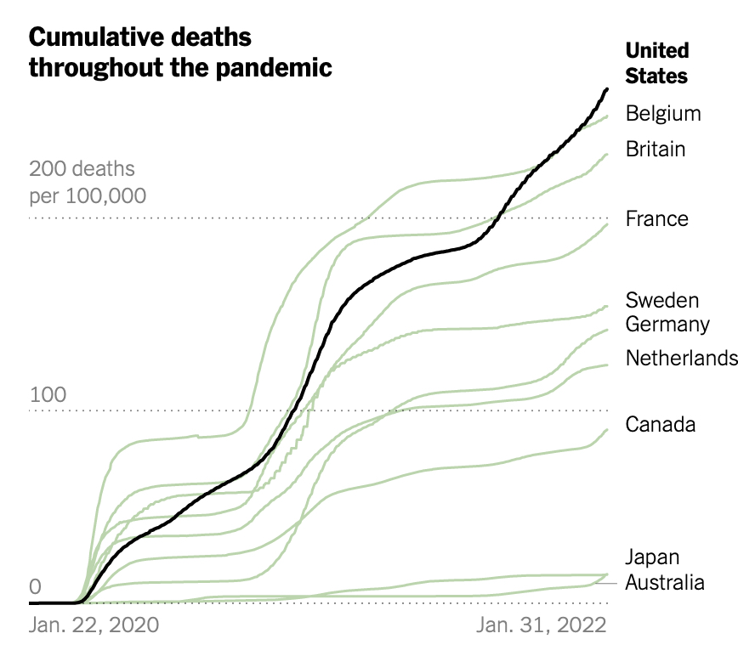
Pandemic outcomes:
Australia has experienced fewer cases with a lower-than-average case fatality rate of 0.13% and only 232 deaths per million people from Covid-19
this compares to 6500 deaths per million for Peru and just 47 deaths per million for New Zealand

Slide 19
Transition to endemicity*:
vaccination reduces the severity of illness, the susceptibility to infection, and the likelihood of infecting others.
where immunity provides lifelong protection from infection, then widespread vaccination can generate sufficient herd immunity to lead to elimination.
if immunity wanes over time, then endemicity is the likely outcome.
in the epidemic phase, large numbers of susceptible individuals result in waves of numerous primary infections and deaths.
once endemic, there is a relatively stable number of infections arising in the population - repeated reinfection will likely lead to milder disease.
as the virus evolves, we need to monitor its severity in various groups.
*Transition to endemicity: Understanding COVID-19. Immunity. 2021 Oct 12; 54(10): 2172-2176

Slide 20
Three factors that distort political decision making:
Inappropriate self-interest
Distorting ideologies
Misleading memories

Slide 21
Planning fallacy:
first proposed in a 1979 paper by Daniel Kahneman and Amos Tversky*
a cognitive bias whereby people tend to underestimate the costs, completion times and risks of planned actions, while overestimating the benefits of those same measures.
such error is caused by a cognitive bias toward taking an “inside view,” where focus is on the constituents of the planned action, instead of an “outside view” of the actual outcomes of similar ventures that have already been completed or obviously failed!
* Kahneman, D. and Tversky, A., 1979, “Intuitive Prediction: Biases and Corrective Procedures.” In S. Makridakis and S. C. Wheelwright, Eds., Studies in the Management Sciences: Forecasting, 12 (Amsterdam: North Holland).

Slide 22
Reference class forecasting:
Kahneman and Tversky concluded that disregard of distributional information, that is, risk, is perhaps the major source of error in forecasting
RCF is a method of predicting the future, through looking at similar past situations and their outcomes.
using distributional information from previous ventures similar to the one being forecast is the “outside view”
in his 2011 book "Thinking, Fast and Slow," Kahneman counsel to use reference class forecasting where possible, and add that "the single most important piece of advice regarding how to increase accuracy in forecasting”.

Slide 23
3 “e principles” of good policy:
engagement
communicates respect for stakeholders & their ideas
encourages refutation & sharpens decision making
explanation
increases confidence that policy makers have considered options and implementation issues
expectation clarity
once policy agreed, there is a clear understanding of the scheme of implementation and what is expected.

Slide 24
What is fair process in public policy?
when individuals feel recognised for their intellectual or social worth they are willing to:
share knowledge
feel inspired
suggest ideas and share experiences
feel emotionally tied to the strategy
engage in voluntary co-operation

Slide 25
Why does fair process in matter?
if people’s worth is not recognised:
they will feel angry
not invest their energy in participating
drag their feet and apply counter measures
commitment, trust and voluntary co-operation = intangible capital of health policy.
committed, engaged members of society will usually ignore self interest in the pursuit of policies that enhance the care and safety of others.

Slide 26
Thankyou for your attention:
Please contact Associate Professor Julian Rait at:
Julian.Rait@visionaustralia.org

