Slide 1
Born accessible ebooks Are we there yet?
17 May 2022

Slide 2
Overview
What are born accessible ebooks and why care?
Born accessible ebooks IRL
Where are we in the journey?
Where next is on the itinerary?
Notes:
Join us on a journey to Canada, Europe, Latin America, and the USA on this extended tour to learn about progress toward the destination of inclusive publishing. What steps are being taken by publishers, platforms and policymakers to ensure that digital books are accessible to people with print disabilities? And what does the map look like for libraries and consumer organizations? Bring your own refreshments, opinions, and questions.

Slide 3
About your speaker
Richard Orme Chief Executive DAISY Consortium
Notes:
Richard Orme is Chief Executive of the DAISY Consortium, the global organisation whose mission is to develop standards and solutions for accessible publishing and reading. He is a founding member of the UK Publishers Association Accessibility Action Group, serves on the board of the Accessible Books Consortium (an initiative of the UN agency WIPO) and the UK Association of Accessible Formats. Richard also volunteers in his community providing support for older people with disabilities.

Slide 4
About the DAISY Consortium
DAISY Consortium is a non-profit members association
Mission is “working towards equal access to information and knowledge regardless of disability”
Founded 1996
Registered in Zurich, our team members are around the world.
Our website is at daisy.org
Notes:
The DAISY Consortium is an association of non-profit members “working towards equal access to information and knowledge regardless of disability”
Our members include special libraries for visually impaired people, disability groups, government agencies, universities
Our partners include publishers, vendors, developers of production and reading systems, retail and library platforms, technology companies
More than 150 organizations in 70 countries are part of our family
Founded 1996, more than 25 years effort to expand accessible publishing and reading
Registered in Zurich, our team members are based in Belgium, Brazil, Canada, China, France, India, Kenya, UK, USA and Vietnam.

Slide 5
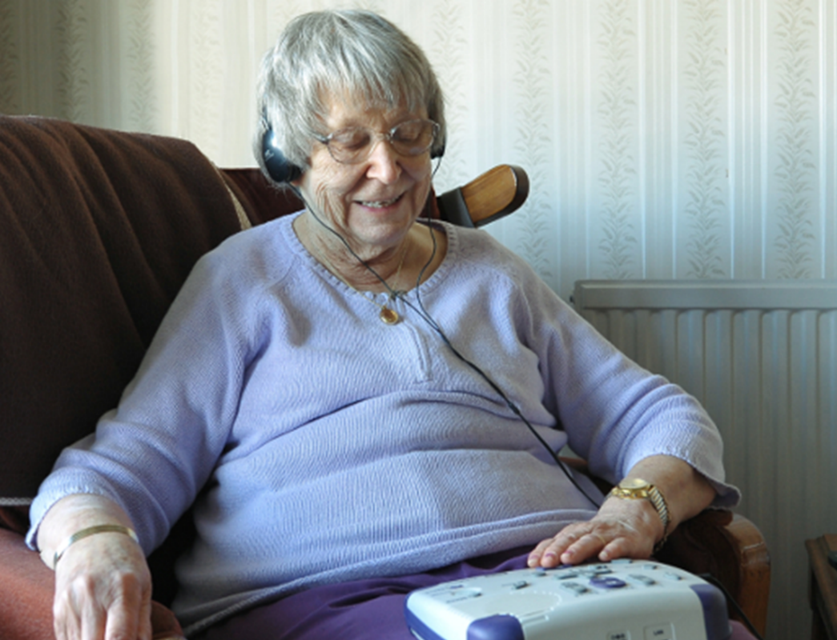
The heritage of DAISY
Notes:
USA 275K
UK 188K (UK publishers released more than 20 new titles every hour )
Australia 28K

Slide 6
Modern accessible reading

Slide 7
Inclusive publishing
Publications that meet the needs of:
People who just need a little bigger font
People with low vision
People who are dyslexic or need learning tools
People who are blind who use screen readers and refreshable braille
People who cannot hold a book or turn the pages
People without disabilities
Born accessible reading:
The same publication from day 1
The discovery, borrowing/buying experience is accessible
The reading experience is accessible and equitable

Slide 8
Born accessible ebooks IRL
Millions of titles available today
Including The Metamorphosis and Great Expectations
Where are we in the journey?
USA, Canada, Europe, Africa
Notes:
Metamorphosis and Great Expectations
can be read with display adjusted to suit individual needs – text size, font, margins and spacing
Supports read aloud using text to speech or you can read along with human narration
Using a screen reader the books can be read with text to speech or braille display
Great navigation with table of Contents, page navigation, search and bookmarks

Slide 9
USA
Impressive progress in trade publishing
Special shout out to higher ed textbooks
Education institutions requiring accessible titles
Platforms providing a11y information
Third party certification with Global Certified Accessible from Benetech

Slide 10
Canada
Accessible Digital Books initiative
“To increase the availability of born accessible Canadian-authored digital titles”
DAISY Award for Accessibility in Publishing
Supported by CAD 22.8 million
Wide range of activities including research, trainings, production, evaluations and marketing
Notes:
The Department of Canadian Heritage is running an amazing initiative to empower the Canadian book industry to integrate accessible publishing features into the production and distribution of digital books (ebooks and audio books). The program will support the production and distribution of accessible digital publications that can be used by everyone, including readers with print disabilities. The initiative is supported by a funding program of CA$22.8M over 5 years.
As part of the Digital Book World industry conference DAISY recognized the Department of Canadian Heritage with Accessibility in Publishing the award for this activity which will not only benefit readers in Canada, but also people reading Canadian publications around the world.

Slide 11
Europe
European Accessibility Act (EAA) into force 2025
Accessible ebooks, websites and apps
Governments, publishers, consumer orgs
DAISY baseline survey 2021
Activities of Fondazione LIA and EDRLab
Case studies available at inclusivepublishing.org/eaa
Notes:
The EU Accessibility Act is currently being transposed into national laws which will be complete by June 28, 2022
The Act itself will come into force on June 28, 2025
Ebooks in the market will need to be accessible
Also covers websites and apps used to discover, download and read ebooks
A broad range of pressing needs were identified, including the following themes:
Awareness-raising: concern was highlighted about communication within the publishing community and all parts of the supply chain to ensure everyone was conscious of their roles and responsibilities.
Training: even some of the countries with training available highlighted the need for further training resources to upskill staff in all areas of publishing.
Clarity over EAA requirements: progress continues in defining the practices and measures of accessibility in different formats, as well as defining the terms associated with exclusion and implementation (disproportionate burden, fundamental alteration, monitoring, reporting)
Cast studies available: Finland, The Netherlands, Germany, Italy, Lithuania
Discussion is around – how to make quality image descriptions at scale, how fast to make the backlist accessible, getting better EPUB from InDesign

Slide 12
Africa
Accessible Publishing at Nigerian Book Fair
Accessible publishing trainings in Ouagadougo
eKitabu doing wonderful work in Kenya and beyond
Notes:
Seminar on accessible publishing at Nigerian Book Fair
This week DAISY is delivering accessible publishing trainings in Ouagadougou, Burkina Faso
Challenges of text to speech in many languages
eKitabu run trainings for publishers and run competitions
Also integrate human narration and sign language video in education titles

Slide 13
Brave New World
Publishers are embracing born accessible
They ask:
What do I need to do?
How do I do it?
Did I get it right?

Slide 14
Suite of Supporting Tools
EPUB Accessibility Conformance and Discovery Specification
Established the baseline and answers the What question
DAISY Accessible Publishing Knowledge Base
Establishes best practice and answers the How question
Accessibility Checker for EPUB (Ace by DAISY)
Answers the Did question
Simple Manual Accessibility Reporting Tool (smart.daisy.org)
Because automated testing is never enough and great for training
Accessibility testing of reading apps at EPUBtest

Slide 15
Where next is on the itinerary?
Support publishers transition to Born Accessible as Business As Usual
Help the publishers to get it right, like GCA and LIA
Test and demand reading system accessibility
Identify and improve reading apps that are not fully accessible
Pushing accessibility requirements in all publishing technical specifications
Not just EPUB, but HTML, PDF, and emerging formats
Expand beyond books to all published materials: journals, manga, comics, manuals, health reports, etc.
Make sure legal requirements include accessibility
Enable consumers to take advantage, support those who need alternatives
Notes:
Hope Coupled with Hard Work

Slide 16
Orgs Serving Persons with Disabilities
Those serving blind, low vision and other print disabled consumers are part of the Brave New World
Patrons need to know their options and may need training
People have a wide range of technical ability
May need additional support or transformations
EPUB can be transformed to many formats: HTML, BRF, DAISY, MP3 playlists, Word files
Accessible ebooks provide greater choice and inclusion to complement much loved special services

Slide 17
Are we there yet?
Yes and no
Accessible ebooks have arrived, even for complex publications
Of course, not 100%
The European Accessibility Act is speeding this up
Platforms and reading systems can be a weak link
Consumers and disability orgs increasing engaged

Slide 18
Q&A

Slide 19
Thanks for your attention
Contact details:
rorme@daisy.org
daisy.org
inclusivepublishing.org

