Slide 1
Online accessibility for people with deafblindness
Learnings from an accessibility audit
Notes:
Melanie
I would like to acknowledge the traditional custodians of the lands from which Phoebe and I are presenting today, the
Whadjuk people of the Noongar Nation
and Wurundjeri people of the Kulin Nation
We pay our respects to their Elders, past and present, and Aboriginal Elders of other communities who may be here today.

Slide 2
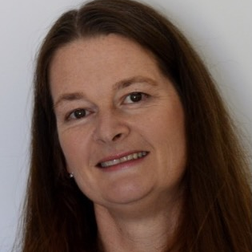
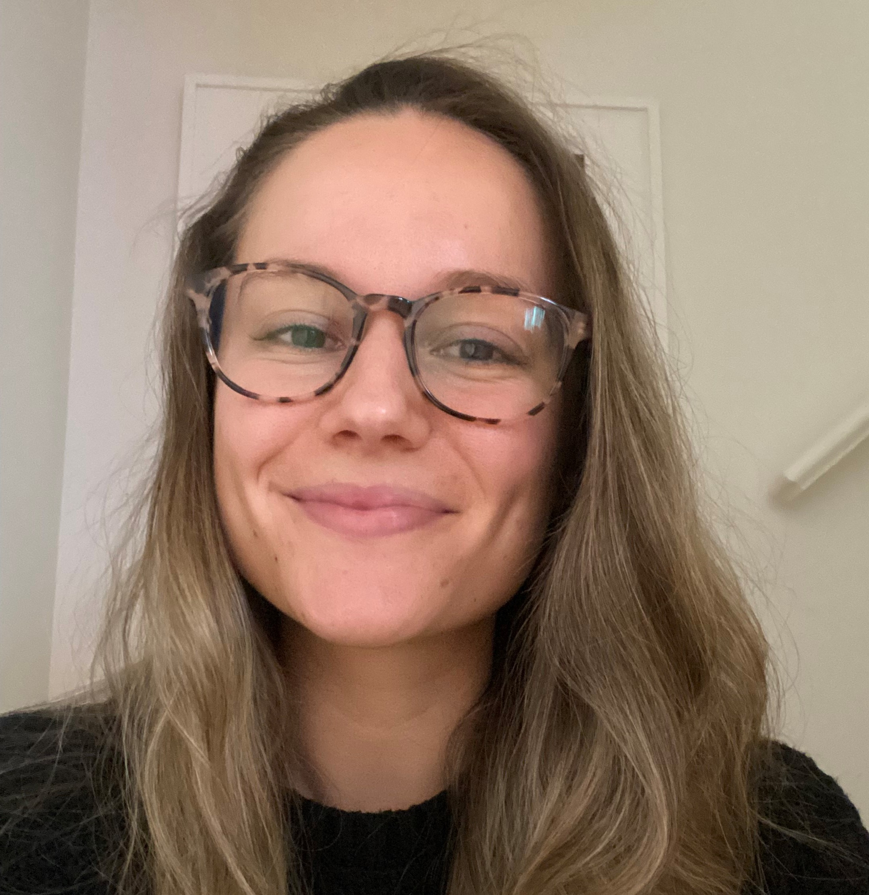
About the presenters
Melanie Robartson
Deafblind Consultant and Senior Speech Pathologist SensesWA
Project Officer – Deafblind Information Australia
Phoebe Wells
Deafblind Consultant and Behaviour Support Practitioner Able Australia
Project Officer – Deafblind Information Australia
Notes:
Melanie

Slide 3
Overview
Introduction to deafblindness
Deafblind communication and technologies
Accessibility audit process
Summary of results
Significant learnings
Notes:
Melanie

Slide 4
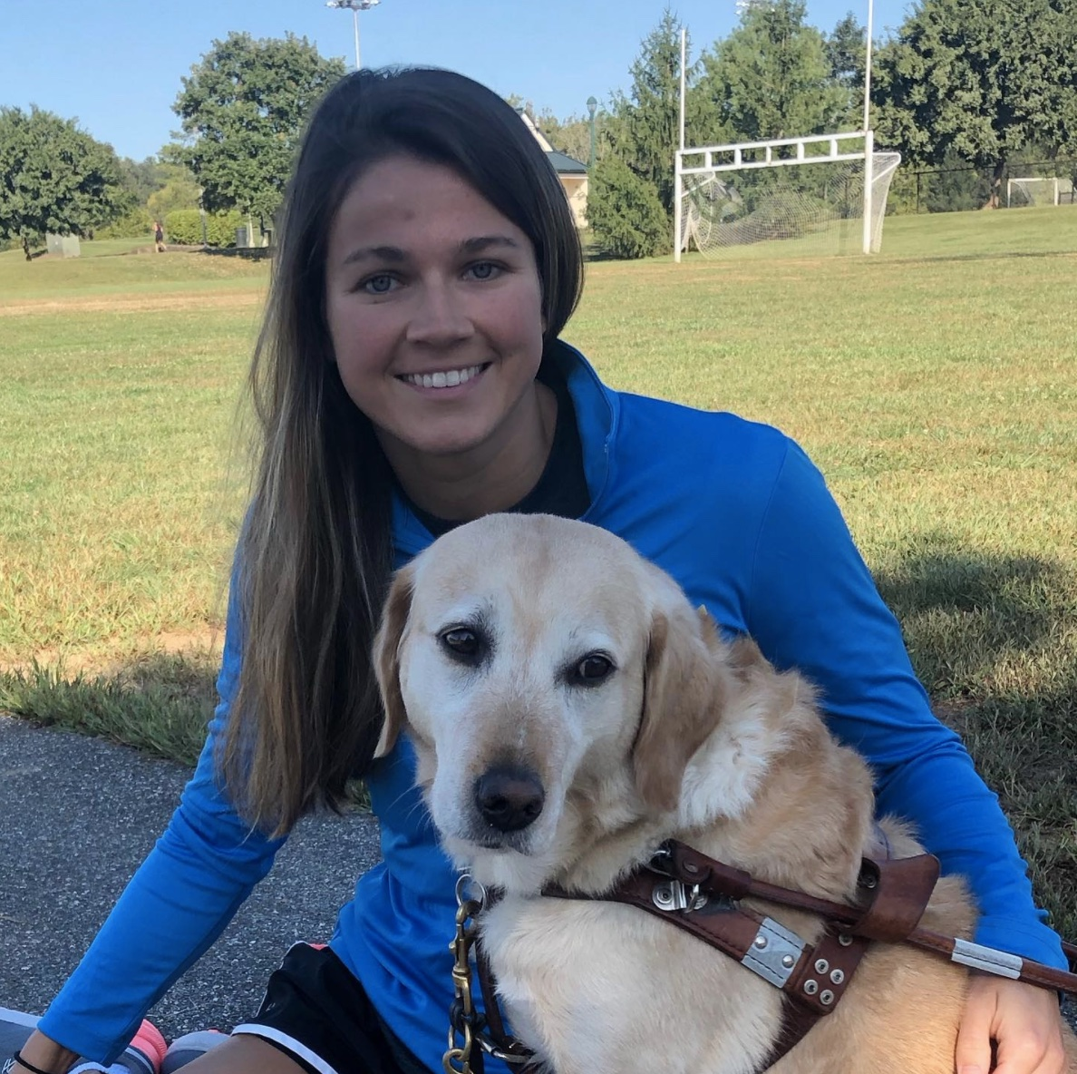
What is deafblindness?
Sensory disability
combination of both hearing and vision loss or impairment
significant effect on communication, socialisation, mobility and daily living
Notes:
Melanie
Disability of access
Single sensory compensatory strategies cannot always be relied on
The photographed displayed is of Becca Meyers, paralympic swimmer with deafblindness and her guide dog, Birdie.
Image source: https://www.instagram.com/p/B2jqr0oASnn/

Slide 5
Deafblind communication
signed
modified for residual vision
tactile forms
spoken
aided hearing
lip reading
written
modified print
braille
Notes:
Melanie
For a very quick overview of methods of communication that might be used for communicating with someone with deafblindness.
The methods that an individual with deafblindness uses to communicate may be different to the methods they use to receive communication., which could include the following.

Slide 6
Deafblind digital access
Audio
Screen reader
Visual
Captions
Visual frame sign language
Plain language, written communication
Screen magnification
Tactile
Refreshable braille display
Notes:
Melanie
To access digital communication, some may have enough functional hearing to hear a screen reader, however adequate aided hearing technology and an appropriate acoustic environment is necessary.
With enough residual vision access is possible through any or some of the following: high contrast content, adjustable captions for any spoken information and screen magnification.
For sign language users, content translated to Auslan with signing occurring with a reduced visual space, (visual frame signing) and use of plain language all assist culturally Deaf users, where English may be a second language.
For those who use braille, refreshable braille displays may be the preferred access method.
Audio – Screen reader
Visual – Captions, visual frame sign language, written communication, screen magnification.
Tactile – Refreshable braille display
Considering language (Sign vs. English)
- Videos – Visual frame, captions, transcript etc.
- Auslan user with written Eng 2nd lang
- Acquired DB (low vision: screen magnification + captions)

Slide 7
Website history
Deafblind Australia
an Information Centre 2012
adjustable font size
2 high contrast display options
text only
Alt text for images (inconsistent)
Notes:
Melanie
Was designed with accessibility standards of the time in mind (2012), with a focus on accommodating direct access for those with low vision.
Colour contrast, adjustable font size, 2 high contrast options, a text only version.
There was however inconsistency with use of Alt text to describe images
I have included a screen shot of some of the original branding, which contained a line of overlapping circles of different colours.
A lot of the content was written in complex English, potentially excluding some of our target audience, being Auslan users, with English as a second language.

Slide 8
Several transformations
Deafblind Information Australia
information in audio visual format
transcripts
Auslan interpretation & translation
high contrast captions
Notes:
Melanie
Since 2012 the website has undergone several transformations.
The image on this page is a screen shot of a part of today’s home page and shows a portion of our introductory website video, with speaker and Auslan interpreter.

Slide 9
Accessibility audit experience
November 2020 to October 2021
Notes:
Phoebe
Now more than ever, with quarantine, self isolation, lockdowns, social distancing and masks, people with deafblindness have added degrees of enforced disconnection and a greater need for independent access to information.

Slide 10
Accessibility standard
WCAG 2.1 Level A, AA
selected AAA criteria
tested on selection of 6 assistive technologies
iOS and android
screen readers, magnifiers
speech recognition software
Notes:
Phoebe
Needed to make our website accessible to a broad audience including a deafblind audience using a diverse range of deafblind communication and access methods
The auditors tested the website against the Web Content Accessibility Guidelines 2.1 level A, AA and selected AAA criteria.
Selected AAA criteria included:
- Pre-recorded sign language
- Pre-recorded audio description
- Enhanced contrast, and
- Reading level
To name a few.
Testing was performed on assistive technologies, web browsers and devices, including:
- iOS and android
- Number of different screen readers and magnifiers
- Speech recognition software
Desktop
JAWS 2019 with Chrome (latest) on Windows 10
NVDA with Firefox (latest) on Windows 10
ZoomText (latest) with Internet Explorer 11 on Windows 10
Dragon NaturallySpeaking (v13 or later) with Internet Explorer 11 on Windows 10
Mobile
VoiceOver with Safari on iOS iPhone (latest)
TalkBack with Chrome (latest) on Android 8.x
These 18 WCAG 2.1 AAA criteria were assessed as part of this accessibility review:
• 1.2.6 Sign Language (Pre-recorded)
• 1.2.7 Extended Audio description (Pre-recorded)
• 1.2.8 Media Alternative (Pre-recorded)
• 1.2.9 Audio Only (Live)
• 1.4.6 Contrast (Enhanced)
• 1.4.7 Low or No Background Audio
• 1.4.8 Visual Presentation
• 1.4.9 Images of Text (No Exception)
• 2.1.3 Keyboard (No Exception)
• 2.2.4 Interruptions
• 2.4.8 Location
• 2.4.9 Link Purpose (Link Only)
• 2.5.6 Concurrent Input Mechanisms
• 3.1.3 Unusual Words
• 3.1.4 Abbreviations
• 3.1.5 Reading Level
• 3.1.6 Pronunciation
• 3.2.5 Change on Request

Slide 11
Audit process
Nov-Dec 2020: Scope and quote
Jan-Feb 2021: Assessment and report
Mar-Sep 2021: Implement changes and 1st round retesting
Oct 2021: Retests to check fixes
Current: Remaining website pages
Notes:
Phoebe
Scope of work to be achieved, and quote from Auditors November-Dec 2020
Jan / Feb 2021 Assessment undertaken by auditors & report received
10 pages on website audited – Representative sample selected by Melanie
205 page report – error descriptions, the impact of these errors, recommendations on how to fix, including diagrams, illustrations and coding suggestions.
162 items to be fixed – included platform and content changes
March – September
High-critical issues – changes and retested in round 1
Round 2 – we focused on less 'critical' issues and those that we had not successfully passed in round 1 changes.
Originally 3 months (March-May) to implement changes and have the fixes tested.
Extensions requested twice, from May to October 2021.
Current: Combing through remaining webpages and making simple content fixes.
Big focus on accessible service tables (screen reading/braille reader). In discussions with web developers for alternatives.

Slide 12
Classification of errors
Severity rating
Critical: people cannot complete a task
High: very confusing / lots of extra work
Medium: confusing / time consuming
Low: minor annoyance
Most critical issues
Link text is not standalone
Site navigation difficult on mobile
Interactive elements (donation form) not coded correctly
Notes:
Phoebe
Breaking down how auditors classified errors.
Severity rating – Critical, high (addressed by our team first), medium and low.
Most critical issues
1. Link text was not standalone. Without preceding information, you wouldn't know where the link would lead.
2. Site navigation difficult on mobile. Related to where menus and sub-menus sit in mobile view and how easily you can access different pages.
3. Related to a donations form which was faulty. We ended up removing this all together and now have a link to our consortium organisation's donations pages.

Slide 13
Summary of results
Final result | Content issues | Platform issues | Third party issues | Total
Fixed | 43 | 81 |  | 124
Partial fix | 1 | 1 |  | 2
Accepted – not going to fix | 8 | 16 | 16 | 42
Notes:
Phoebe
Describe table – rows and columns
There is a table showing information about what was fixed, partially fixed or not fixed.
The types of issues were either content, platform or third party.
FIXED A LOT
We fixed 43 content issues and 81 platform issues
We partially fixed 1 content issue and 1 platform issue
We accepted and didn’t fix 8 content issues, 16 platform issues and 16 third party issues
- Third party aspects – not used (e.g. donor box) or continued to use as is (eg YouTube to play website videos)

Slide 14
Platform improvements 1
accessible on mobile phone
no more empty or ambiguous links
decorative elements hidden
no more disappearing content when magnification increased
viewing of images
Notes:
Melanie
The information received about fixing platform issues, were often in language only a programmer would understand, therefore we were reliant on programmer to help us understand our options and implications of making recommended changes on the page, other parts of the website, or user experience. The fixes were quoted and work began.
accessible on mobile phone – site was not functional on mobile – no one could access menus
no more empty or ambiguous links – links that did not describe where they were linking or contained unhelpful or unclear descriptions
decorative elements hidden
no more disappearing content when magnification increased - in drop down boxes
logical & efficient navigation through a page -
Image viewing improved: our images can now be selected to pop up and enlarge, images in high contrast mode, the button to expand the image is now more visible

Slide 15
Platform improvements 2
website elements correctly labeled with their function
focus styles more visible
reliable voice activation for menu selection
text size, contrast, paragraph line height
auto completion of forms
Notes:
Melanie
Functions of the website were now correctly lables
Focus styles eg. Greater contrast for submit buttons, tick boxes, navigation links
Voice activation for menu selection is now more reliable
Text size, contrast for most of the website and space between lines of text now pass web standards
Where any filling in of forms is required, automatic text to complete has been implemented, so details can be filled in without having to input predictable detail

Slide 16
Platform improvements 3
skip links
logical & efficient keyboard navigation
Notes:
Melanie
skip links [5] [98], users can now move quickly through content or past content they do not need or want to know about
For those who navigate through a website with their keyboard, they can now do so in a logical and efficient sequence

Slide 17
Ongoing platform issues
page controls
table design & search bar
some design colours no longer pass contrast
Notes:
Melanie -
There are some issues that either could not be fixed, could be partially fixed within current website setup or can be fixed but still require time and resources to improve.
Page display controls appear at the end of the page on our mobile site (ie choose text size, change contrast) - medium issue
*partial fix – accessed after menu for screen readers, still at bottom of page for sighted users
Tables:
table design & search bar – as mentioned – current area of focus for redesign – currently also provided table data in a downloadable accessible spreadsheets
Some design colours no longer pass contrast
– accepted – nearly pass contrast, do at some magnification, implication of changing time consuming and complex

Slide 18
Third party software
table design & search bar
YouTube controls
Donation boxes
Notes:
Melanie -
table design & search bar – as mentioned – current area of focus for redesign – currently also provided table data in a downloadable accessible spreadsheets
YouTube controls - accepted
Donation boxes – removed from website – can't donate to our supporting organisations

Slide 19
Content errors | corrections
Text
Reading level complexity
Heading hierarchy
Images
Alt-text
Videos​
Closed captions ​
Text alternative (transcript)
Links
Ambiguous text
File download
Notes:
Phoebe
Text
Reading level complexity (Grade 9 reading level on below to cater for English as second lang, intellectual disability etc.)
Heading hierarchy (logical order to make sense for people who aren't accessing via vision)
Images
Alt-text
Videos
Closed captions (always available, not burned in so that viewer can adjust size to suit them)
Text alternative (transcript)
Links
Ambiguous text (not standalone e.g. 'see more' or 'click here')
File download (should specify what the download format will be (e.g. word, pdf, excel) and download size (e.g. in megabites))

Slide 20
Useful tools
Microsoft Accessibility Checker
Hemingway Editor (hemingwayapp.com)
Colour Contrast Analyser (Vision Australia)
Tanaguru Contrast-Finder (contrast-finder.tanaguru.com)
Notes:
Phoebe
- Accessibility checker MS – can search for tool on any MS program – FOR US ON WEBSITE - creating content (e.g. in word) and copying across to website
- Hemingway editor – Simplifying language to grade 9 reading level
- Colour contract analyser - Search on Vision Australia website – download the tool
- Tanaguru Contrast-finder

Slide 21
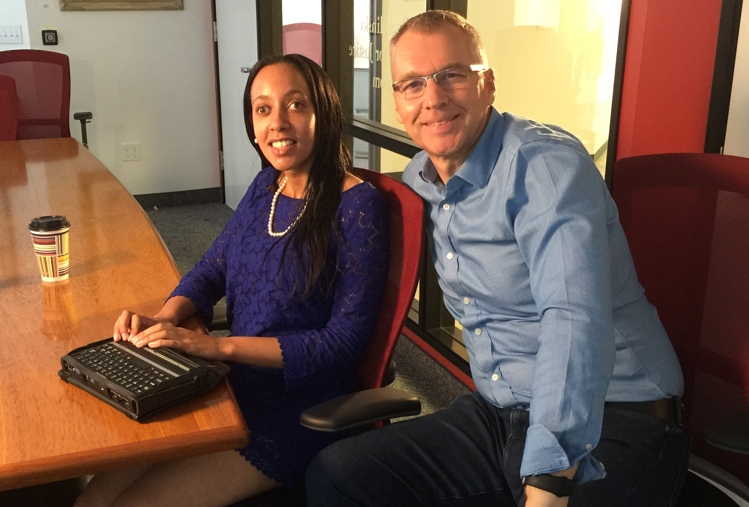
User experiences
Key feedback from deafblind community members
The way information is presented
Example: reduce amount of written content, bullet points, Auslan video alternative
Screen reading
Notes:
Phoebe
Reference Group feedback + User experience audit early 2021
Key feedback
- Auslan users – too much written content- condense / make info into Auslan videos
Videos are highly desired – ideally, every page
should have the option to have the info given via
video with Auslan interpretation and captions.
- Screen reading
Different softwares: JAWs, Apple voiceover
Heading ordering -illogical ordering

Slide 22
Maximising audit benefit
Live site vs. Staging site – use one
Communication
Weighing up what's logical for different access needs
Costs working retrospectively
Negotiating timeframes
Notes:
Phoebe
- Live site vs. Staging site – using one
- Communication between programmers & auditors – negotiate support for programmers depending on skill
- Some changes will affect layout/what's logical for other access needs. (It's impossible to suit everyone's preferences).
- Making changes retrospectively rather than from scratch – investigating how much it will cost to do retrospectively - you might get a better result if you begin on a clean slate with designer who specifically works in accessibility. If website was not designed by expert in accessibility, it's probably not very accessible – consider whether it's worth starting from scratch?
- Negotiating longer timeframes to implement changes

Slide 23
Where to next?
high contrast versions of forms
information in tables --> e-Directory
reviewing and correcting content errors on over 100 remaining pages
Notes:
Melanie -
Page display controls at the end of page (ie larger text, contrast) - medium issue
*partial fix – accessed after menu for screen readers, still at bottom of page for sighted users
Tables:

Slide 24
Conclusions
Our advice to you...
Incorporate accessibility from the start
'End user' testing
What standard of accessibility are you aiming for?
What is achievable?
Review it every few years
Notes:
Melanie
Pros: knowledge and skills have increased through process
Guidance from experts in accessibility
We know our audience and our users know their needs even better
Cons:
Still don't have highly accessible website – a lot more content to fix
Solid year of dedicating time and finances
Not done yet!
Our advice:
If you are going to create a website, make it accessible from the start, rather than create one and decide to add accessibility later
If you have a website but it is old , building a new website designed by a service with accessibility expertise may be more financially viable.
If in doubt, get an 'end user' to review/test something for you.
People programming your website/end users have same definition of accessibility as you (AAA standard in our case).
Pursuit of completely accessible website – is this realistic? – best practice accessibility is changing all the time, technology and software changes quickly
If you’re thinking about it, getting quality advice and guidance, you're making things more accessible than they were yesterday. It a process and an ongoing one to achieve a high level of accessibility.

Slide 25
Contact us
Website
www.deafblindinformation.org.au
Email
info@deafblindinformation.org.au
Notes:
Melanie

