Slide 1
Tactile Playgrounds - Improving Tactility, Mobility and Inclusion for Blind and Low Vision Audiences in Urban Playground Environments
Dagmar Reinhardt
School of Architecture, Design and Planning
The University of Sydney

Slide 2
Team
Associate Professor Dagmar Reinhardt – University of Sydney
Dr. Sue Silveira – NextSense and Macquarie University
Associate Professor Kathleen Tait – Macquarie School of Education - MQU
Leona Holloway – Inclusive Technologies, Faculty of Information Technology, Monash University
Dr. Shirley Wyver – Macquarie School of Education - MQU
Associate Professor Lian Loke – University of Sydney
Tricia D’Apice, Nextsense
Sonali Marathe, Manager Accessibility and Inclusion, NextSense

Slide 3
Outline
Introduction
Playgrounds
Playground survey
Touch Access
Building Capacities: Scan, print, mill
Next steps: ARC Discovery
Contact Us
Notes:
ALT text: A young, seven year old girl hanging upside down from a bright yellow playground structure. She is wearing a red shirt and jeans, thick glasses, with floating hair and is brightly smiling.

Slide 4
Tactile Urban Playground
We present our initial research into into tactile playgrounds for inclusive access. We aim to develop strategies and tools to make urban playgrounds accessible for blind children and parents. We are early childhood educators, BLV educators, touch access designers, architects, and interaction designers from the University of Sydney, Macquarie University, Monash University and Nextsense.
Notes:
ALT text: 4 logos from the partners in the team: University of Sydney, Maquarie University, Monash University and Nextsense.

Slide 5
Introduction: Play
Play is an essential part of childhood.
Play is worldmaking and feeds imagination.
Outdoor play supports the development of physical skills such as strength, coordination and balance.
This includes also cognitive and emotional skills.
Encouraging play is a positive method for supporting child development.
We know that children with BLV are much less physically active than their peers.
Notes:
ALT text: Two children are jumping on a trampoline, a boy aged four and a six year old girl. The girl is suspended in mid air. Another girl watches, all are smiling happily.

Slide 6
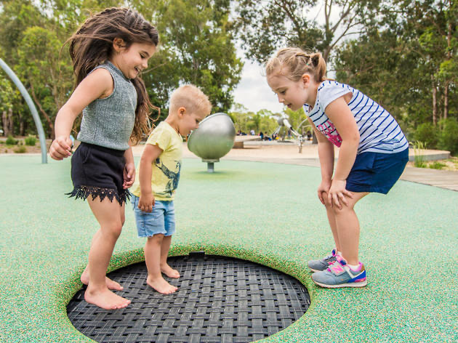
Playgrounds
Outdoor spaces such as parks and playgrounds provide opportunities for play and intergenerational experiences between adults and children. Playgrounds enhance quality of life, enabling development, learning, flexibility, and resilience for all users (including the elderly).
Notes:
Blind and low vis children need movement.
Children with vision impairments were observed to have developmental delays in gross motor, manipulative, self-stimulation and social/play behaviours due to a lack of opportunity for gross motor interactions with the environment [5].
ALT text: Two children are jumping on a trampoline, a boy aged four and a six year old girl. The girl is suspended in mid air. Another girl watches, all are smiling happily.

Slide 7
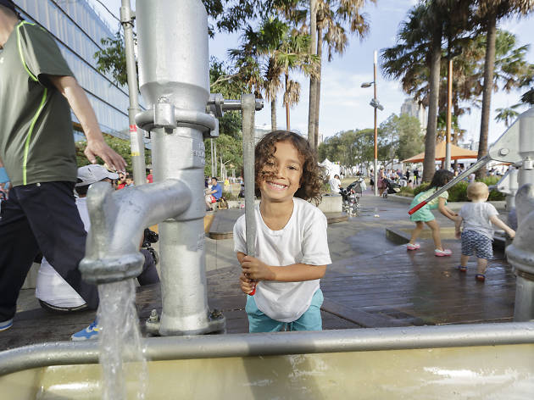
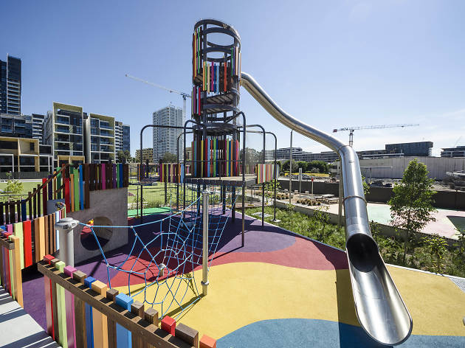
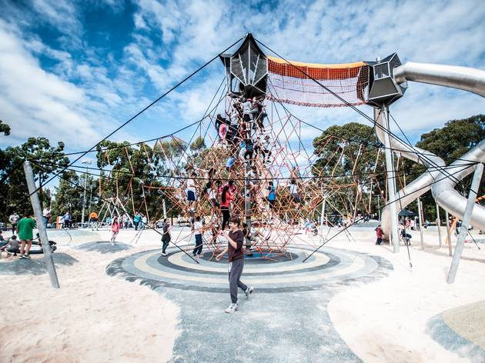
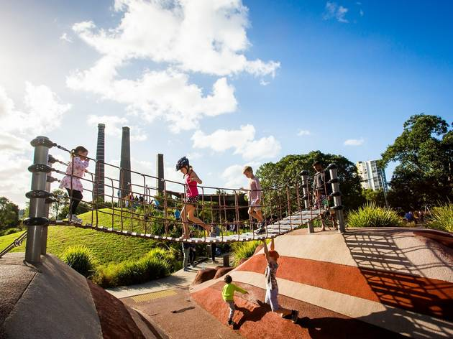
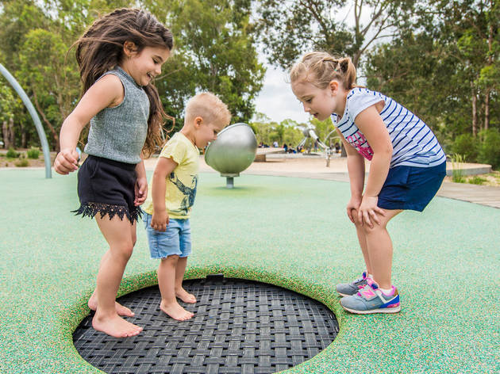
Physical Movement
Children that are blind or partially sighted enjoy strong physical movements: above, below, around playground equipment and objects. Educators and parents are often scared and hold children back. Instead of children losing confidence, we aim to support both.
.
Notes:
ALT text: A playground located at Sydney Park, St Peters. Children passing a hanging bridge from two sides/ Two other children playing on a surface below.
Sydney Park (also, Kids Bike Track that has purpose-built cycleways and working traffic lights)
Ref:
The 17 best playgrounds in Sydney
Swing, climb, slide, slip and dip across the 17 best playgrounds around
By Emma Joyce Posted: Wednesday January 13 2021 https://www.timeout.com/sydney/kids/the-best-playgrounds-in-sydney

Slide 8
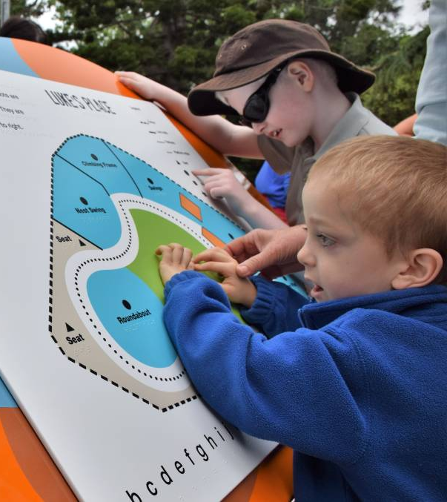
Touch Access
Our project explores how we can design playgrounds for all-inclusive access. We will design tactile maps that give an overview of the areas, and design equipment that encourages movement activities and learning.
Notes:
Sydney Park (also, Kids Bike Track that has purpose-built cycleways and working traffic lights)
Ref:
The 17 best playgrounds in Sydney
Swing, climb, slide, slip and dip across the 17 best playgrounds around
By Emma Joyce Posted: Wednesday January 13 2021 https://www.timeout.com/sydney/kids/the-best-playgrounds-in-sydney

Slide 9
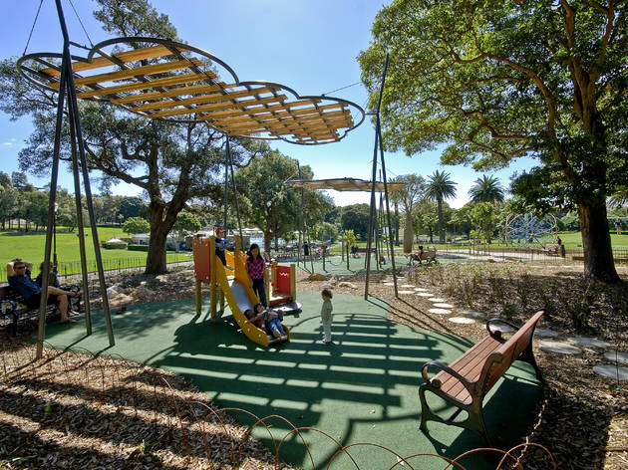
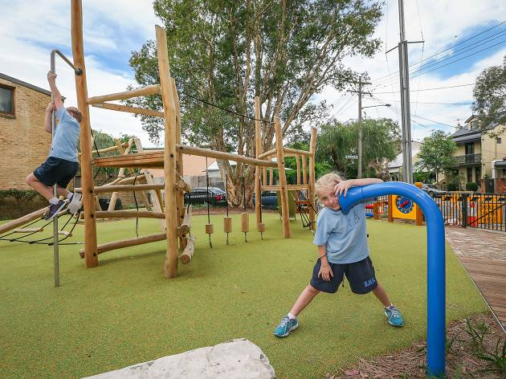
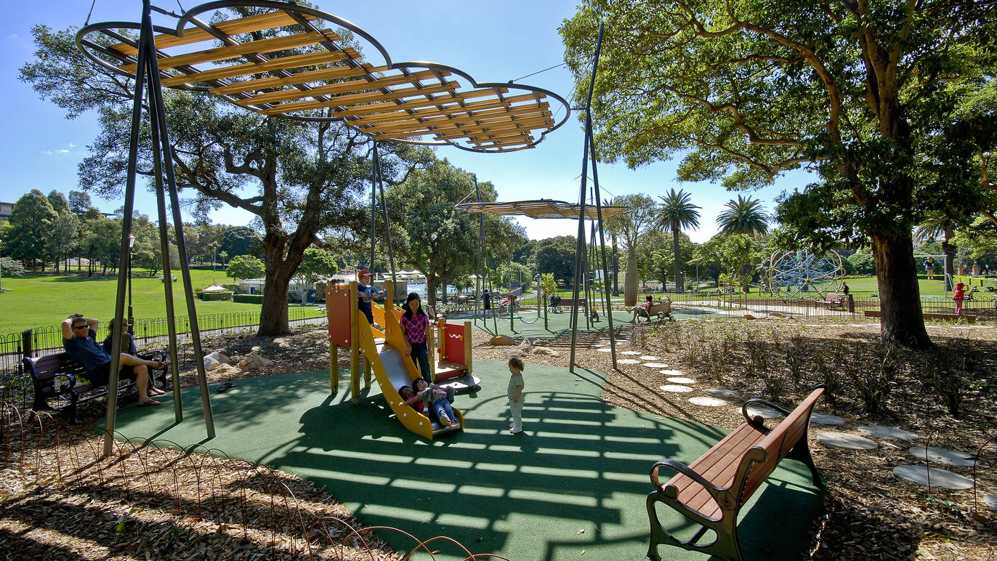
Playground Elements
Play equipment, furniture and shade
Gates and fences
Raised ground and soft surfaces
Supervision and safety
Stimulation for all sense
Overview, stories and learning
Notes:
For children
For children with different abilities
For parents and caregivers

Slide 10
A Playground Survey
To better understand the use of playgrounds for children with vision impairment and intellectual disability and to trial fundamental questions, two initial, small-scale surveys were conducted in 2021 with two focus groups (teachers/parent-child-teacher).
We aim to determine a set of best practice guidelines for designing accessible and inclusive community environments that enable the social inclusion of as many people as possible to enhance community integration, belonging, health and wellbeing.

Slide 11
Survey 1: teachers note barriers and lack
The teachers reported on significant safety barriers
A lack of rails for trailing and no safe paved areas
Uneven surfaces and an absence of textured surfaces
No colour contrast on objects such as poles and pillars in the playground
Lack of access to a "quiet area" for retreat
A lack of multisensory experience
A lack of free movement play area
A lack of opportunity for students to use their hands to explore spaces

Slide 12
Survey 2 results: Children want
Swings, Running Rope, Flying fox/ Zip line,
Climbing chain, Jumping balloon, Musical pipes, Stairs, Slide, Wobbly Bridge,
Climbing, Rockers, Railings,
Supervised free running in open space

Slide 13
Survey 2: Educators want
Educators want opportunities
to explore, with whole body and fine motor, e.g. alcoves, fixed sensory gear
to hold own weight, e.g. zip line
to fall safely from low height (may need to be taught)
to commit body into space, e.g. jump from low height, run downhill safely
to reach to sound, e.g. movement activated soundscape poles (orientation) musical instruments

Slide 14
Building capacities
We have been working since 2019 in different collaborations to better understand how to capture real world data and make convincing or stimulating representations for touch access, and for play.

Slide 15
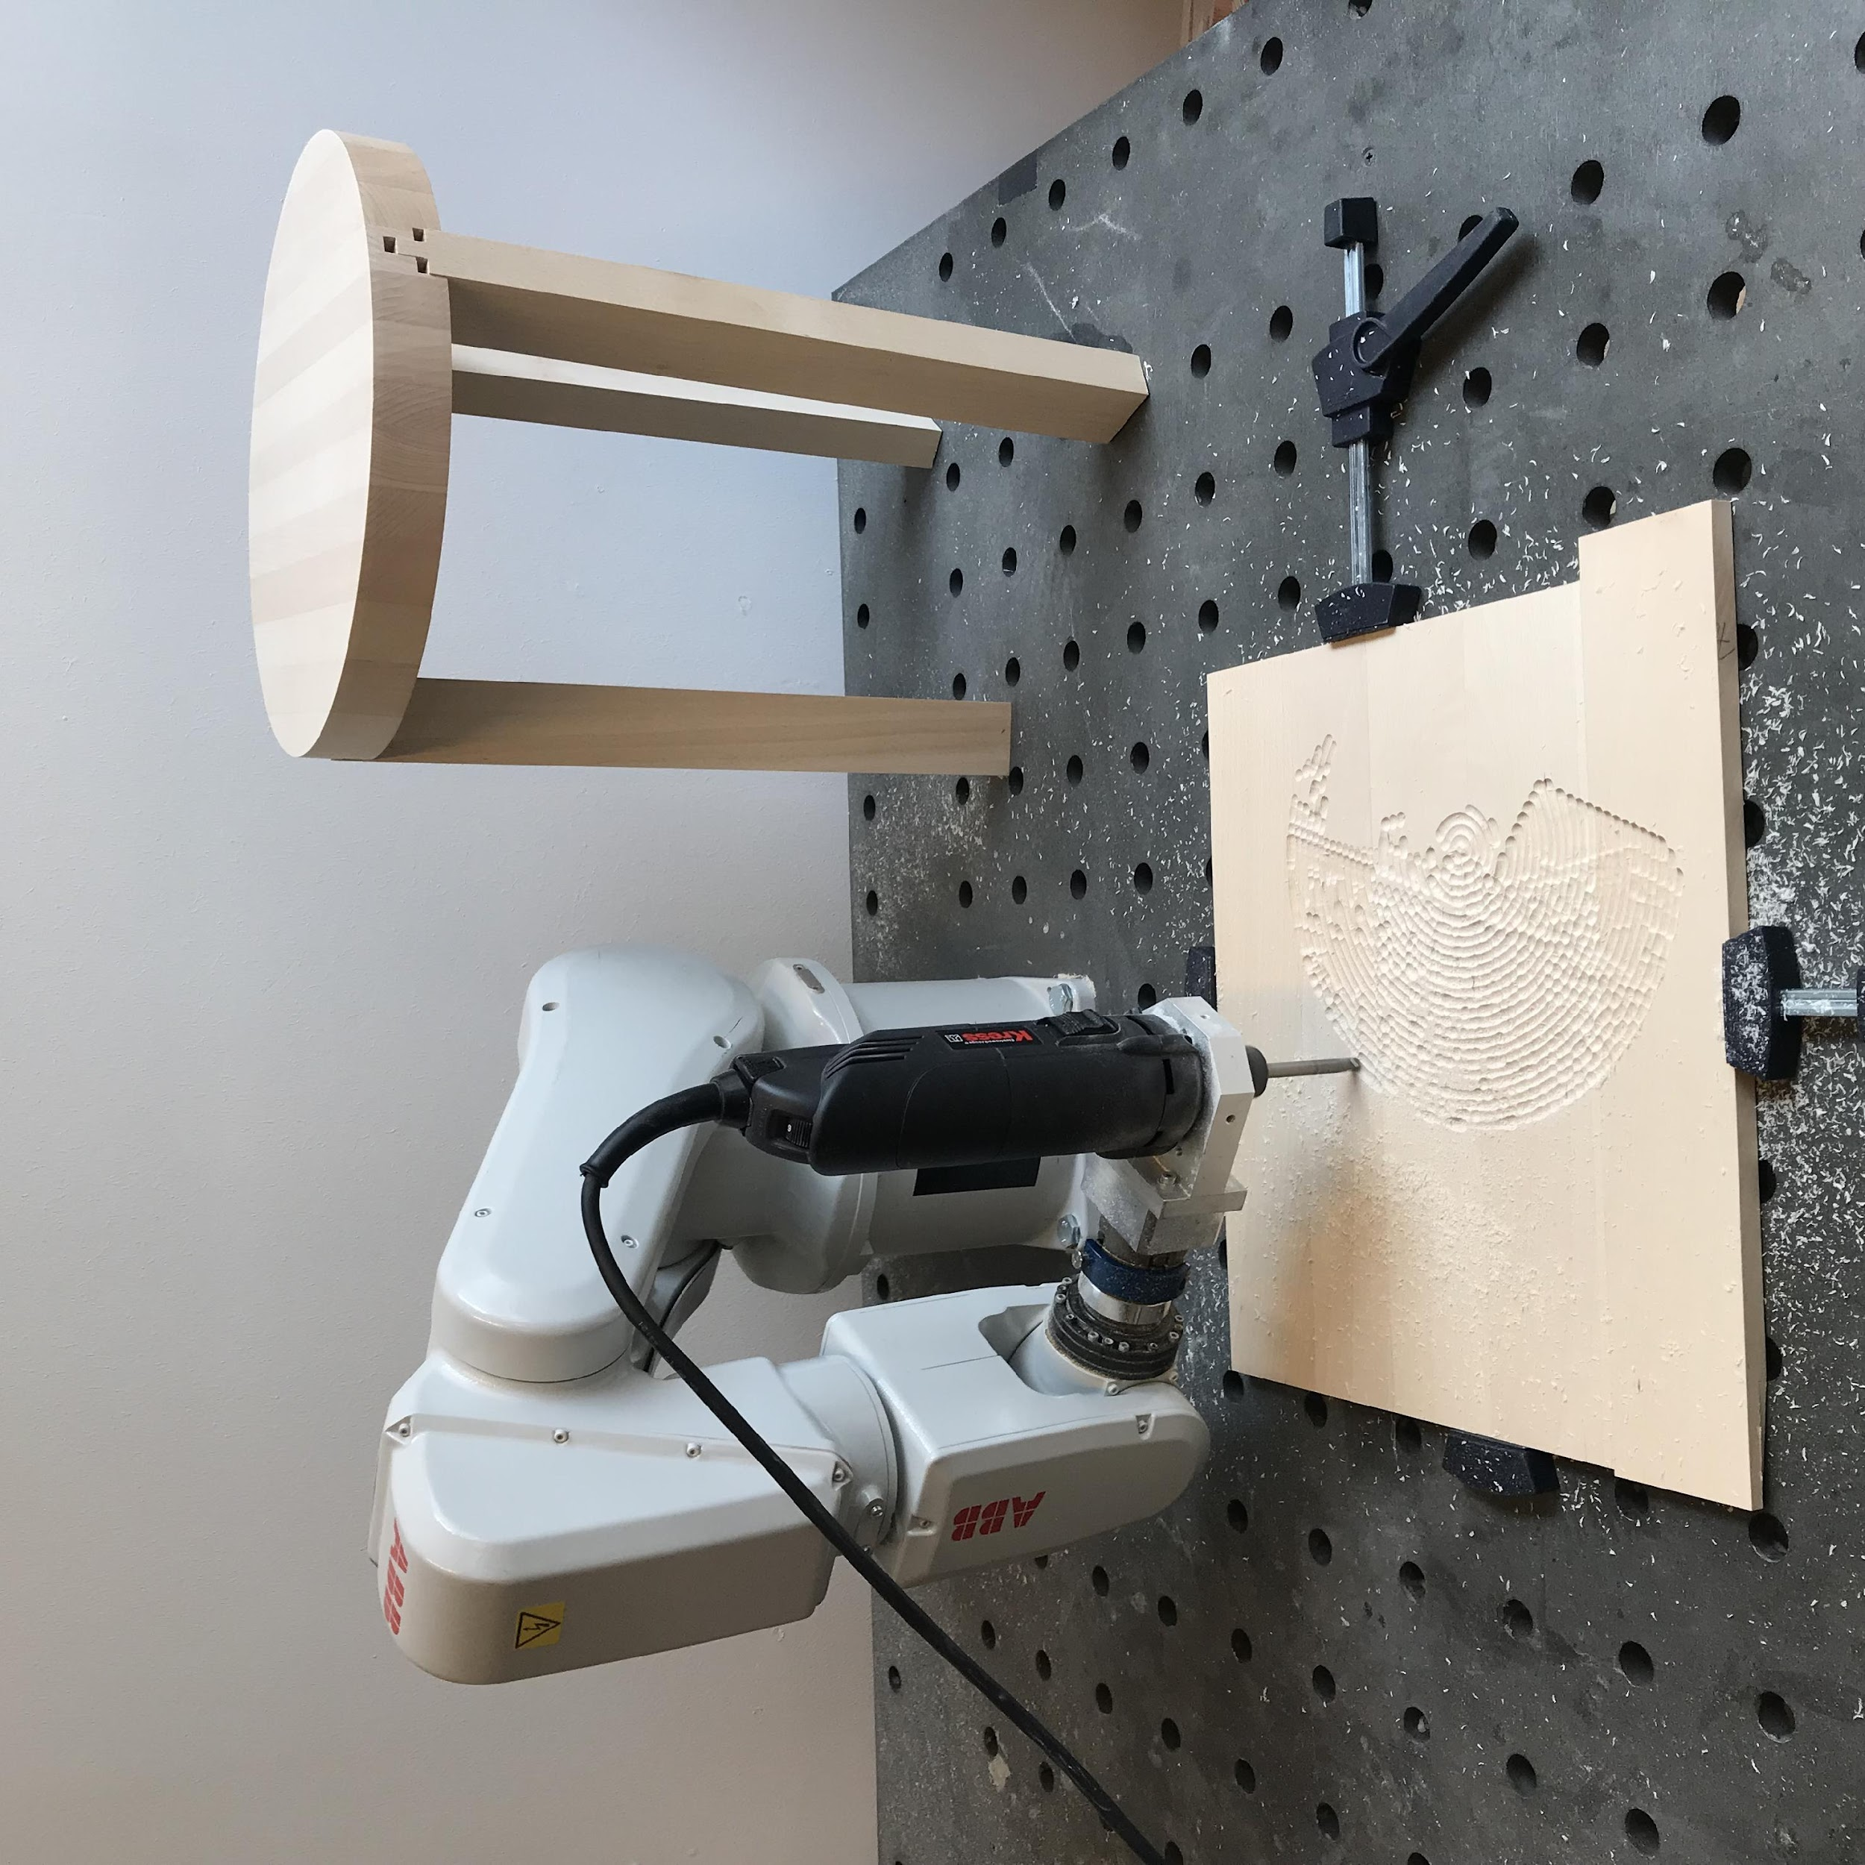
Robot Pattern Milling
We use small industrial robots since 2019 for milling patterns into wood plates to test touch access for BLV with architectural surfaces.
We also use milling to produce pixelated images for visual audiences. The combination of both a hypersurfaces with information that can be decoded by both groups.
Notes:
ALT text: A robot (a small six axis industrial robotic arm) that is mounted on a worktable. The robot mills with a drill bit into a wood plate, producing an engraved pattern of a city. On the right hand site a small chair stands ready for fabrication.

Slide 16
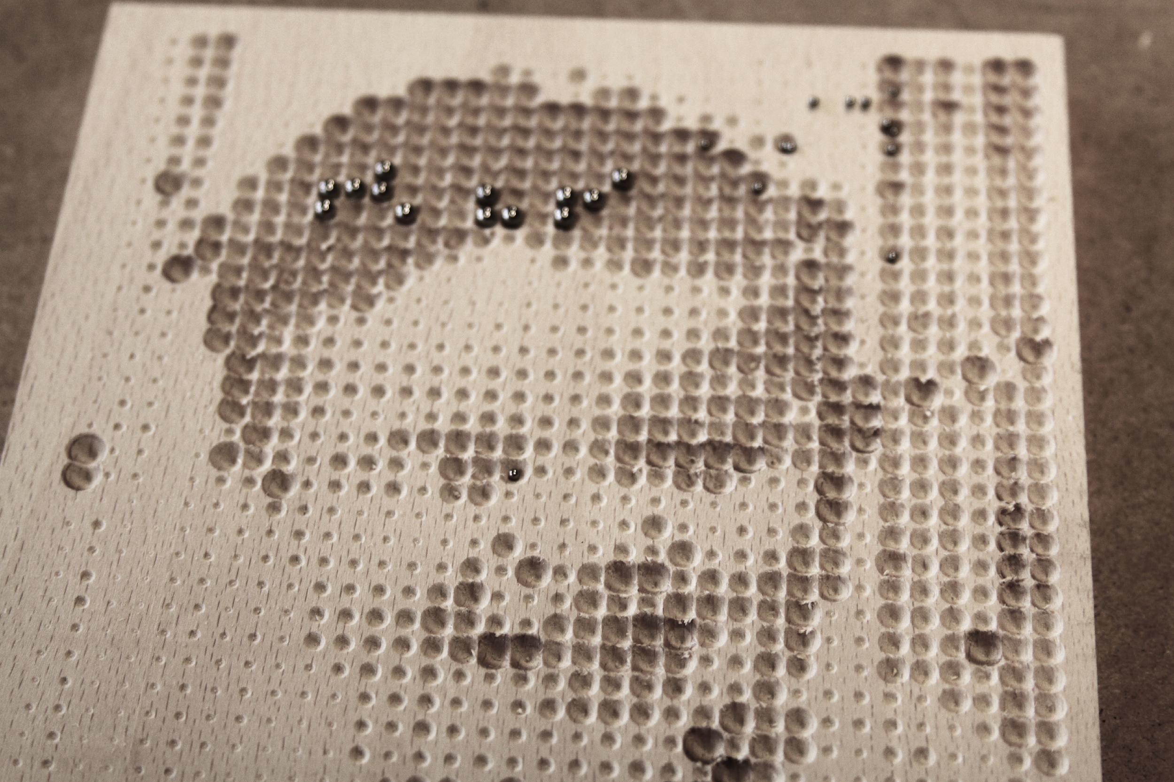
Notes:
Talk:
Combinations of pictorial information and Braille. Step 1: image source with RGB values used to instruct depth and angle for robot milling. Step 2: increased point grid with Braille inserts ( text insets: ‘mor’, ‘far’, ‘kat’). Step 3: graphical material is analysed for potential overlaps with the braille, with locational information of graphical material is overlaid with braille inserts.
ALT text: A picture of the same boy smiling, not as black and white photograph, but as engraved pixel pattern on a wood plate. There are metal balls inserted in the pattern that are meant to spell out a word in braille.

Slide 17
Imagining a Walk
The most attractive model to BLV audiences we designed to date depicts the walk of astronaut Neil Armstrong over the surface of the moon at the Apollo landing on 21 July 1969.
Notes:
An overview of spatial locations for blind or partially sighted people is provided by a 3D raised map that depicts the spatial volumes and the accessible pathways between them.
The model depicts the IBOS building structure and is situated at the main public entrance.

Slide 18
Patterns for Touch
Notes:
ALT ext: Different examples of robotic milled wood plates with patterns that test touch access.

Slide 19
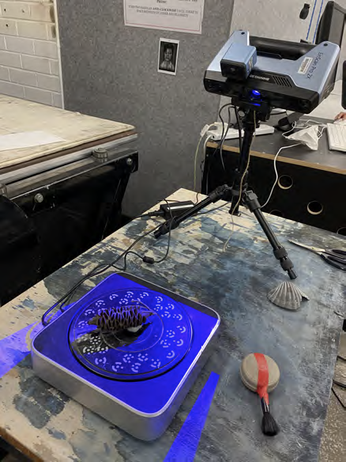
3D Scan
Scanning with a camera
Scanning with a station
Scanning objects and details
Result is a dataset that is scaleable and can be 3D printed
Notes:
Scans, multiple scales: from object scan in lab to onsite photogrammetry
ALT text: An image of a scanning station with a turntable and a camera.. A banksia is placed on the turntable.

Slide 20
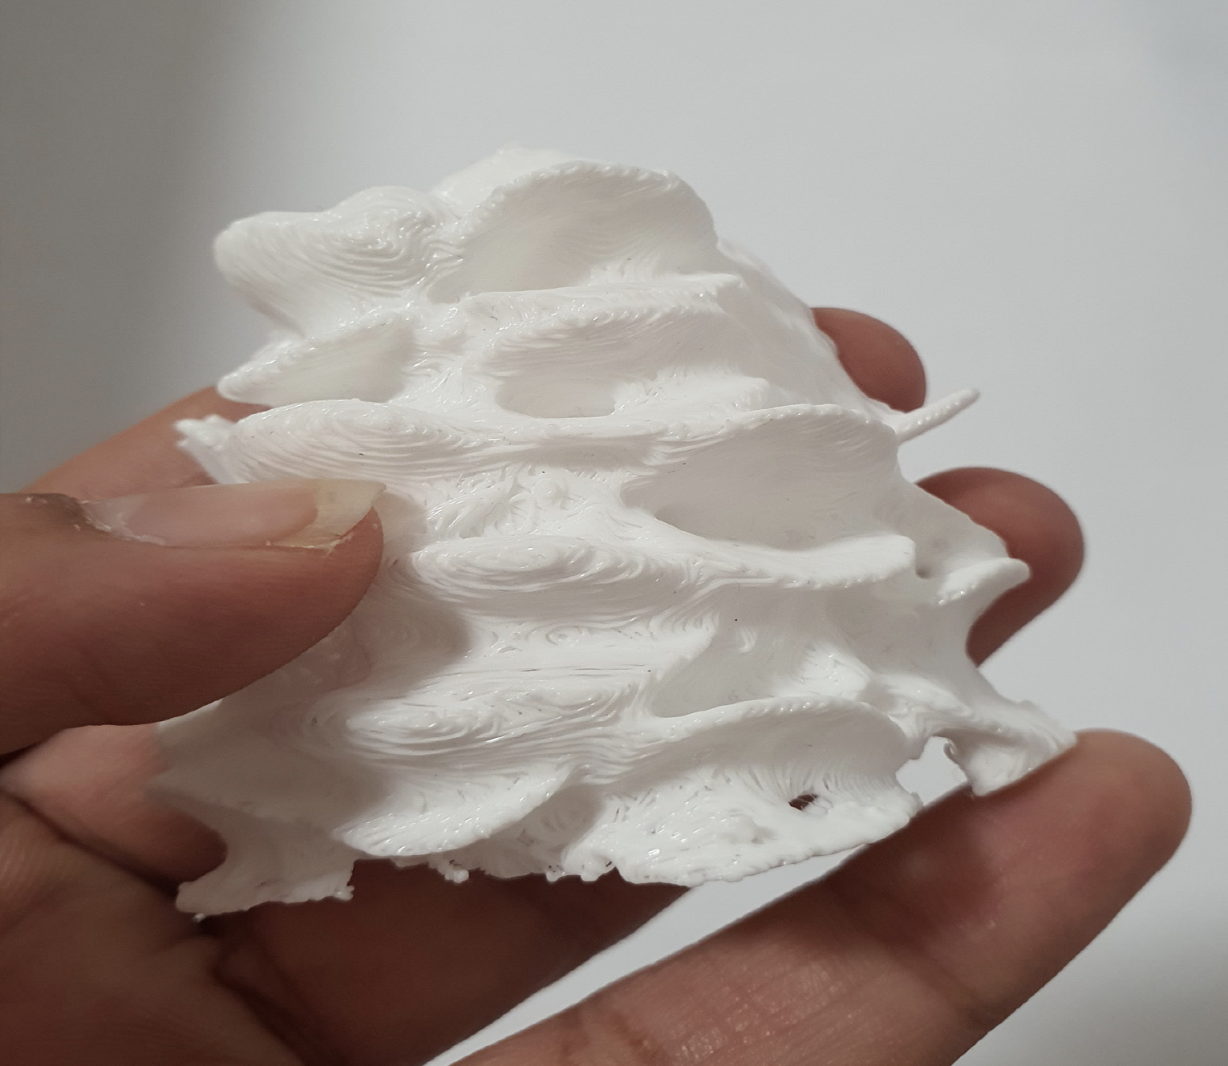
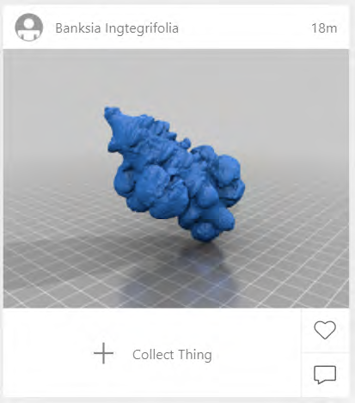
3D Print
The 3D data can be printed at different scales
and also shared via the web.
Notes:
Scans, multiple scales: from object scan in lab to onsite photogrammetry
ALT text: A hand holds a 3D printed banksia part (left), and an image of a virtual banksia from the share website (right).

Slide 21
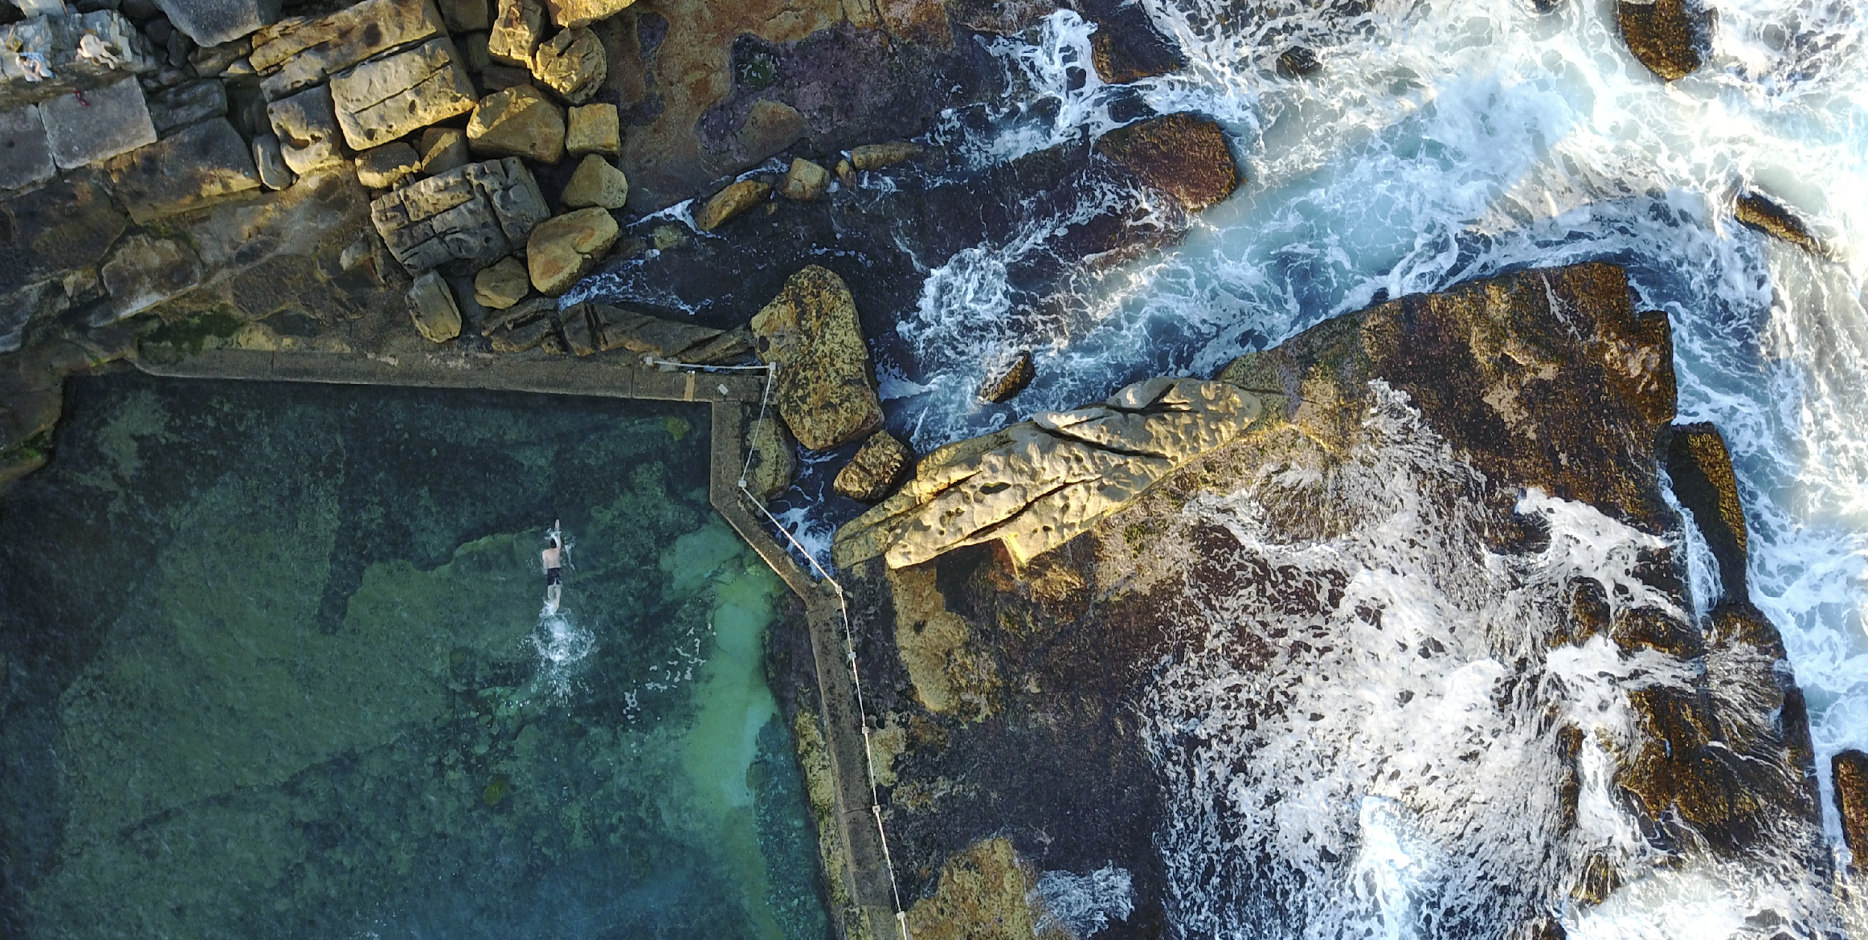
Ocean Pools: A Case Study

Slide 22
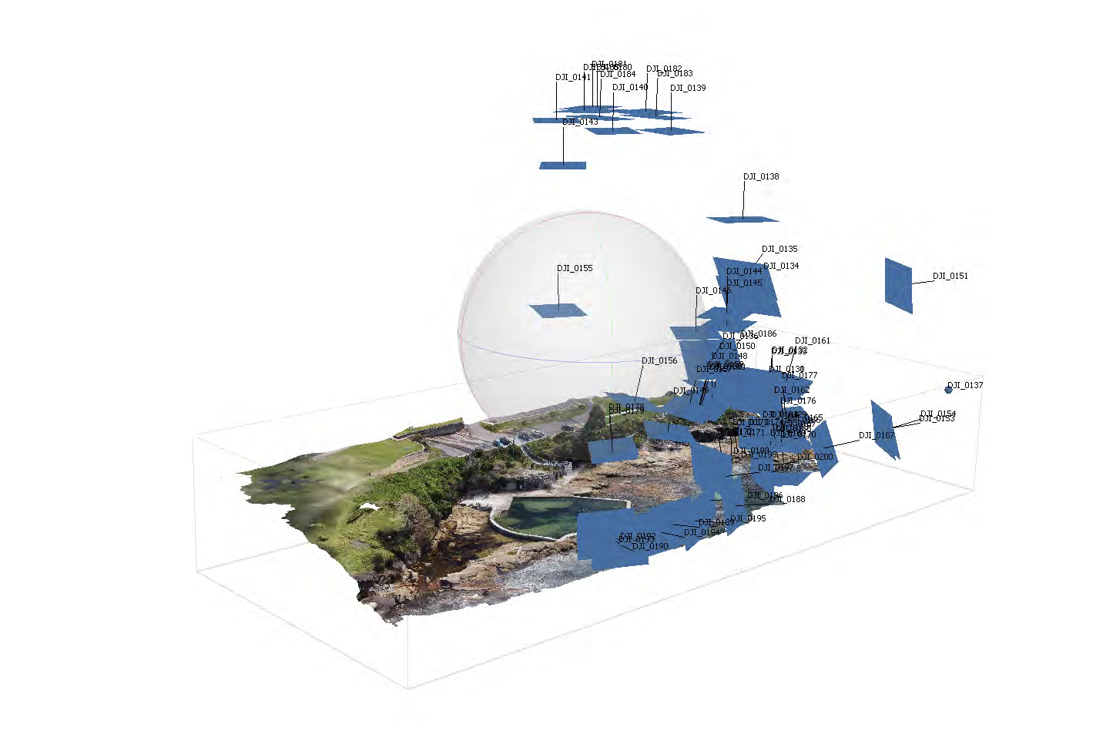
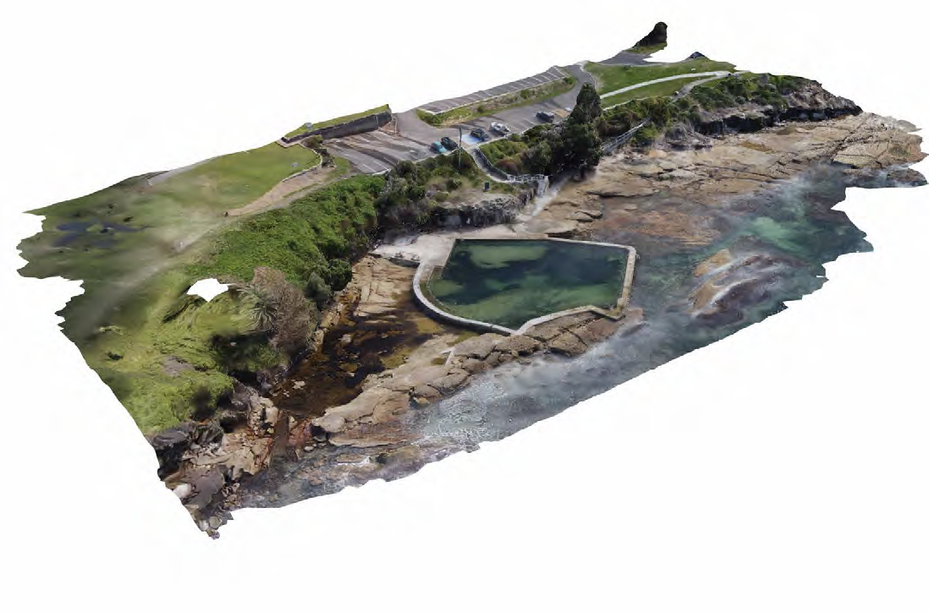
Scale: Aerial Photography
A drone flying over a public open space can retrieve pictures that can be collated into a dataset.
1
Notes:
L a r g e S c a l e P h o t o g r a m m e t r y
Scanning of the overall Malabar site utilising aerial drone photography and photogrammetry software.
y
ALT text: A diagram of images that are retrieved by a drone flying over Malabar ocean pool and beach.

Slide 23
Fabrication Data
3D datasets are used in our research for three-dimensional tactile models of open environments, so that BLV users can touch (and embody) the raised maps.
This is a tactile map of Malabar Ocean pool.
Notes:
SDG 9: Scaleable Data for Advanced Fabrication.
ALT text: A raised topography model that is routed out with a drill from a wood block.
A robot millimg a scaled model of the Malabar ocean pool and topography out of a piece of wood

Slide 24
Notes:
ALT text: An image of an old lady holding on to the handrail and a family with child in the background, below this image is the diagram of a tactile map that shows vegetation, Rockpool and ocean

Slide 25
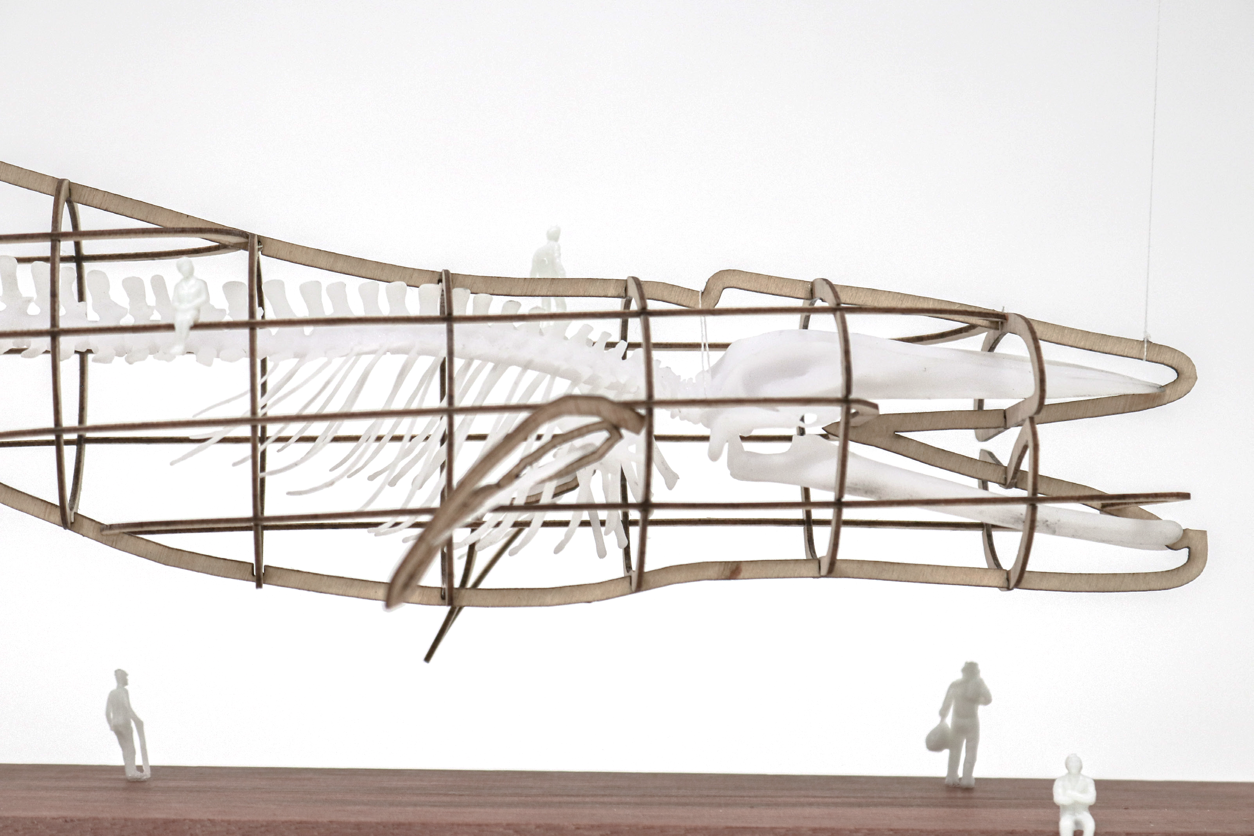
Notes:
ALT text: A photograph of a model of a giant whaleskeleton in a construction, with people below. The model shows the proposal for a playground.

Slide 26
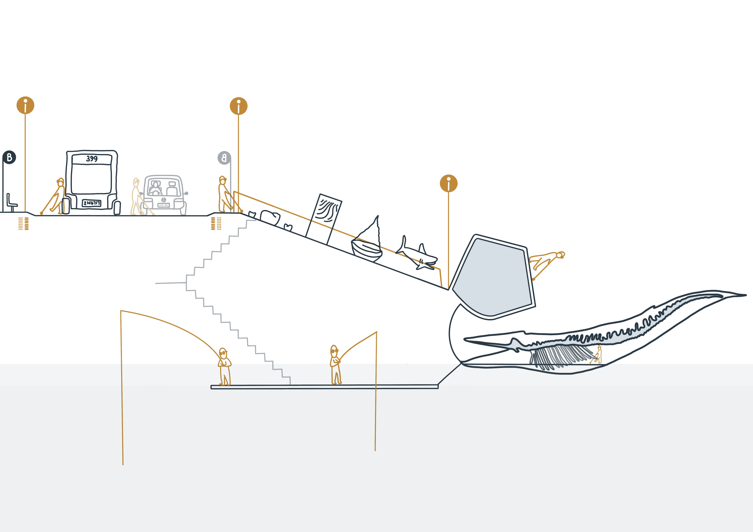
Notes:
Alt text: This proposal for a playground shows a diagram with several activities: arriving by bus, walking down a staircase, several exhibits on a ramp/staircase, walking along the Rockpool, going through the giant whale skeleton, and finally fishing at the ocean.

Slide 27
[hold up, show and describe]

Slide 28
Research Pathways (ARC)
1 exploring models of playgrounds as 3D maps
2 developing equitable and inclusive playground equipment which utilise braille games, tactiles, touchables, equipment for health and play, and
for storytelling, all of which will encourage natural socialisation and collaborative play
3 designing guidelines and frameworks for existing playgrounds that permit retrofitting, and/or development of new concepts in these spaces

Slide 29
Research Pathways (ARC)
4 designing spatial maps for finding playgrounds including connecting to existing systems such as BindiMaps, and the beacon infrastructure system, with development of interfaces for these systems
5 designing user interfaces such as apps connecting to the playgrounds that will assist parents and carers with blindness and low vision to locate playgrounds and be aware of obstacles and potential risks when supervising sighted children

Slide 30
Our Goal for 2024
A playground can provide a safe environment that enables not only movement and play for parents and children, but more importantly enables social connections for children-children, parent-children, parent-parent constellations.
Importantly, this also means improving and supporting resilience to the changing nature of cities, infrastructure, employment, people and communities, for enabling sustainable, socially equitable, environmentally friendly and commercially viable communities.

Slide 31
Contact us
We are looking for people willing to test playgrounds (or tell us about their experiences) and to touch and evaluate our prototypes. Or just to talk to us.
Please call Dagmar: 0407-346473
or mail: dagmar.reinhardt@sydney.edu.au
Thank you.

