Slide 1
Finding Saliens on Sonoplanet
Learning Sonification as Technology for Inclusion and Access to Information
Phia Damsma – Sonokids Australia

Slide 2
Sonification is…
Mainstream technology using non-speech audio to represent information or data

Slide 3
Sonification in Education: Accessibility
Faster process
‘Impression’: quick overview before diving into the real content
Multi-modal benefits all
Equity of access - Alternative mode of access (STEM)
Independent access in real-time
Notes:
Benefits. Faster process for data analysis than exploring tactile graphics. When going through tens of images with astronomical data, can’t rely on them being output in tactile format.
Neurodiverse students
Imagine students can access digital content and sonify it independently for equal access to images and data, at home.
No more waiting for access, relying on others to supply alternate formats. No problems during pandemic in classrooms

Slide 4
SWC Working Group LEARN #10
Bring sonification into the classroom, lesson plans (year 6 – 8)
Science and Art curriculum
Sonification tool
Notes:
Lead of working group ‘Learn’ of the Sonification World Chat. Tenth meeting this month.
Ages 9/10 to 12/13

Slide 5
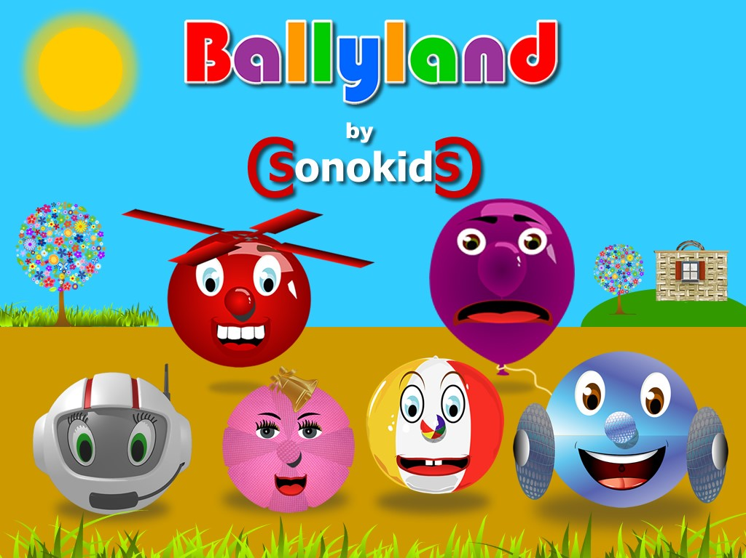
Gamified Early Learning of essential digital skills

Slide 6
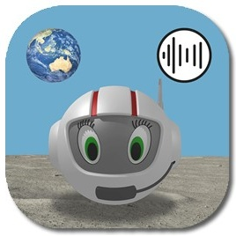
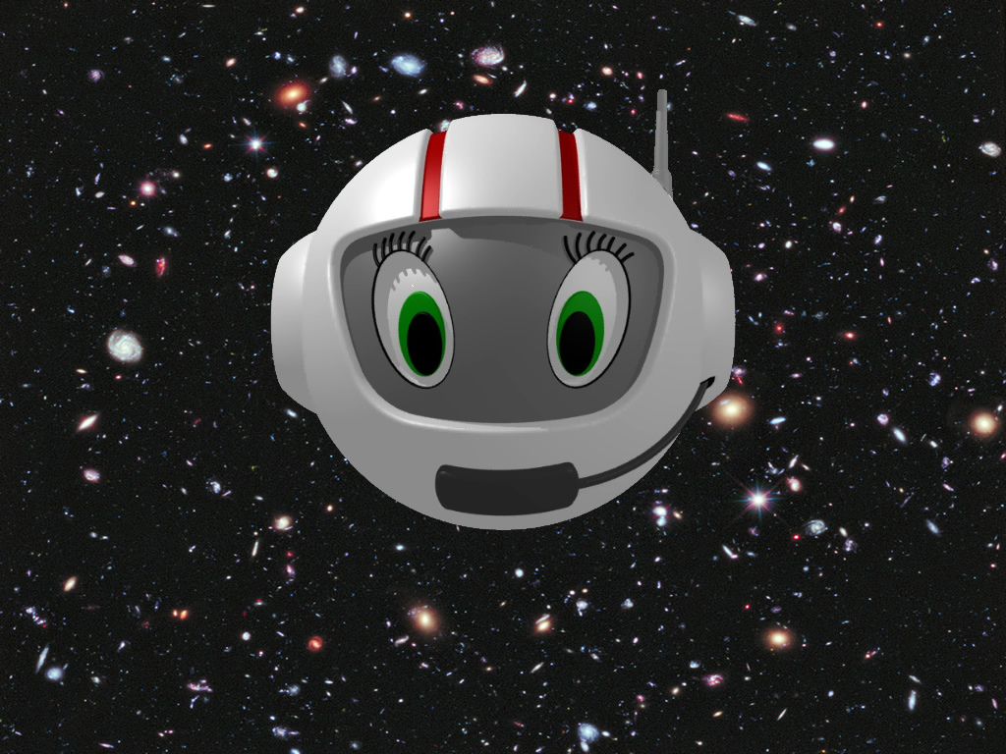
CosmoBally on Sonoplanet
CosmoBally
Free app for iPad and Android tablets
Support site: https://www.sonoplanet.com
Early Learning generic sonification skills and concepts
(Ballyland CosmoBally in Space)

Slide 7
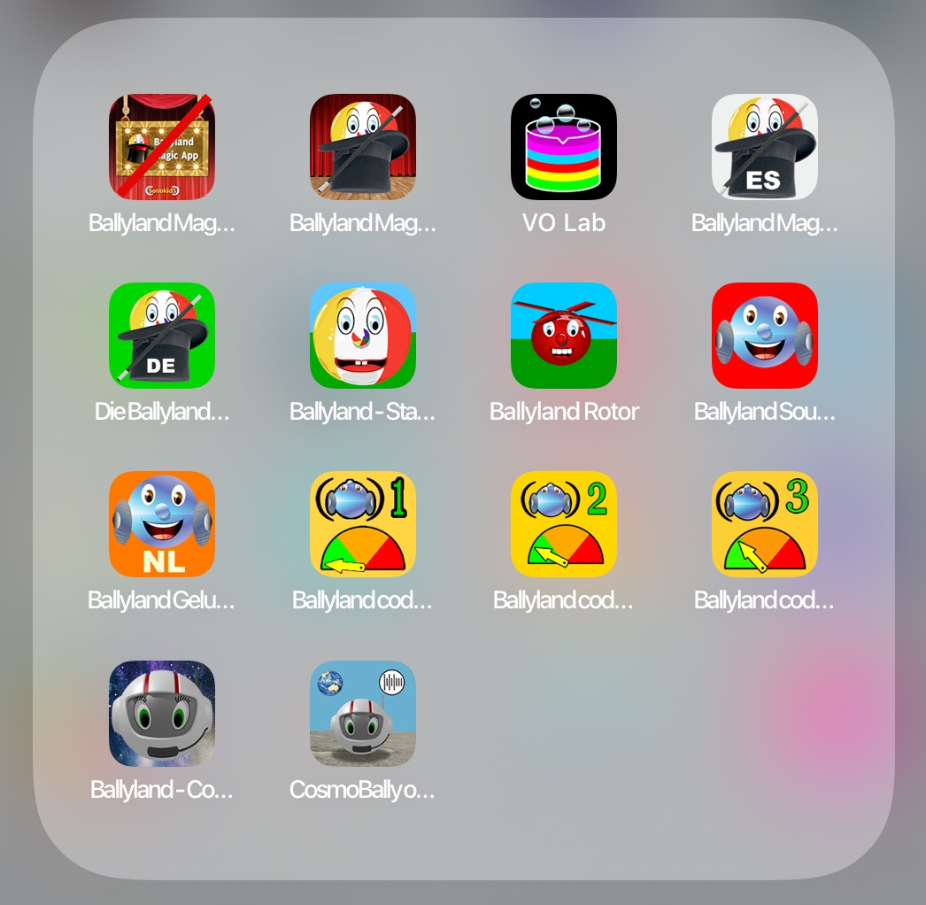
Notes:
Sonokids apps. 13 apps. On iOS 10 original, Magic in Spanish and German, Sound Memory in Dutch. Three Code apps and now two space-themed apps. 4 apps on Android.

Slide 8
Aims
Raise awareness about (accessible) sonification

Slide 9
Aims
Raise awareness about (accessible) sonification
Build capacity in young students to develop a fundamental understanding of sonification through the development of ‘emergent sonification literacy’

Slide 10
Aims
Raise awareness about (accessible) sonification
Build capacity in young students to develop a fundamental understanding of sonification through the development of ‘emergent sonification literacy’
Provide insights into the prerequisites and capabilities of young students in using this technology

Slide 11
Aims
Raise awareness about (accessible) sonification
Build capacity in young students to develop a fundamental understanding of sonification through the development of ‘emergent sonification literacy’
Provide insights into the prerequisites and capabilities of young students in using this technology
Provide a proof of concept for accessible, innovative, gamified applications of sonification for students who are blind or vision impaired

Slide 12
Aims
Raise awareness about (accessible) sonification
Build capacity in young students to develop a fundamental understanding of sonification through the development of ‘emergent sonification literacy’
Provide insights into the prerequisites and capabilities of young students in using this technology
Provide a proof of concept for accessible, innovative, gamified applications of sonification for students who are blind or vision impaired
Contribute to students’ (future) use of sonification and access to STEM.
Notes:
sonification can remove barriers currently experienced by children to pursue a specific education or career, such as in STEAM

Slide 13
Survey
Free app
Short and anonymous user survey
www.sonoplanet.com
Notes:
PLEASE complete the survey, even if you only try a little bit of the app.

Slide 14
Specs
Four original sonification concepts
Four types of (audio) games
Theme is space
Explore power/limitations of sonification in Early Learning

Slide 15
Audio
Audio games = Self-voicing games
Screen readers OFF
Self-voicing menus ON
Attentive listening. Headsets optional
Sonification
Spoken guidance
Audio Described ‘Setting of the Scene’
Notes:
Mission Briefings, Setting of the Scene, Instructions

Slide 16
Adjustable Settings
Sound only, or sound with images
Apple team
Notes:
Apple assessment of the app

Slide 17
No standard way of mapping
Sonification the Sonokids’ way
Trialed at 2021 SPEVI and Round Table Conference
No stereo sound
Game 1

Slide 18
Space Flight

Slide 21
Game 1: Hearing Shapes. Shape Crater
Designed as a Quiz in two parts.
In Part 1 you are asked to compare two sonified shapes.
Part 2 plays one sonified shape at a time. Select right answer.

Slide 24
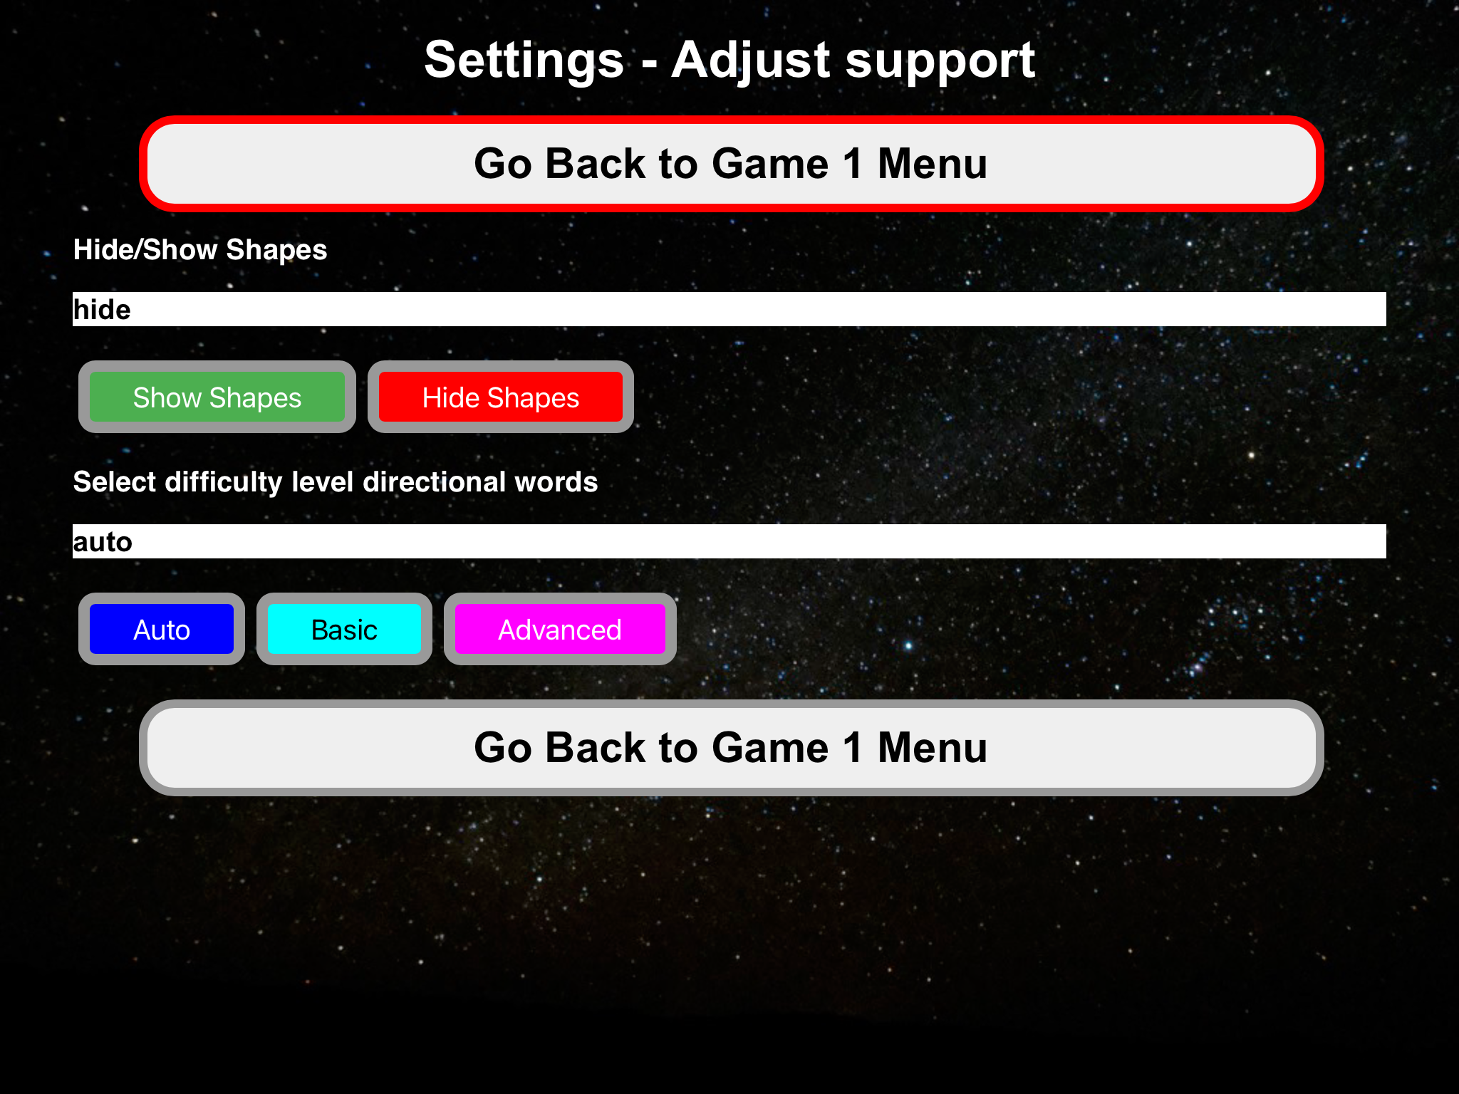

Slide 25
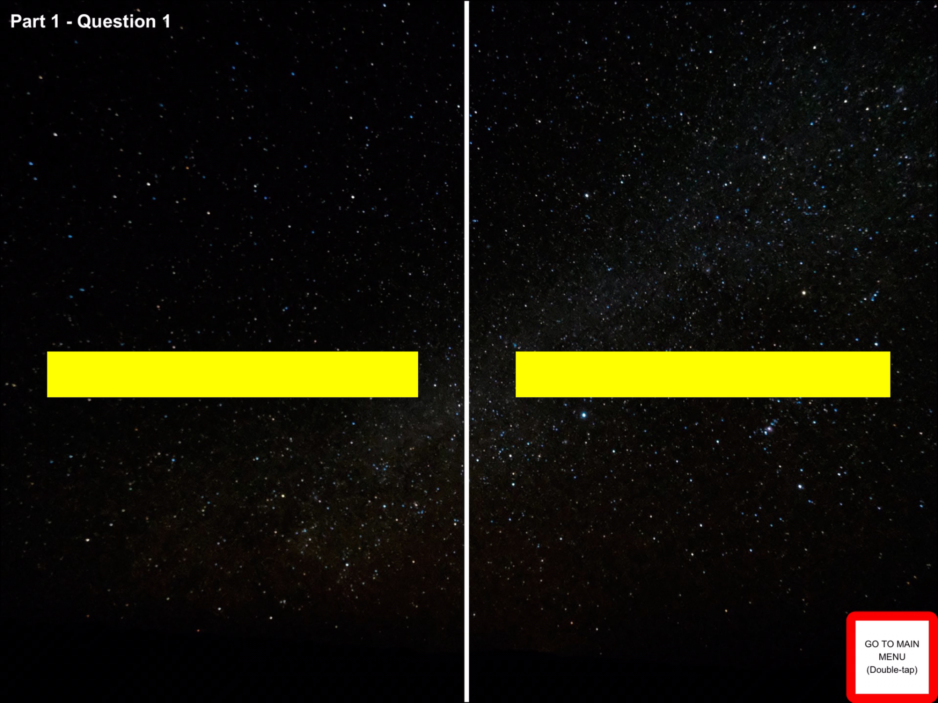
Notes:
Even if there are now visuals of the horizontal lines, sonification still adds a dimension, because you can hear the direction in which the line is sonified.

Slide 26
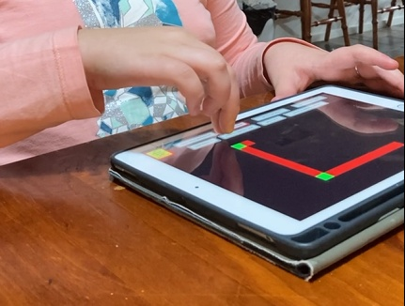
Following the process of creation
“I like being able to actually hear the shape being drawn”.
Sonoplanet TestFlight Pilot (9 years old)
Notes:
Hovers finger above shape as being drawn. Besides building spatial awareness and supporting spatial orientation, also mental mapping of creation process of rectangle

Slide 27
Complements tactile exploration
Sonification adds direction to shape
Dynamic process <> ‘static’ tactile graphic

Slide 28
Game 2: Explore with the Scooper
More difficult?
Use sonification to find Base Station
Analyse sounds of objects
Analyse and Trace sonified line/shape

Slide 30
Game 3: Sonified drawing. Cave
Designed as Sonification MakerSpace.
Creative.
Learn better by actively producing sonification
Draw and Trace shapes with sonification.

Slide 31
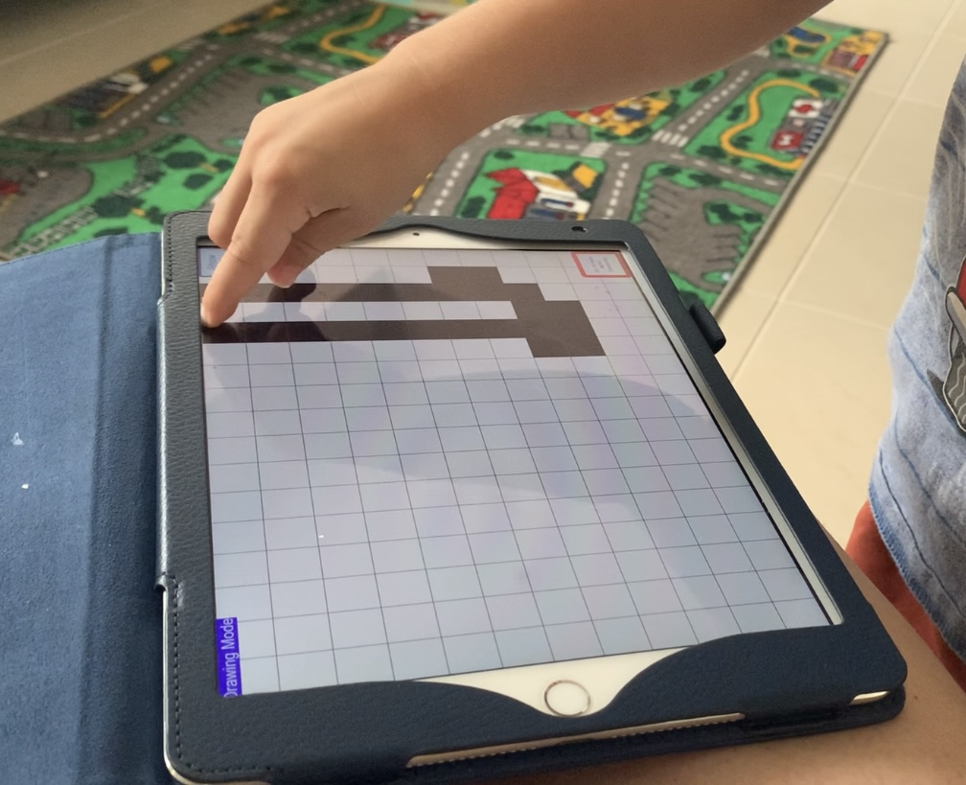
Notes:
Can change colour settings

Slide 32
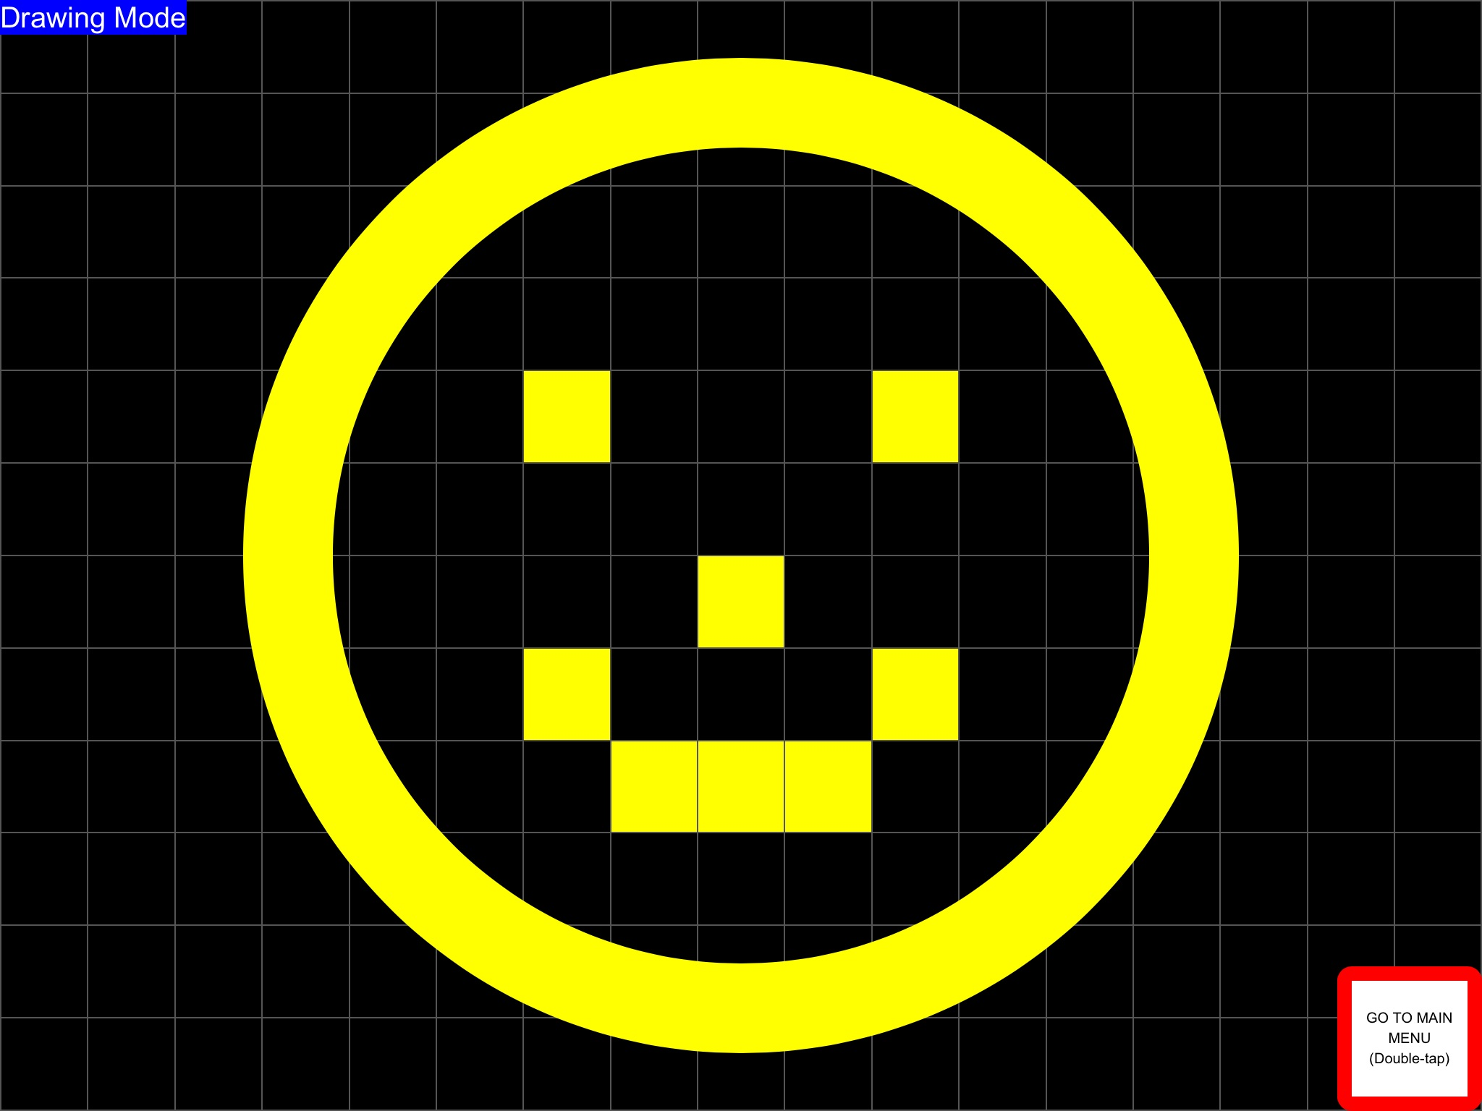

Slide 33
Game 4. Find the Saliens
Directional Sonification in a grid.
Sets of ‘sound indicators’
Mission Briefing Game 4
Notes:
Now you know where this presentation’s title originates.

Slide 34
Game 4
Spatial terms
Grid terms

Slide 35
Tactile Learning Tool CosmoBally
Notes:
Sneak preview

Slide 36
Credits
The Sonoplanet app project is supported by a grant from South Pacific Educators in Vision Impairment (SPEVI Inc.)
Tactile learning tool project made possible thanks to Mable Community Grants
Morgan Tyrrell, Oliver Fanshawe, other testers
Parents, carers, professional consultants
PeppaCode

Slide 37
Thank YOU!
To learn more about Sonoplanet visit: www.sonoplanet.com
Complete the user survey!!
For questions, suggestions and ideas around sonification: Email: support@sonokids.org
Notes:
Any suggestions for how to apply sonification to learning of various skills.
List with links to resources is handout available on the conference platform.

