Slide 1
Refreshable Tactile Displays
What, When, Why and Wow!
Swamy Ananthanarayan, Leona Holloway and Kate Stephens
Inclusive Technologies, Monash University

Slide 2
What is a refreshable tactile graphics display?
Moving surface to display electronic image files in tactile form.
Can rely on a variety of different technologies.
Promises:
Electronic storage of graphics
Access to many tactile diagrams on one device
Immediate access to electronic images
Drawing capabilities

Slide 3
Displays in development or on the market

Slide 4
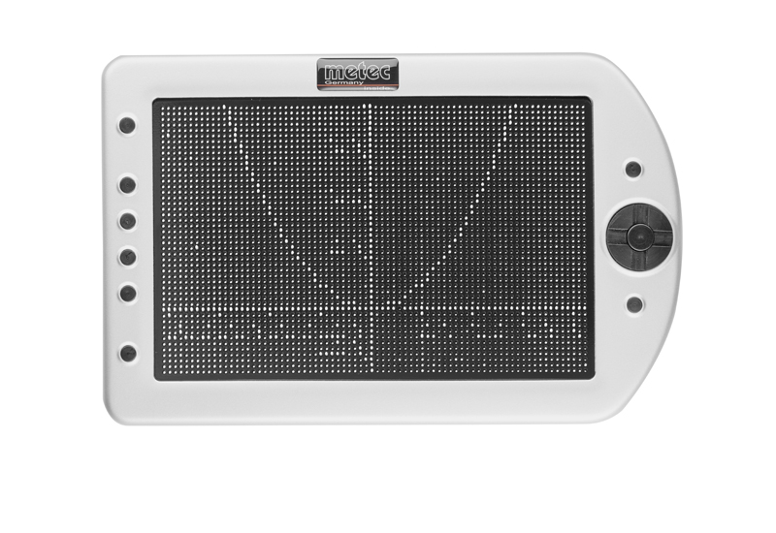
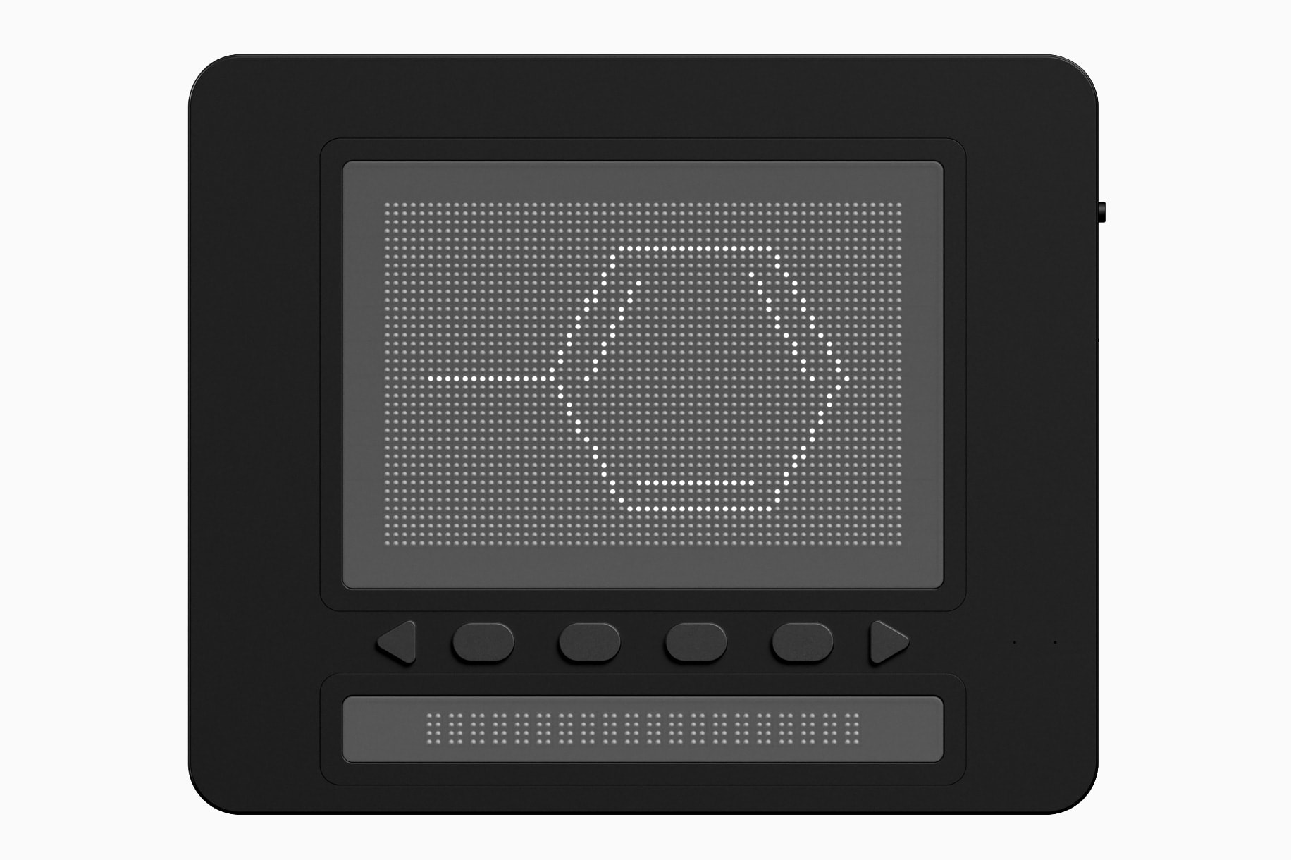
Refreshable Pin Displays
Device | Specs | Status | Image
Metec Tactile 2D, Hyperflat and HyperBraille F devices | Up to 6240 pins | On sale since 2012
Graphiti and Graphiti Plus by Orbit Research | 40 x 60 (2400) pins 4 heights | Limited production Cost around $30K
Dot Pad by Dot Inc. | 2400 pins | In development

Slide 5
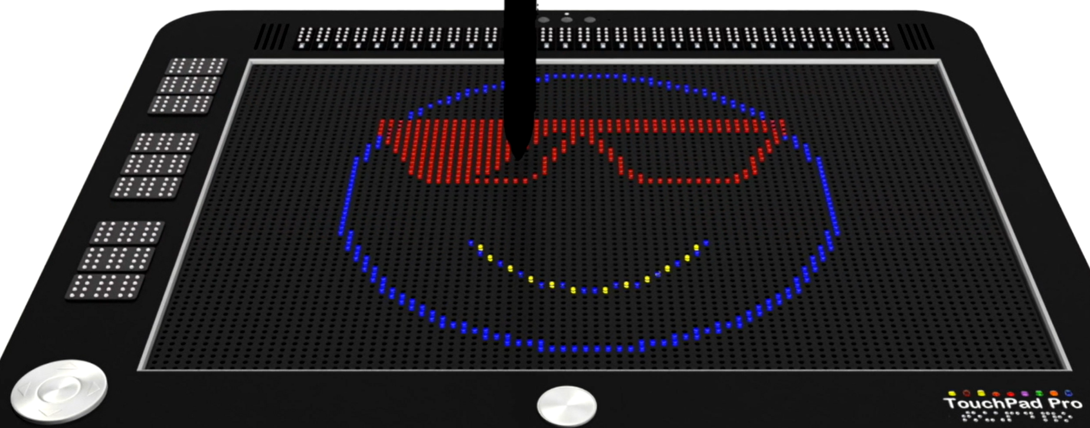
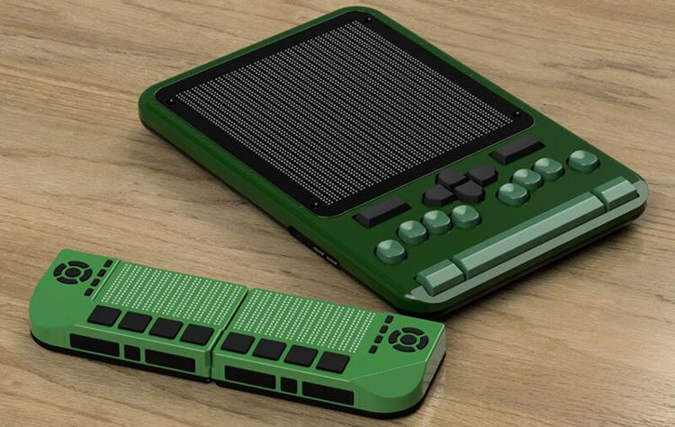
(More) Refreshable Pin Devices
Device | Specs | Status | Image
TouchPad Pro by TTPAT | Variable heights. Coloured backlights. | In development
SciDot by Independence Science | Braille spacing. Software for analysing & displaying scientific data. | In development - 1 year funding awarded in Feb 2022

Slide 6
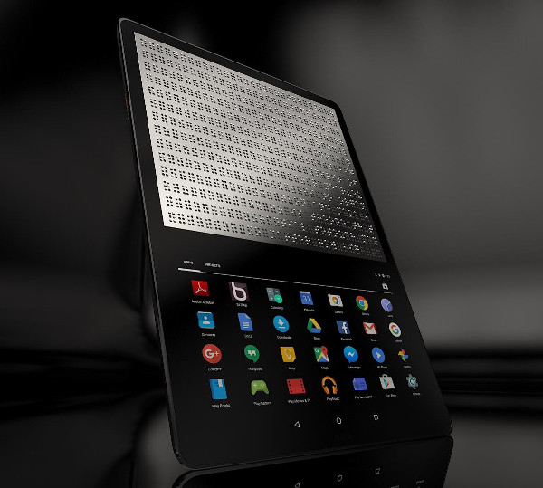
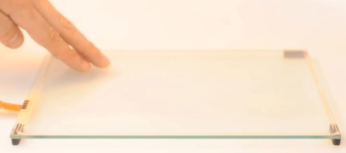
Tactile Touch Screen Devices
Device | Specs | Status | Image
Blitab Android Tablet | 14 rows of 23 6-dot braille cells (1932 dots) | In development
Tesla Touch | Electrostatic resistance on a flat screen | Research project (not for sale)

Slide 7
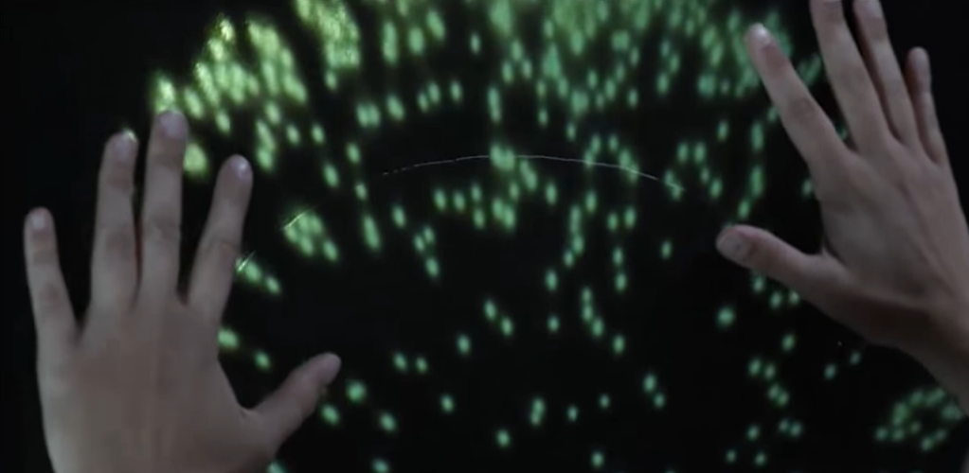
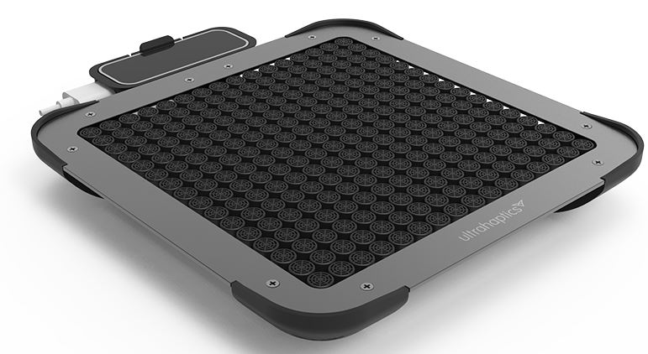
Other solutions
Device | Specs | Status | Image
Disney Research “Feeling Fireworks” | Water jets and colour projection on a flexible screen | Research project; not for sale
Ultrahaptics | Mid-air haptics using air pressure | Dev kit available for $2,500

Slide 8
Graphiti display by Orbit

Slide 9
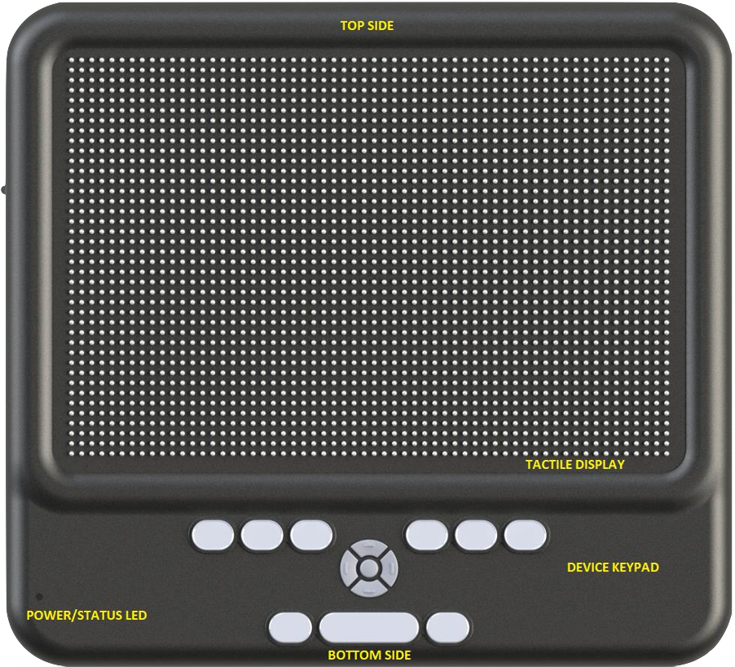
Capabilities

Slide 10
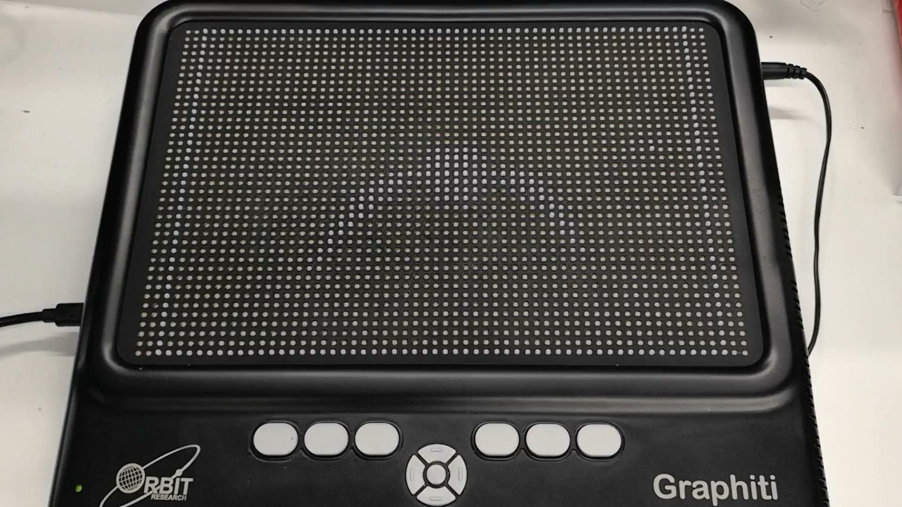
Demonstration

Slide 11
Creating diagrams for a refreshable display

Slide 12
Simplify

Slide 13
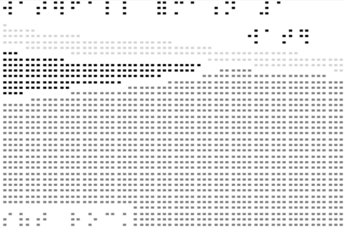
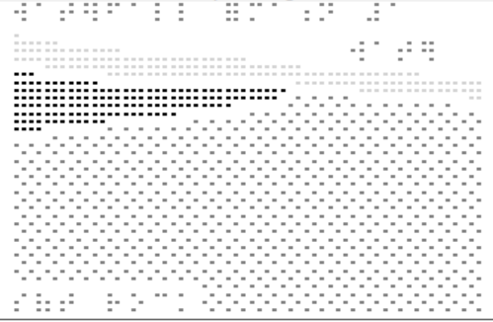
Contrast

Slide 14
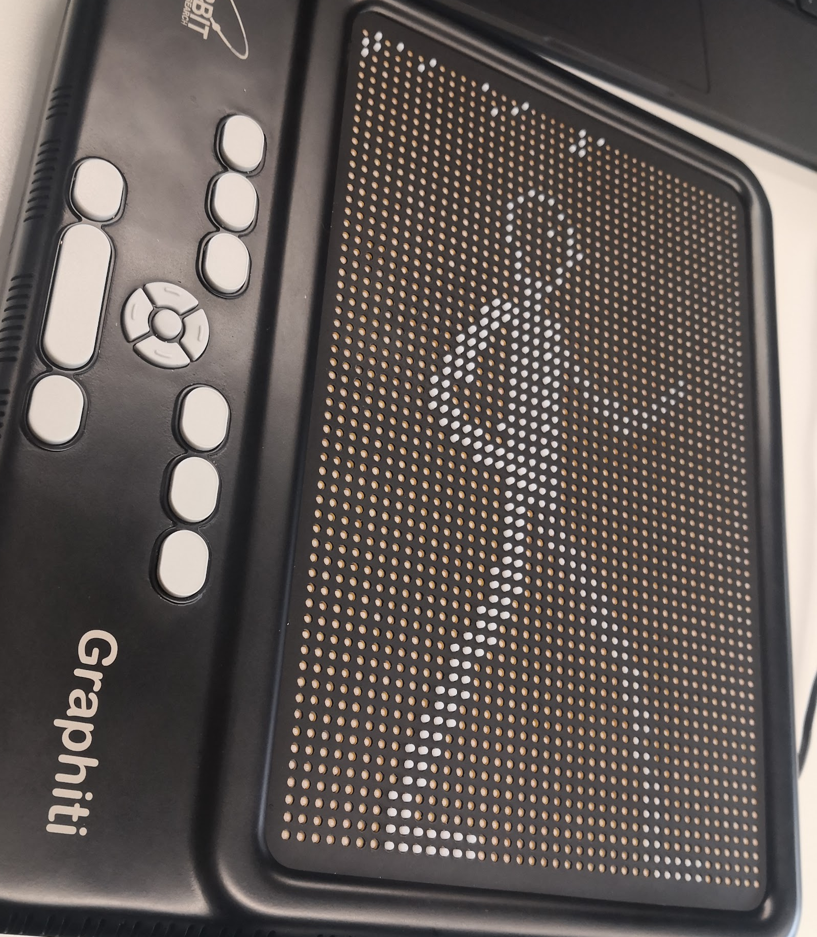
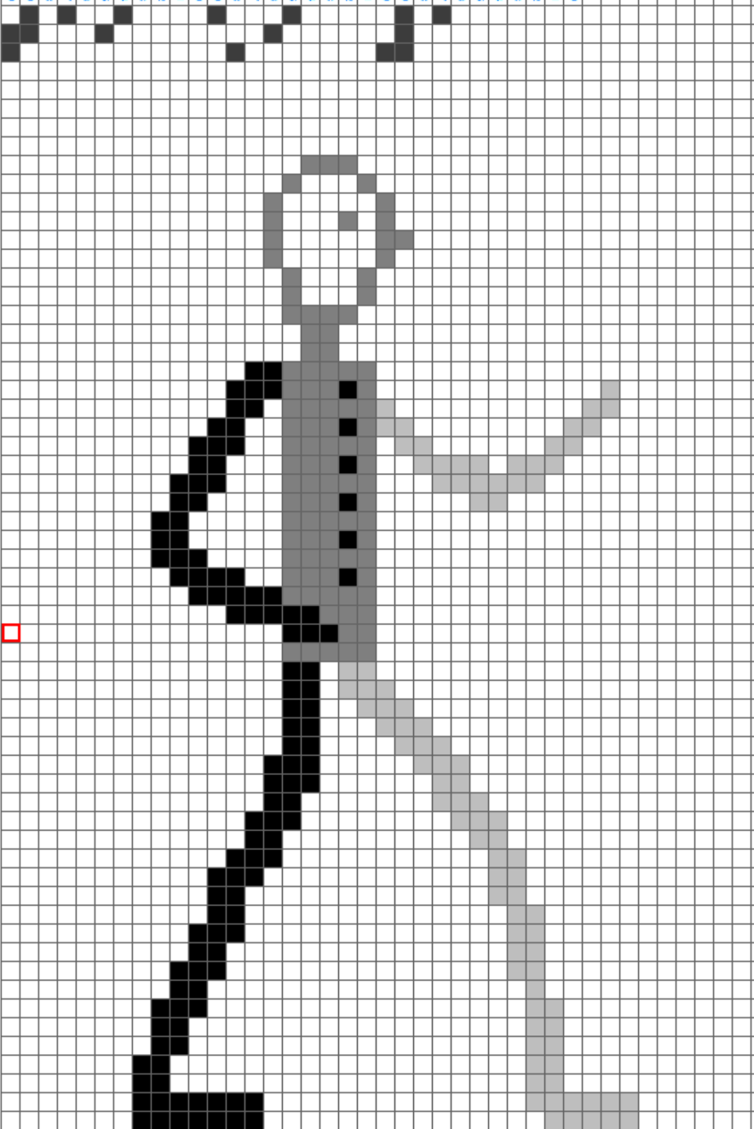
Height

Slide 15
On-the-spot editing
[video of the editing process]

Slide 16
Reading diagrams on a refreshable display

Slide 17
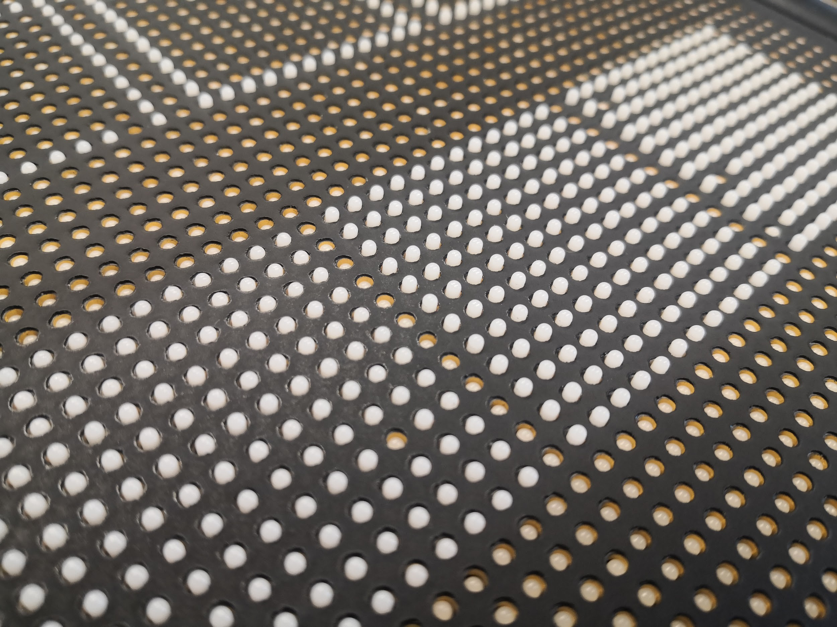
How it feels

Slide 18
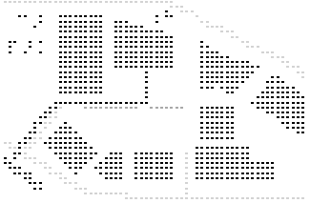
Using the cursor

Slide 19
Animated graphics
[video of Tai Chi movements on a Graphiti device]

Slide 20
Animated graphics
[video of wave formation on a Graphiti device]

Slide 21
Closing Remarks

Slide 22
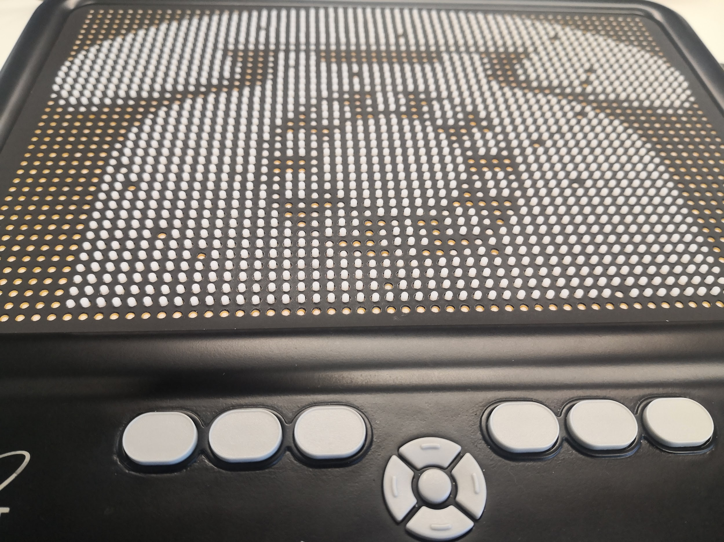
Contact Us
https://www.monash.edu/it/hcc/inclusive-technologies
Twitter @MonashInclusive
Swamy.Ananthanarayan@monash.edu
Leona.Holloway@monash.edu
Kate.Stephens@monash.edu

