Slide 1
3D Printing for Touch Readers: ARC Linkage Project Update
Kim Marriott, Leona Holloway & Ruth Nagassa
Inclusive Technologies, Monash University

Slide 2
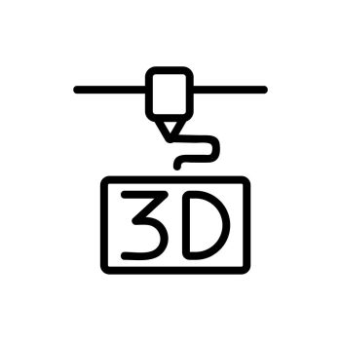
Outline
About the Project
Project Updates
3D Printed Street Crossings
Multi-level Building Plans
Interactive Labelling
3D Printing for Education
Outcomes
Next Steps

Slide 3
About the Project

Slide 4
Project Partners
Australian Research Council
Round Table on Information Access for People with Print Disabilities, with special thanks to
South Pacific Educators in Vision Impairment
VisAbility
Blind and Low Vision New Zealand
Department of Education Victoria (SVRC)
Guide Dogs Victoria
NextSense
Royal Society for the Blind (SA)
And Expert Advisory Group members from Blind Citizens Australia, Vision Australia and Queensland Tactual Mapping Committee.

Slide 5
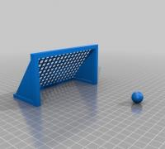
Project Aims
Investigating the use of 3D printing for touch readers
with application for Education and Orientation & Mobility.
Aiming to support best-practice adoption of 3D printing
by the print accessibility community in Australia and New Zealand.

Slide 6
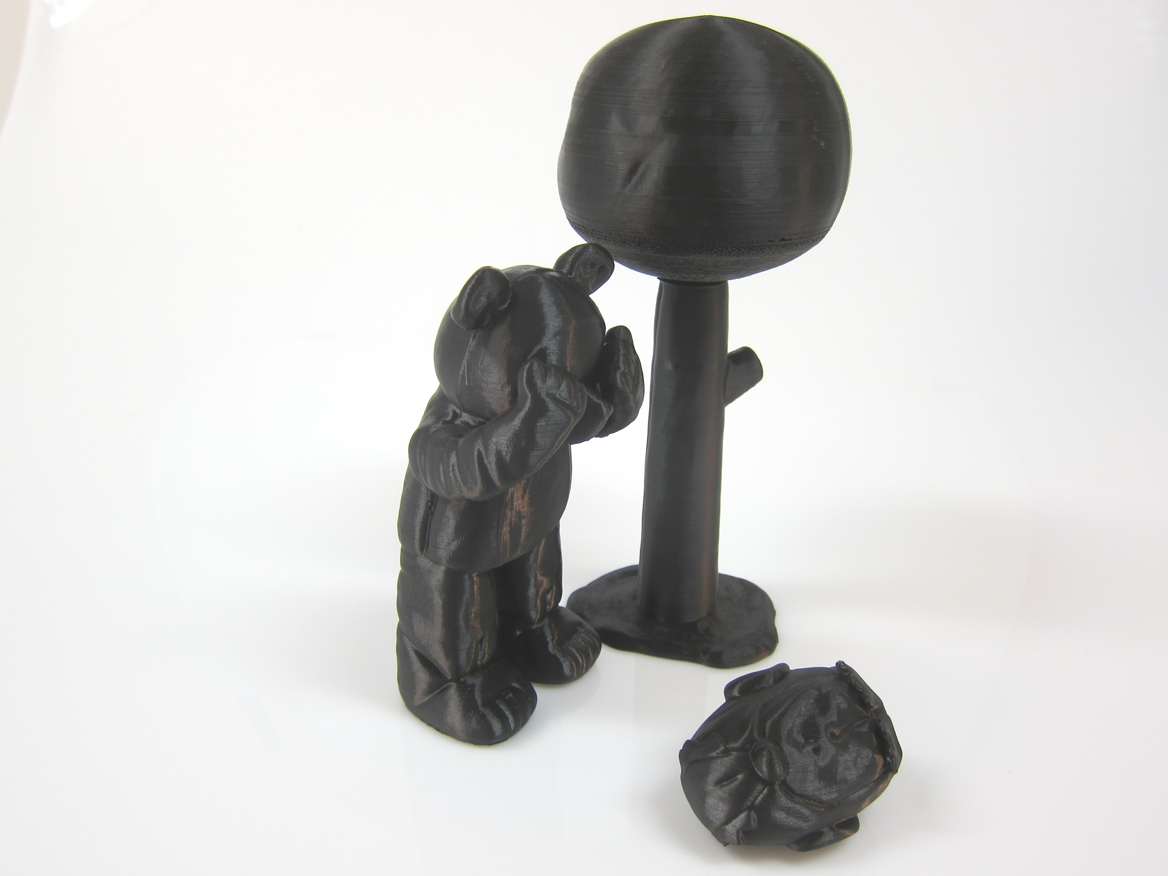
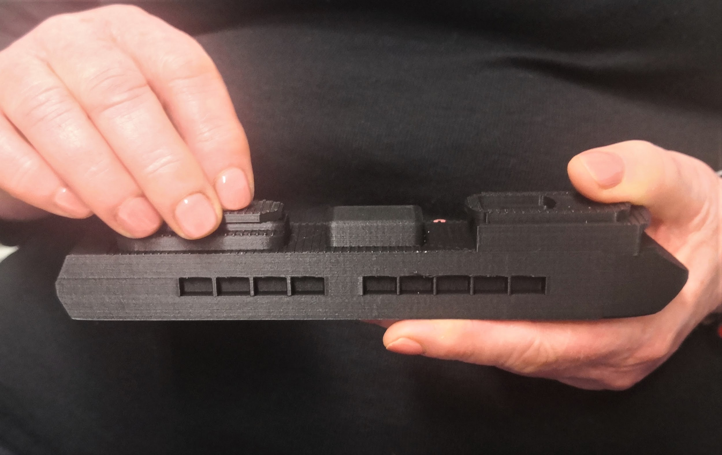
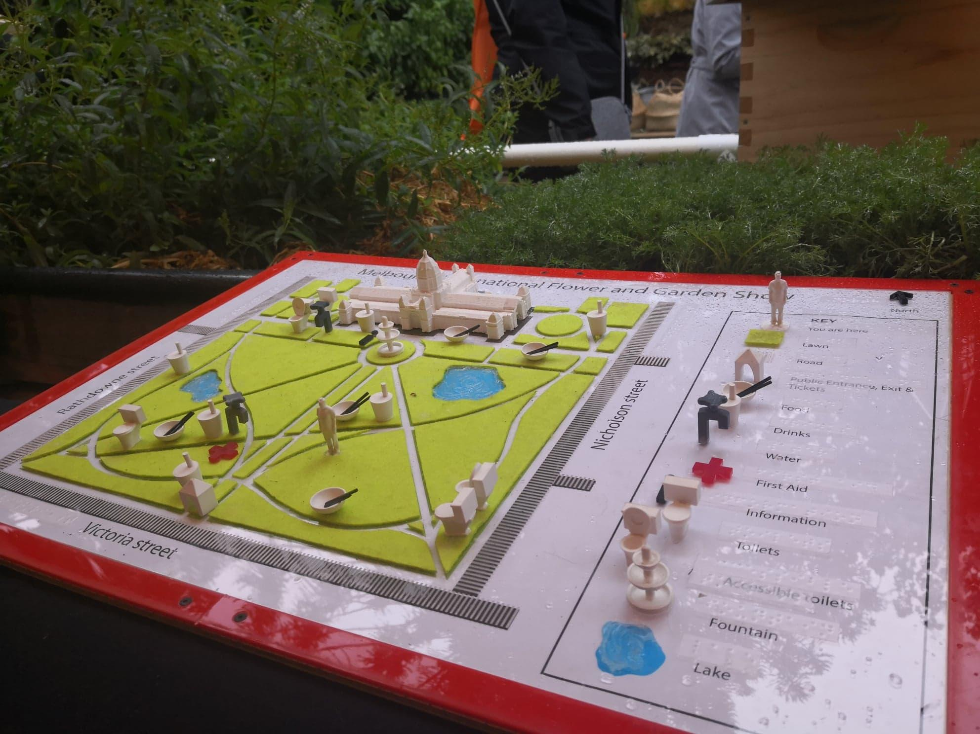
Achievements Prior to 2021
Awareness raising / promotion
ANZAGG 3D printing group
Research projects and publications
Guidelines sections on Round Table website https://printdisability.org/about-us/accessible-graphics/3d-printing/

Slide 7
3D Printed Street Crossings

Slide 8
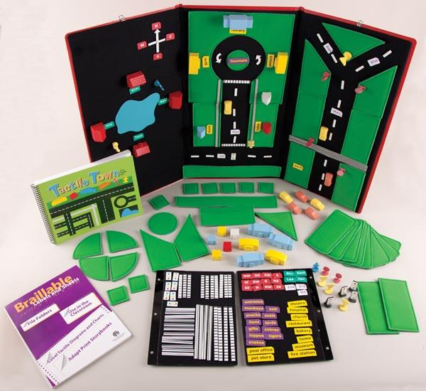
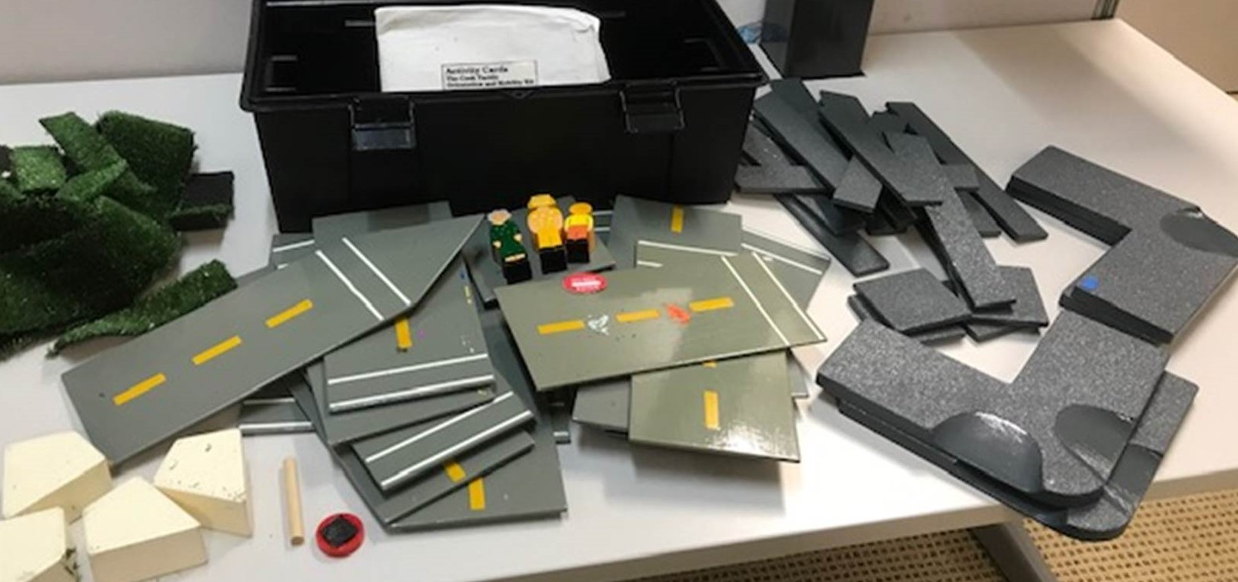
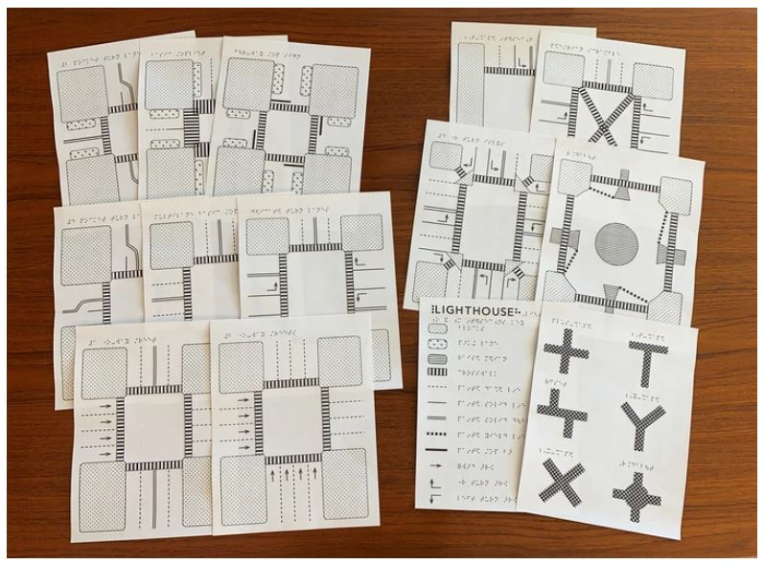
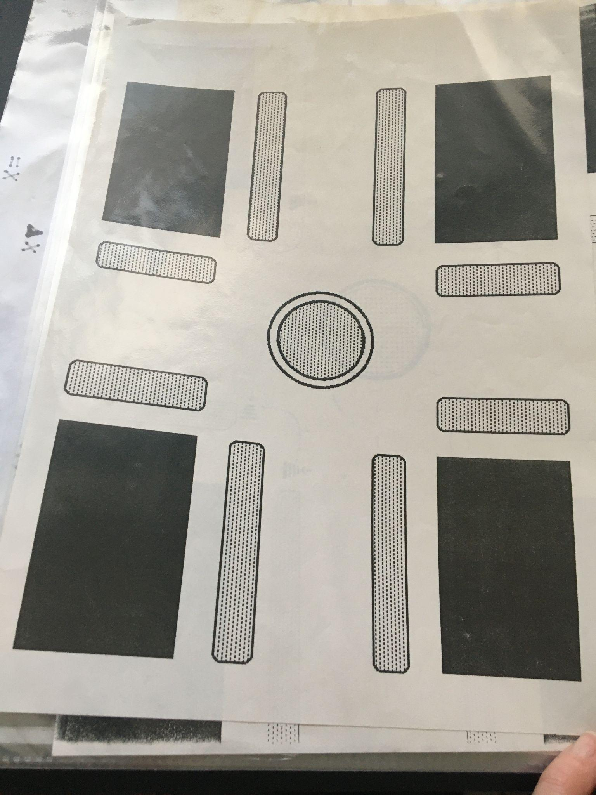
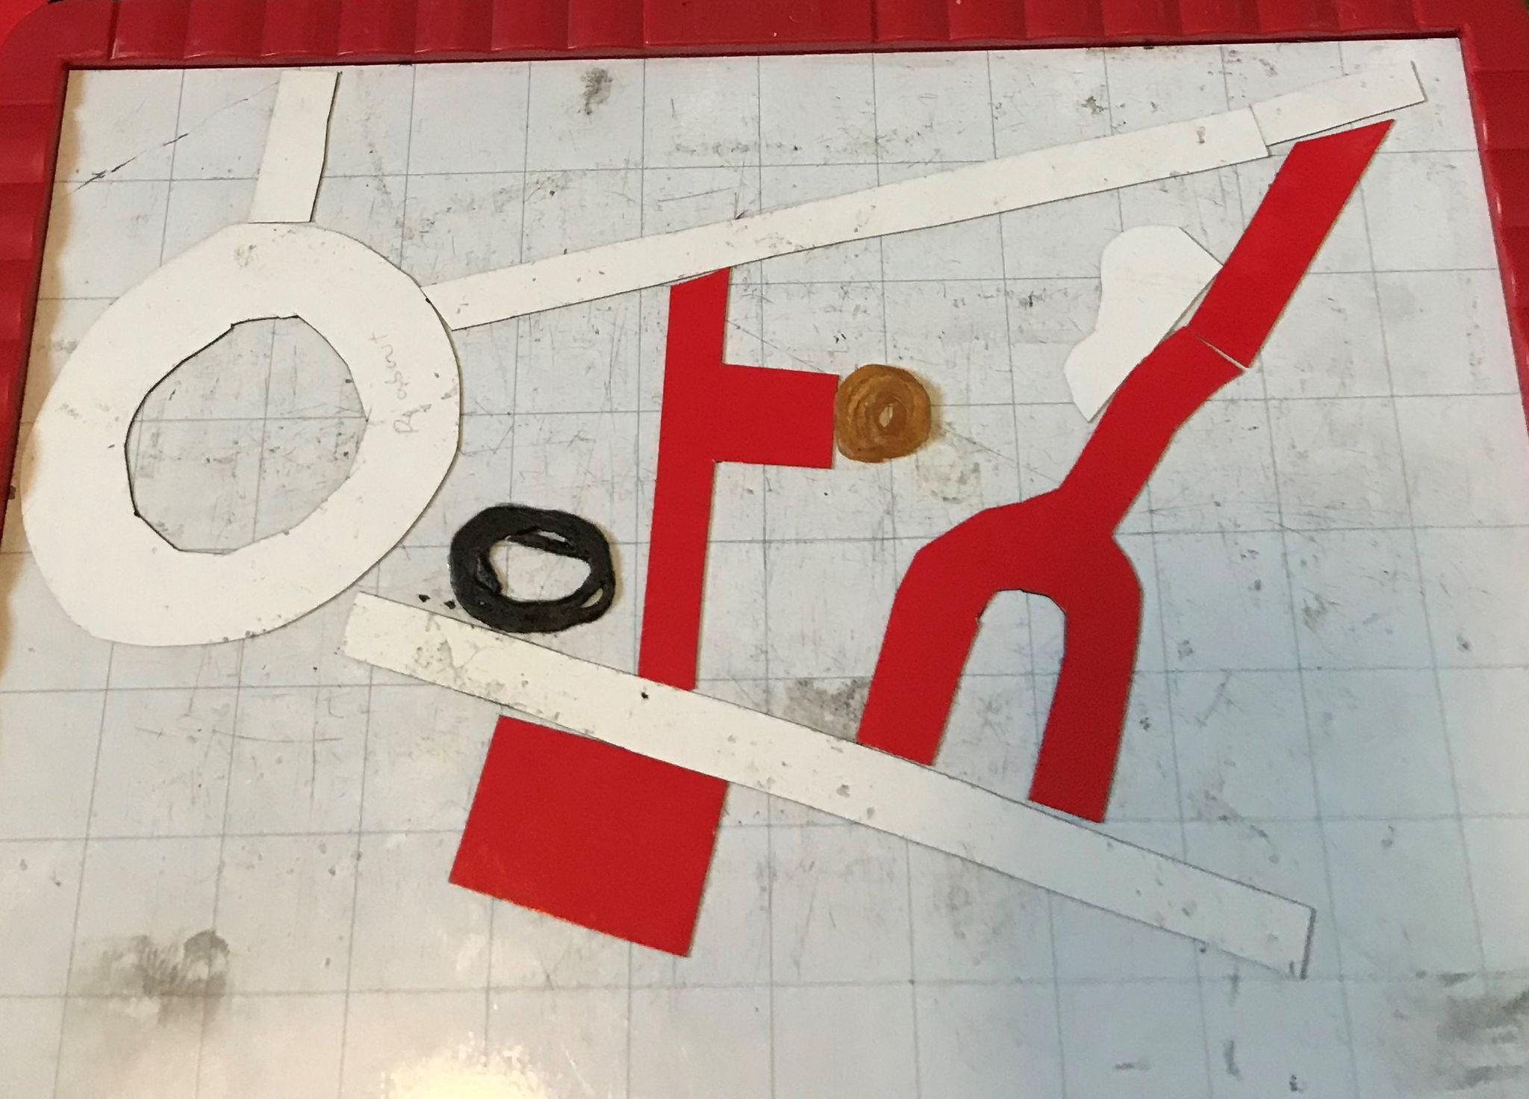
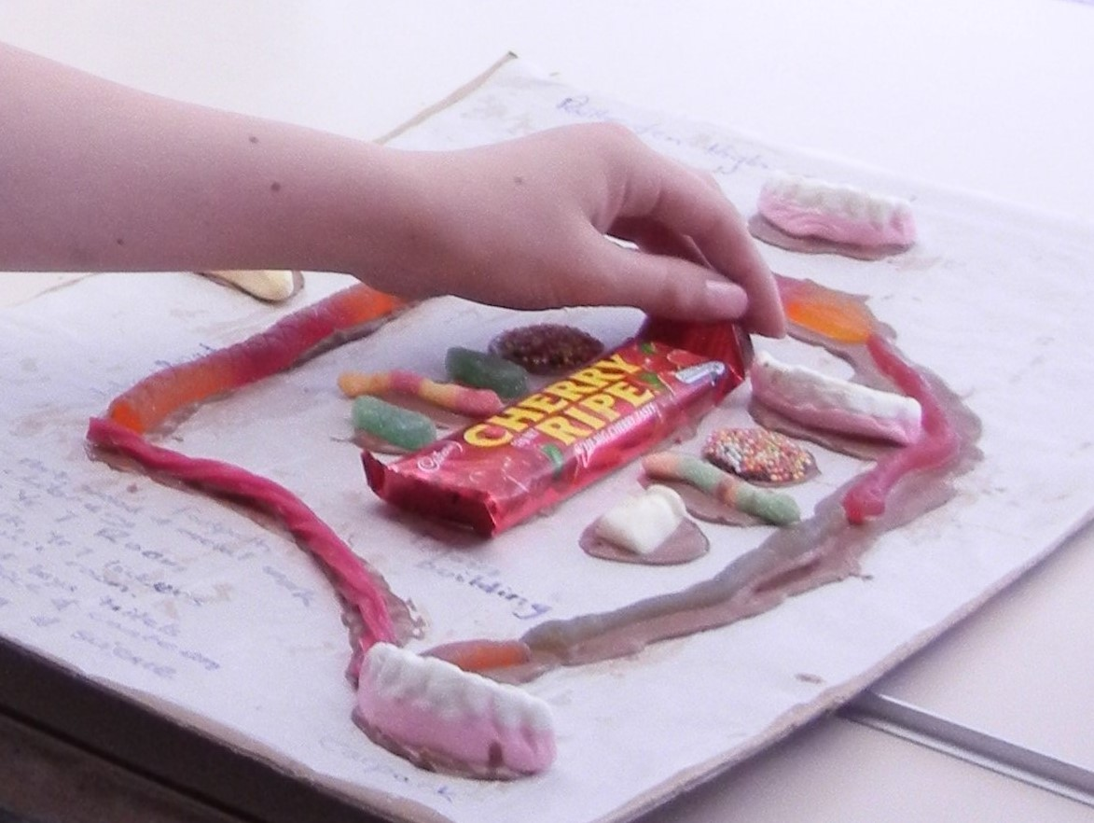
Street Crossing Aims

Slide 9
[video animation showing 3D printed street corner pieces in different configurations in a frame, with accessory pieces like pedestrians and cars illustrating traffic and pedestrian movement]

Slide 10
Street Crossing Outcomes
STL files to print your own https://www.thingiverse.com/thing:5177801
Guidelines on how to print and use
Holloway, Butler & Marriott (2022) “3D Printed Street Crossings: Supporting Orientation and Mobility Training with People who are Blind or have Low Vision”, CHI Conference on Human Factors in Computing Systems

Slide 11
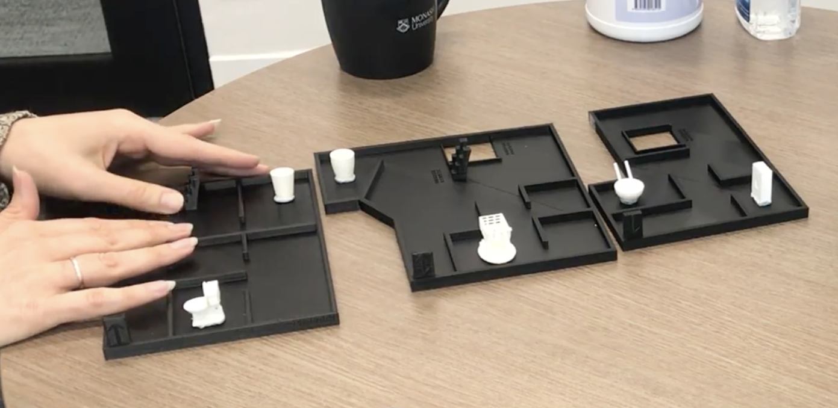
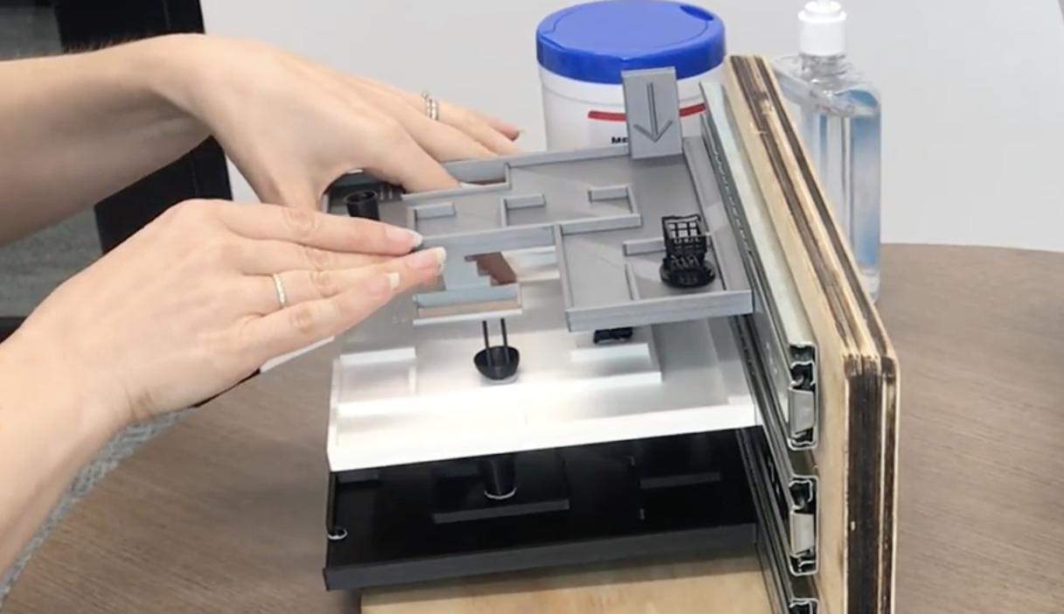
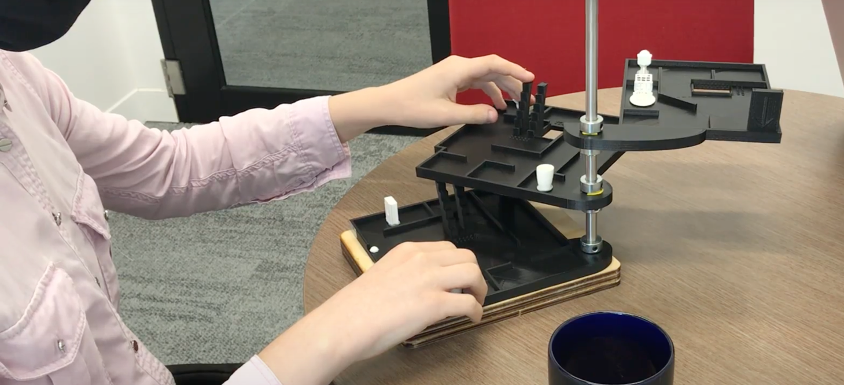
Multi-level Building Plans

Slide 12
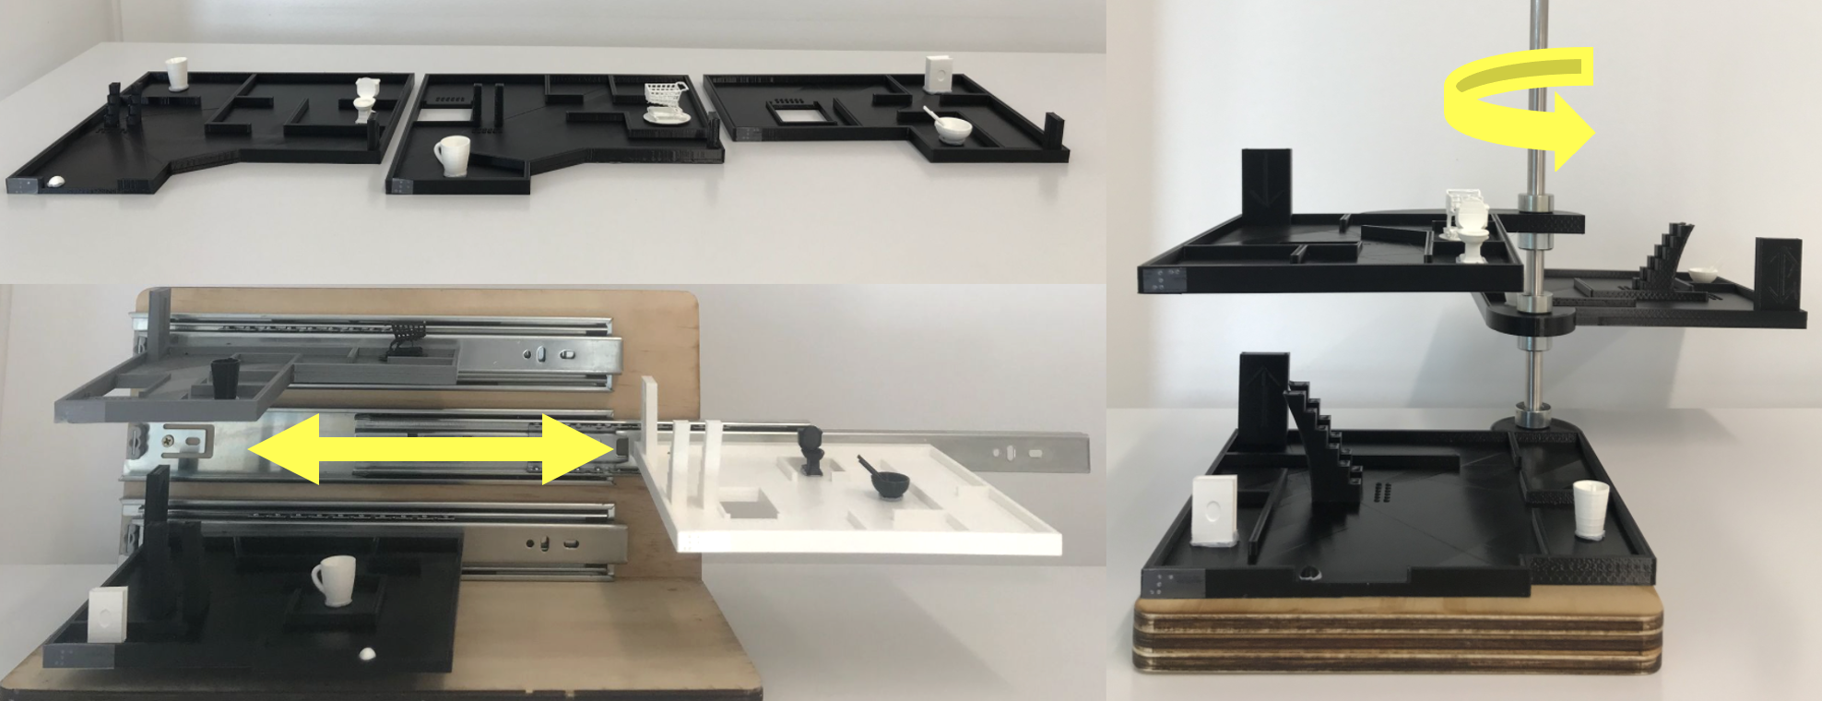
Materials

Slide 13
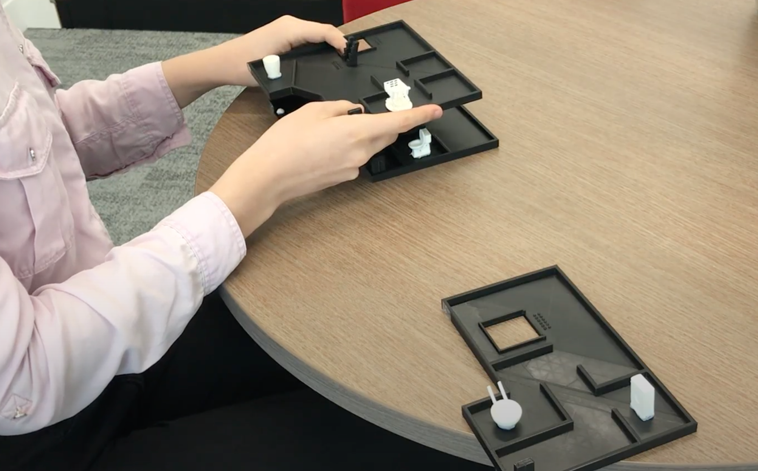
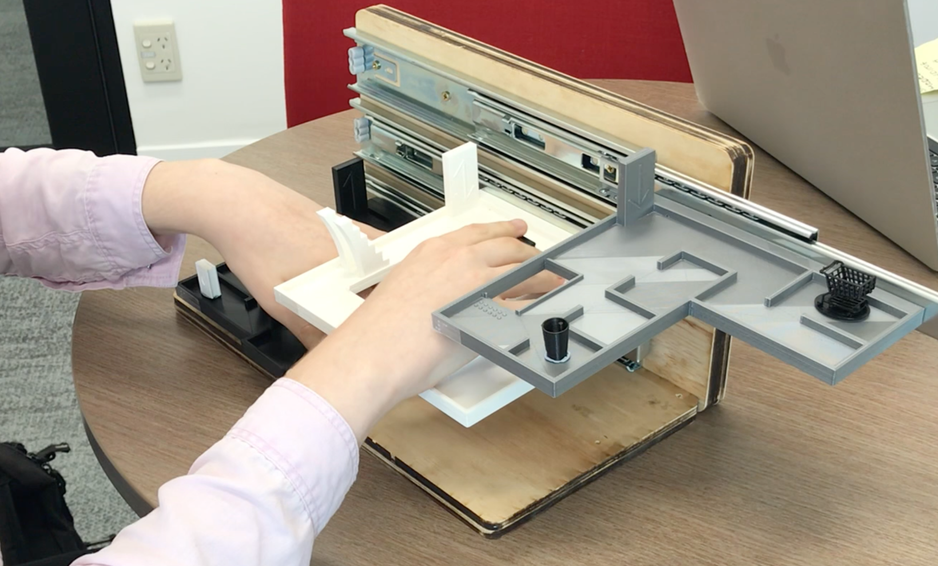
Key Findings
All three were effective, usable and engaging
Clear preference for overlapped floors
Almost all reported that it was important to them to have a cognitive map of an unfamiliar building before visiting it
About half indicated that building a cognitive map was more difficult if the building was multi-storey All reported that the models would be useful
Confirmed the importance of providing models like these for O&M training before visiting multi-storey public spaces

Slide 14
Interactive Labelling

Slide 15
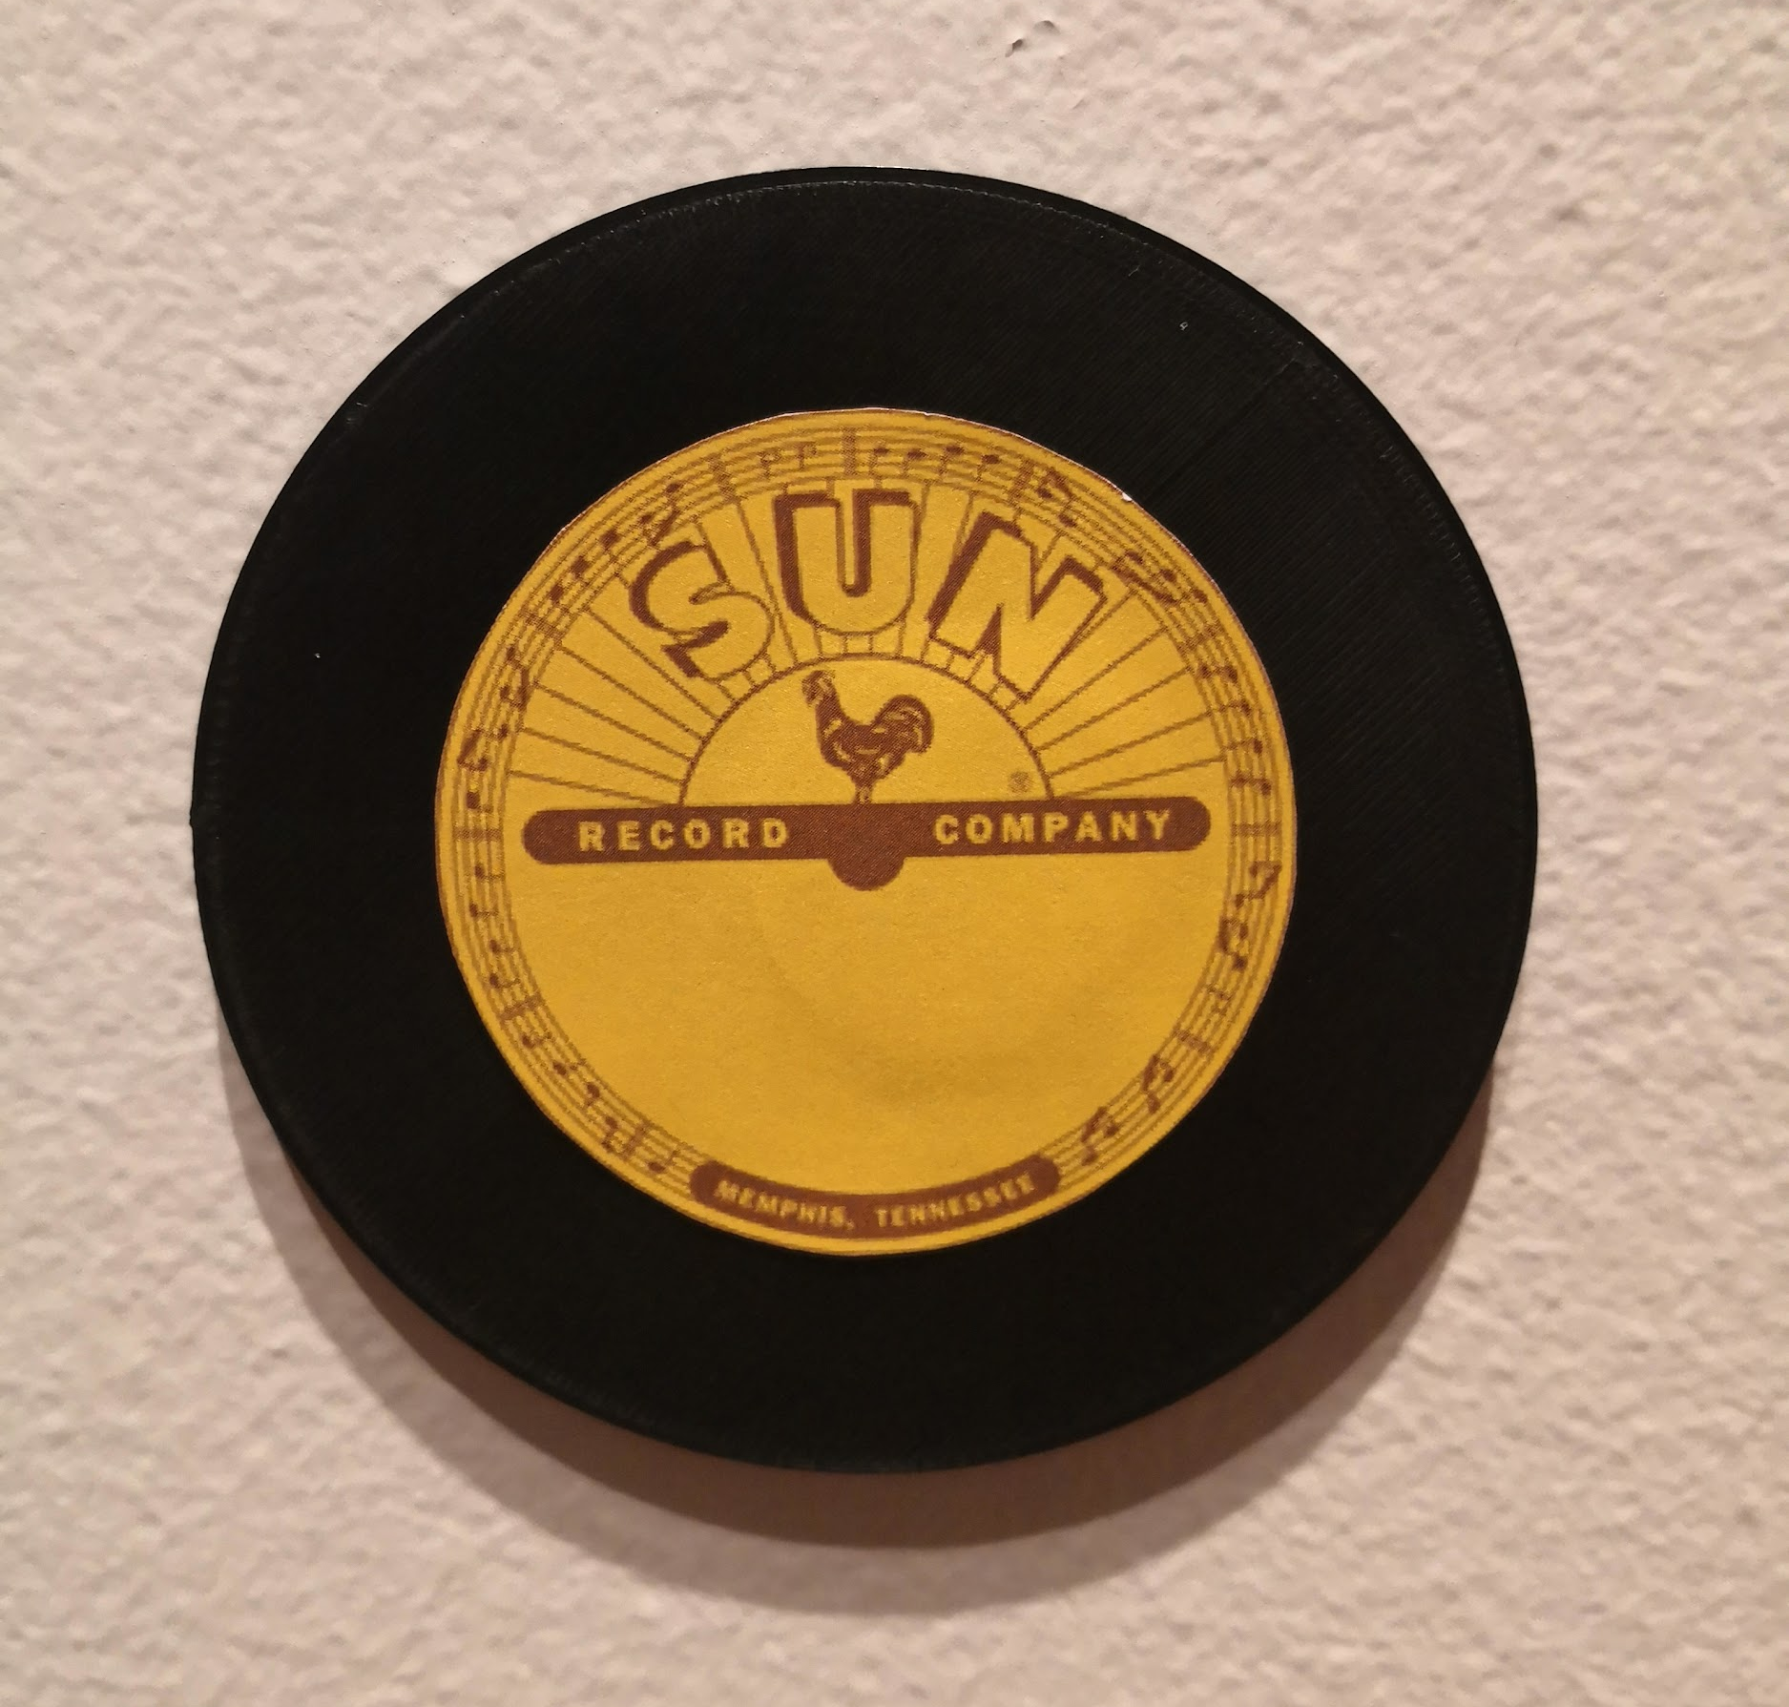
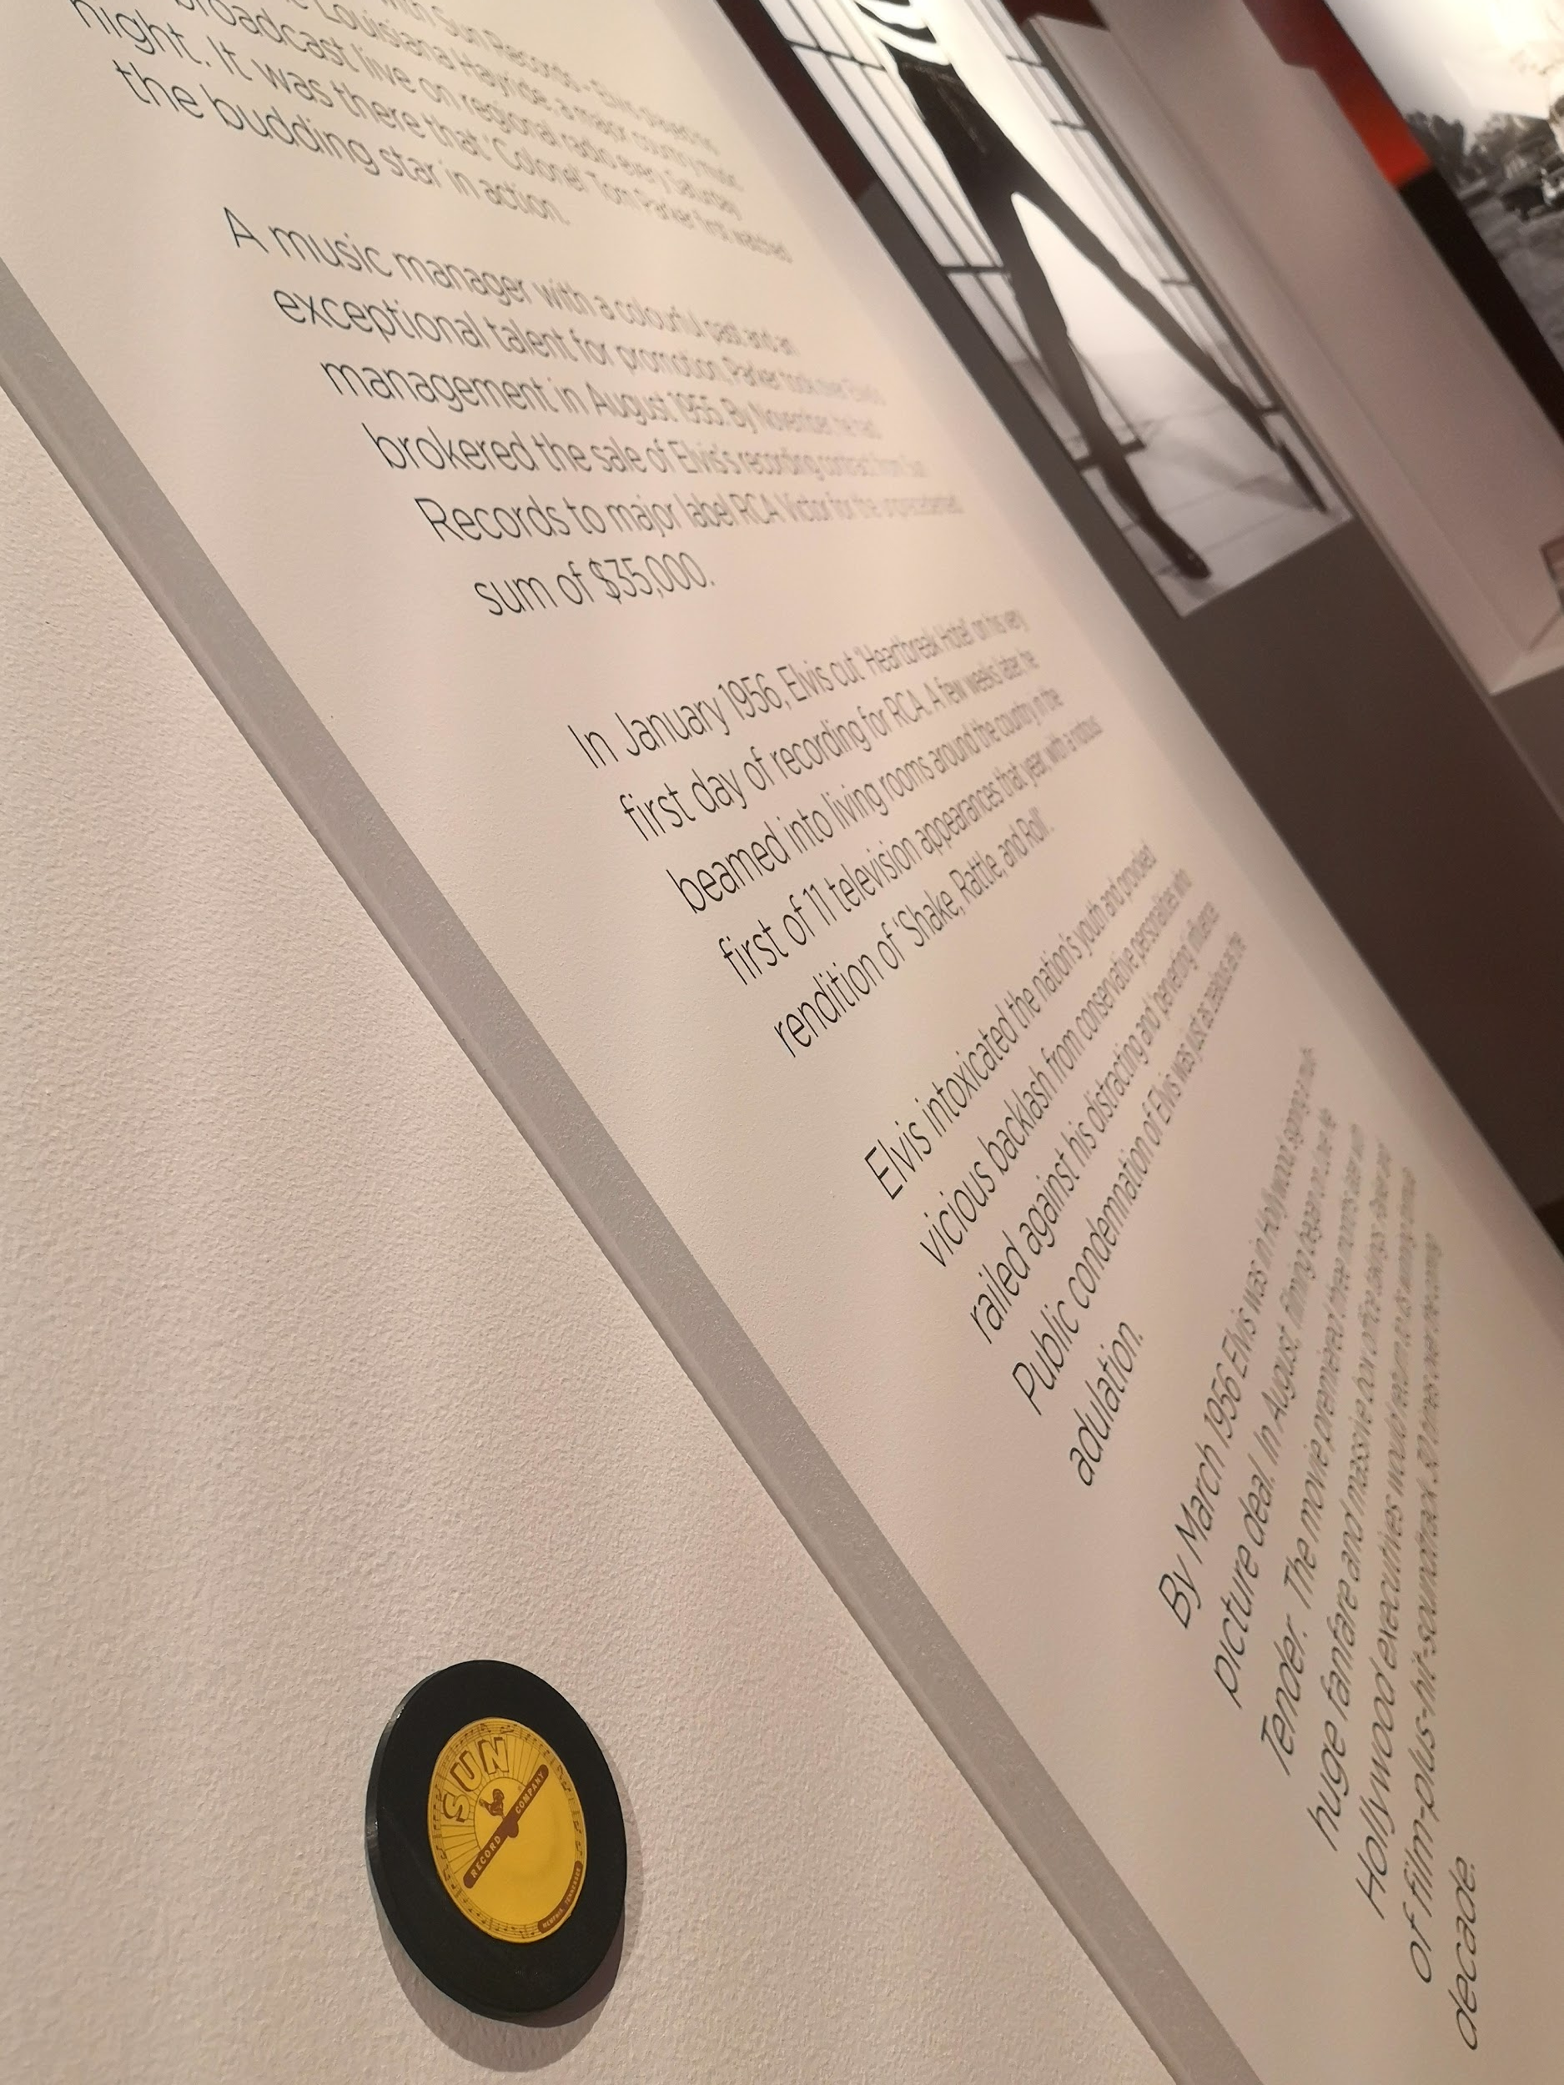
NFC tags
Access Elvis
May 20th
https://www.bendigoregion.com.au/bendigo-art-gallery/bag-events/access-elvis-for-visitors-who-are-blind-or-have-low-vision

Slide 16
3D Printing for Education

Slide 17
Methods
Survey of teachers working with BLV student in the early years (prep-grade 2)
Audit of 3D prints available for people who are BLV
Survey and interviews with accessible formats producers and teachers using 3D prints with BLV students (ongoing)

Slide 18
Key Findings
3D printed models are needed
3D models assist with inclusion
3D models are used for the curriculum, classroom tools and mapping
Tactile properties are of primary importance
We need highly visible catalogues and easy request systems

Slide 19
Outcomes

Slide 20
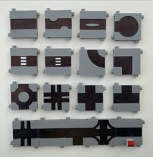
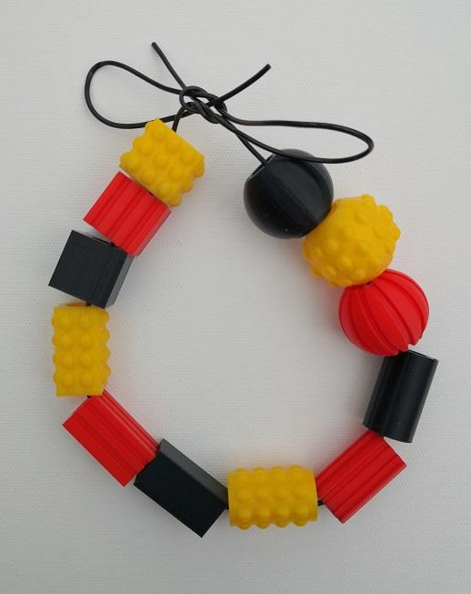
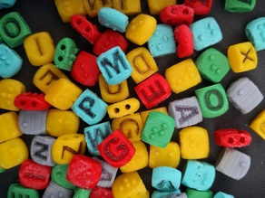
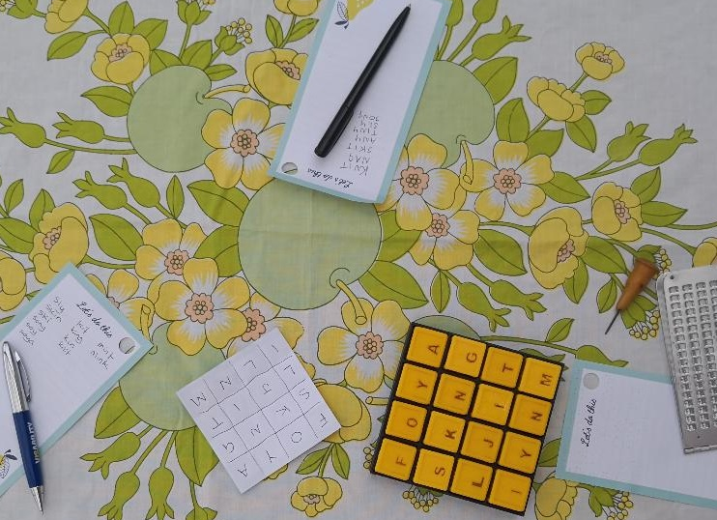
Materials
https://www.thingiverse.com/leonah/designs

Slide 21
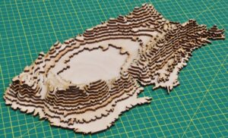
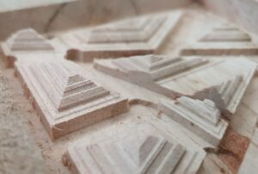
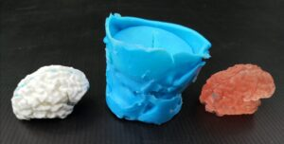
Guidelines and Publications
Labelling 3D models
Other methods for creating 3D models
Leona Holloway, Kate Stephens & Ramona Mandy (2021) Touch Reading 3D Prints, JSPEVI Journal of the South Pacific Educators in Vision Impairment.
Leona Holloway, Matthew Butler & Kim Marriott (2022) 3D Printed Street Crossings: Supporting Orientation and Mobility for People who are Blind or have Low Vision, CHI Conference on Human Factors in Computing Systems.
Dagmar Reinhardt, Leona Holloway, Nicole Larkin & Sue Silveira (2022) Tactile Oceans - Enabling Inclusive Access to Ocean Pools for Blind and Low Vision Communities, CAADRIA 2022 International Conference for The Association for Computer-Aided Architectural Design Research in Asia.
Samuel Reinders (2021) Accessible Interactive 3D Models for Blind and Low-Vision People, ASSETS ‘21 ACM International ACM SIGACCESS Conference on Computers and Accessibility.

Slide 22
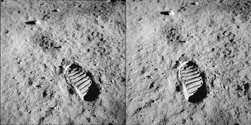
Next Steps

Slide 23
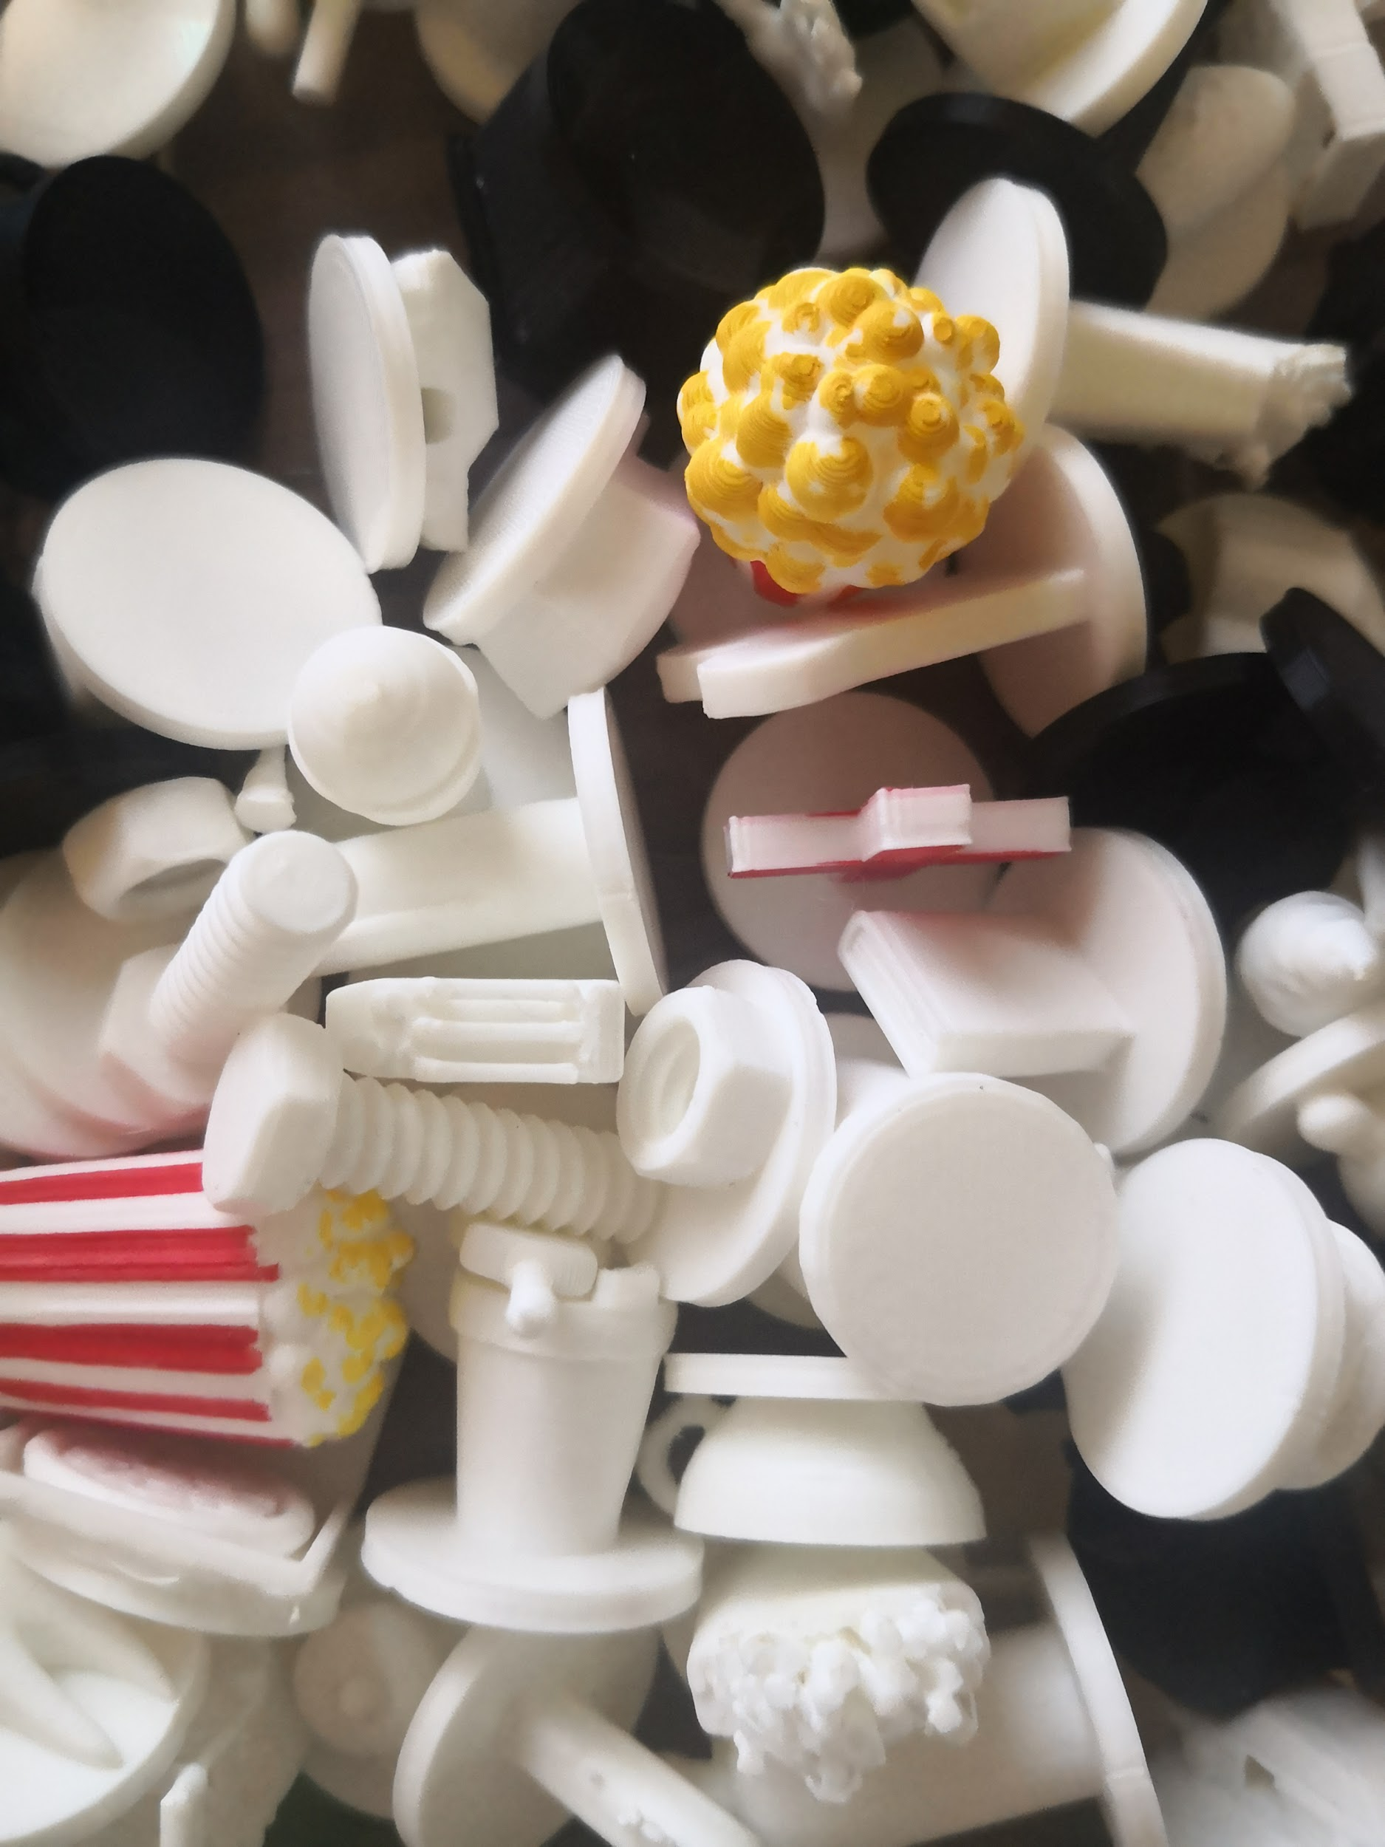
To-Do List
Touch Testing:
Textures
Icons
Design Guidelines
Project completion October 2022

Slide 24
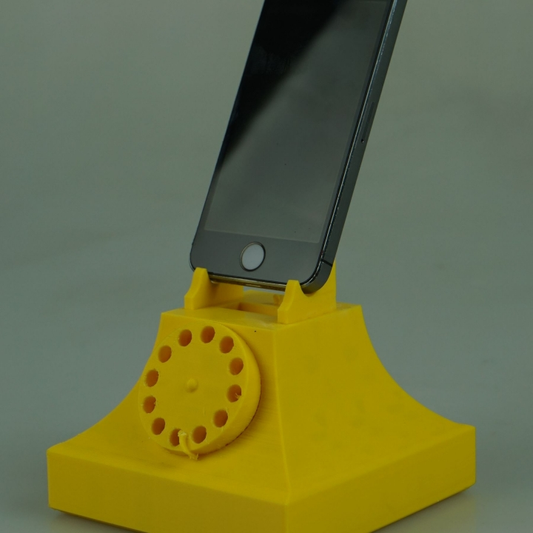
Contact Us
https://www.monash.edu/it/hcc/inclusive-technologies
Twitter @MonashInclusive
Kim.Marriott@monash.edu
Leona.Holloway@monash.edu
Ruth.Nagassa@monash.edu
https://www.thingiverse.com/leonah/designs
https://accessiblegraphics.org/research/3dprints/arc/updates/

