Slide 1
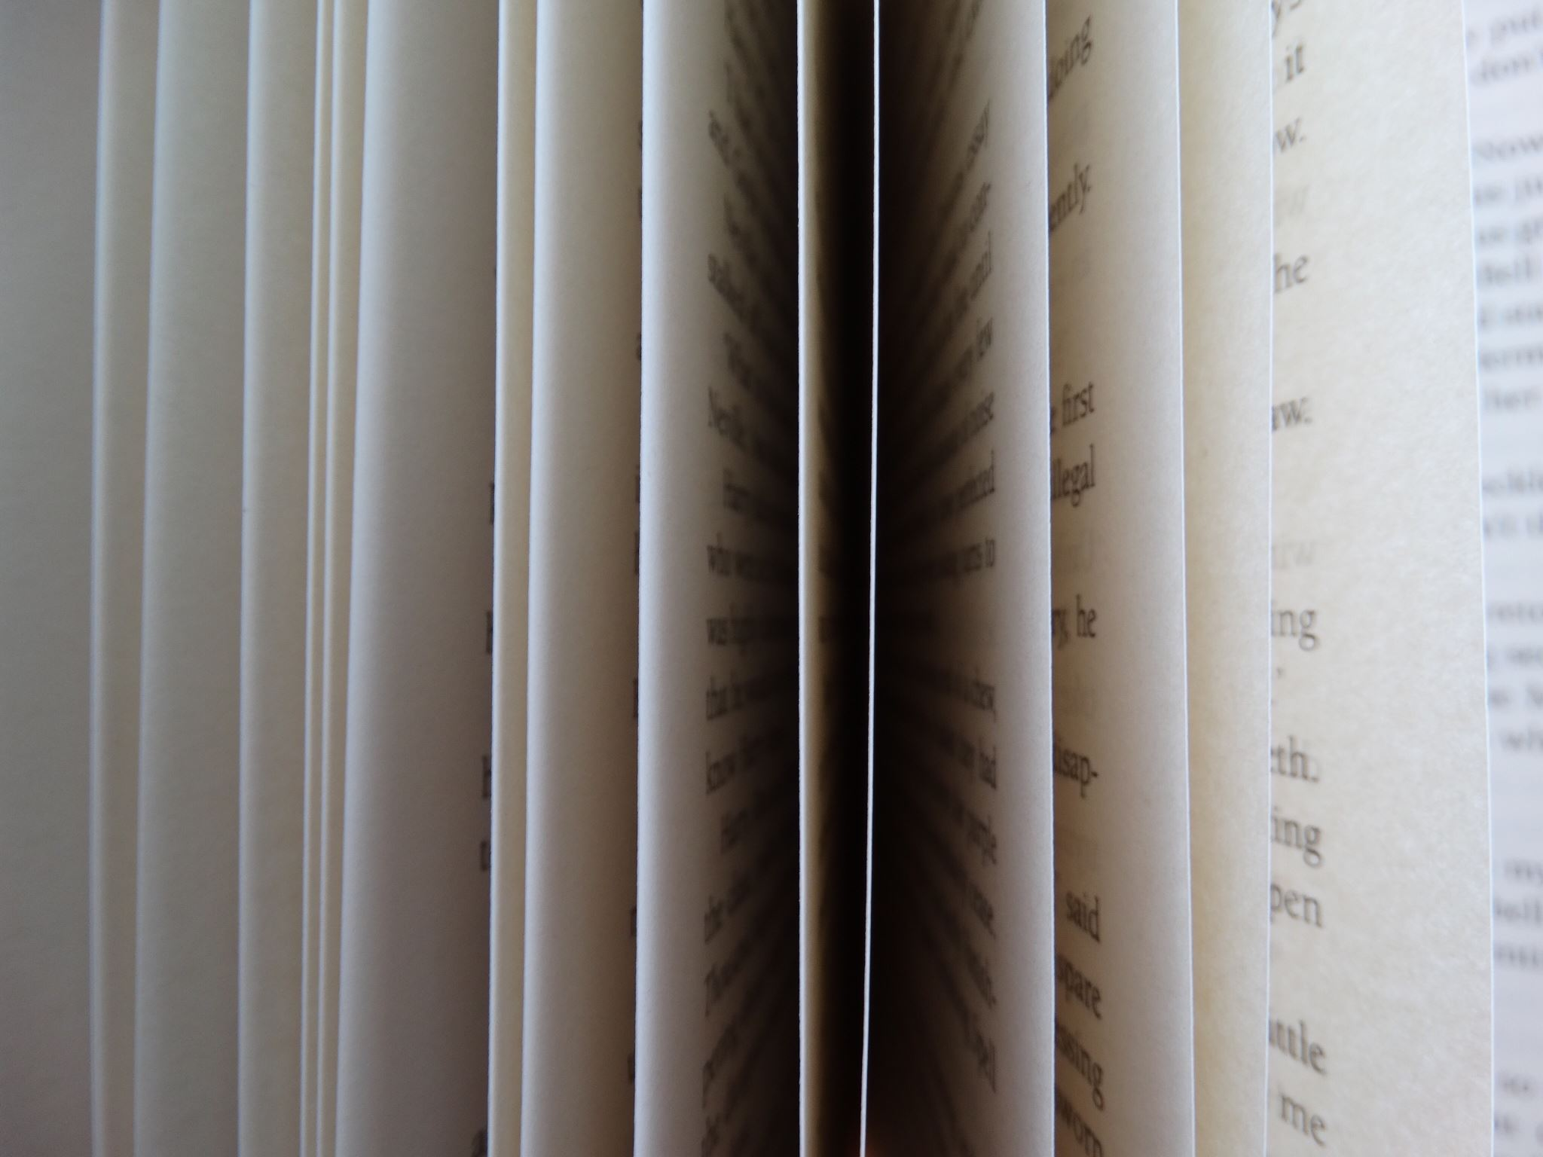
Creating “born accessible” publications
What can editors do to help?

Slide 2
The Institute of Professional Editors (IPEd)
IPEd is a volunteer-run membership organisation.
It exists to advance the profession of editing and to support and promote editors.
IPEd’s programs and initiatives for members include:
A professional development program
Standards for Editing Practice
A professional accreditation scheme

Slide 3
Where can editors and writers find the information they need?
Information on accessibility can be time-consuming to collect.
WCAG is for web accessibility.
Audiences such as early readers and primary school students are often not addressed.
Guidelines do not always consider the needs of braille users.
The managerial aspects of publishing are not included.

Slide 4
What do editors actually do?
Substantive editing:
Appropriate structure, content, language, style and presentation
Copyediting:
Accuracy, clarity and consistency
Proofreading:
Checking that the document is ready to be published

Slide 5
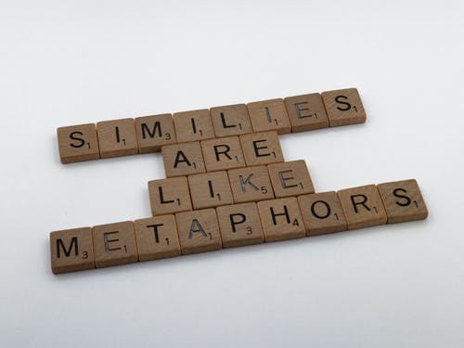

Slide 6
What do editors actually do?
Managerial roles:
Draft author contracts and briefs
Undertake development editing
Plan schedules and workflows
Create house style
Brief and oversee contractors
Manage the production process

Slide 7
A sample style sheet

Slide 8
A sample spelling list

Slide 9
Editors aim to minimise problems for readers and transcribers
Markus Winkler/Unsplash

Slide 10
We have questions for you too!
Simone Secci/Unsplash

Slide 11
Picture books and storybooks
At what age can/should colour be introduced?
At what age are children ready to start using alt text?
Do adult readers with vision impairment read picture books to children? Should the alt text be designed for their use instead?

Slide 12
Textbooks
What problems do you encounter with maths texts?
What is the best way to set science abbreviations (e.g. CO2) for digital publications?
Should the alt text identify areas that are not labelled in an illustration?
Should alt text be edited for style?
Are merged cells in tables accessible for digital braille users if they are coded correctly?

Slide 13
References
Do you prefer in-text citations or footnotes?
Should punctuation always be minimised?
“Smith and Jones” or “Smith & Jones”?
Should the year of publication be in parenthesis or not?
Page numbers:
: or pp. ?
234‒5 or 234‒235 ?

Slide 14
Contact us
Complete the questionnaire at https://bit.ly/AIWP22
Contact Julie Ganner at aipi@iped-editors.org
Contact Agata Mrva-Montoya at
agata.mrva-montoya@sydney.edu.au

