Slide 1
Making Accessible Art Through a Multisensory Experience
By John O’Neill and Deanna Geneva Lorianni

Slide 2
Why are we here today?
We’re creating an accessible art book that features poetry and photography.
Notes:
But why? Why do we event need to create this book?

Slide 3
What’s the problem?
The world has a “book famine.”
Notes:
Worldwide, book creators are not making books accessible to people with visual- and print-disabilities. This deficit has created a book famine that leaves millions of people globally without access to the information books provide us.

Slide 4
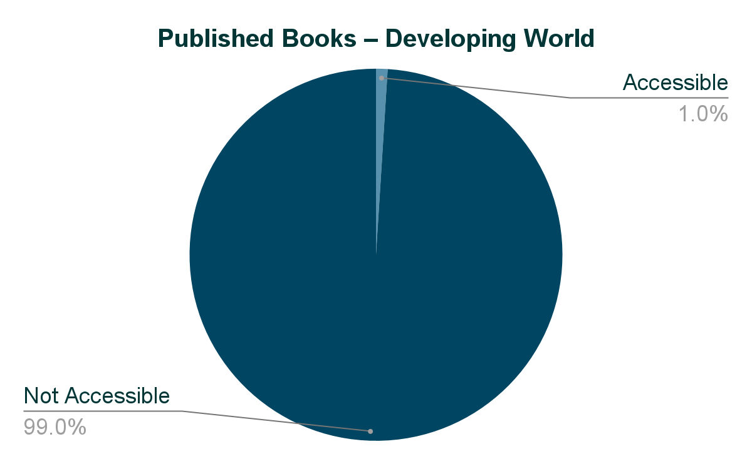
What’s the problem?
https://worldblindunion.org/wp-content/uploads/2020/10/Press-Release-AP-Marrakesh-2017.pdf
Notes:
For books that are published in the developing world, less than 1% of them are accessible.

Slide 5
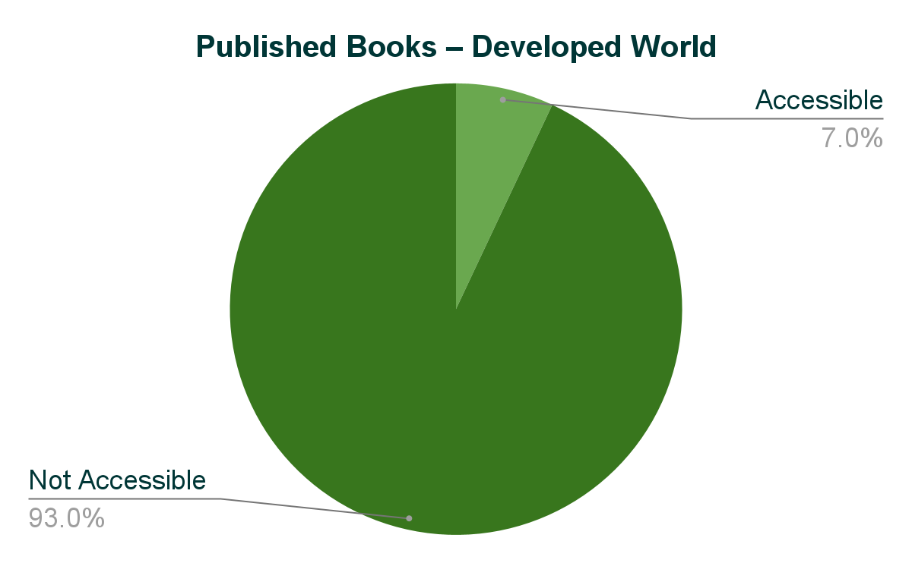
What’s the problem?
https://worldblindunion.org/wp-content/uploads/2020/10/Press-Release-AP-Marrakesh-2017.pdf
Notes:
And the developed world isn’t doing much better. Only 7% of all published books are accessible to people with visual- and print disabilities.

Slide 6
What’s the problem?
Traditional art books create full-vision experiences.

Slide 7
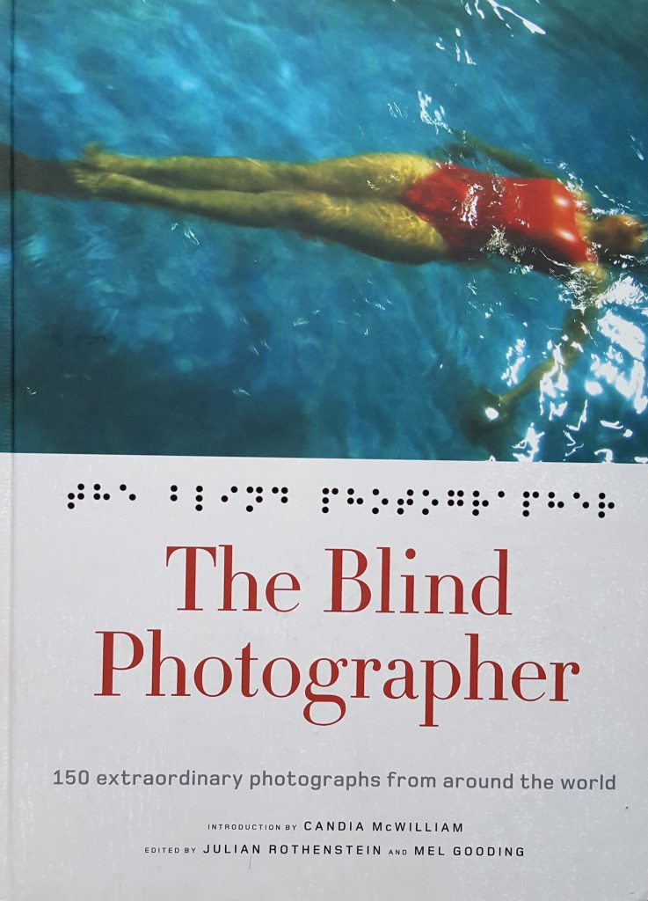
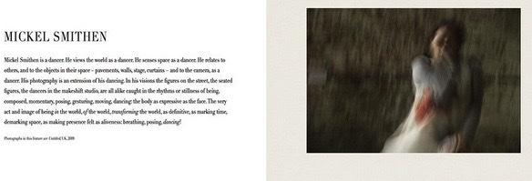
Book showcases
50 blind and low-vision photographers.
But the content is not accessible to blind audiences.

Slide 8
What’s the problem?
Most poetry books aren’t even offered in Braille.

Slide 9
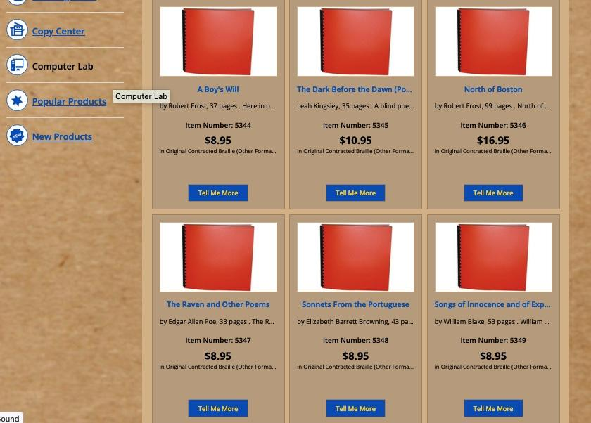
Poetry books are difficult
to find in Braille.
Usually, those that are available feature classic poets.
Contemporary poets are rarely offered.
Notes:
Here is a Braille bookstore online and the small collection of poetry they offer only features classic American poets like Edgar Allen Poe and William Blake.

Slide 10
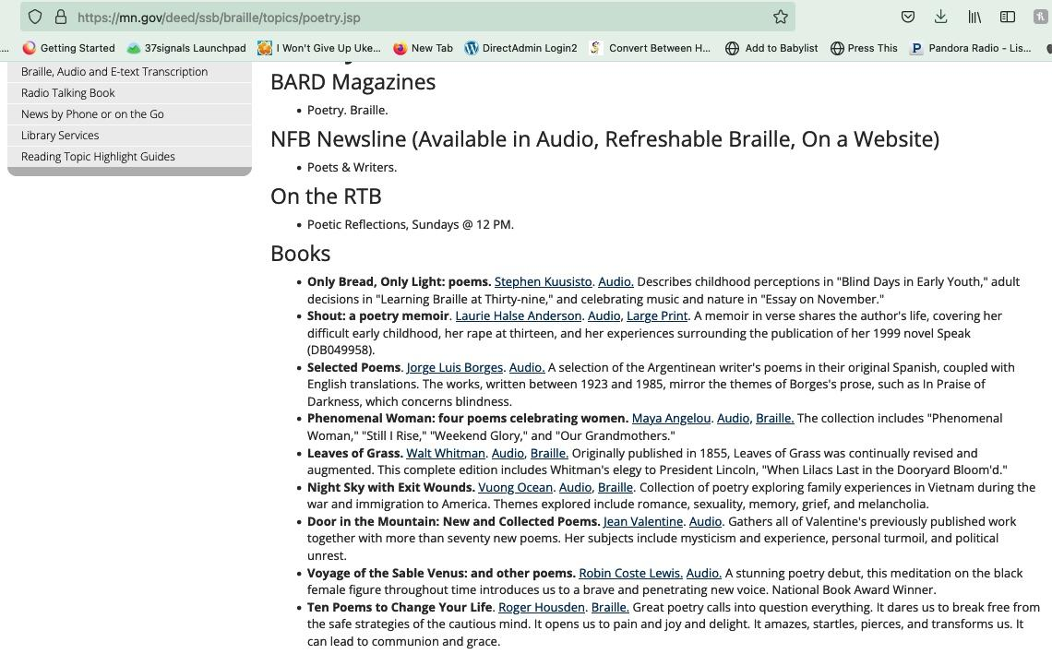
Poetry books are difficult
to find in Braille.
Usually, those that are available feature classic poets.
Contemporary poets are rarely offered.
Notes:
Here is a list of the poetry that the Minnesota State Government offers to blind- and low-vision audiences. Of the 9 options, only 4 books are available in Braille and half of the titles are classic poets.

Slide 11
Making the Photographic Arts Accessible

Slide 12
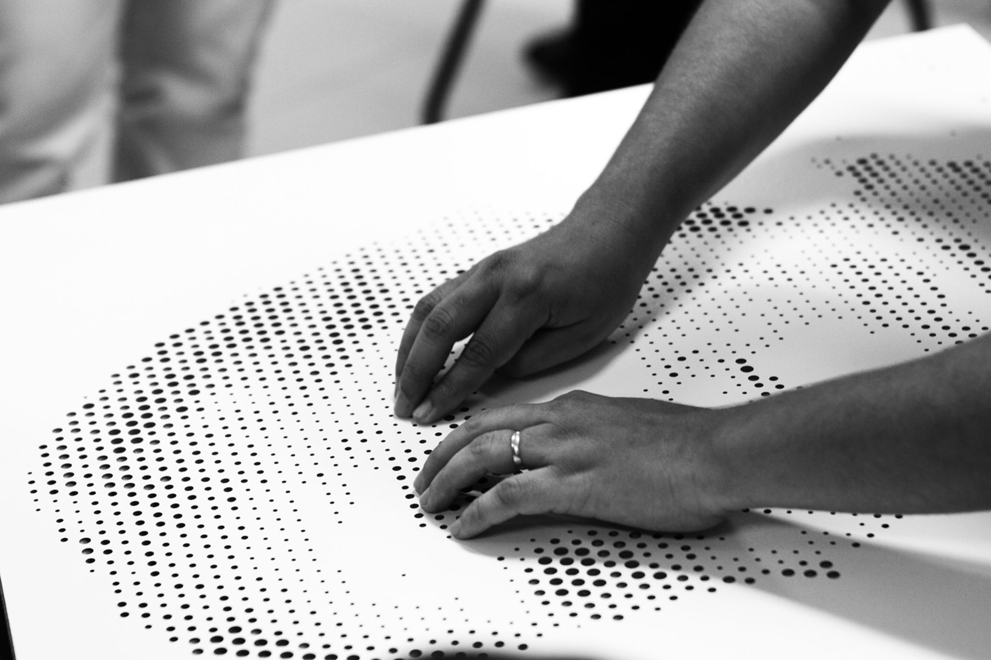
Lack of detail

Slide 13
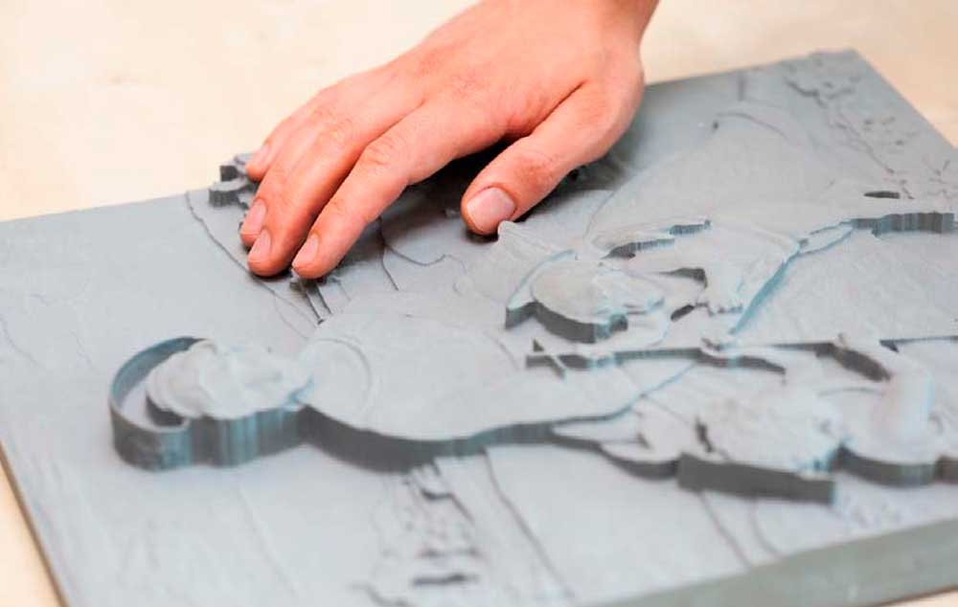
Lack of color

Slide 14
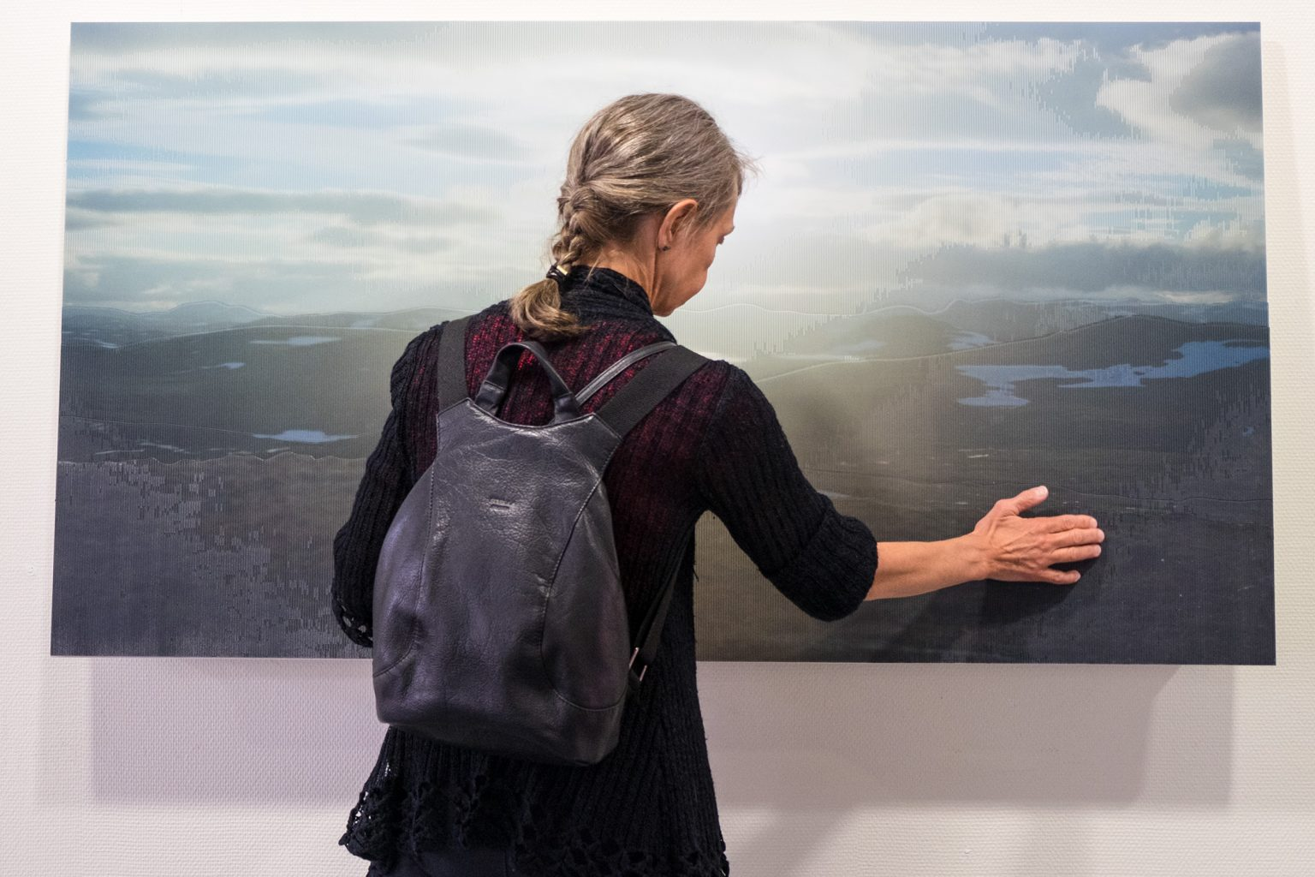
Can only be experienced in a gallery setting

Slide 15
How can you create inclusive media?
Explore using the different senses.

Slide 16
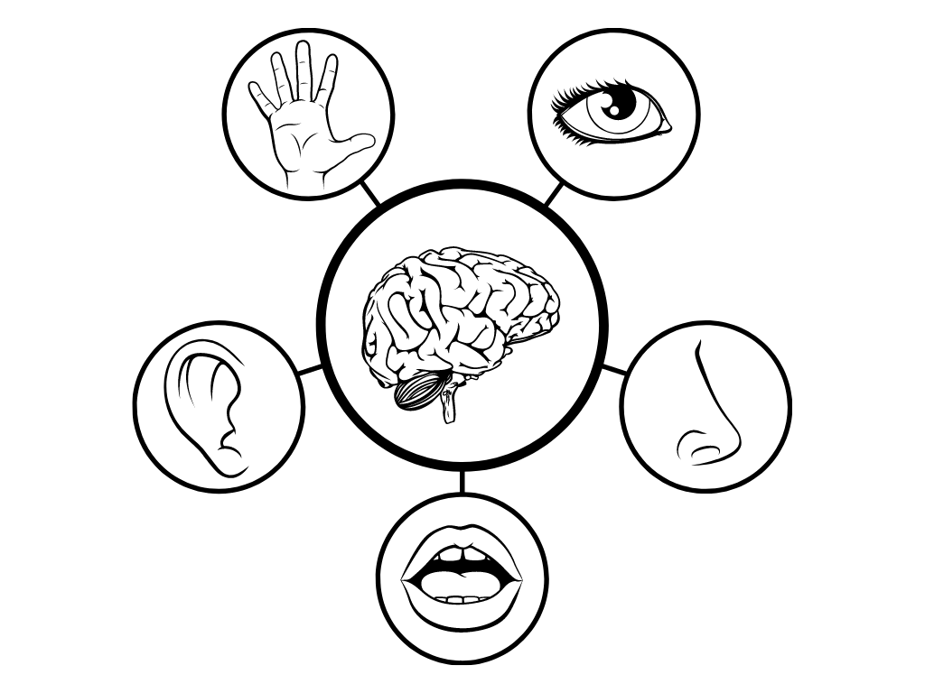
“Sensory design supports everyone’s opportunity to receive information, explore the world, and experience joy, wonder, and social communications, regardless of our sensory abilities”
Ellen Lupton & Andrea Lipps
Authors of The Senses: Design Beyond Vision

Slide 17
Our Goal
1: Create a beautiful, high-quality art book.
2: Everyone — regardless of their visual ability — can experience
the book’s content.
3: A person with full vision will also experience the book as
someone who has low vision or who is blind.

Slide 18
Our Goal
Visual
Photographic images
Low-vision Typeface: Atkinson Hyperlegible
Large font size: 18 points for body text and 28-points for headers
All images will have descriptions accessible in text and in audio

Slide 19
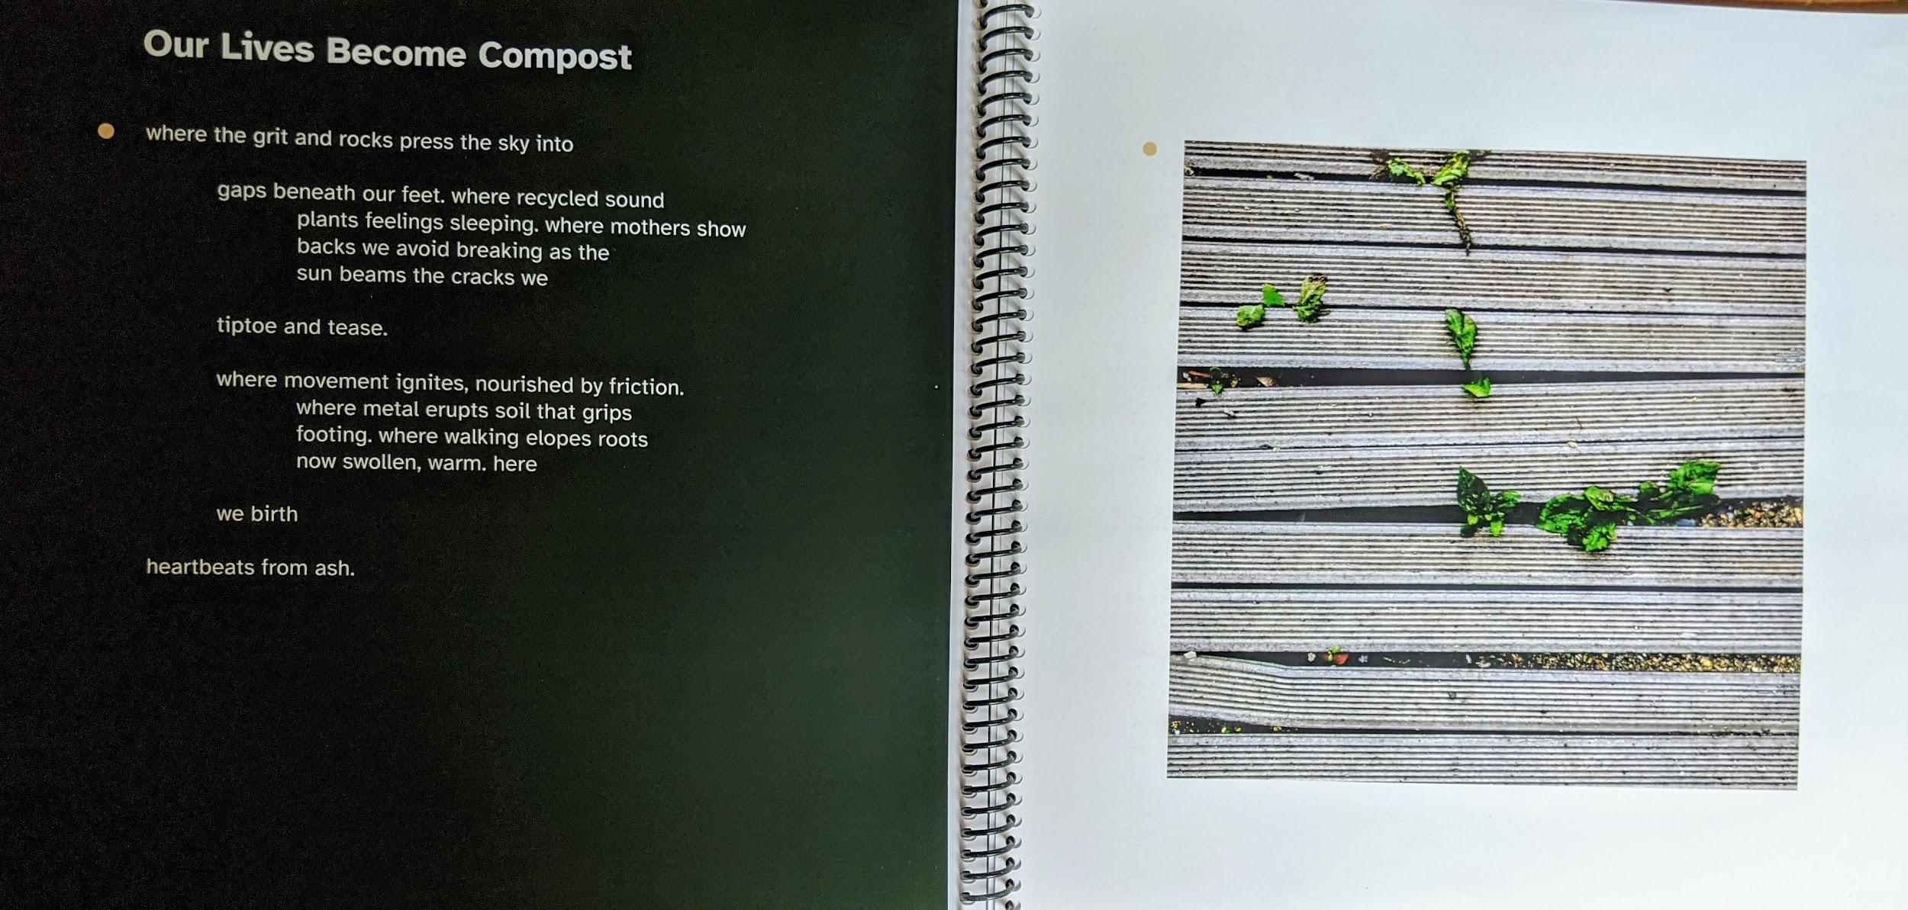

Slide 20
Our Goal
Auditory
All content throughout the book will have audio files online to share an auditory experience.

Slide 21
Our Goal
Tactile
Braille is throughout the book.

Slide 22
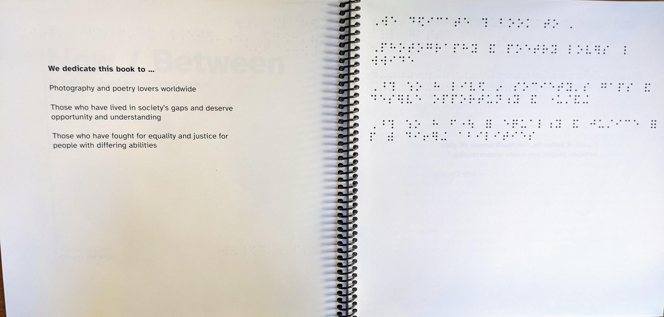
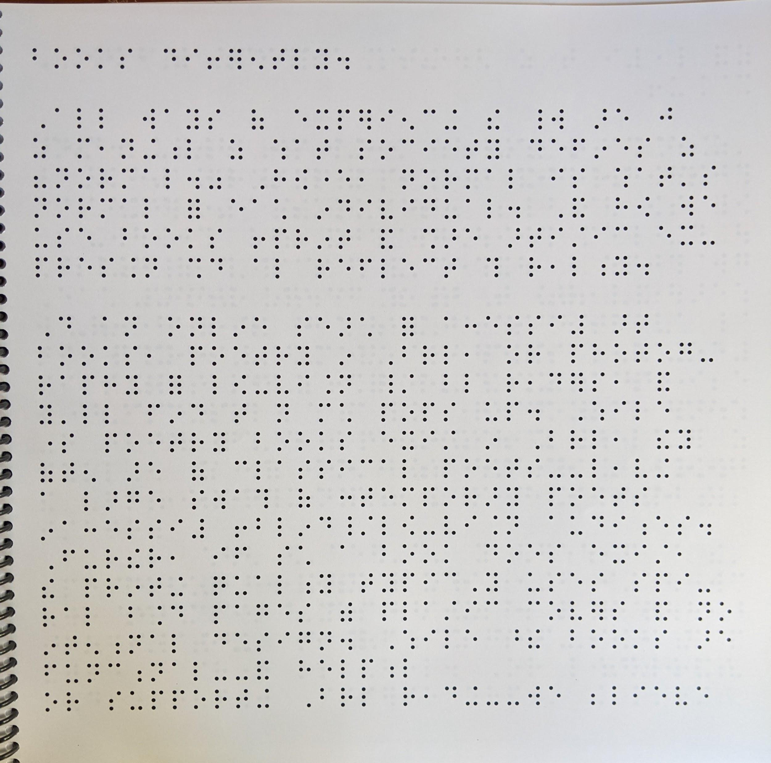

Slide 23
Our Goal
Tactile
Texturization enables people to feel the photographic elements.

Slide 24
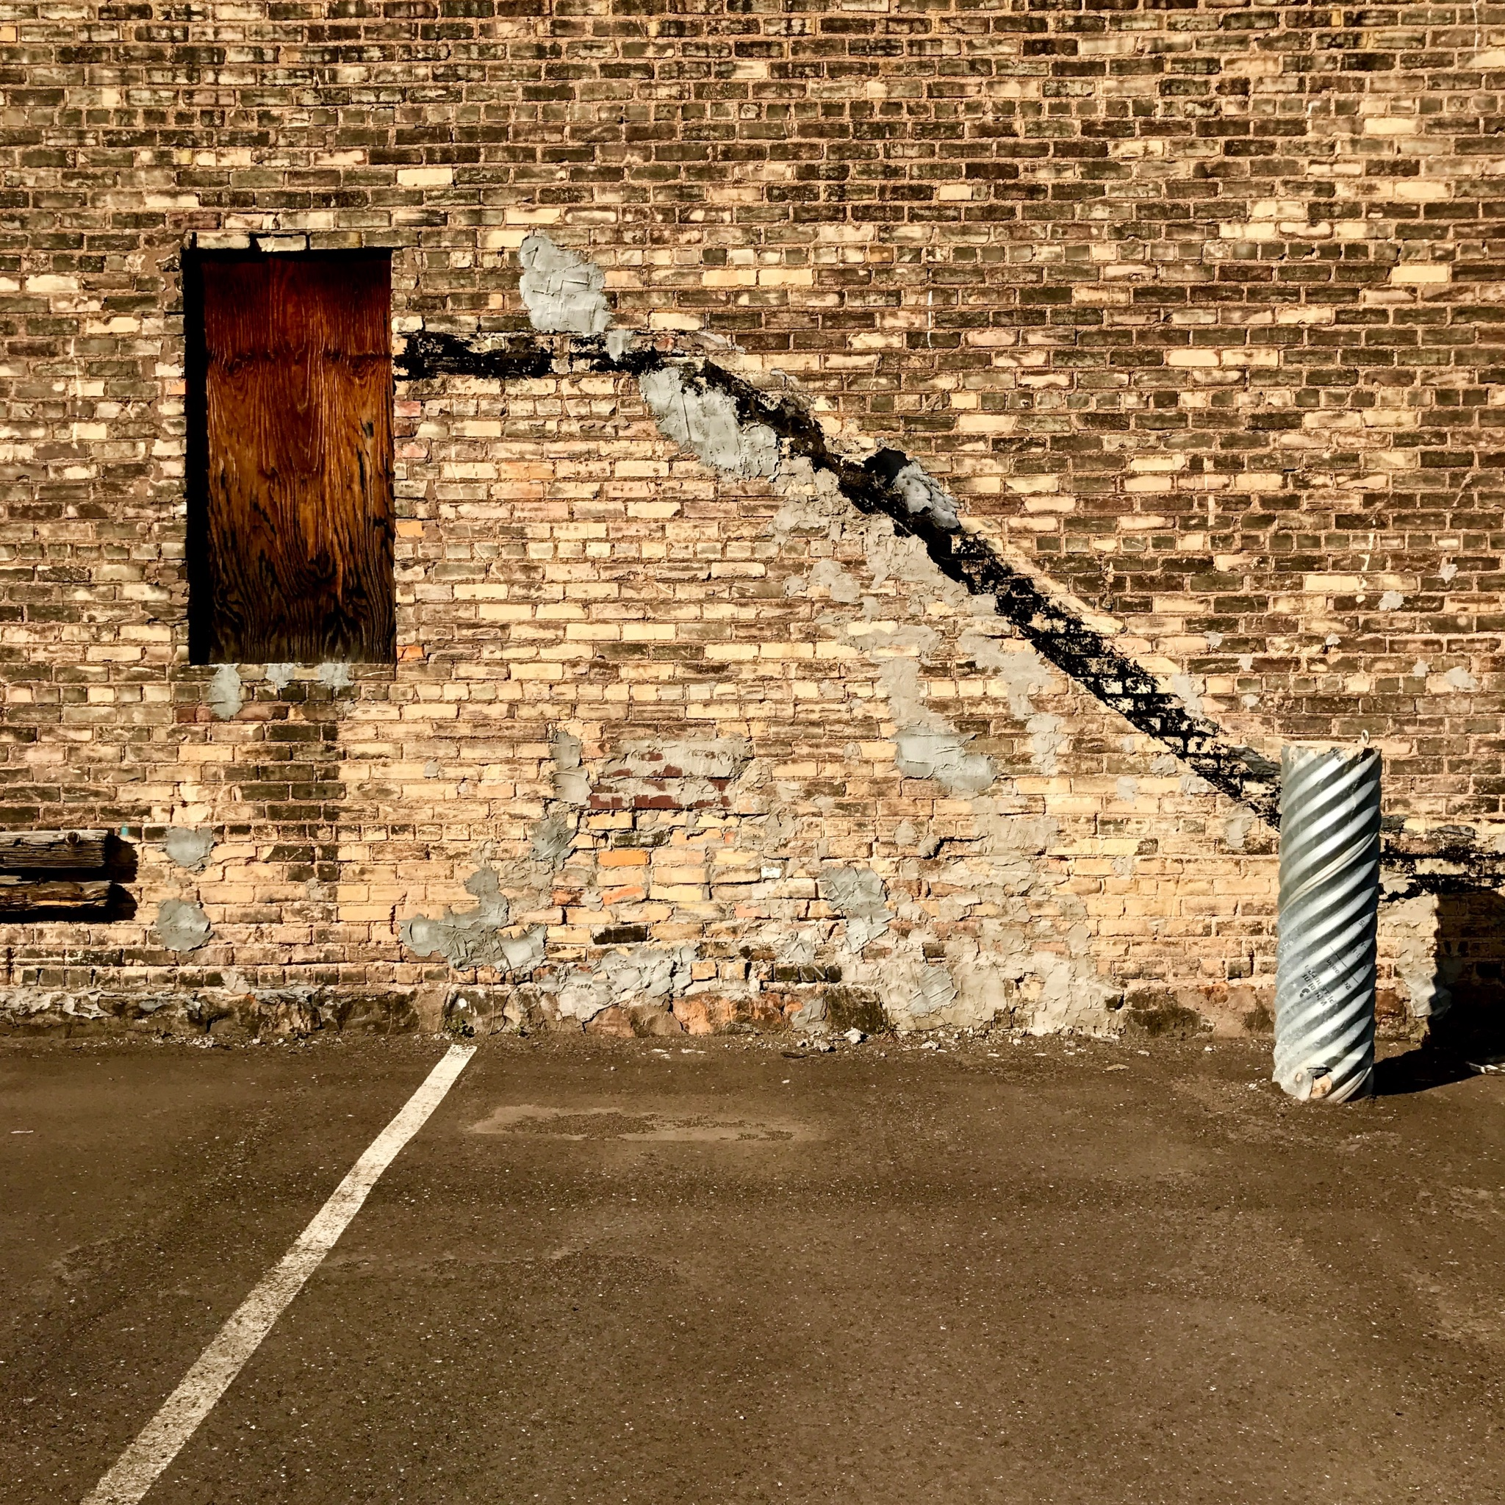
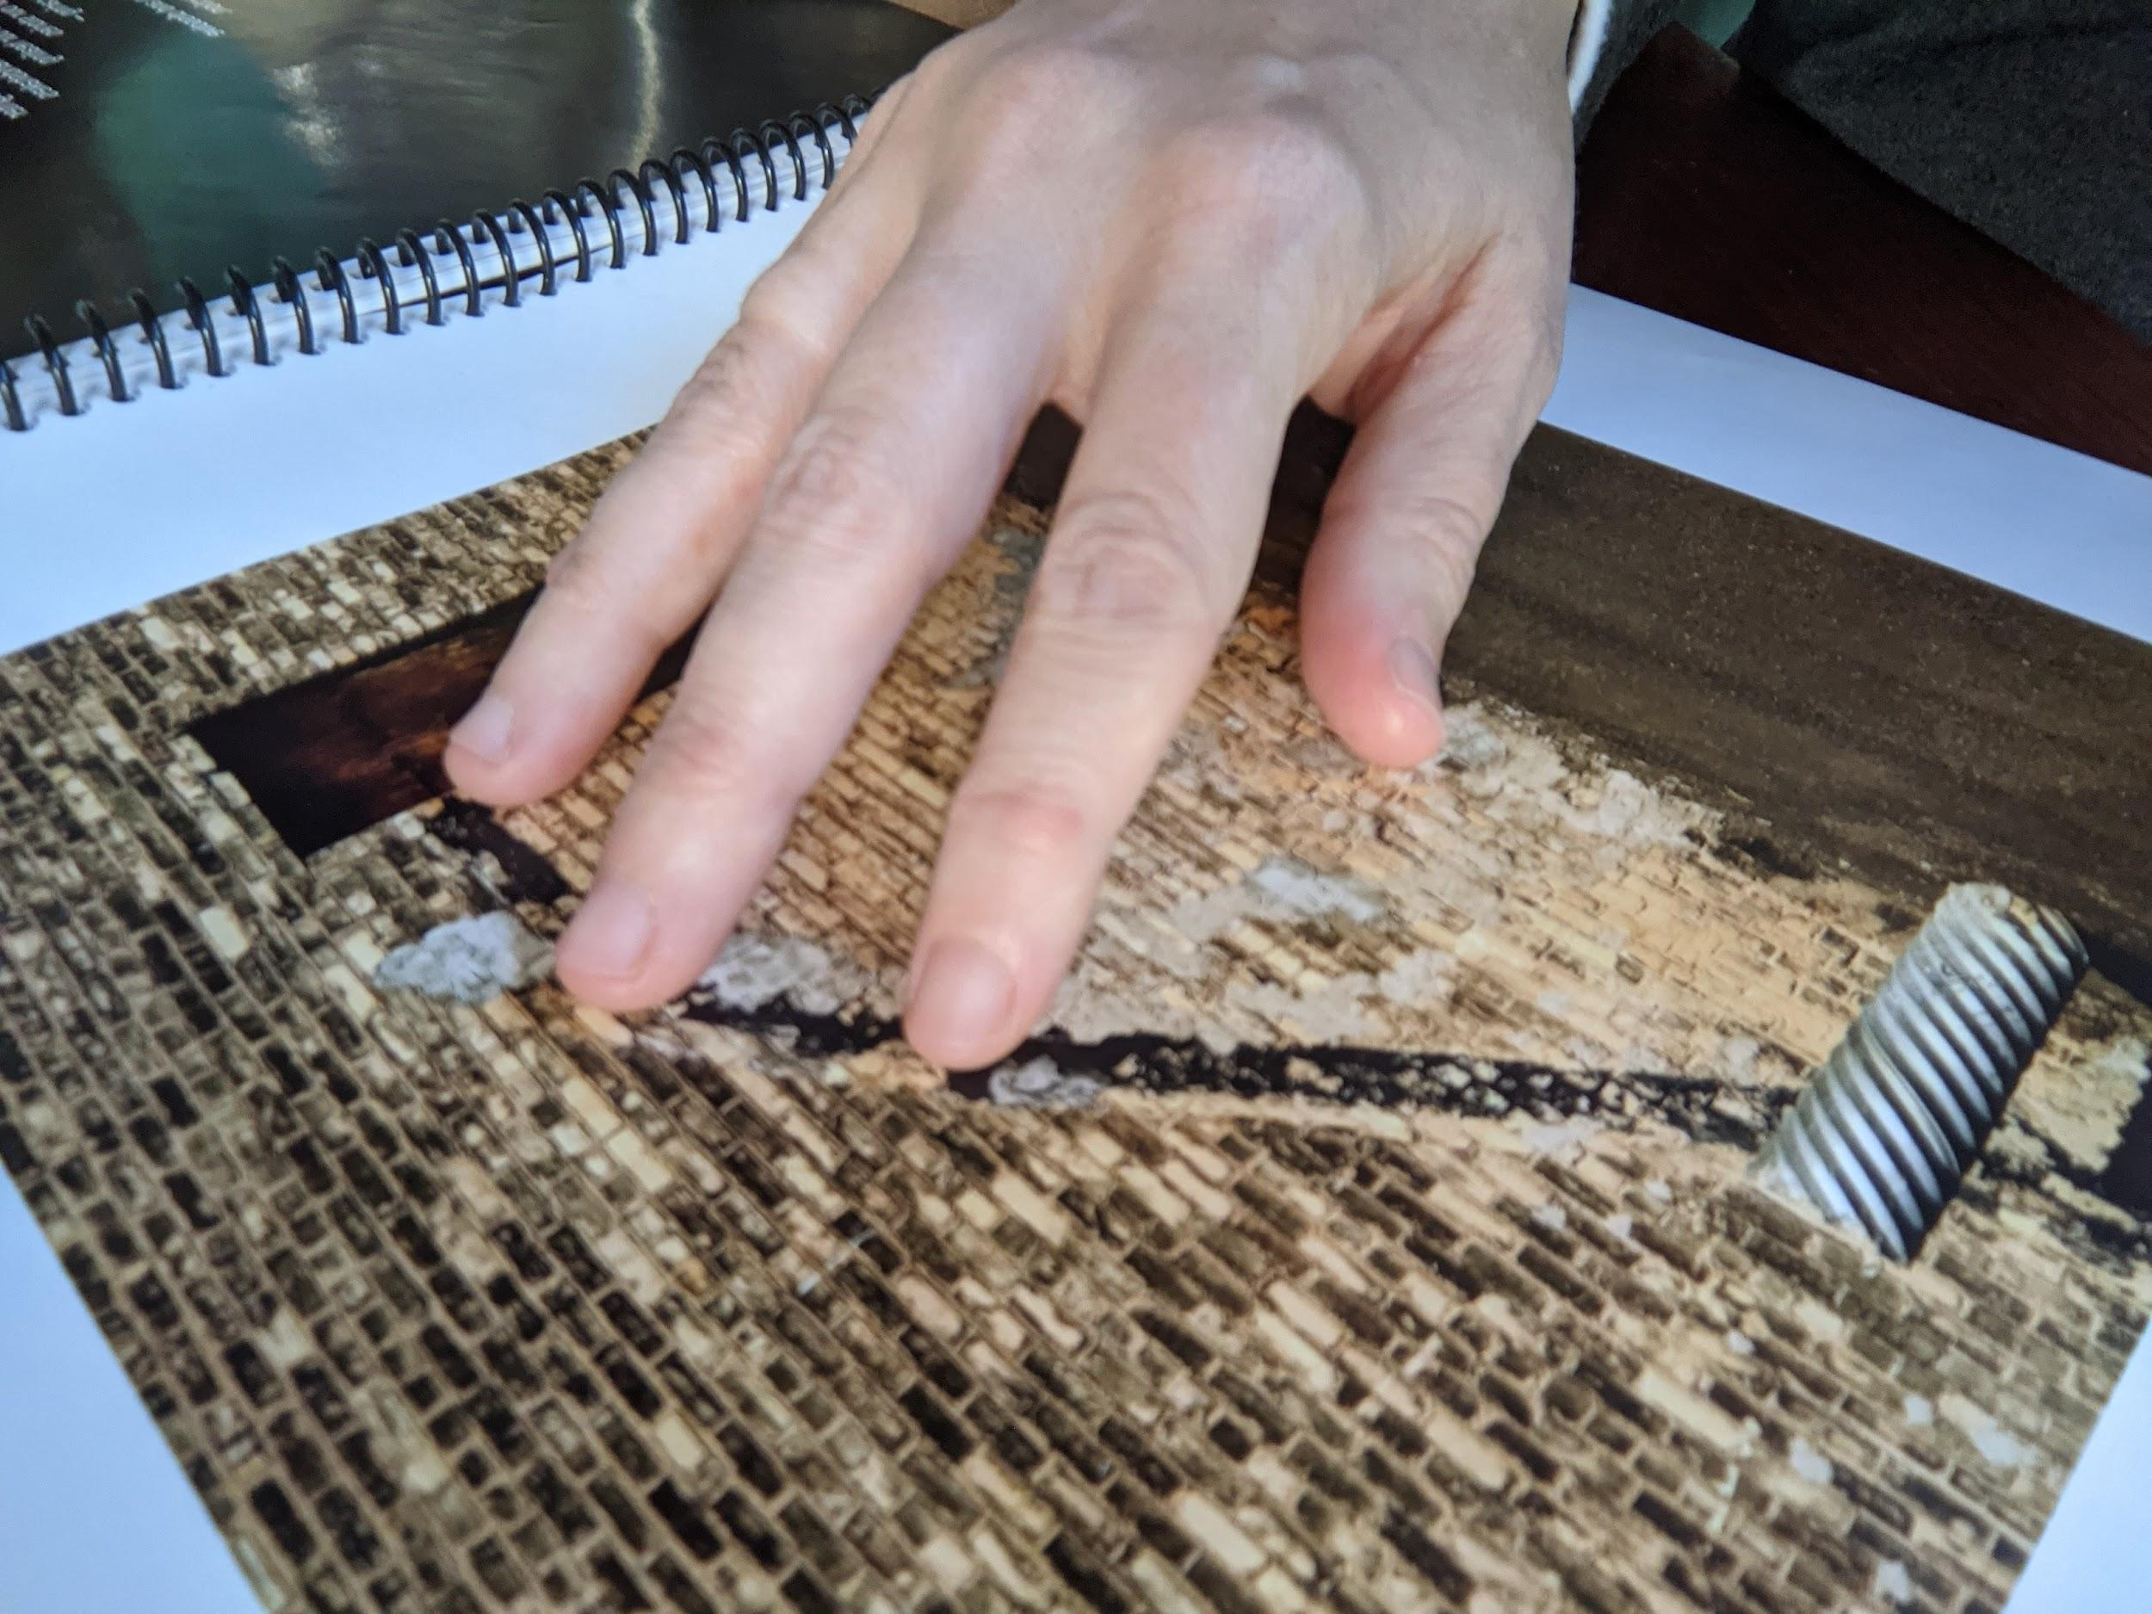
Photographic prints inside the book are tactile.

Slide 25
Our Challenges
1: Making tactile imagery
Process takes a lot of time to texturize the images
Texturization technique makes creating intricate details difficult —
a more generalized interpretation

Slide 26
Our Challenges
2: Braille printing techniques are limited
Difficult to protect Braille’s ability to endure time and use due to the limited materials available for its traditional printing methods
Braille format is so large that it creates more pages to print

Slide 27
Our Challenges
3: Braille printing is expensive
Uses many panels, even for small amounts of text, creating a costly production

Slide 28
Our Challenges
4: Traditional print production models do not apply
Printing and binding the book does not use existing print capabilities
Design partner is having to help engineer a new way to produce and bind the book

Slide 29
Our Challenges
5: Keeping cost low and accessible
Want to keep the book price accessible to people of all income levels, but doing so is difficult
Fabrication goals and Braille panels are driving up the costs

Slide 30
Our Next Steps
1: Prototyping
2: Creating the book’s online experience
3: User testing

Slide 31
Our Next Steps
“This book is great! Why don’t more people create books
like this? It’s very difficult to find art books in Braille.”
– Blind individual, Minnesota, USA

Slide 32
Our Next Steps
“This book is ground breaking!”
– The Lighthouse for Vital Living

Slide 33
Contact Us
Website
accessibilityartbook.com
Email
John O’Neill
jloneill@d.umn.edu
Deanna Geneva Lorianni
heyadgl@gmail.com

Slide 34
Credits
1: https://www.pinterest.com/pin/496170083928083118/
2: https://www.wearecollins.com/work/dropbox/
3: https://www.ricardoshimosakai.com.br/from-stereoscopy-to-tactile-photography-accessibility-in-art/
4: https://www.diyphotography.net/photographer-creates-a-tactile-wedding-photo-album-for-a-blind-bride/
5: https://ifworlddesignguide.com/entry/158765-tactile-photography
6: https://truls.se
7: https://worldblindunion.org/wp-content/uploads/2020/10/Press-Release-AP-Marrakesh-2017.pdf

