Slide 1
Producing Accessible Graphics
Round Table Conference Workshop 2021
Notes:
ANNETTE
Welcome to the Producing Accessible Graphics Workshop 2021
The Guidelines on Producing Accessible Graphics (2021) represent a significant update to Round Table’s Guidelines on Conveying Visual Information (2005).
These Guidelines offer some suggestions and examples of ways in which non-textual information can be presented in a format accessible to people who are blind or vision impaired.
It would be impossible to provide examples to meet every contingency. Rather, an attempt has been made to provide guidelines in a wide variety of areas to demonstrate some principles to provide guidance to anyone producing accessible graphics. The information provided should not be considered a hard and fast set of “rules”, but rather, as implied in the title, a set of guidelines or as a reference and resource manual.
We have included an extensive list of Resource sites for further detailed information. This list includes
3D Models and 3D printing
Alt Text
Art
Clear print
Descriptions
Tactile Graphics
Tactile Story Books
And Online Groups.

Slide 2
Workshop plan
Introduction & history
What’s new
Approach
New sections
3. Focus on selected diagram types (the nitty gritty)
Artwork
Graphic Novels
Chemistry (have your lollies and toothpicks ready!)
Node link diagrams
Orthographic drawing
3D models
Electronic symbols
Notes:
ANNETTE
I’ll read the slide outline at this point

Slide 3
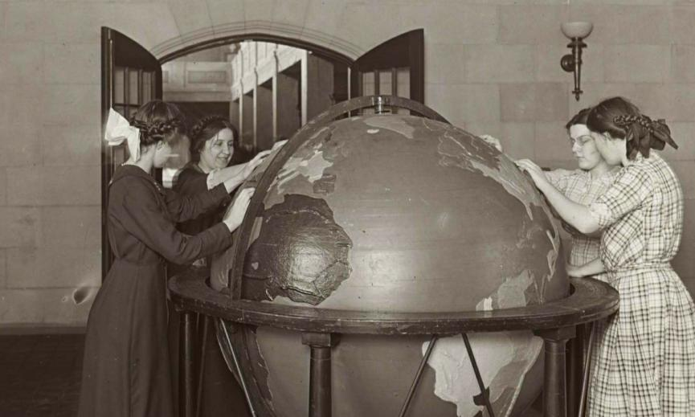
History
Working groups:
1997 draft
2001-2004: Guidelines for Conveying Visual Information (2005)
2019-2021: Guidelines on Producing Accessible Graphics (2021)
Notes:
· ANNETTE
TImage on slide shows a sepia tone historic photograph of 4 young students exploring the Perkins school tactile globe. This represents an historical approach to accessible graphics.
The Guidelines for Conveying Visual Information was first drafted in 1997. Members of that working party were:
JJulie Azzopardi - Manager Transcription Royal Victorian Institute for the Blind
Anthony Cooke - Manager Transcription Services Royal New Zealand Foundation for the Blind
Ann Cooper - Studio Coordinator Royal New Zealand Foundation for the Blind
Peg Gosper - Itinerant Teacher for Blind and Vision Impaired Students ACT Department of Education
Shaun McCarthy - Audio Transcription Manager Royal Victorian Institute for the Blind
Bruce Maguire - Proprietor BrailleWays
Nicola Stanbridge - Audio Production Coordinator Royal Blind Society of NSW
· In 2001, a Working Party was reconvened to revise the Guidelines. resulting in ‘Guidelines for Conveying Visual Information - 2005’.
Members of the 2001-2004 Working Party
Convenor Maureen Ward: Statewide Advisory Visiting Teacher – Vision
Impairment, Disability Services Support Unit, Education Queensland
Gillian Gale: Project Officer 2003-04, private & RVIB Educational Consultant
Alison Banks: Production Officer, Queensland Narrating Service
Josie Howse: Manager, New South Wales State Braille & Large Print Service
Tom Macmahon: Statewide Advisory Visiting Teacher - Assistive
Technology, Disability Services Support Unit, Education Queensland
Leonie Swainston: Community Information Program, Queensland Narrating
Service (from September 2002)
Bruce Maguire: Proprietor, Brailleways NSW (April 2001 – April 2003) Elisabeth Wegener: St Edmund’s School NSW (April 2001 – April 2003) Diane Francis: Royal Society for the Blind South Australia (April 2001 – April 2003)
Debra Murphy: Braille transcriber, National Information and Library Service
(February 2002 – April 2003)
Consultant Advisor Anthony Cooke: Braille transcriber, consultant & editor of first version of Guidelines
· The name of the document was changed from “Guidelines on Conveying Visual Information” to “Guidelines on Producing Accessible Graphics” for clarity and to avoid confusion with CVI as a now common acronym for Cortical Vision Impairment. In spite of the name change, this volume should be considered an update rather than an entirely new document.
Members of the 2018-2020 Working Group were as follows:
Annette Sutherland (Chair) – Sydney Regional Braille Forum
Joanne Chua – Australia and New Zealand Accessible Graphics Group (ANZAGG)
Leona Holloway – Monash University & Australia and New Zealand Accessible Graphics Group (ANZAGG)
Debra Murphy – Vision Australia
David Smith – Blind & Low Vision NZ, formerly Blind Foundation
Vithya Vijayakumare – VisAbility
Leone Carroll – VisAbility

Slide 4
Approach
Language to reflect the shift in methods for producing accessible graphics
More in depth information on producing accessible graphics
Updated examples
Notes:
ANNETTE
Image on slide shows a 3D printed tactile globe.
What’s new in these Guidelines
language to reflect the different methods of communicating information and the technology available to the producer and end user. Such as Alt Text, Electronic Text, 3D models, sonification, banners, logos, icons, emoticons and graphic novels to name a few.
· more in depth information on the general principles for producing accessible graphics and on the formats for accessible graphics.
In this age of media, creating born-accessible materials is the responsibility of all people, regardless of what they are producing: Professional published materials; less formal print materials such as newsletters, bills and brochures; online content such as web pages and blog posts; or simply posting a photograph on social media.
Producers of accessible formats should ensure that all information, both textual and non-textual, is made accessible to people who are blind or have low vision. It is no longer appropriate to assume that visual information can be omitted from special format versions of printed matter.
· updated examples of graphics
The examples in these updated guidelines have been reproduced electronically and more examples have been included to encompass the changing environment of printed material. Some of the inclusions we found necessary to include are banners, logos, icons and emoticons, which are included more extensively in print material.

Slide 5
What’s New
Contents
General Principles for producing accessible graphics with reference to
Clear Print
3D models
Sonification
Notes:
ANNETTE
The contents of these guidelines now include:
When we began this review it was thought that only an update would be necessary, however as we progressed it became more apparent that the extent of visual information not mentioned warranted inclusion.
We need to keep in mind that these guidelines are not only for producers of educational material, but rather for producers of all printed and graphic material. For example, access to arts and culture are an important aspect of inclusion. As public institutions, galleries and museums have a responsibility to ensure that there collections are accessible to all.

Slide 6
What’s New 2/3
Example Accessible Graphics
Banners
Logos
Icons
Emoticons
Graphic Novels
Picture Story Books

Slide 7
What’s New 3/3
Network Diagrams
Electronics (inclusion of an updated Electronic Symbols List)

Slide 8
Accessibility of the document
Accessible content benefits everyone.
Microsoft Word interface is reasonably accessible.
Assistive technologies like screen readers and Braille devices can easily interpret documents.
The document was formatted using the Guidelines for Producing e-Text Guidelines 2018
Notes:
1. Microsoft Word has become a de facto program that is almost used by everyone with or without disabilities.
2. The interface is reasonably accessible for everyone to use in order to create a word document.
3. documents created/authored based on the accessibility standards in MS Word can be read and accessed by assistive technologies such as screen readers, Braille devices and screen magnification software.
4. Also, embedding accessibility into your workflow from the very beginning is important because:
a)this will benefit everyone and
b)nobody will be disadvantaged from access your content
b) this will be make editing and reading documents easier.
The document was formatted using the Round table accessible eText guidelines 2018 - You can find this set of guidelines on the Routable

Slide 9
Accessibility of the document (continued)
Headings and structure (H1, H2, H3, etc.)
Using Sans Serif fonts
Describing all images and illustrations (Alt text)
Ensuring links are active and descriptive
Notes:
A good structure for documents are created through the implementation of Headings. Screen reader users are able to jump from one section to another, easily.
Sans Serif fonts are clearer and easier to read for those using screen magnification
Alternative text or Alt text is a way to describe images or illustrations in the form of text to screen reader users.

Slide 10
Choosing a format
Use a variety of formats
Omission
Descriptions
Clear Print
Tactile Graphics
3D Models
Sonification
Notes:
ANNETTE
No single format is best for access to graphics.
The ideal strategy is to always provide a range of choices. In the case of accessible graphics, this could mean providing a high-resolution print graphic with alt-text; a tactile graphic with an introductory description to provide context; or a guided tour of an art gallery with description and touch access to artworks, models and materials.
Omission: Omission of graphics is only recommended when the graphic is purely decorative, adding no information to the text, and would unnecessarily add to the burden of reading in an accessible format.
If it is absolutely necessary to omit something from an educational text, the student should be informed of the existence of the item and the fact that it has not been included.
Descriptions: Descriptions of graphics are almost always useful, even if another accessible format is also being provided. However, visual material need not be described if:
the information involved is directly duplicated in the text;
the description would be so long and convoluted that it would disrupt the main text completely and/or it would be very difficult to understand;
the material adds little meaning to the text, for example, a decorative image behind the text;
it is virtually impossible to describe the material in a comprehensible manner.
Where and How to place Image Descriptions:
Alt text (Alternative Text)
Alt text can be attached to images in websites or electronic documents. The text will not be visible but it will be read by screen readers or through refreshable braille displays.
Alt text should be a short description.
Braille
Captions should precede any description.
Insert image descriptions in transcriber notes brackets
Audio: Use “Narrator’s notes” for captions, descriptions and verbalisations. The caption should be read before the description
Social Media: Always include alt text with images shared on social media.
Clear Print: Consider whether the original image is clear, in which case access may be possible via enlargement on the page or using software or magnifiers.
Clear Print Graphics for Low Vision: Often, it may be necessary to adjust or re-draw the graphic
Clear Print Graphics for Cortical Vision Impairment: In the case of Cortical Vision Impairment, simplification can greatly enhance ability to interpret the graphic.
Tactile Graphics: Tactile graphics are the ideal format for graphics in which spatial relationships are important, but they can also be used for most other diagrams.
It cannot be assumed that all people who are blind or have low vision are able to use tactile graphics, due to the level of experience and skills required. Therefore, when designing materials for a general audience, tactile graphics should be provided as one option alongside other formats.
3D models: 3D models are ideal for representing three-dimensional objects or concepts that are not readily available for touch. Consider using 3D models to accompany or replace a diagram. A solid or concrete shape, or three-dimensional object, will often be easier to understand than a tactile graphic.
Sonification: Sonification software converts data to audio tones. It is most often used to convey graphs from an equation or data, but can also be used for things like charting stars, examining data density clouds, and mapping locations in augmented or virtual reality. Sonification is particularly well-suited to giving an overview of data trends but may need to be accompanied by another format, such as a data table, for access to more detailed information.

Slide 11
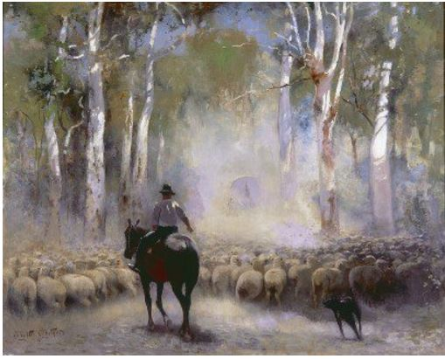
Artworks (1/2)
The Drover (1912)
by Walter Withers
Oil on canvas
Notes:
LEONA
The original guidelines dealt mainly with artworks in an educational context. But of course, more wide ...
It is impossible to directly convert an artwork into another format - the original format, stylistic choices, materials and scale are part of the artwork and contribute to its impression on viewers.
Instead we advocate for using a mix of approaches.
On screen is an image of The Drover, an Australian impressionist oil painting by Walter Withers from 1912. It uses a painterly style in oils to depict a drover on his horse, with his sheepdog herding cattle in the dusty Australian bush.
A full description of the painting would include the subject matter, the painting style and context, such as the artist’s story and how the painting relates to others hung alongside it.

Slide 12
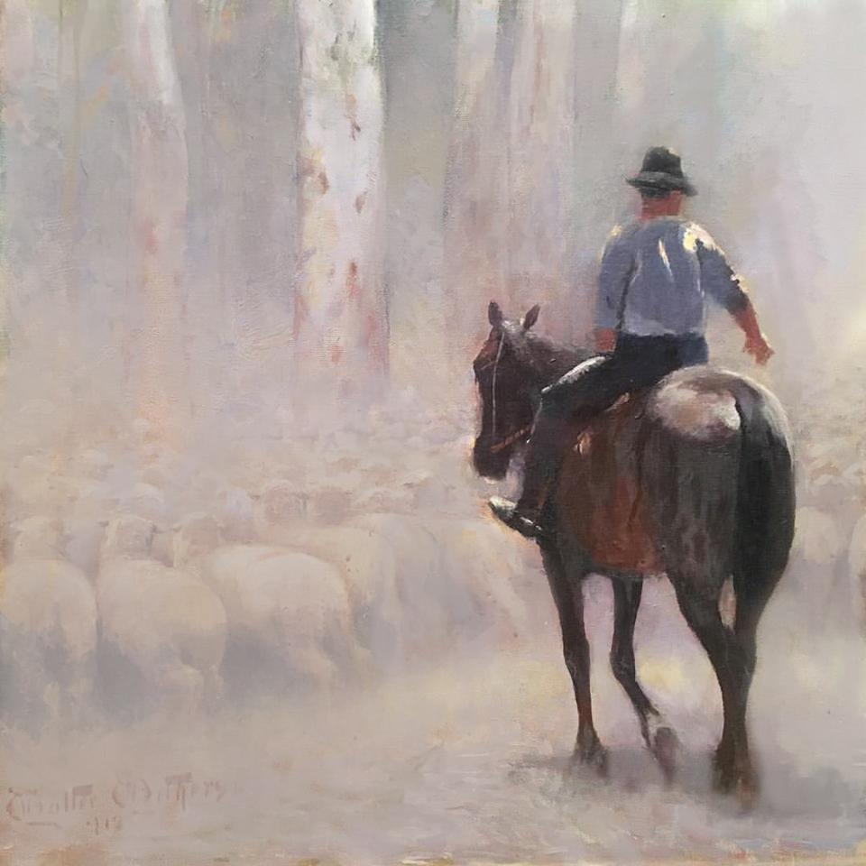
Artworks (2/2)
Use a variety of approaches:
Enhanced graphics
Description
Tactile graphic
3D model
Related objects
Materials used to create the artwork
Role play
Soundscape or music
Notes:
LEONA
For The Drover, in addition to an extended description, we provided enhanced images on a website for access by people with low vision. On screen is a portion of the painting with the drover on his horse, with the background faded out.
As part of a specialised gallery tour with The Drover, we also provided a tactile graphic, a 3D printed relief picture, touch access to a wooden frame similar to the one in which the original is hung, touch access to some unprocessed (smelly, greasy) wool and fragrant eucalyptus leaves, an akubra hat similar to that worn by the drover, and a soundscape to create an appropriate atmosphere. [play audio]
For other artworks, you may also consider providing props to role play the scene being depicted in the artwork, provide access to the materials used to create the artwork, or come up with any number of activities that relate to the artwork or context. Be creative!

Slide 13
Emojis (1/1)
In most cases:
Replace emojis with text descriptions, e.g.
Respond with 👍🏼 if you agree or 👎🏼 if you disagree.
Respond with [thumbs up emoji] if you agree or [thumbs down emoji] if you disagree.
Refer to Emoji: https://emojipedia.org/ for the standard emoji names.
If emojis are being studied you may consider:
Emojis as tactile graphics
Keyboard shortcuts to create the emojis ;)
Notes:
LEONA
Emojis are increasingly used as part of mainstream text and are a recurring source of headaches for transcribers.
In general, we would suggest replacing emojis with a description inside transcriber note brackets. In our example, we replace the thumbs up symbol with the words “thumbs up emoji” in transcriber note brackets.
If you don’t know what the emoji is called - quite likely as there are so many of them! - you can refer to the emojipedia. The link is given in the slides.
If the same one or two emojis are being used a lot in a document, there is also the option to replace it with a transcriber-defined symbol. However, this is only recommended if space is at a premium, as a descriptive word is much more easy to remember and understand than a random symbol.
On the rare occasion when emojis are actually the topic of discussion, you may consider providing them as tactile graphics and/or giving the keyboard equivalents, such as as a semi-colon then close bracket for a winky face.

Slide 14
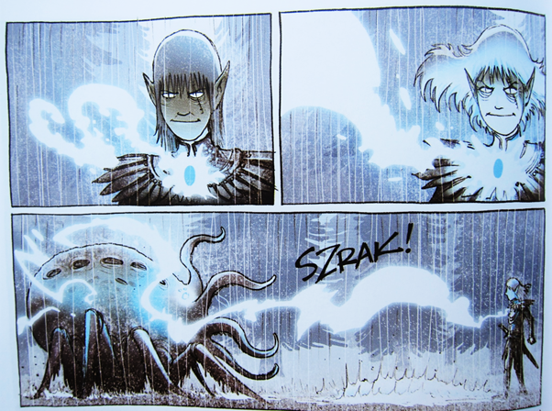
Graphic Novels (1/3)
Convey the story in an easy and entertaining fashion
Notes:
ANNETTE
When creating an accessible version of a graphic novel, it is important to convey the story in an easy and entertaining fashion.
It is not necessary to describe every image separately.
For example the image on the screen shows 3 slides from the graphic novel “The Amulet” The transcribers description reads:
The Elf prince stares intently. Light from the amulet grows until it strikes the Raker. SZRAK!

Slide 15
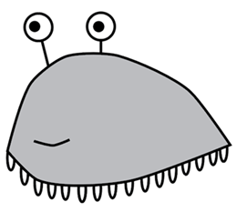
Graphic Novels (2/3)
Include simple tactile graphics
Notes:
ANNETTE
When an unusual and important creature or object is first introduced, you may wish to include a simple tactile graphic.
Image on screen shows a simple tactile graphic of “Slug Creature” from “The Amulet”

Slide 16
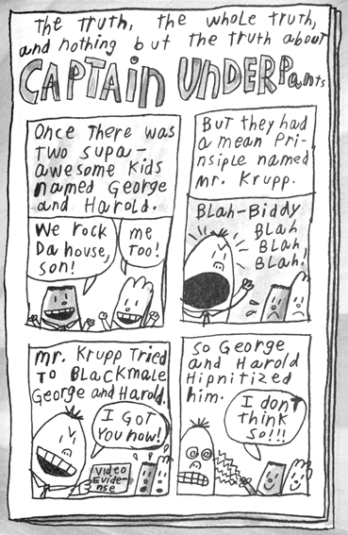
Graphic novels (3/3)
Can also be in comic strip format
Notes:
ANNETTE
Graphic novels in comic strip format can be described frame by frame.
Image shows a page from the graphic novel Captain Underpants. The description is presented slide by slide as follows:
The frames have been numbered. The spelling is as per the comic strip.
The truth, the whole truth, and nothing but the truth about Captain Underpants.
Frame 1
Once there was two supa-awesome kids named George and Harold.
George: We rock da house son!
Harold: Me too!
Frame 2
But they had a mean prinsiple named Mr. Krupp.
Mr Krupp: Blah—Biddy Blah Blah Blah!
Frame 3
Mr Krupp tried to blackmale George and Harold.
Mr Krupp: [Holding up “Video Evidense”.] I got you now!
Frame 4
So George and Harold hipnitized him.
George: I don’t think so!!!

Slide 17
Chemistry (1/5)
Participant Activity
Grab your toothpicks and lollies it’s time to have some fun.
Notes:
If everyone could grab their toothpicks and lollies we are going to create a chemical structure from the following description:
This molecule has 2 carbon atoms connected by a single bond. From each of the carbon atoms there are 3 hydrogen atoms connected to each carbon atom by single bonds. 6 hydrogen atoms in total.
Now it is time to build the chemical structure using your toothpicks and lollies. I will give everyone a couple of minutes to build.
No eating the lollies until we have show and tell.

Slide 18
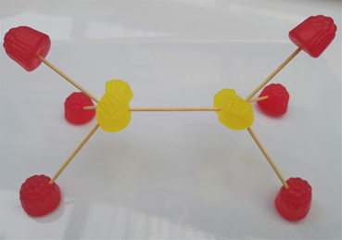
Chemistry (2/5)
Notes:
Here is a photo of one version of what you could create.
Does anyone want to show off their creation. You have all built an ethane molecule.
Touch and manipulation are the best tools to teach people about chemical concepts. Be creative and use all the methods available to you, from low tech lollies to high tech 3D models.

Slide 19
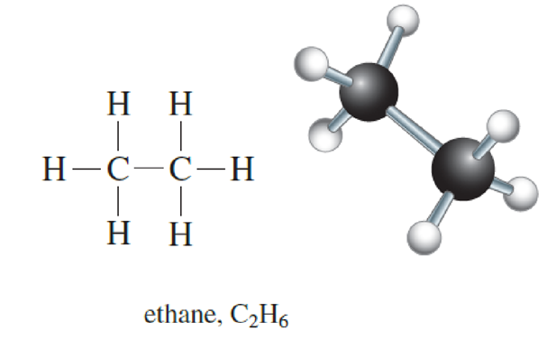
Chemistry (3/5)
Chemical Structures
Notes:
DEB
· Tactile diagrams should be used in preference to visual descriptions wherever possible as spatial layout is important in understanding chemical concepts;
The image on the screen is ethane molecule, formula which has 2 Carbon and 6 Hydrogen atoms. The image on the left is the chemical structure. The image on the right is still ethane but shown in what is referred to as a ball and stick model.
· The use of 3D models should also be used as much as possible to assist the student;
· Avoid expanding or using chemistry conventions with which the reader may not be familiar. For example, (g) should be read as “open bracket, lower case g, close bracket” rather than “gas”.
T

Slide 20
Chemistry (4/5)
Notes:
Image shows the way to braille the chemical structure. This method is preferred as it allows the student to reproduce the structure themselves. This is very effective for simple chemical structures. When they become more complex then they will need to be shown tactually.
The Guidelines for Technical Material has a section in the back (Section 16) on brailling chemistry and Section 16.7 covers Structural Formulae.

Slide 21
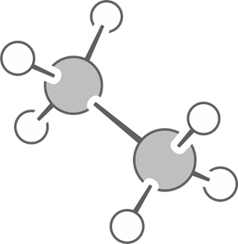
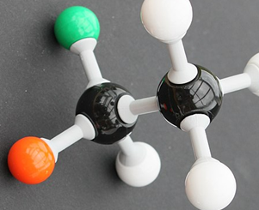
Chemistry (5/5)
Notes:
The image on the screen show 2 ways of approaching the representation of the ball and stick model of ethane.
On the left is the image drawn tactually.
On the right is a 3D model of the structure using a kit.
The use of 3D models should also be used as much as possible to assist the student, the more a student can feel and manipulate the structures the easier it is when they have to start to understand the more complex concepts in science.

Slide 22
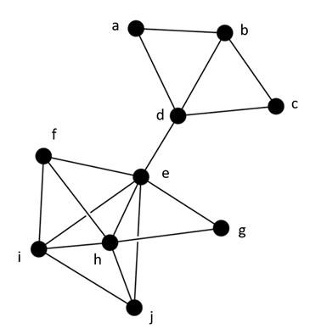
Node Link Diagrams / Network Graphs (1/3)
Nodes = points (items)
Links = lines (relationships)
Yang, Y., Marriott, K., Butler, M., Goncu, C., & Holloway, L. (2020). Tactile Presentation of Network Data: Text, Matrix or Diagram? https://arxiv.org/pdf/2003.14274.pdf
Notes:
[LEONA]
Node link diagrams, also known as Network Graphs, consist of nodes (points, usually labelled) and links (lines) between the nodes. They are used to illustrate relationships, for example to show a social network with links between friends.
The image on screen shows nodes (dots) labelled a to j. Each node has up to five lines linking it to other nodes.
When choosing an accessible format, it is important to consider how the diagram will be used.
A recent study at Monash University compared task performance by blind people using node link diagrams in three different formats: as a tactile graphic, as a matrix or as a list.

Slide 23
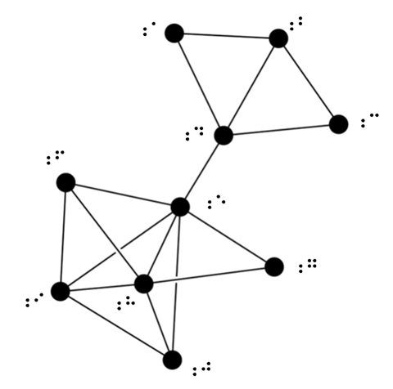
Node Link Diagrams / Network Graphs (2/3)
Use a tactile graphic for:
Illustrating the concept of node link diagrams
Looking for clusters
Finding pathways
Notes:
Tactile graphics are generally the best format for BLV people to explore node link diagrams.
They illustrate what a node link diagram looks like.
They are best for finding clusters (e.g. groups of friends). In the example on screen, there are two clusters: A, B, C and D are friends with each other, and E to J are friends with each other. There is just one link between the two groups, in the friendship between D and E.
Tactile graphics are also best for finding pathways (e.g. finding the shortest path between two people, somewhat like playing “seven degrees of Kevin Bacon”).
Because following the links is so important to understanding a node link diagram, make sure that the link pathways are clear. Spread out the diagram to minimise confusion. If using swell paper, leave a gap on either side when one line crosses over another. Even better, create an embossed diagram with a higher height for links crossing over the top, or a hand-made diagram with full pieces of string crossing on top of one another.

Slide 24
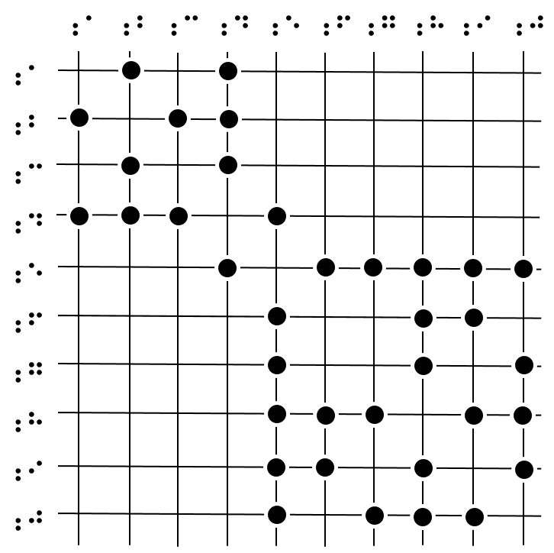
Node Link Diagrams / Network Graphs (3/3)
Matrix
Retain only to illustrate what a matrix is.
Otherwise, convert to a list format, e.g. A is linked with B and D B is linked with A, C and D
Notes:
[Cut this slide if workshop is too long]
Node links can also be presented as matrices, especially in computer science.
A matrix is a grid with the nodes listed along the top and side, and indicators on the grid where there is a link between two nodes.
In the matrix on screen, we have 10 lines across and 10 lines down marked a-j in braille. You will notice that the circles marking connections are symmetrical along the diagonal line because the connection between a and b, etc. is shown in two ways.
However, matrices can be difficult to understand and use, especially in a tactile format.
We suggest that you do retain the first instance of a matrix for illustrative purposes.
But afterwards, if both a node link diagram and matrix are given, just the diagram (as a tactile graphic) should be sufficient.
If only a matrix is given, it may be better to convert it to a list.
For example,
A is linked with B and D.
B is linked with A, C and D,
etc.

Slide 25
Orthographic drawings (1/3)
Participant Activity
Time to use your lego blocks
Notes:
ANNETTE
[intro needs to be added ]
For this activity you will need 20 lego bricks. Don’t worry if you have any left over at the end!
Place 5 blocks in a row. These blocks are numbered 1 to 5, working from left to right.
Place an extra block onto block number 3
Place an extra block onto block number 4
Place 2 blocks onto block number 5
Start a new row.
Place 2 blocks below block number 4
Place 2 blocks below block number 5
Start a new row.
Place 1 block below block number 3
Place 1 block below block number 4
Place 2 blocks below block number 5
Start a new row.
Place 1 block below block number 5

Slide 26
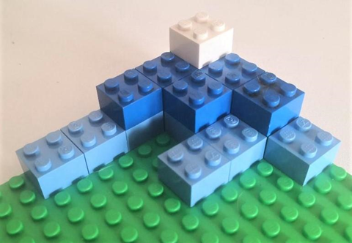
Orthographic drawings (2/3)
This is how your 3D-model should look. How did you go?
Notes:
The image on screen shows an orthographic model constructed from Lego blocks.

Slide 27
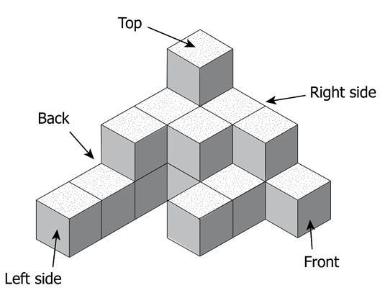
Orthographic Drawings (3/3)
3D models are ideal and can be constructed from Lego, or wooden blocks or similar.
As a tactile, a mat plan is the simplest.
Descriptions are not recommended.
Use a transcriber’s note.
Notes:
DAVID to write
The images on screen are an orthographic drawing at top, and a mat plan below.
Orthographic drawings are challenge not just for the student to read, but also the tactile producer to create something that is easily understood. The majority of orthographic drawings will be for students and, if possible, ideally should be discussed with the teacher to determine the student’s experience.
You should not try to reproduce the structure, as shown on the slide, as a tactile graphic
A mat plan is the simplest way to represent an orthographic drawing as a tactile diagram, ideally in conjunction with a 3D model. Provide the footprint and a count of layer height for each section. Indicate the front, back, left and right sides.
A transcriber’s note can be “Cubes stacked in columns”
The layering method, in which each separate layer of the drawing is shown, can also be used. This is good for when there are “missing” blocks.

Slide 28
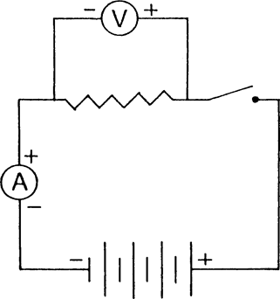
Electronic symbols (1/4)
Circuit diagram
Can be shown in braille or tactually
Notes:
DEB
Image on the screen of a electronic circuit diagram.
This circuit diagram consists of two joined rectangles, each representing a loop. The main loop includes a power supply, an Ammeter, a resistor and a switch. The secondary loop bypasses the resistor on the main loop, and includes a Voltmeter.
This diagram can be produced using direct braille or it can be drawn tactually. This decision will depend upon whether the student needs to be able to replicate the circuits themselves.
Most important is that there is consistency in how things are represented for the student such as the same symbol is always used for a voltmeter.
This includes all tests and exams. These circuits can get very complex so whenever possible it is better to show them tactually rather than a description. Electronic kits are also of great benefit to allow the person to create the circuits.

Slide 29
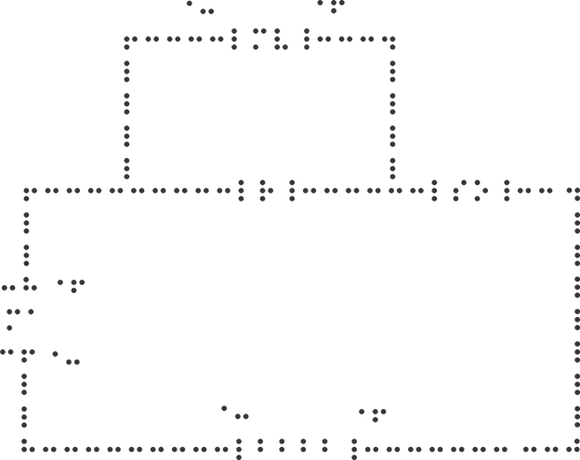
Electronic symbols (2/4)
Braille version of a circuit
Reproducible using Duxbury or a brailler
Symbols list in guidelines
Notes:
Image of a braille version of the electronic circuit that can be produced with Duxbury or on a brailler.
Items such as circles around letters and zigzags are replaced by symbols without compromising the information presented in the diagram.
This allows the student to also reproduce the circuit if they are required to an answer questions.
In the back of this section in the guidelines is a list of Electronic symbols to assist you in producing these.
Very important to be consistent
When preparing tactiles for test situations, it is essential to ensure that references to specific items and features in the questions are consistent with what is depicted tactually. For example, if there were a question about the use of a zigzag line to indicate a resistor, then it would obviously be more appropriate to braille a series of “st” or “ch” signs (or “en”/“in” signs), or devise another zigzag line depiction, rather than simply using the letter “R”.

Slide 30
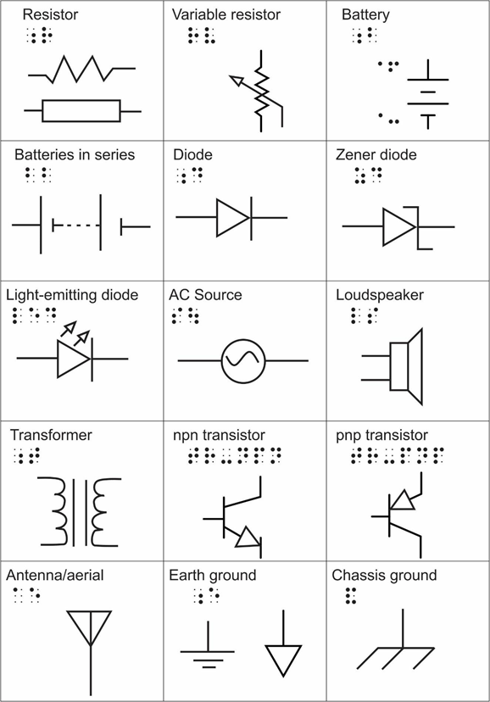
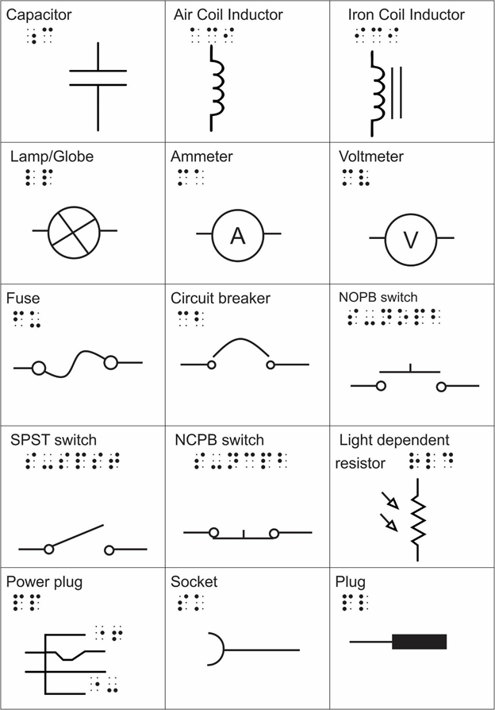
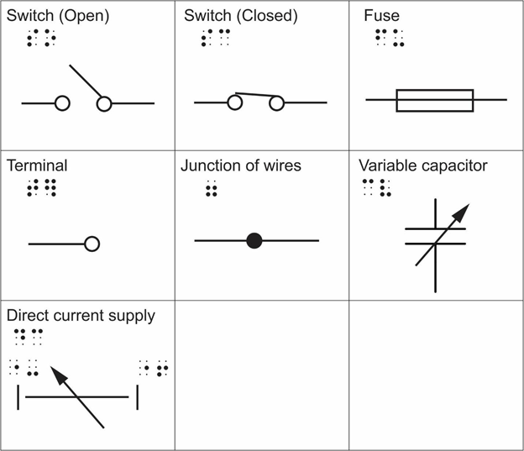
Electronic symbols (3/4)
Notes:
The 3 images on the pages of Electronic Symbols at the end of the Electronics section in the Guidelines.
They have been shrunk down here to fit on 1 slide. Each has the name of the symbol, a braille letter/s to represent the symbol and a drawing of what the symbol looks. These drawings can also be used to represent the circuit is drawing it tactually.
For example: Resistor is show in print as either a rectangle or a zigzag line. It is shown in braille by the letter r.
An AC Source is shown as a circle with a s shaped line inside. It is shown in braille by the letters sou.
These are only some of the ways the electronic symbols can be shown. There is a wide amount of variation and so this is not an exhaustive list and only includes some of the symbols.

Slide 31
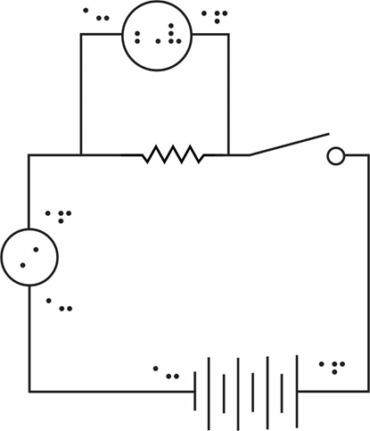
Electronic symbols (4/4)
Tactile diagram of the circuit
For more on producing tactile electronic Symbols see Designing Tactile Schematics by Lauren Race
Notes:
This image shows how to produce an electronic symbol in a tactile form.
Lauren Race has done extensive research in this area and developed a set of tactile symbols to represent electronic components.
For more information on Lauren’s work and the symbols refer to Designing Tactile Schematics.This includes a library of over 50 tactile schematics that can be downloaded for free. This is a wonderful resource and very valuable when producing complex circuits.

Slide 32
Question and Answer Time
The guidelines will be released at Producing Accessible Graphics: http://printdisability.org/guidelines/graphics-2021/

Slide 33
For Further Information
If you require any further information with regards to these guidelines contact Annette Sutherland
annette.sutherland2@gmail.com

