Slide 1
3D Printing for Touch Readers: Guidelines and Discussion
Round Table Conference 2021 Workshop
Wednesday 19 May 10am-11.30am AEST
Presented by Monash University Inclusive Technologies
Leona Holloway & Ruth Nagassa

Slide 2
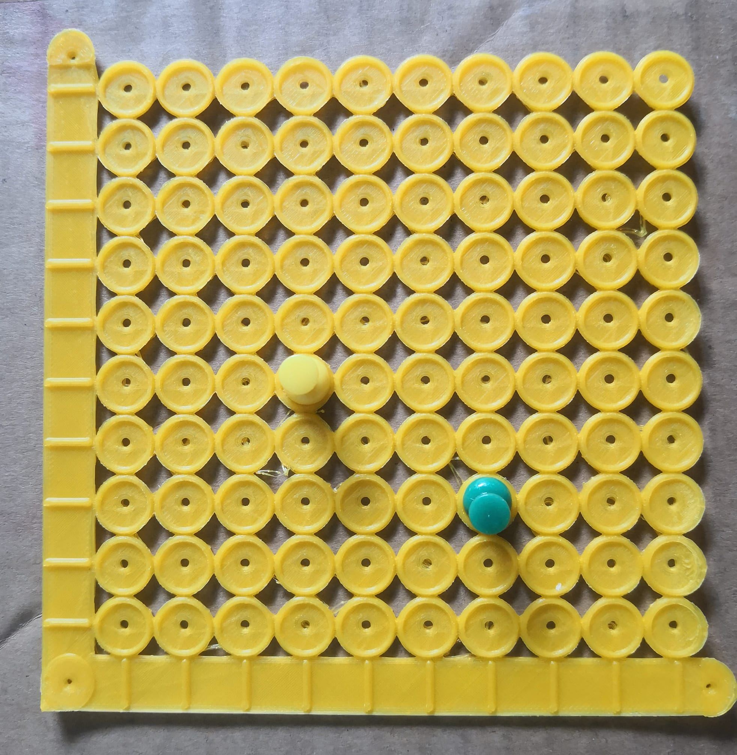
Outline
Guidelines
What to print
Where to find existing models
3D printing design software
3D printing by BLV
Finishing
Touch reading 3D models
Braille and print labelling
Demo and Discussion
Audio labelling techniques

Slide 3
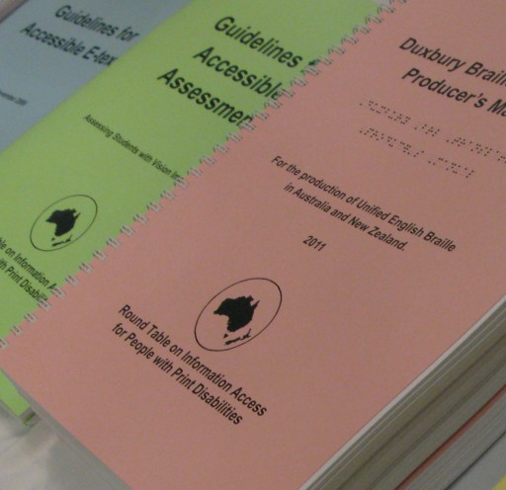
Guidelines
http://printdisability.org/about-us/accessible-graphics/3d-printing/

Slide 4
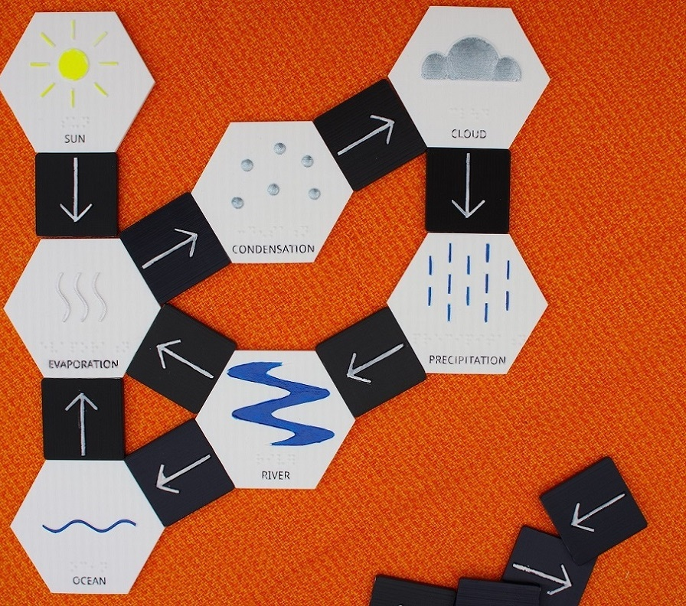
What to print
http://printdisability.org/about-us/accessible-graphics/3d-printing/when-to-use-3d/

Slide 5
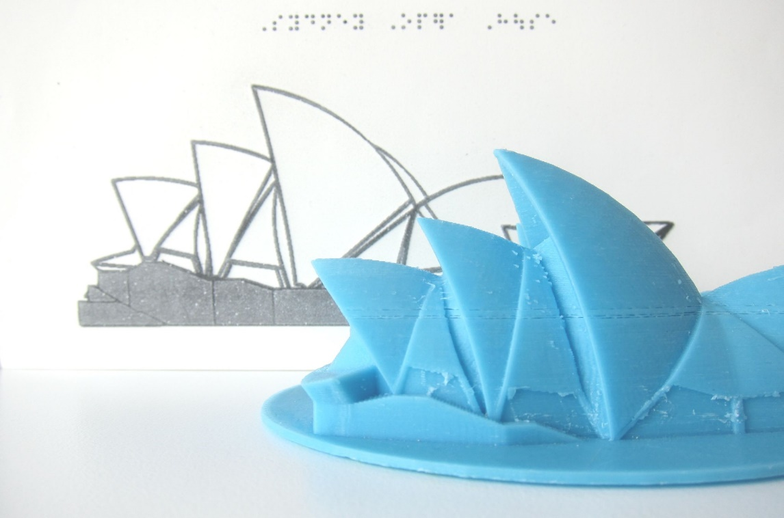
Why use 3D printing?
To convey 3D concepts
To explain the conventions used in 2.5 tactile graphics
For durability
For interaction with moving parts
For engagement
For inclusion
To create customised tools

Slide 6
Accessible Graphics Decision Tree
Can you access the real object by touch?
Can you easily purchase a model?
Is it important?
YES
Is it simple?
NO
NO
NO
Is it flat?
NO
YES
YES
YES
YES
NO
Ignore
Description
Tactile Graphic
Real Object
Purchased Model
3D Printed Model

Slide 7
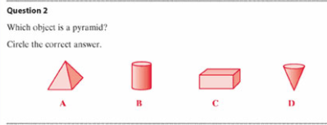
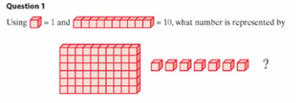
Activity 1: Pick a format
To test “what is a pyramid”:
Wooden blocks
OR 3D prints (if blocks not available)
To test ability to read 3D diagrams:
Tactile graphic
Tactile graphic
OR MAB blocks (standard or 3D printed)
OR
Worded question

Slide 8
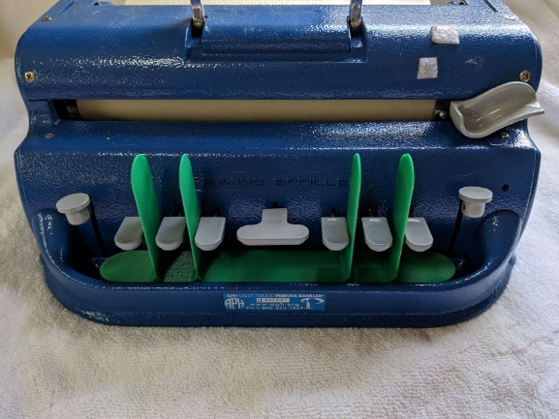
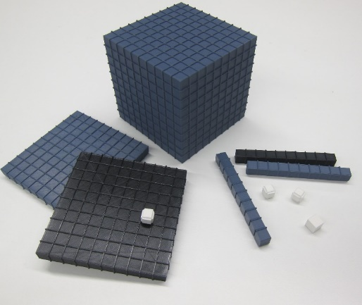
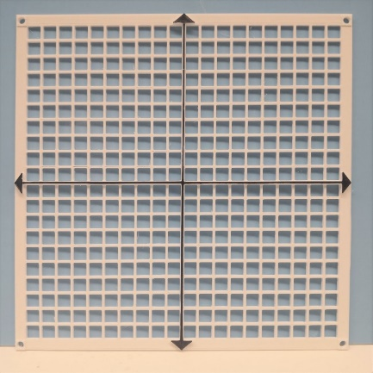
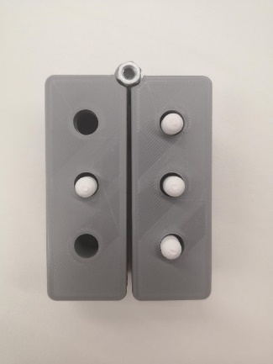
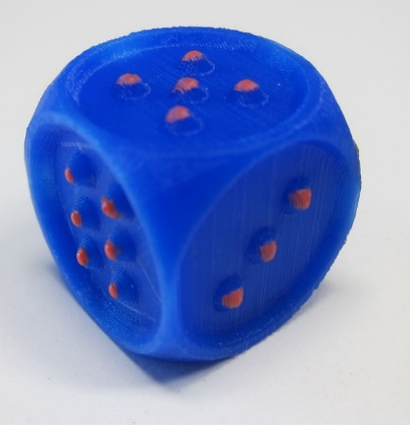
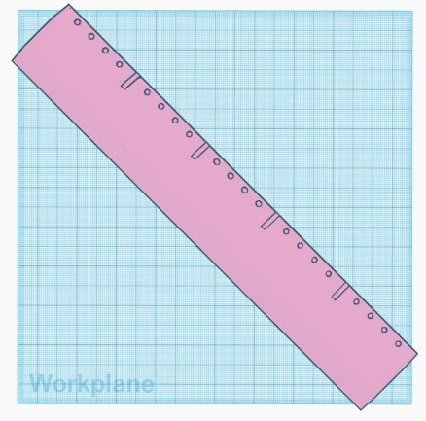
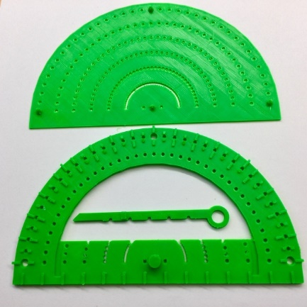
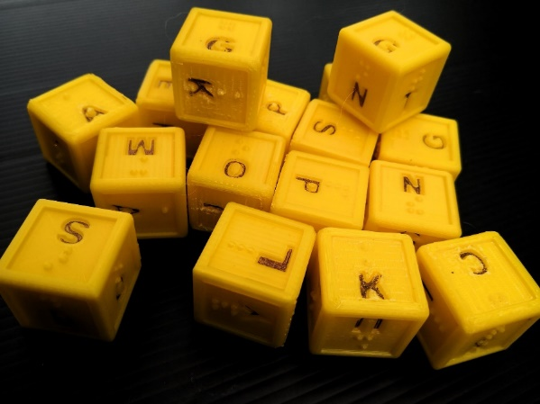
3D printed tools

Slide 9
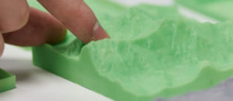
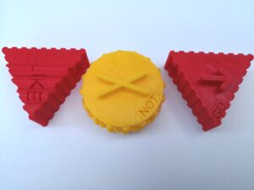
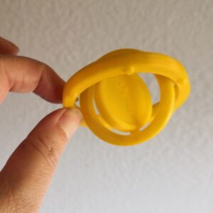
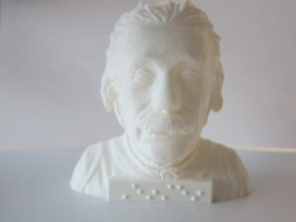
“Top 10” 3D prints for touch readers
http://accessiblegraphics.org/2021/03/22/top10_3d/

Slide 10
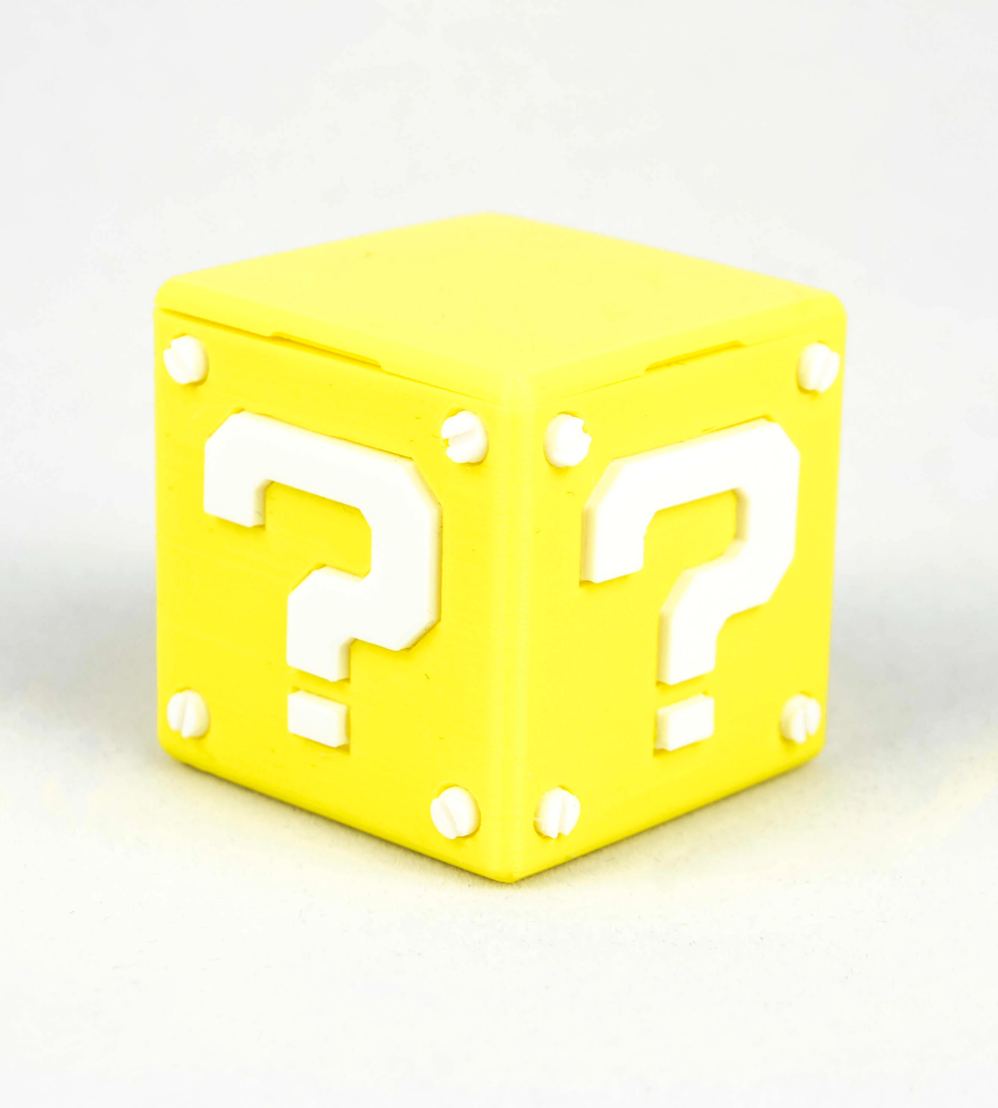
Questions?

Slide 11
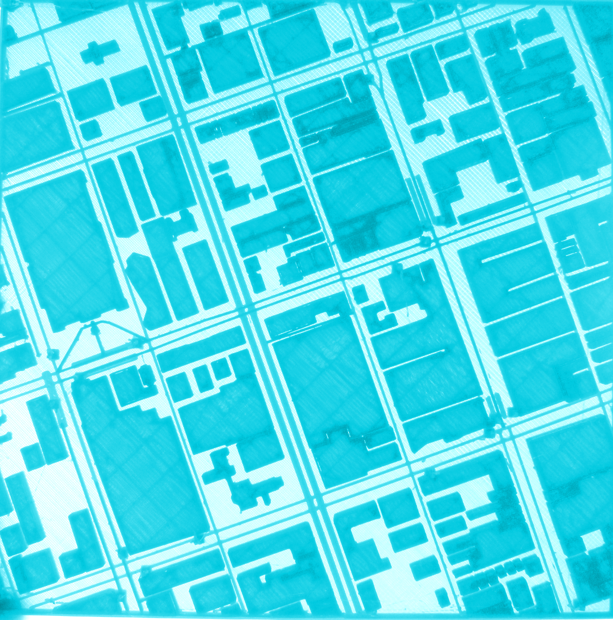
Where to find existing models
http://printdisability.org/about-us/accessible-graphics/3d-printing/repositories/

Slide 12
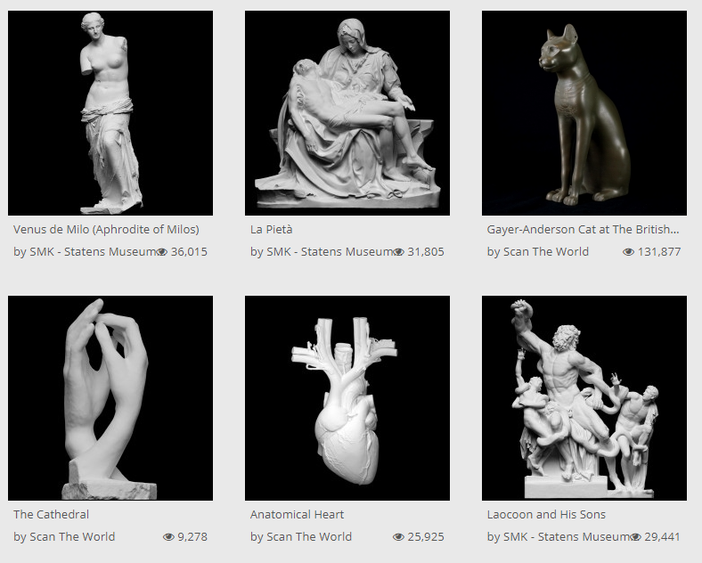
3D printing repositories
Generalist
Thingiverse https://www.thingiverse.com/
STL finder https://www.stlfinder.com/
For touch readers
BTactile https://btactile.com/
Medien Augenbit https://medien.augenbit.de/category/modelle/
Education, STEM and specialist
NASA 3D resources https://nasa3d.arc.nasa.gov/
Scan the World https://www.myminifactory.com/category/ scan-the-world

Slide 13
Activity 2 - Finding a 3D model
Can you find one or more of the following 3D models, which would be suitable for use by a touch reader?
Tactile dice
Human brain
Tactile ruler
A sculpture of your choice
https://www.thingiverse.com/
https://www.stlfinder.com/
https://btactile.com/
https://medien.augenbit.de/category/modelle/
https://www.myminifactory.com/category/ scan-the-world

Slide 14
Questions?

Slide 15
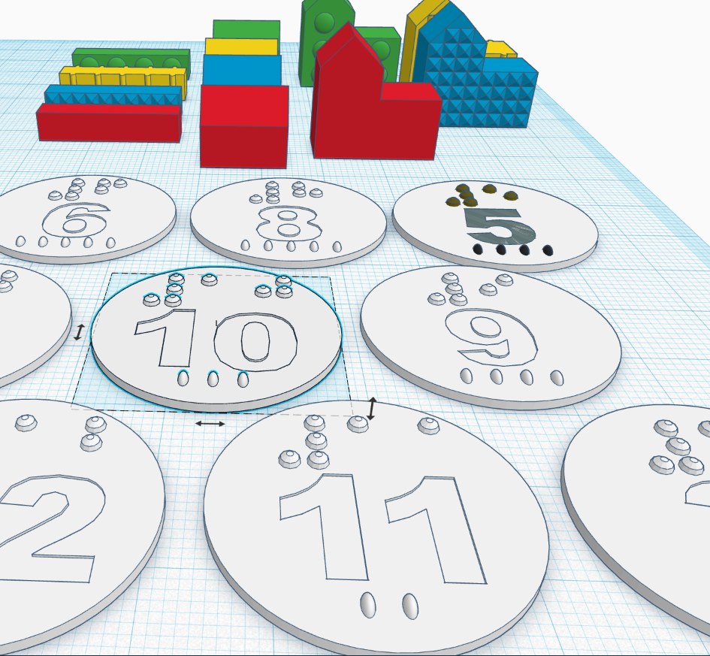
Software
http://printdisability.org/about-us/accessible-graphics/3d-printing/design-software/

Slide 16
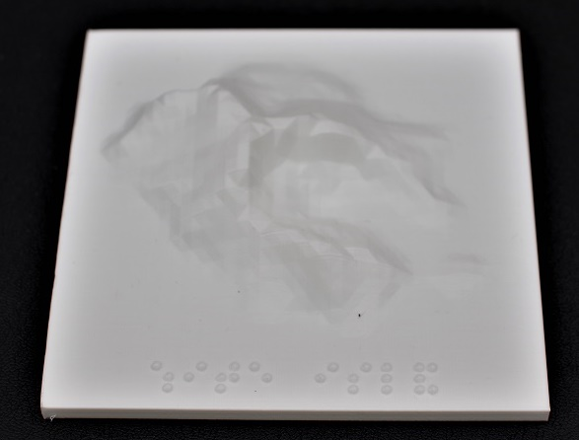
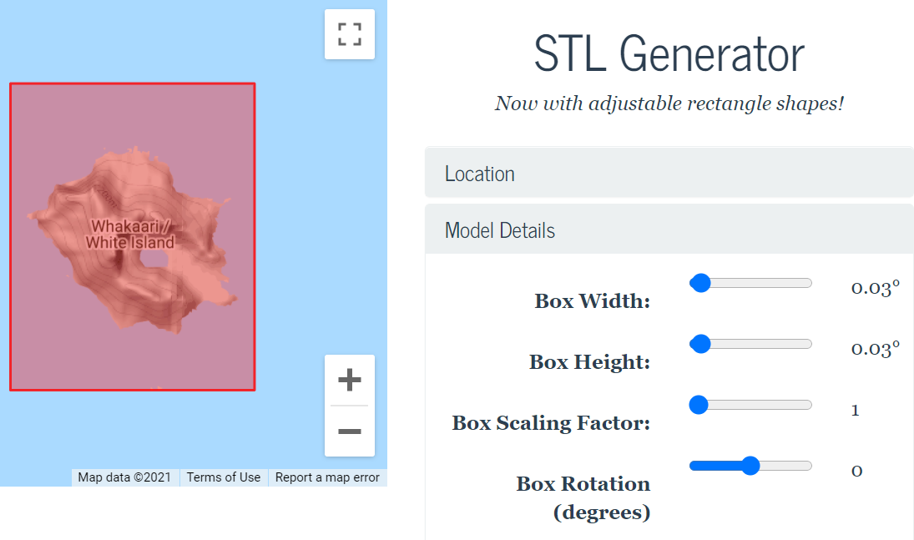
Automated software - Terrain2STL
http://jthatch.com/Terrain2STL/

Slide 17
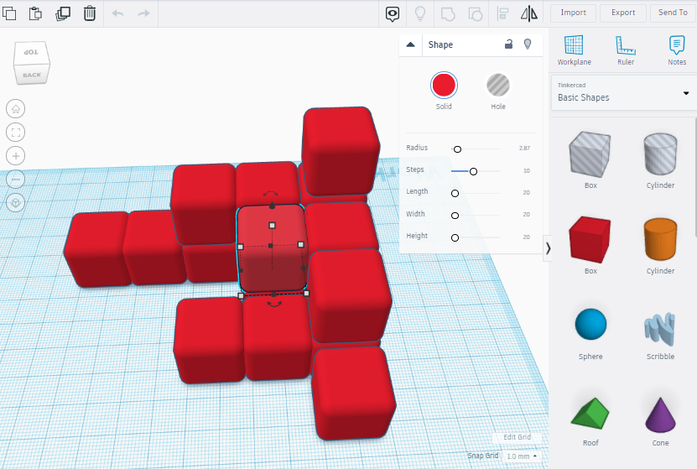
Design software - TinkerCAD
https://www.tinkercad.com/
Free
Online
Very easy to use - suitable for beginners
Best suited for sighted designers adding and subtracting shapes

Slide 18
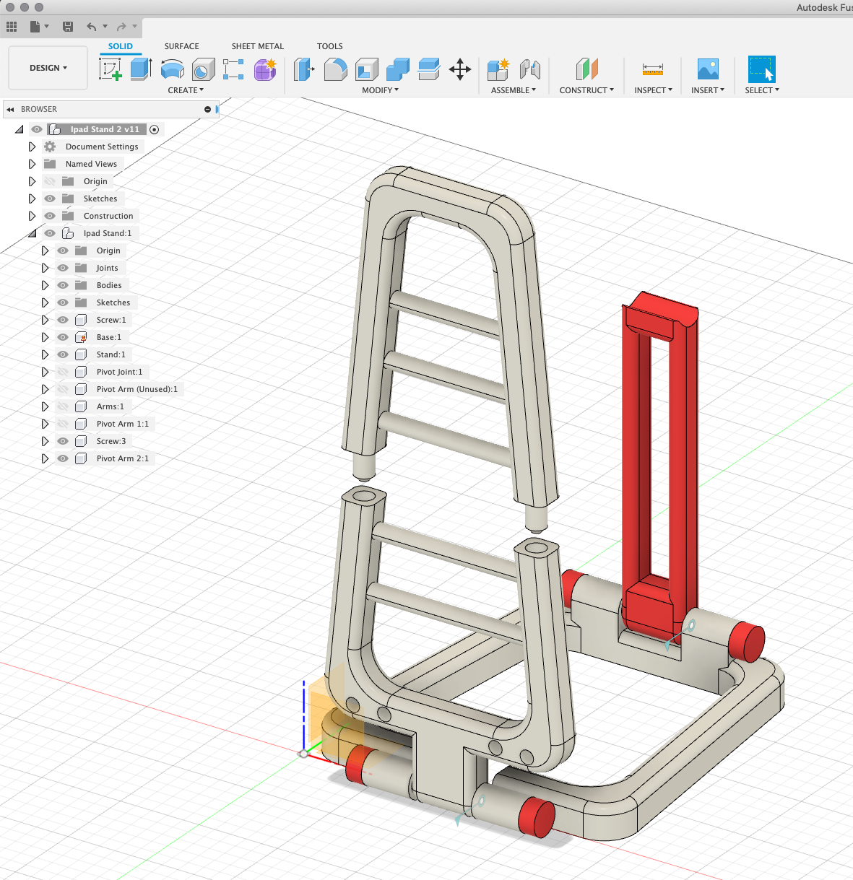
Design software - Fusion360
https://www.autodesk.com.au/products/fusion- 360/overview
Free with educational license
Offline
More powerful
Parametric design (change any part)
Timeline
Precise measurements and tolerances
Import reference sketches

Slide 19
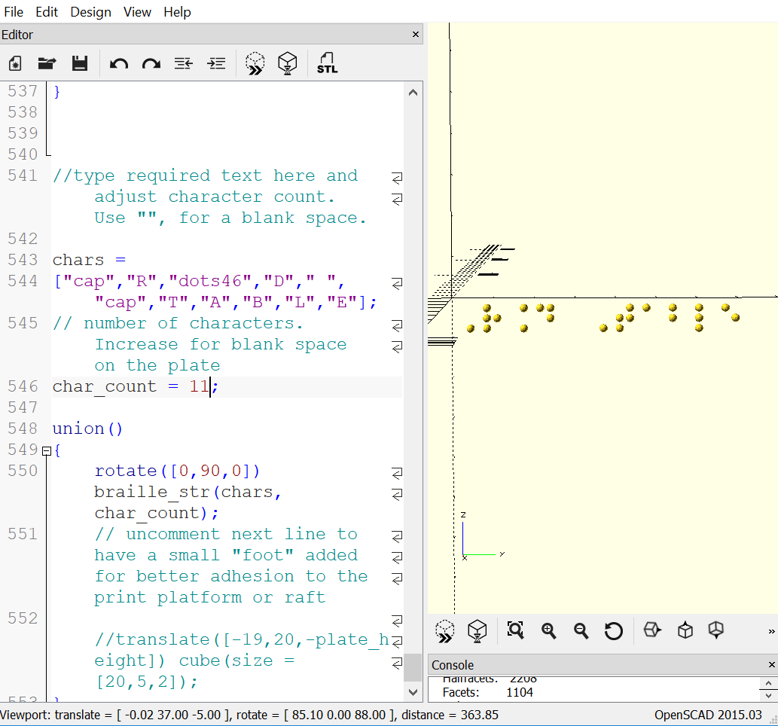
Design software - OpenSCAD
https://openscad.org/
Free
Offline
Code-based, therefore good for
Mathematical models
Braille labels
Non-visual (accessible) design
Easy to learn, with excellent documentation

Slide 20
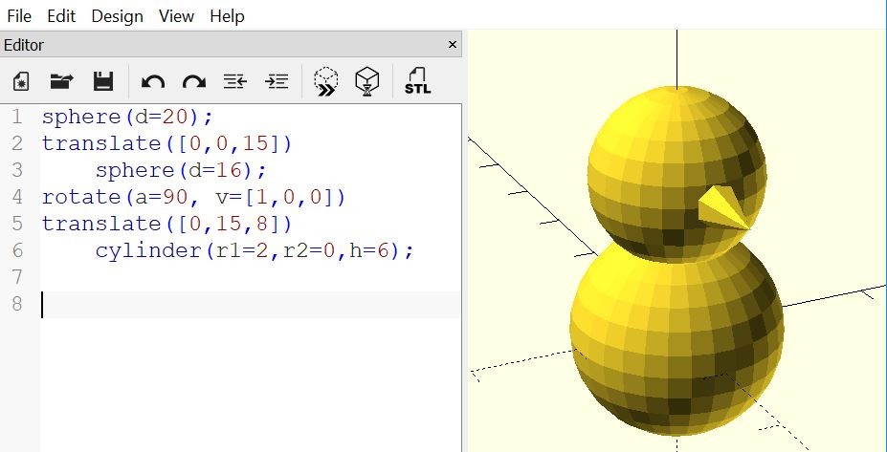
Design software - OpenSCAD

Slide 21
Questions?

Slide 22
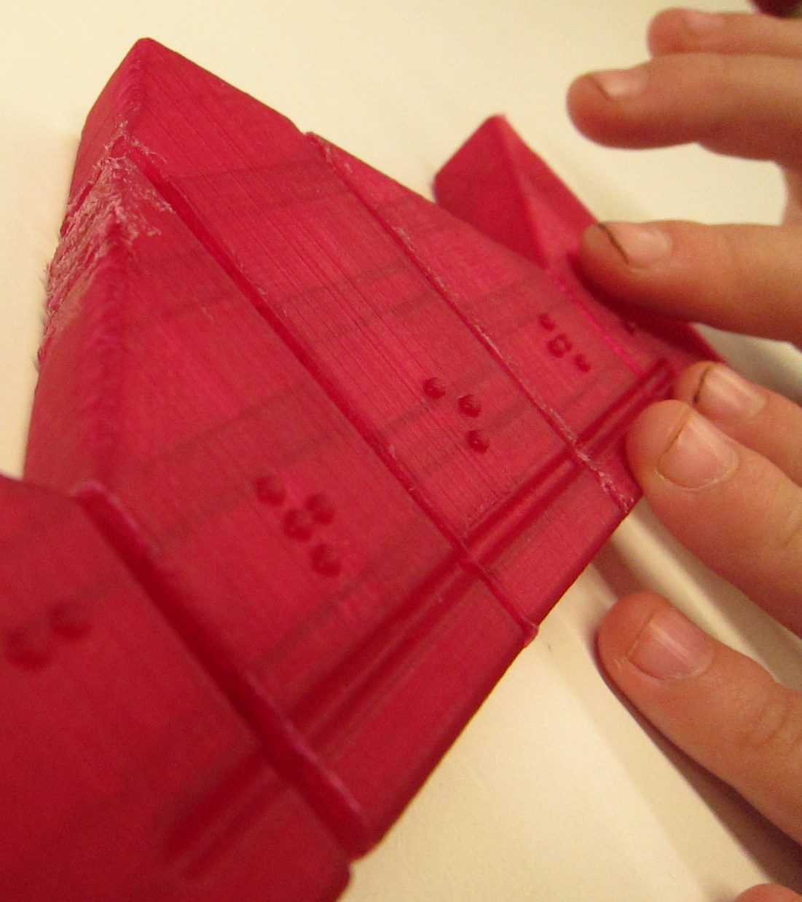
Accessible Making
http://printdisability.org/about-us/accessible-graphics/3d-printing/design-software/

Slide 23
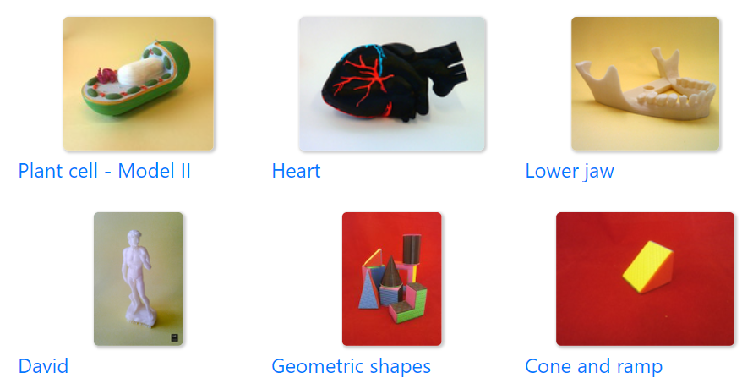
Accessible Design Selection
Use collections specifically for touch readers:
BTactile
ImageShare
3DOpal (physics, chemistry, astronomy)
Nonscriptum (maths)
Fittle (early literacy jigsaw puzzles)
Medien Augenbit (maths, science, tools)
Microbiology for the Blind and Visually Impaired
Star Coins (constellations)
Tactile Universe (astronomy)
Written descriptions of models is a priority for future/refined repositories.

Slide 24
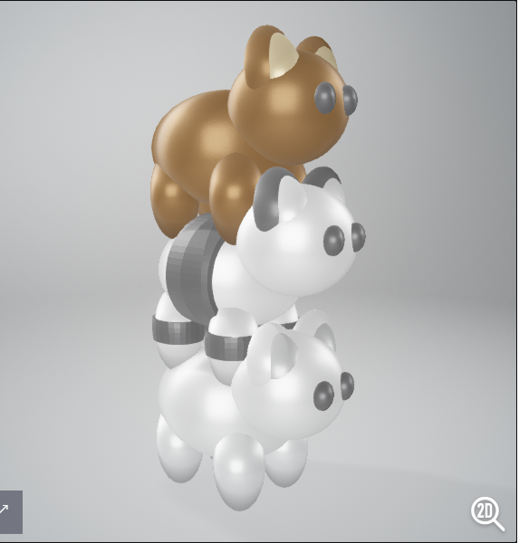
Accessible Design Software
Accessible software:
Makers Empire https://www.makersempire.com/ suitable for students with low vision
Fusion 360 works well with ZoomText for low vision designers
“OpenSCAD for 3D Printing” available in accessible Word or ePub from NNELS

Slide 25
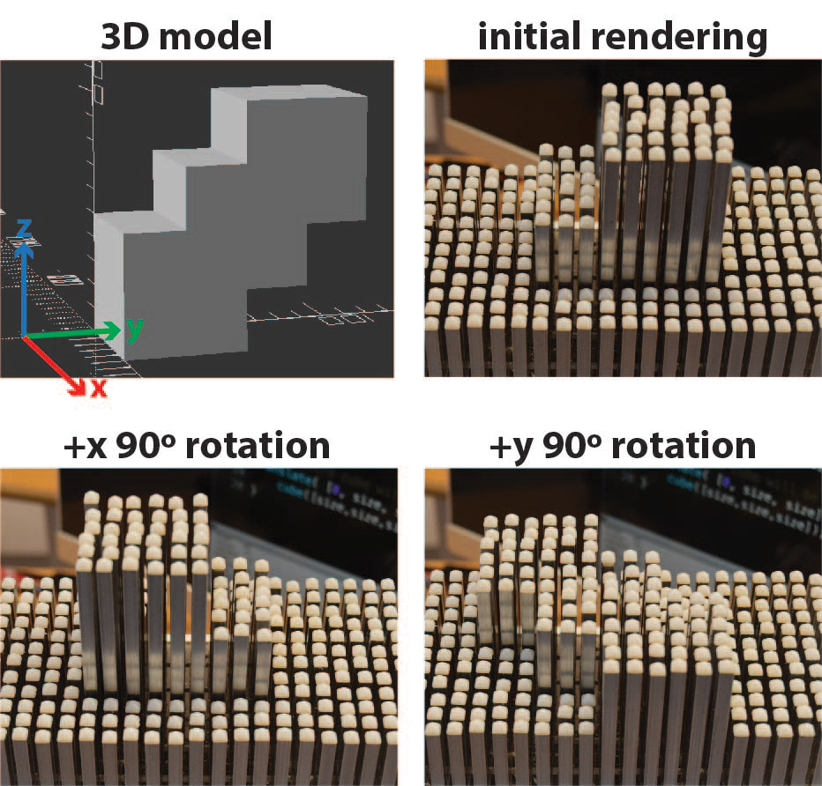
Checking your design
3D print the first layer
Output the rendering as a tactile graphic
Refreshable graphics display
Sighted assistance

Slide 26
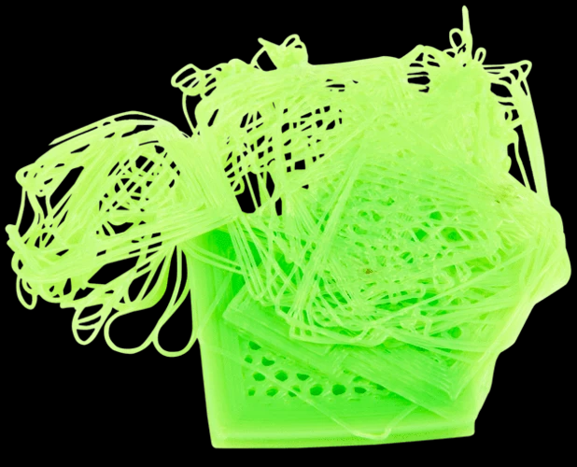
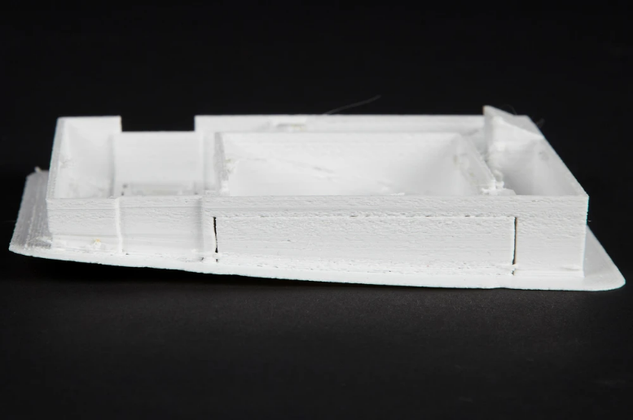
Accessible Printing
Equipment:
Prusa
Cura
OctoPrint
Observing the print with your ears and hands:
Clink = loose filament on the printing plate
Scraping = poor adhesion on corners
Touch or hear the filament spool
Touch the printing area with caution

Slide 27
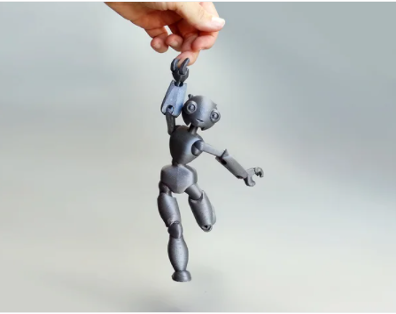
Accessible Design - Further Resources
“Blind and Low Vision 3D printing” facebook group https://www.facebook.com/groups/blv3p
New York Public Library workshops on accessible making

Slide 28
Questions?

Slide 29
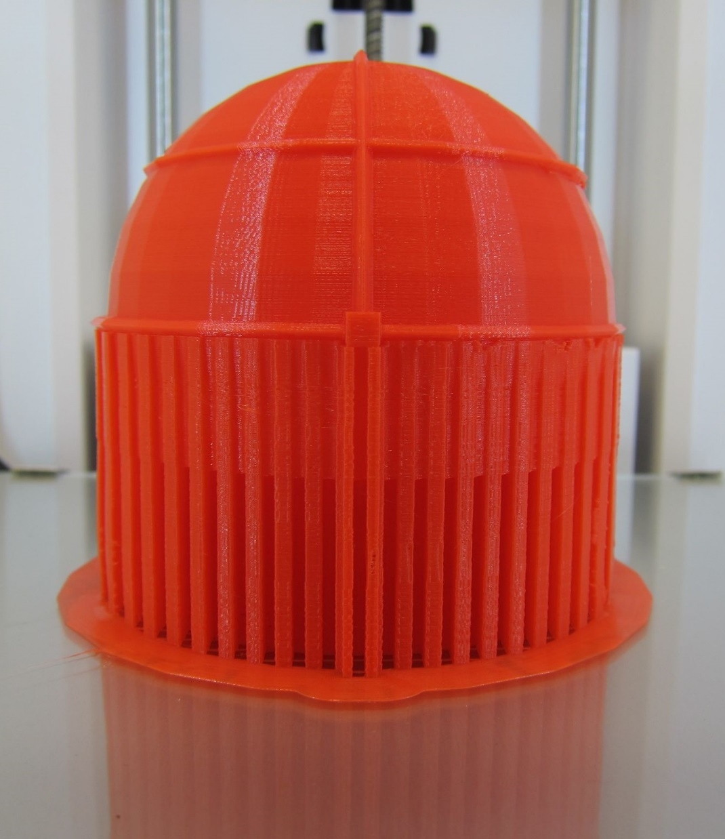
Finishing
http://printdisability.org/about-us/accessible-graphics/3d-printing/finishing/

Slide 30
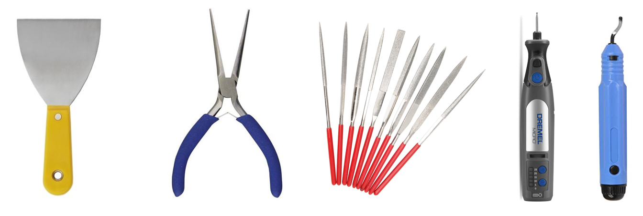
Smoothing
Sharp or rough areas can occur:
At the base where a foot has been removed
Under overhanging areas
Where supports have been removed
On the top, where the print head has lifted
Tools/techniques for smoothing:
Art knife
Sanding
Epoxies - XTC3D
Painting - Rustoleum Triple Thick Glaze

Slide 31
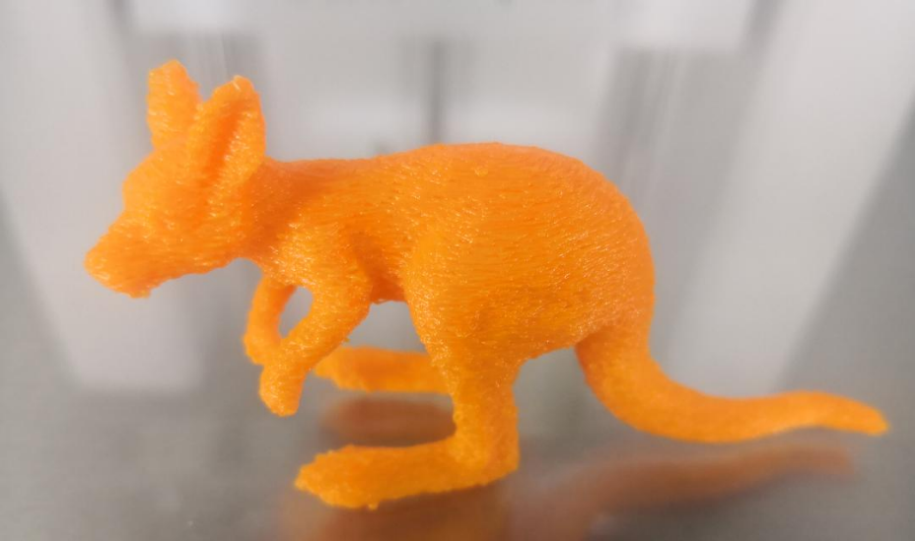
Texture
Embed into the 3D model design
Use Cura “fuzzy” setting
Add textures after printing:
Glue with sand, glitter, fake grass, etc.
Glue on fabric, sandpaper, etc.

Slide 32
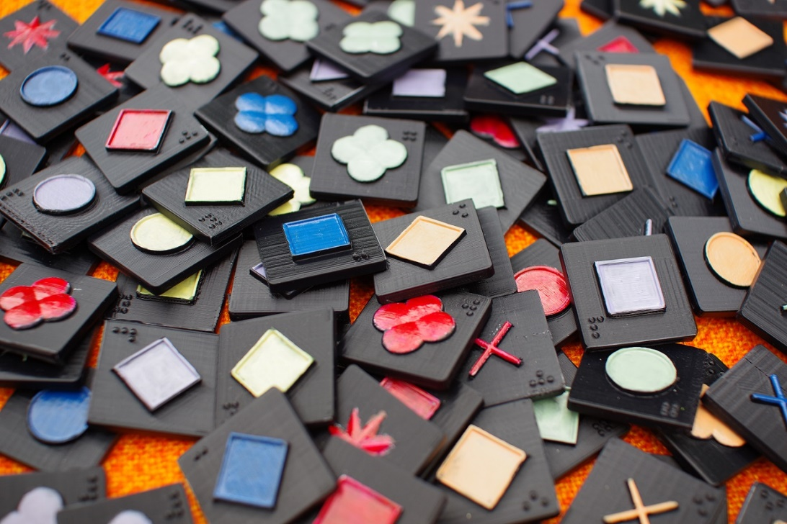
Colour
Dual head printing
Change the filament
Paint pens
Nail polish
Modelling paint
Markers only in indented spaces

Slide 33
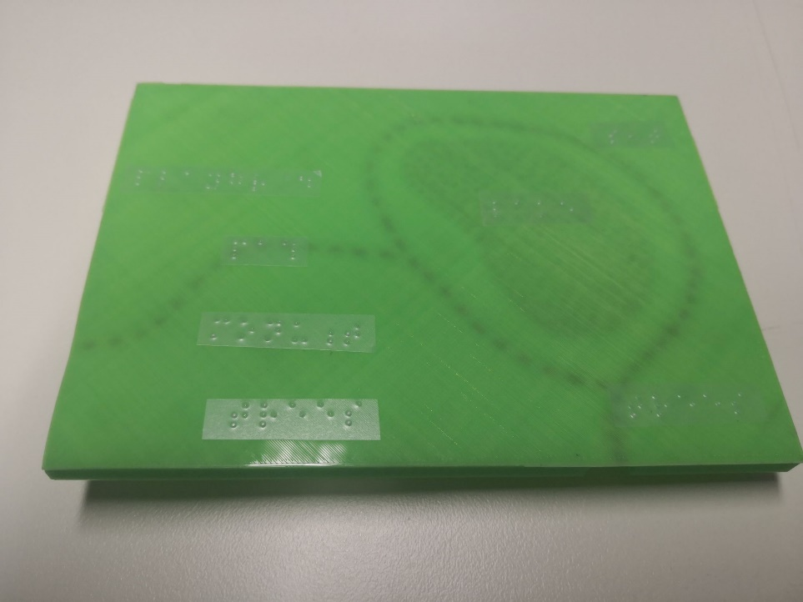
Tactile labels
3D printed braille
Sticky braille labels
3D symbols
Basement

Slide 34
Questions?

Slide 35
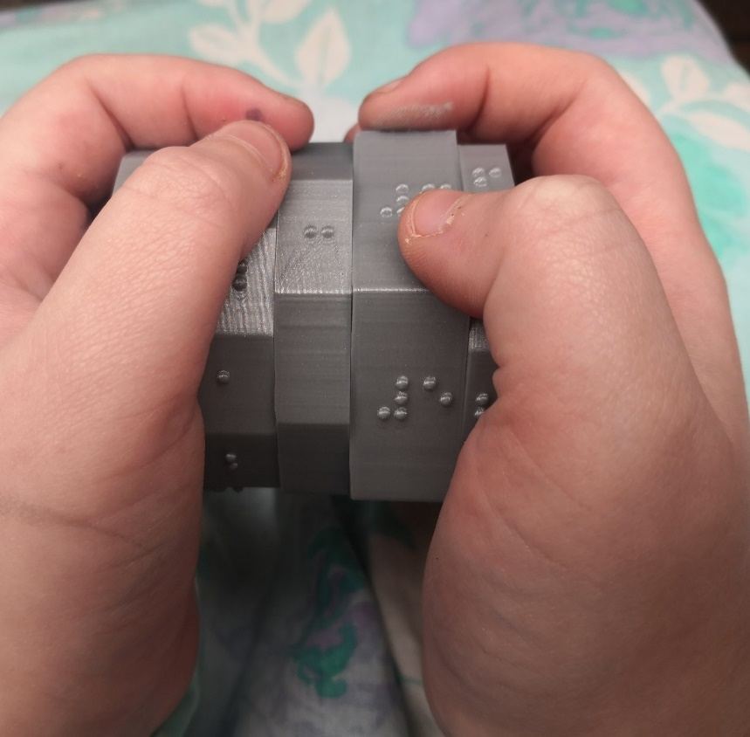
Reading by Touch
http://printdisability.org/about-us/accessible-graphics/3d-printing/touch/

Slide 36
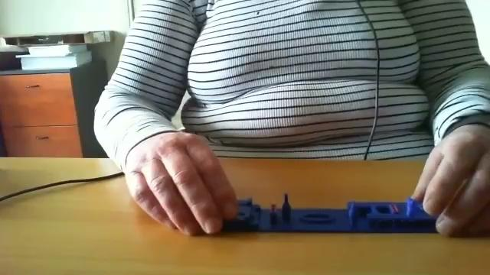
Principles for touch reading 3D printed models
Know what to expect
Gain an overview first
Use appropriate touch
Use reference points
Explore the detail

Slide 37
Questions?

Slide 38
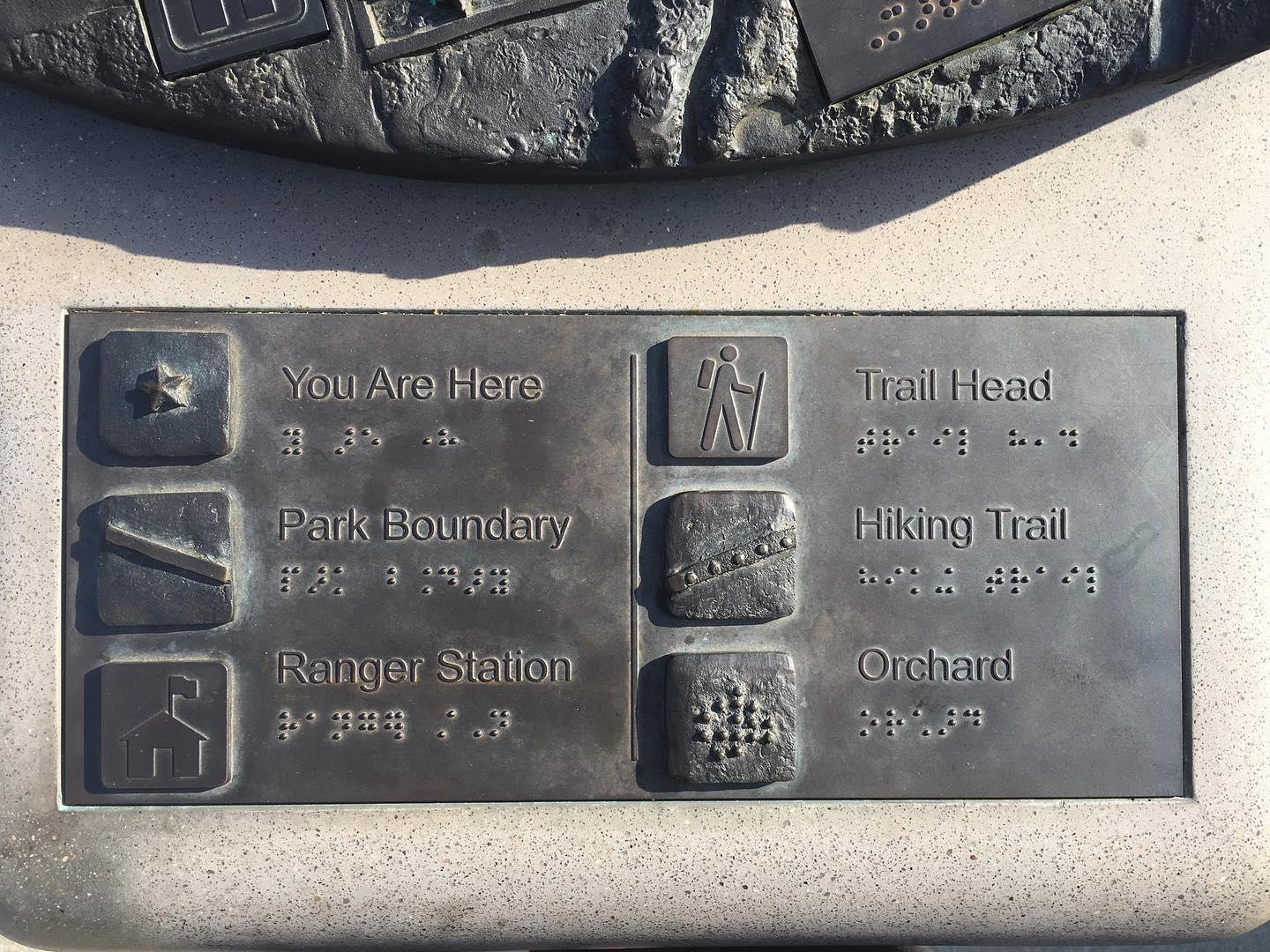
Labelling

Slide 39
Audio Labelling
Overcomes the spatial limitations of conventional tactile labelling techniques
BLV end-users prefer to have control over the audio information they are accessing.
Control of the amount of information, repetition, as well as, turning the audio output on and off.

Slide 40
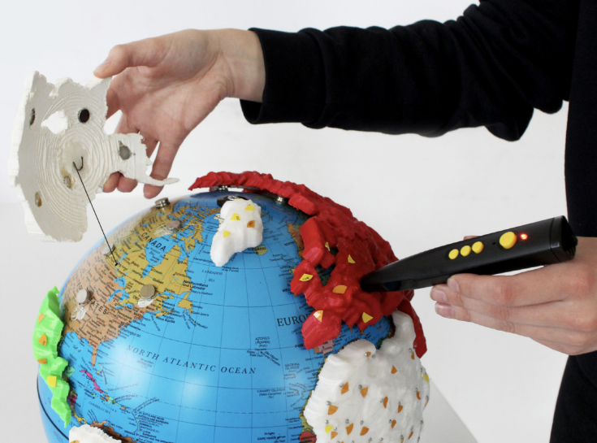
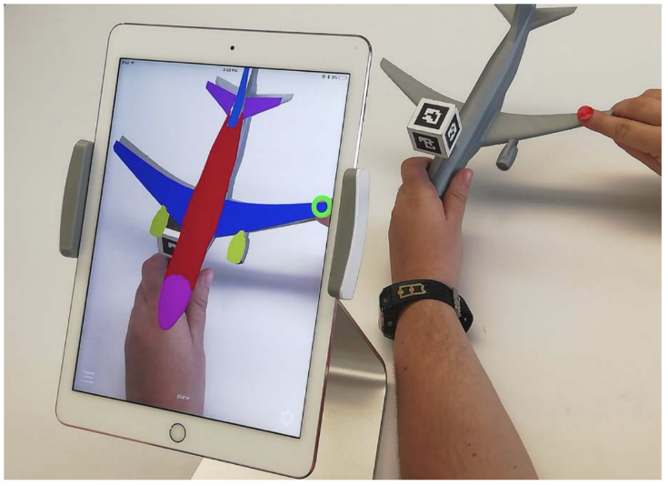
Audio Labelling Techniques
QR codes
NFC tags
Touch triggered
Overlay on touch screen
Penfriend
Computer vision
[1] U. Ghodke, L. Yusim, S. Somanath, and P. Coppin, "The Cross-Sensory Globe: Participatory Design of a 3D Audio-Tactile Globe Prototype for Blind and Low-Vision Users to Learn Geography," presented at the Proceedings of the 2019 on Designing Interactive Systems Conference, San Diego, CA, USA, 2019. [Online]. Available: https://doi.org/10.1145/3322276.3323686.
[2] Shi, H. Lawson, Z. Zhang, and S. Azenkot, "Designing Interactive 3D Printed Models with Teachers of the Visually Impaired," presented at the Proceedings of the 2019 CHI Conference on Human Factors in Computing Systems, Glasgow, Scotland Uk, 2019. [Online]. Available: https://doi.org/10.1145/3290605.3300427 https://dl.acm.org/doi/pdf/10.1145/3290605.3300427.

Slide 41
QR Codes
Easily be generated online for free
Direct end-users to specific multimedia content
Can be printed on paper or on the model directly
Location and size can be tailored to the model

Slide 42
NFC Tags
Direct end-users to specific multimedia content
Smartphones with NFC readers are widely available
Inexpensive

Slide 43
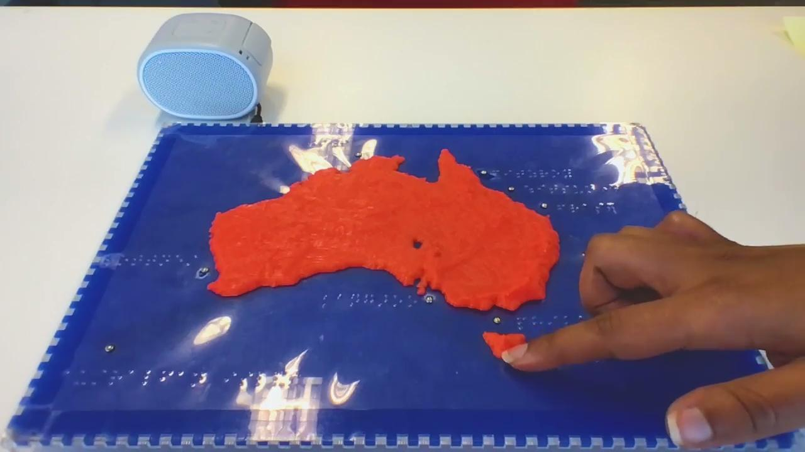
Touch Triggered Labels
Can be strategically positioned on the model or on an auxiliary component
Familiar interaction technique i.e., single- tap, double-tap for more information, press and hold

Slide 44
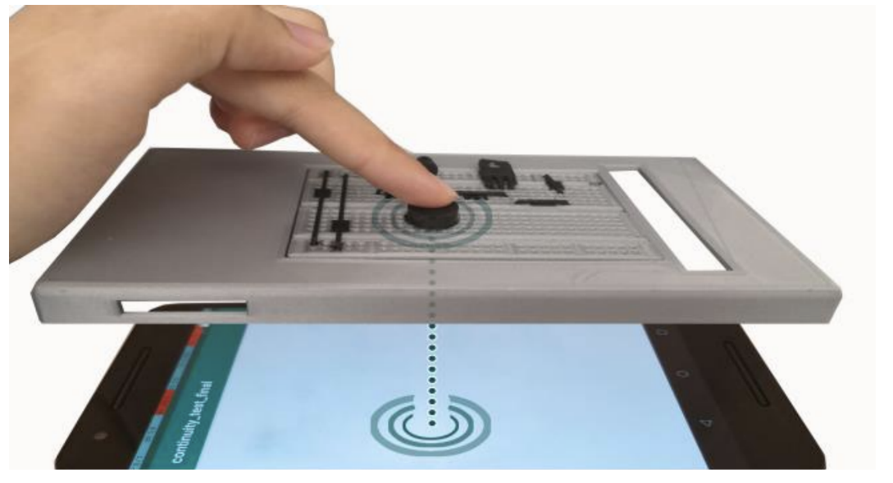
Overlay on Touch Screens
Affixed to a smartphone or tablet
Familiar touch-based interaction
Interaction with printed overlay or touchscreen
J. U. Davis et al., "TangibleCircuits: An Interactive 3D Printed Circuit Education Tool for People with Visual Impairments," presented at the Proceedings of the 2020 CHI Conference on Human Factors in Computing Systems, Honolulu, HI, USA, 2020. [Online]. Available: https://doi.org/10.1145/3313831.3376513.

Slide 45
Questions?

Slide 46
Quick Survey
What methods do you currently use for labelling?
What are the most important practical considerations for labelling?
https://forms.gle/UULK5vNLXmehmg2F8
Notes:
Open up discussion : How might you use these labelling methods mentioned?
https://docs.google.com/forms/d/1WQuP3-AInptGW0Ym35iRw7G7T1oe1uI3BfC2GB4AwOo/edit?usp=sharing

Slide 47
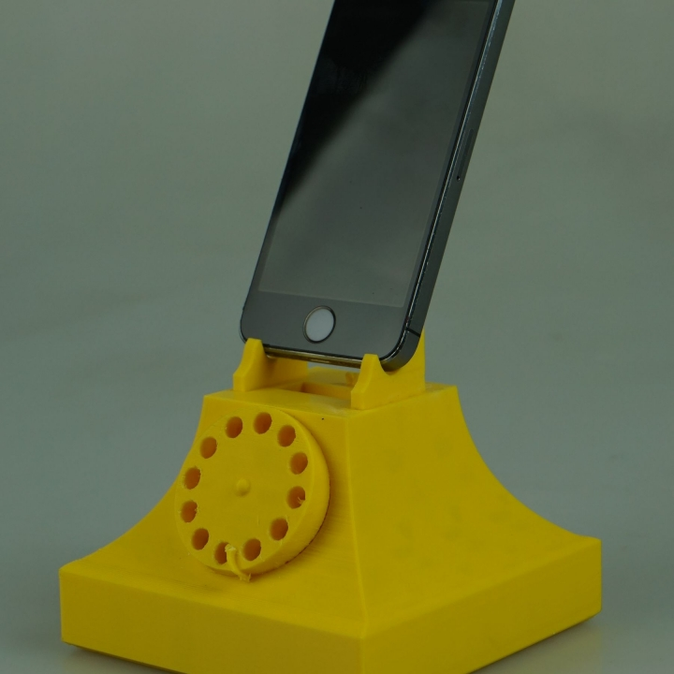
Contact Us
leona.holloway@monash.edu
ruth.nagassa@monash.edu
http://accessiblegraphics.org

